Slide 1
Testing of Objective Analysis of Precipitation Structures
(Snowbands) using the
NCAR Developmental Testbed Center (DTC)
Model Evaluation Tools (MET) Software
Sara A. Ganetis
Ph.D. Candidate
School of Marine and Atmospheric Sciences
Stony Brook University
sara.ganetis@stonybrook.edu
14 March 2016

Slide 2
Objective Analysis of Precipitation Structures using the NCAR Developmental Testbed Center (DTC) Model Evaluation Tools (MET) Software v. 5.0
26-27 Dec 2010 East Coast winter storm test case -- MODE
  Reflectivity structures ranged in scale including
    small convective cells
    meso-β bands
    large meso-α primary snowband
  Goal: Tune MODE to objectively identify objects across all scales for observational dataset

Slide 3
Objective Analysis of Precipitation Structures using the NCAR Developmental Testbed Center (DTC) Model Evaluation Tools (MET) Software v. 5.0
Step 1: MATLAB to NetCDF
  Input data: NCState stitched radar composite MATLAB files of ~5-minute 1 km AGL reflectivity on a 2-km x 2-km grid
  MATLAB script converts MATLAB file to NetCDF while retaining all grid information
Step 2: Format file for Model Evaluation Tools (MET) Method for Object-based Diagnostic Evaluation (MODE) use
  Perl script to add the necessary global and variable attributes that MODE requires, such as time in EPOCH units
Step 3: Run MODE
    After tuning the following parameters, MODE is run to identify objects
      raw_thresh = 28 dBZ;
      conv_radius = 1 grid unit;
      conv_thresh = >= 15.0;
      vld_thresh = 0.75;
      area_thresh = NA;
      inten_perc_value = 100;
      inten_perc_thresh = NA;
      merge_thresh = >= 1.25;
      merge_flag = NONE;
  Step 4: Reformat text output (Perl script) and plot (NCL)

Slide 4
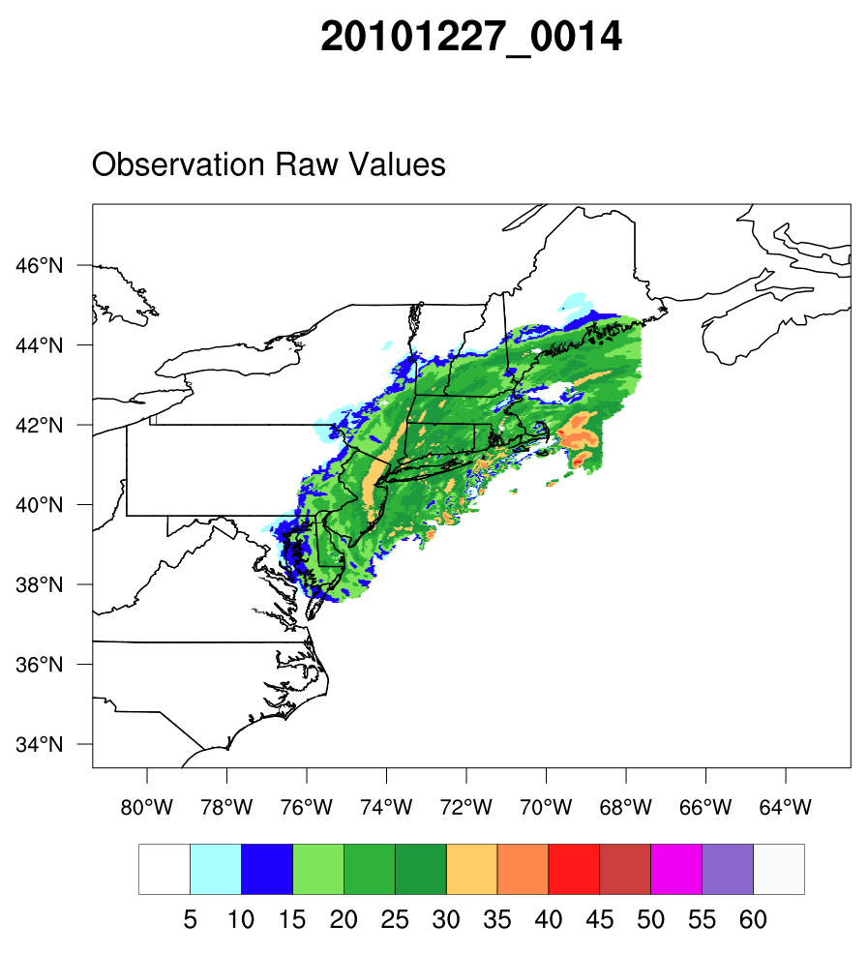
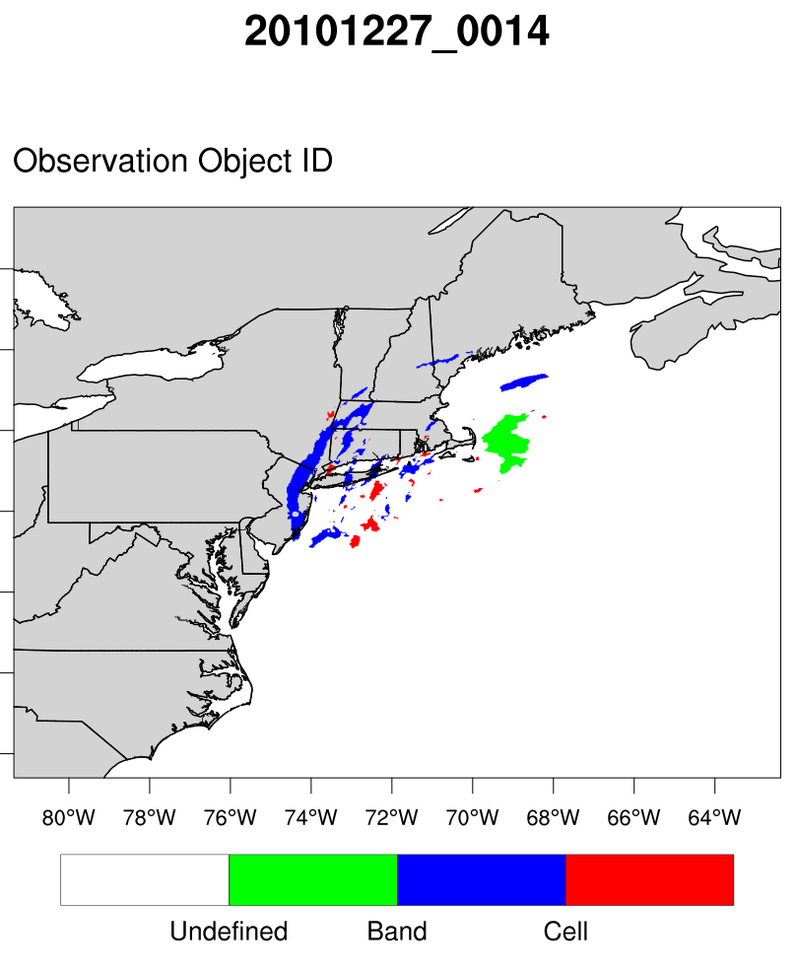
Reflectivity
Band | Aspect Ratio (AR) ≤ 0.75
Cell | Area ≤ 2500 km² and 0.75 < AR < 1.00
Undefined | Area > 2500 km² and AR > 0.75

Slide 5

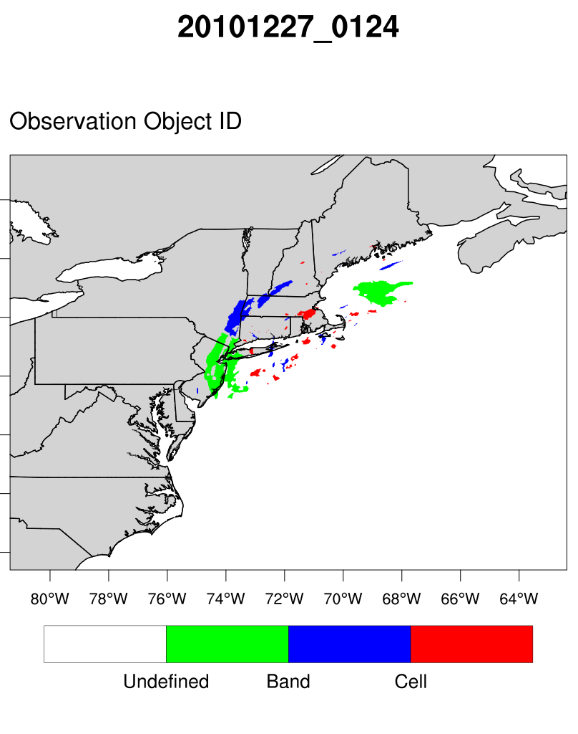
Reflectivity
Band | Aspect Ratio (AR) ≤ 0.75
Cell | Area ≤ 2500 km² and 0.75 < AR < 1.00
Undefined | Area > 2500 km² and AR > 0.75

Slide 6
Objective Analysis of Precipitation Structures using the NCAR Developmental Testbed Center (DTC) Model Evaluation Tools (MET) Software v. 5.0
26-27 Dec 2010 East Coast winter storm test case -- MODE
  Strengths
    Objects are separated out from each other, i.e. not clustered into one large object
    Length, width, area, and centroid location information is readily available for each object
  Weaknesses
    Large number of objects are identified, which makes working with the data more difficult
    Tracking individual objects between time steps must be done manually

Slide 7
Objective Analysis of Precipitation Structures using the NCAR Developmental Testbed Center (DTC) Model Evaluation Tools (MET) Software v. 5.1
Tests of MODE Time Domain (MTD)
  Goal: objectively identify, track, and get spatial information about precipitation structures of varying scales
  MTD configuration
    grid_res = 2; ⦁ raw_thresh= >=27.0;
    conv_radius = 1.0; ⦁ conv_thresh = >=27.0;
    vld_thresh = 0.75; ⦁ area_thresh = NA;
    inten_perc_value = 100; ⦁ inten_perc_thresh = NA;
    merge_thresh = >=1.25; ⦁ merge_flag = NONE;
    min_volume = 25;
  Edits done to MTD code
    Added length and width 2d text output by editing the following files:
      2d_moments.cc / 2d_moments.h
      2d_att.cc
      mtd_file_int.cc / mtd_file_int.h

Slide 8
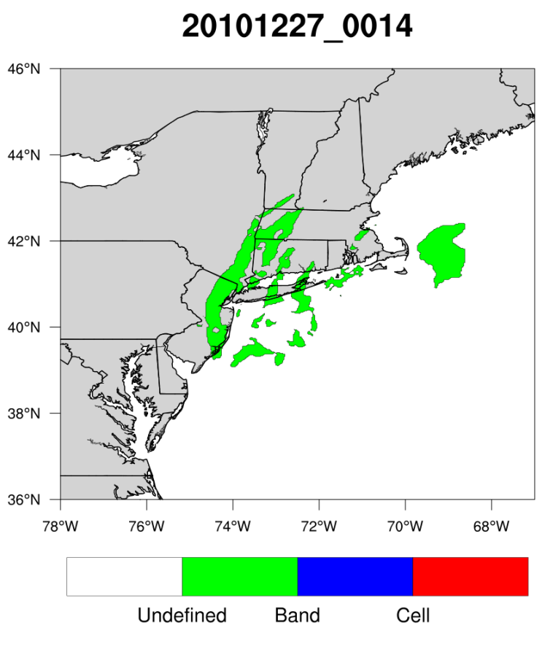
Reflectivity
Band | Aspect Ratio (AR) ≤ 0.75
Cell | Area ≤ 2500 km² and 0.75 < AR < 1.00
Undefined | Area > 2500 km² and AR > 0.75

Slide 9
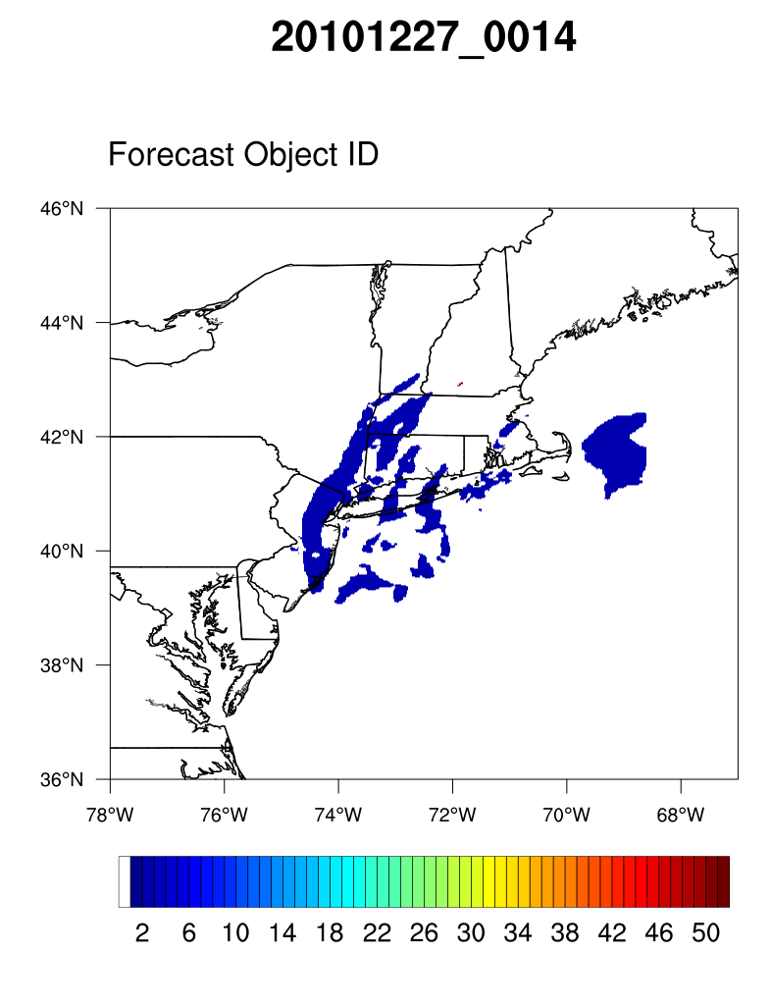
Object ID #
Reflectivity
Features are being clustered into a single object

Slide 10
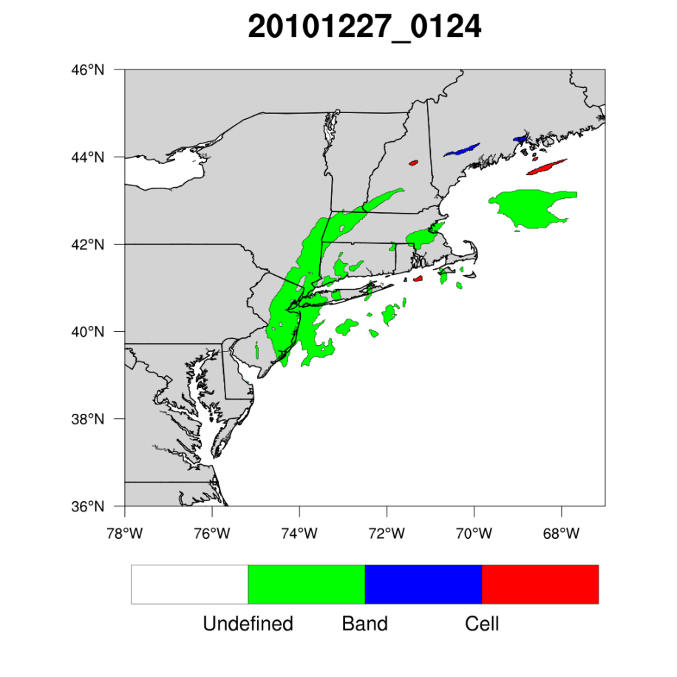
Reflectivity
Band | Aspect Ratio (AR) ≤ 0.75
Cell | Area ≤ 2500 km² and 0.75 < AR < 1.00
Undefined | Area > 2500 km² and AR > 0.75

Slide 11
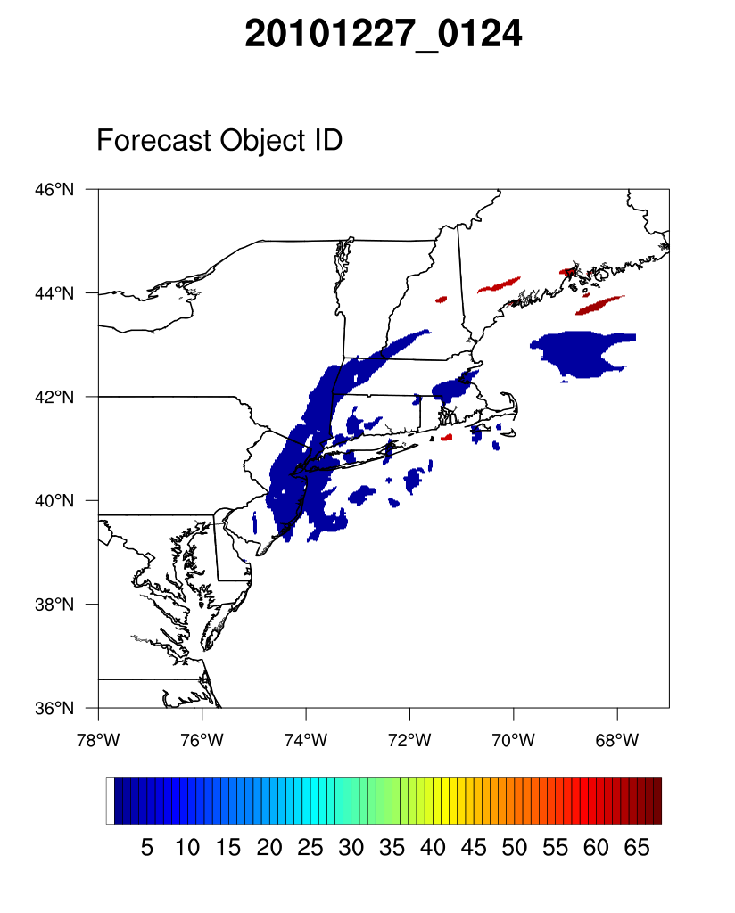
Object ID #
Reflectivity
Features are still being mostly clustered into a single object

Slide 12
Objective Analysis of Precipitation Structures using the NCAR Developmental Testbed Center (DTC) Model Evaluation Tools (MET) Software v. 5.1
26-27 Dec 2010 East Coast winter storm test case -- MTD
  Strengths
    Objects are organized and tracked within a case
    Length, width, area, and centroid location information is readily available for each object
  Weaknesses
    Less separation between objects as compared to MODE, in fact no separation in the snapshots provided on the previous slides, thus rendering the length/width/area/centroid location information faulty
  Next steps
    Test of the “one config. setup fits all band sizes” approach by tuning for larger bands, mid-sized multi-bands and small-scale cells separately
    Potentially use MODE data instead of MTD for information about the degree of bandedness within each case, instead of gaining information about the tracking and evolution of objects
    Apply similar methods to WRF data

