Slide 1
Introduction to Yellowstone
at NWSC
January 15, 2013
Peter Schmitt
schmitt@ucar.edu

Slide 2
Outline
Computing at NCAR
Yellowstone
How to Compile & Run LTR codes

Slide 3
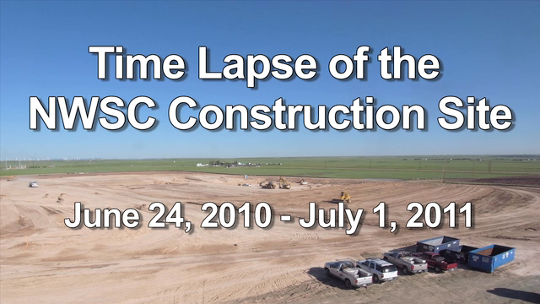
NCAR Wyoming Supercomputing Center

Slide 4
NCAR Wyoming Supercomputing Center
Yellowstone
  72,288 core (16 core/node) -> 4518 nodes
  Intel processors
  Low-latency high bandwidth interconnect

Slide 5
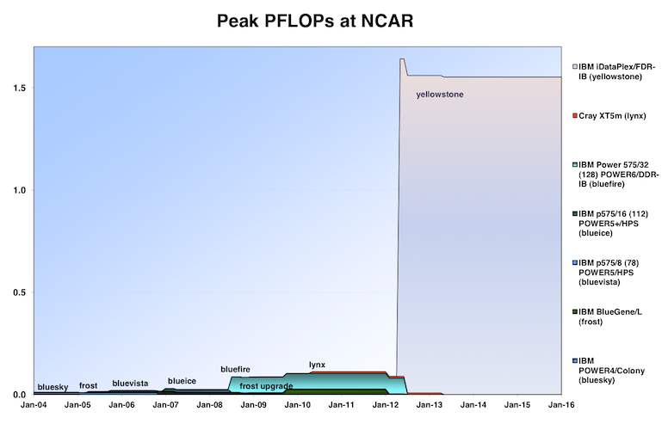

Slide 6
Mesa Lab
/ptmp: read-only as of January 14
Bluefire: January 31
Mirage & Storm: February 28
/glade: March 31

Slide 7
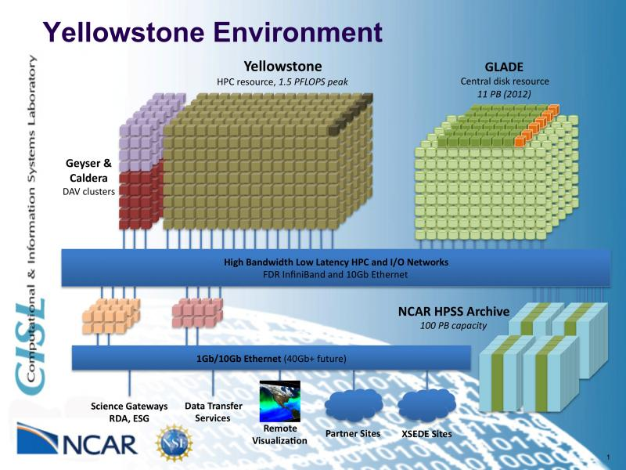

Slide 8
Yellowstone
Yellowstone, Geyser & Caldera
http://sam.ucar.edu
Software modules
File systems
Compute queues
ssh username@yellowstone.ucar.edu

Slide 9
LTR version 2.2.0
InterComm-2.0
MakeItSo
MPMD job scripts
https://bugs.hao.ucar.edu/versions/17

Slide 10
LTR-2.2.0
Demo
    Download
    Compile
    Run
    Post-process

