Slide 1
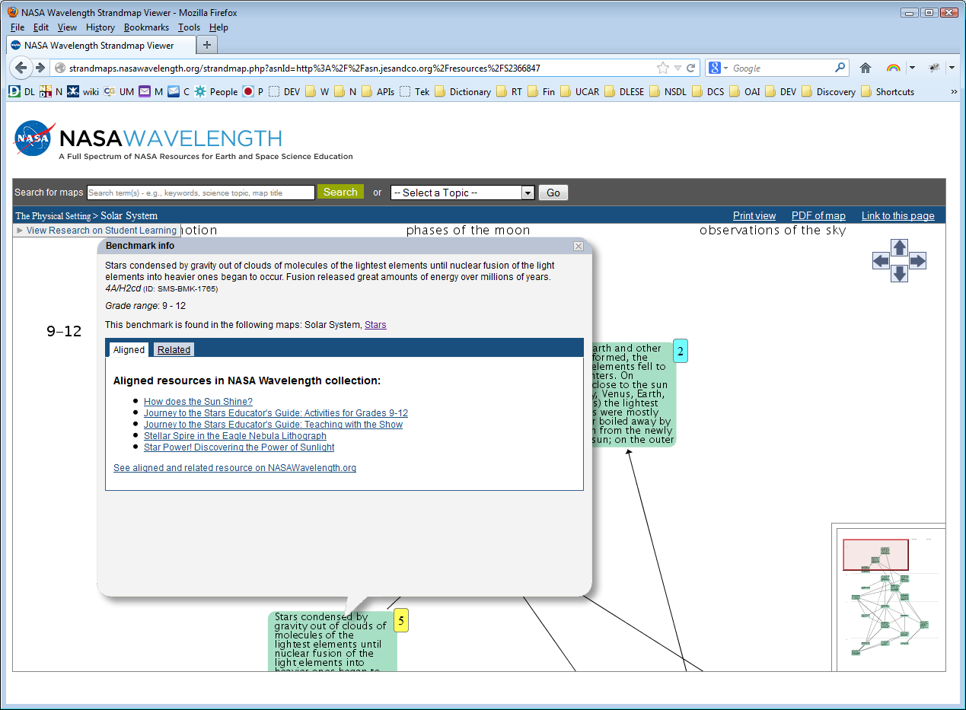
NASA SMS Interface (by SMILE)
Shows number of resources indicated for each Benchmark. Screen shot captured 2/27/2013 from:
http://strandmaps.nasawavelength.org/strandmap.php?asnId=http%3A%2F%2Fasn.jesandco.org%2Fresources%2FS2366847

