Slide 1
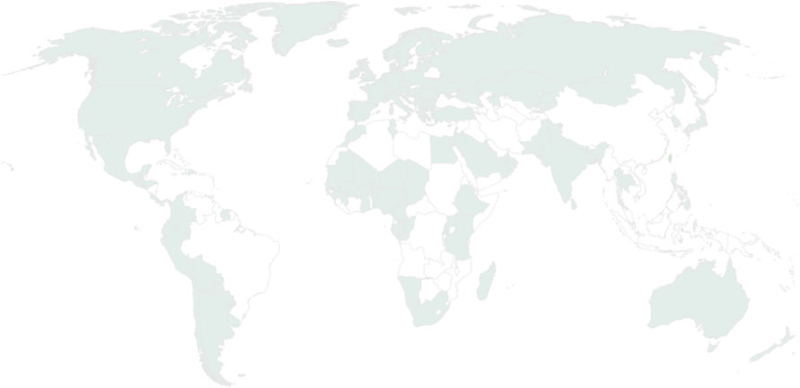
Technical Notes
Type your questions in the Chat Window.
Remember to make sure the speaker icon above is enabled! It should be green.
Check your volume levels by selecting “Adjust Speaker Volume”. Audio/Video has only been enabled for presenters during this webinar.
If you have trouble connecting or lose a connection and need assistance during the webinar email climatecampaign@globe.gov

Slide 2
Scientist Skills:
How to develop a research question
11 September 2012
Dr. Dixon Butler and
GLOBE Program Office
Science & Education Team

Slide 3
Outline
Overview of this webinar
The GLOBE Inquiry Model
  Finding it online
Developing a research question
  Qualities of a good question
  What to avoid
  Using the research question worksheet and finding it online
Important upcoming dates for the SCRC

Slide 4
Scientist Skills webinar series
This is the first in a three-part series of webinars on building scientist skills that is part of Phase 2 of the Student Climate Research Campaign (SCRC). The remaining parts of this series will be on:
  8 January 2013—Scientist Skills: How to overcome research problems
  2 April 2013—Scientist Skills: Presenting your results
As members of the GLOBE community you’ve been trained on how to collect scientific data and enter it into the database
  This is an important part of the scientific process!
  However when it comes to conducting a research investigation, there are other steps that must take place, both before, during, and after you collect data
Notes:
The Scientist Skills series is designed to provide guidance on conducting scientific inquiry.

Slide 5
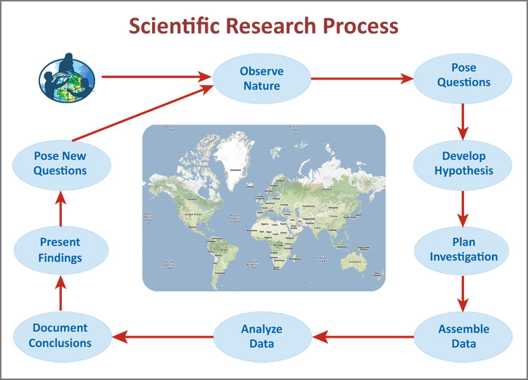
The GLOBE Inquiry Model
This model is available online in the Student Zone
Notes:
The GLOBE inquiry model illustrates the scientific inquiry process. There are many steps that are followed by a scientist conducting a research investigation. You can find out more about each of these steps online.

Slide 6
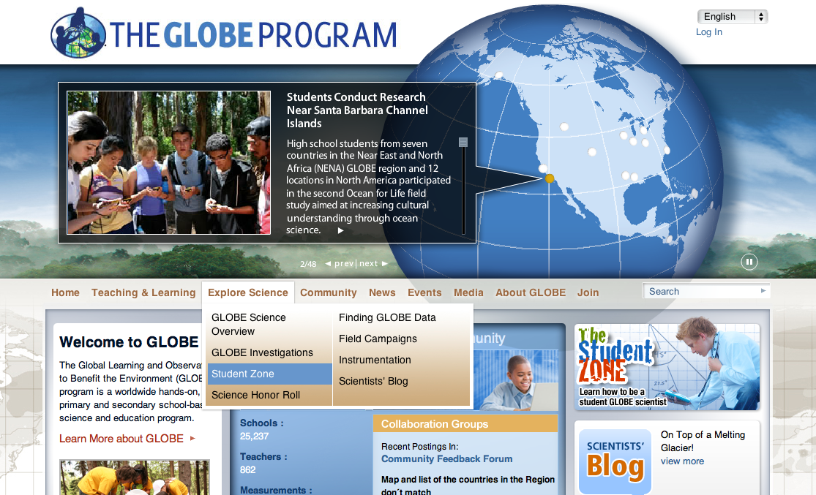

Slide 7
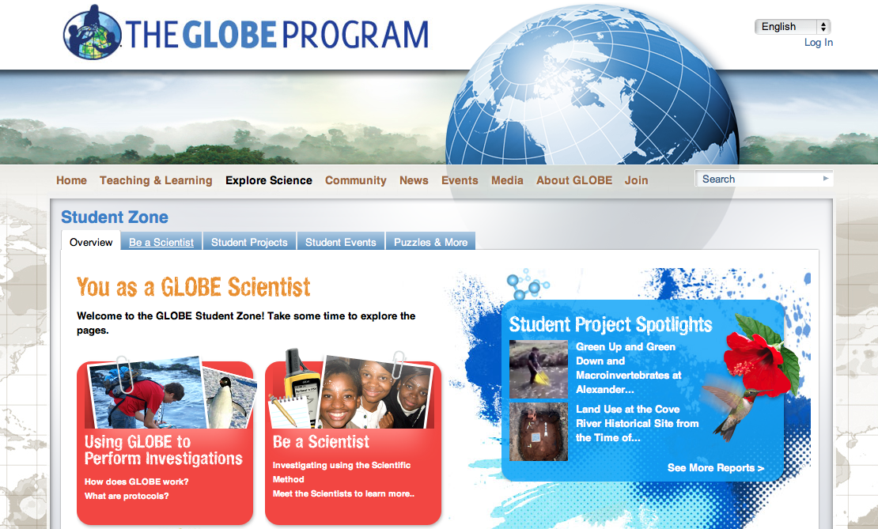

Slide 8
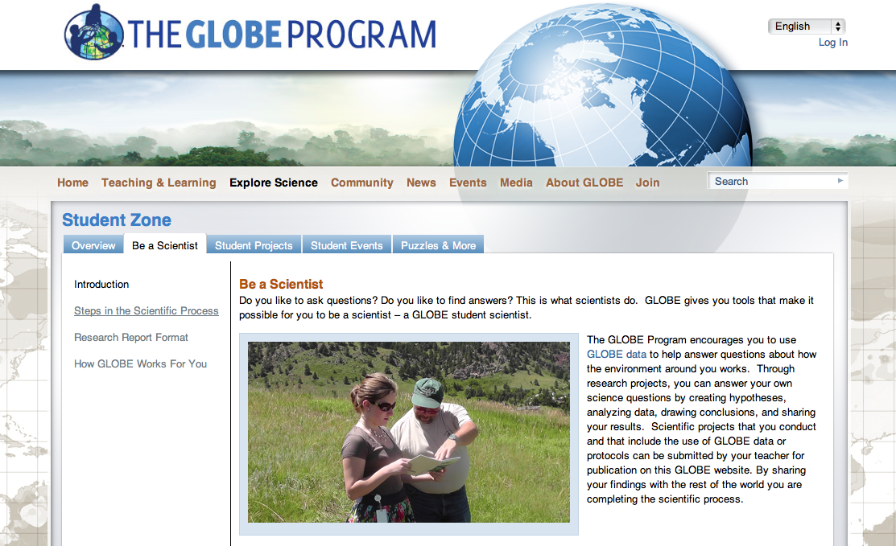

Slide 9
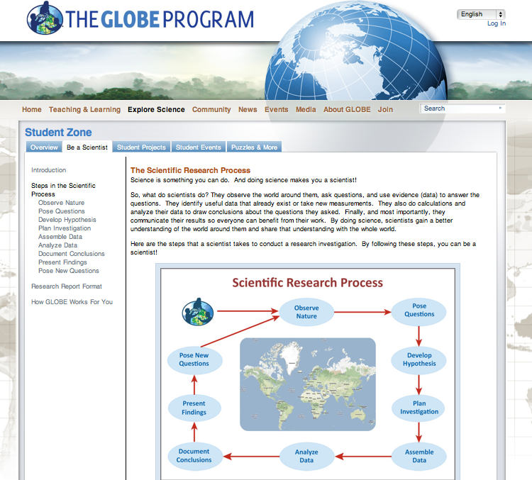

Slide 10
Pose Questions
Notes:
The focus of today’s webinar is related to the “Pose questions” step of this process.

Slide 11
Where do you begin? I wonder……?
After you have observed the environment around you:
Brainstorm questions you wish to investigate
Identify one or more questions that are:
  Interesting to you
  Able to be answered using available data or GLOBE measurements
  Answerable in the time available for your research project
Revisit these questions throughout the course of the project, as necessary.
Scientists often refine their questions as they do research –they are always learning!

Slide 12
Brainstorm questions you wish to investigate
Think about what you have seen or measured
Was anything unusual?
Were you surprised by anything?
  Can you explain what you saw or measured?
If you were with other students,
  Did everybody see things in the same way?
  Did anything you observed trigger an argument or discussion?
If you went to the same place again, what changes would you expect?
If you went to a different place, how would you expect it to be different?

Slide 13
Answering a Question
Do you care about the answer? Would your classmates?
What do you think the answer might be?
  How many answers are possible?
What will it take to answer the question?
  Is there more than one way to get to the answer?
Will it be easy or hard to get to an answer?
How good do you need the answer to be?
What help and/or equipment will you need to answer the question?
Can you do it?
How long should it take to get the answer?

Slide 14
Qualities of a good research question
A question that poses a problem worth solving
A question that forces you to evaluate evidence and compare different possible answers
A good research question takes real work to answer, so it should also interest you
  It helps if the question also interests others (important for engaging others when you present your research)
A good research question must be practical as well
  Should be able to be answered in the time available to you
  Data required to answer the question must be available or obtainable

Slide 15
Things to avoid…
Avoid a question with a simple yes or no answer
  A good research question could have more than one answer!
Avoid a question that could easily be answered by looking it up in a book or on the Internet
  The answer to a good research question should not be immediately obvious!
Avoid a question whose answer depends on just one or two missing facts
  A good research question requires you to go beyond existing explanations or perhaps completes or adapts existing explanations for a phenomenon or a place

Slide 16
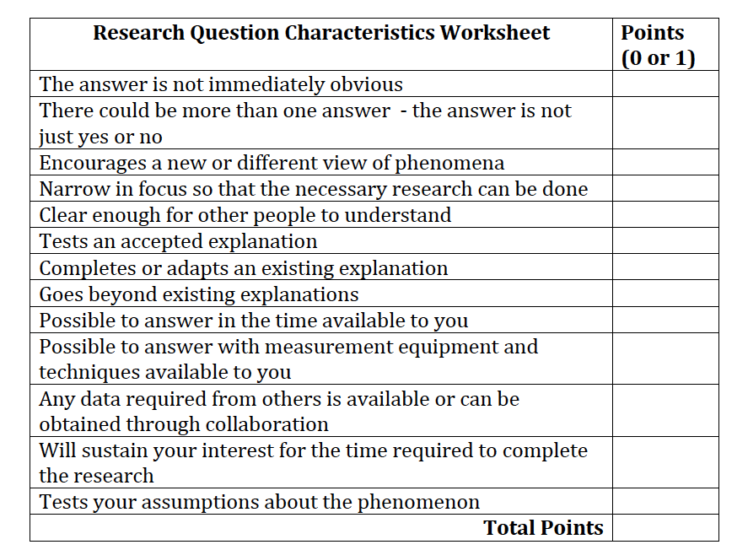
Worksheet to evaluate questions
Notes:
GLOBE has provided a worksheet to help you evaluate the quality of your question. It is also available online.

Slide 17
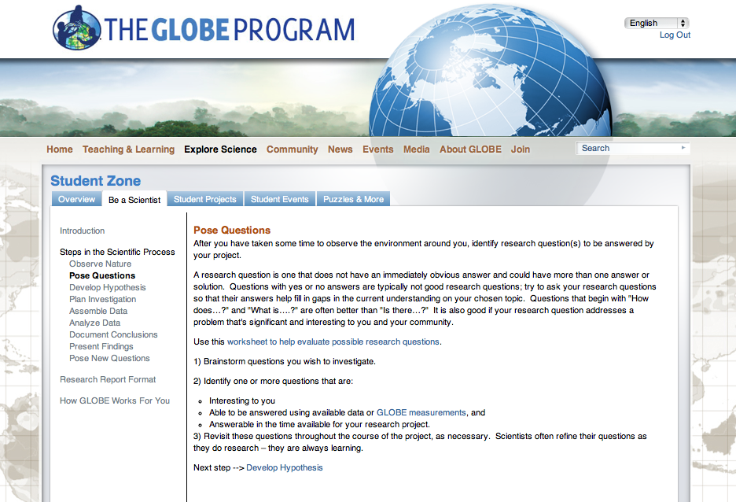
Show where worksheet is (web screenshot)
Notes:
You can find this worksheet on the GLOBE website under the Student Zone, Be a Scientist pages, in the Pose Questions step of the Scientific Process

Slide 18
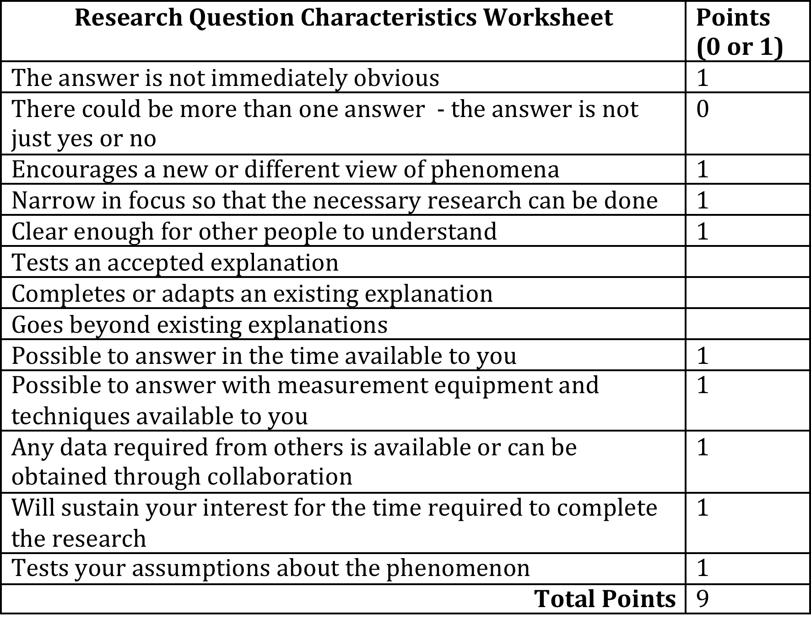
Using the worksheet: An example
Is there a relationship between today’s clouds and tomorrow’s weather?
Notes:
Here is an example of how the worksheet can help you.

Slide 19

Using the worksheet: An example
How reliable is a prediction of tomorrow’s weather based on today’s cloud observations?
Notes:
Here is an example of how the worksheet can help you.

Slide 20
Summary: A good research question…
Is a problem worth solving
Evaluate evidence
Interests you
Is Practical

Slide 21
Important upcoming dates for SCRC – Phase 2
10 September 2012: Official launch of Phase 2!
  If you participated in Phase 1, get your e-gift on the SCRC webpage
September 2012: Great Global Investigation of Climate IOP
September 2012-June 2013: Phenology and Climate project
30 September 2012: Calendar Competition entries due
October 2012: Climate and Land Cover IOP
2 October 2012: Next SCRC webinar “Learning how to study climate using GLOBE Phenology protocols”
  14 UTC
  00 UTC (3 October)
Thank you for attending!

