Slide 1

In a world of high bandwidth…
Networks and NCAR
Go Hand-in-Hand
Ed Group 7/25/13
Teri Eastburn, Spark
Source:
Jeff Custard, CISL NETS

Slide 2
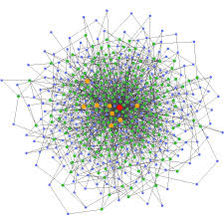
Connections
Over 50,000 schools, libraries, museums, zoos,
aquariums, and other cultural organizations
across the US are connected with each other
and thousands of institutions around the world
via the next-generation Internet?

Slide 3

Acronym soup
Front Range GigaPoP (FRGP)
UCAR Point of Presence (UPoP)
Sponsored Education Group Participant (SEGP)
Decoder page: http://tinyurl.com/nw-decoder

Slide 4
FRGP members, www.frgp.net
Albuquerque GigaPop (ABQG)/University of NM
Colorado School of Mines
Colorado State University System
Ithaka
National Oceanic and Atmospheric Administration
State of Colorado
United States Antarctic Program
University Corporation for Atmospheric Research
University NAVSTAR Consortium (UNAVCO)
University of Colorado Boulder
University of Colorado Colorado Springs
University of Colorado Denver
University of Denver
University of Northern Colorado
University of Wyoming

Slide 5
UPoP members, http://upop.ucar.edu
Auraria Higher Education Center
Boulder Valley School District
Colorado Association of Research Libraries
Centennial Board of Cooperative Educational Services (EAGLE-Net)
City of Boulder
City and County of Denver
Colorado Community College System
Community College of Denver
Colorado Department of Higher Education
Colorado Mountain College
Deproduction
Denver Health and Hospital Authority
EDUCAUSE
Fort Lewis College
Metropolitan State College of Denver

Slide 6
UPoP members cont., http://upop.ucar.edu
St. Mary's Academy
Science and Technology in Atmospheric Research (STAR) Institute
UCD Education Support Services
Thompson School District in Loveland, Colorado
Elbert County School District Elizabeth
Colorado Telehealth Network
Thompson School District
Elbert County School District
Colorado Telehealth Network

Slide 7
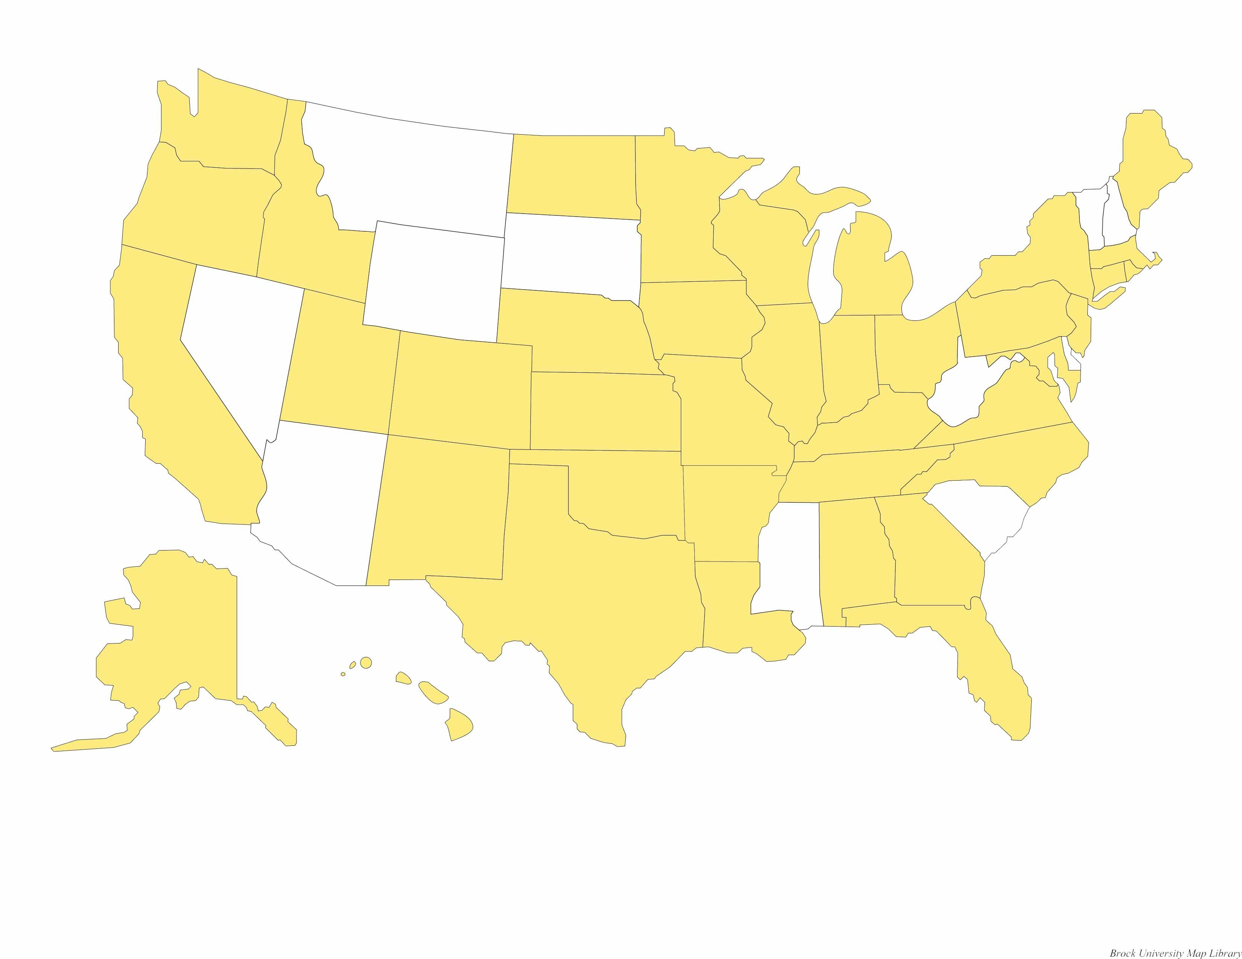
Internet 2, national network and Sponsored Education Group Participant (SEGP)
Bring education innovators into advanced networking efforts
Encourage and help sustain partnerships
Enhance teaching and learning by extending access to
educational resources
Timely communication across all educational sectors
and regions to enable quick, pervasive technology diffusion

Slide 8
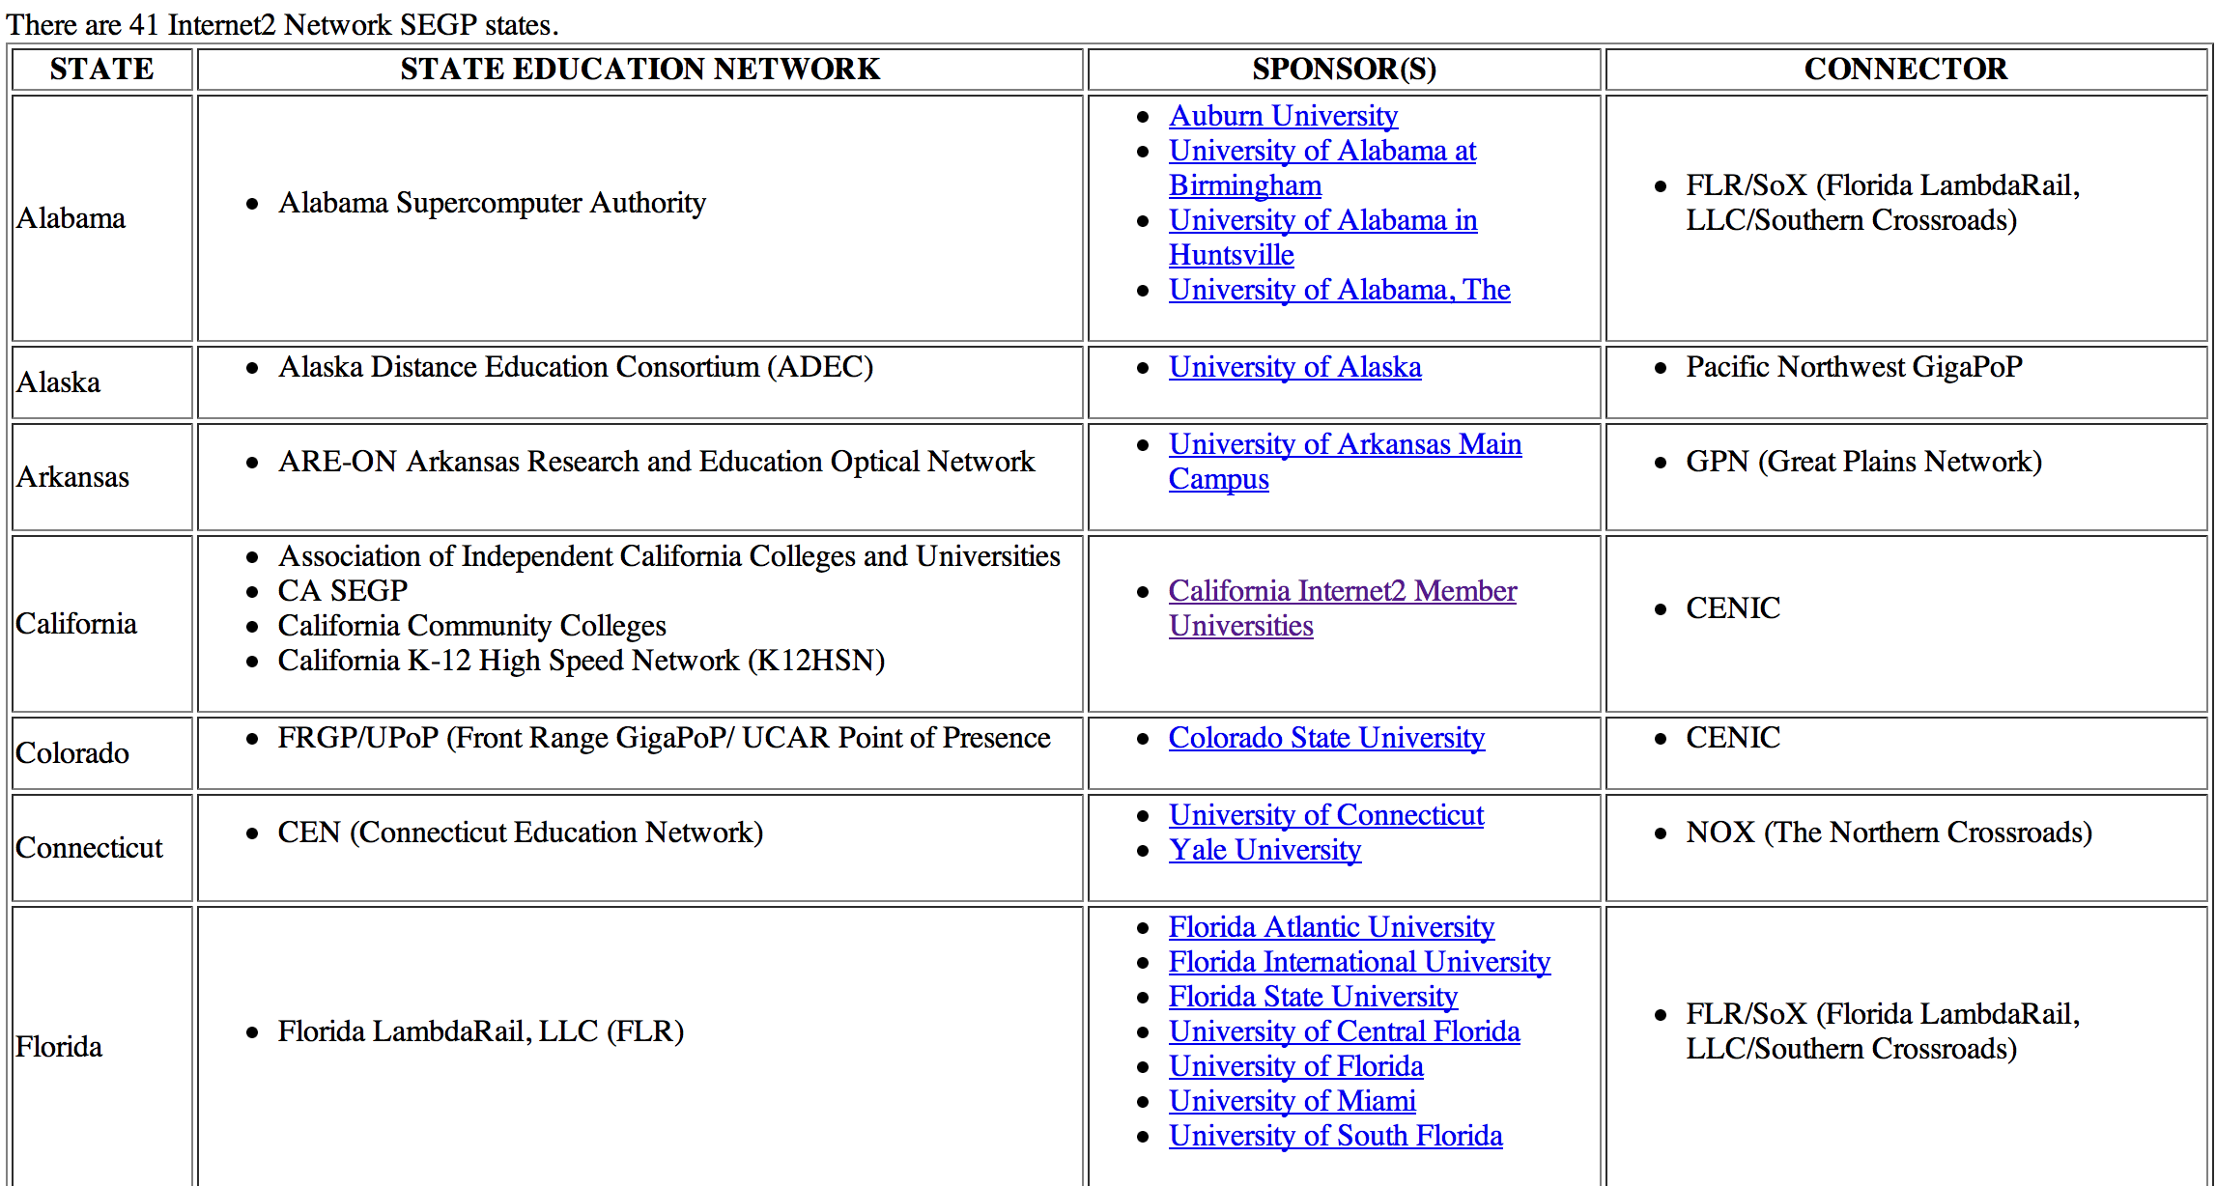

Slide 9
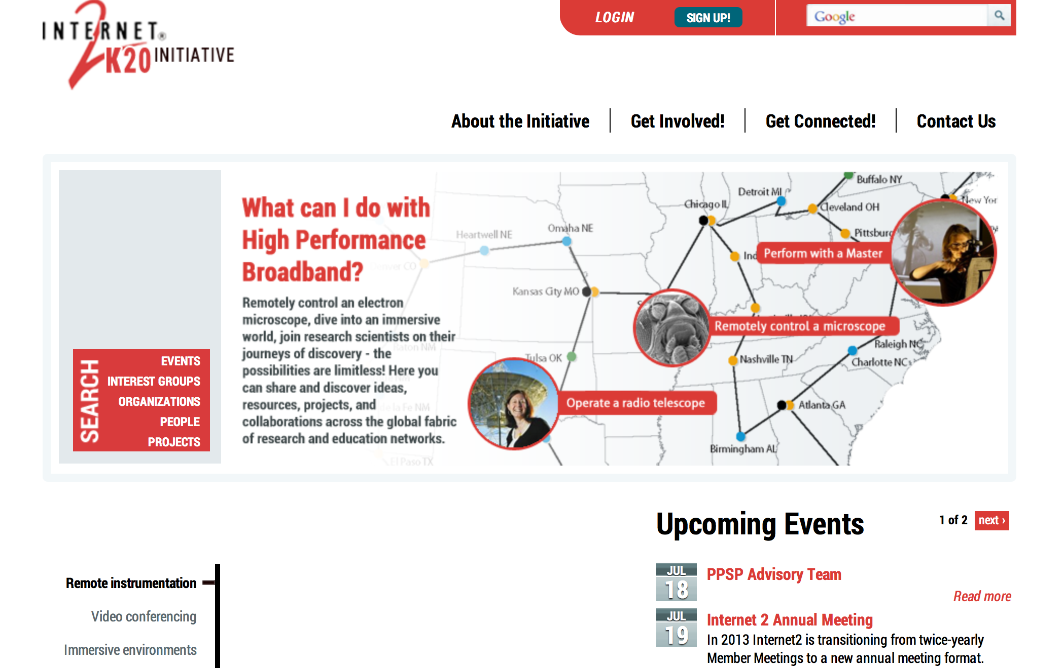
Internet2 K20 Muse site

Slide 10
Internet2 K20 Websites
http://www.internet2.edu/k20
http://k20.internet2.edu/getstarted
http://k20.internet2.edu/about/segp
http://k20dev.internet2.edu (BETA**)

Slide 11
Internet Video Conferencing (IVC)
Polycom Point of Presence
Vidyo for mobile connections
Google Hangouts coming soon to UCAR
Spranto (Try it. Free. Non commercial.)

Slide 12
Internet2
K20 Meeting: Utah, August 7-9th
National Internet2 Meeting in Denver, April 6-10th, 2014

Slide 13
Opportunities
Climate Change Communication. As a result of the IPCC, interest will be higher than usual.
Field Campaigns, EOL
Virtual field trips vs onsite alone via Spark
Professional Development via Hangouts, etc.
Connections to our member
Universities and
research community broadly…

Slide 14

Thank you.

Slide 15
Connecting soon
Thompson School District [ http://www.thompson.k12.co.us/ ] in Loveland, Colorado
Elbert County School District Elizabeth C-1 [ http://elizabeth.k12.co.us/ ]
Colorado Telehealth Network [CTN; http://www.cotelehealth.com/ ]

