Slide 1
Effective Virtual Classroom Sessions
WMO Train the Trainer Workshop
The COMET Program®
Lon Goldstein
November 2011

Slide 2
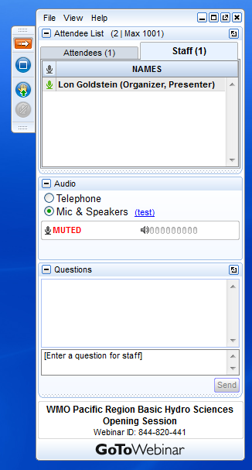
Participating in this Session
Please feel free to ask questions during this session.
You may ask a question by speaking, or by typing it into the questions box.
Click here to “raise your hand” to get our attention
Type here to ask a question

Slide 3
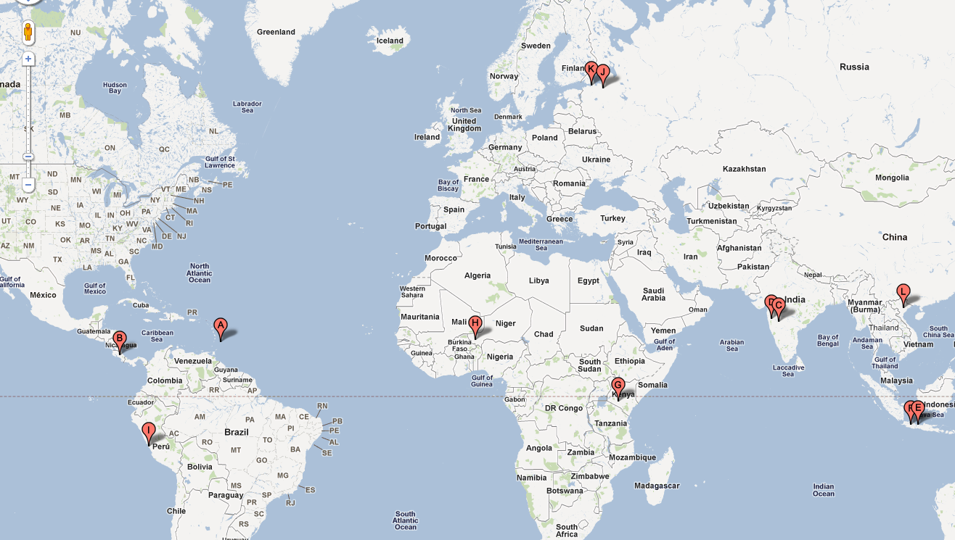
Welcome
Who are you?
Where are you? (At home/office?)
What do you see around you?
      (View outside/inside? Weather?)

Slide 4

Expectations
Expectations for this session:
  Ask questions
  “Raise” your hand
  Turn off distractions
    (phone, email, other work, etc.)
Your expectations?
Notes:
http://www.flickr.com/photos/daniel_gies/5427386376/sizes/m/in/photostream/

Slide 5
Roadmap
Make it Effective
Adapt
Engage
Hold Accountable
Examples
Logistics
Steps
Tools

Slide 6
Poll Question
Virtual classroom sessions can be as effective and engaging as a live classroom session.
  Yes, definitely
  Perhaps
  Definitely not

Slide 7
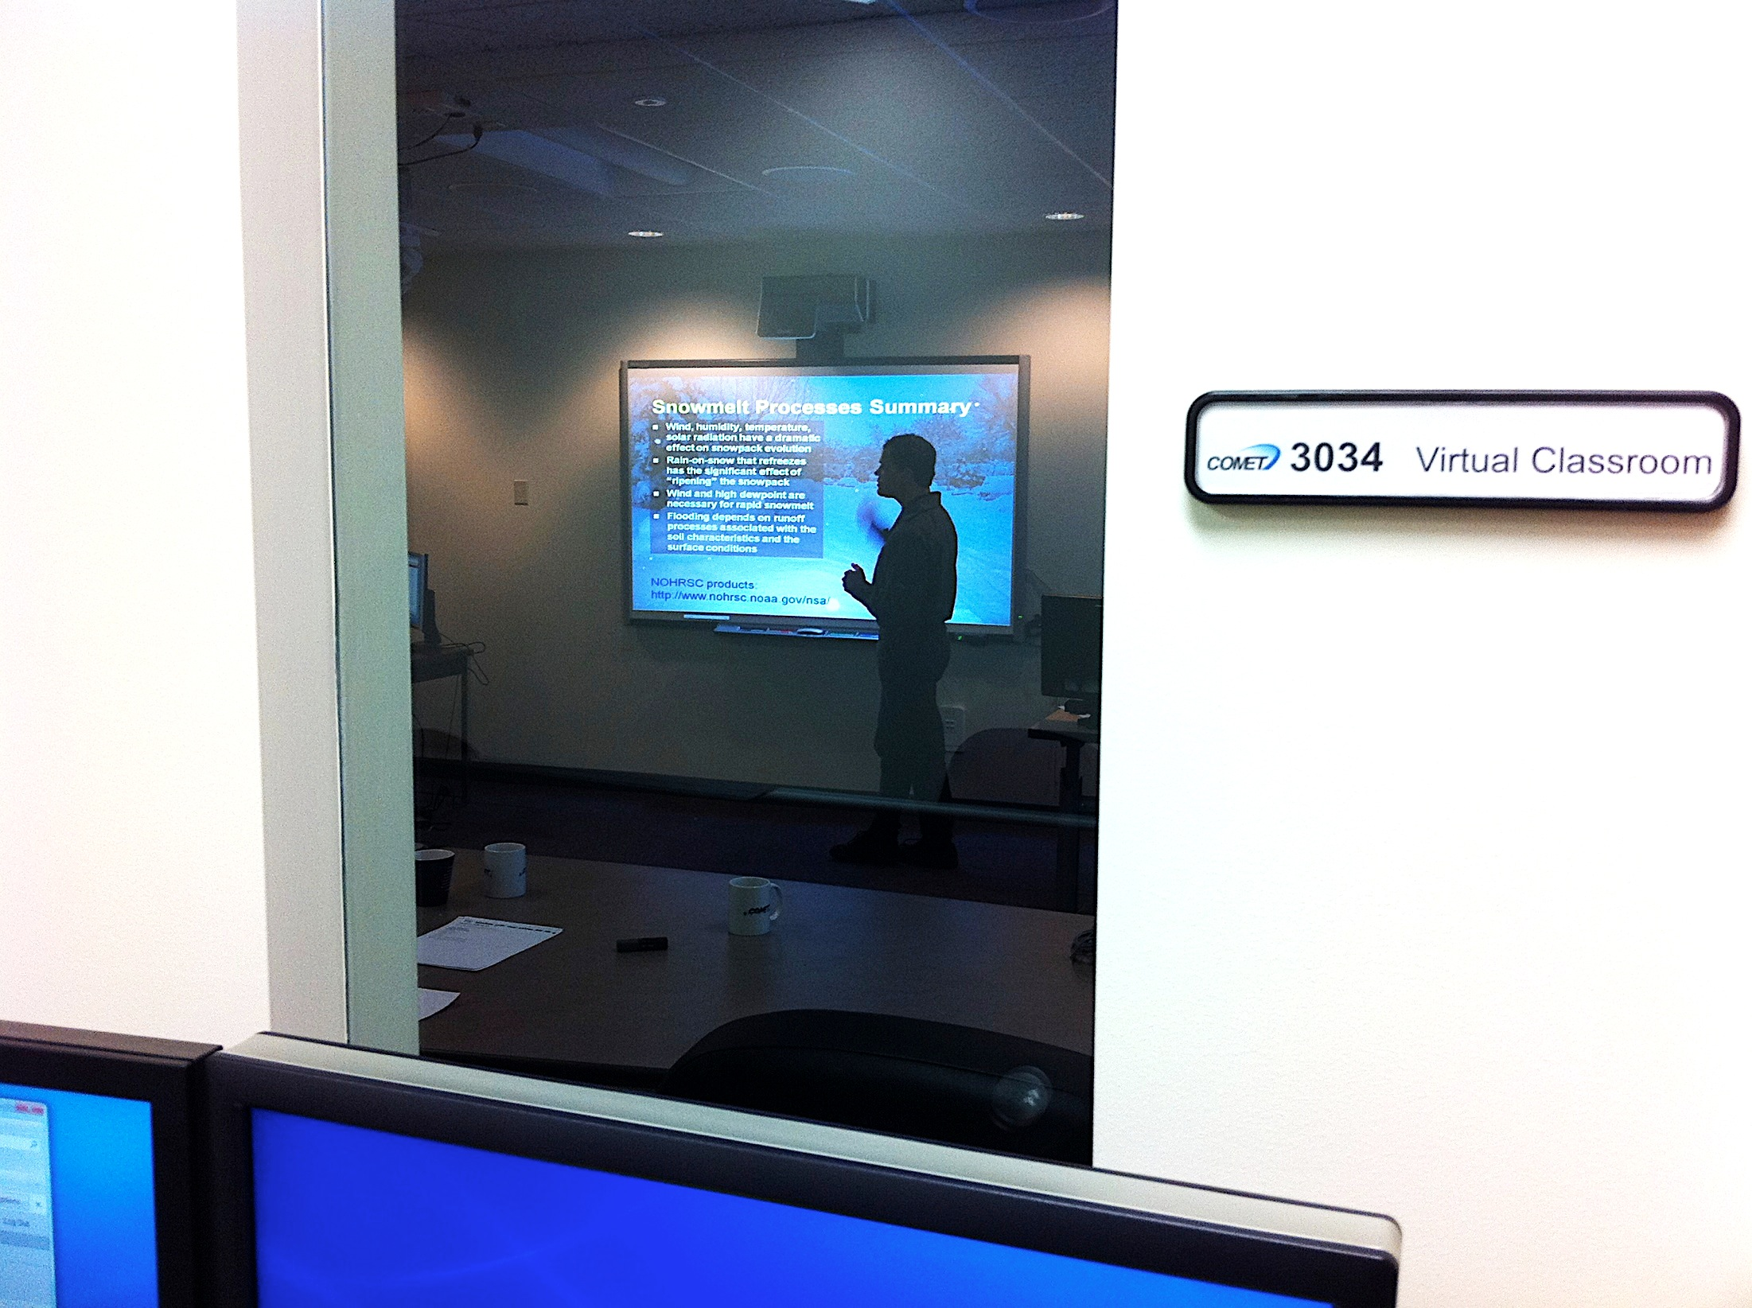

Effective Virtual Training
Different approach required
Virtual training can be very effective
Not an “online meeting” but a learning experience

Slide 8
Brainstorm
What are some techniques that you might use to make a virtual live session more interesting and engaging and effective?
Type 1-3 ideas into your chat box
Notes:
Type ideas into word doc to show

Slide 9
Roadmap
Make it Effective
Adapt
Engage
Hold Accountable
Examples
Logistics
Steps
Tools

Slide 10
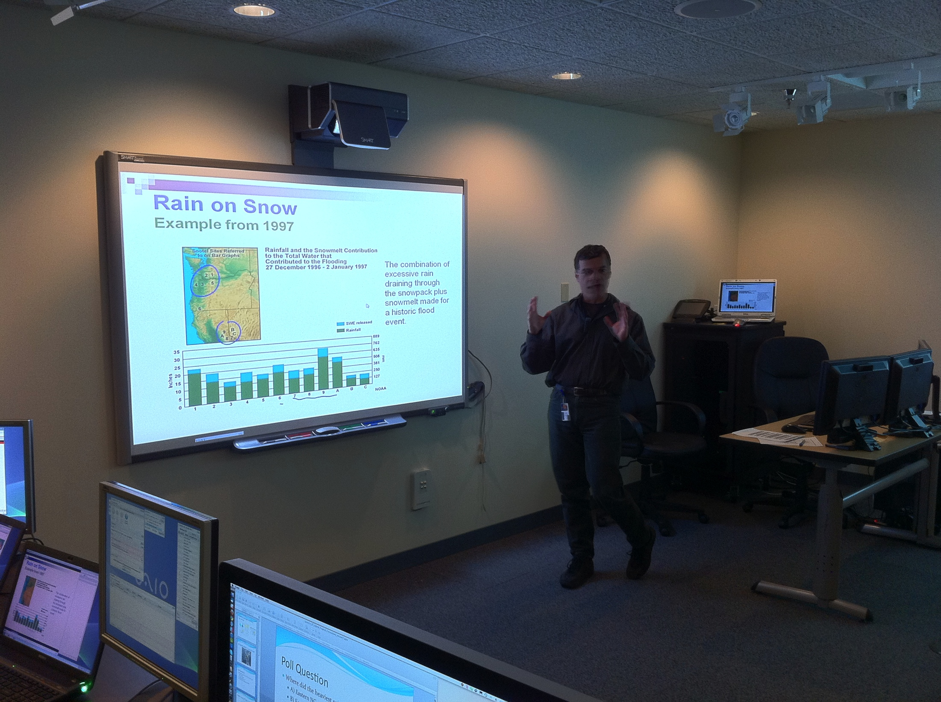
Adapt
Materials:
Adapt presentations for virtual
Simplify content
Plan interactions/questions more often

Slide 11

Keep it Short
Keeping learners attention is harder online
Maximum 90 min per session (ideally)
Use smaller “chunks” of information
Multi-day virtual classes:
  6hr/day maximum!
  Intersperse shorter days
  Use breakout sessions/activities
  Examples:
    5-day Climate Variability and Change
    Virtual Course – 6-6-4-6-4
    4-day Symposium on QPF/Rapid
      Onset Floods – 6-6-6-4

Slide 12
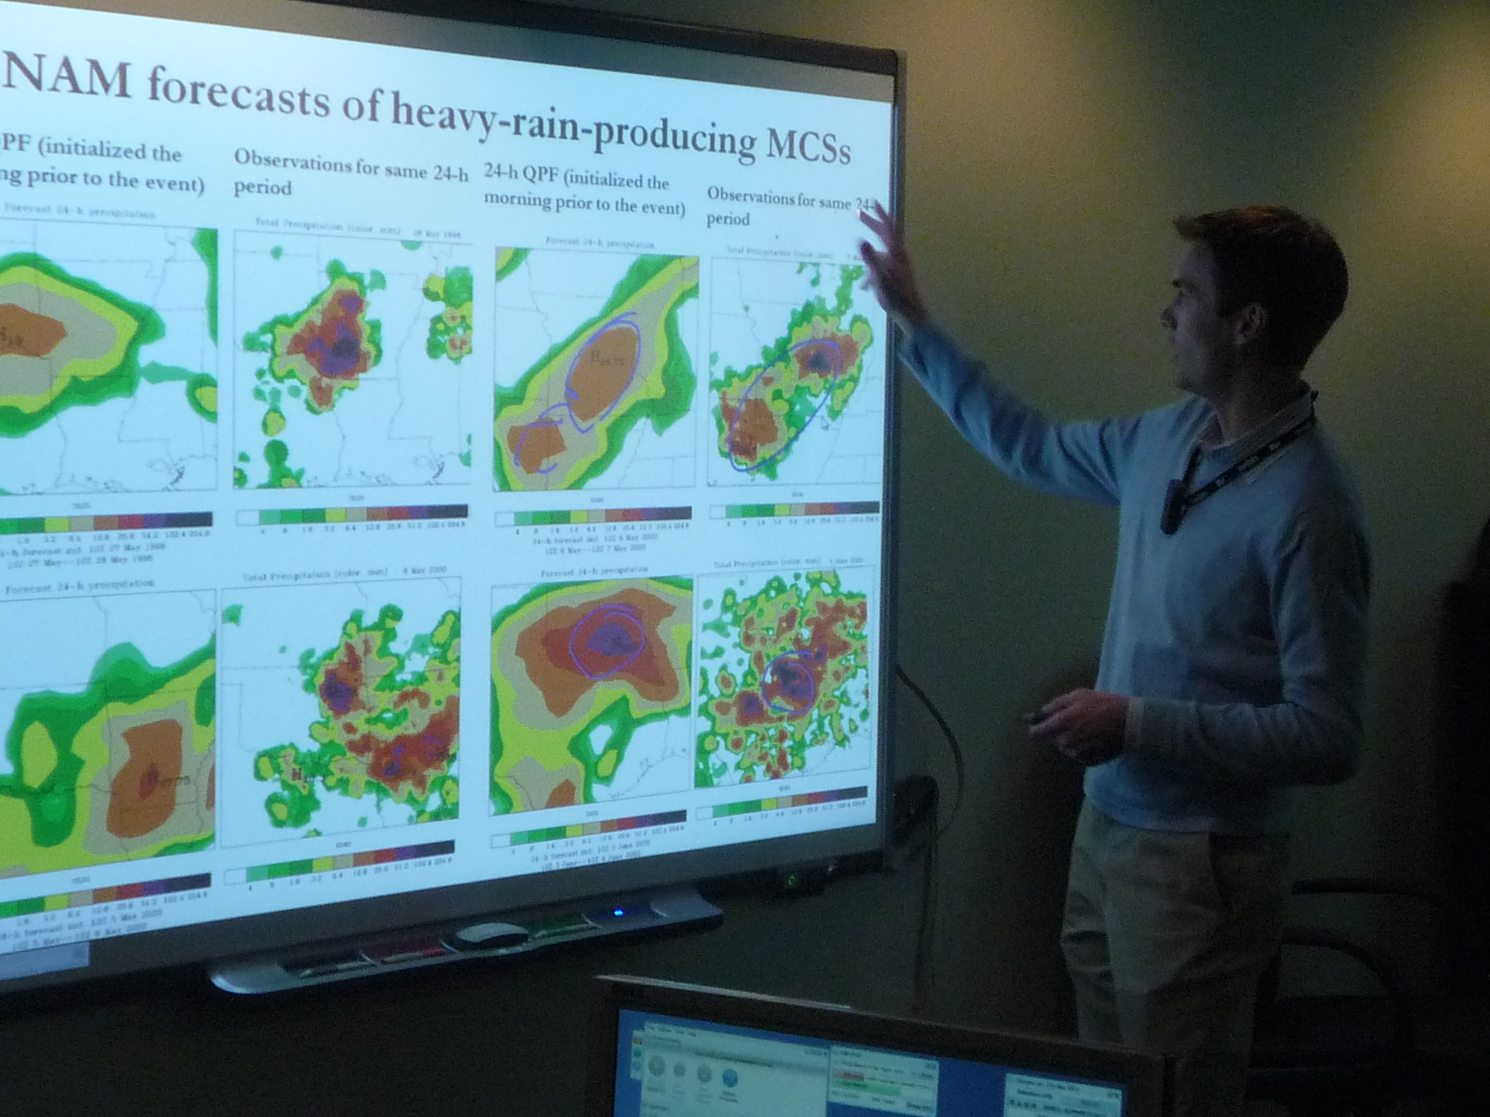
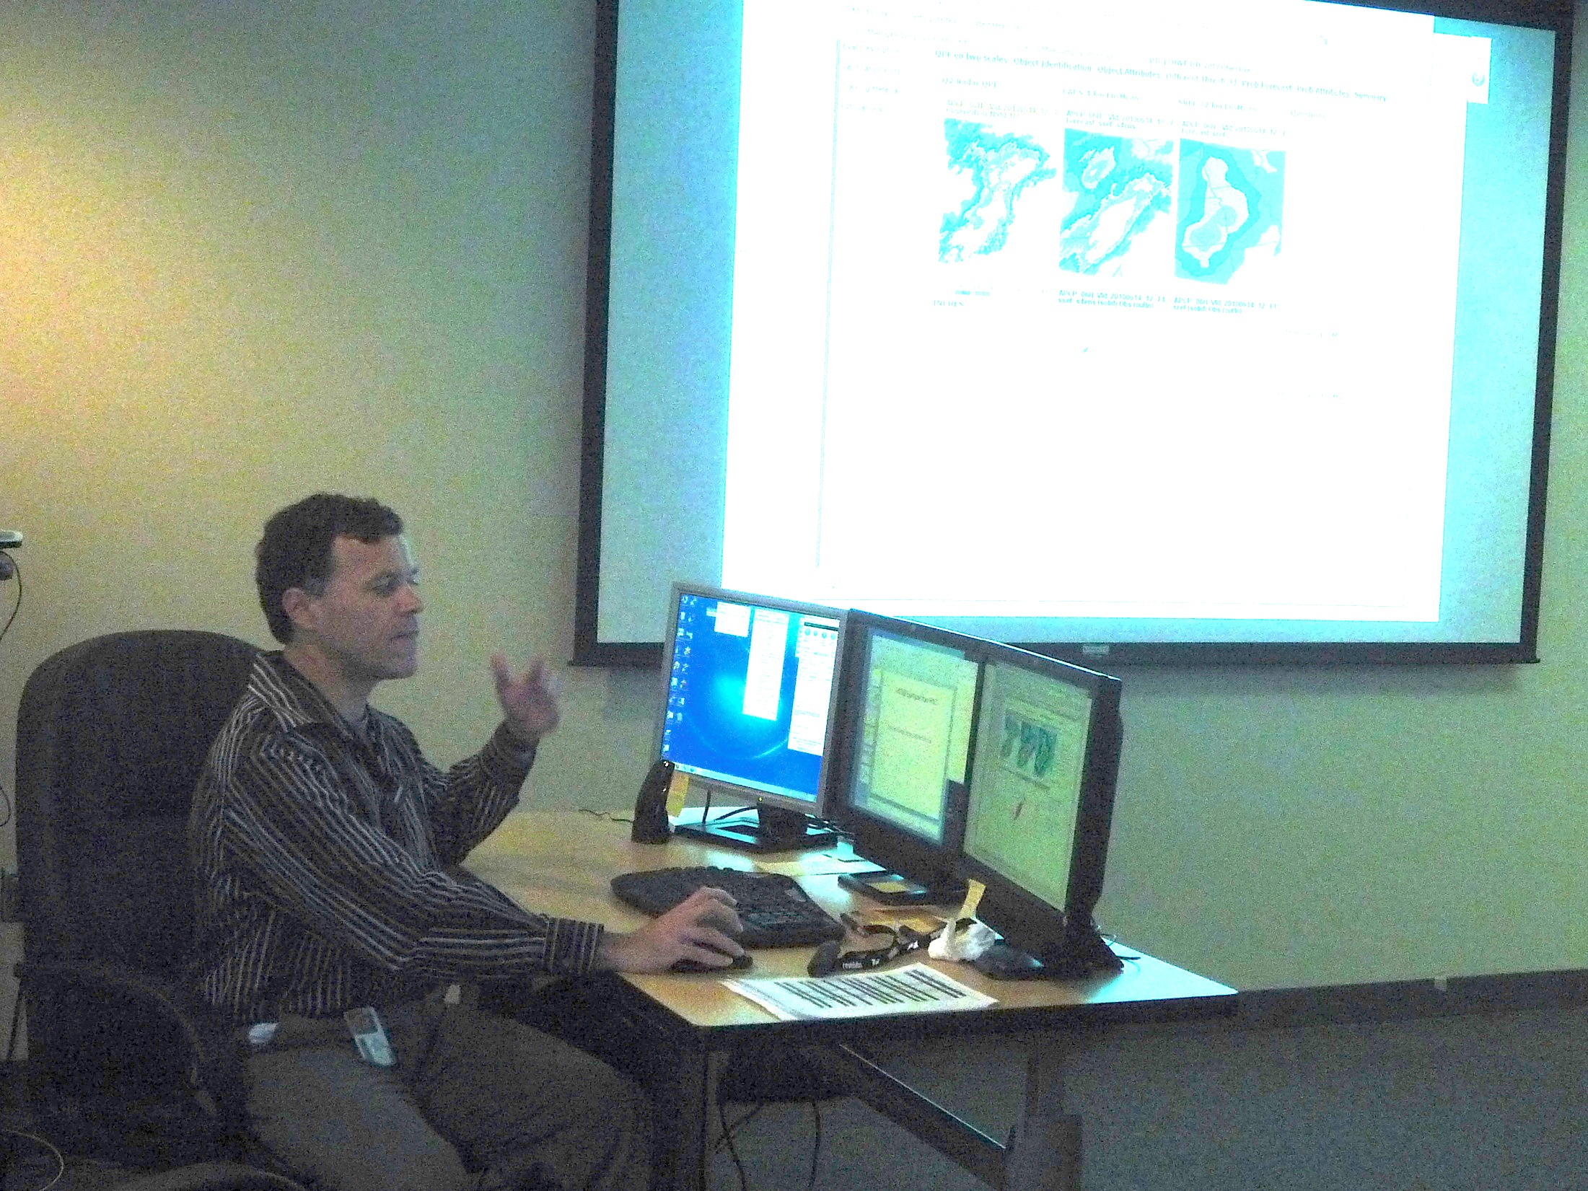
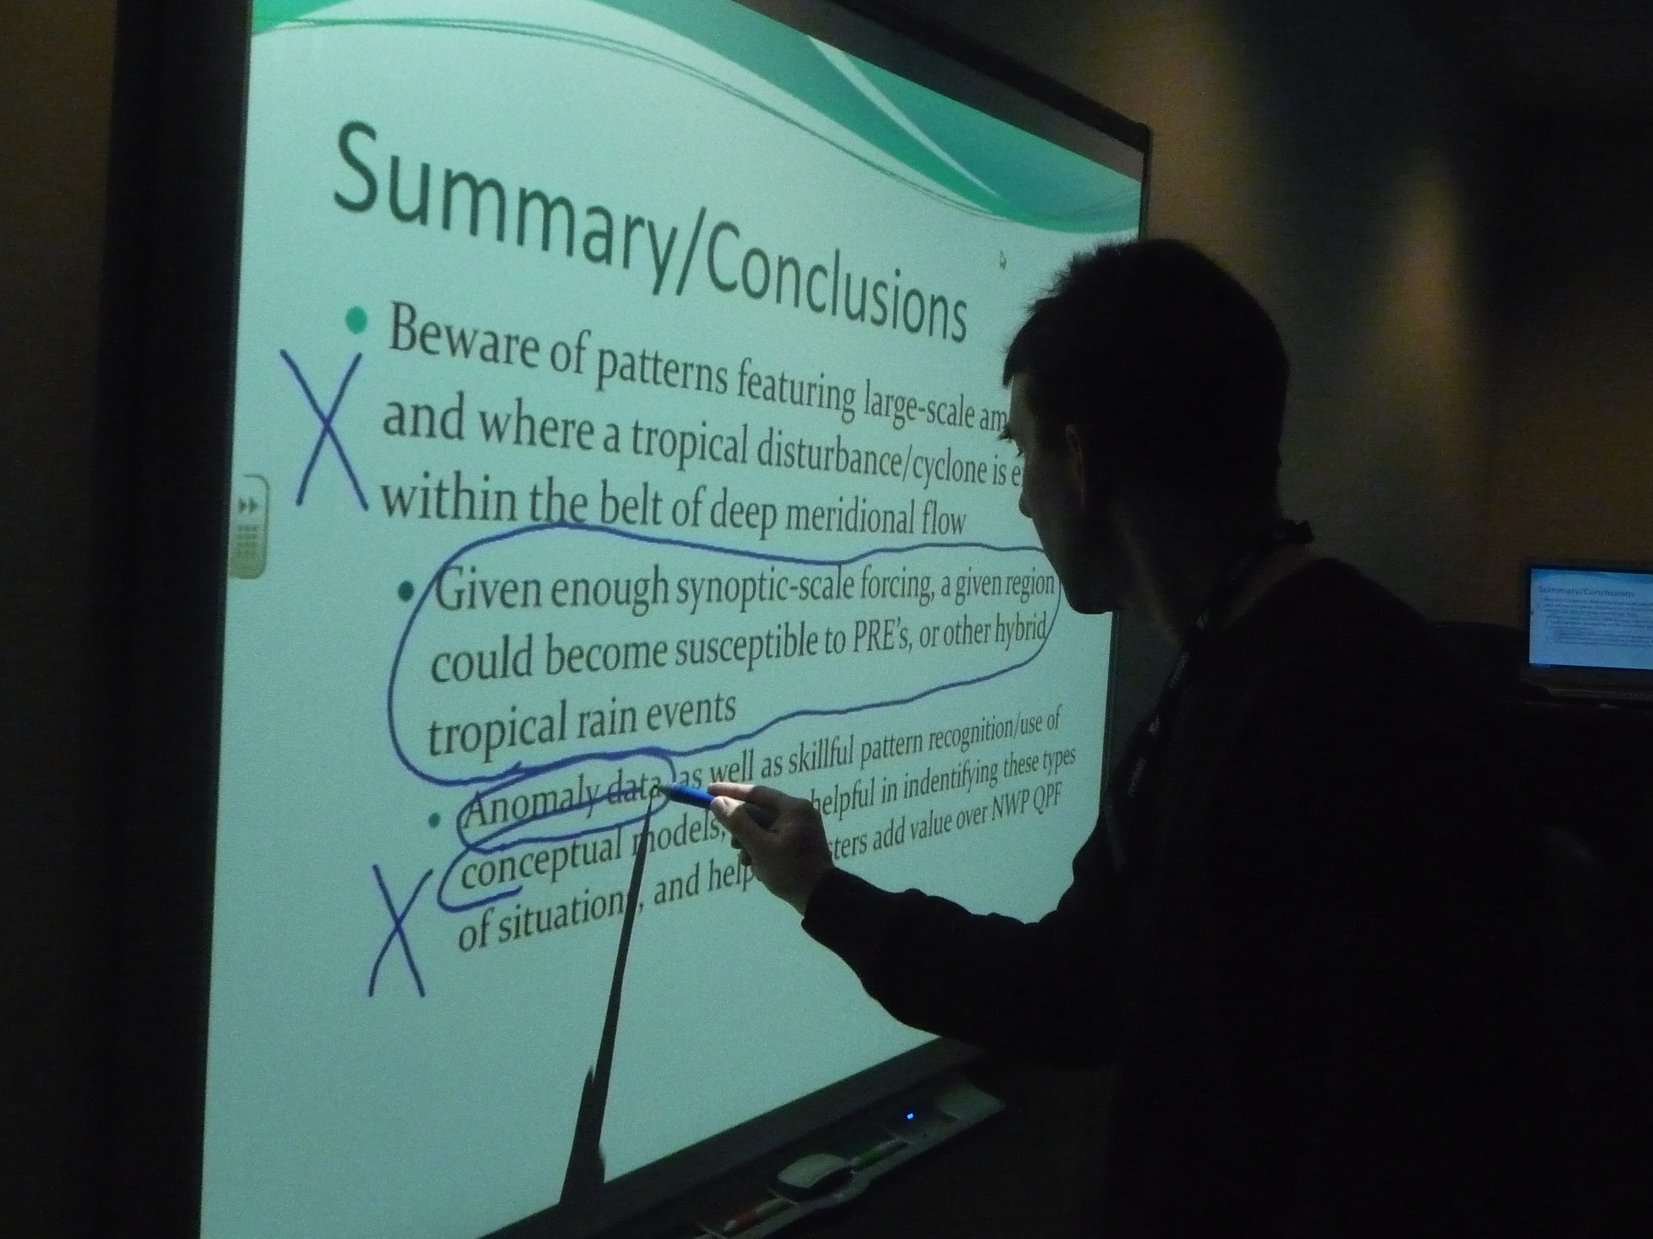
Adapt
Presentation style:
Annotate – Use tools to show what is being referred to
Pacing – keep it moving, keep it interesting
Dynamic voice – hold attention, be expressive

Slide 13
Poll Question
How often should you engage students in an interaction in the virtual classroom environment?
  Once a minute
  Every 2-3 minutes
  Every 5-10 minutes
  Every 10-15 minutes
  Every 20-30 minutes

Slide 14
Roadmap
Make it Effective
Adapt
Engage
Hold Accountable
Examples
Logistics
Steps
Tools

Slide 15
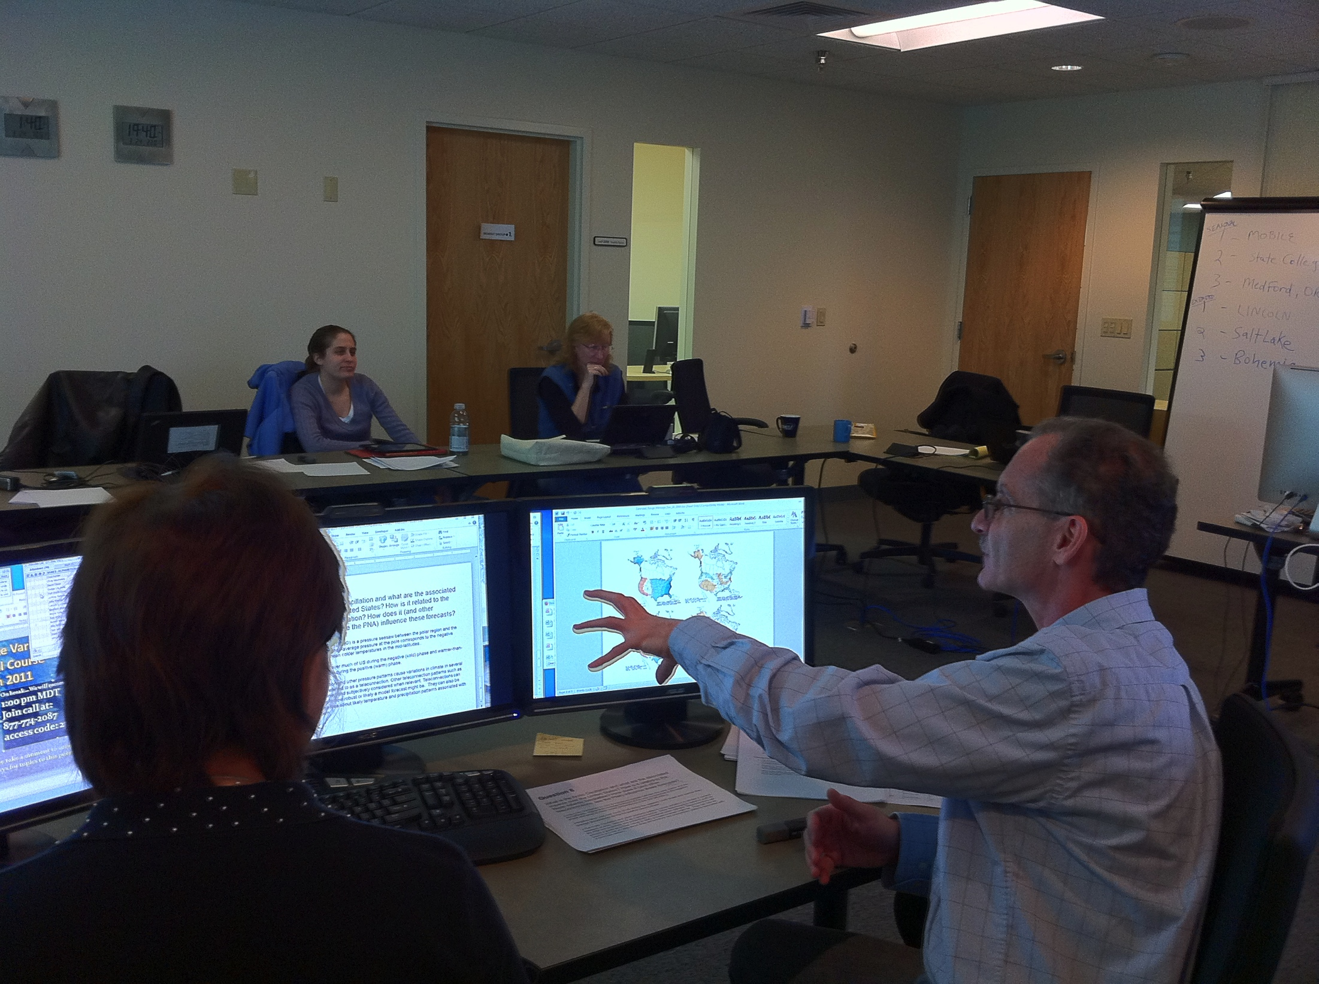
Engage
Stop to interact with students every 2-3 (or 5-10) minutes
  No answer = no interaction!
Call on students directly
Notes:
http://www.flickr.com/photos/jiscimages/435083548/sizes/o/in/photostream/

Slide 16
Discuss: How to Engage?
How do you engage students in the physical classroom?
How do you know whether they are understanding?
How can you engage students in the virtual classroom?
How do you know if they are understanding?

Slide 17

Engage
Adapt classroom methods:
  Use hand-raising tools, chat, questions
  Check-in frequently; are they following?
  Stick to the point; avoid side conversations (e.g. off topic conversation with an individual)
  Expect side conversations at multiple person locations – repeat important information
  Hold them accountable - Verbal, Visual, Kinesthetic

Slide 18
Roadmap
Make it Effective
Adapt
Engage
Hold Accountable
Examples
Logistics
Steps
Tools

Slide 19
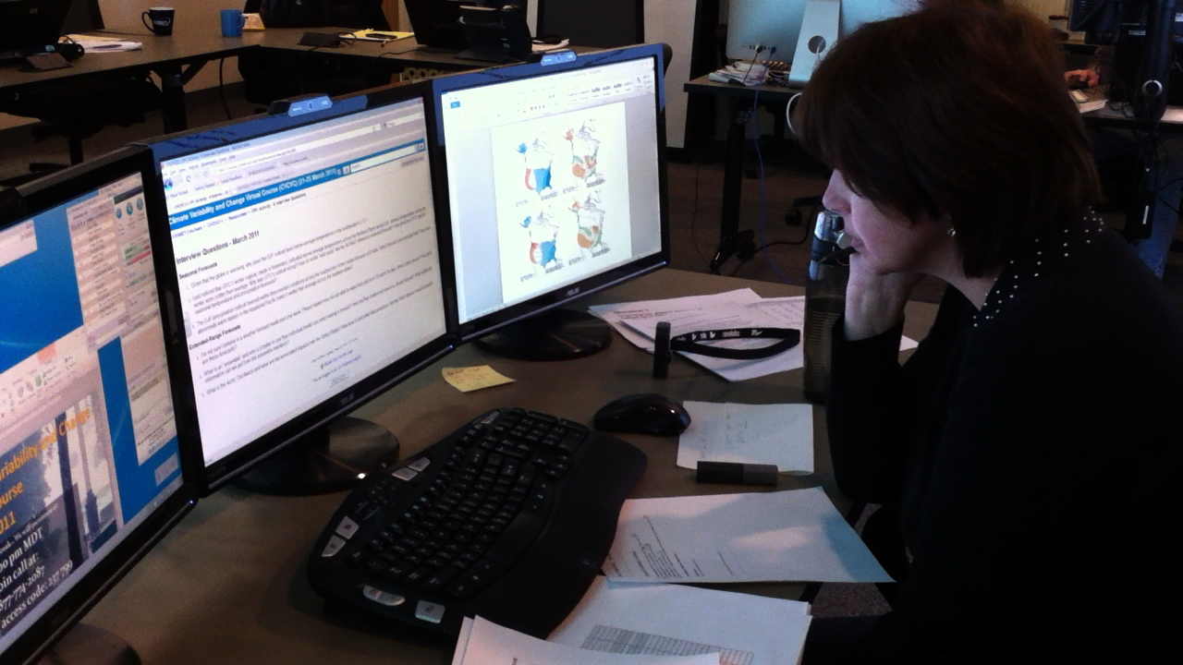
Virtual Accountability
Verbal:
Condition learners to respond
Count to 15 after first question
Call on people by name
Notes:
Verbal:
Condition learners to respond – e.g. Marco-polo game
Count to 15 after first question – leave time to respond, and let them know a response is expected
Call on people by name, tell them up front you’ll be doing this, start with someone you have a rapport with
Use polls for quick check-ins to see if people are getting it

Slide 20
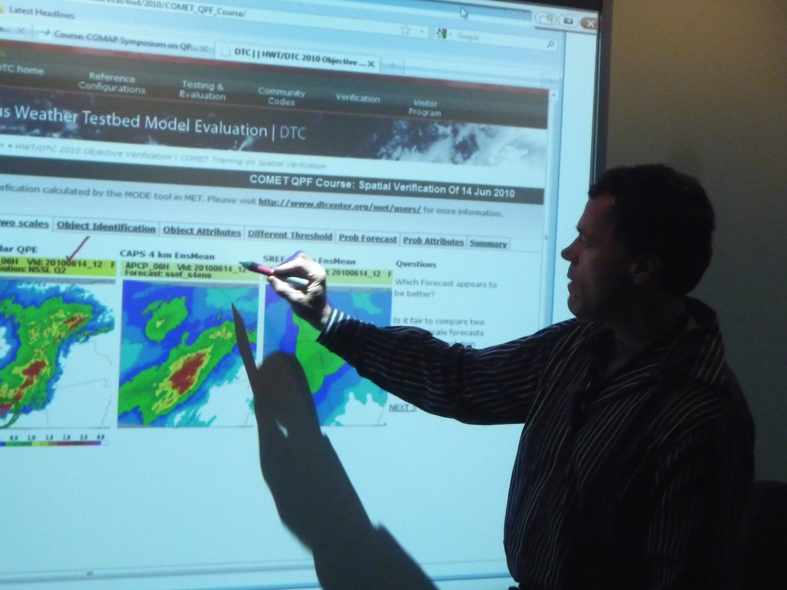
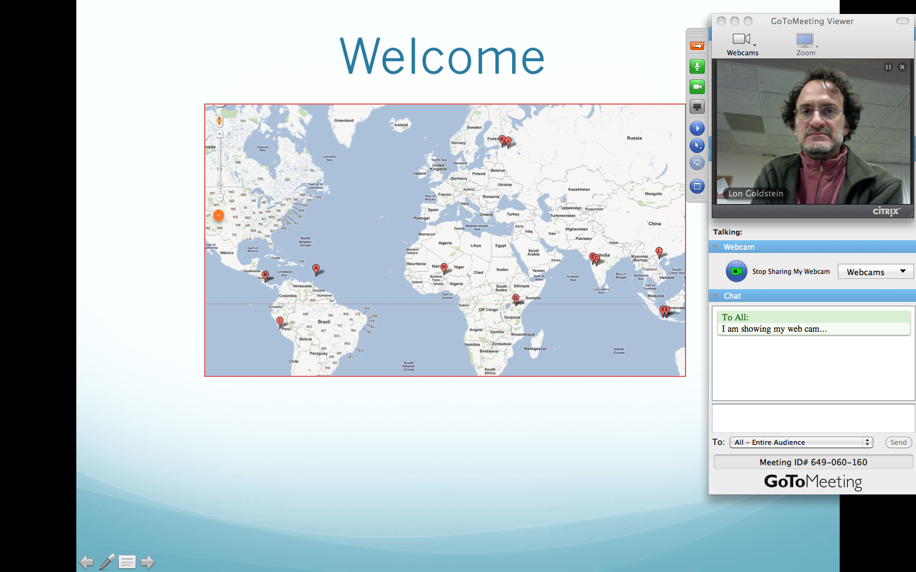
Virtual Accountability
Visual:
Use good slide design
Use visual data, annotate
Use online tools: chat, collaborative whiteboard, quizzes
Use webcam
(in moderation)
Notes:
Visual:
Use good slide design (Same as for classroom)
Use a road map to provide an overview
Use chat window, collaborative whiteboard, quizzes, polls with images
Have students do work in parallel on their own screen
Use webcam in moderation

Slide 21
Virtual Accountability
Kinesthetic:
How can you hold people accountable on the kinesthetic (physical) level in the virtual classroom?
Notes:
Kinesthetic:
Have students download and print worksheets, have them write/do exercises on paper and report results
Have short offline activities, share results with group

Slide 22
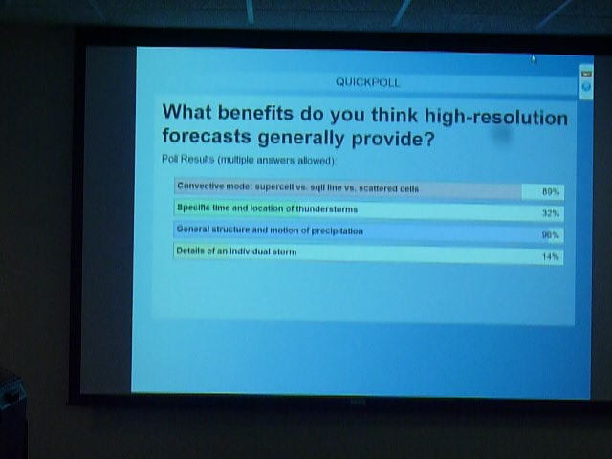
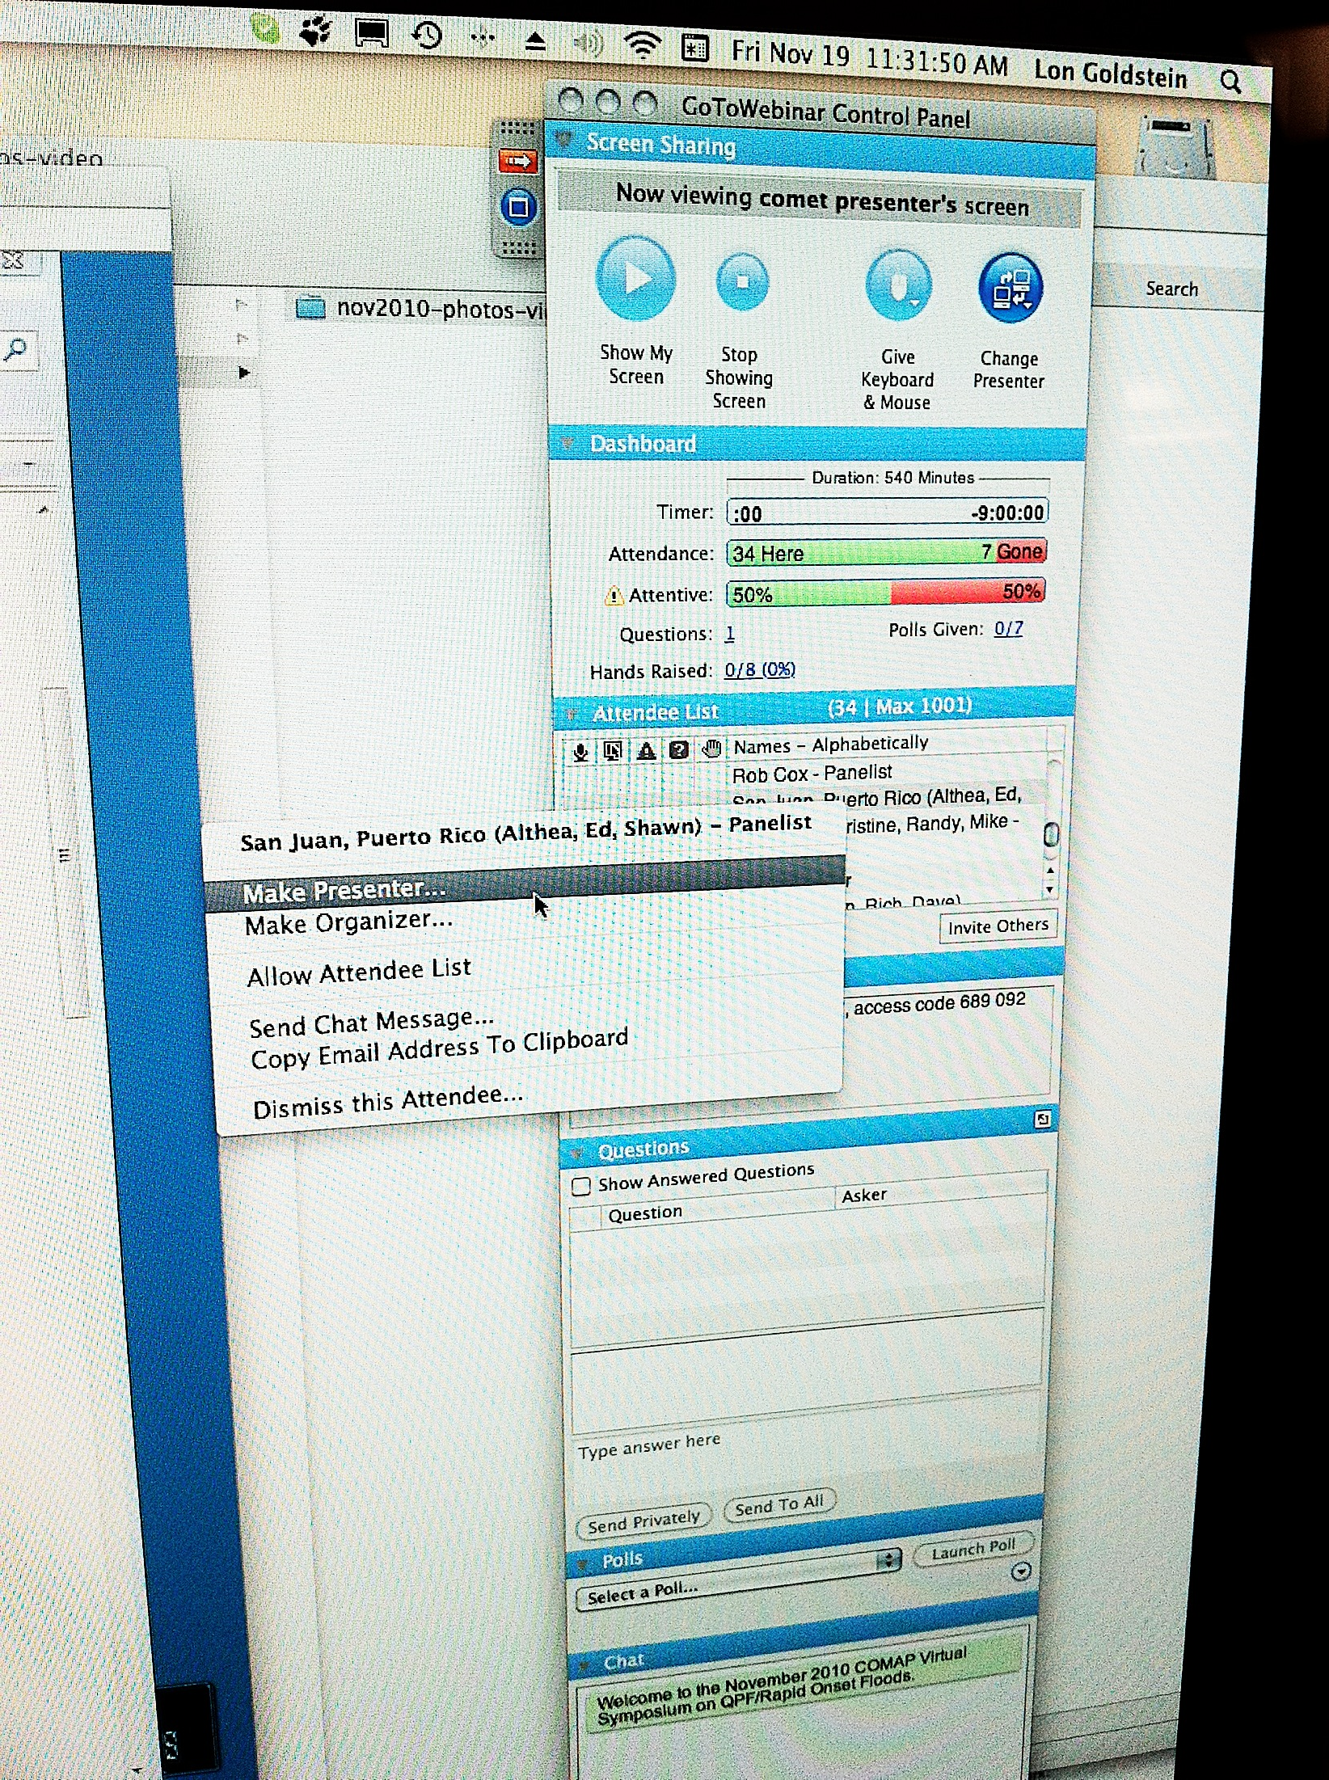
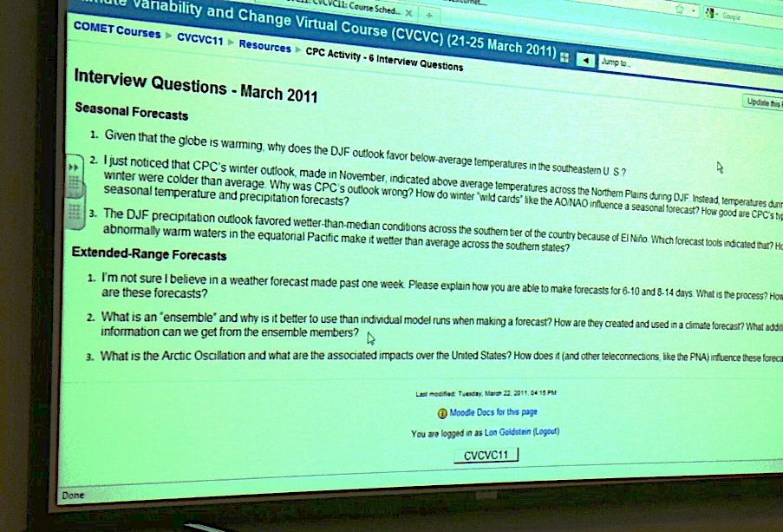
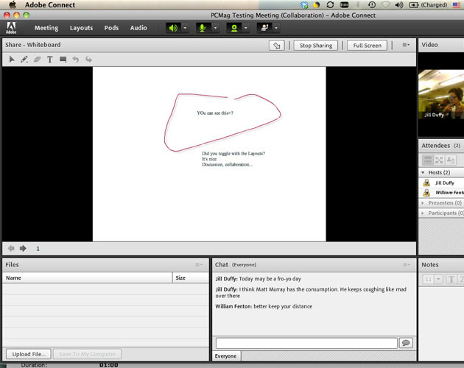
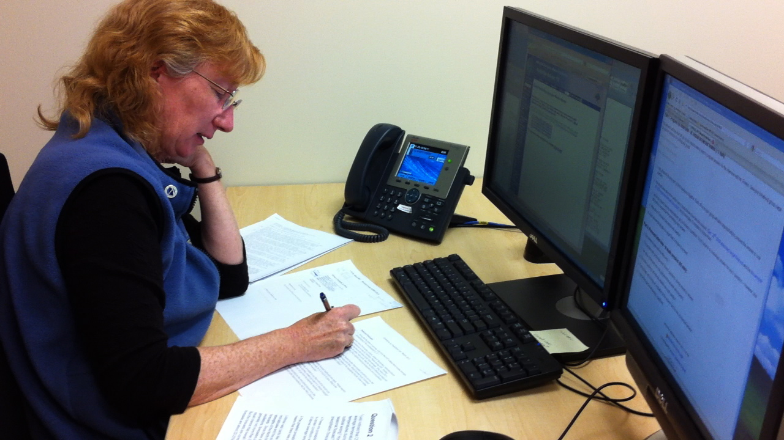
Virtual Accountability
Kinesthetic:
Local exercises
  do worksheets, exercises on paper and report results
Polls, whiteboard
Offline activities – share results with group
  Make participant presenter
Pass control to student
Notes:
Kinesthetic:
Have students download and print worksheets, have them write/do exercises on paper and report results
Have short offline activities, share results with group

Slide 23
Roadmap
Make it Effective
Adapt
Engage
Hold Accountable
Examples
Logistics
Steps
Tools

Slide 24
Example 1: Climate Variability and Change Virtual Course
http://courses.comet.ucar.edu/course/view.php?id=67
1 week Climate course > 1 week virtual
10 instructors, 3 local, others remote
~30-35 participants plus observers
5 days, 3 x 6hrs, 2 x 4hrs
Presentations, labs, exercises
2 small groups breakout sessions

Slide 25
Example 2: Symposium on QPF/Rapid Onset Floods
http://courses.comet.ucar.edu/course/view.php?id=56
12 instructors, 3 local, others remote
~45 full-time participants plus 25 part-time
4 days, 3 x 6hrs, 1 x 4hrs
Presentations, labs, exercises
2 small groups breakout sessions
Participant presentation of their local case analysis
  Required to relate their case to class topics

Slide 26
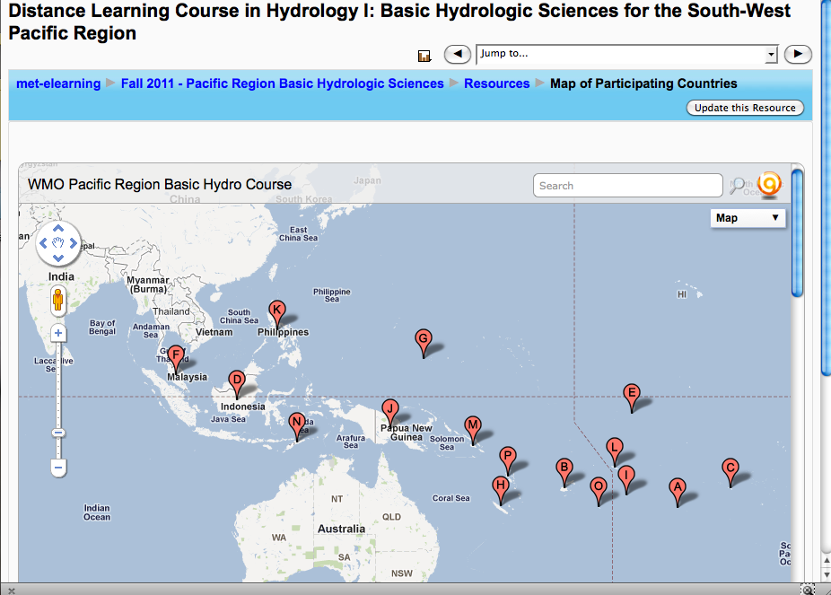
Example 3: Basic Hydrologic Sciences for the South-West Pacific Region
http://www.met-elearning.org/moodle/course/view.php?id=93
1 hour opening/closing webinar session
10-15 participants over 5-6 countries, 4 time zones

Slide 27
How will you use virtual classroom?
Do you have any ideas in mind for virtual classroom sessions in your training area?
Would it be part of a larger online course?
What are your challenges?

Slide 28
Roadmap
Make it Effective
Adapt
Engage
Hold Accountable
Examples
Logistics
Steps
Tools

Slide 29
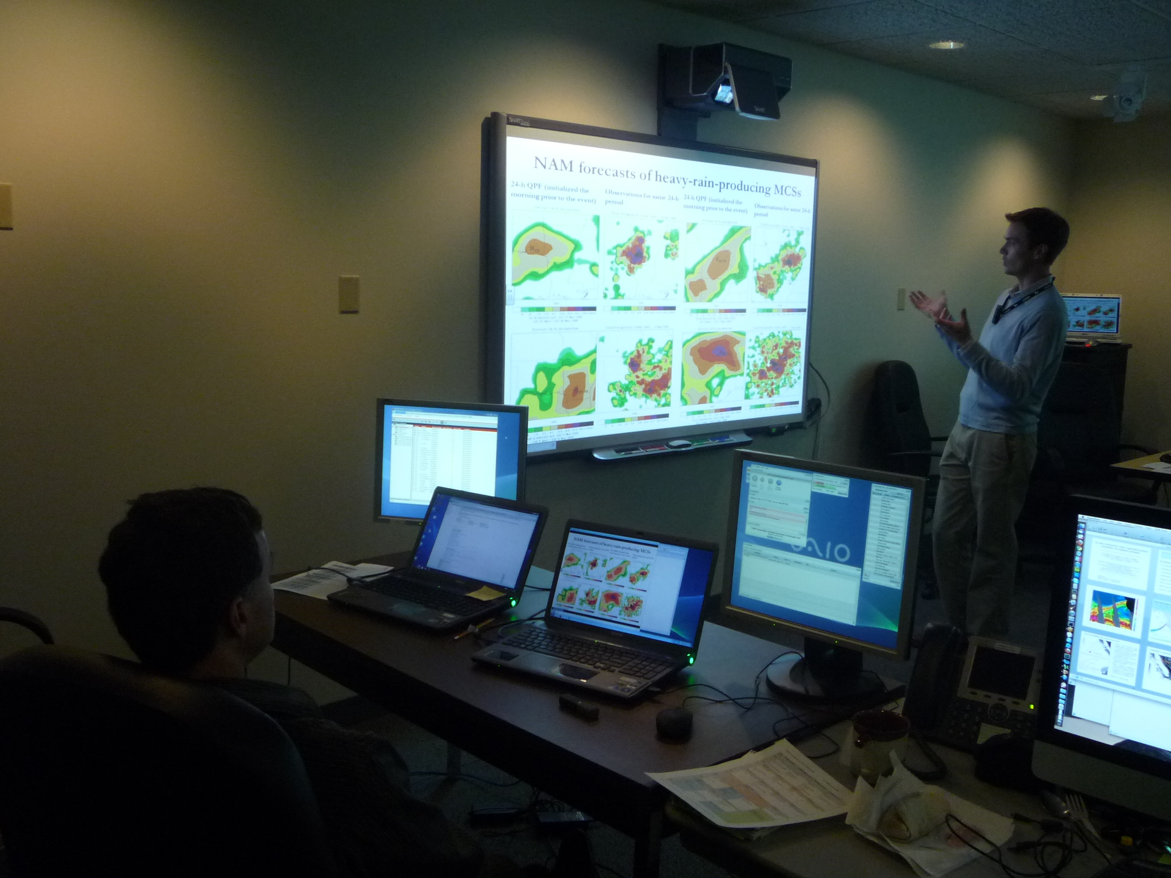
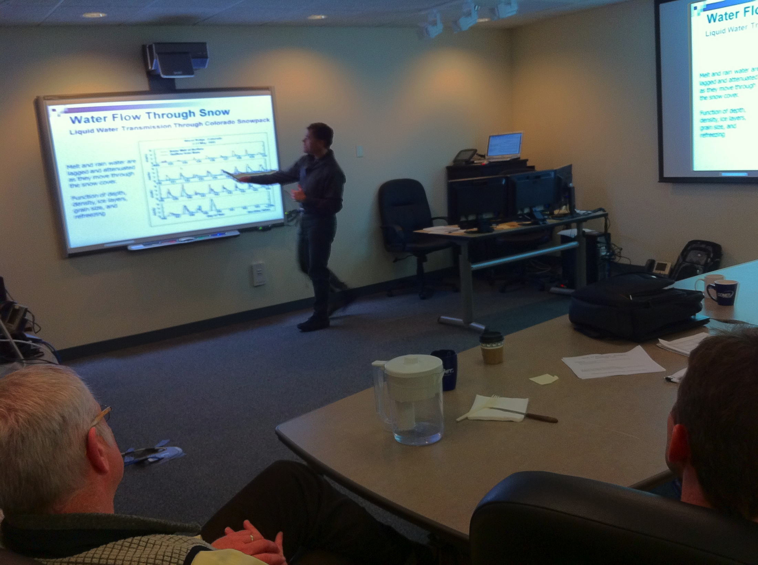
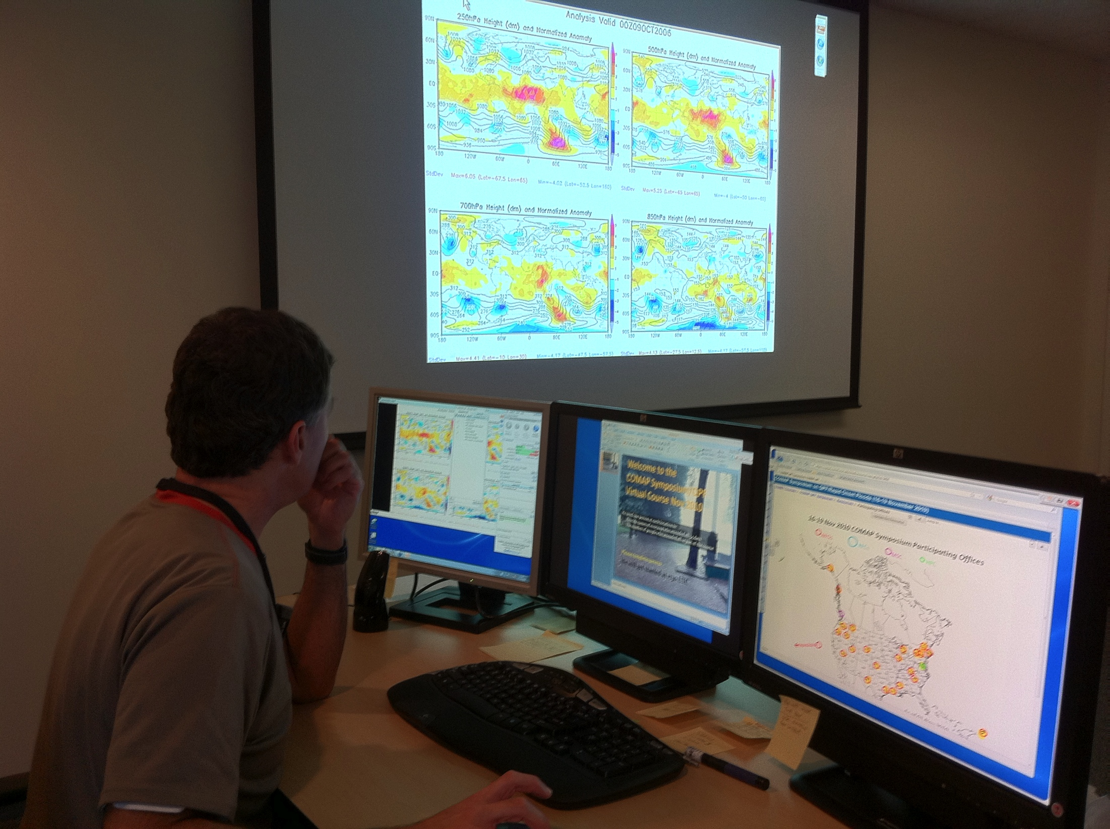
Logistics
Use second computer for participant view
Use second monitor to see chats/questions student list
Have a live audience in the room if possible
Use at least one other person as facilitator

Slide 30
Poll: Logistics
Which of the following are recommended for a smooth virtual class?
  Test all technology in advance
  Use video clips often to make things interesting
  Have students use a headset when using VOIP
  Plan breaks every hour to 1.5 hours
  Have students join the session at the scheduled start time

Slide 31
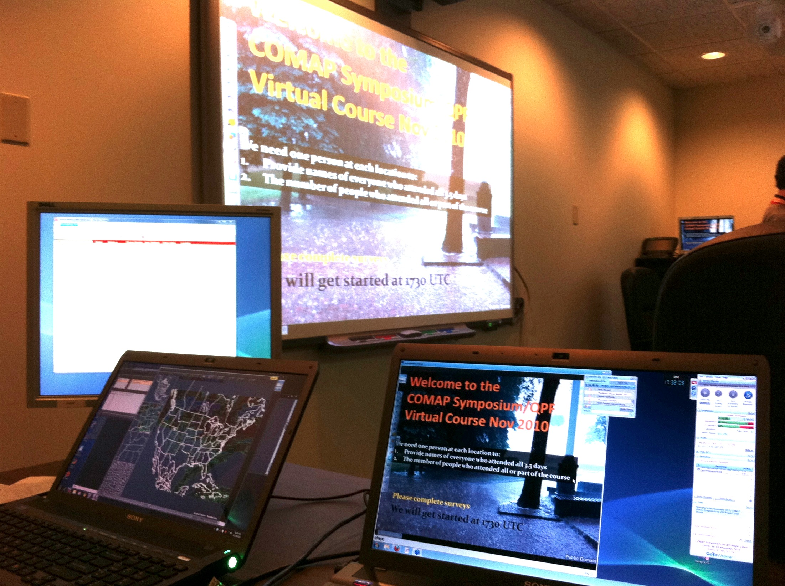
Logistics (continued)
Technology
Test in advance!
Audio
  VOIP or phone?
    VOIP - headsets much
    better, avoid echos
    Phone
      speakerphones ok, but mute when not talking
Video
    bandwidth issues, screen sharing

Slide 32
Logistics (continued)
Always tell students to join early in case of technology issues
  10-15 min before start
Test media in advance - videos, links
Check out audience bandwidth: internet speed test sites
Keep on schedule, plan breaks every hour to 1.5 hours at least
If using phone for audio, have students download slides in advance in case of internet problems

Slide 33
Small Group Activities
Main Session
Breakout group 1
Breakout group 2
Use separate webinar sessions (some tools include built-in sub-conferencing)
3 groups: (Group 1 stays in the main session)

Slide 34
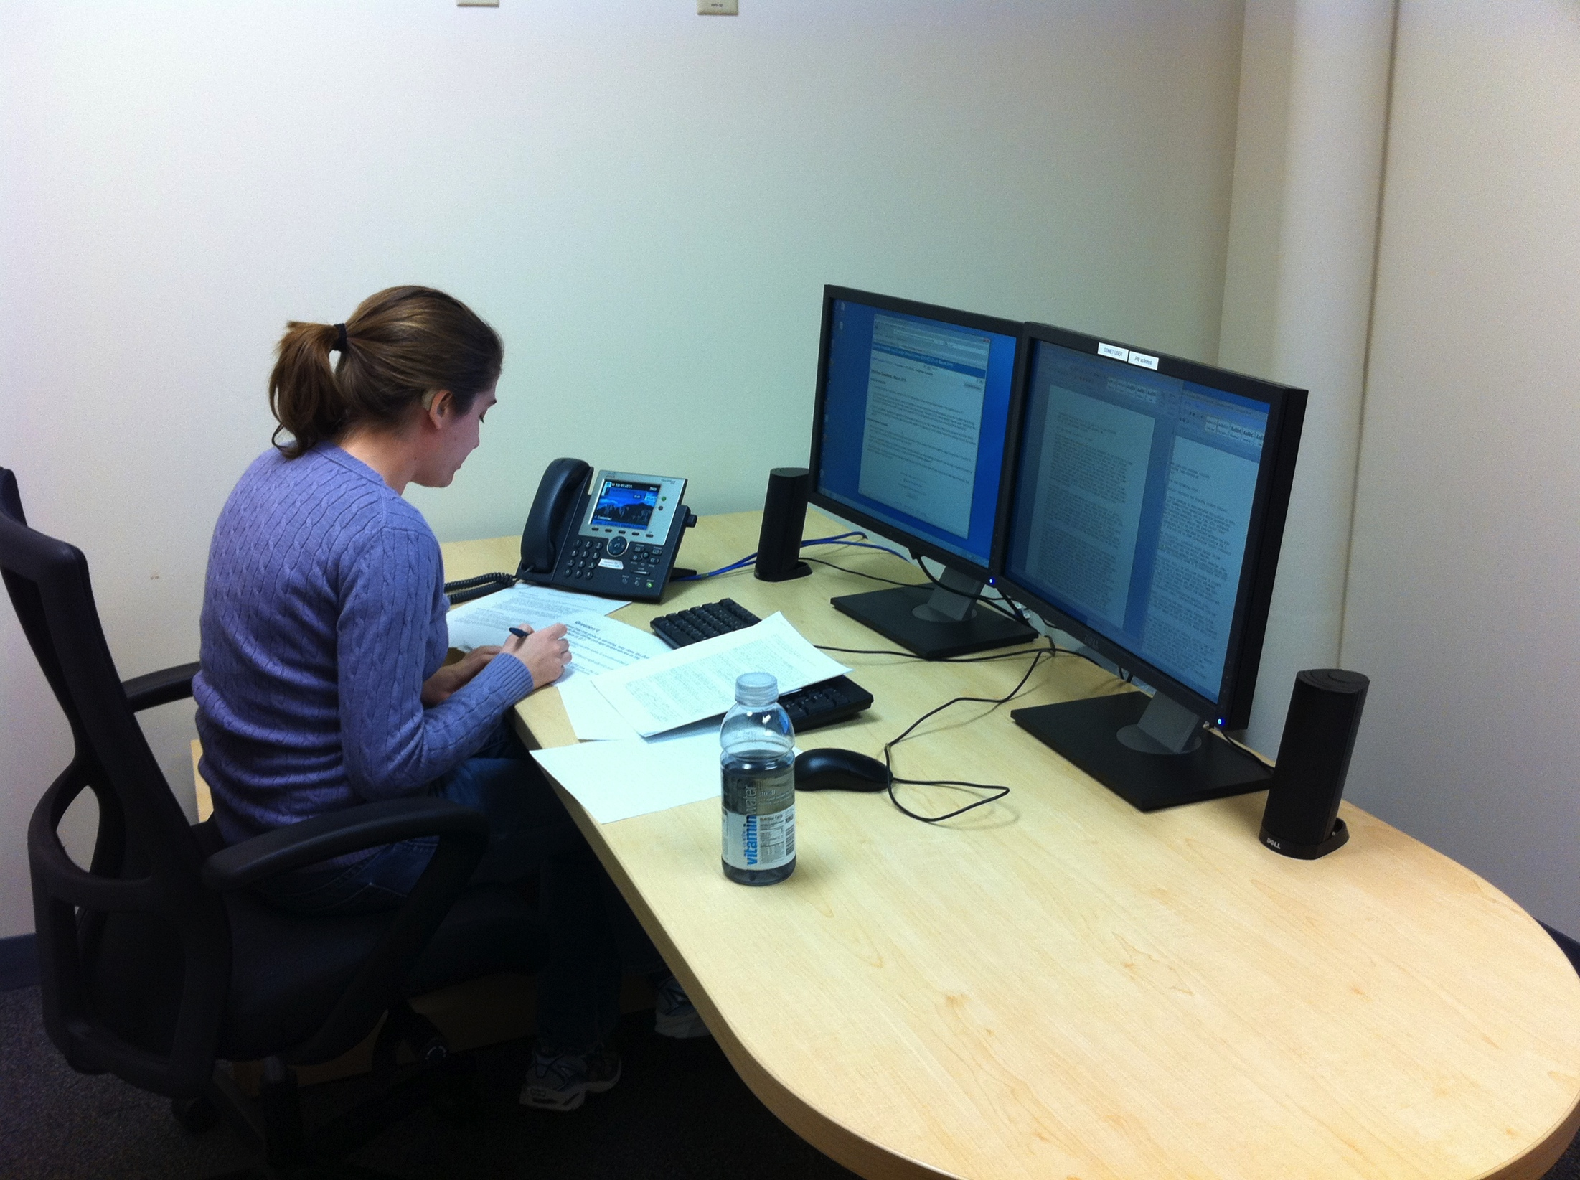
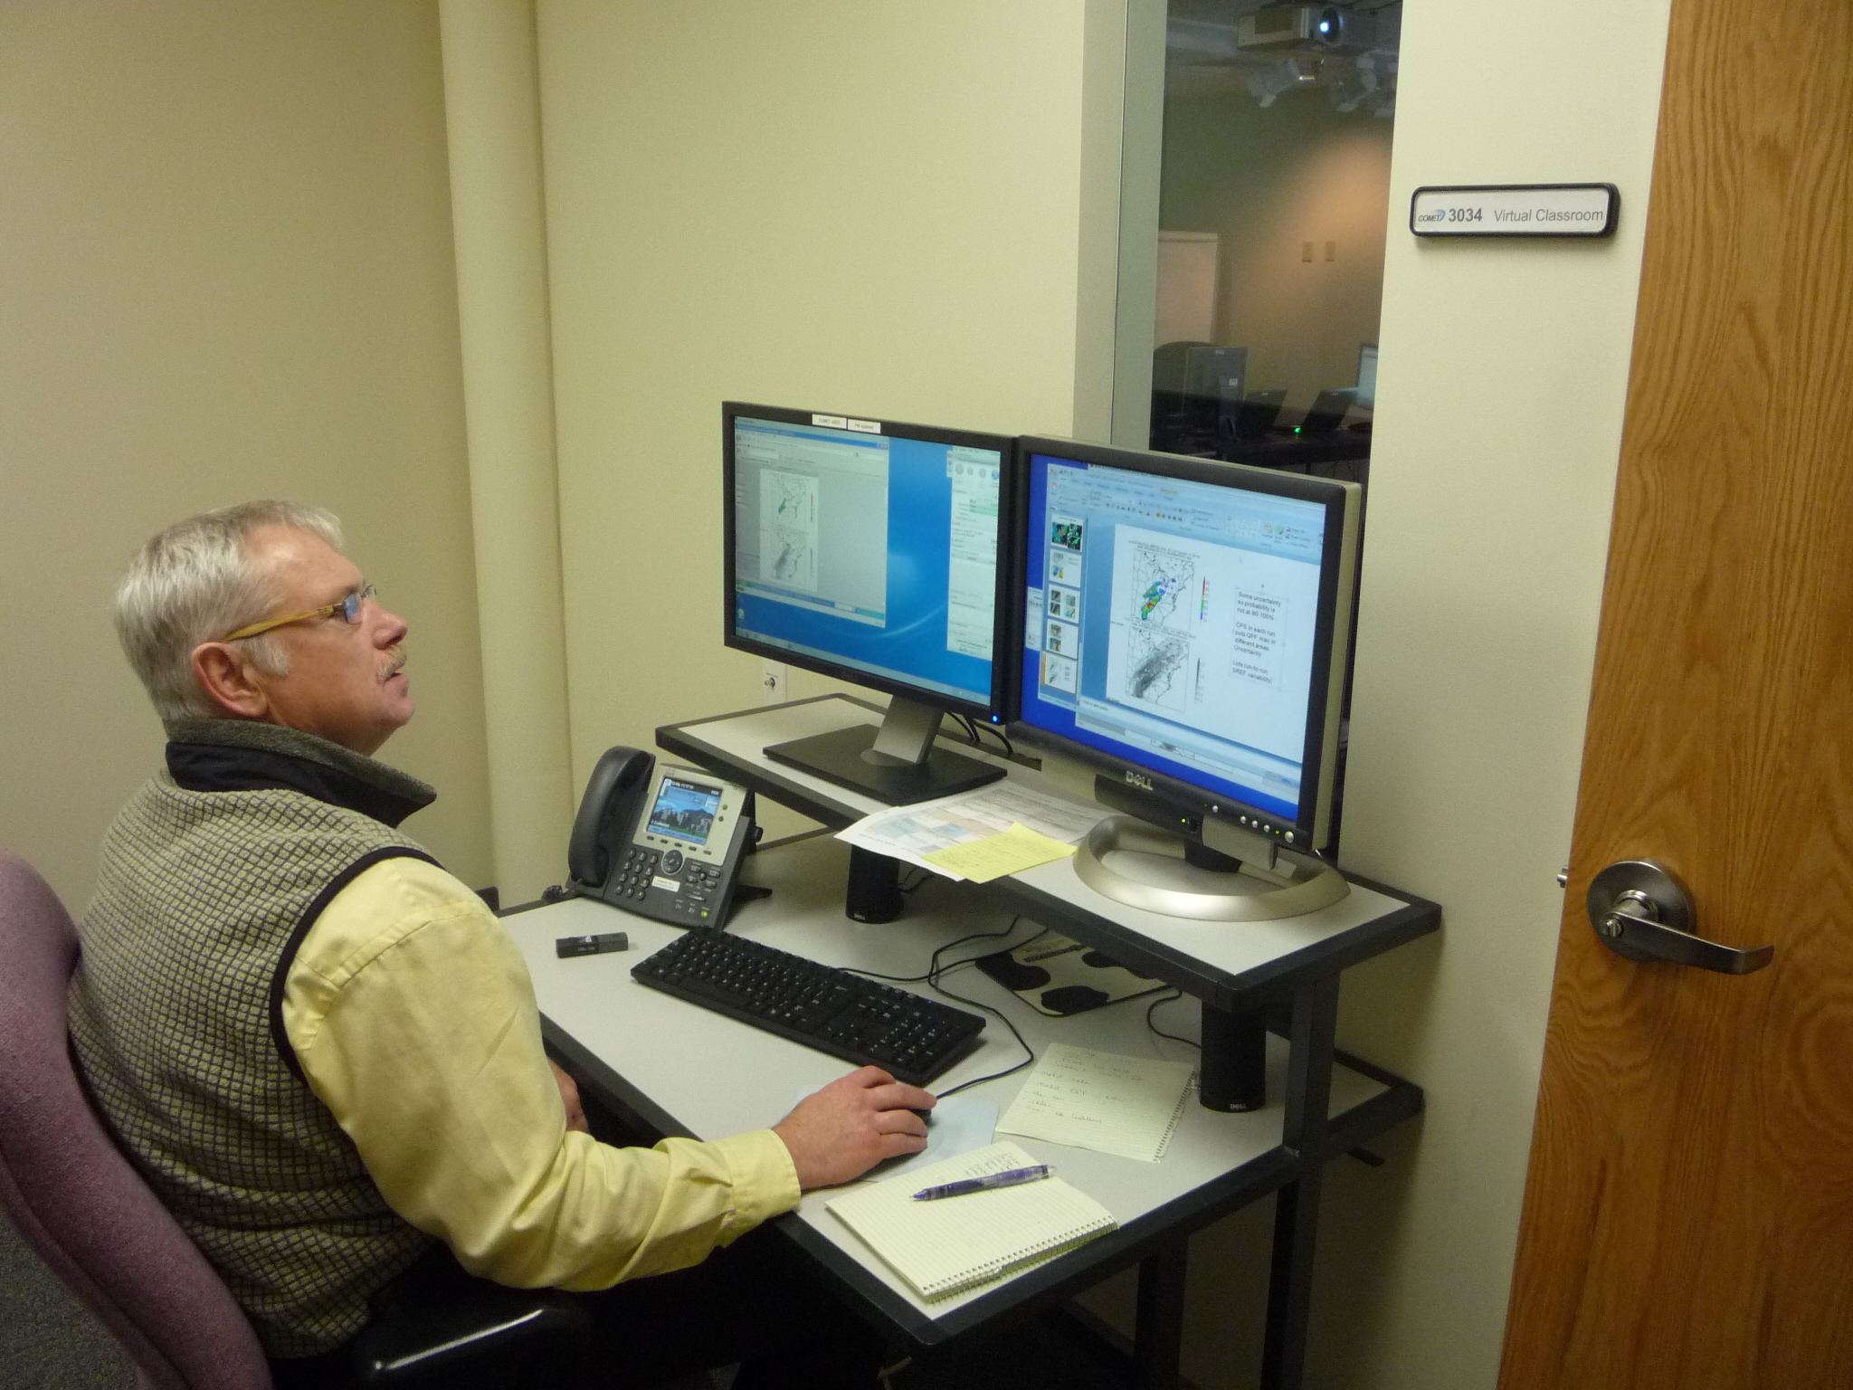
Small Group Activities
Make a very smooth transition from the main session
  Explain fully what will happen, THEN move... don’t lose people
Use adjoining rooms if possible
Keep to time frame for activity
Smoothly transition back to main session
    One group is already there…

Slide 35
Roadmap
Make it Effective
Adapt
Engage
Hold Accountable
Examples
Logistics
Steps
Tools

Slide 36
10 Steps for Adapting IL Training to Virtual
Identify IL training to transition
Identify existing IL materials, PPTs, guidebooks, etc.
Break up content into manageable chunks or summarize
Identify virtual class tools – chat, polls, whiteboard, breakouts, assessment functions, emoticons, screen-sharing, video, share web links, file sharing
Apply ID best practices
Adapt current materials to virtual classroom – e.g. send materials that are trimmed down to be printable
Review content with SME
Test with end users
Get feedback from users – apply feedback philosophy
Repeat as necessary

Slide 37
Web Conferencing Tools
A sample of many tools available:
  Citrix Online: GoTo Meeting/Webinar/Training
  Adobe Connect
  Cisco WebEx
  Blackboard Collaborate
  Saba Classroom
  Free tools:
    Wiziq http://www.wiziq.com/
    Big Blue Button http://bigbluebutton.org/

Slide 38
Roadmap
Make it Effective
Adapt
Engage
Hold Accountable
Examples
Logistics
Steps
Tools

Slide 39
References
The Learning Explosion: 9 Rules to Ignite Your Virtual Classrooms, Murdoch/Mullerhttp://www.amazon.com/Learning-Explosion-Ignite-Virtual-Classrooms/dp/1936111217/ref=sr_1_1?ie=UTF8&qid=1322676071&sr=8-1
Virtual Training: Are You Engaging or Boring? http://www.learningsolutionsmag.com/articles/802/virtual-training-are-you-engaging-or-boring

