Slide 1
Working in the
Federal Education Terrain
Where to start & How to gain an Edge
Notes:
This PPT contains an iov

Slide 2
Which Agencies Are We Talking About?
Those with education mandates (NSF, DoEd, NASA)
Those with vested programs (NOAA, DoI, DoAg, DoD, DoE)
~$3B annually, most in DoEd block grants
Most have competitive calls
Many have internal agendas: Research vs. Programs
Sometimes it’s who you know as much as anything
Notes:
Not an exhaustive list of agencies, but many of the ones we are likely most interested in and vice versa.
Note that NASA is an exploratory organization, not a science organization and they, unlike most, have an engineering mission.
Of the $3B annually, about 1.4B is available in competitive calls.
Agencies don’t fund STEM for STEM sake, but all sorts of other factors DO come in to play: politics, economics, etc. etc.
We discussed that it is imperative at the PI level (and also up the chain) to have personal interaction regarding solicitations with key players in the process. 6 mo in advance is good time. Can provide invaluable information and save a lot of unnecessary work.
In a related note, invited proposals (because you are known to be the ones to execute the work) are much more appealing than the “crap shoots”.
Very soon we can also look toward foundations for funding!

Slide 3
How Are Agendas Set?
Best Case: Research Based (e.g. NAS, NSF Reports, other federal reports…)
Not-so-best Case:
Internal Agendas and Decisions, Often not by Educators

Slide 4
Where do you find the trends?
Federal reports and Federal education news
Professional organizations
Conferences/pubs (to a point….)
See what’s been funded recently
Perpetual issues: Diversity, Technology, etc.
Notes:
Good to subscribe to receive key docs (email or snail mail on regular basis, and for NASA: good to be regularly involved in both the forum committees on Heliophysics and Earth Science).
This is an action for Spark to get folks involved with these. Do we have anyone already involved?

Slide 5
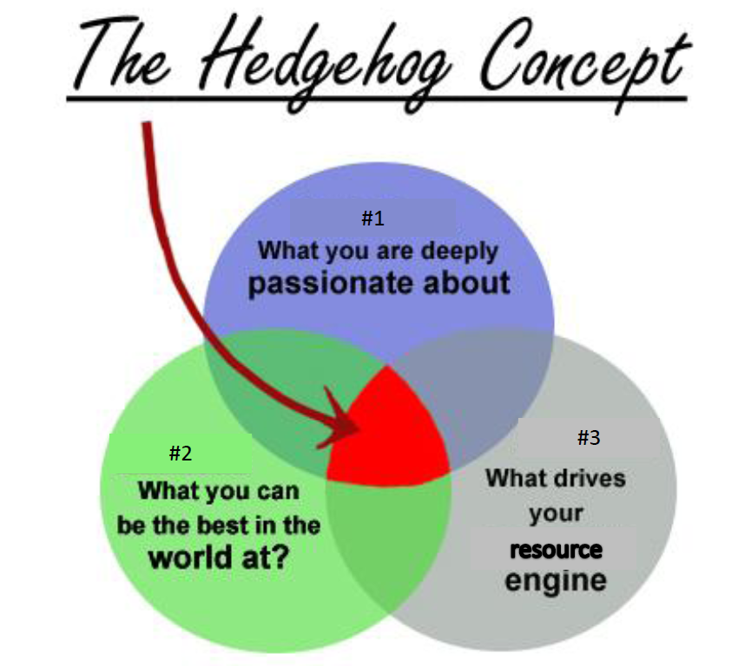
Where is the Sweet Spot?
Notes:
From “Good to Great”.
This is the process we will go after as a group (at least management team) to know which proposals we will go after.

Slide 6


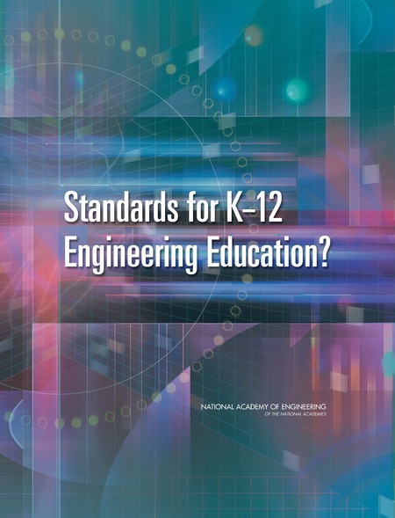
Example: Engineering Education
One of the few
Agencies with Engineering
Mission
Engineering Ed Research
Identified a Problem
Indication that NextGen
Would have Engineering Thread
Notes:
Emily talked about a very successful experience she had in the recent past.

Slide 7

Example: Engineering Education
Juno Mission’s
Designing Juno Series
Engineering Education WG
Proposal to develop
NASA Teacher PD that
adds engineering ed day to
existing science mission pd
Development of strategy
that NASA support
engineering ed models
across federal gov’t

Slide 8
What Will Review Criteria Look Like?
Intrinsic Merit
Relevance to Agency Objectives
Program Balance
Cost
  Quality, Scope, Realism
  Tie to science
– Partnerships/Leverage/Sustainability
– Evaluation
  Content
  Customer Needs Focus
  Pipeline
  Diversity
  Resource Utilization
Notes:
Spark needs to especially beef up our attention on Evaluation and Customer Needs Focus.
As we write proposals this fall/winter, (managers need to begin scouting immediately) we will be promoting Spark. Integrated UCP Ed work will follow later…
We discussed that it isn’t ALWAYS all the very best proposals that get funded. The VERY best ones do, but if a proposal is on the bubble, other factors are considered.

Slide 9
What do good proposals have in common?
Audience-focused: A marriage between what I want to tell them and what they need
  Ex. If I want to bring my lunar research into the classroom, I should understand how the Moon is taught in the classroom and how it appears in the National Science Education Standards.
  Ex. I may want to give a series of 10 public lectures on the details of the last Cassini fly-by of Enceladus, but who wants to hear it?
Well-scoped and budgeted: A clear plan of what I want to do that matches what it costs to do.
  Ex. If I want to run a week-long teacher workshop for 100 teachers, the ROSES Supplements will not cover the costs. But if I want to bring a specific topic to a workshop that already exists, a ROSES Supplements might be perfect!
Tied to the Science of the Parent Proposal and any collaborators: Real science is a key component – As long as it is targeted at the appropriate level for your audience.
1/27/2011
Notes:
Early in her career Emily read 300 successful proposals to clean what they had in common.

Slide 10
A Word about Evaluation
Evaluation is an important component of any E/PO proposal, and it should be!
  It lets me know whether what I’m bringing to my audience is having the desired impact.
  It gives me data that allows me to make my program better.
  It allows me to show NASA that this program is worthwhile.
Evaluation plans should be presented in the proposal. They should be scaled to fit the budget and the scope of the proposed work.
  No one is expecting end-to-end evaluation for a $10k proposal!
  Proposals should have independent and professional evaluators involved.
  There is an entire profession of education evaluators out there. It’s worthwhile to get to know one…
1/27/2011

Slide 11
A Word about Evaluation
Evaluations should follows established protocols and procedures.
  For example, if you are surveying students participating in your program, you must have an IRB certification.
  For example, surveys of your audiences may require paying attention to OEPM requirements.
  If you do not know what an IRB and OEPM are, you are still okay. You need to 1) find an external evaluator or 2) read the official information guides.
1/27/2011
Notes:
We share that UCAR does have a process for review for anything that involves human subjects. Emily D shared more about how that works.

