Slide 1

Refinement and Evaluation of Automated High-Resolution Ensemble-Based Hazard Detection Guidance Tools for Transition to NWS Operations
Kick off JNTP project meeting

Slide 2
Project Organization
GSD
JNTP
MMM
EMC-MMB
WPC
HWT
AWC
OPG

Slide 3
Project Organization
Evaluation / Diagnostics
Isidora
Curtis
Trevor
Our Team
Julie Rebecca
Jacob Carly / NAM RR
Dave Novak WPC-HMT folks
Adam Clark/Greg Stumpf
AWC
OPG
Social Science
NAM RR
Developers
FACETS project

Slide 4
Staffing - 775046
Tara – 280 hours
Jamie – 236 hours
Tressa – 120 hours
John - 270 hours
Tatiana – need to decide what is needed
Randy – 220 hours
Josh – 50 hours
Louisa – 50 hours
Per year for 3 years

Slide 5
Goals
Develop probabilistic guidance on a set of hazards based on HRRR / NAM-RR for the testbeds to use and subjectively evaluate
  Prob QPF
  Prob of Snowfall
  Prob of Tornados, Hail, Wind
  Convective Prob
Objectively evaluate the members to help with development and the products to give forecasters confidence
Work with forecasters to understand how they will use the product and how to best represent probabilities for more effective communication
Have products flowing into N-AWIPS, AWIPS, AWIPS II
Transfer probability system and verification system at end of project
PHDT
Probabilistic Hazard Detection Tool

Slide 6
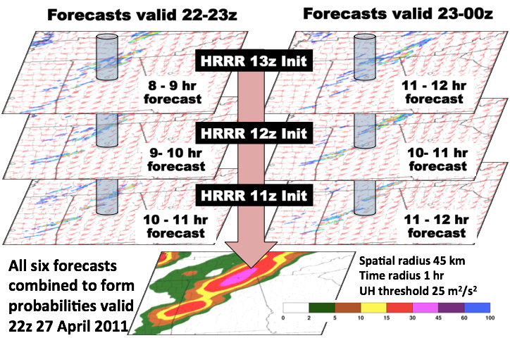
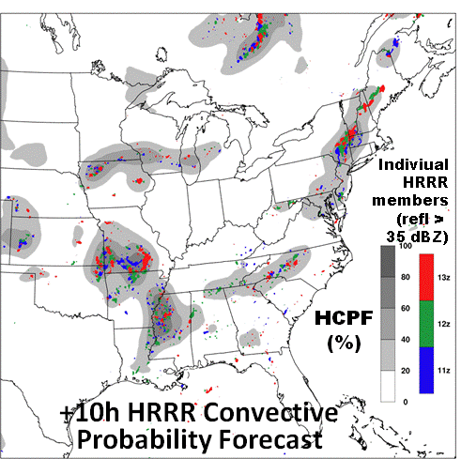
What’s to be evaluated
00Z forecast uses - 18,19,20,21,22Z HRRR runs
All points within XX km are used to formulate probability
Being explored by GSD
  XX
  Calibration
  Other methods for formulating probability
  Adding in NAM-RR members

Slide 7
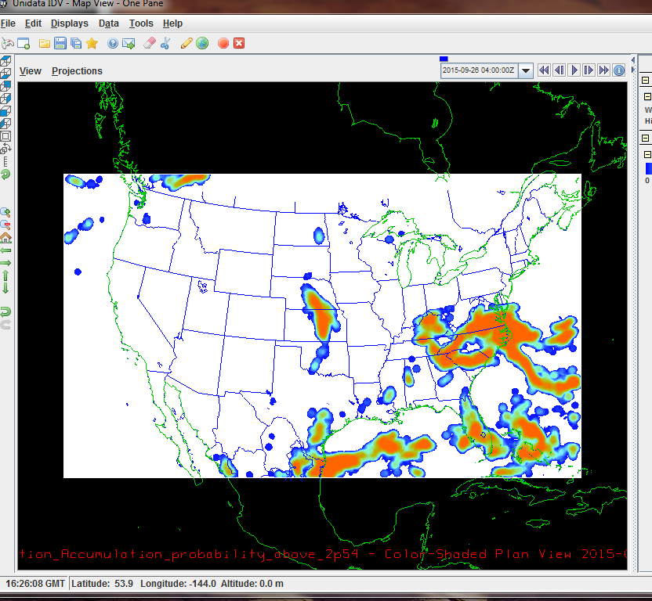
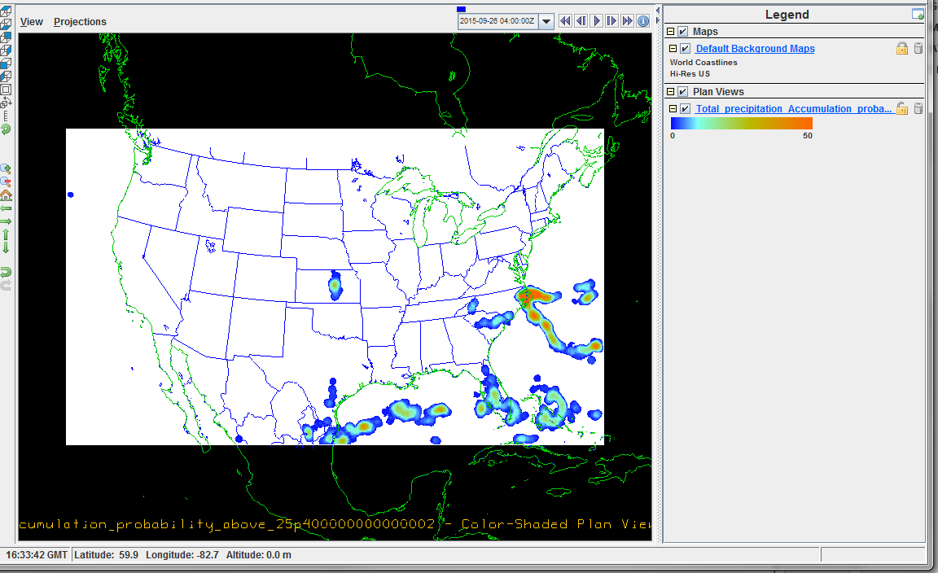
First Cut at Product
Prob > 25.4 mm in 6 hrs
Prob > 2.54 mm in 6 hrs

Slide 8
Initial Areas of Emphasis

Slide 9
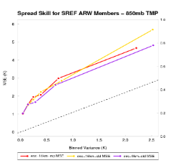
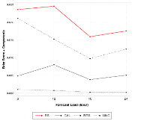
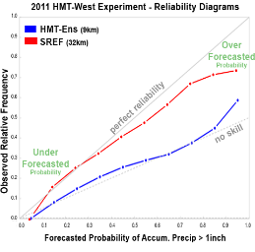
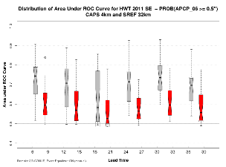
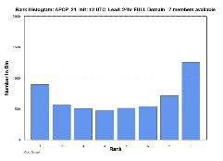
MET Ensemble and Probability Evaluation
Ensemble Characteristics (Ensemble Stat)
Probability Measures
(Grid and Point stat)
Rank Histogram
PIT
CRPS
Ignorance Score
Spread-Skill
Brier Score + Decomposition
Brier Skill Score
ROC and Area Under ROC
Reliability

Slide 10
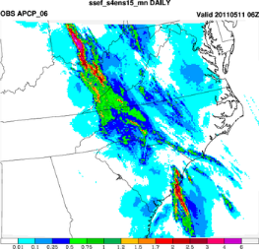
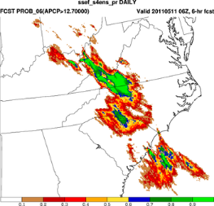
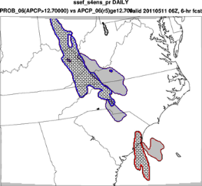
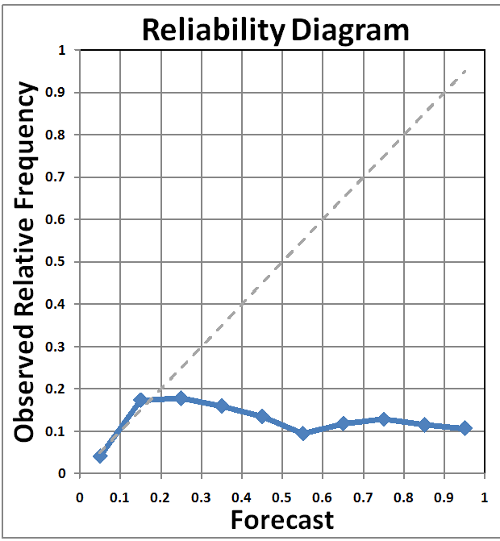

QPE_06 >12.7 mm vs. 50% Prob(APCP_06>12.7 mm)
Probability Compared with QPE field
Good Forecast
with
Displacement
Error?
Traditional
Metrics
Brier: 0.07
Area Under
ROC: 0.62
Spatial Metrics
Centroid Distance:
Obj1) 200 km
Obj2) 88km
Area Ratio:
Obj1) 0.69
Obj2) 0.65
1
Obj PODY: 0.72
Obj FAR: 0.32
2
Notes:
Convolution Radius = 2gs
Threshold = 0.5 Probability and 12.7 mm for QPE

Slide 11
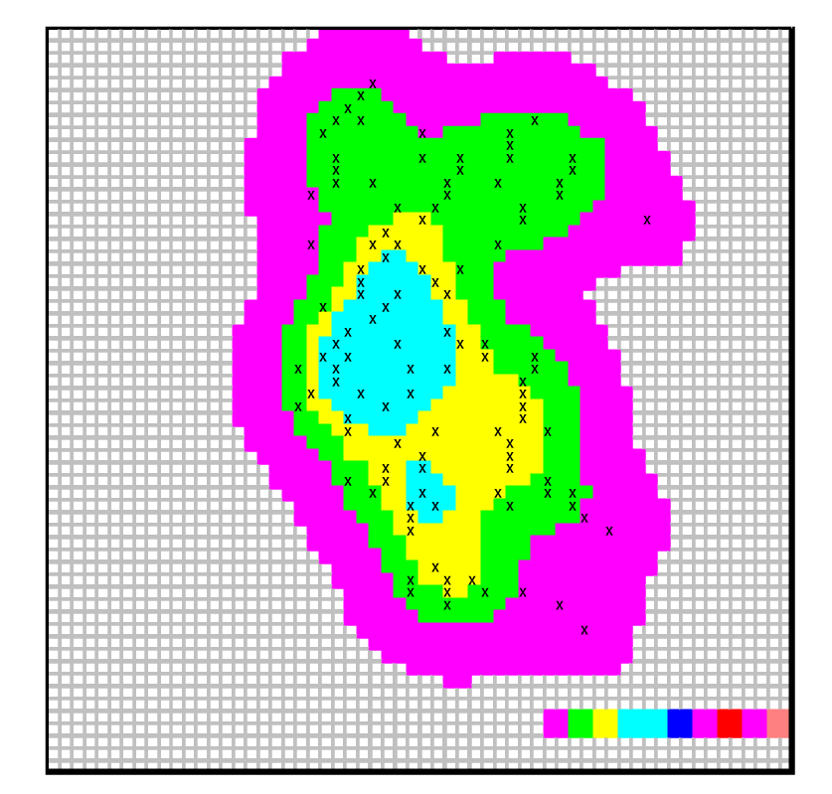
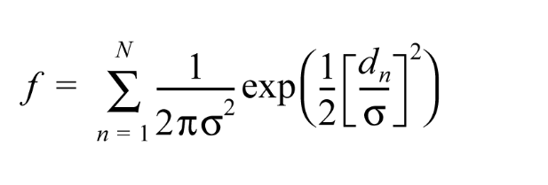
Practically Perfect Fcst as Obs
Take obs (in this case storm reports) and apply Gaussian filter to generate probability field for obs
Then use this field in MODE…
Courtesy of Brooks et al. 1998

Slide 12
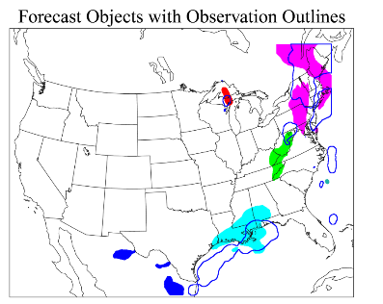
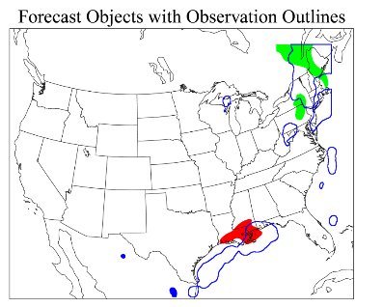
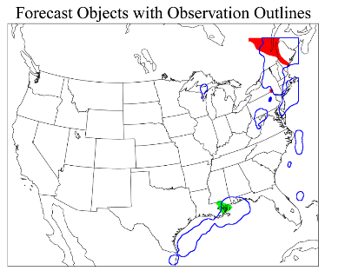
MODE for Different Probabilities – May 11, 2013 (DTC SREF tests)
NWS PoP - Percent chance that rain will occur at any given point in the area.
A
Intersection Area
Forecast Area
0.89
0.61
0.85
0.58
1.51
0.36
C
Symmetric Difference
(non-intersecting area)
Forecast Area
3.10
0.11
0.91
0.35
0.87
0.75
1.05
0.41
Prob >50% of 2.54mm in 3hr
Prob >25% of 2.54mm in 3hr
NWS PoP = C x A where
"C" = the confidence that precipitation will occur somewhere in the forecast area
"A" = the percent of the area that will receive measureable precipitation.
Observation
0.96
0.72
Forecast
Prob >75% of 2.54mm in 3hr
Notes:
PoP = C x A where "C" = the confidence that precipitation will occur somewhere in the forecast area, and where "A" = the percent of the area that will receive measureable precipitation, if it occurs at all.

Slide 13
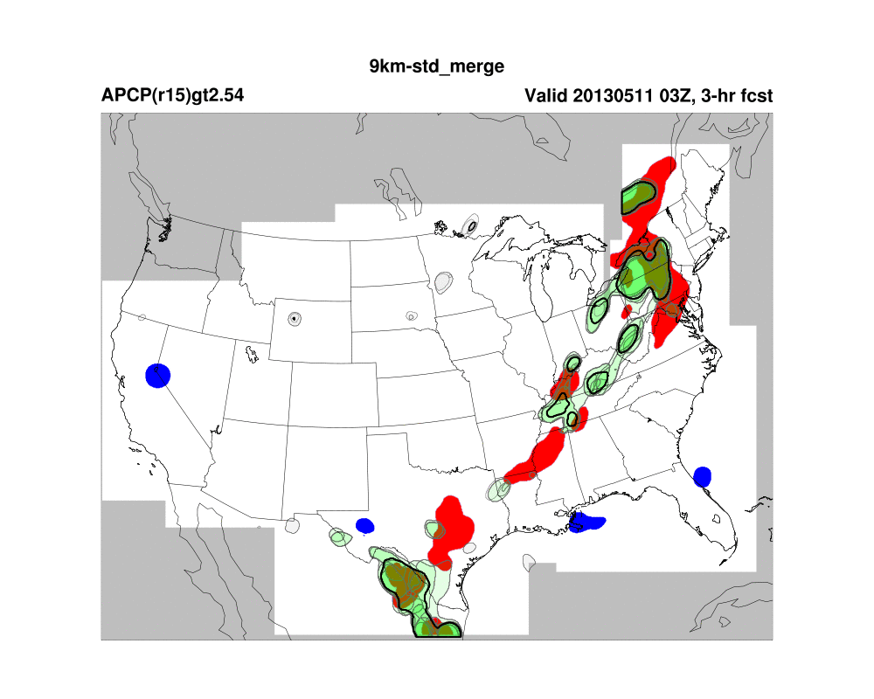
Ensemble MODE

Slide 14
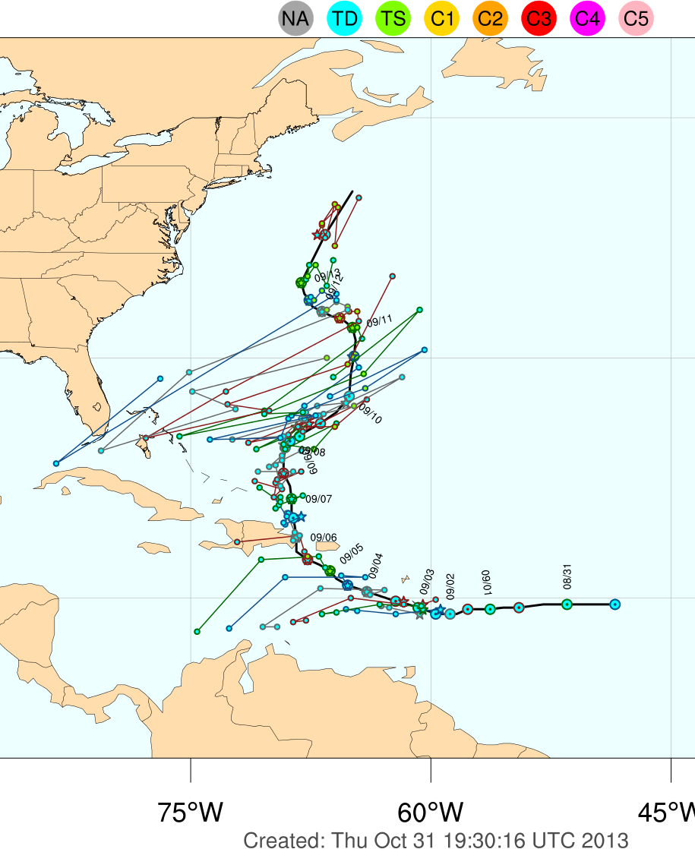
Time Series Consistency Evaluations
Change in TC Intensity with new initialization
Magnitude of TC Intensity Revision
What can be measured?
Number of ‘crossovers’
(using Wald-Wolfowitz test)
Current focus on TC, but may apply to other ‘objects’ and general time series.

Slide 15
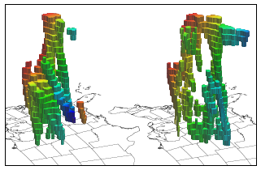
MODE Time DOMAIN
X, Y, Time
Great tool for high temporal resolution to look at forecast consistency and evolution
Planning to include in next release

Slide 16
What’s to be evaluated
Evaluate ensemble members to help assess “best members” and optimal configuration
  HRRR
  NAM-RR
Employ Ensemble-Stat, Grid-Stat and MODE on PHDT
Look at Forecast Consistency – helps development phase
Explore MODE-TD in out-years but why not start now?

Slide 17
JNTP SOW
Year 1
Month 1-2:
  Identify metrics and variables needed.
Months 3-9:
  Develop verification system on NOAA supercomputer (e.g. Zeus or Theia) for 1-2 ensembles and 1-2 deterministic baselines.
  Develop initial operating capability for Ensemble-MODE evaluation of rain and snow bands.
Months 9-12:
  Attend HMT-WPC.
  Explore use of MODE-TD on variables relevant to rain and snowband prediction.
  Demonstrate initial operating capability.
Months 12:
  Identify enhancements needed to verification system per user feedback.

Slide 18
JNTP SOW
Year 2
Months 1-9:
  Enhance MET system to include ensemble methodologies tested in year 1 and confirm applicability to rain and snowbands
Months 9-12:
  Attend HMT-WPC.
  Demonstrate extended capability to WPC staff.
  Integrate additions to MODE and MODE-TD into MET repository.
Month 12:
  Identify final enhancements needed to verification system per user feedback.
Year 3
Months 1-9:
  Make final modifications to verification system.
  Document capabilities, including interpretation of output.
Months 9-12:
  Attend HMT-WPC.
  Demonstrate operational capability to WPC staff.
  Transition verification system to WPC and provide user support.

