Slide 1
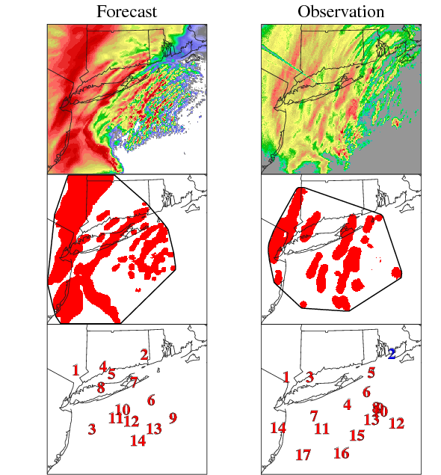
Idea for Modeling Analysis
MET-MODE feature analysis
Objectively compare structure (length, width, area, angle), intensity, timing
Come up with a measure like SAL or SAPTD (Barrett et a. 2015) that can be used within and across cases
  Structure, amplitude, location, timing, duration
Example: 0000 UTC 27 Dec 2010 KOKX Base Reflectivity
vs
0300 UTC (FH21) 27 Dec 2010 WRF
d03 Simulated Reflectivity at 1 km AGL

