Slide 1

Meeting with SBU Project Team - Extratropical Cyclones
May 14, 2015

Slide 2
MET-TC
John Halley Gotway, Kathryn Newman, Tressa Fowler, Mrinal Biswas, Ligia Bernardet,
Tara Jensen and Barbara Brown

Slide 3
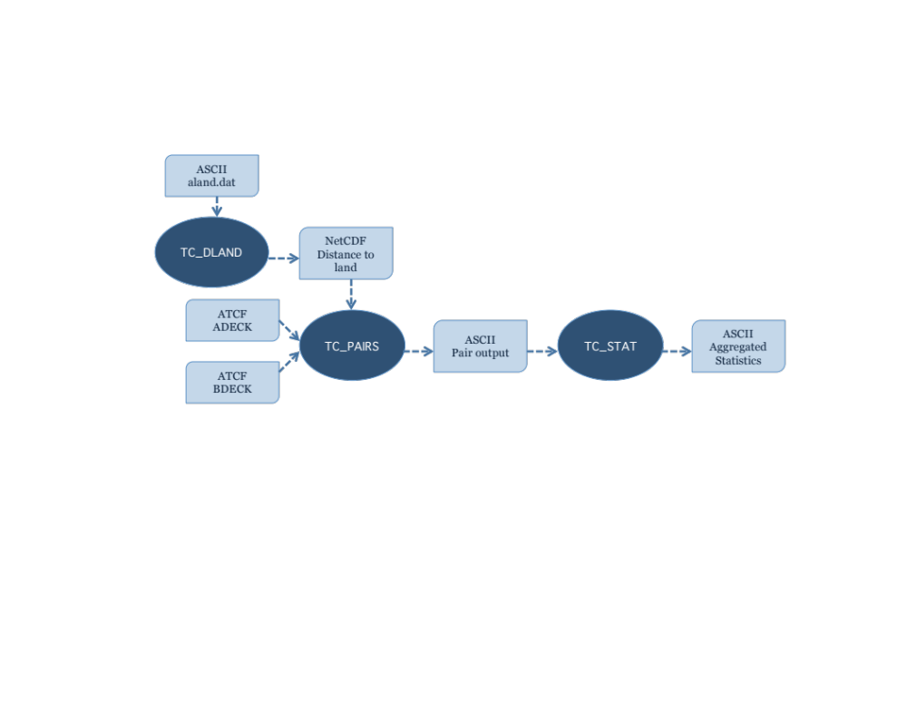
MET-TC components
Dark circles represent MET-TC modules
Light boxes represent input/output
Primary functions of the code are:
  Compute pair statistics from ATCF input files
  Filter pair statistics based on user specifications
  Compute summary statistics

Slide 4
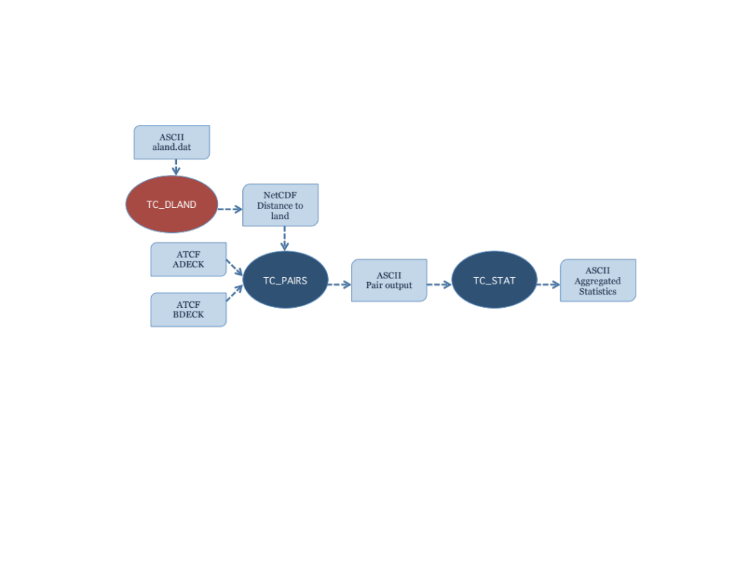
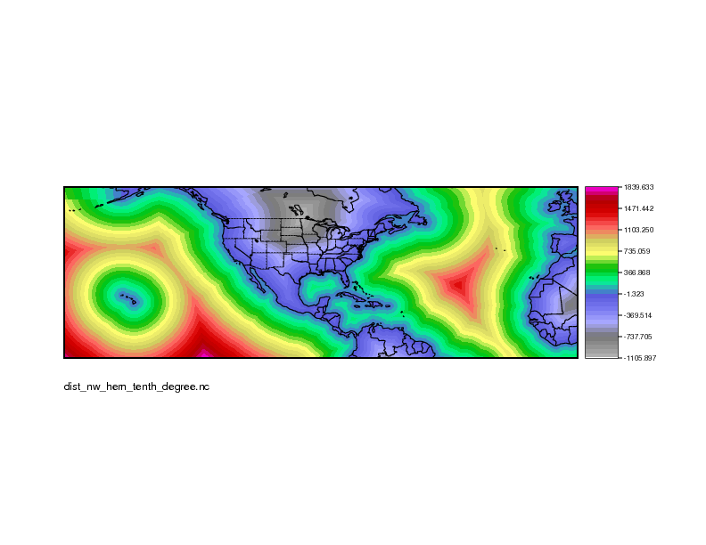
TC_DLAND
Aids in quickly parsing data for filter jobs:
  Only verify over water
  Threshold verification based on distance to land
  Exclusion/inclusion of forecasts within a specified window of landfall
Input: ASCII file containing Lon/Lat coordinates of all coastlines/islands considered to be a significant landmass. (aland.dat)
Output: gridded field representing distance to nearest coastline/island in NetCDF format

Slide 5
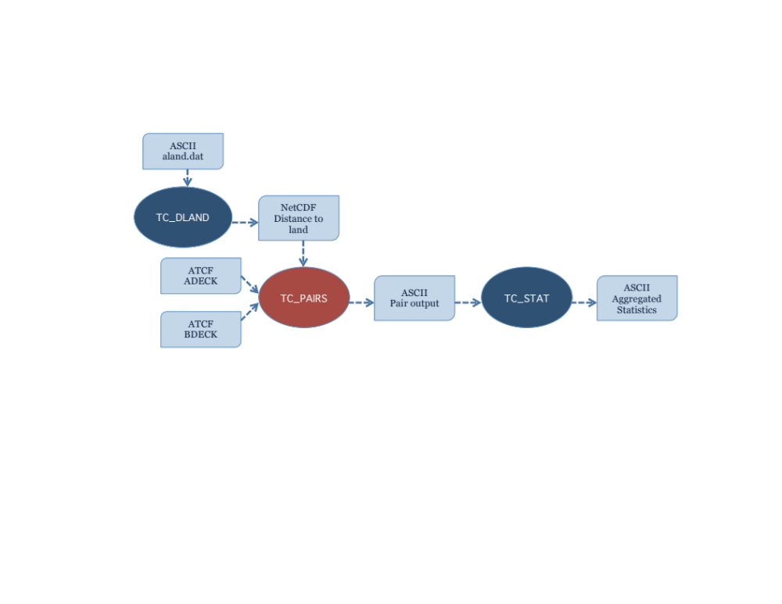
TC_PAIRS
Produces pair statistics on independent model input or user-specified consensus forecasts
Matches forecast with reference TC dataset (most commonly Best Track Analysis)
Pair generation can be subset based on user-defined filtering criteria
ASCII pair output allows for new or additional analyses to be completed without performing full verification process

Slide 6

TC_STAT
Provides summary statistics and filtering jobs on TCST output
Filter job:
  Stratifies pair output by various conditions and thresholds
Summary job:
  Produces summary statistics on specific column of interest
Input: TCST output from tc_pairs
Output: TCST output file for either filter or summary job

Slide 7
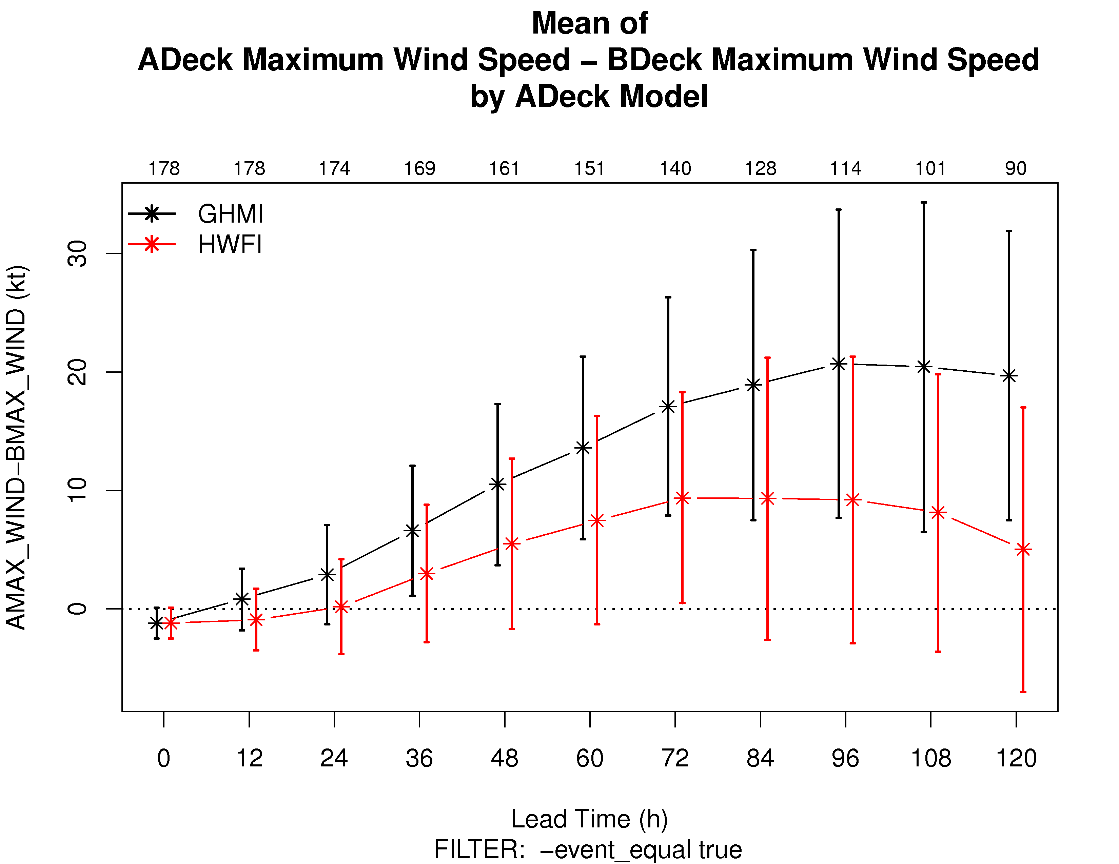
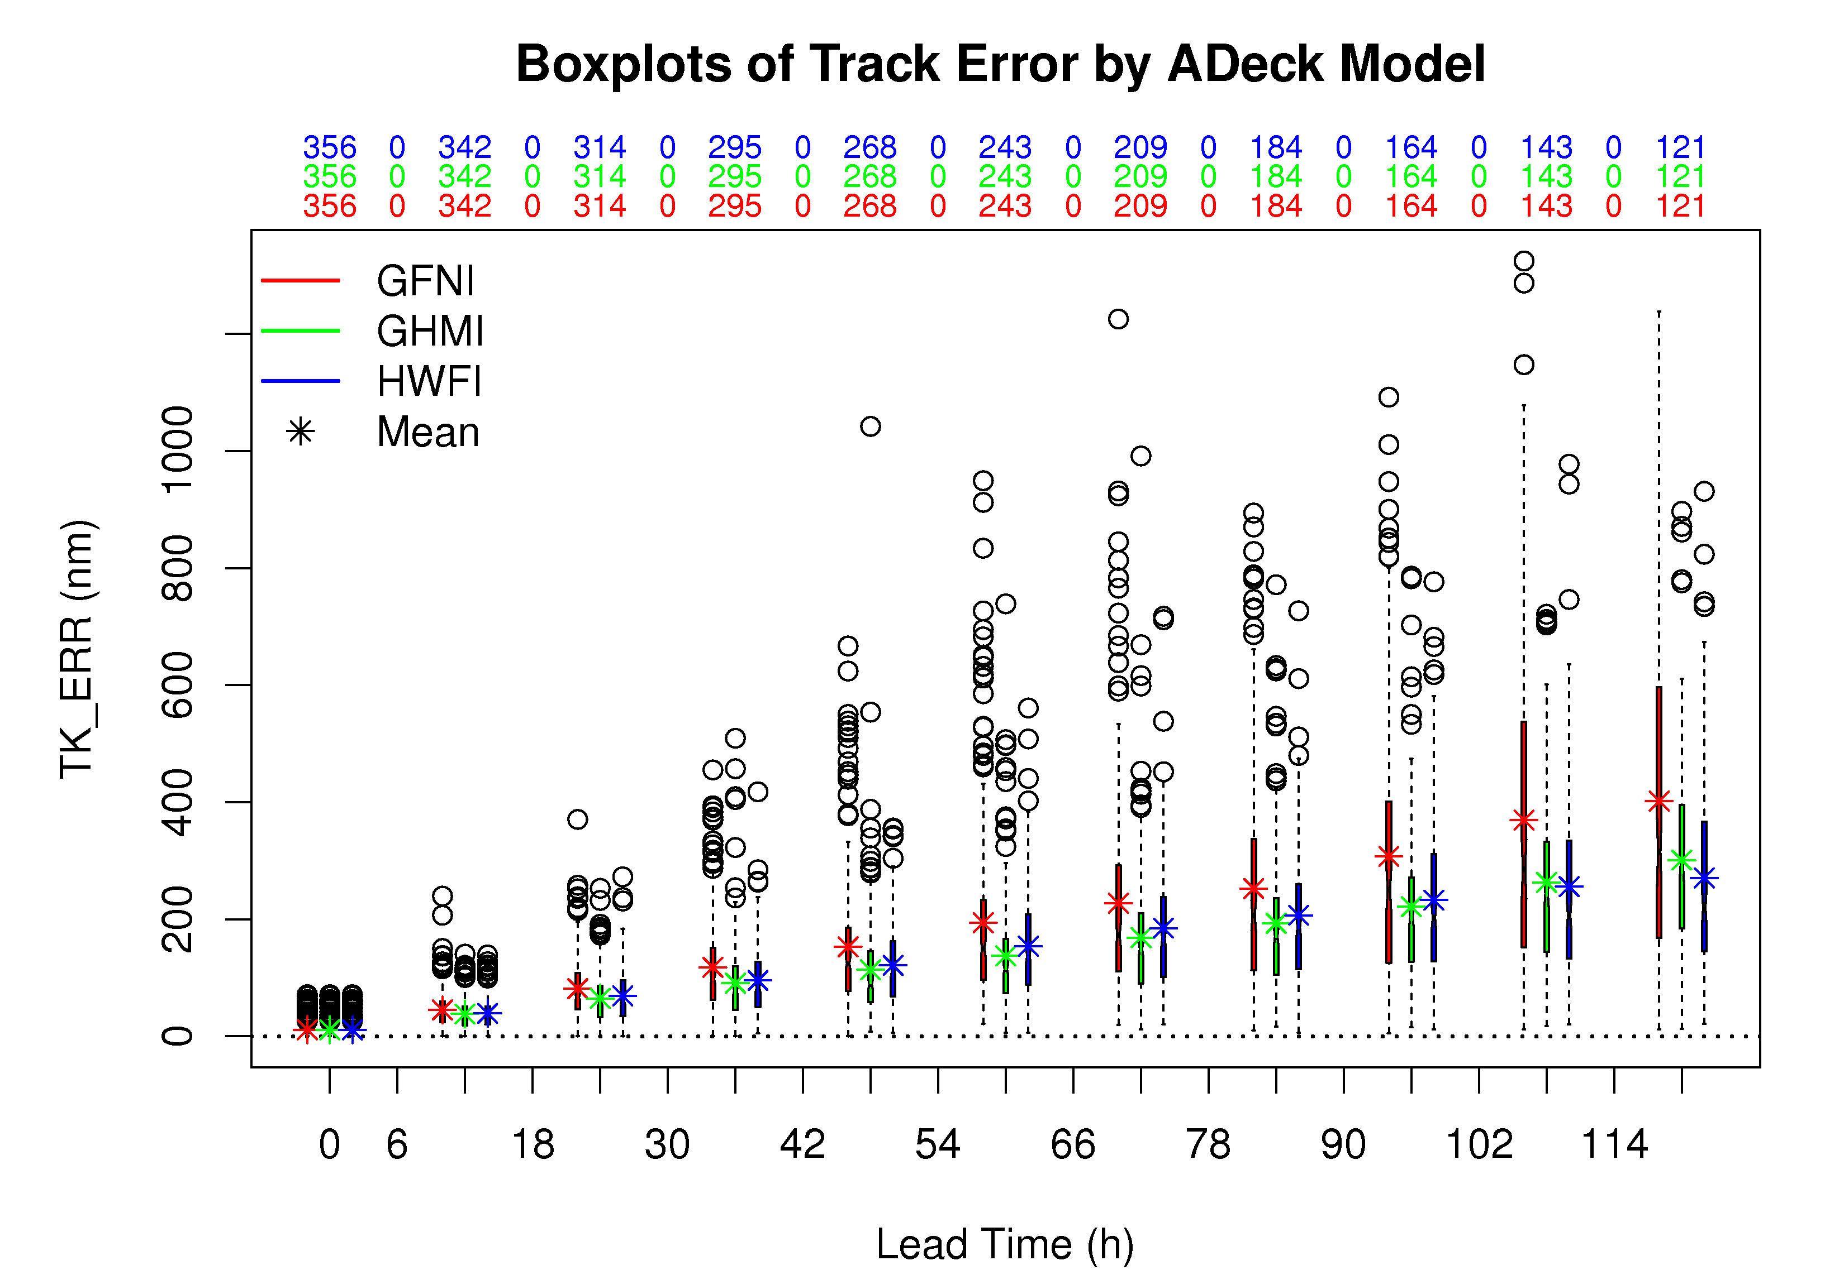
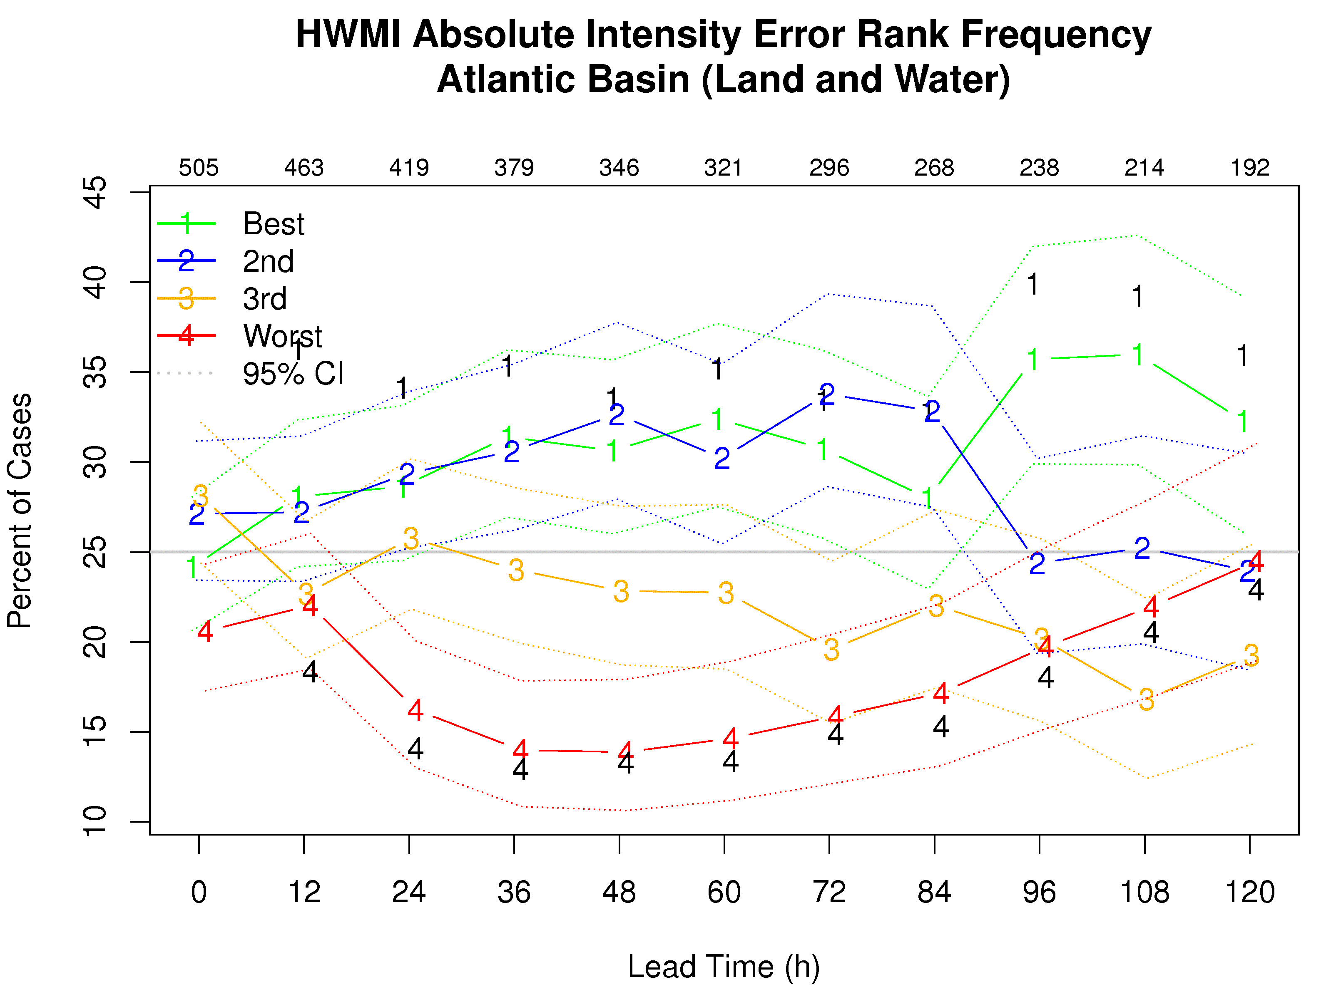
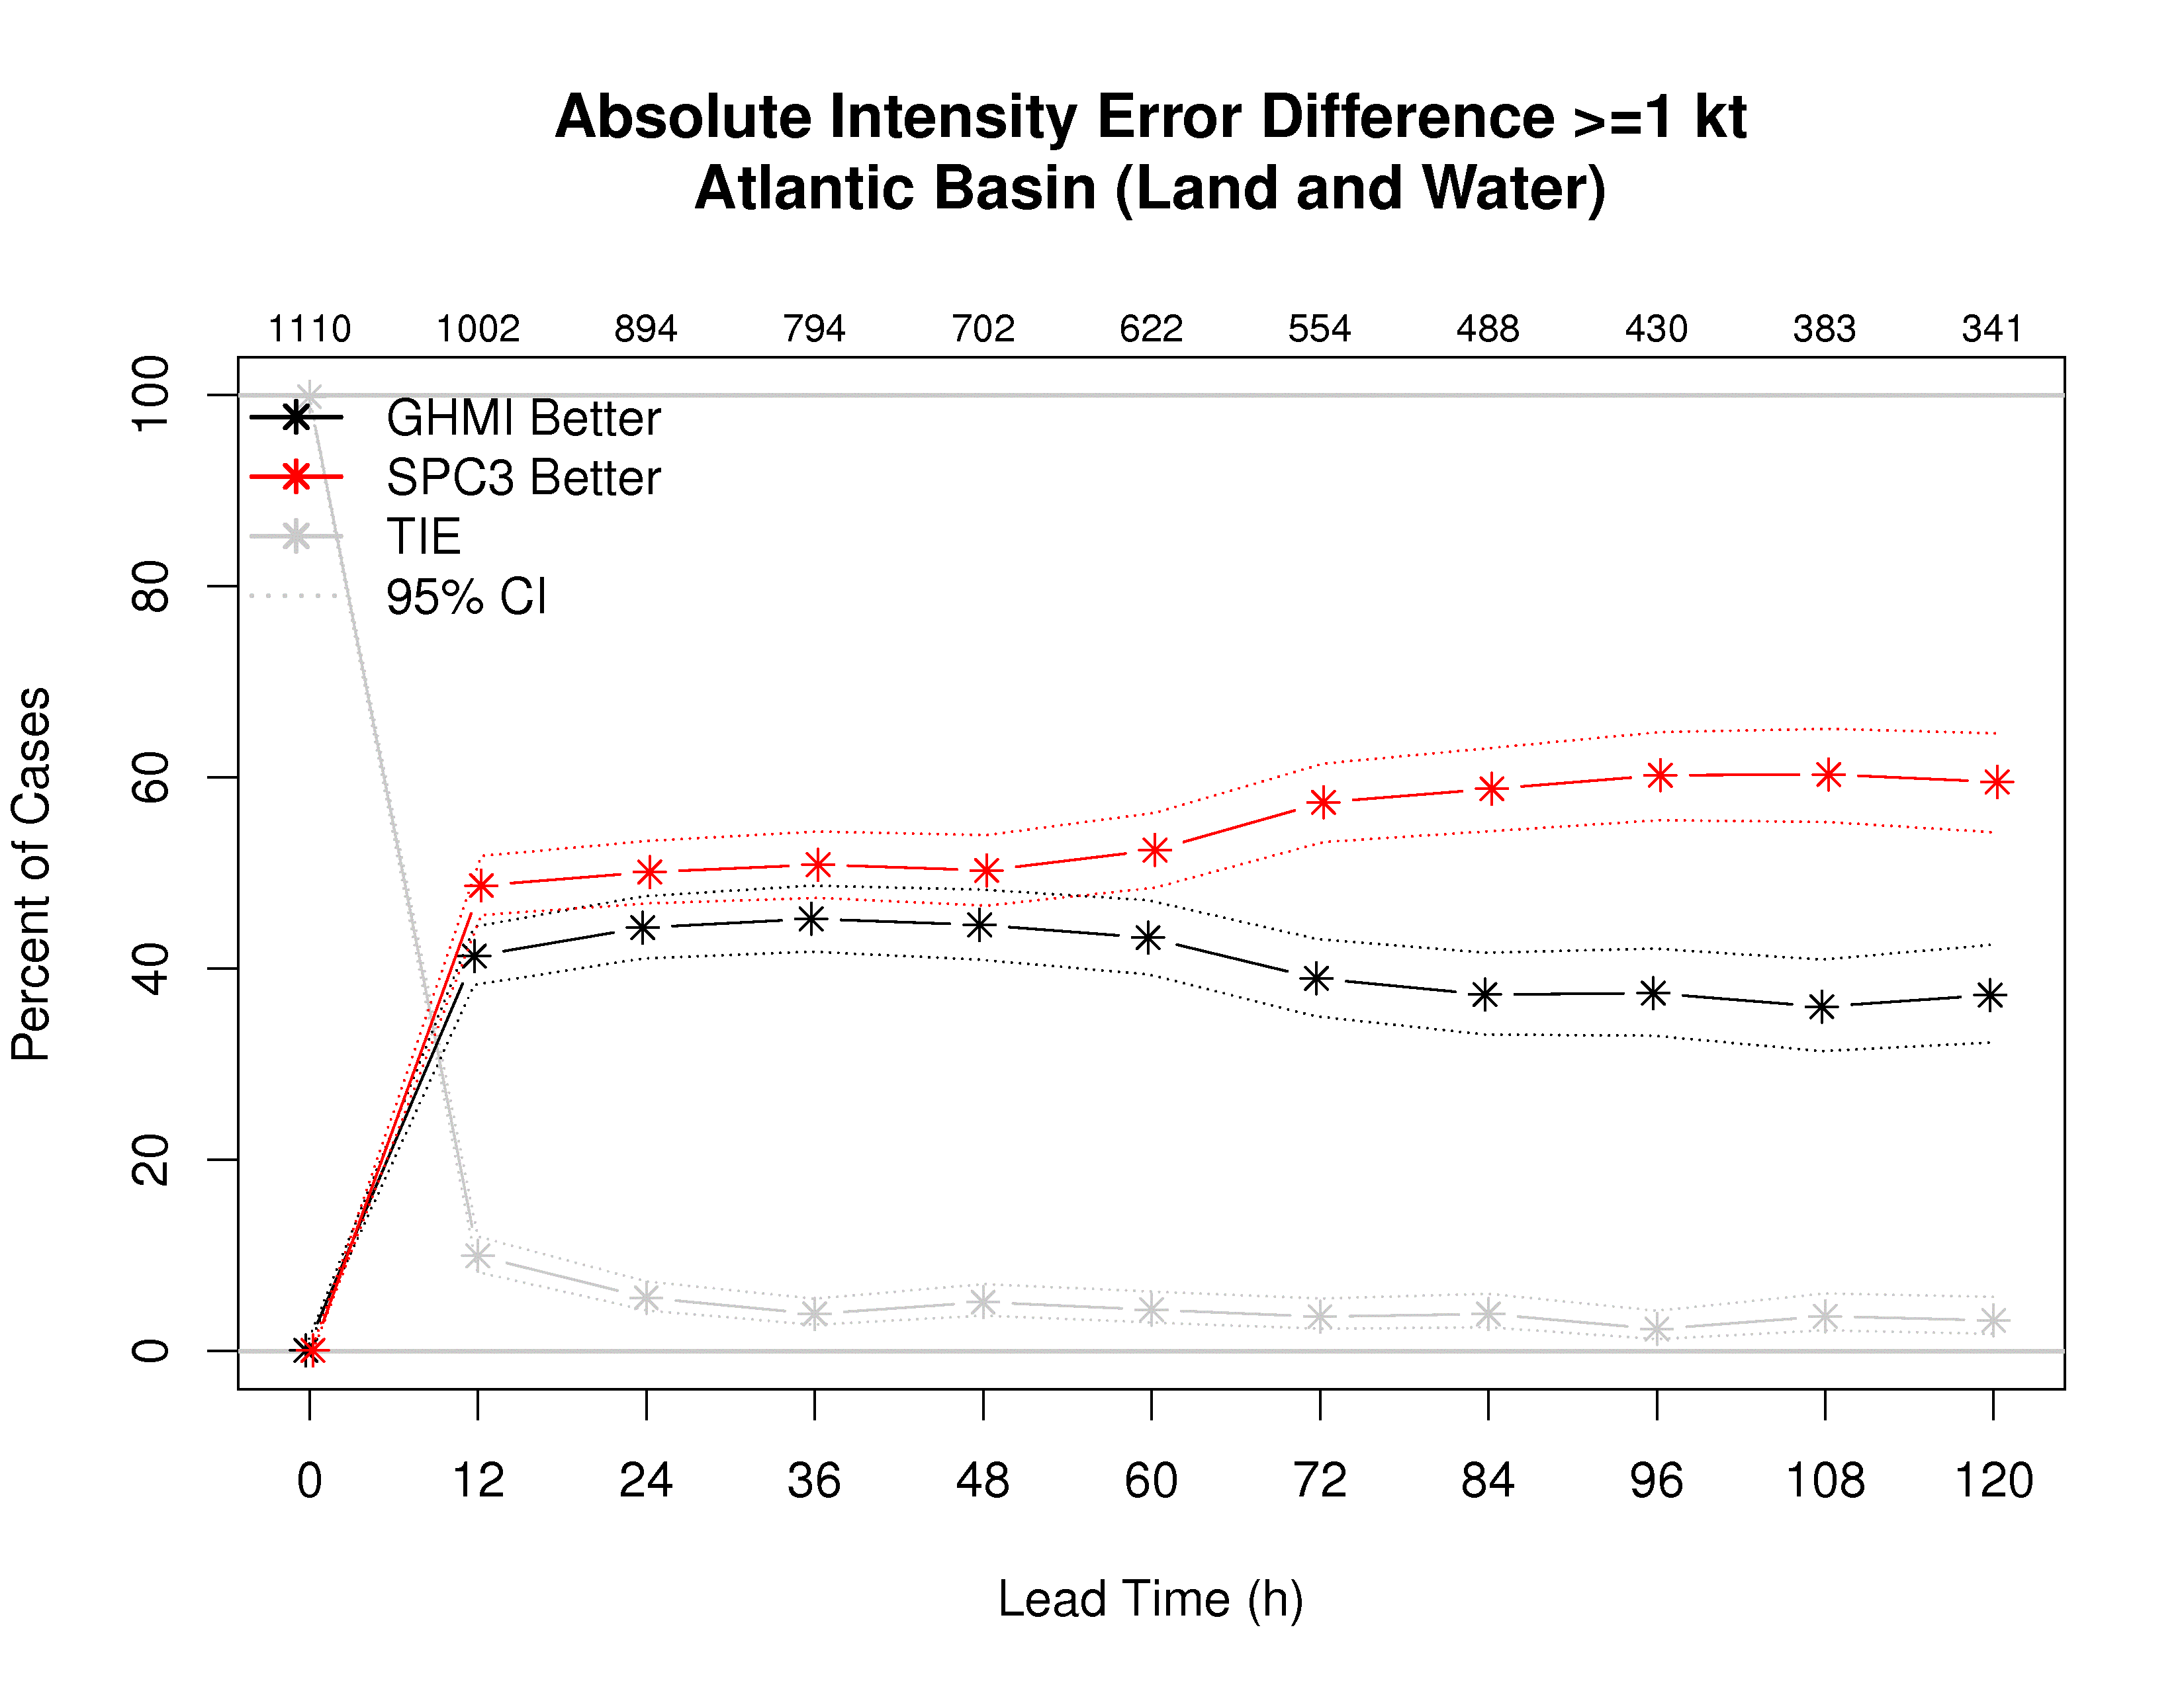
R Scripts - examples
MET-TC: Introduction | Getting Started | TC-dland | TC-pairs | TC-stat | Graphics

Slide 8
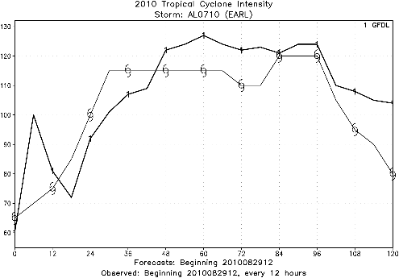
Rapid Intensification / Rapid Weakening
In Next Release:
Flexible definition of Rapid Intensification / Rapid Weakening events:
NHC Definition 30m/s in 24 hours
Different Definition 30m/s in 12 hours
Adjustable window to give credit even if there is a timing error
Miss: Events in Fcst and Observed Track do not occur at same time
Hit: Events in Fcst and Observed Track both fall into an 18 hour window
Categorical statistics for RI/RW events then calculated

Slide 9
QPF Verification of HWRF
Mrinal K Biswas
In collaboration with
John Halley Gotway, Tara Jensen, Barbara Brown, Ligia Bernardet
Excerpted from DTC Staff Meeting, April 9, 2015

Slide 10
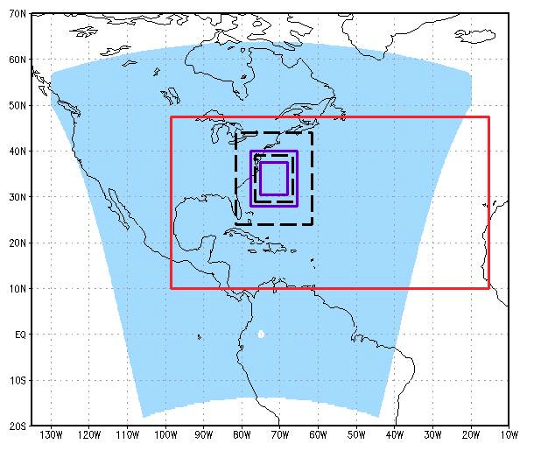
HWRF 2014 grid configuration
Atmospheric configuration
Horizontal grid spacing: 27, 9, 3 km
Inner nests move to follow storm
Domain location vary from run to run depending on storm location
61 vertical levels; top at 2 hPa
MPIPOM-TC Atlantic domain
Oceanic configuration
Horizontal grid spacing: 1/12 deg ( ~9km)
Location of grid depends of location of storm
Atlantic and Pacific
  3-D model
  23 vertical levels
d02
d03
d01

Slide 11
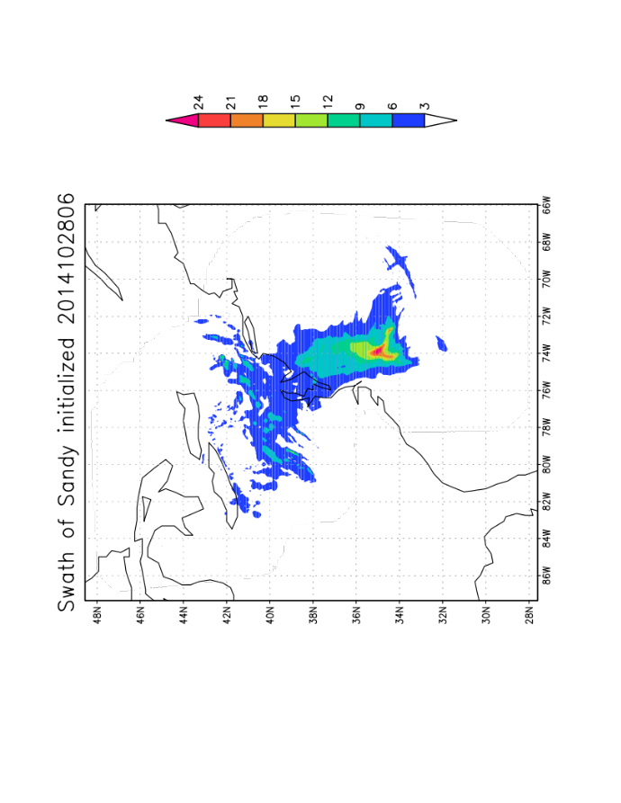
Model Data
HWRF
The 2014 pre-implementation runs (H214) conducted by EMC were used in this study
Included are 2014 operational runs for 2014 storms
HWRF data used
Parent domain (~27 km resolution)
Swath data (Mostly from D03 ~3 km resolution)
GFS (Used as a baseline to compare HWRF)
Operational GRIB1 data at 0.5 deg resolution

Slide 12
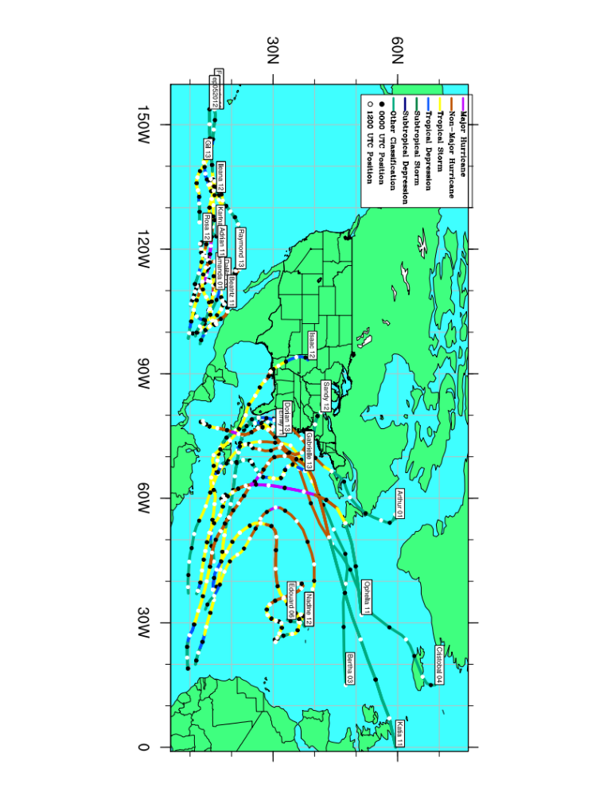
Storms for Verification
22 Storms included are from 2011-2014

Slide 13
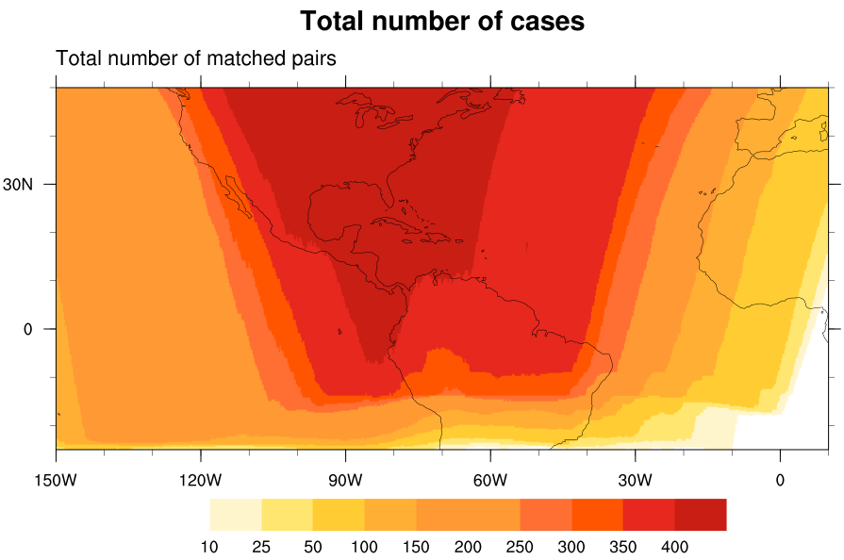
Methodology
HWRF’s parent domain shifts with every initialization according to the location of the storm – verification becomes difficult.
HWRF parent domain and GFS data are re-gridded to 0.25 deg resolution and projected on a “Mega Domain”
24 h accumulations are done using 3 hourly outputs for HWRF.
CMORPH and Stage IV data are also re-gridded to
0.25 deg Mega Domain.
All large scale verifications are done for 24 h
accumulated precipitation
Statistics are computed using the METViewer

Slide 14
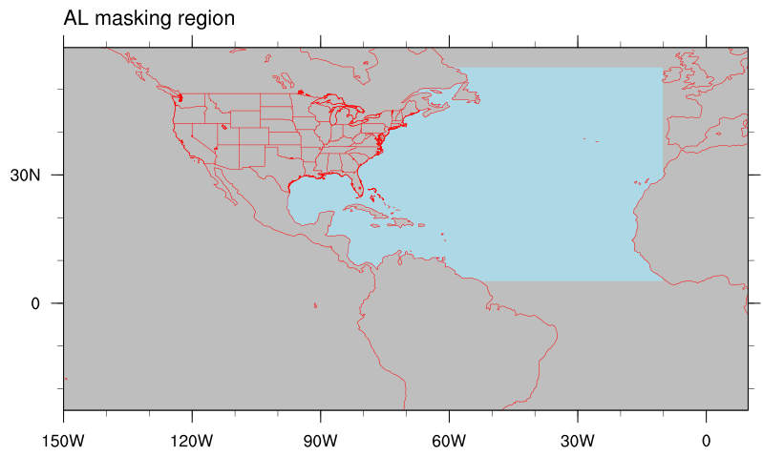
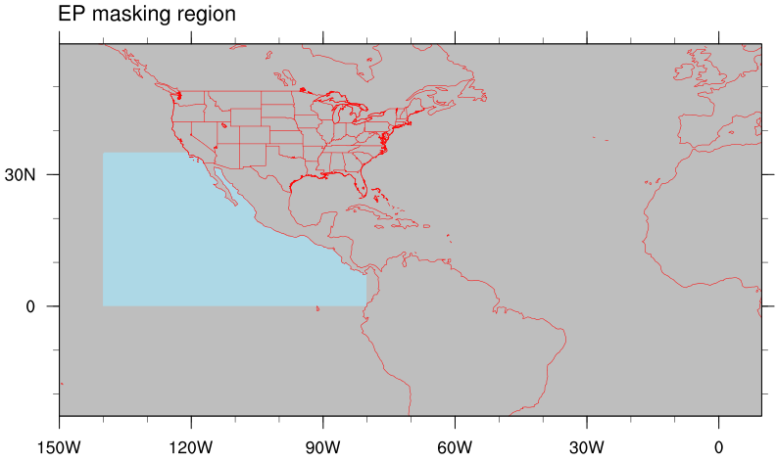
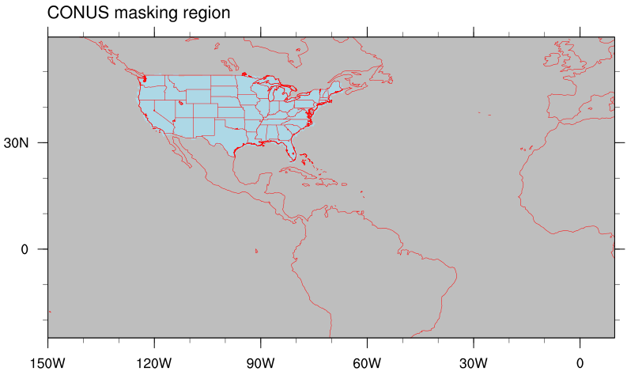
Verification regions
Atlantic
N East Pac
CONUS
Full Mega Domain

Slide 15
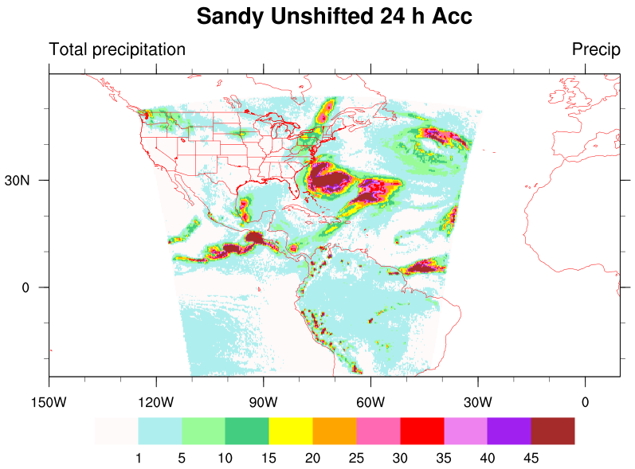
TC track errors and impact on verification
Track errors increases with lead time and can impact QPF verification.
Marchok et al (2007) showed that removing the track error can be informative
The influence of track error is minimized by shifting the entire domain. The amount of shifting is determined by the difference in the forecast lat/lon and the observed lat/lon of the storm’s center.
t+2
t+1
t
FCST
BEST
Track

Slide 16
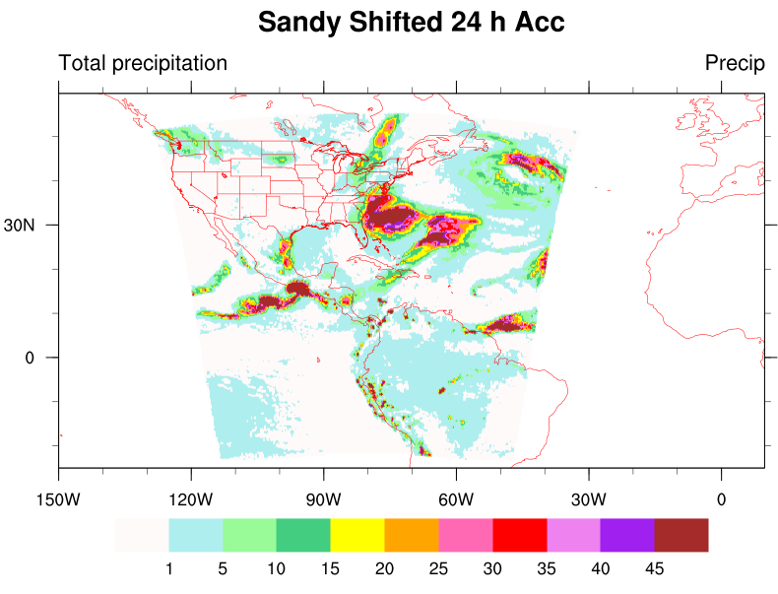
TC track errors and impact on verification
Does not take into account interaction with land, e.g. encounter with high terrain
Storm motion and angle is not taken into account
We did evaluate over land and water separately as well
Shifting removes track error from QPF Vx
The verification is done by taking into account only 600 km rainfall around the storm position.
Radius of Maximum Wind
t+2
t+1
t
FCST
BEST

Slide 17
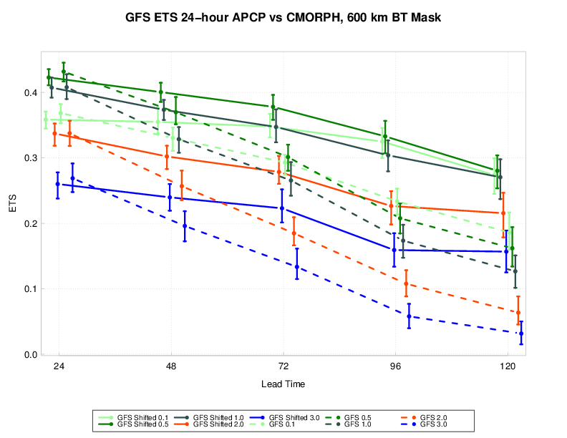
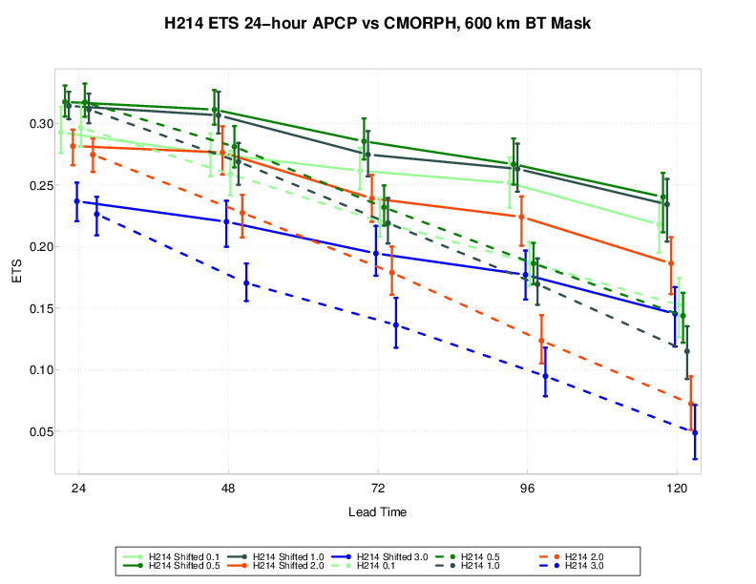
Verification after shifting grids
ETS values increases significantly after the shifting is done.
GFS has higher ETS values than HWRF, even at earlier lead times and higher thresholds

Slide 18
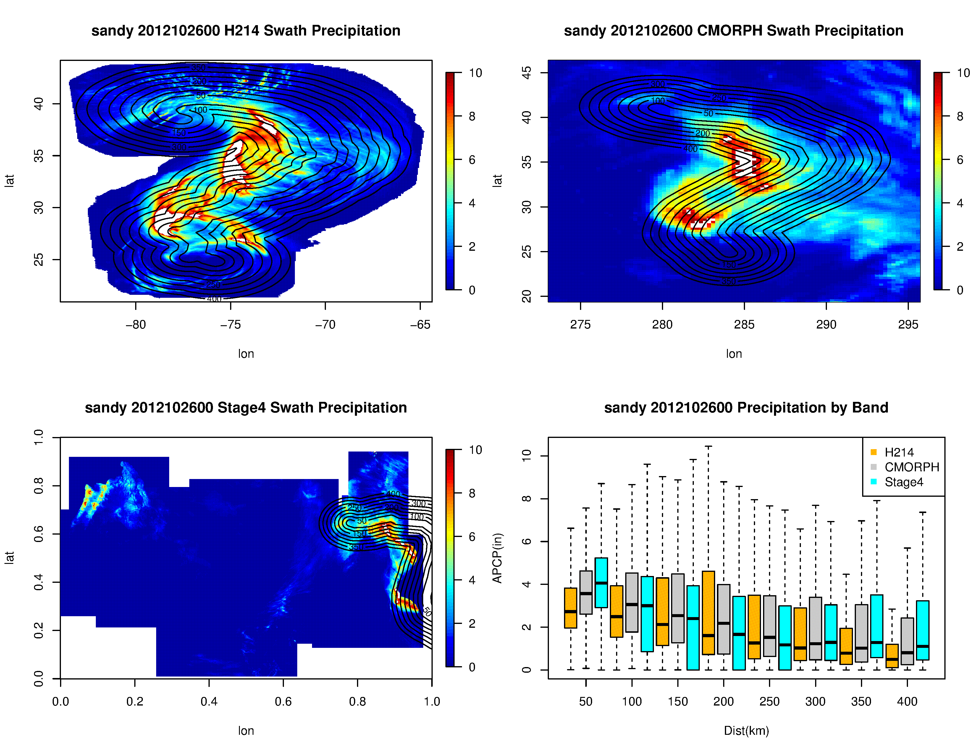
MET Advances in next release
Swath Precipitation Data generated by HWRF
Range Rings generated with MET using new gen-vx-mask tool with the –track option
Analysis performed using R-Statistics
Tropical Cyclones: Storm-following masking with range rings

Slide 19
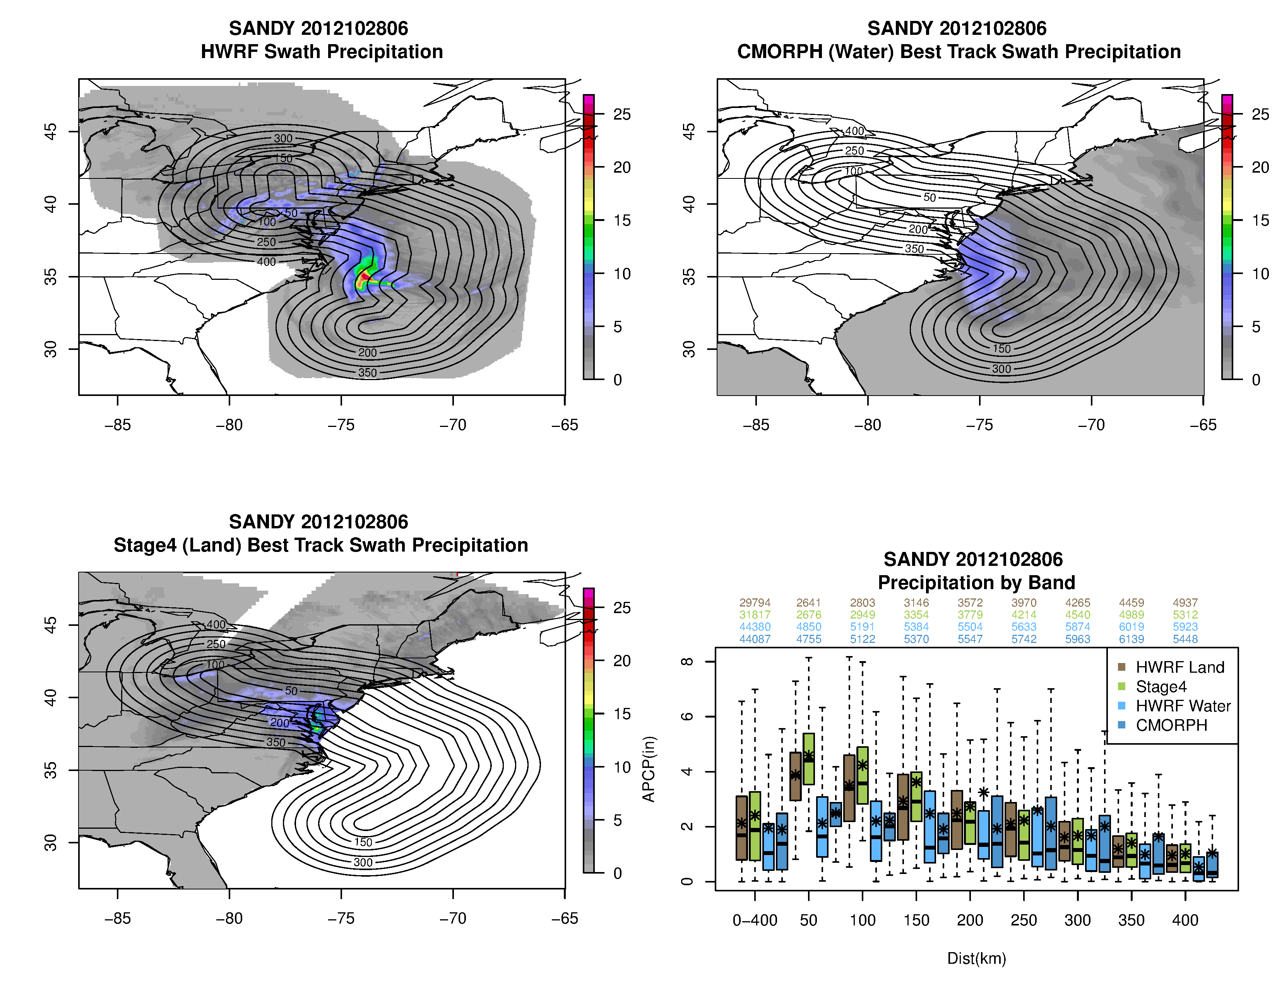
Verification of HWRF swath data
HWRF swath, CMORPH and, Stage IV data are re-gridded to a common 0.05 degree resolution
Bands of 50 km width are drawn around the storm track extending till 400 km. The CMORPH and Stage IV uses the best track.
The verification is done against CMORPH when over water and Stage IV when the track is over land.
Distributions are shown for the different bands and 0-400 km
Due to coarse resolution CMORPH does not truly represent finer scale precipitation

Slide 20
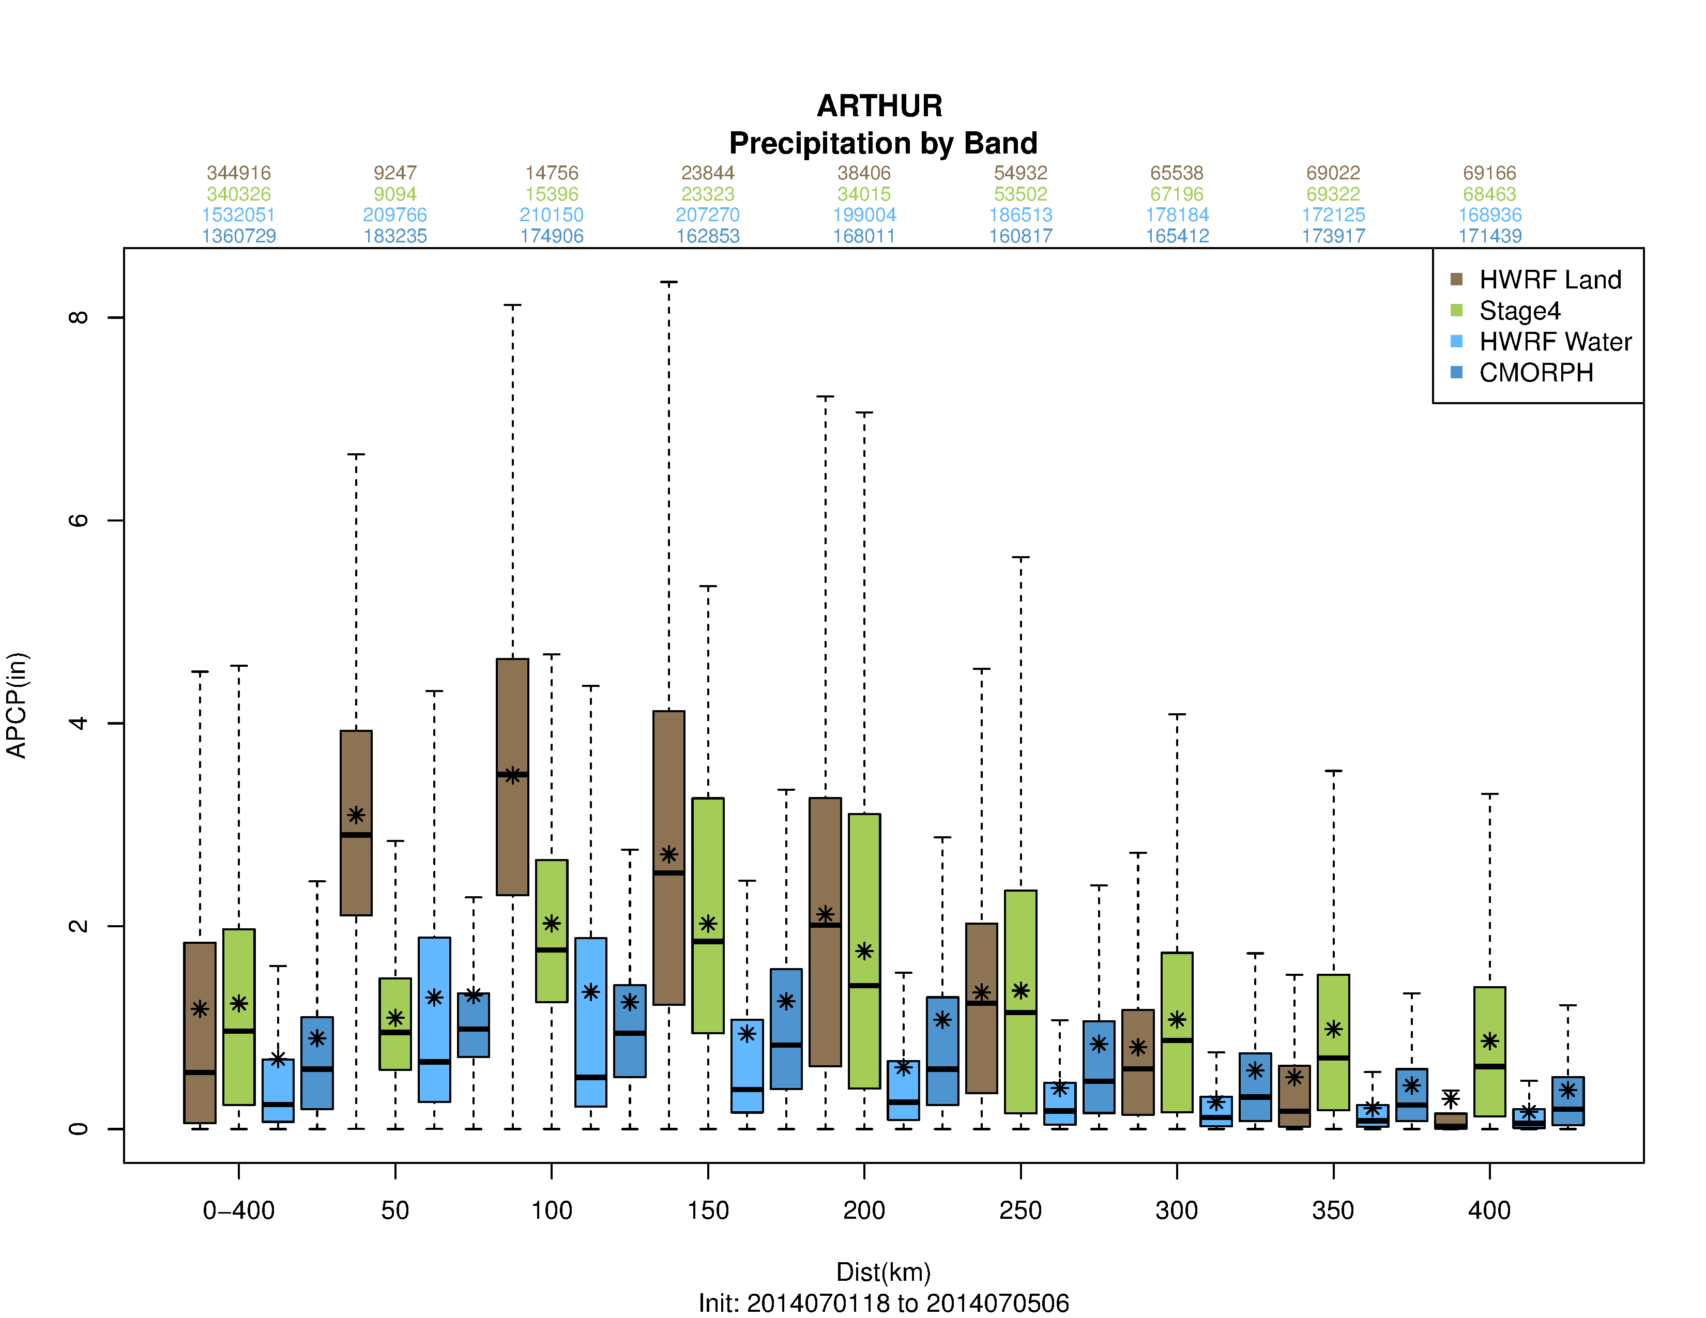
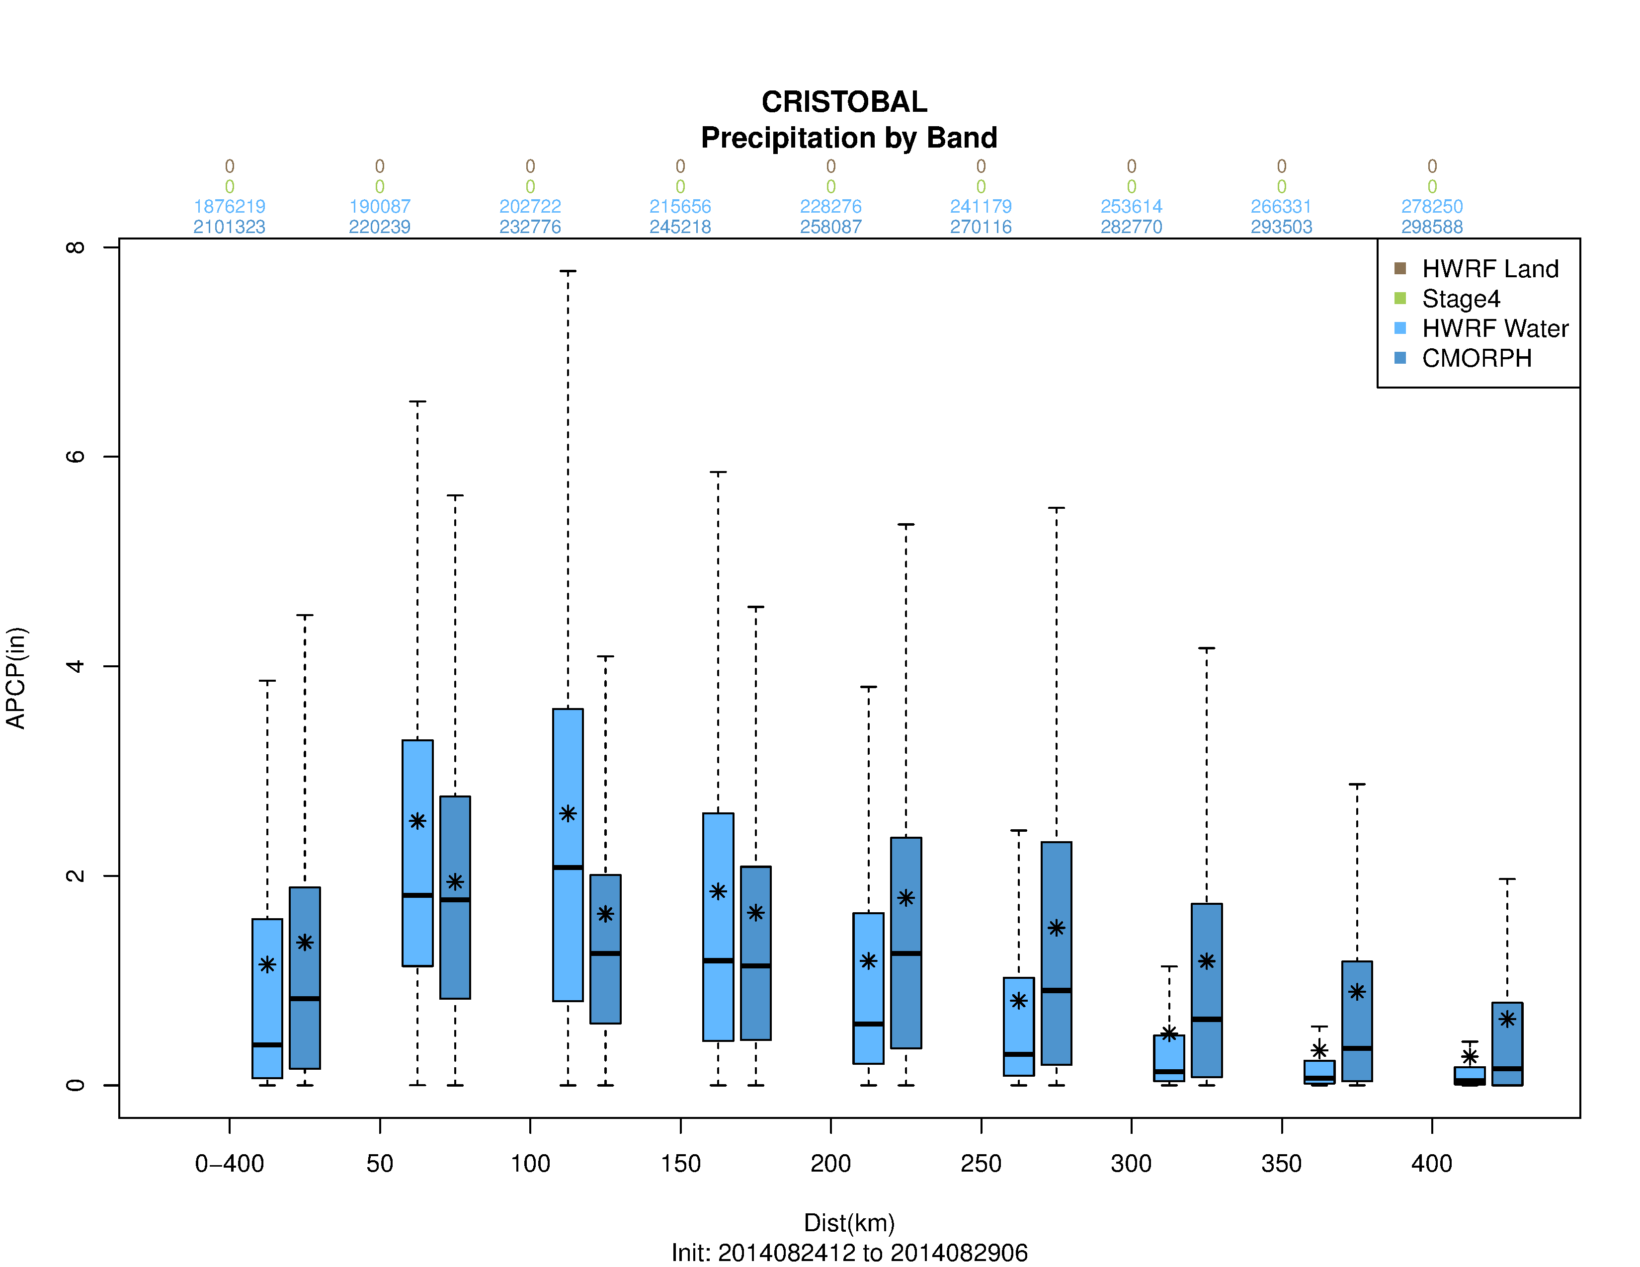
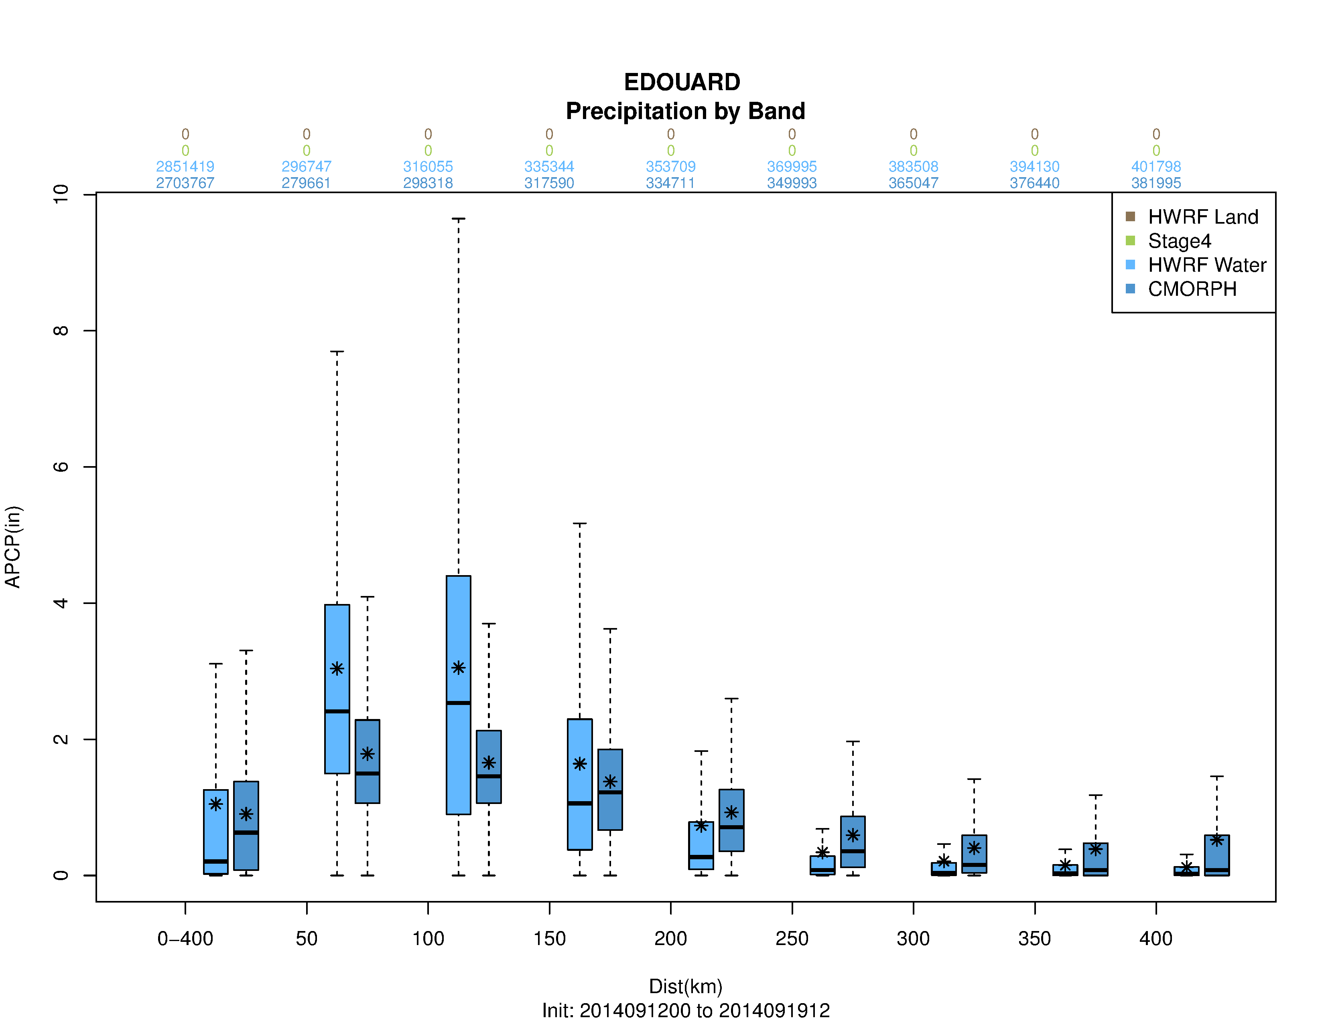
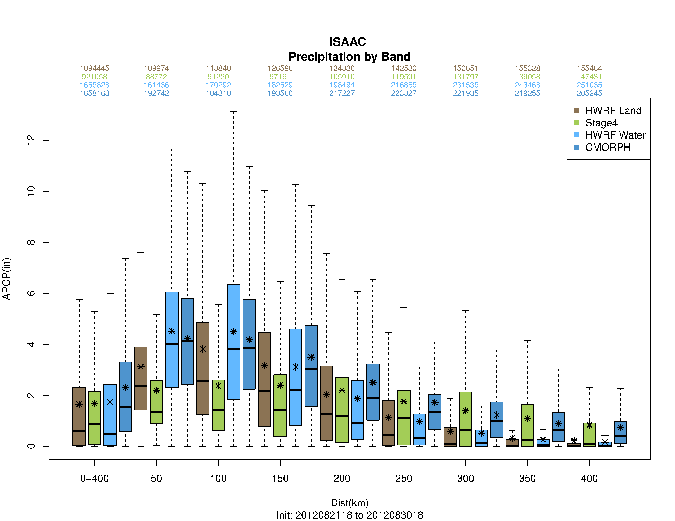
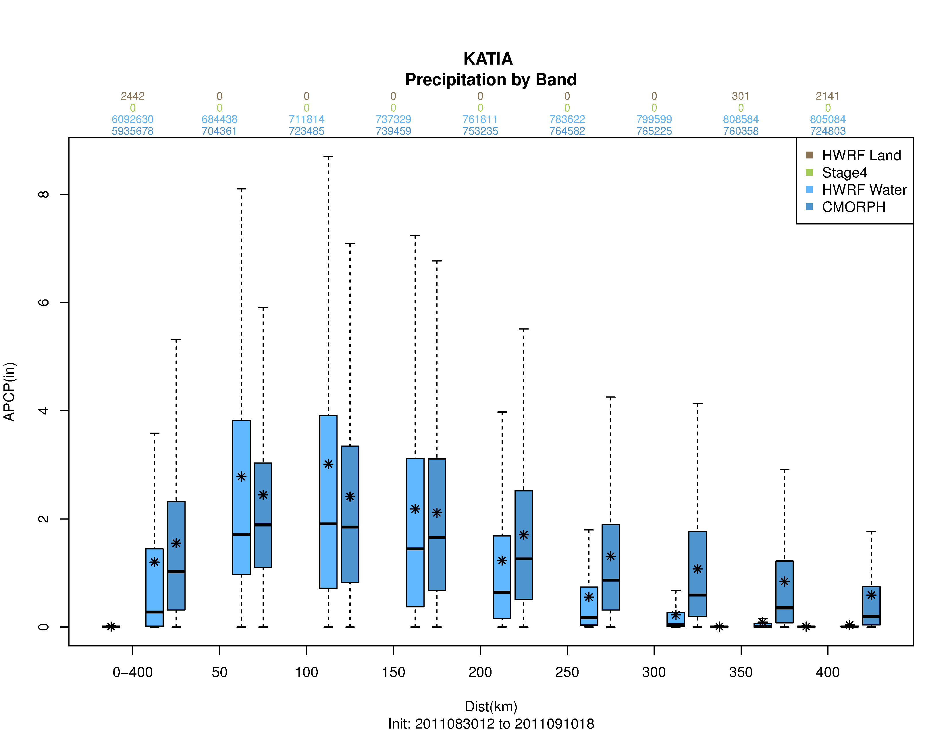
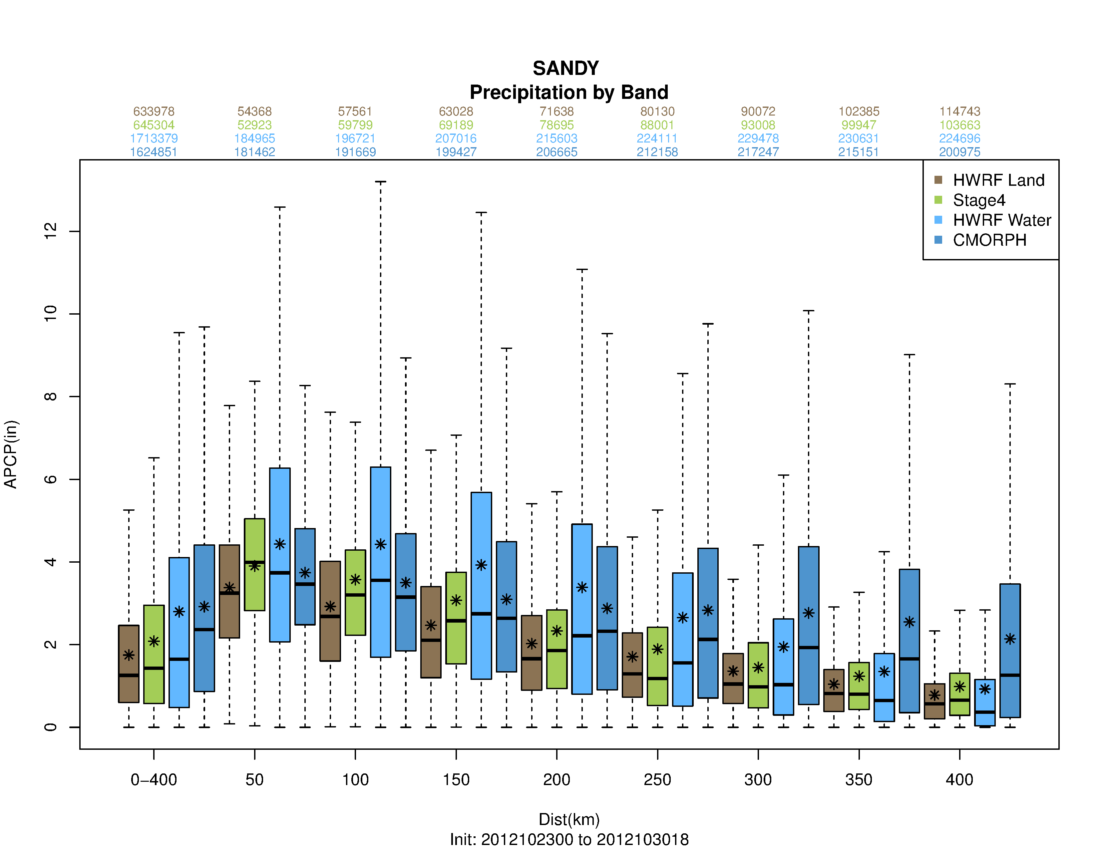
Examples of QPF distributions
Most of the rainfall occurs within 0-100 km around the storm track
Lonfat et al (2004) noted that most of the rainfall occur in a narrow swath along the track. Frank (1977) observed max precip falls around 0-2 deg around center.
Notes:
The distribution of rainfall depends on: (a) translational speed: will impact the areal coverage of the bands, (b) interaction with land: storms (forecast and/or best track) making landfall will be evaluated against Stage IV, (c) location errors: the storms will be in a different environment including impact of orography and (d) environmental factors e.g. shear (Chen et al 2006)
Lonfat et al (2004) also noted that the maximum rain rates occur in a narrow swath along the storm track. Frank (1977) observed that the maximum rainfall occurs 0-2° around the center of the storm and the intensity is higher for western pacific storms around Japan compared to Atlantic due to sheer size and intensity of the storms in that region.

Slide 21
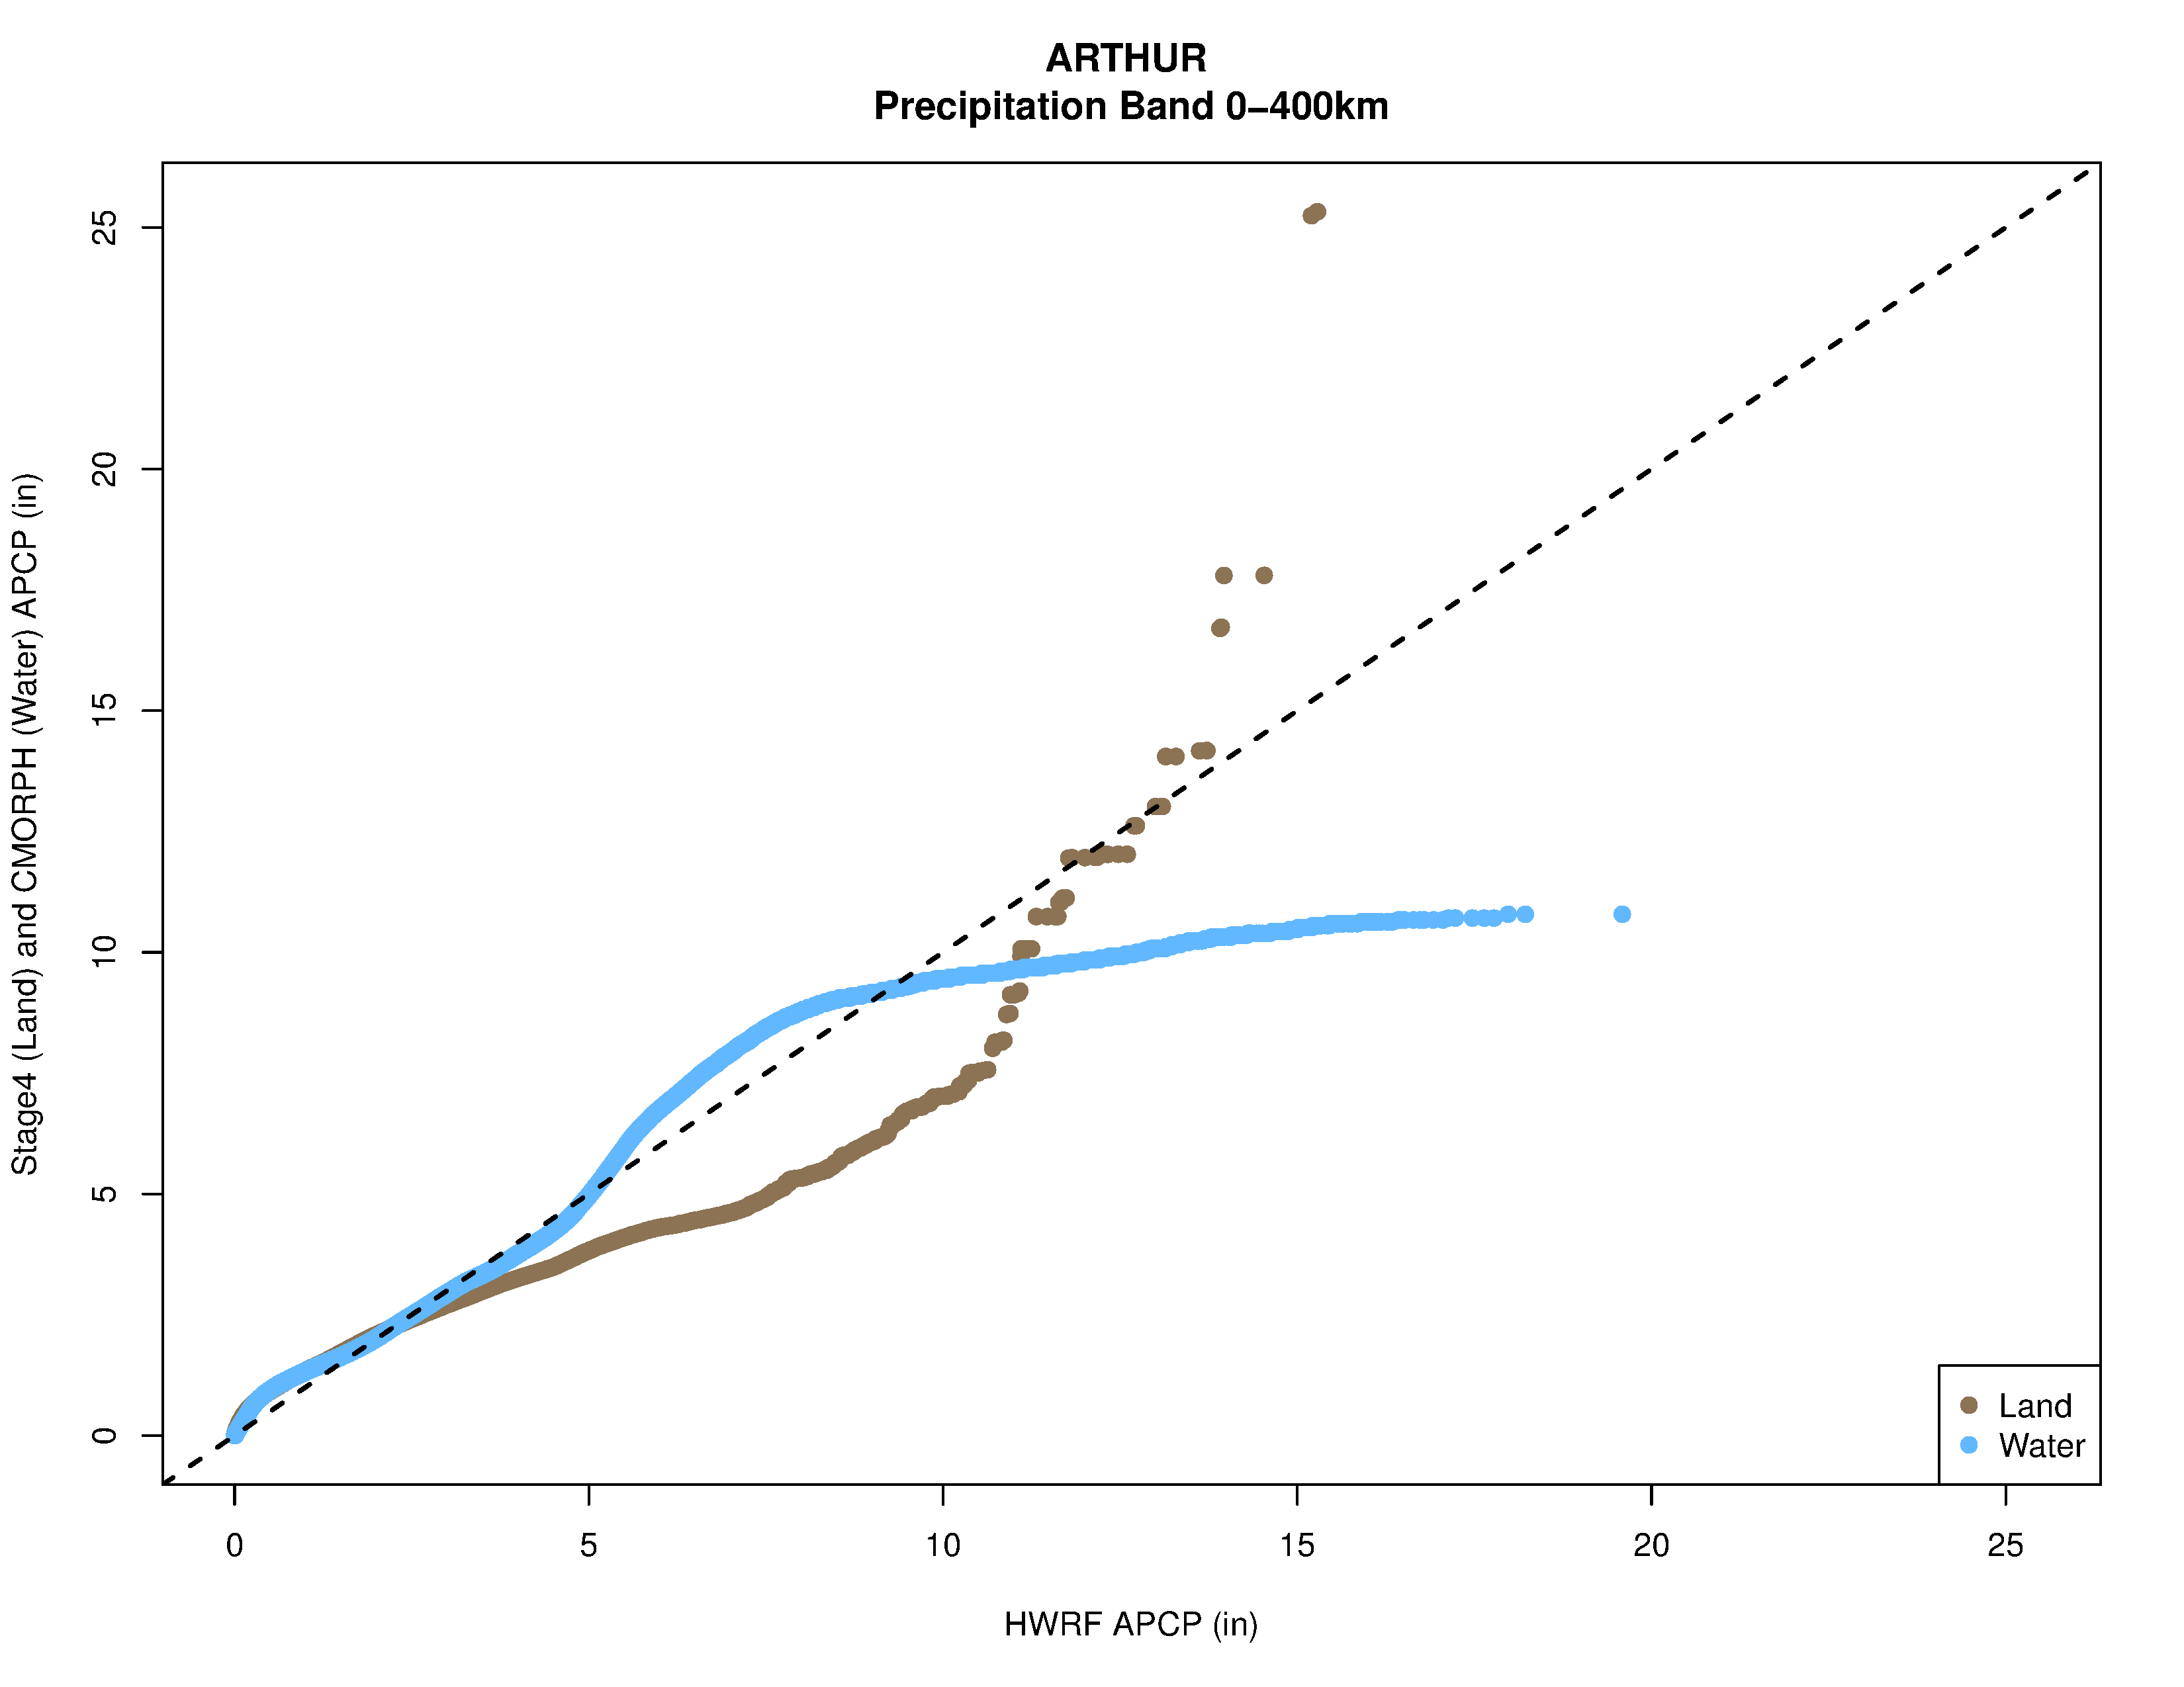
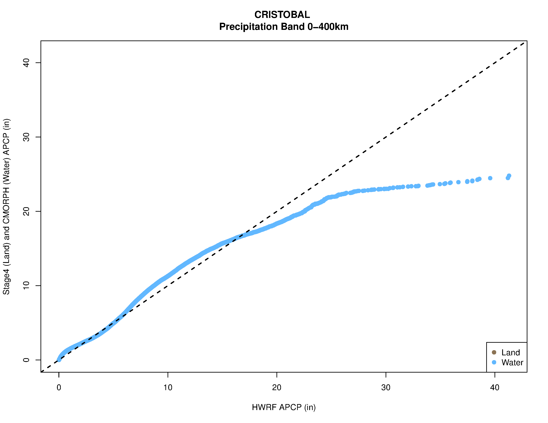
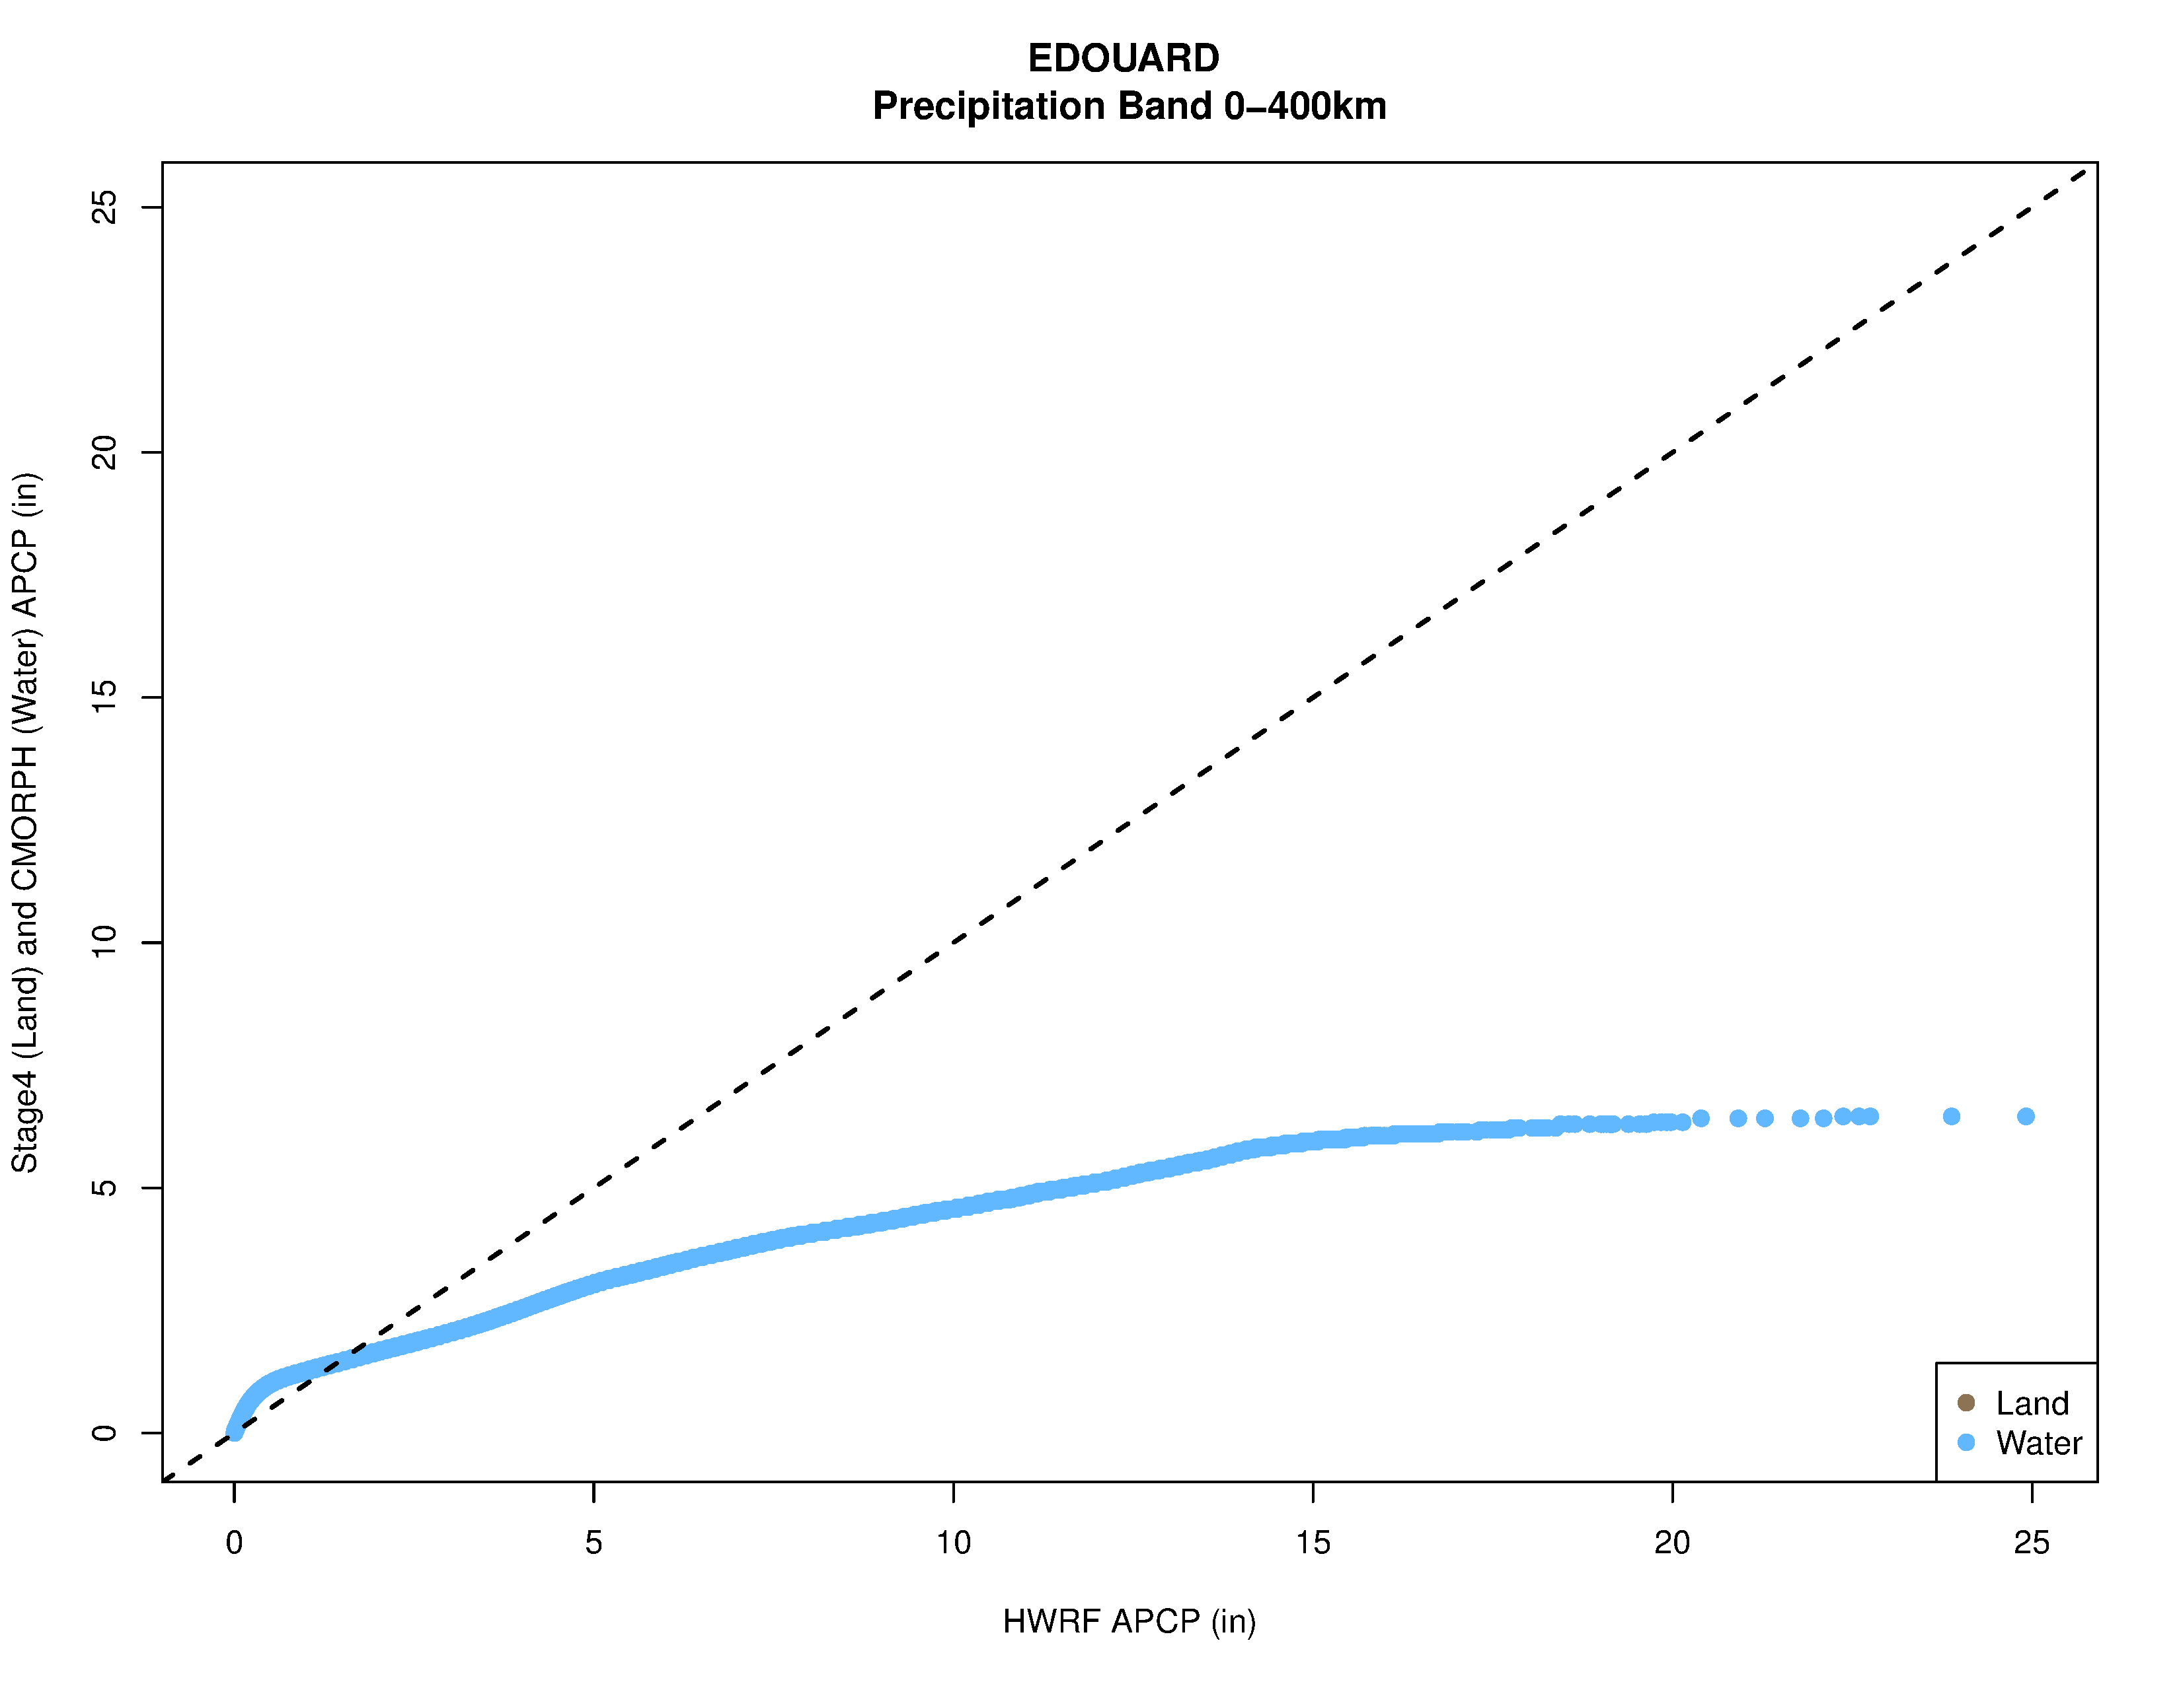
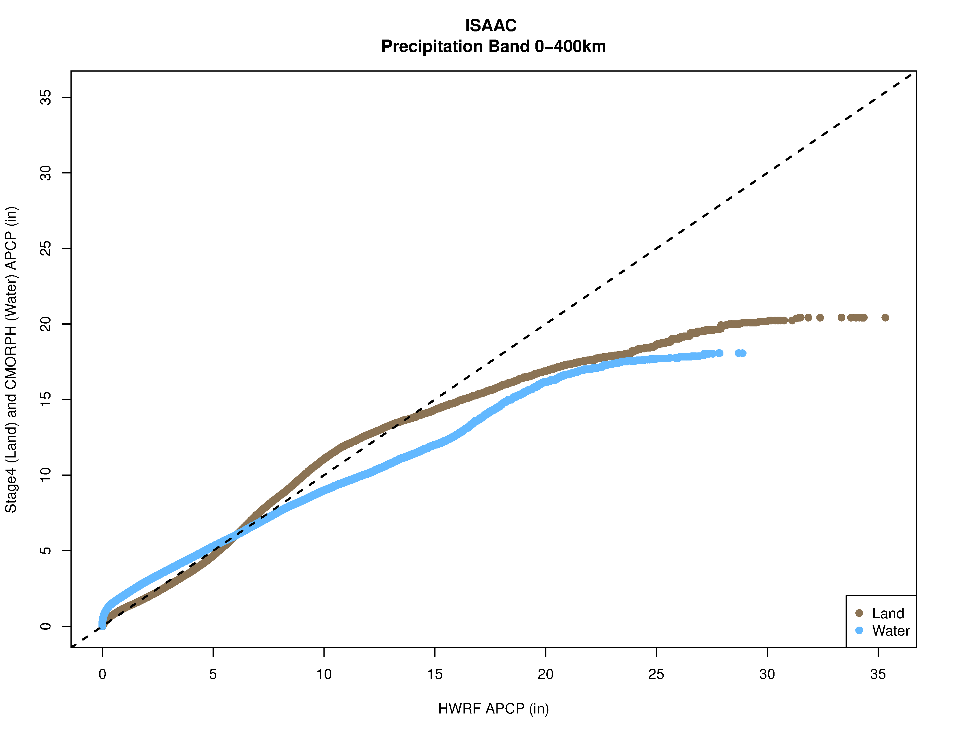
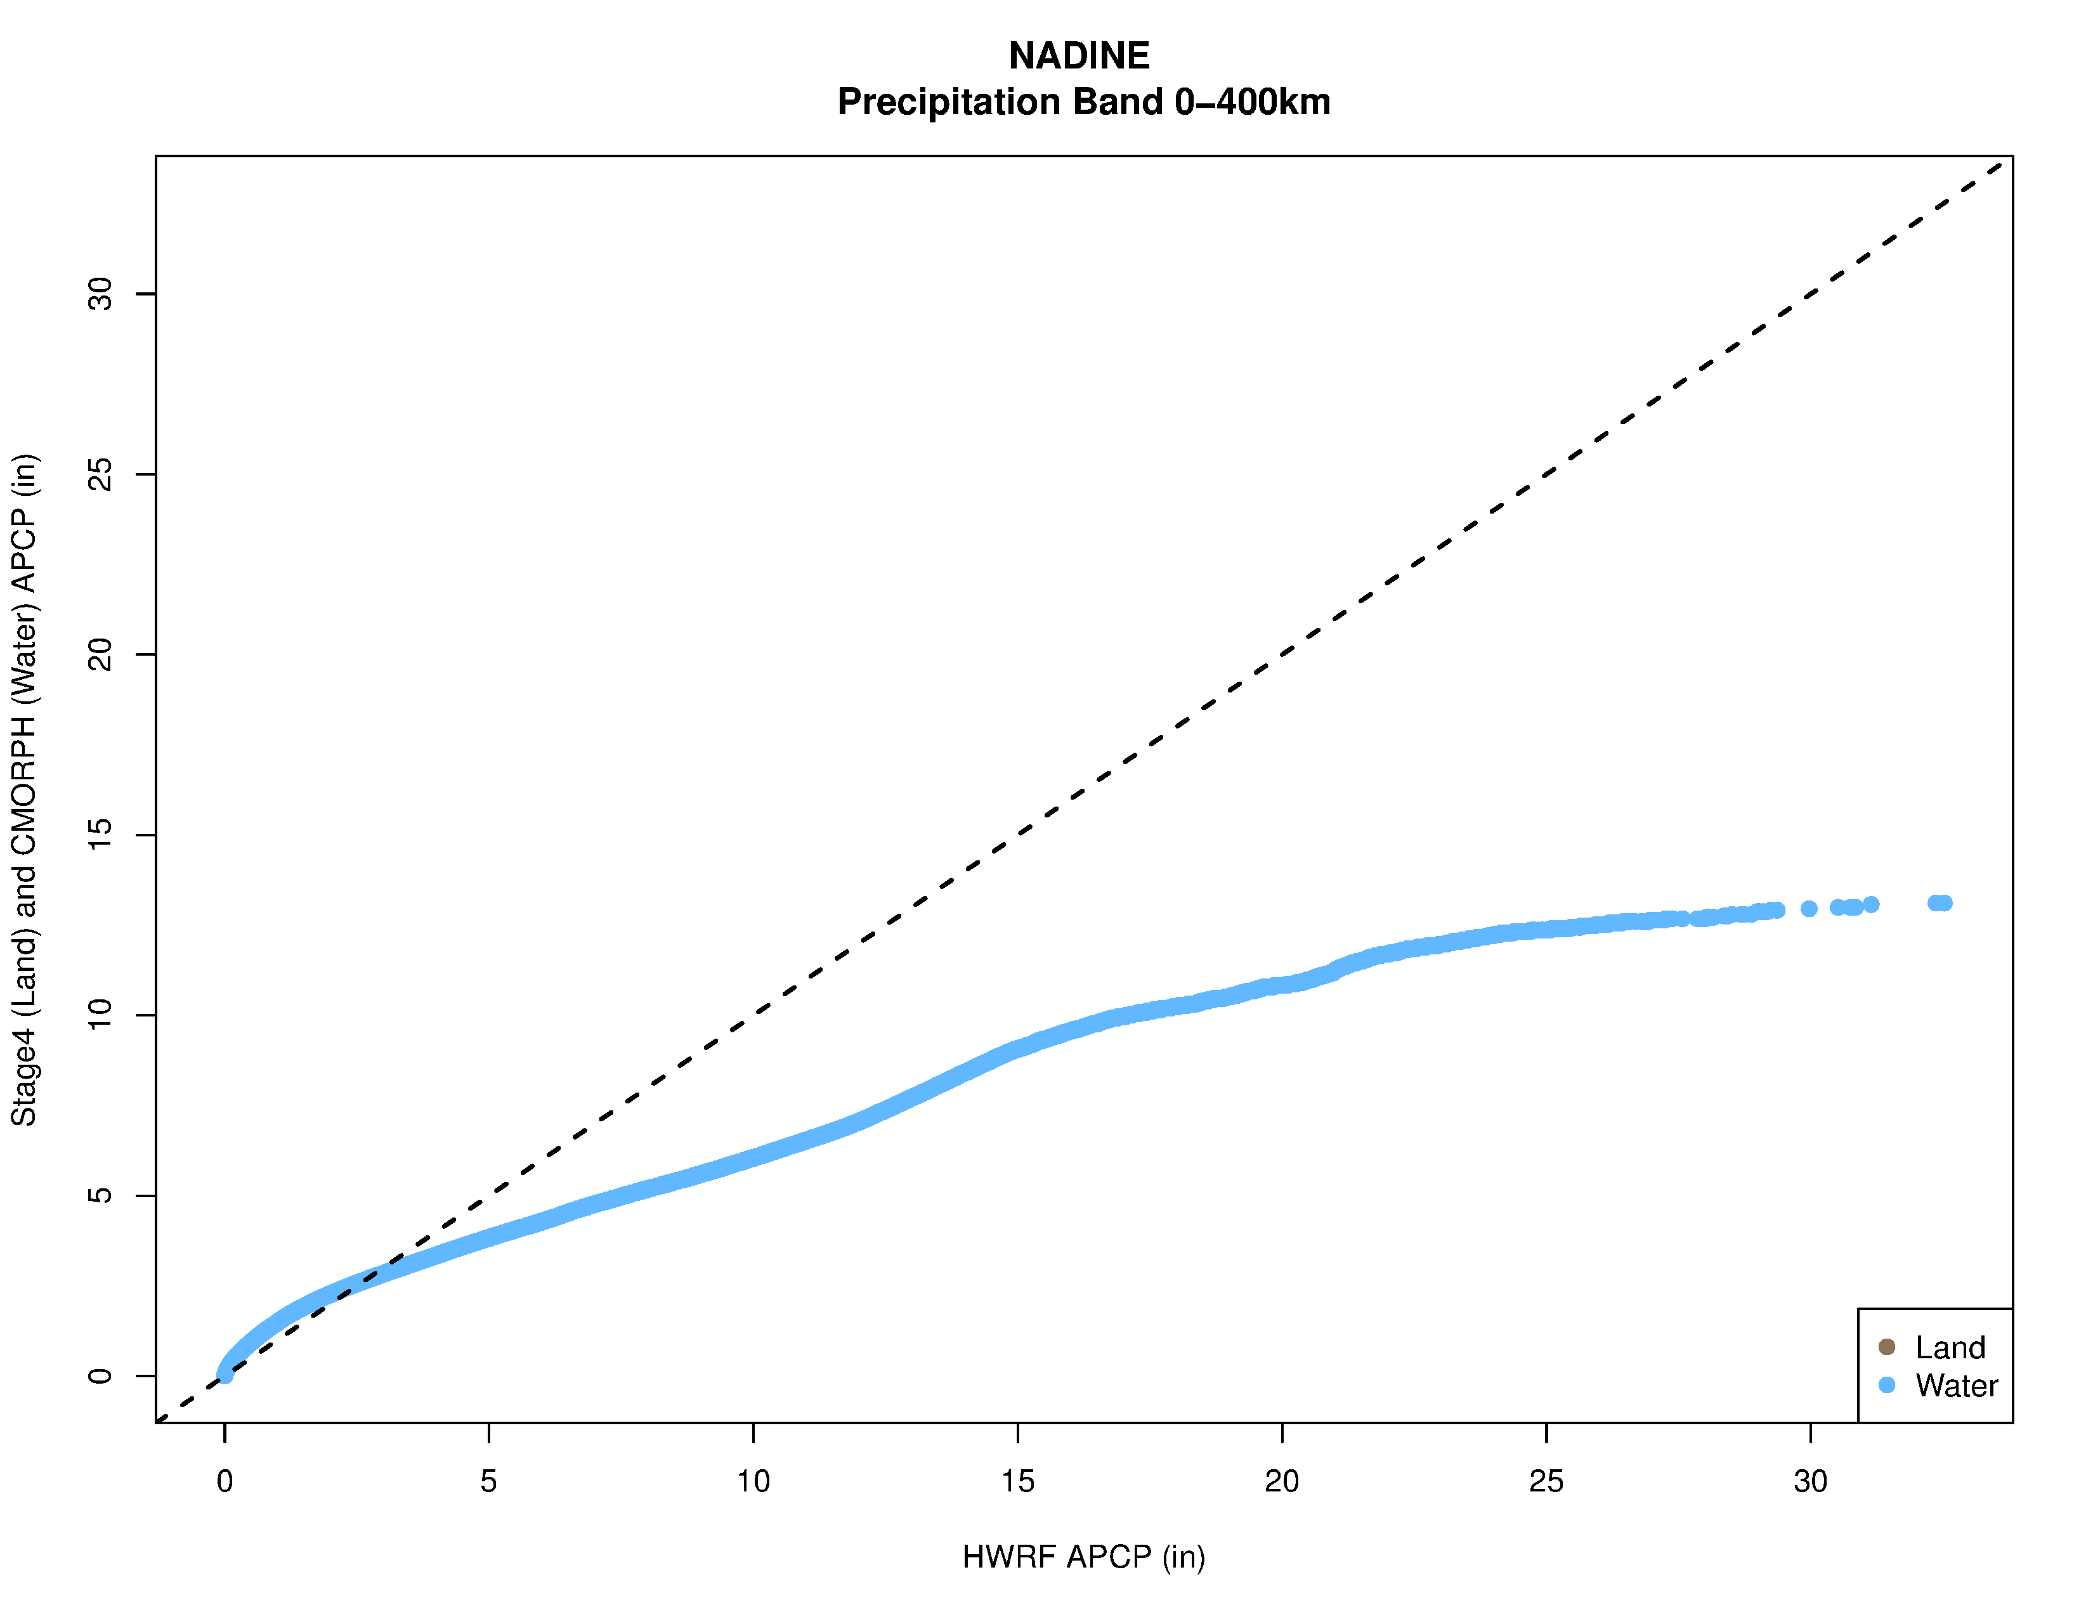
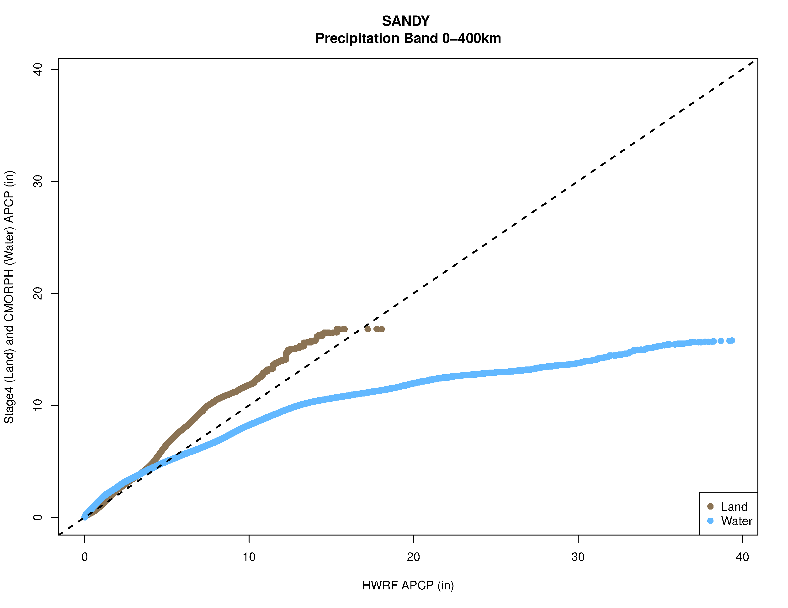
Evaluations of swath data using Q-Q Plots
Stage IV/CMORPH vs HWRF precipitation
Ocean Land
HWRF over-estimates precipitation over water more than over land*
Notes:
Land precip cases are way less compared to ocean

