Slide 1

Demonstrating the utility of the Mesoscale Model Evaluation Testbed (MMET)
MMET Team
Michelle Harrold
Tracy Hertneky
Jamie Wolff

Slide 2
DTC Mission
The fundamental purpose of the DTC is to facilitate the interaction & transition of NWP technology between research & operations.
DTC facilitates:
  O2R transition by making the operational NWP systems available to the research community & providing community user support
  R2O transition by performing testing & evaluation of new NWP innovations in a functionally similar operational environment over an extended period
  Interaction between research & operational NWP communities through the organization of community workshops/meetings on important topics of interest to the NWP community & hosting a DTC Visitor Program
DTC strives to be an effective and efficient community facility for the transition of innovations in NWP between research and operations.
Notes:
Let me start out by providing a very brief background on the mission of the Developmental Testbed Center, or the DTC. The fundamental purpose of the DTC is to facilitate the interaction and transition of numerical weather prediction (NWP) technology between research and operations.
In order to accomplish this mission, focus is placed on two key aspects: 1) advancing science research by providing access to and community support for functionally similar components of NWP systems used at operational centers to the research community (also referred to as O2R), and 2) extensively testing and evaluating promising codes emerging from the research community in a common framework to demonstrate the potential benefits for operational systems (or R2O). Support to facilitate interactions between the research and operational communities is also important and is accommodated by the DTC through the organization of workshops/meetings on relevant topics to the NWP community and through hosting a Visitor Program.
The ultimate goal of these specific activities is to accelerate the rate at which new science innovations are infused into operational weather forecasting, promoting an overall improvement in forecast skill. And, in the end, the DTC strives to be an effective and efficient community facility for the transition of innovations in NWP between research and operations.

Slide 3
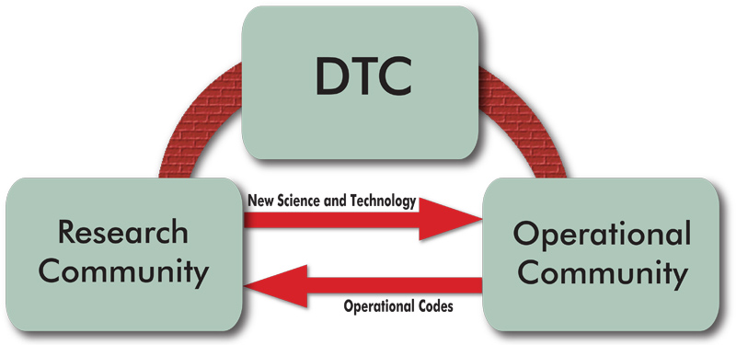
Testing Protocol Motivation
Wide range of NWP science innovations under development in the research community
Testing protocol imperative to advance new innovations through the research to operations (R2O) process efficiently and effectively.
  Three stage process:
    Proving ground for research
    community
    Comprehensive T&E
    performed by the DTC
    Pre-Implementation testing
    at Operational Centers
Notes:
So we have the mechanism in place to facilitate and promote research to operations (or R2O). However, there is a wide range of NWP science innovations are under development in the research community, and with this extensive number of new techniques available, a testing protocol document detailing the procedures necessary to advance new innovations through the R2O process is imperative. Ultimately, the effort should be streamlined to make it not only efficient, but also effective.
A three stage process will be defined for mesoscale modeling code deemed ready to progress through the R2O process. The three stages will be detailed during the rest of this talk, but include testing conducted by the research community, the DTC and, ultimately, the operational centers.

Slide 4
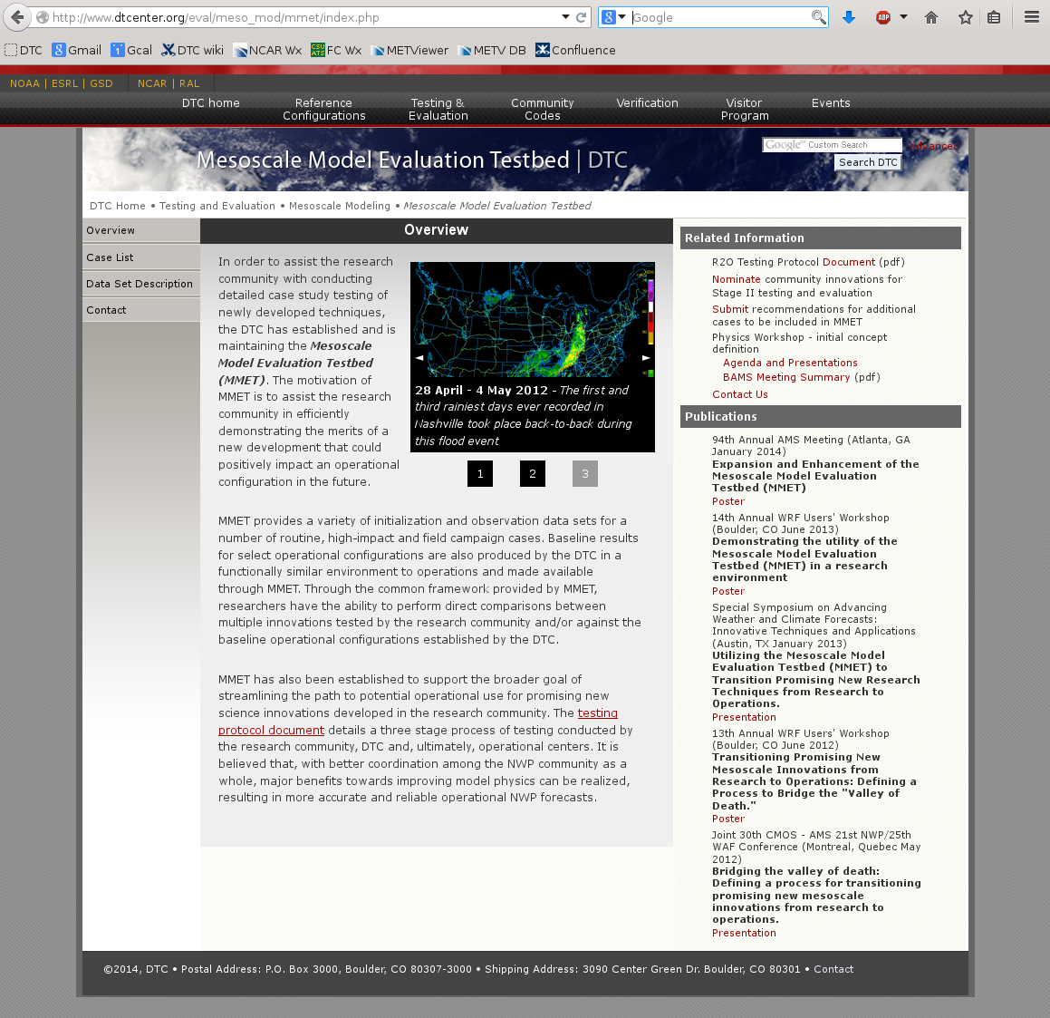
Mesoscale Model Evaluation Testbed (MMET)
Why: Assist the research community in efficiently demonstrating the merits of a new development
Provide a common framework for testing; allow for direct comparisons
  What: Mechanism to efficiently assist research community with initial stage of testing
Provide model input and observational datasets to utilize for testing
Establish and publicize baseline results for select operational models
Where: Hosted by the DTC; served through Repository for Archiving, Managing and Accessing Diverse DAta (RAMADDA)
http://www.dtcenter.org/repository
http://www.dtcenter.org/eval/meso_mod/mmet/index.php
Notes:
Now, let me describe MMET in more detail for you. The motivation of MMET is to assist the research community in efficiently demonstrating the merits of a new development that could positively impact an operational configuration in the future. MMET also provides a common framework for direct comparisons to be made between multiple innovations and select operational configurations.
As I have already mentioned, MMET is a mechanism to assist and support the research community with the initial stage of R2O testing. MMET provides a variety of initialization and observation data sets for routine, high-impact and field campaign cases to be utilized by the research community for testing and evaluation of newly developed innovations that address forecast needs in many different areas. The DTC will utilize the same data sets included in the MMET to provide baseline results to the research community for specific operational configurations.
The so-called “data sets of opportunity” available in MMET are housed at the DTC and accessible to the community-at-large via a web interface (dtcenter site). RAMADDA, a Repository for Archiving, Managing and Accessing Diverse DAta (http://www.unidata.ucar.edu/software/ramadda), is used as the foundation for hosting and distributing the data.

Slide 5
Operational Baselines
Baseline results for select Operational Configurations (OC) using:
  Weather Research and Forecasting - Advanced Research WRF (WRF-ARW)
    RAP/HRRR OC (Air Force OC prior to 2015)
  NOAA Environmental Modeling System – Nonhydrostatic Multiscale Model on the B-grid (NEMS-NMMB)
    North American Mesoscale Forecast System (NAM) OC
Physics Suite | WRF-ARW RAP/HRRR OC | NEMS-NMMB NAM OC
Microphysics | Thompson | Ferrier-Hires
Radiation (LW/SW) | RRTMG/RRTMG | GFDL/GFDL
Surface Layer | MYNN | Mellor-Yamada-Janjic
LSM | RUC | Noah
PBL | MYNN 2.5 | Mellor-Yamada-Janjic
Convection | Grell-Freitas (RAP) | Betts-Miller-Janjic

Slide 6
MMET – Case Inventory
Date(s) | Meteorological Scenario
20110404 | Record breaking severe report day
20111128 | Cutoff low over SW US
20120203-05 | Snow storm over Colorado, Nebraska, etc.
20120628 | Derecho event that began in Iowa and traveled eastward through the Mid-Atlantic states
20130729 | Mesoscale convective system (MCS) over SE Kansas
20130908-14 | Historic Colorado flooding associated w/ long duration and warm rain processes
20140105 | Arctic air outbreak impacting much of the United States east of the Rockies
20110214-17 | Atmospheric river impacting the West Coast
20090228 | Mid-Atlantic snow storm -NAM high QPF shifted too far north
20090311 | High dew point predictions by NAM over the upper Midwest and in areas of snow
20091007 | HIRESW runs underperformed compared to coarser NAM model
20091217 | “Snowpocalypse ‘09”
20100428-0504 | Historic Tennessee flooding associated w/ an atmospheric river
20110518-26 | Extended severe weather outbreak covering much of the Midwest and into the eastern states
Notes:
Cases of interest to EMC – represent cases for which operational models did not perform well
Initial solicitation of cases was sent to the DTC Science Advisory Board Members participants of a physics workshop that the DTC and EMC co-hosted last summer. The response was overwhelmingly positive and a large number of cases were proposed. Nine cases were selected as the initial focus for this first year and those are listed here.
The cases selected contain a good cross-section of weather events, including winter weather, flooding, severe weather and a few more quote-un-quote routine (or less extreme) weather events.

Slide 7
What does MMET provide?
Initialization datasets
Pre-processing datasets
Model configurations
Post-processing scripts
Graphics of model output and scripts
Observation datasets
Verification output and scripts

Slide 8
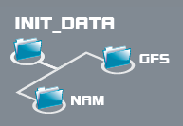
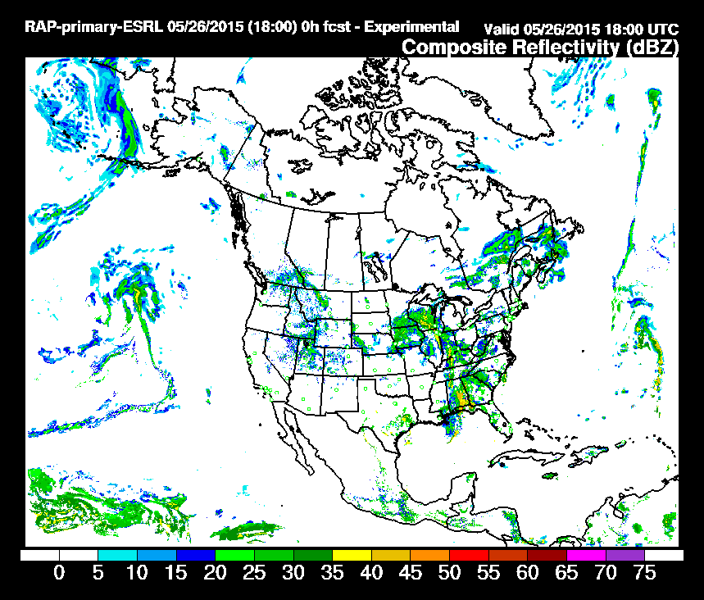
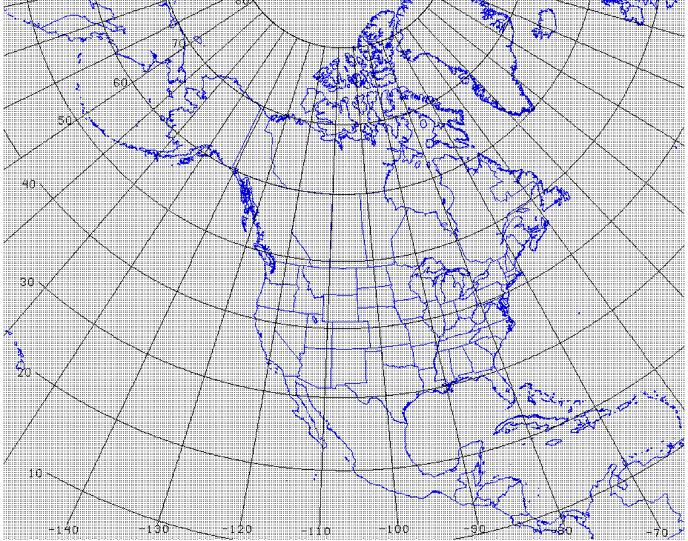
Initialization Datasets
NAM on NCEP Grid 221 (~32-km North American domain)
  GFS on 0.5° grid
  13-km RAP data on North American domain
  3-km HRRR data for select cases
NCEP Grid 221
Notes:
Currently, all cases are initial and boundary conditions are derived from NAM on grid 221, a 32-km North American domain. In addition, to providing NAM IC/BCs, we also provide GFS data on a 0.5 deg grid. As we look to the future, MMET will soon provide the 13-km RAP on a North American domain for IC/BCs. The addition of the RAP provides the user community with a higher-resolution model that includes the GSI system for updating analysis fields hourly as well as ingesting satellite radiance and radar data in the assimilation process.
This year, the MMET team is also working to implement GSI in the testing framework. The necessary files to run GSI (e.g., conventional and satellite/radiance obs) will be included in the data repository.

Slide 9
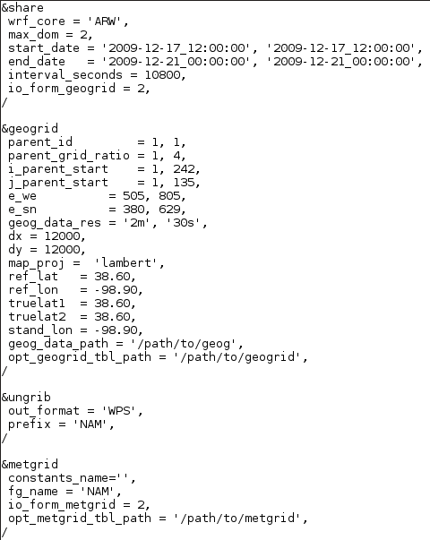
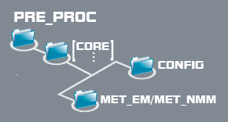
Pre-processing
namelist.wps and namelist.nps
met_em* files and met_nmb* files
Notes:
MMET provides the necessary files for running WPS and NPS (NEMS-NMMB pre-processor). In addition, we make the met_em* and met_nmb files available; this allows users who want to use our same domain set-up the ability to “skip” the WPS/NPS portion and start with running real and wrf.

Slide 10
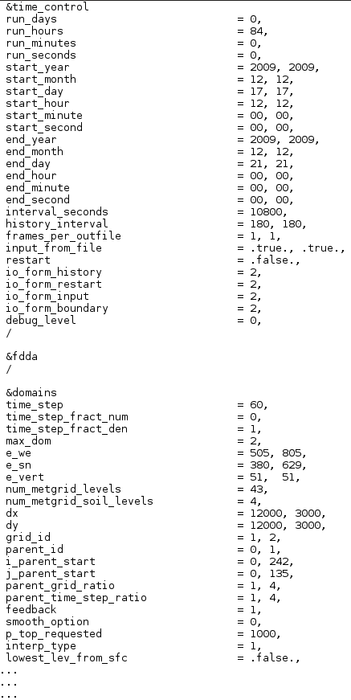
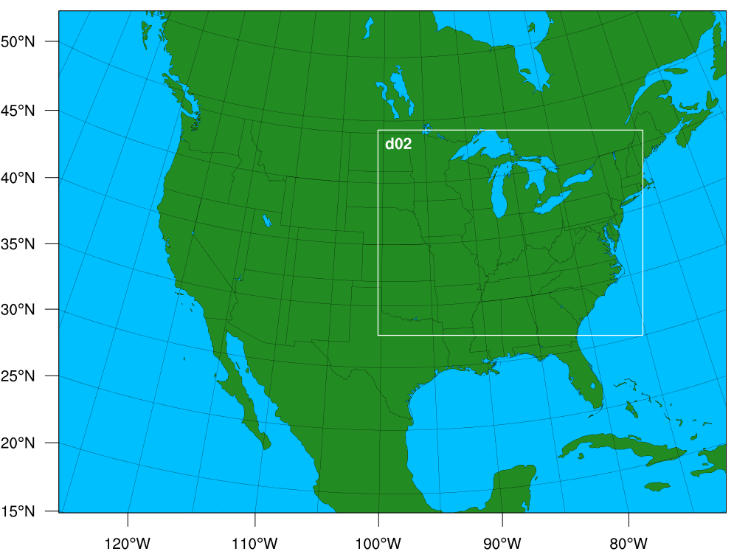
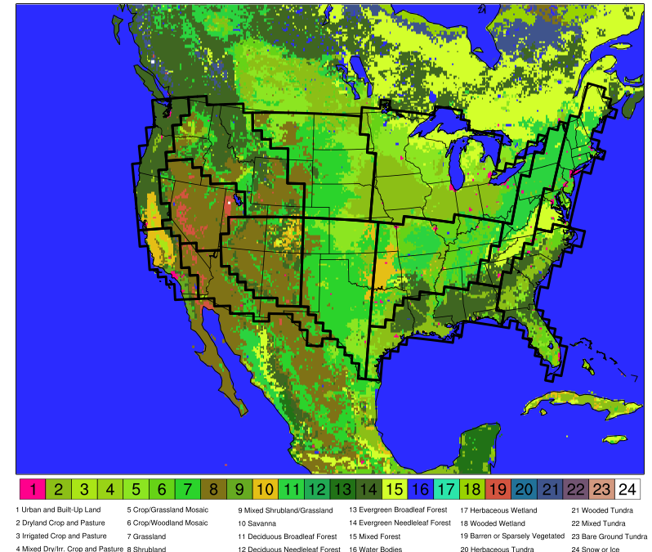
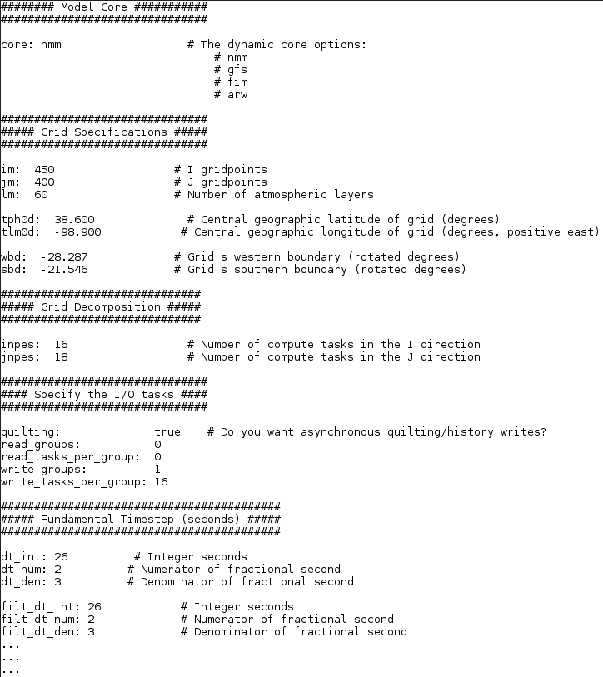
Model
WRF-ARW namelist
Model domain
Model domain
Domain: 12-km CONUS grid with 3-km nest over area of interest
namelist.input and configure_file
NMMB configure file
20120628 12 UTC – derecho case
Notes:
In previous years, all baselines have been run on a 15-km CONUS grid. This year we are transitioning to a 12-km CONUS grid with a 3-km nest, when appropriate, over the area of interest. Show example from derecho case.
The namelist.input and configure_files are provided with the settings used to run the operational baselines.

Slide 11
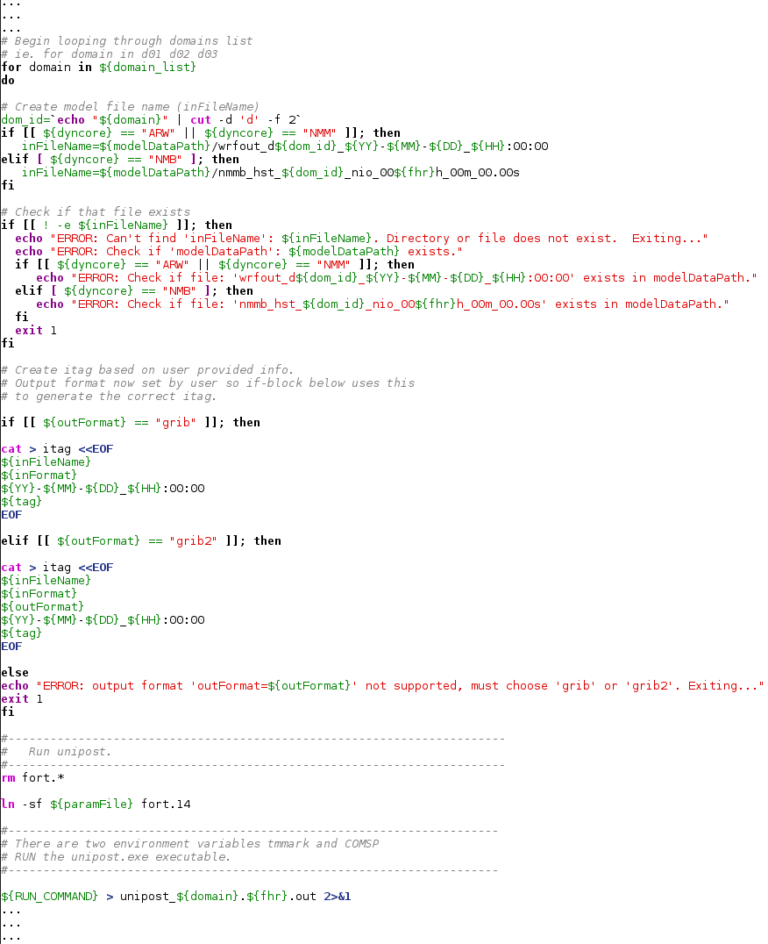
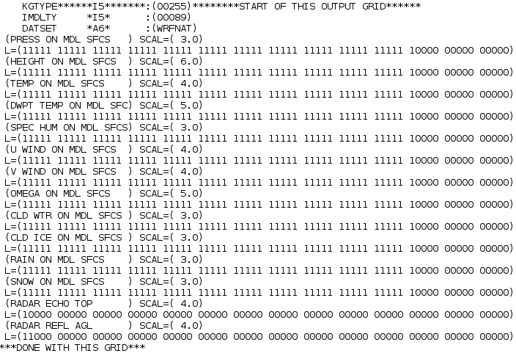
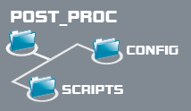
Post-processing
For more information on the Unified Post Processor (UPP): http://www.dtcenter.org/upp/users/
run_unipost script
wrf_cntrl.parm and nmb_cntrl.parm
Notes:
To post-process our model output (netcdf/binary → grib1), we use the unified post-processor. An example run script for UPP is provided in the data repository (example on slide). To get more information on downloading, compiling, and running UPP, the web address is provided above. Examples of parameter files on what variables and levels to output are provided.

Slide 12

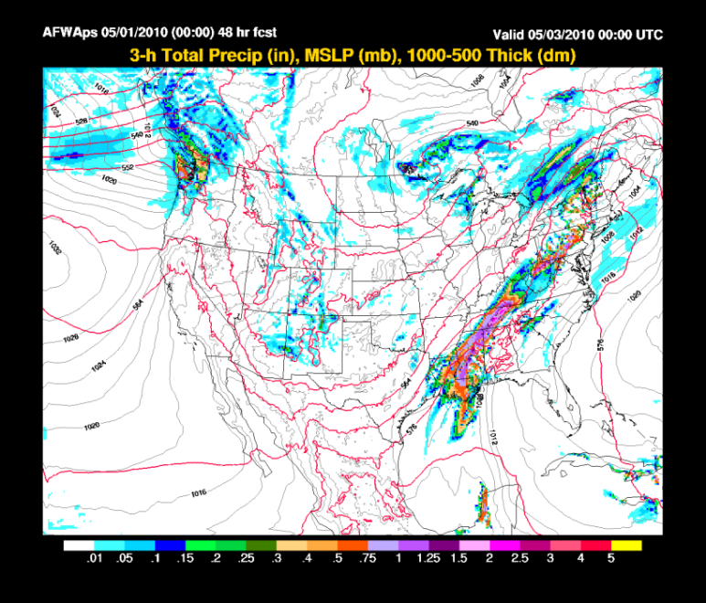
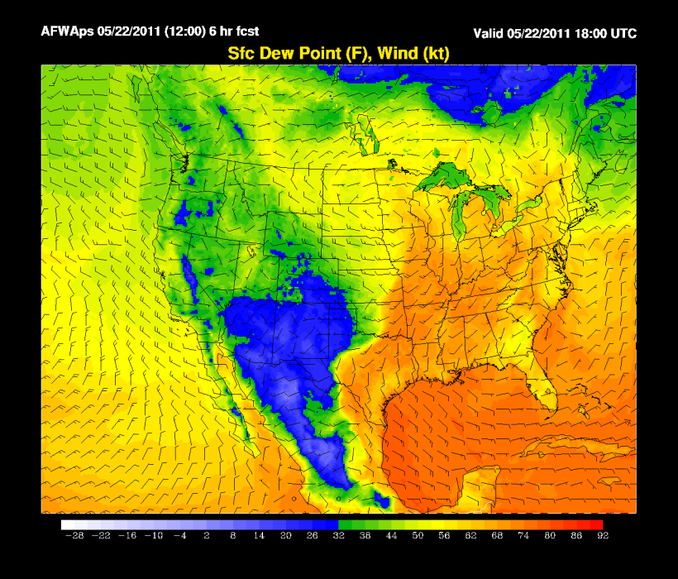
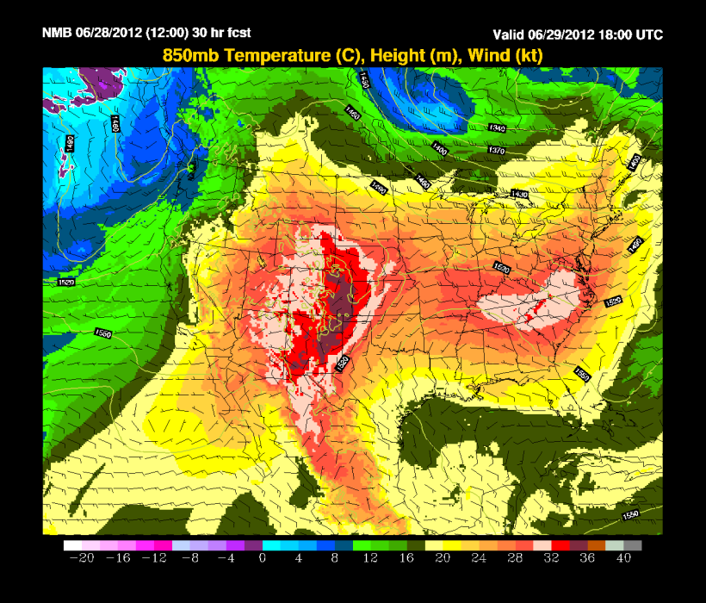
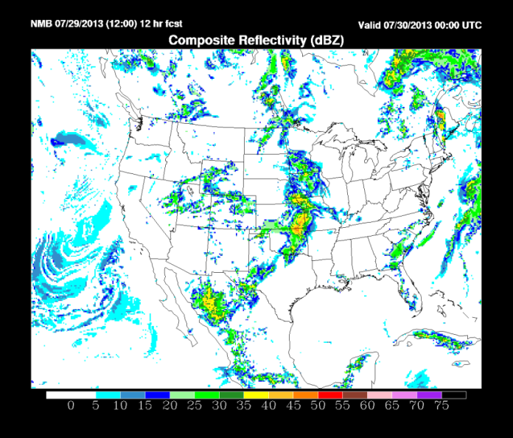
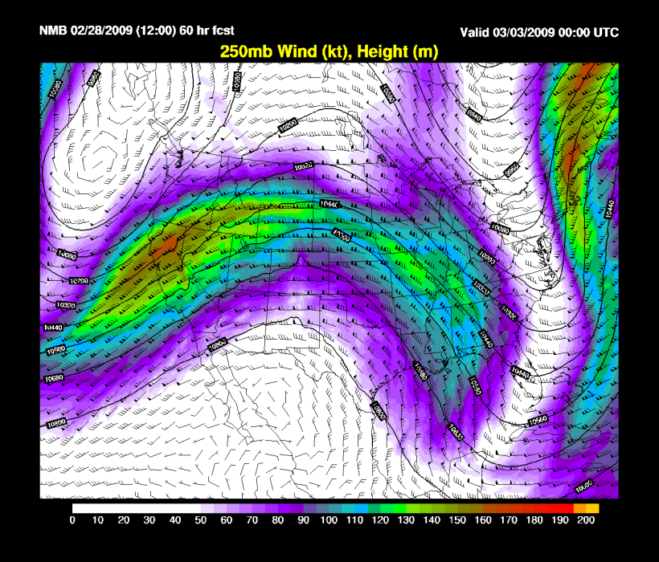
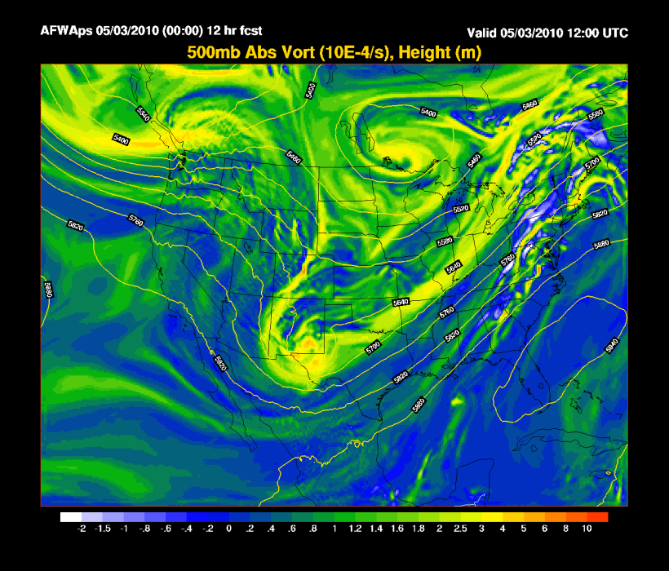
Graphics
NCL scripts and plots for a number of variables:
  Surface and upper air fields (e.g., temperature, wind, and moisture fields)
  Accumulated precipitation, composite reflectivity, CAPE, vorticity, etc.
Notes:
Once the model output is post-processed, NCL is run to generate a large number of plots to visualize standard surface and upper-air fields as well as a number of other fields such as apcp, comp ref, vorticity, etc. Not only does MMET provide all the graphics of model output, but the scripts used to generate the graphics are also available for users.

Slide 13
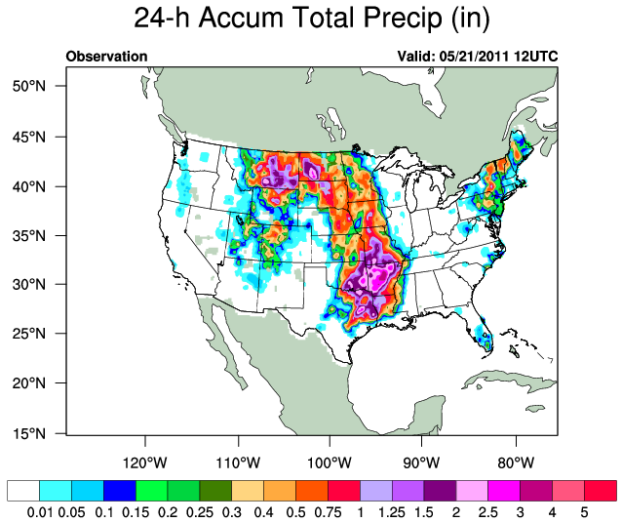
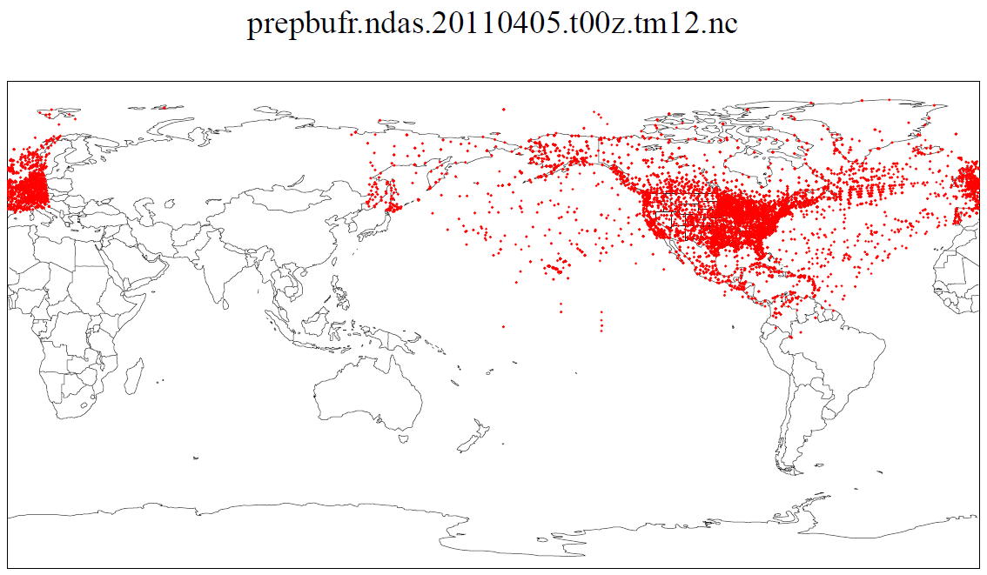
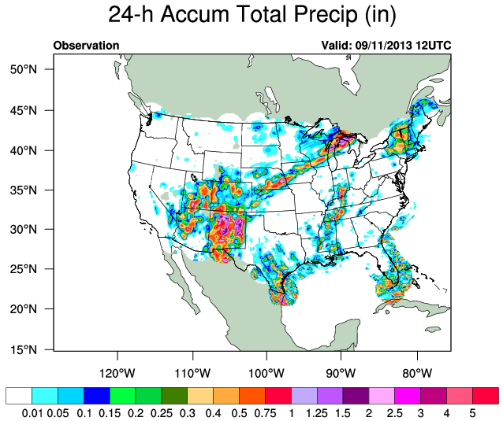
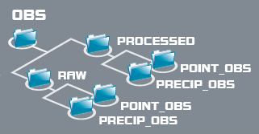
Observation Datasets
Raw and processed North American Data Assimilation System (NDAS) prepbufr files for point observations
NCL scripts and plots for accumulated observed precipitation
Raw and processed observations (regridded and in 3- and 24-h accumulations)
  Climate Prediction Center Unified Gauge-Based Analysis (CPC)
  Stage II
  Stage IV (currently only available for the 20110213-16 atmospheric river case)
CPC
Stage II
Notes:
Native resolutions on precip observations?
Since verification is such a large component of what we provide, observation datasets are obviously a large component. Both point obs (METAR, RAOB…) and gridded precipitation analyses are provided. Raw vs. processed; we have access to both types. NDAS files are used for point obs and are in prepbufr format. MET has a tool which converts prepbufr format to an easily-usable netcdf format. Scripts and plots available for observed precip. Currently, several gridded precip datasets are available – CPC (24-h precip data, used in come older cases), Stage II data (3-hr and some 24-hr precip for more recent cases), and Stage IV for one of our atmospheric river cases.

Slide 14
Potential Cases to consider
Recent hourly HRRR datasets added to MMET focused on snow bands
  00-18 UTC 26 Nov 2014: Northeast US
  18 UTC 9 Dec 2014 – 12 UTC 10 Dec 2014: Northeast US
  06 UTC 26 Jan 2015 – 06 UTC 27 Jan 2015: Northeast US
  00-17 UTC 5 Jan 2015 – Midwest
  06-21 UTC 22 Mar 2015: Midwest
Notes:
Collaboration with SOO’s
Phil Schumacher (Sioux Falls, SD)
Marty Baxter (Central Michigan)
Mike Evans (Binghamton, NY)
26 Jan 2015 06 UTC - 27 January 2015 06 UTC
November 26, 2014 00-18 UTC : The band set up in the afternoon into early evening. I'm thinking that runs starting at 00z, 06z, 12z and 18z on the 26th would be interesting.
December 10, 2014: The band set up during the early morning. I'm thinking that runs starting at 18z on the 9th, 00z, 06z and 12z on the 10th would be what we want.
March 22-23, 2015 - This was an much more narrow and intense band that extended from northeast South Dakota through southern Minnesota (gave MSP 5"), and far southern Wisconsin Maximum amounts were 10"+ in parts of southeast MN. This band was not as well forecast days in advance but I recall that there was evidence of banding at least 24 h out in the NMM and/or WRF ARW as well as in a couple of the larger scale models. A window to get HRRR runs would be 06Z 22 March - 21Z 22 March
January 5, 2015 - this was a clipper type system so a bit broader band of snow but very intense snowfall rates. I (Phil) was on mids so I woke up around noon and looked outside and could only see 1/4 mi. That rate lasted for 2 or 3 hours in SiouxFalls. This event was fairly well forecast by the operational models, including HiRes WRF and NMM - all predicted a band at least 48 h out. The location was somewhat uncertain. I believe total snowfall was generally 4-7".You are probably familiar with these sites, but I find them helpful when determining what fields the files contain and other info on the HRRR (namelists, etc.):
http://www.nco.ncep.noaa.gov/pmb/products/hrrr/
http://ruc.noaa.gov/hrrr/

Slide 15
Cases used by SBU
9-10 Dec 2009
26 Dec 2010
7-9 Feb 2013

