Slide 1


Using MODE-TD
John Halley Gotway
NCAR/RAL/JNTP
and
Developmental Testbed Center (DTC)
MET Team:
Tara Jensen, Randy Bullock, Tressa Fowler,
Barbara Brown, Tatiana Burek, and Julie Prestopnik
Notes:
Good morning. My name is John, and I work at NCAR for the Developmental Testbed Center.
I’m going to talk today about some recent work we’ve doing on the Model Evaluation Tools software package.
MET is developed and maintained by a group of us at the DTC. So I’m here representing a much larger group. It’s a good mixture of software engineers, scientists, and statisticians.

Slide 2





Support for MET is provided by
Air Force, NOAA, NSF and NCAR
through the Developmental Testbed Center (DTC)
Notes:
I’d like to acknowledge our sponsors. Without generous support from the Air Force, NOAA, NSF, NCAR, and the DTC, MET would not have been possible.

Slide 3
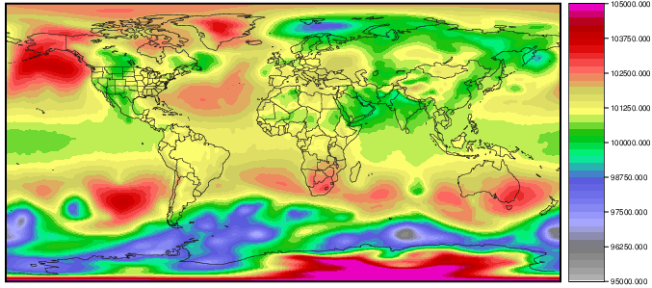
MODE Time-Domain
GFS PRMSL for 20150613 00Z
Intro : Release : Cond : Mask : Thresh : Regrid : MODE-TD
Notes:
Next, I’ll talk about the MODE Time Domain software.
Here’s an image showing mean sea level pressure for GFS from a few weeks ago.
I was interested in picking out and tracking areas of high pressure in this data.
But I wanted to limit it to +/- 50 degrees latitude.
I could either do that by defining a masking polyline or subsetting the data by regridding.
And since I just finished talking about it, I chose the latter.

Slide 4
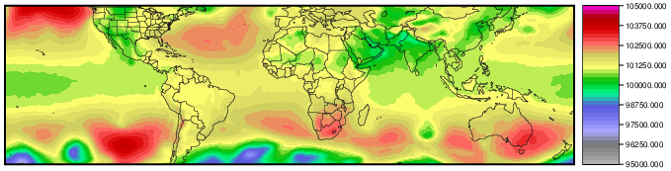
MODE Time-Domain
GFS PRMSL for 20150613 00Z
regrid_data_plane
'latlon 1440 401 -50 -180 0.25 0.25'
Intro : Release : Cond : Mask : Thresh : Regrid : MODE-TD
Notes:
I ran my data through the regrid_data_plane utility, passing in this simple lat/lon grid definition.

Slide 5
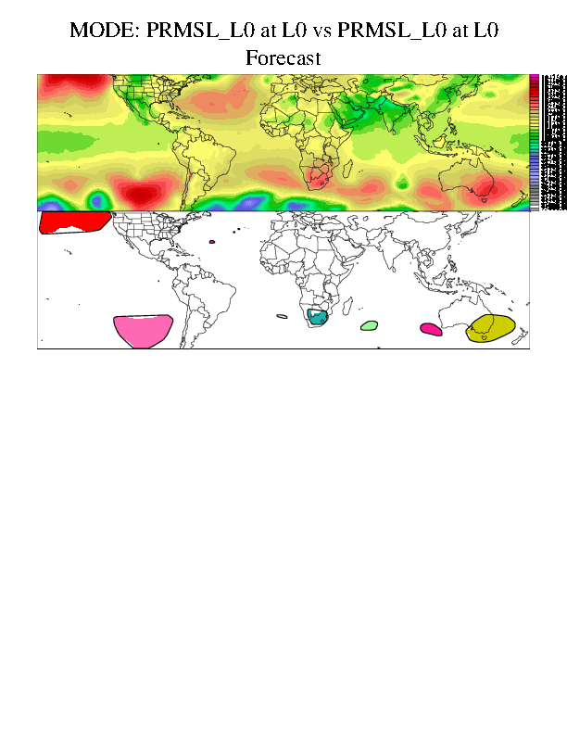

MODE Time-Domain
GFS vs Analysis
f000 to f240 every 6 hours
Objects >= 1025mb
Forecast Analysis
Intro : Release : Cond : Mask : Thresh : Regrid : MODE-TD
Notes:
Next, in order to illustrate what you could get from the current release of MET, I ran this data through the traditional 2 dimensional MODE looking out to the 240 hour forecast every 6 hours.
And I just compared to the GFS analysis at each time, which isn’t a great way of doing verification, but is a great way of demonstrating this functionality.
I defined objects as being greater than 1025mb.
The colors at each time indicate which objects in the forecast field are matched to which objects in the analysis field.
But the colors can change at each time step, because the traditional 2D MODE isn’t using timing information.

Slide 6
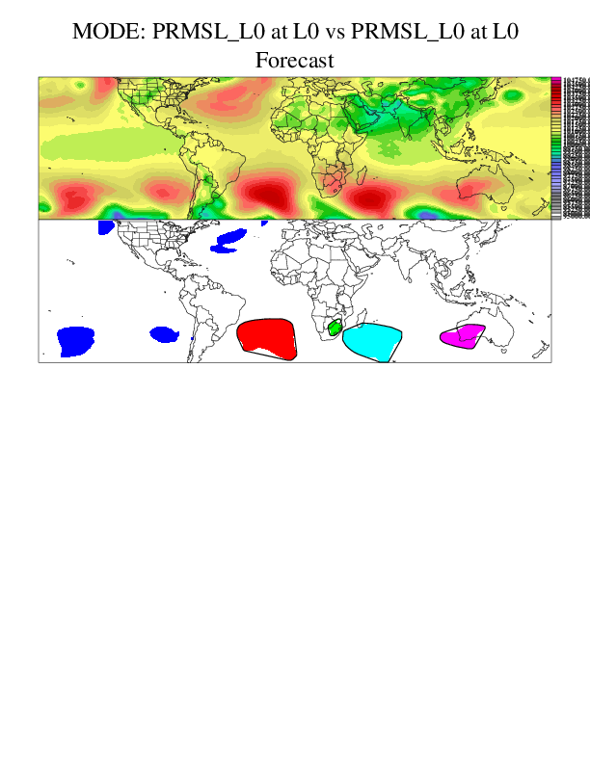
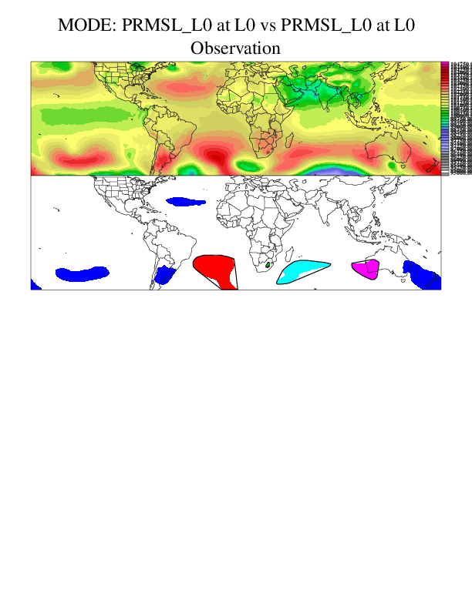
MODE Time-Domain
f240 | Pair 1 | Pair 2 | Pair 3 | Pair 4
Centroid Distance | 4.62 | 10.31 | 10.12 | 11.22
Fcst Area | 13983 | 1097 | 12146 | 5132
Obs Area | 11584 | 133 | 6713 | 4225
Intersection | 10857 | 133 | 5723 | 3610
Forecast Analysis
Intro : Release : Cond : Mask : Thresh : Regrid : MODE-TD
Notes:
Here I’m showing just the 240 hour forecast.
Using the default configuration of MODE yields only matches at this time.
And attributes for each object pair are shown above.
This certainly isn’t an exhaustive list but is meant to give you an idea of the output MODE creates.
We can see things like the distance between the object centroids, the object areas, and their intersection areas.

Slide 7
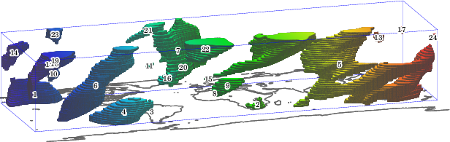
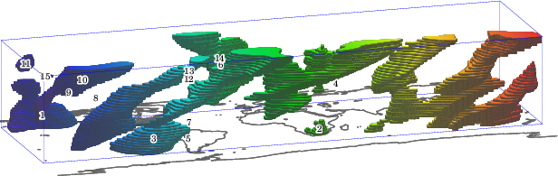
MODE Time-Domain
Forecast
Analysis
Intro : Release : Cond : Mask : Thresh : Regrid : MODE-TD
Notes:
Running this same data through MODE time domain yields a different picture of the data.
It might look to you like the 2D objects have just been stacked on top of each other, like a 3D printer, and basically they have.
Except that MODE-TD also looks 1 time step ahead and 1 time step back when convolving the data and constructing the objects.
Now we can see those areas of high pressure as 3D time-space objects.
The colors here don’t mean anything other than longitude, with blues in the west and reds in the east.
Let’s look at forecast object #3 and analysis object #4 which both live off the west coast of South America.

Slide 8
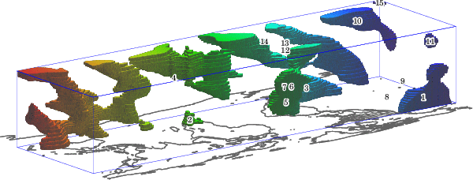
MODE Time-Domain
f000 – f240 | Max Inten | Volume | Centroid(x,y,t) | Velocity
Fcst Object 4 | 103927 | 111493 | 336, 57, 4.19 | 2.85
Analysis Object 3 | 103914 | 113692 | 335, 59, 4.27 | 2.79
Intro : Release : Cond : Mask : Thresh : Regrid : MODE-TD
Notes:
Here’s the type of information we can get from a 3D MODE-TD object.
We can look at the maximum intensity within the object and it’s volume.
It’s centroid is now defined as x and y but also in time.
And we can get it’s velocity by looking at the tilt of the object.
While the majority of the code has been written, we’re still working through the details on exactly what object attributes to dump out and how to organize it.
This work is currently being funded by a climate project within NCAR, so it’s been interesting to apply the technique to some climate datasets.

