Slide 2
Focused on ASNOW field from HRRRx
  Used as the input to the HRRR-TLE probabilities of snow accumulation > 1, 3 or 6 inches in 6 hrs
  Ran through pcp_combine first to create hourly field (it is a run-time total)
  Issues: files prior to 20160216 were missing accum_time so that had to be added
  Data is in meters! So, 0.0127 m = 12.7 mm = 0.5 in
Ran MODE
  Used several configurations:
    conv_rad=5; conv_thresh=0.002 (~0.08”)
    conv_rad=0; conv_thresh=0.0127 (0.5”)
    conv_rad=5; conv_thresh=0.0127 (0.5”)
    conv_rad=5; conv_thresh=0.007 (~0.28”)

Slide 3
Plot HRRR-TLE probability of > x" snow field overlaid with 3 HRRRx members that went into product
  Plotting from HRRRTLE: TSRATE_P5_L1_GLC0(0,:,:) - prob >3.5e-06 (ms-1):probability forecast = prob >0.5 in: probability forecast + MODE output: fcst_obj_id from HRRRx
    Probabilities: green=>0-10%, blue=>10-20%, red=>20-30%, black=>30%

Slide 4
Case #1
20160210 12 UTC
20160210 15 UTC
20160210 18 UTC
20160210 21 UTC
20160211 00 UTC

Slide 5
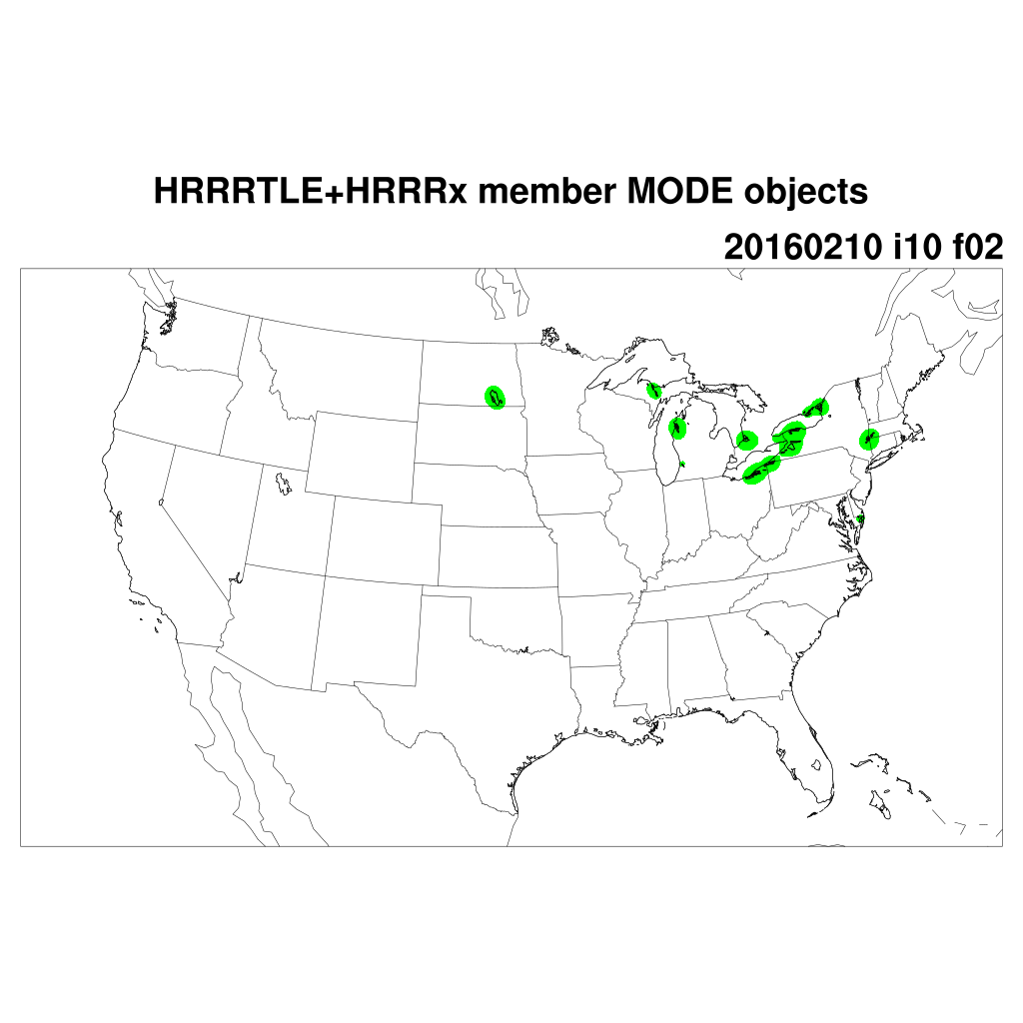
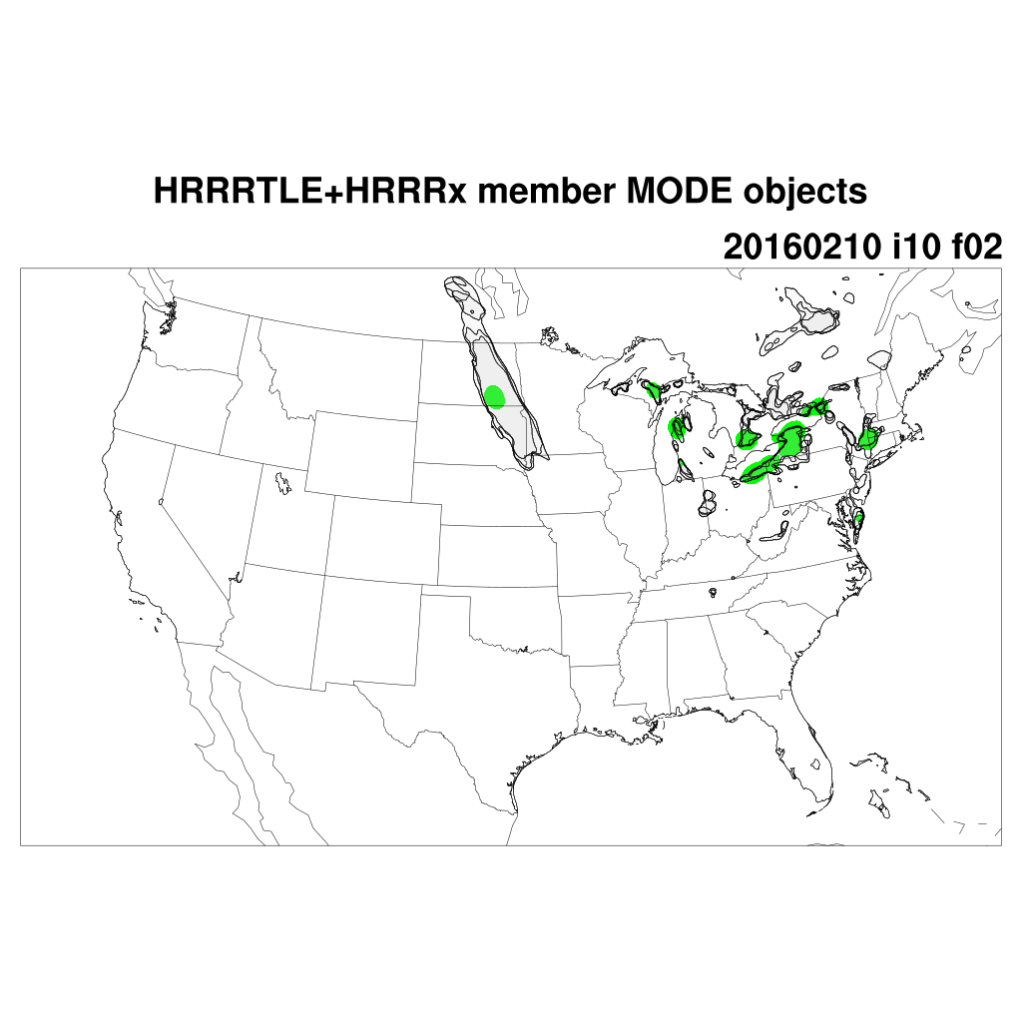
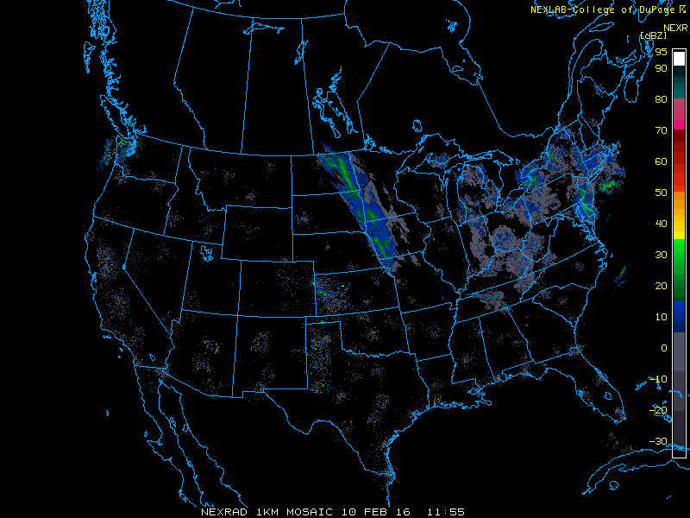
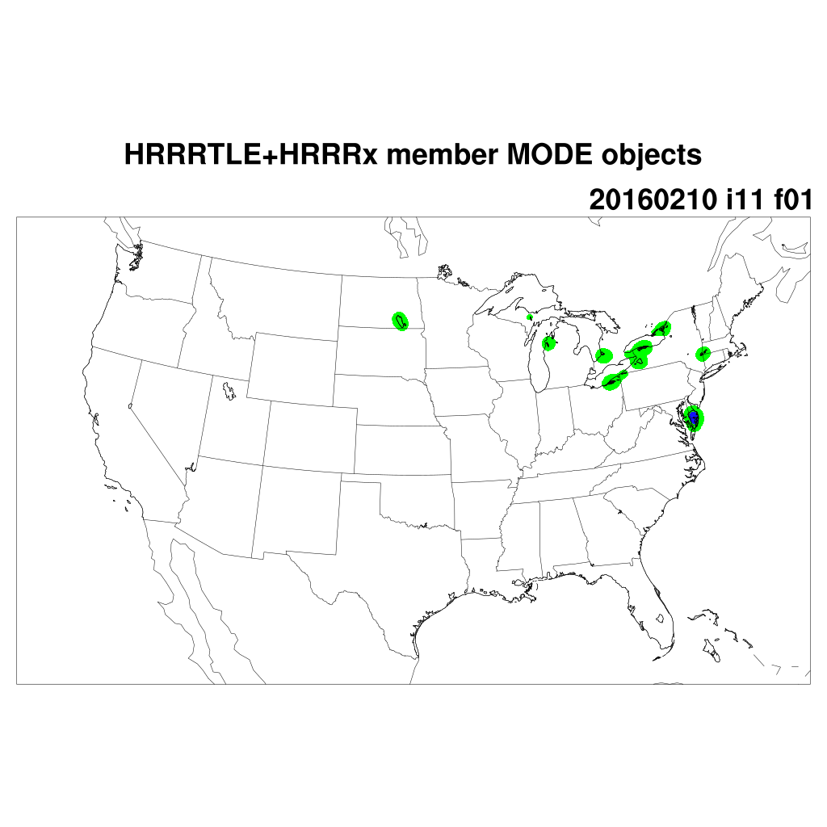
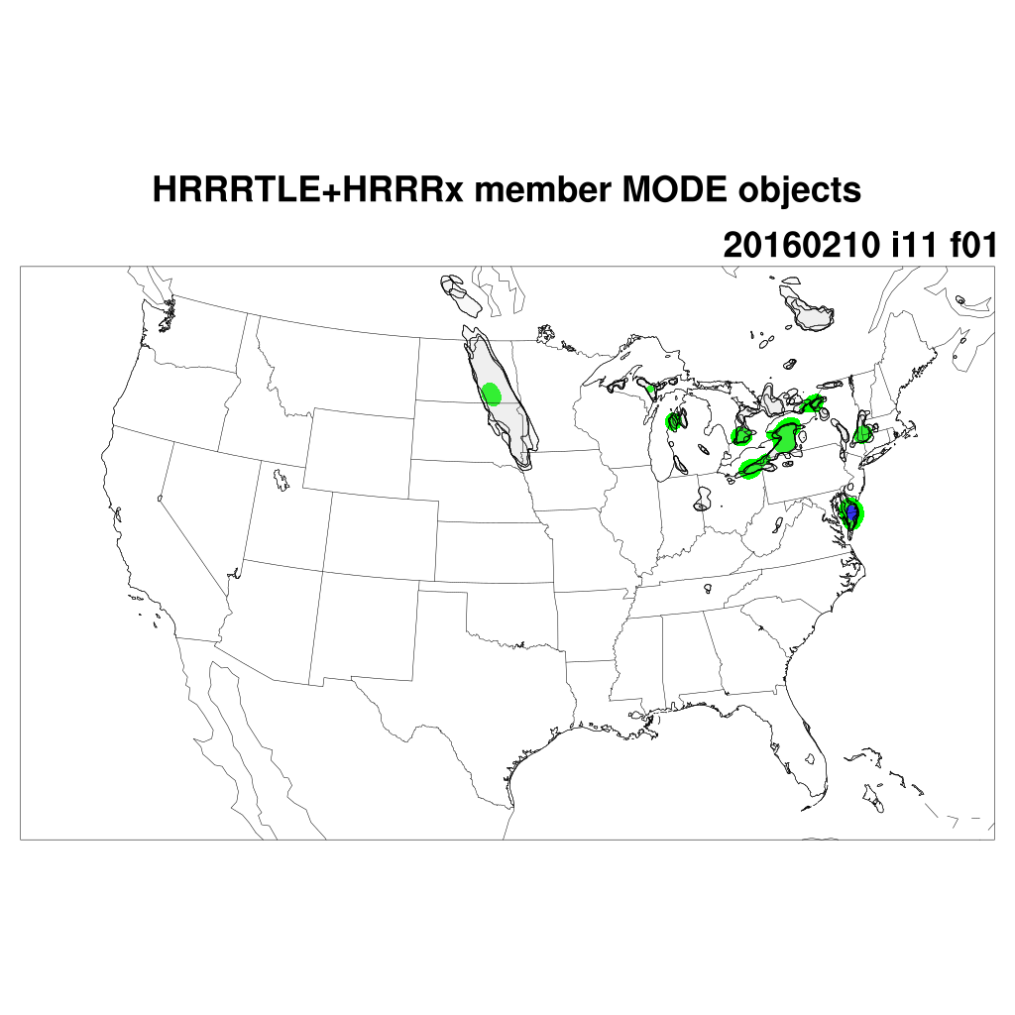
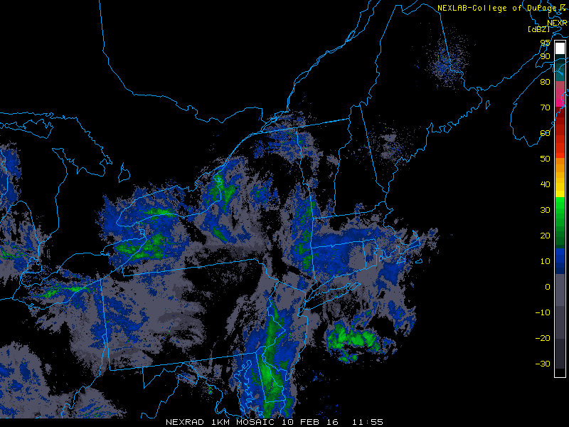
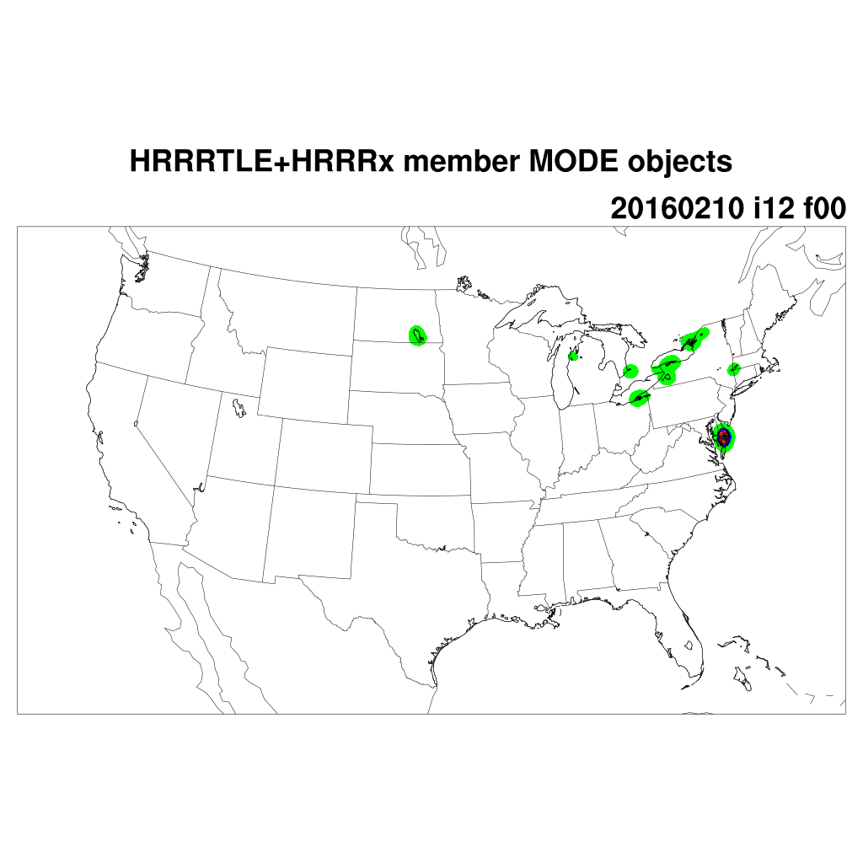
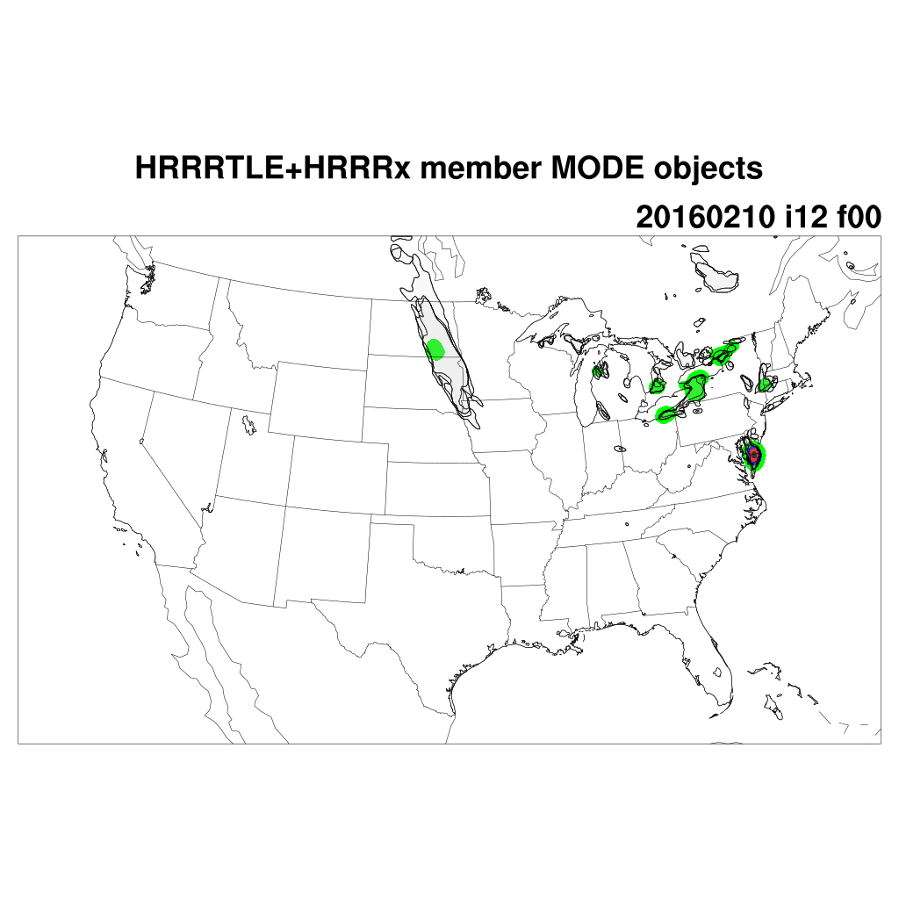
conv_rad=0, conv_thres=0.0127
conv_rad=5, conv_thres=0.002

Slide 6

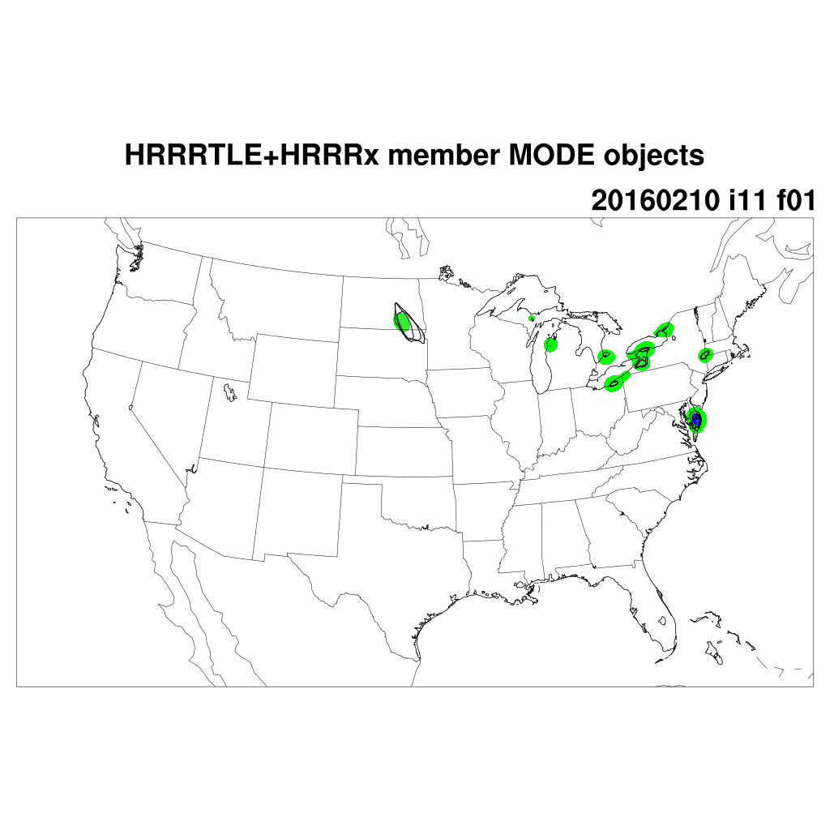
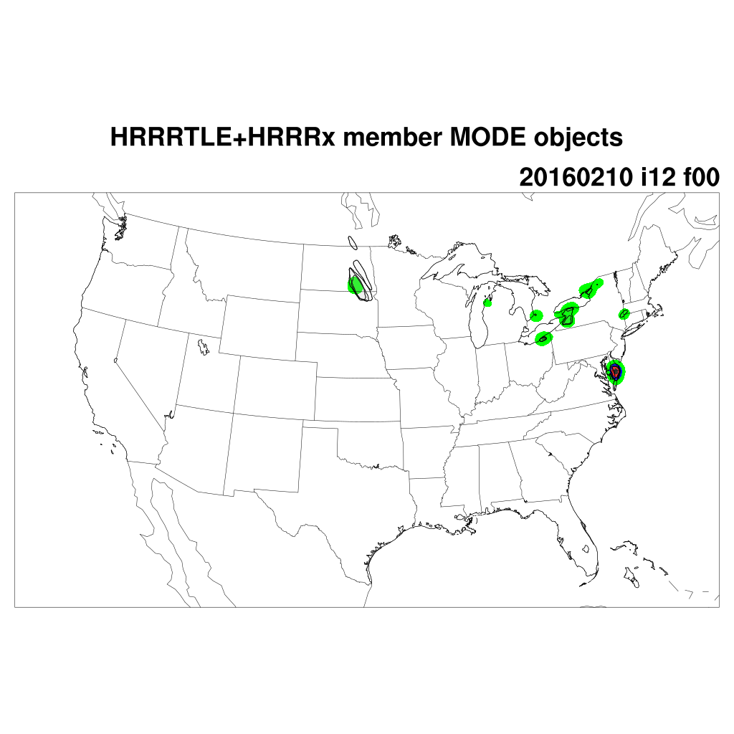
conv_rad=0, conv_thres=0.0127
conv_rad=5, conv_thres=0.007

Slide 7
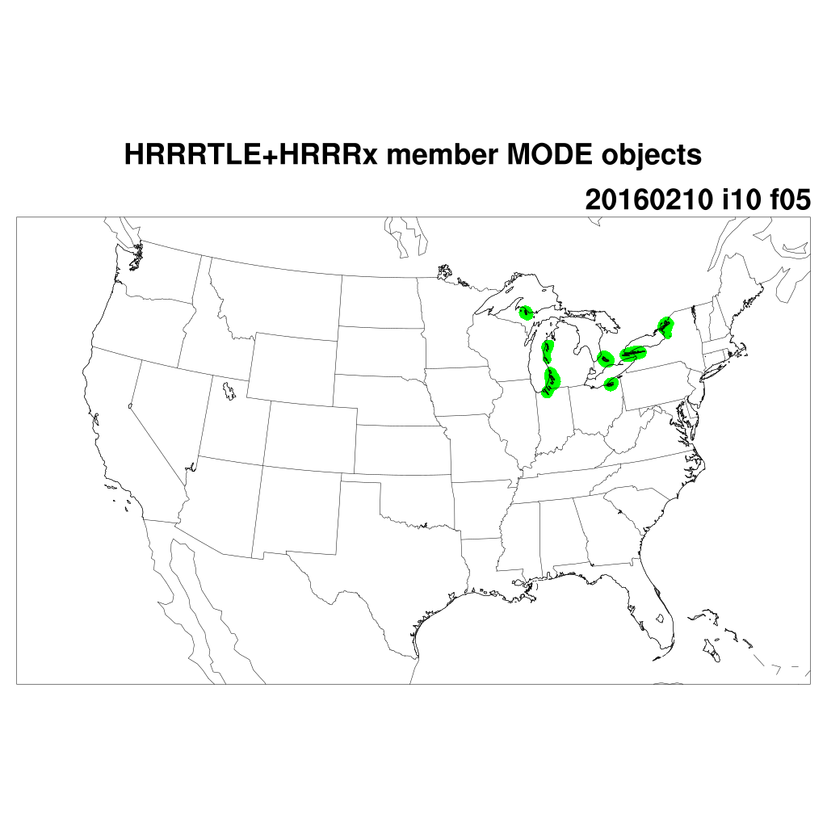
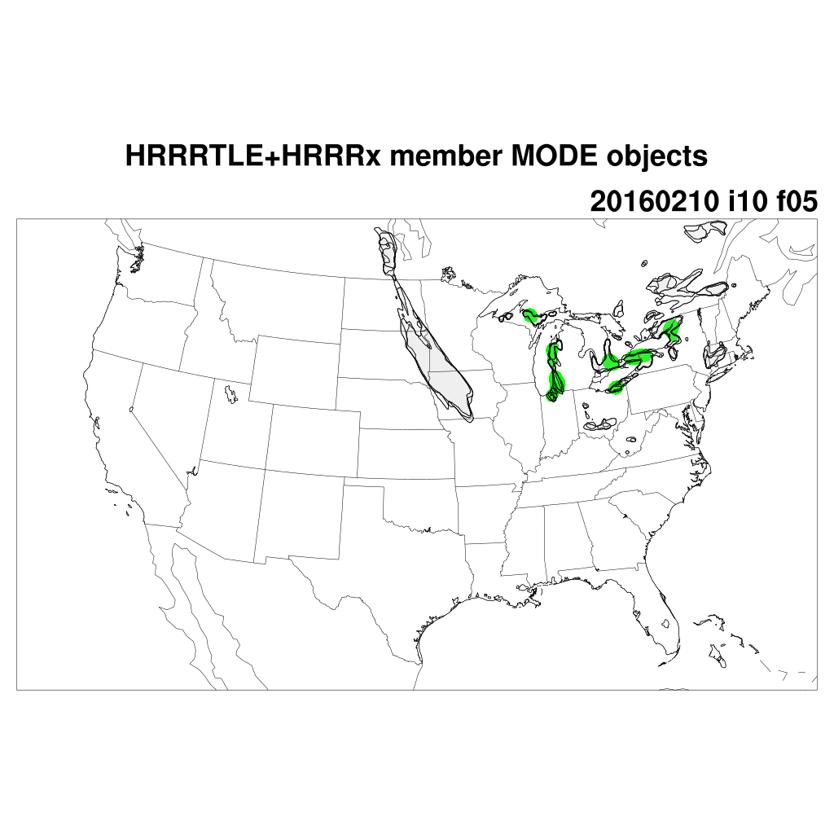
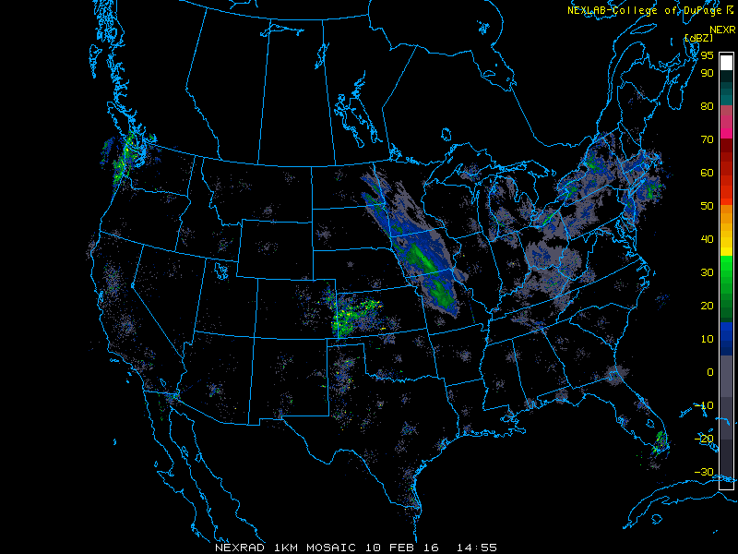
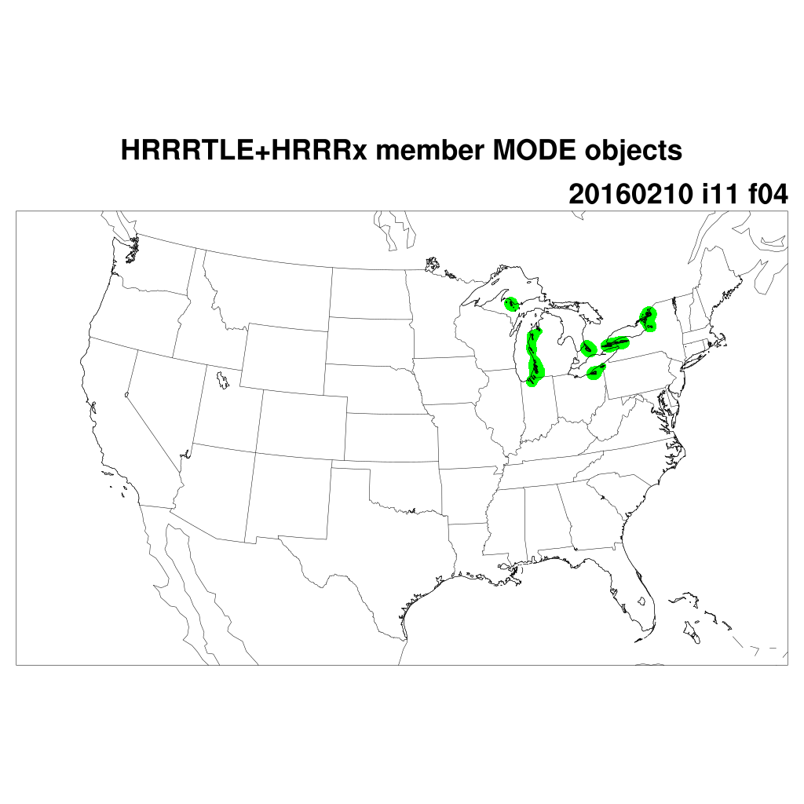
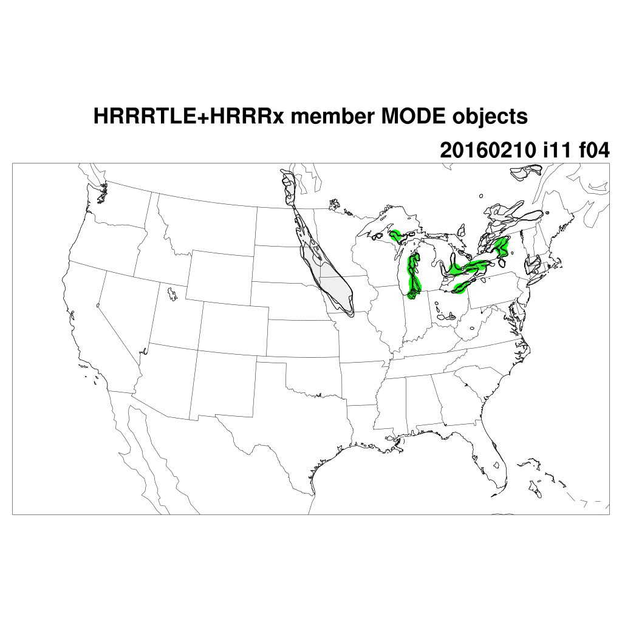
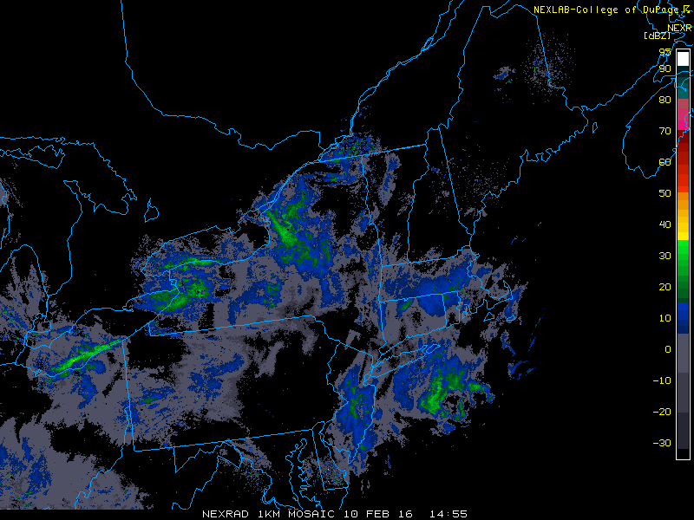

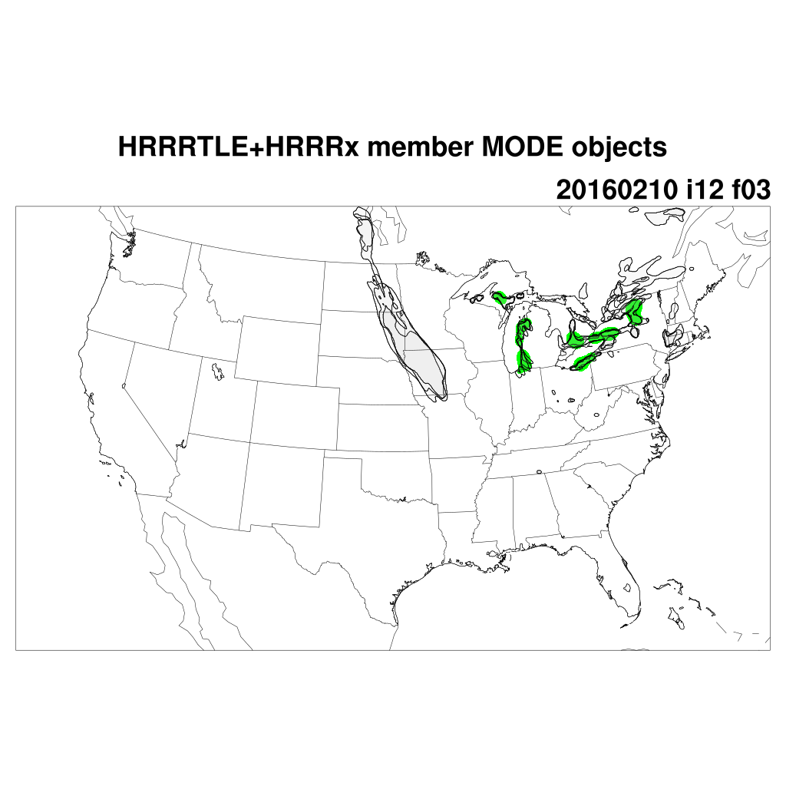
conv_rad=0, conv_thres=0.0127
conv_rad=5, conv_thres=0.002

Slide 8


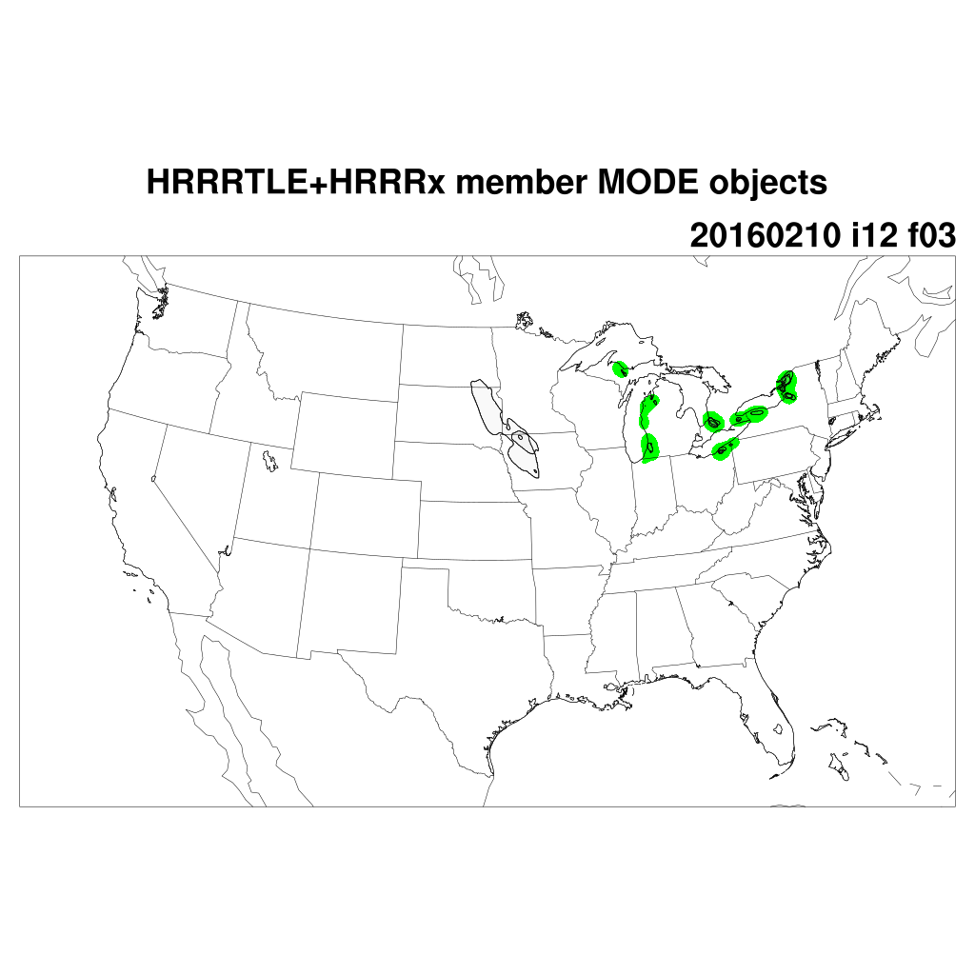
conv_rad=0, conv_thres=0.0127
conv_rad=5, conv_thres=0.007

Slide 9
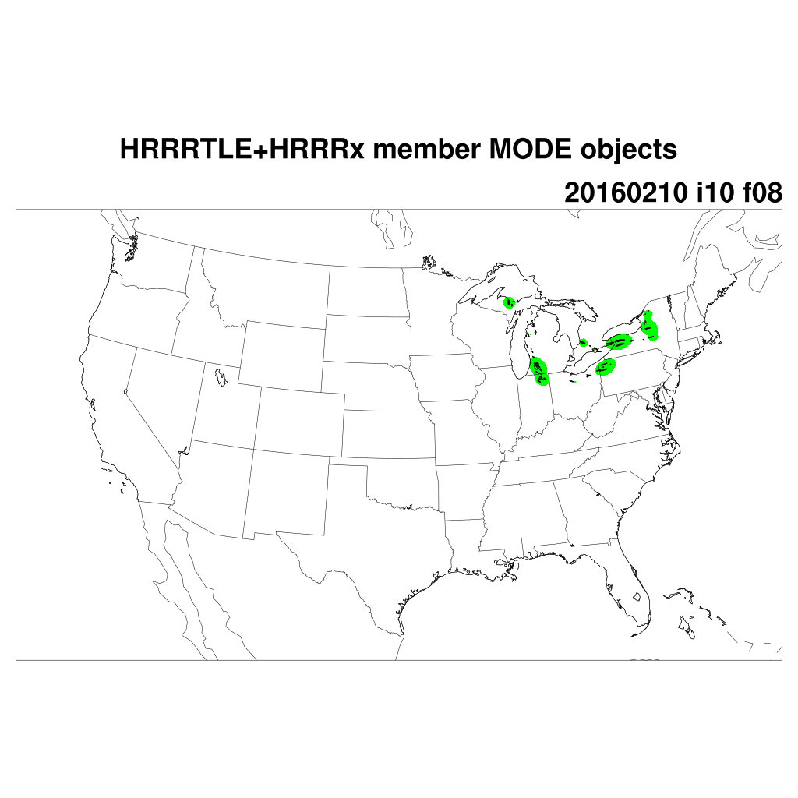
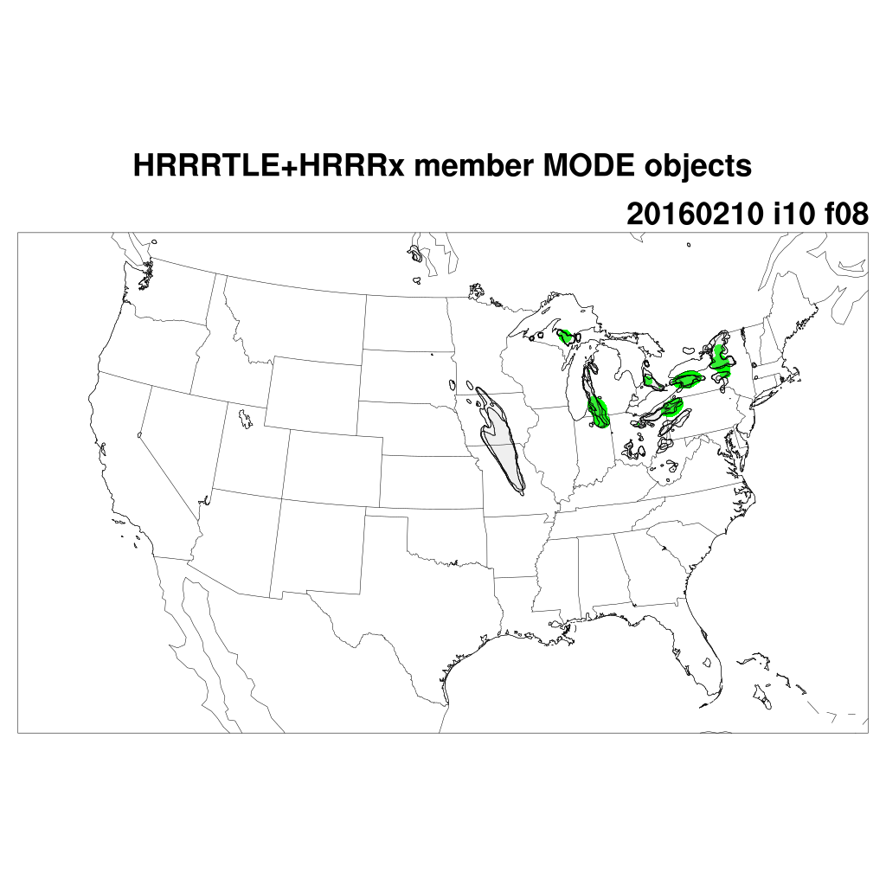
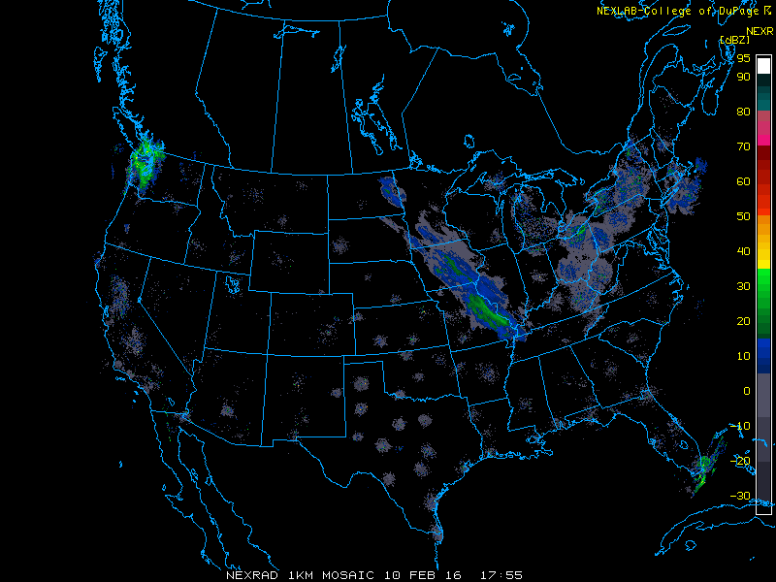

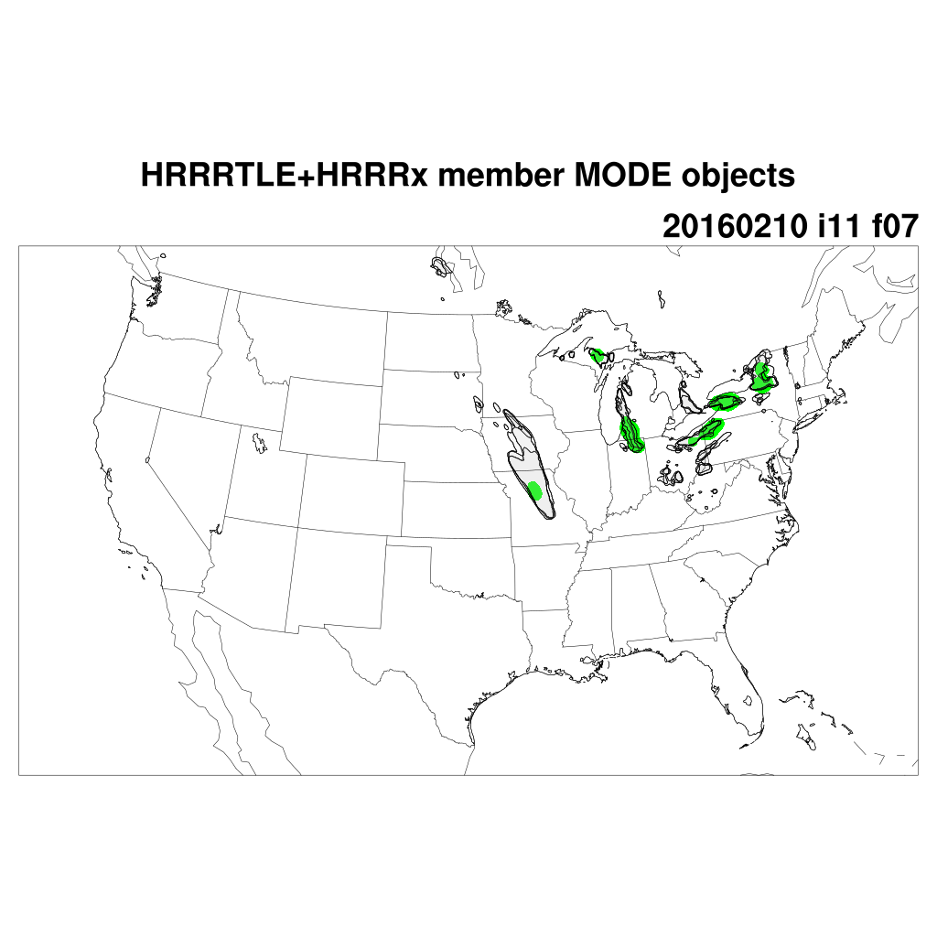
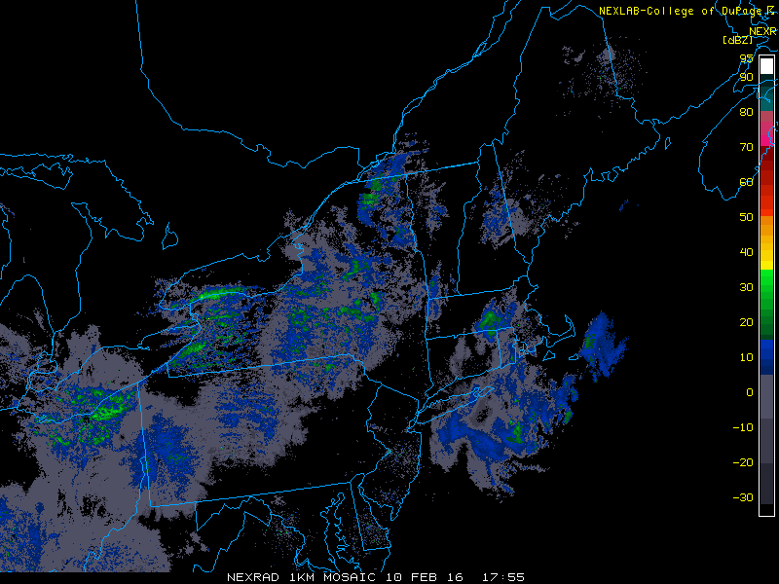
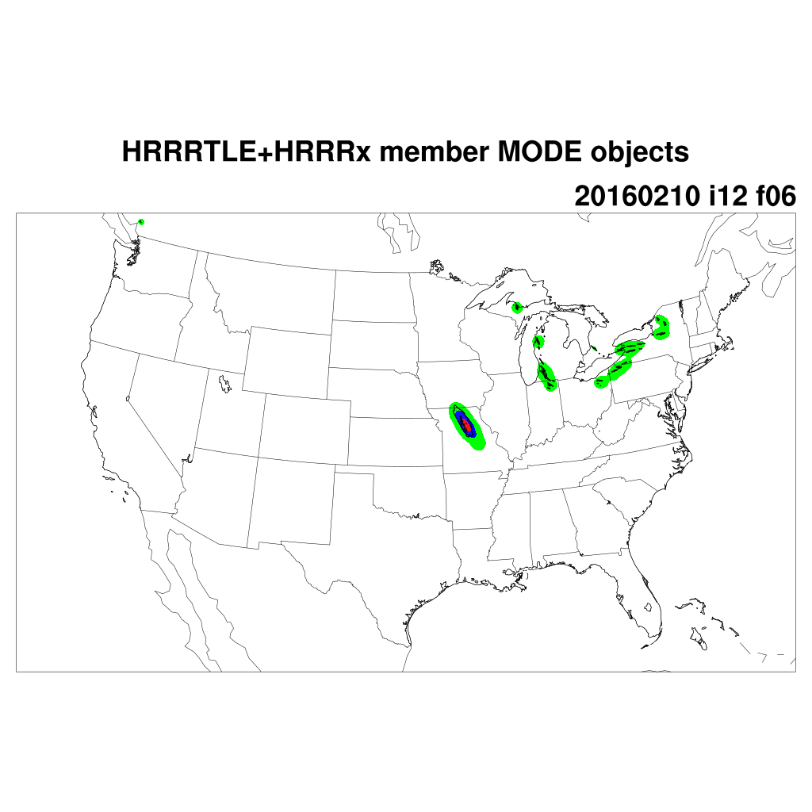
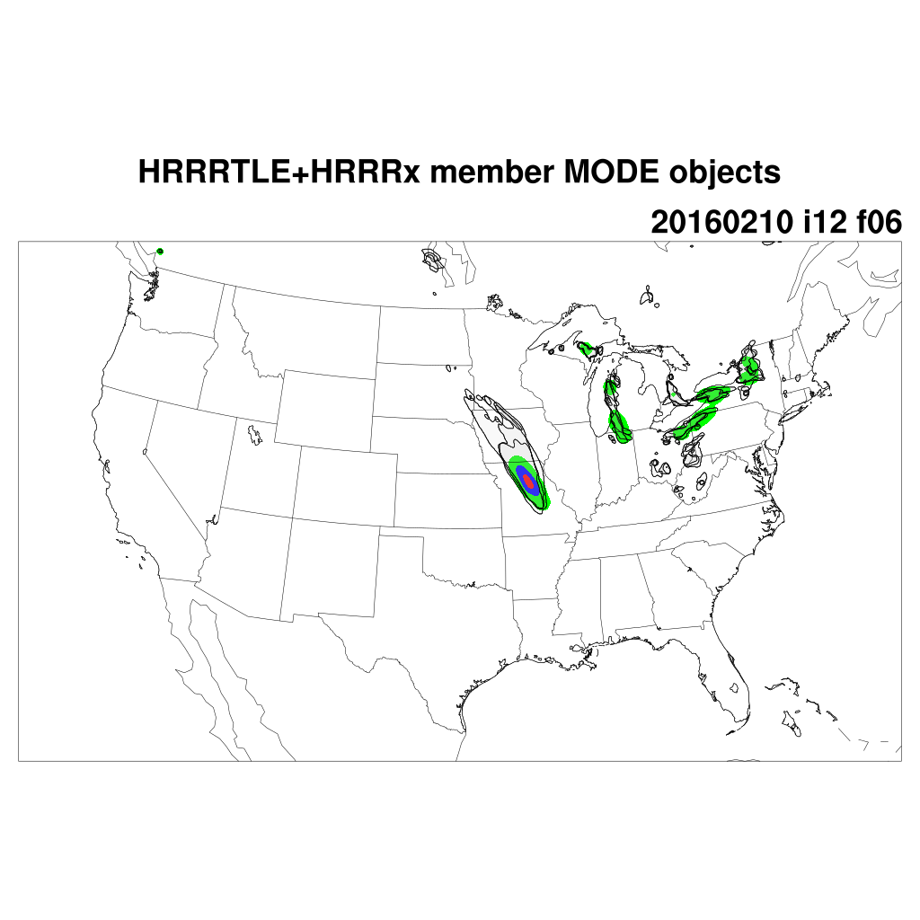
conv_rad=0, conv_thres=0.0127
conv_rad=5, conv_thres=0.002

Slide 10
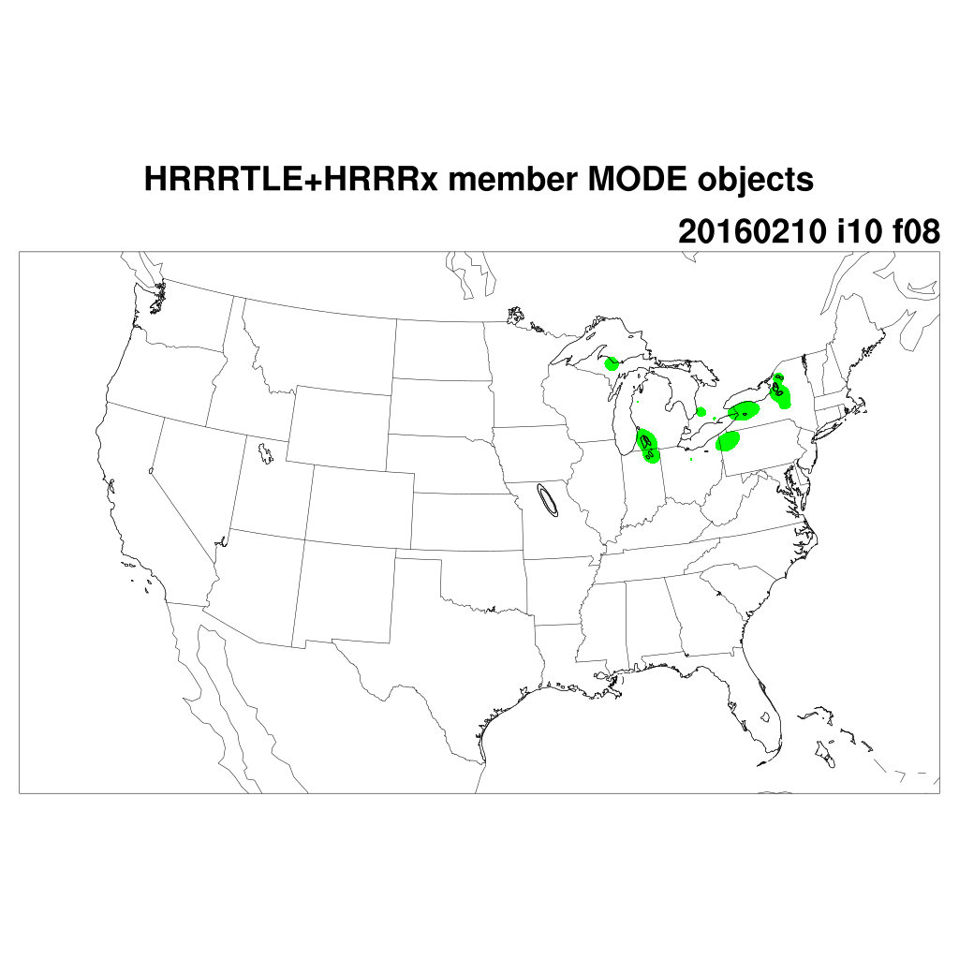
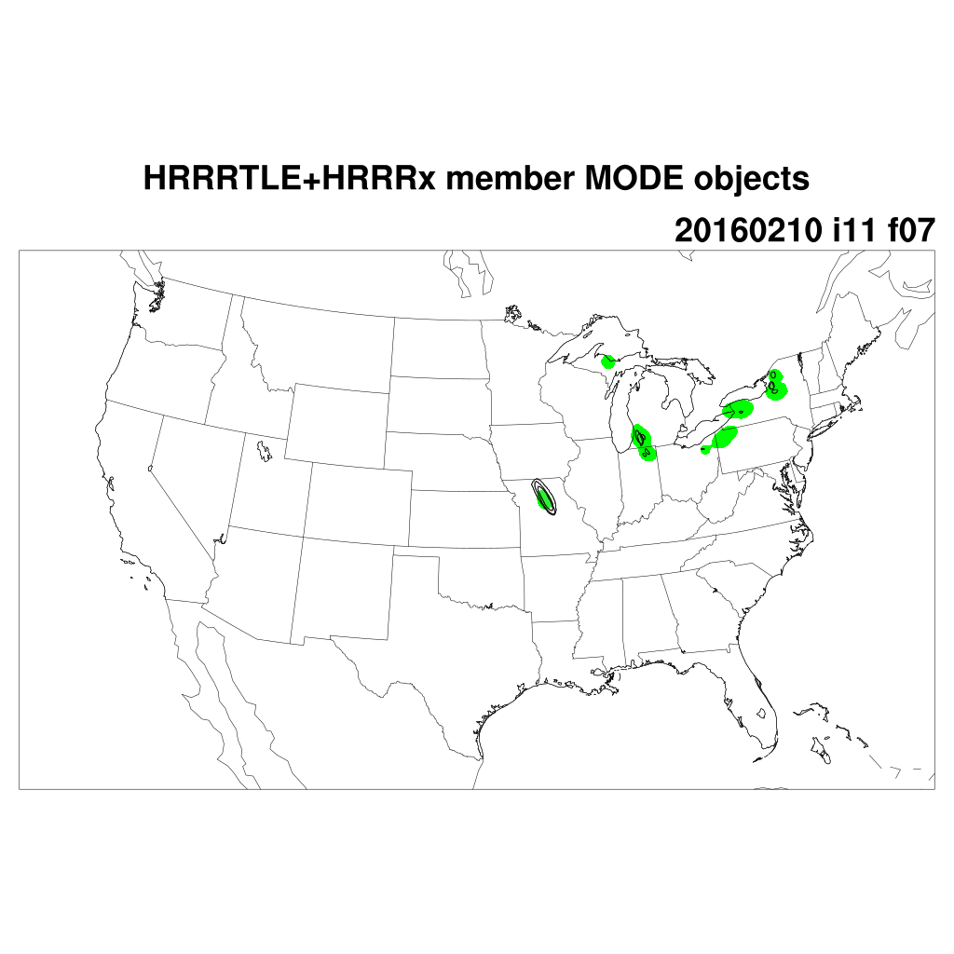
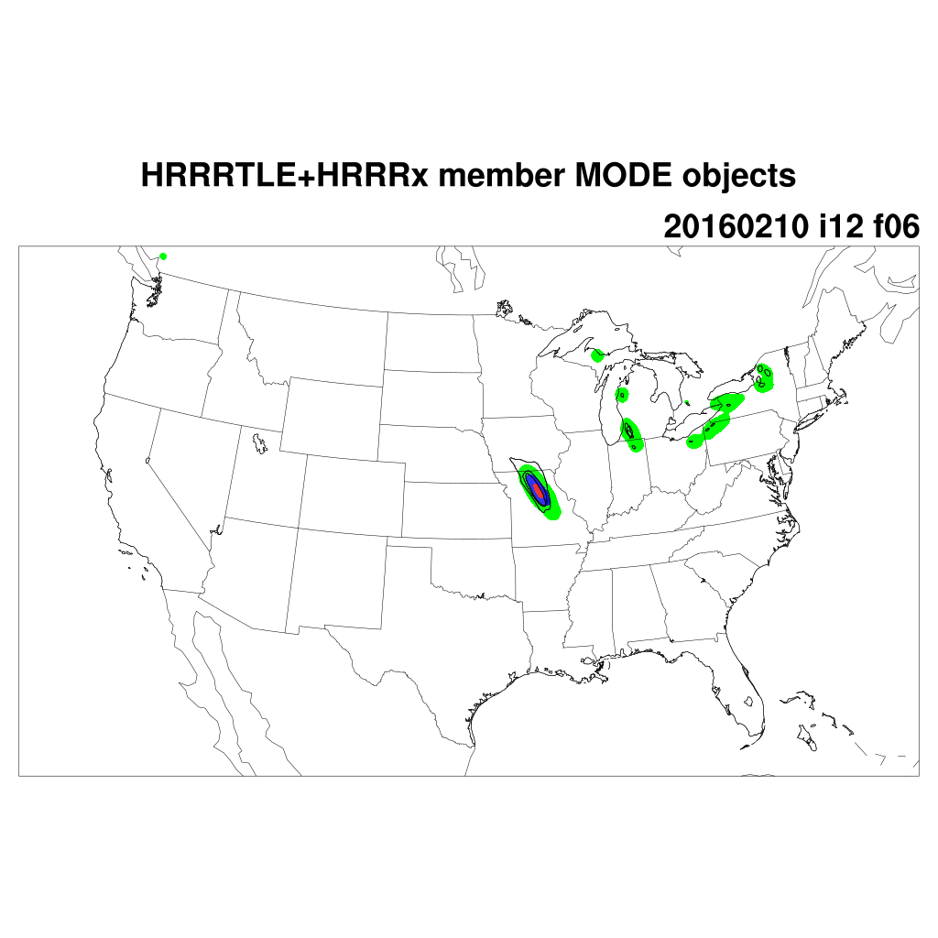
conv_rad=0, conv_thres=0.0127
conv_rad=5, conv_thres=0.007

Slide 11
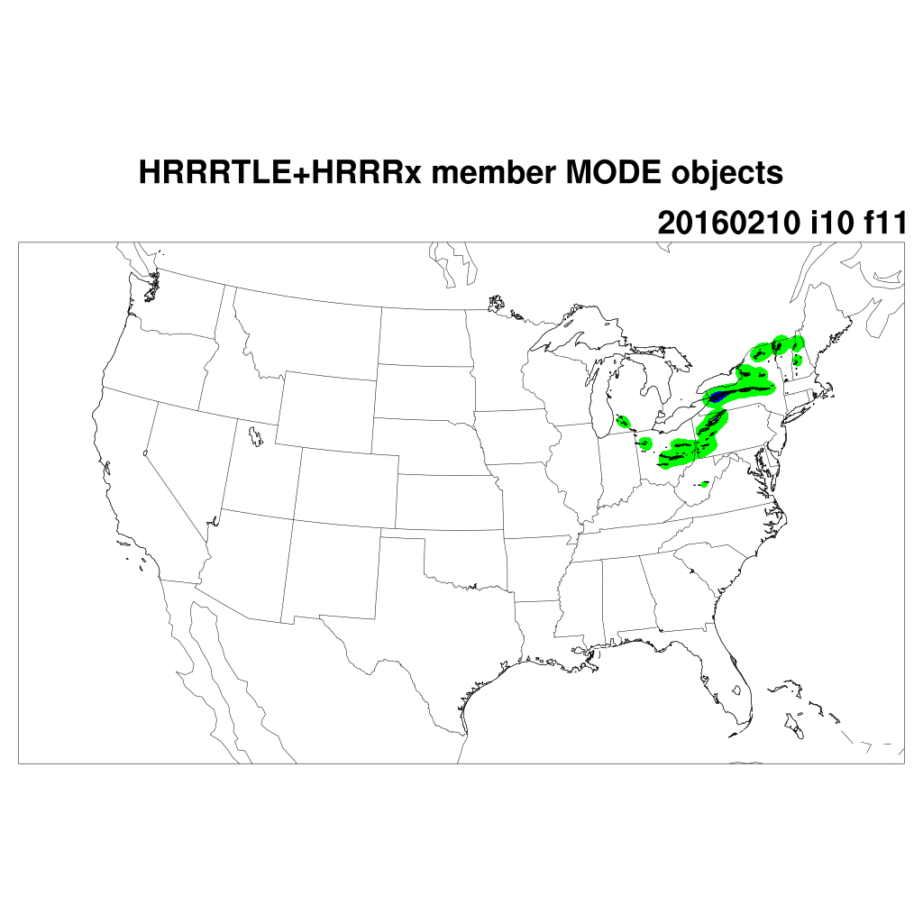
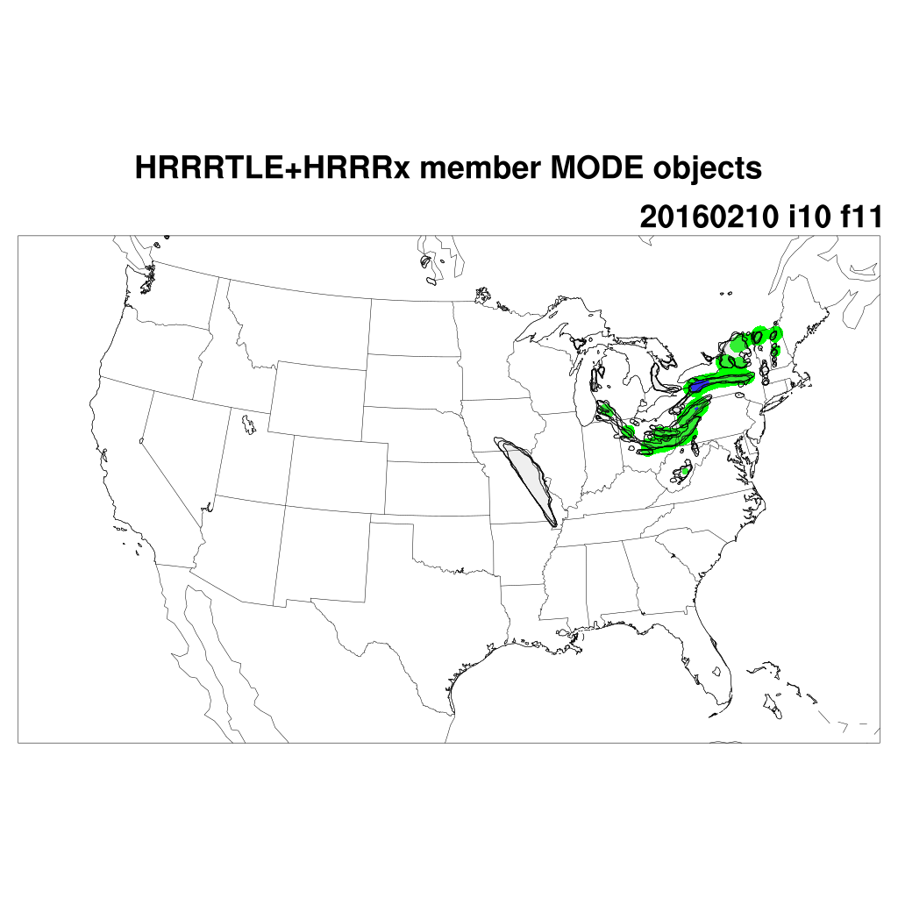
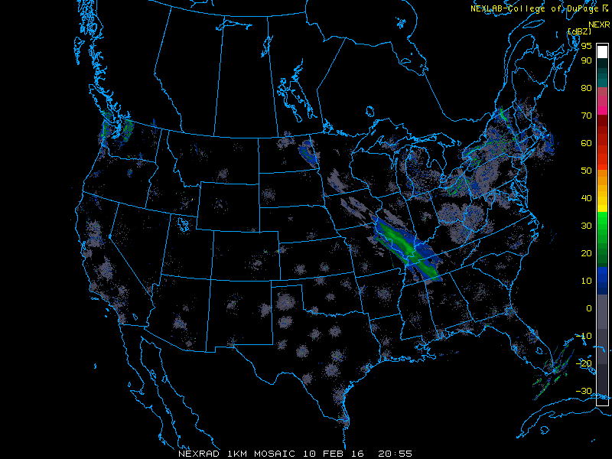
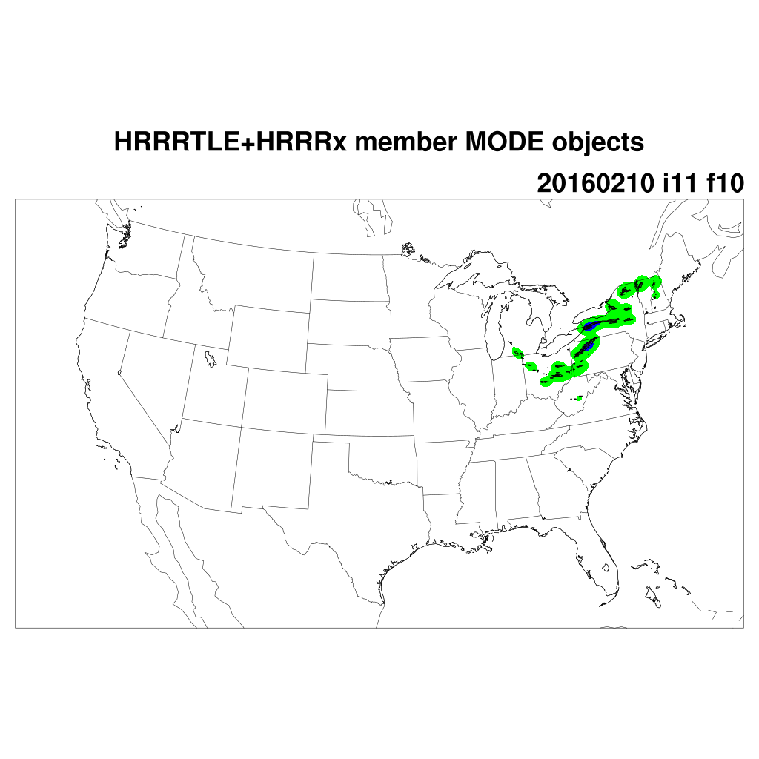

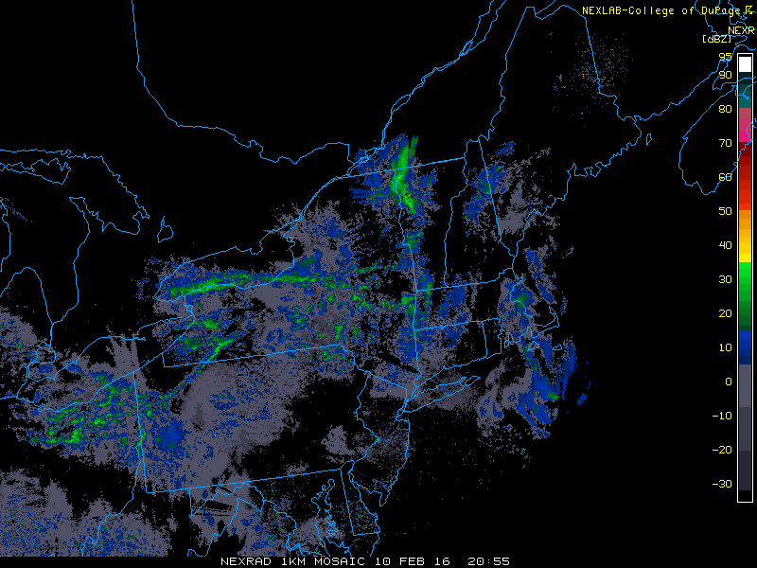


conv_rad=0, conv_thres=0.0127
conv_rad=5, conv_thres=0.002

Slide 12
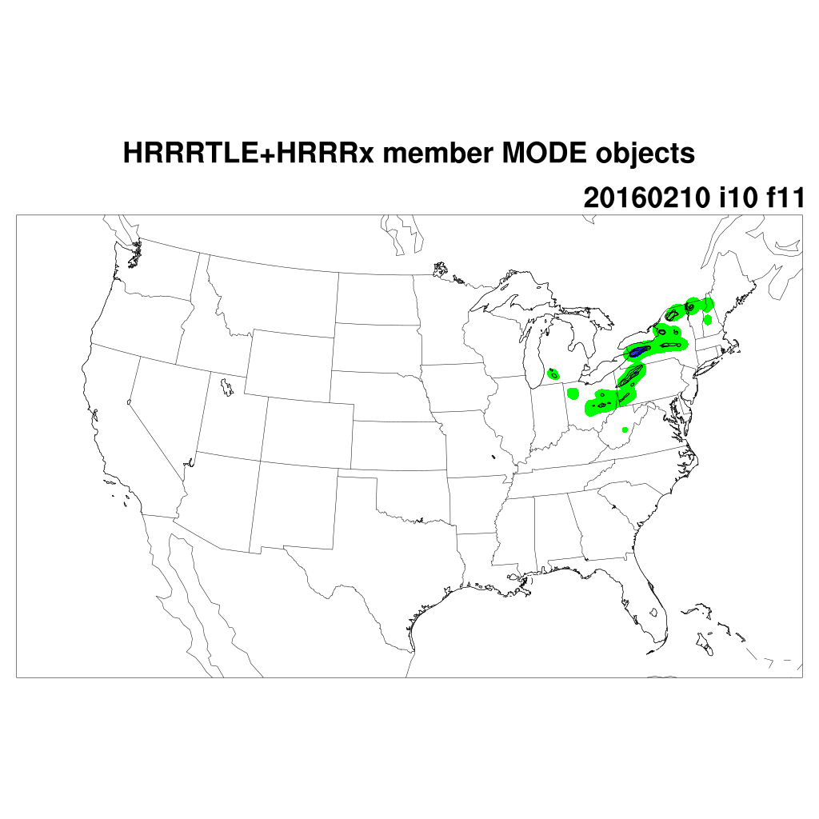

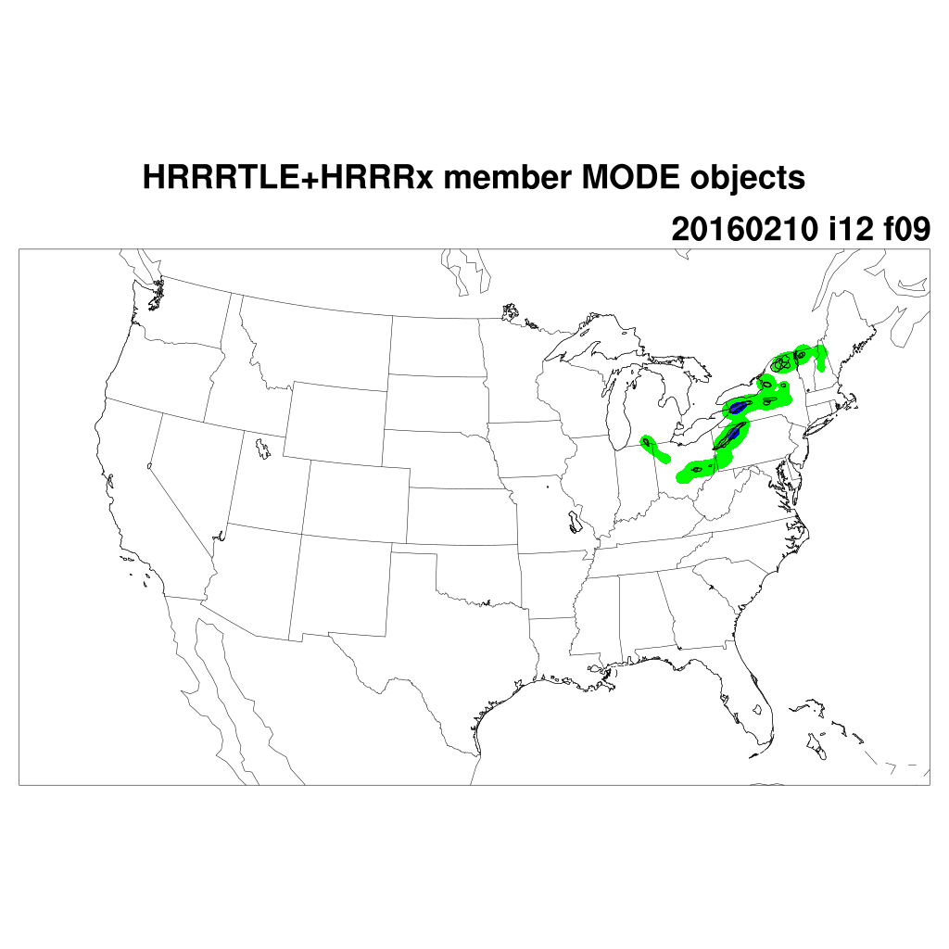
conv_rad=0, conv_thres=0.0127
conv_rad=5, conv_thres=0.007

Slide 13
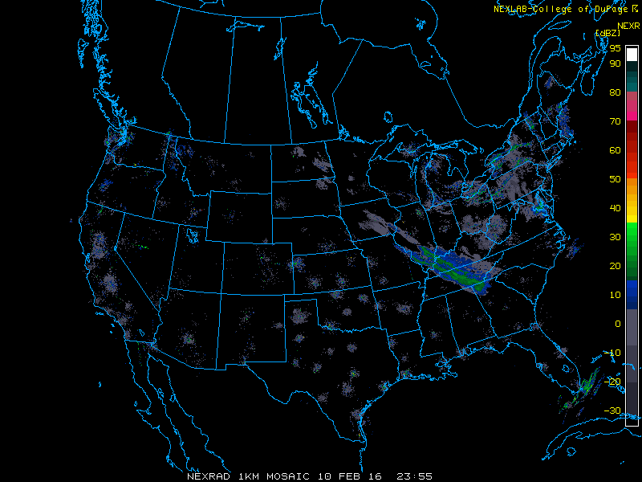
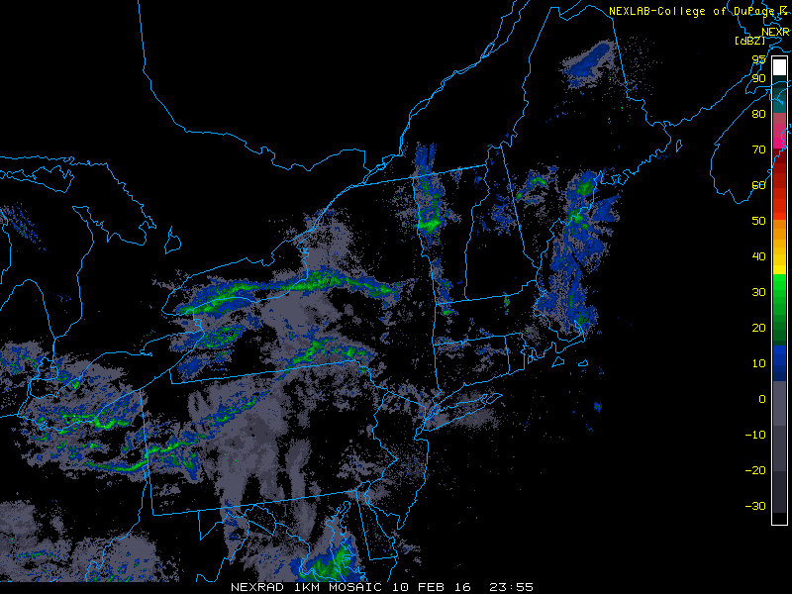
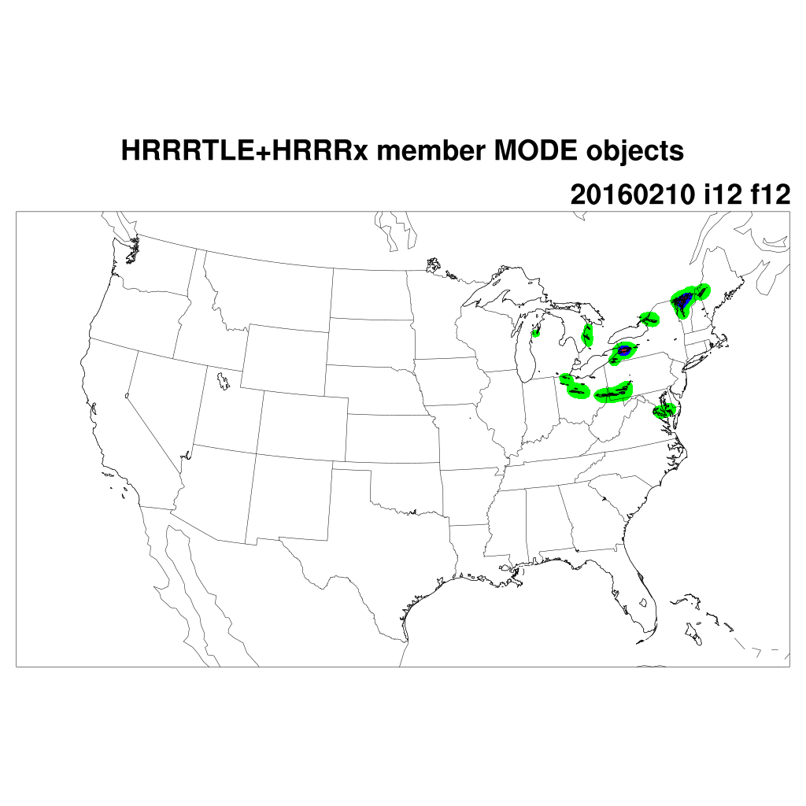
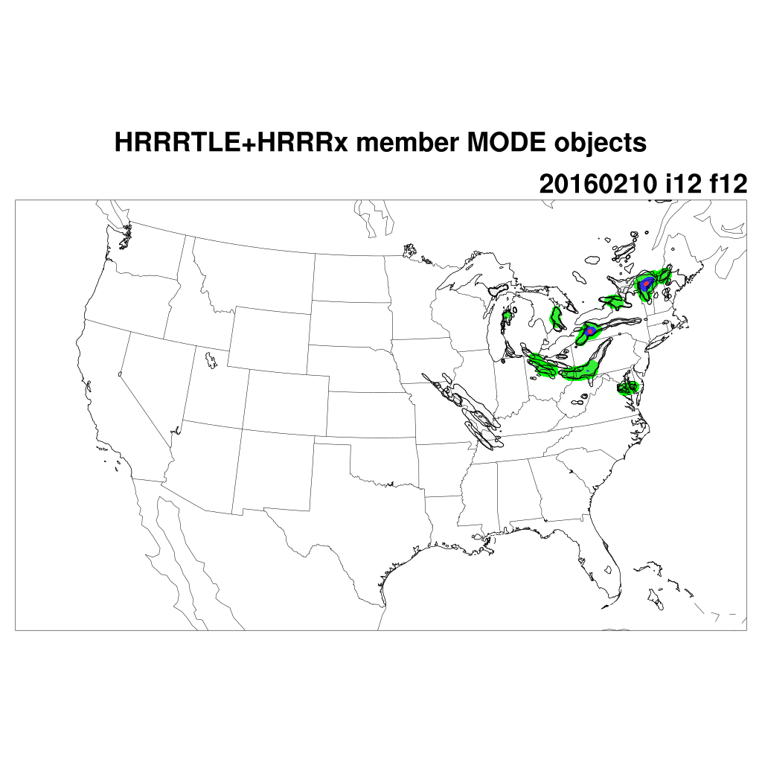
conv_rad=0, conv_thres=0.0127
conv_rad=5, conv_thres=0.002

Slide 14
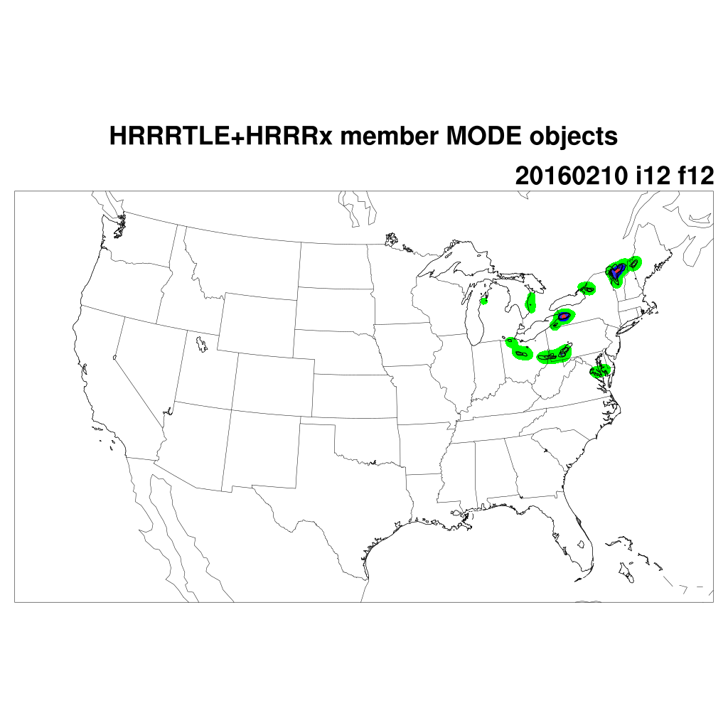
conv_rad=0, conv_thres=0.0127
conv_rad=5, conv_thres=0.007

Slide 15
Case #2
20160211 12 UTC
20160211 15 UTC
20160211 18 UTC
20160211 21 UTC
20160212 00 UTC

Slide 16
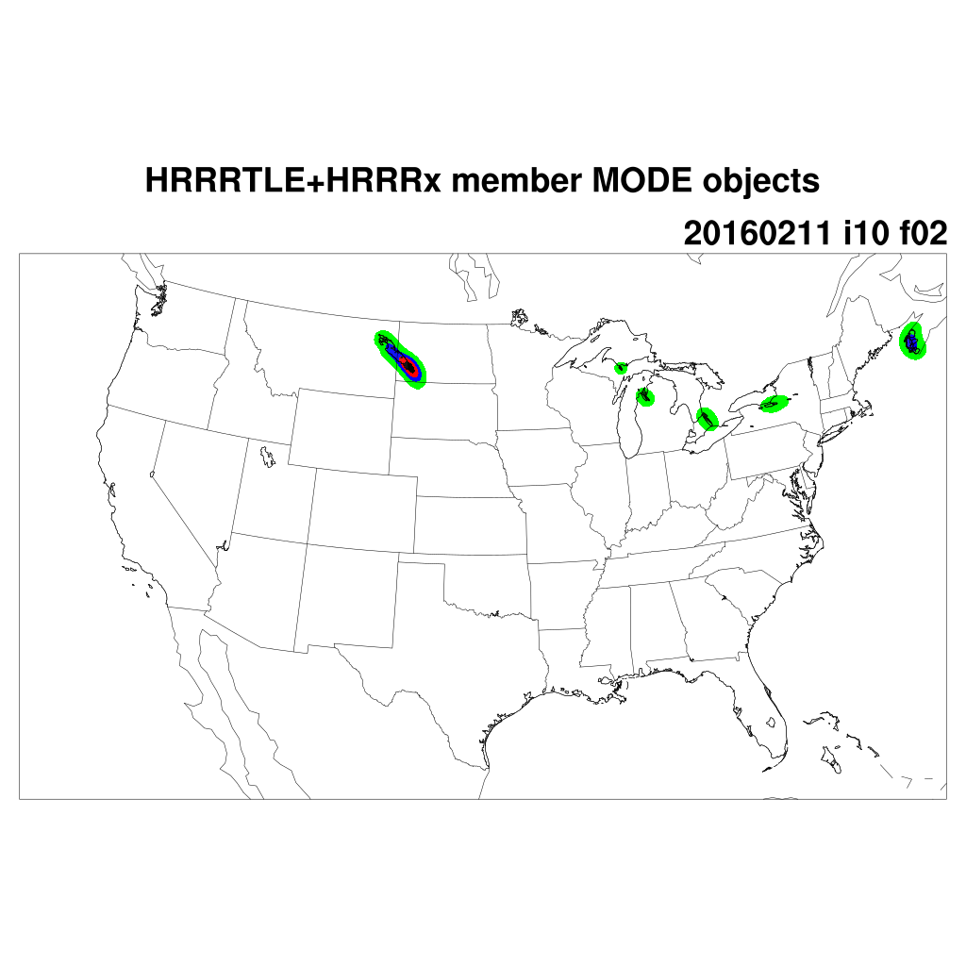
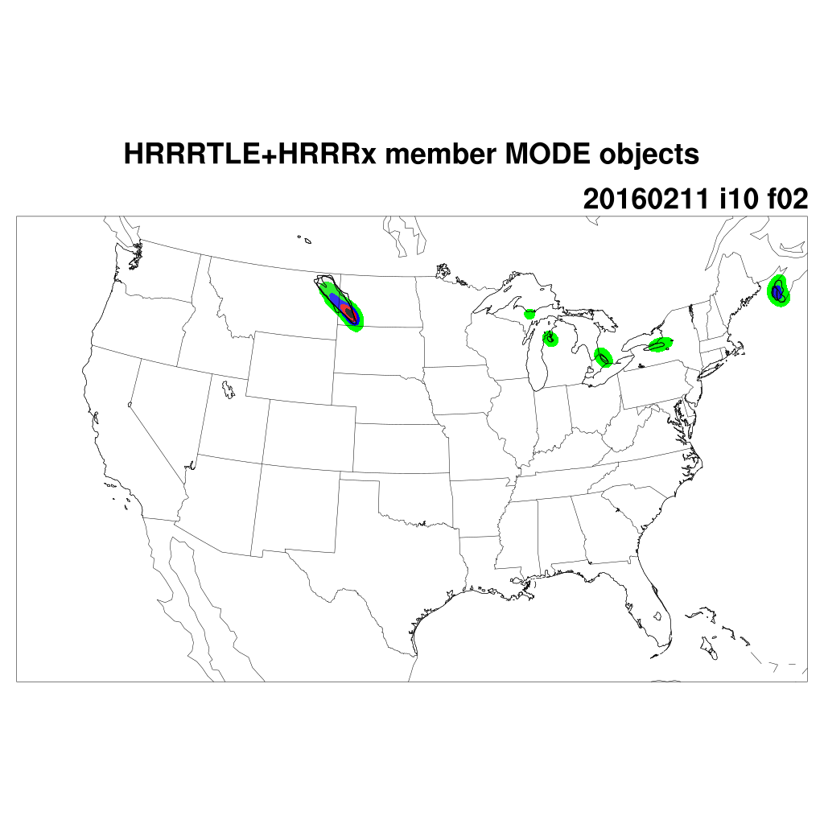
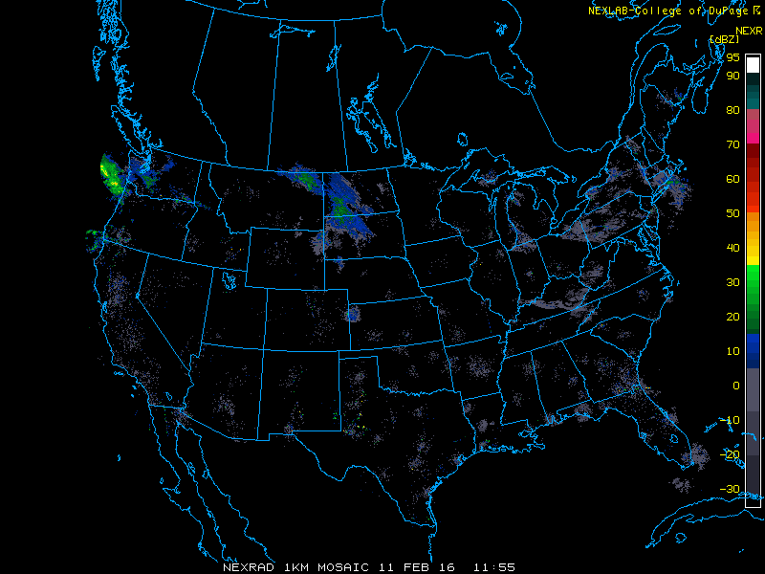
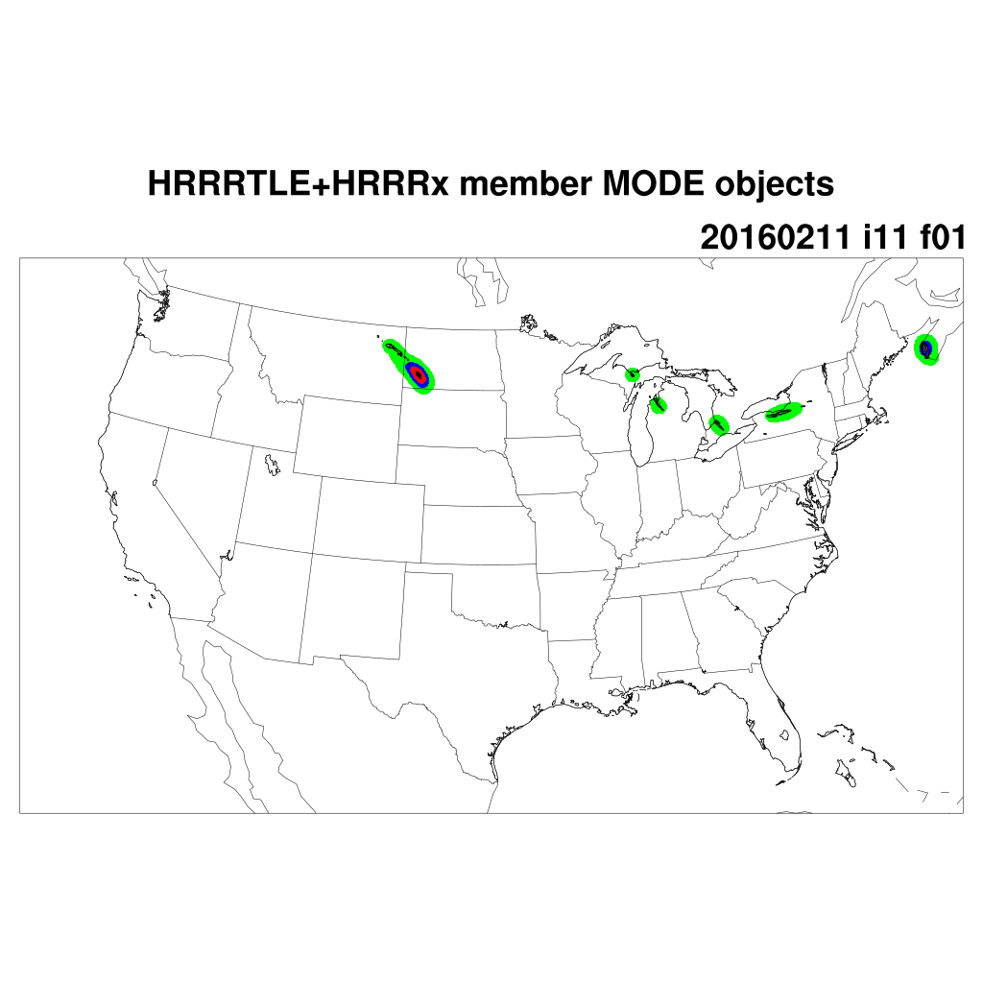
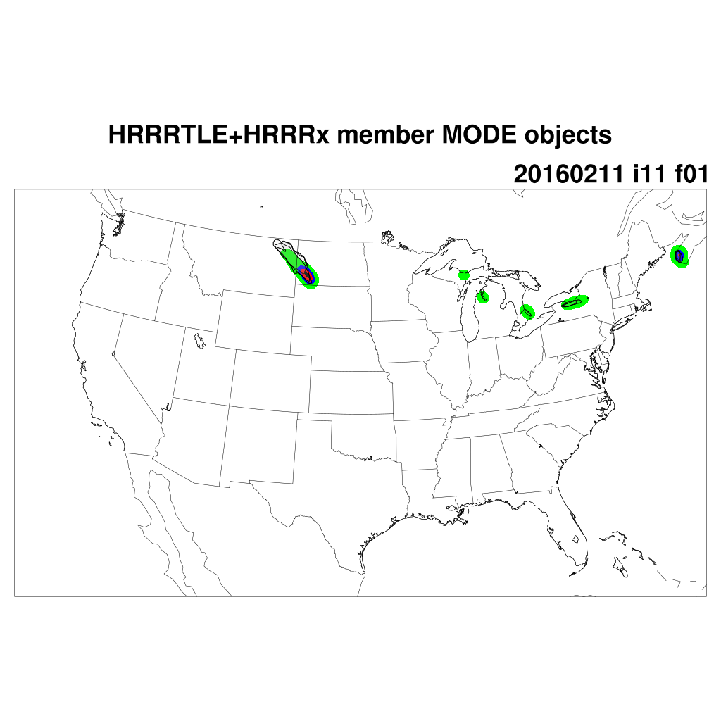
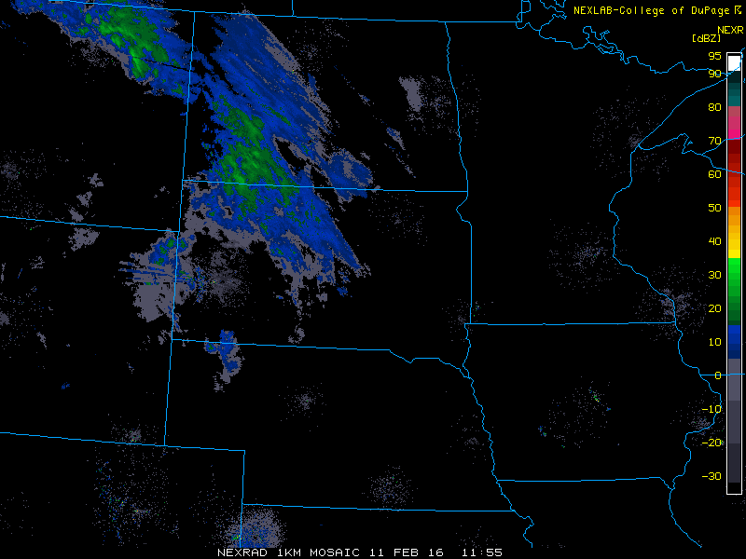
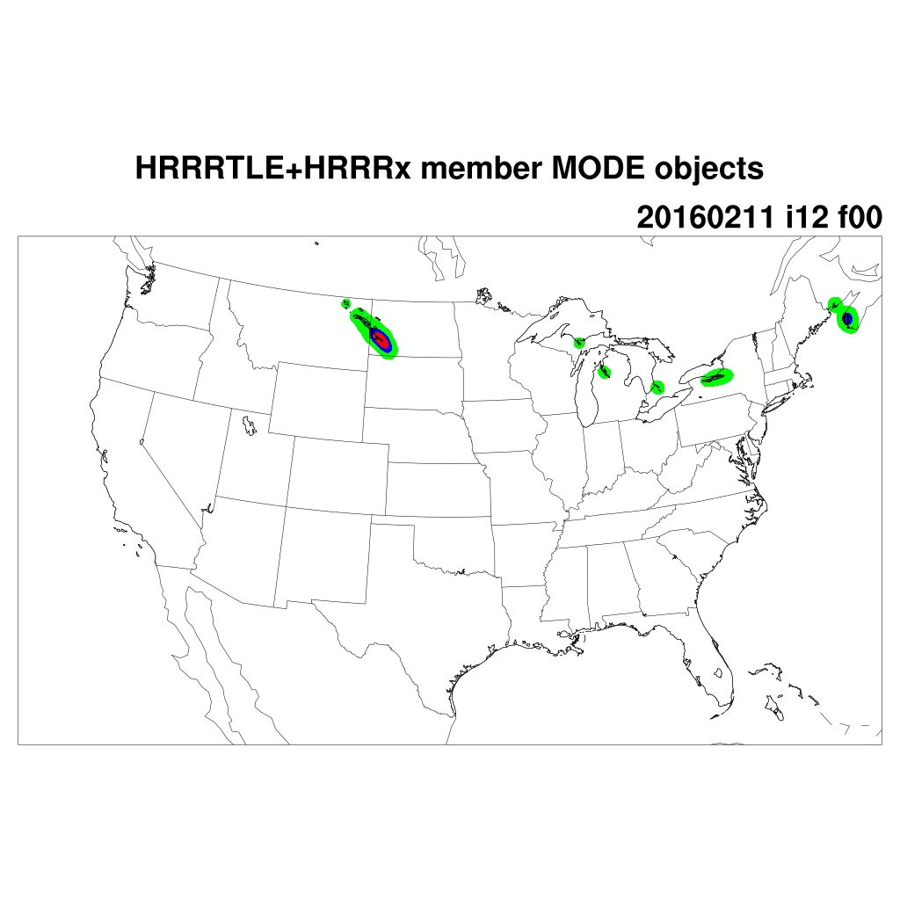
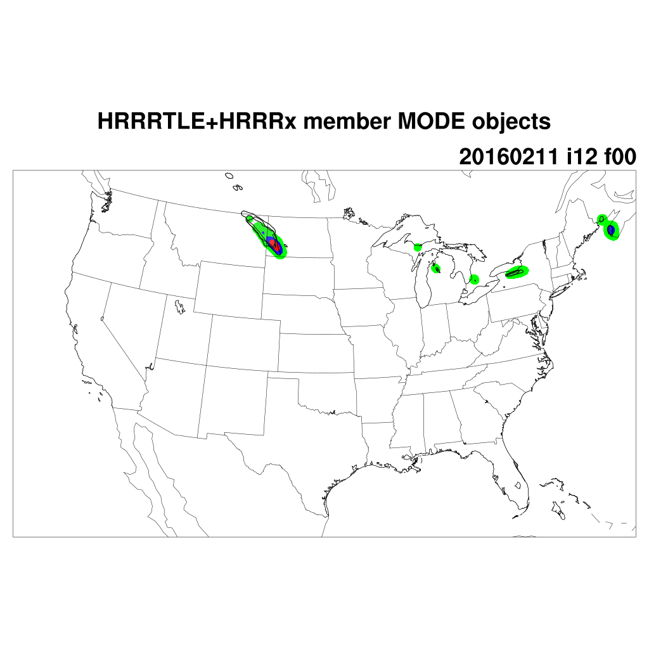
conv_rad=0, conv_thres=0.0127
conv_rad=5, conv_thres=0.007

Slide 17
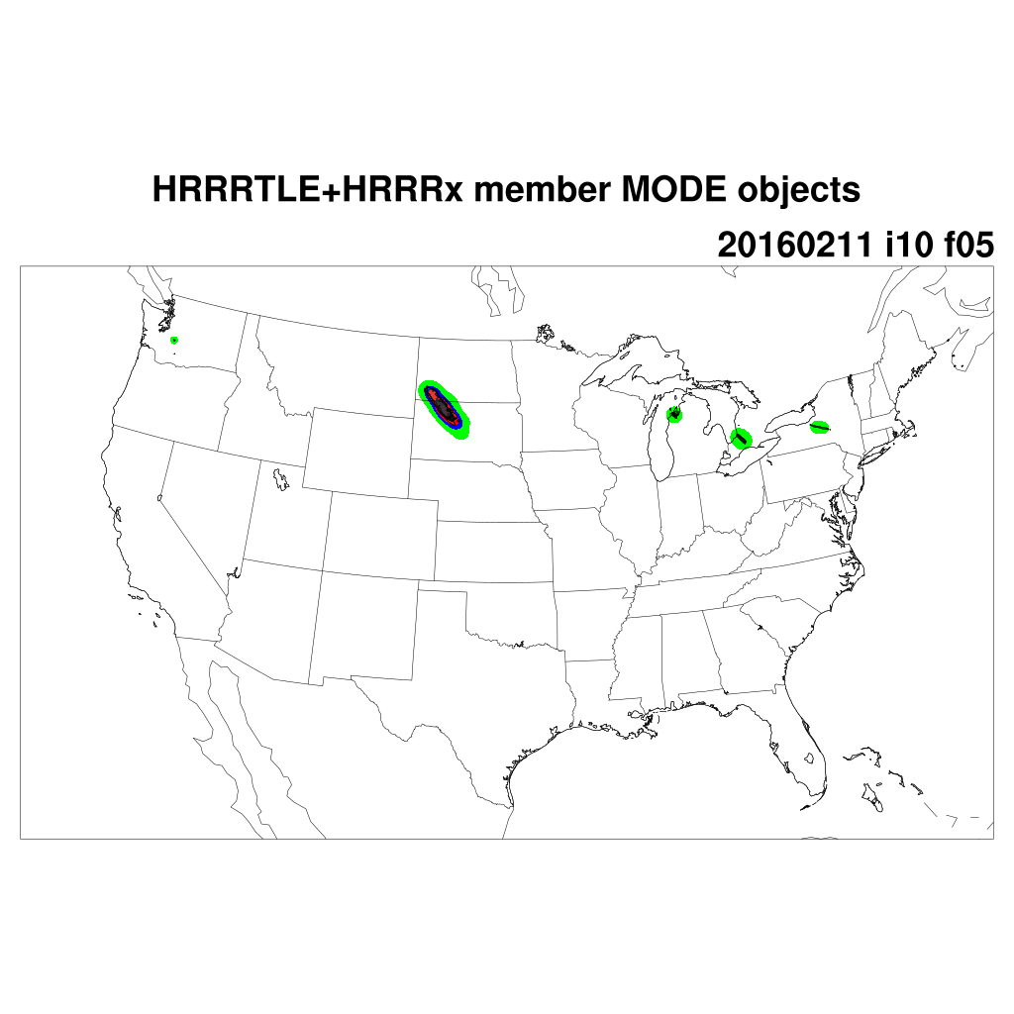
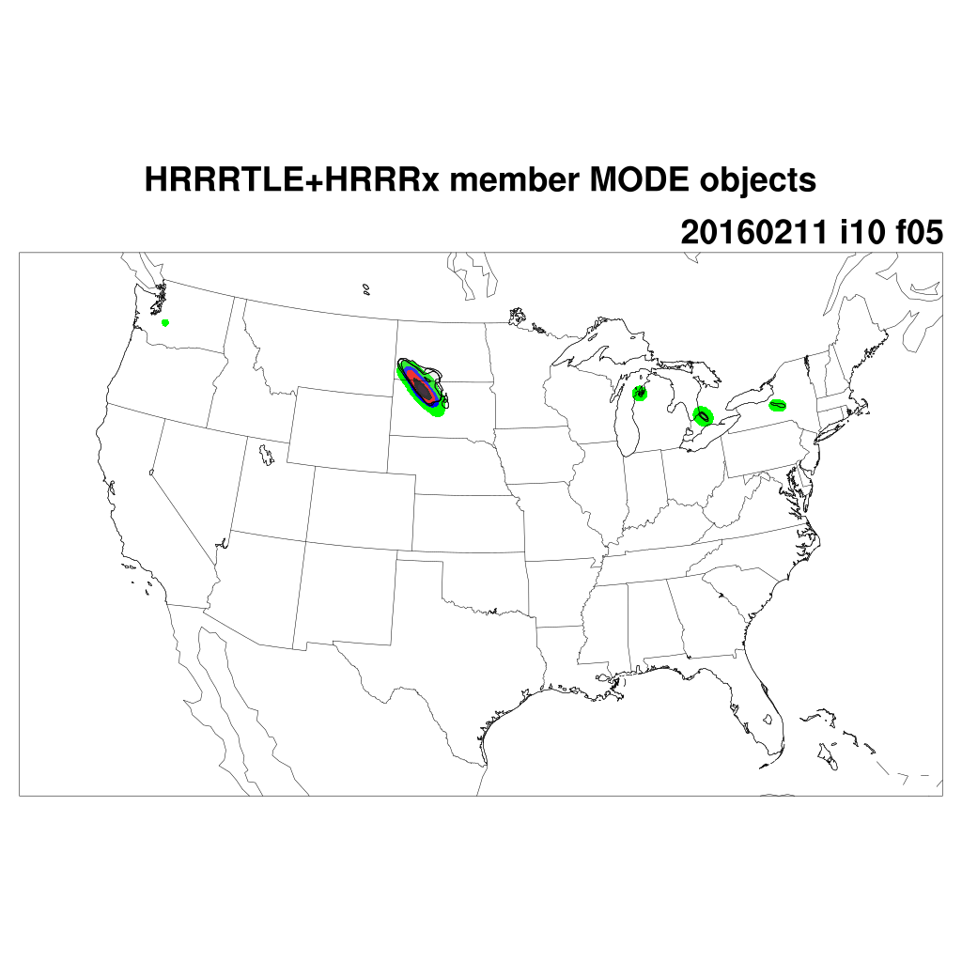






conv_rad=0, conv_thres=0.0127
conv_rad=5, conv_thres=0.007

Slide 18








conv_rad=0, conv_thres=0.0127
conv_rad=5, conv_thres=0.007

Slide 19








conv_rad=0, conv_thres=0.0127
conv_rad=5, conv_thres=0.007

Slide 20




conv_rad=0, conv_thres=0.0127
conv_rad=5, conv_thres=0.007

Slide 21
Case #3
20160212 12 UTC
20160212 15 UTC
20160212 18 UTC
20160212 21 UTC
20160213 00 UTC

Slide 22








conv_rad=0, conv_thres=0.0127
conv_rad=5, conv_thres=0.007

Slide 23








conv_rad=0, conv_thres=0.0127
conv_rad=5, conv_thres=0.007

Slide 24








conv_rad=0, conv_thres=0.0127
conv_rad=5, conv_thres=0.007

Slide 25








conv_rad=0, conv_thres=0.0127
conv_rad=5, conv_thres=0.007

Slide 26




conv_rad=0, conv_thres=0.0127
conv_rad=5, conv_thres=0.007

