Slide 1
Cloud Verification package post-processing
G. Descombes, 05/02/2014

Slide 2
Cloud verification
Comparing integrated mask over the vertical between GOES-imager retrieval from NASA. Done for each forecast range of a forecast (verification 3-D, (i,j,t))
Comparison bottom and cloud top
Extraction of time series and comparison with solar irradiance SURFRAD data (verification 1-D).
Aggregated scores : Bias, hit, false alarm, …

Slide 3
Input data
Code
Satellite
Gridded data
forecast model
Gridded data
Surfrad
Point data
VERIFICATION PACKAGE
ncl:
post-processing script
Interpolation on a regular lat/lon grid
Extraction of cloudy radiation parameter
Cloud mask obs
Cloud mask model
Cloud_verification:
fortran code and scripts
Statistic score
Output data
2-D/3-D Verification Cloud fraction results
ascii files & plots
1-D Verification Irradiance total, direct, diffuse
time series & plots

Slide 4
How to install
(1) Unzip cloud_verifcation.zip
(2) Compile fortran code in the directory cloud verification
(3) Download the goes imager-NASA data
ftp://integrity.larc.nasa.gov/pub/rabi/RR/
(4) Set up the global variables in the file envars.csh

Slide 5
Set up
The GLOBAL VARIABLES and PARMATER need to be set-up in the envars.csf file
obs_dir_surfrad : directroy of the surfrad station data
setenv obs_dir_goes_east : directroy of NASA-Goes-east retrieval data
setenv obs_dir_goes_east : directroy of NASA-Goes-west retrieval data
setenv model_dir : directory of forecast model output
THR3D=0.02 : threshold 3D for cloud fraction (2%)
model_cloud_thresh=0.10 : threshold 3D for cloud fraction (10%)
obs_fhrs_to_process : list of Obs frequency...probably every half hour for GOES-NASA retrieval
ex: "0h 30m 1h"
fhrs_to_verify : list of forecast range matched with Obs.
ex:"0h 30m 1h 1h30m 2h 2h30m 3h 4h 5h 6h” for 6 hour forecast
ROIS : list of point taking into account to compute statistics (-do_stc)
ex "0" no neighbours, or "0 1 2"

Slide 6
Run cloud verification options
Command:
./verify_cldfra.csh YYYYMMDDHH_ini YYYYMMDDHH_end -"option1" -"option2" (...)
Options available:
-do_ppc : interpolate data and model on regular grid lat/lon
-do_fst : plot results forecast 2-D integrated over the vertical
-do_srd : compare times series SURFRAD ground stations with model output
-do_stc : compute aggregated statistics
-do_plt : plot results
-do_arc : archive results

Slide 7
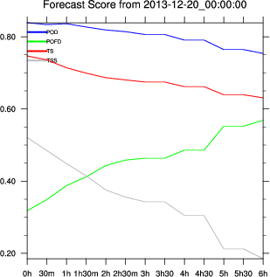
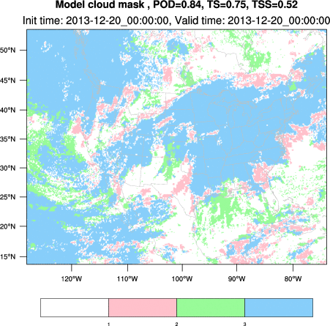
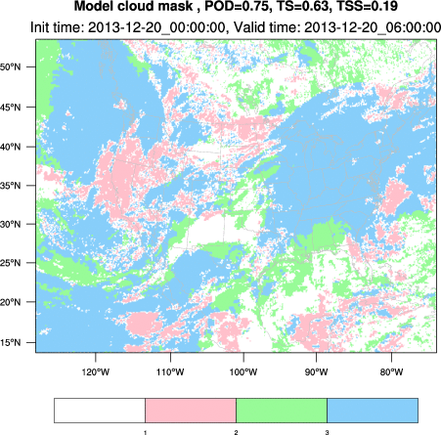
Demo1: plot mask
Command:
./verify_cldfra.csh 2013122000 2013122000 -do_ppc –do_plt
F+6h
F+0h

Slide 8
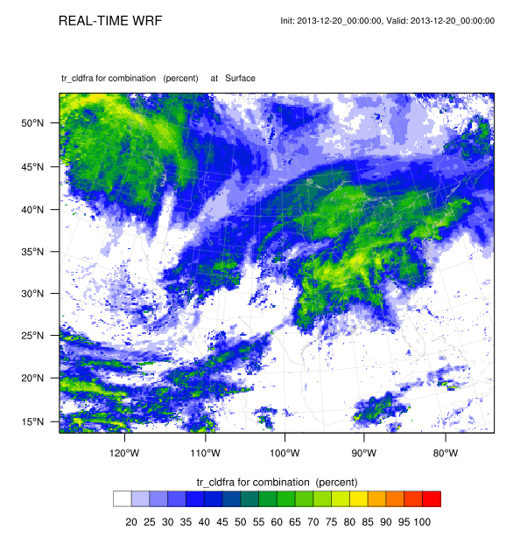
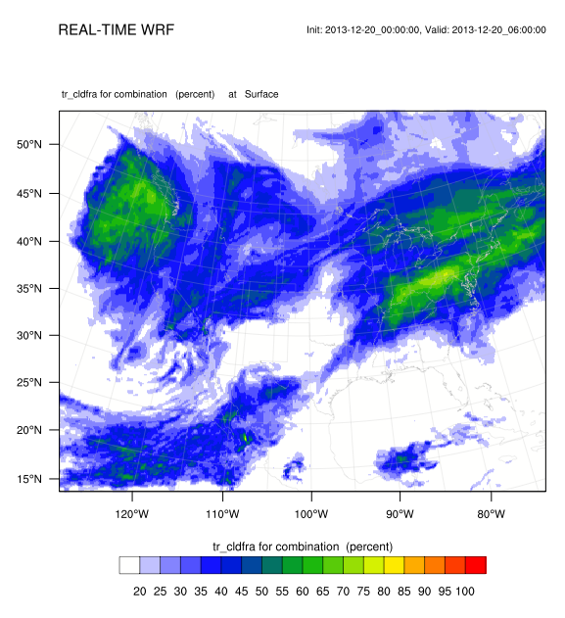
Demo2: plot forecast
Command:
./verify_cldfra.csh 20131220 20131220 –do_fst
F+0h
F+6h

Slide 9
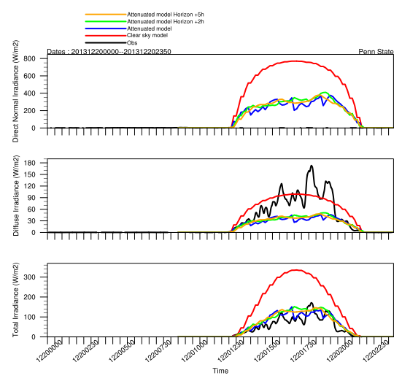
Demo3: comparison SURFRAD ground station
Command:
./verify_cldfra.csh 20131220 20131220 –do_srd

Slide 10
Demo4: aggregated statitics
Command:
./verify_cldfra.csh 20131201 20131231 –do_stc
ETS Higher is better
  (perfect is 1)
ETS > 0 means forecast
better than chance
Note: Bias increases
with time due to
diffusion of cloud

