Slide 1
Sensitivity analysis and others
Lei Meng
Cornell University
04/01/2010

Slide 2
Potential parameters for sensitivity analsysis

Slide 3
Base_case: f_ch4=0.2, vmax_ch4_oxid = 1.25e-5, k_m =5.0e-3, q10_ch4oxid=1.9, k_m_o2 =20, porosity of tiller =0.3
Sensitivity analysis for Panama site
F_ch4=0.1, 0.2, 0.3
Vmax_ch4_oxid=1.39e-5, 1.25e-5,1.11 e-5, 0.14e-5
K_m (ch4) = 10, 5, 1
Q10_ch4oxid = 2.1, 1.9, 1.4
K_m_o2 = 25, 20,17
Porosity of tiller = 0.8,0.3,0.1

Slide 4
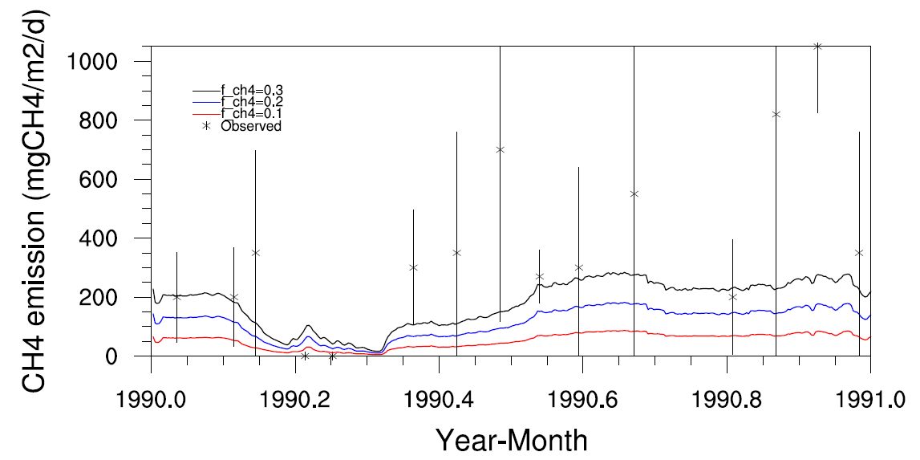
f_ch4

Slide 5
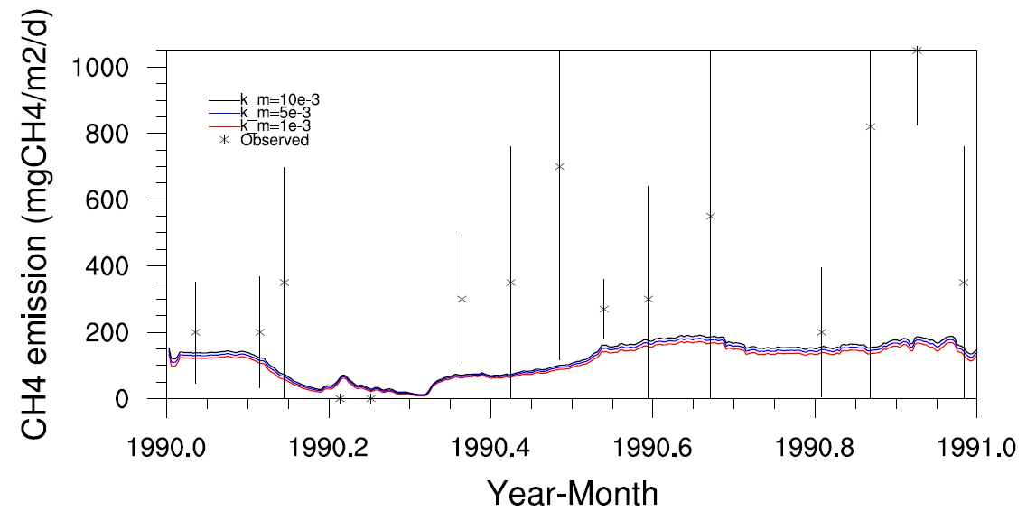
k_m

Slide 6
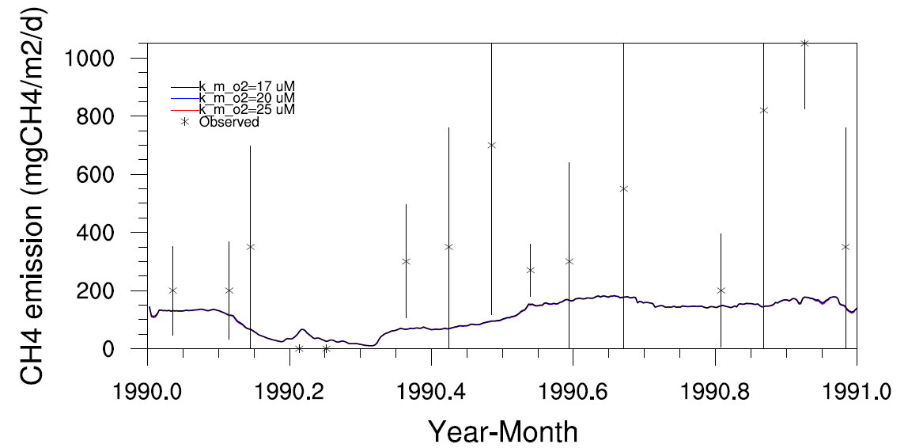

Slide 7
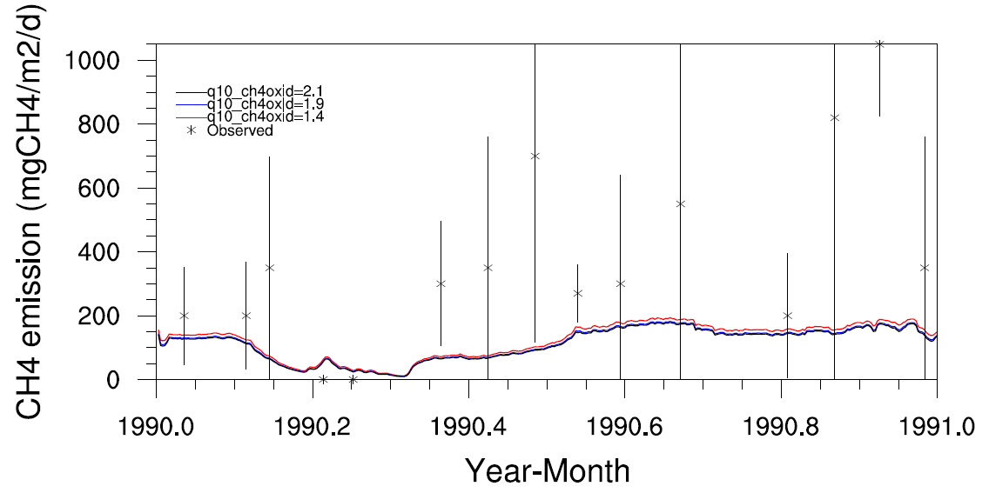

Slide 8
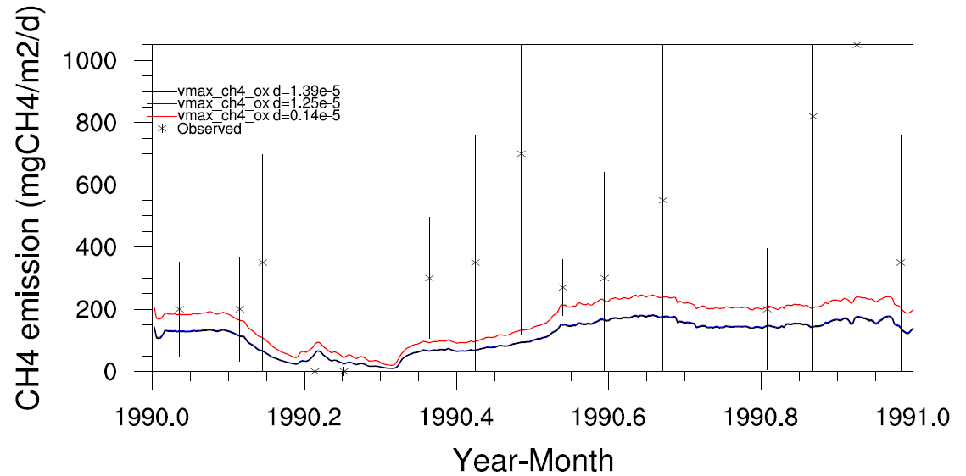

Slide 9
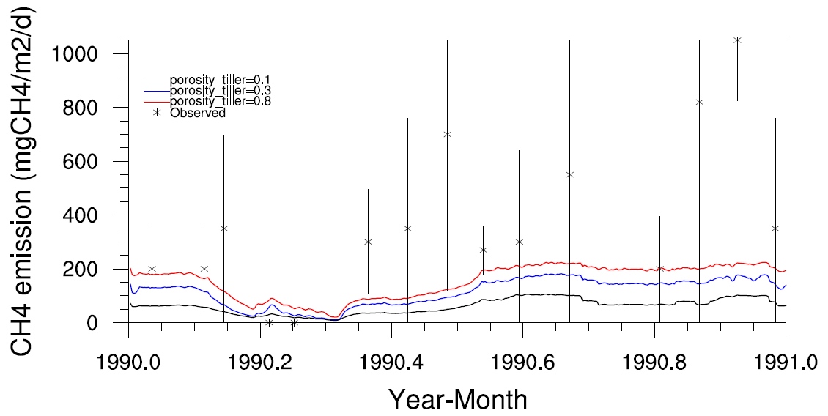

Slide 10
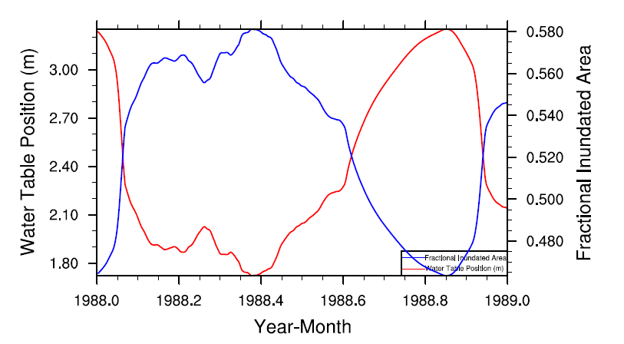
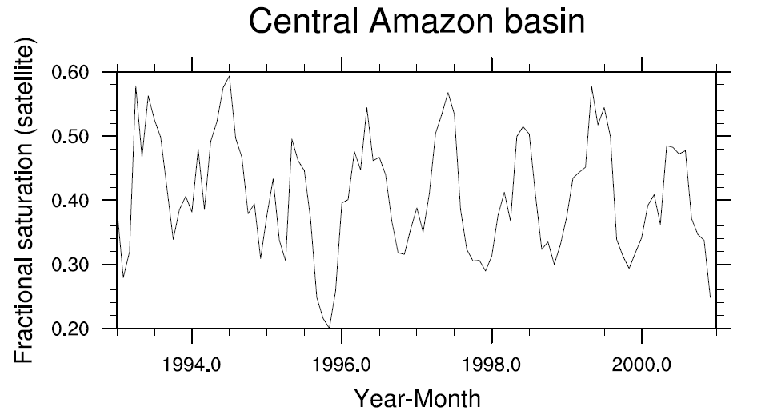
Central Amazon basin

Slide 11
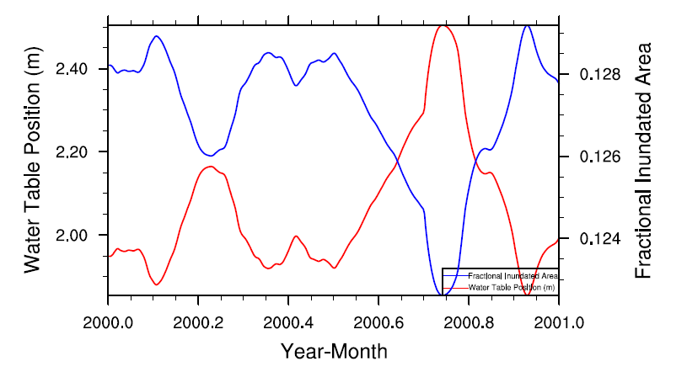
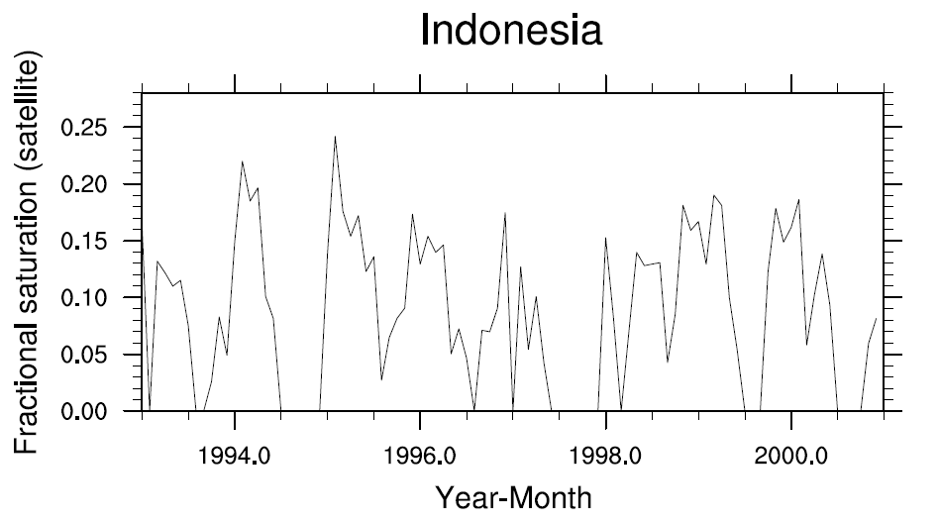
Indonesia

Slide 12
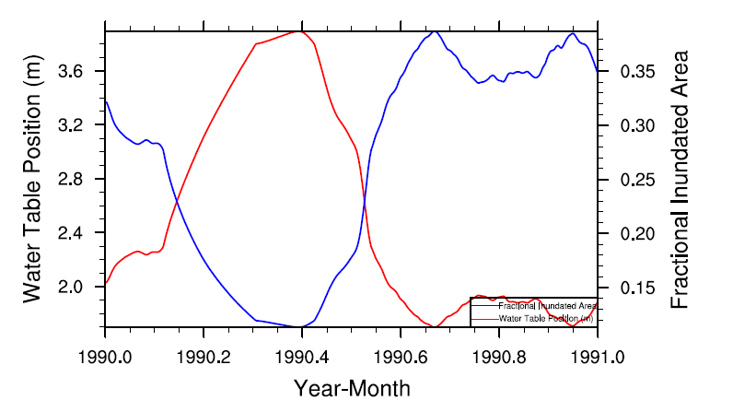
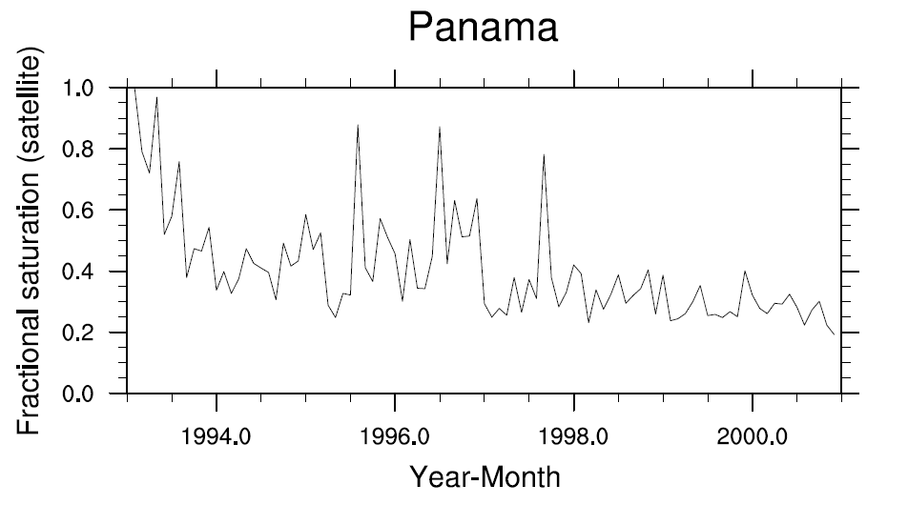
Panama

Slide 13
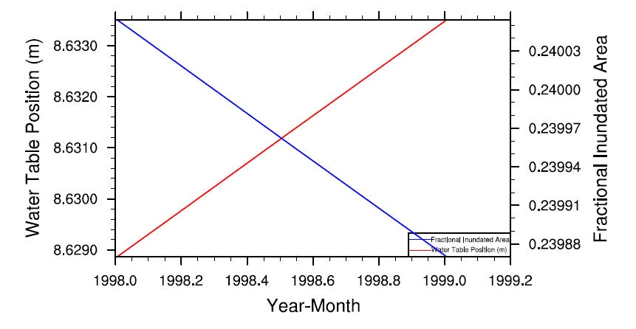
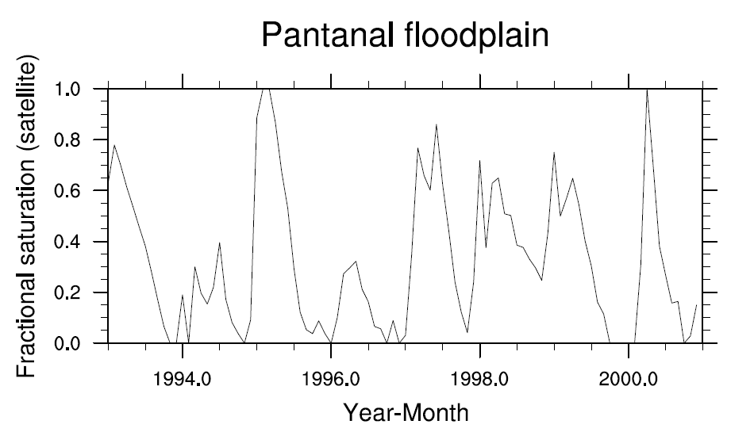
Pantanal floodplain

Slide 14
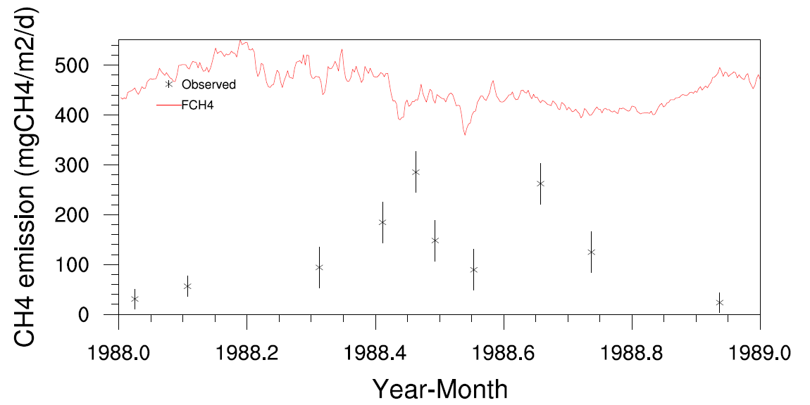
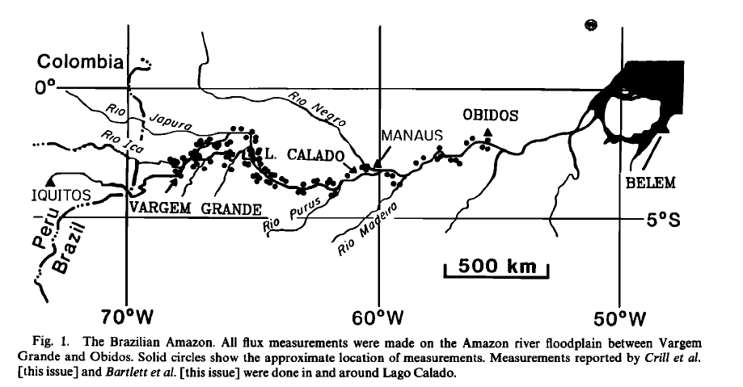
Central Amazon basin

Slide 15
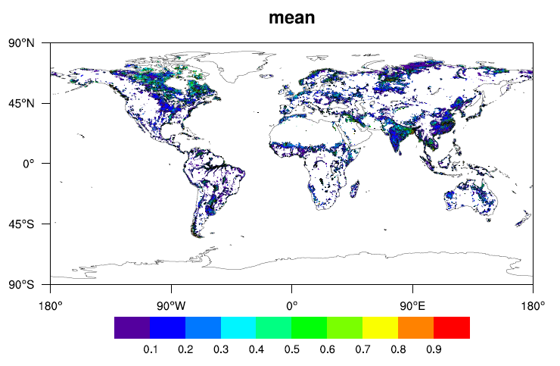
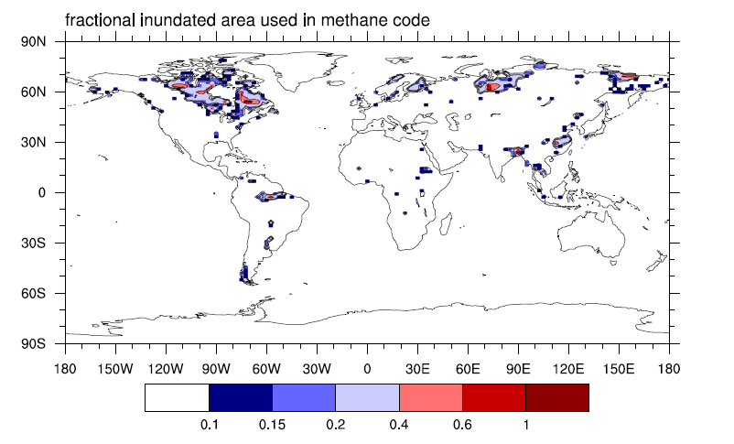
Mean fractional inundation
Satellite observation
vs
Model simulation
Model simulation (one year run)

Slide 16
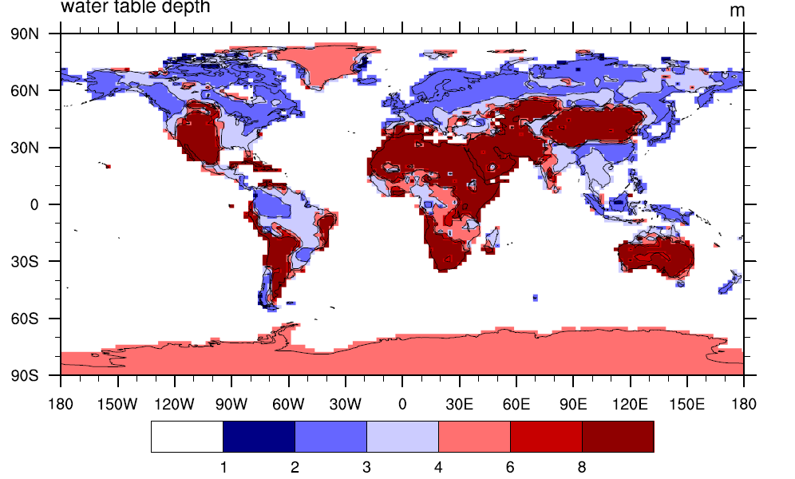
Water Table Depths in CLM

Slide 17
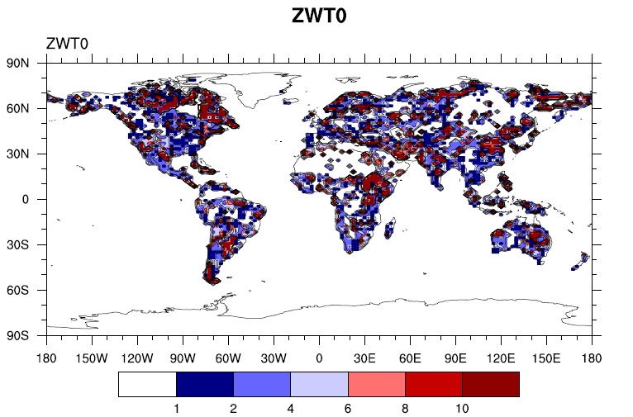
ZWT0- decay factor for finundated

Slide 18

F0-maximum gridcell fractional inundated area

Slide 19
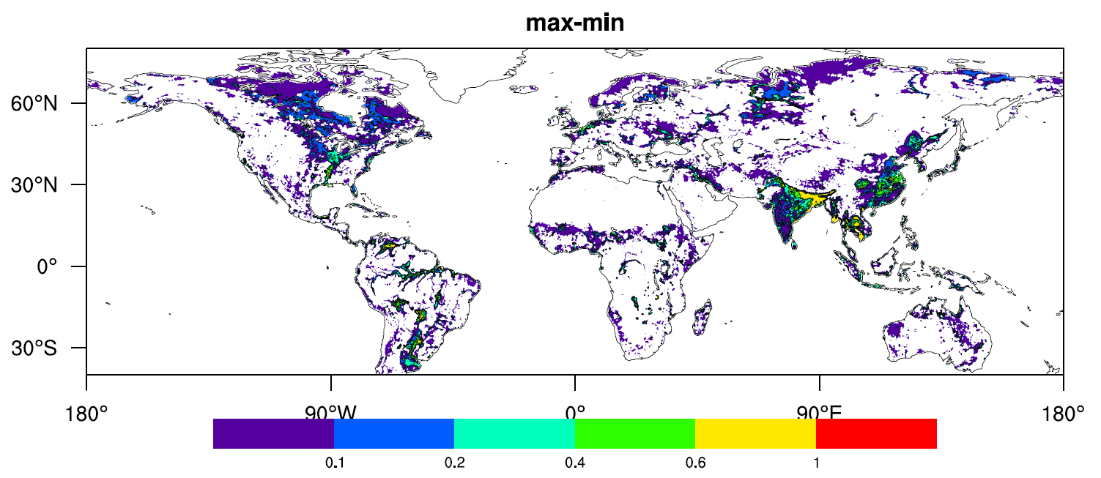
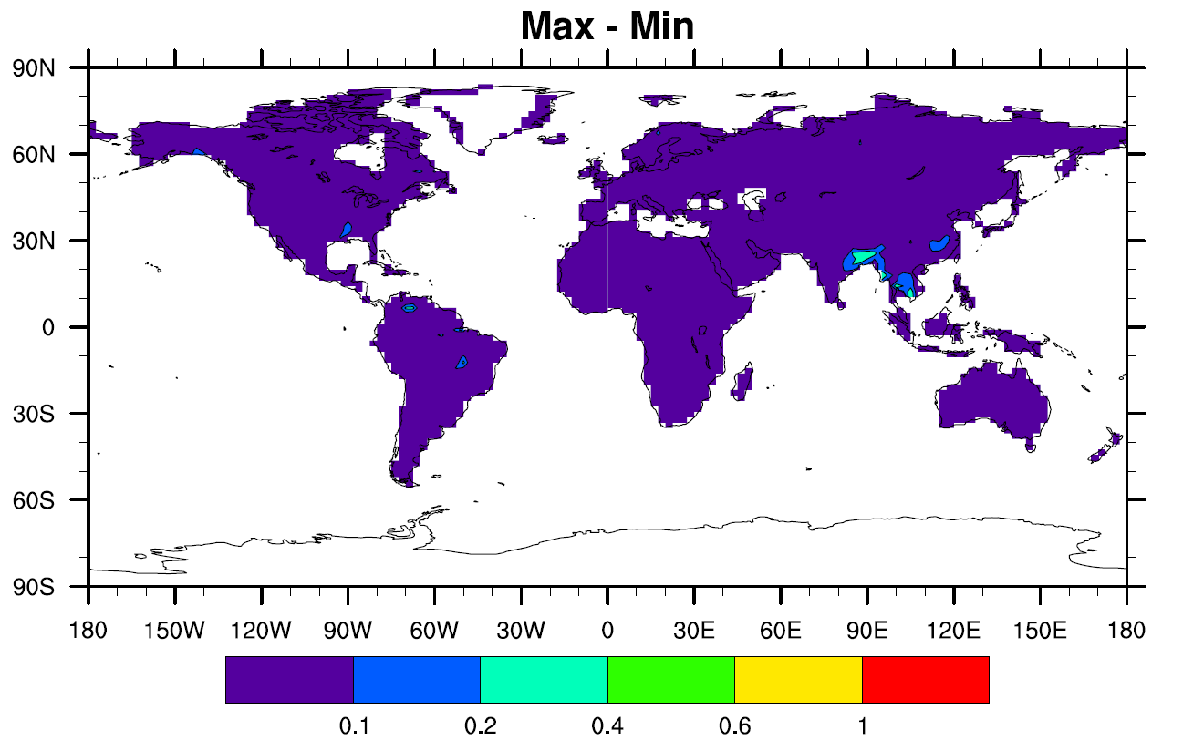
Satellite observation
Vs
Model simulation
Model simulation (one –year run)

