Slide 1
C++ basics, F90 interfaces
Daniel Holdaway

Slide 2
PART I: C++ Basics

Slide 3
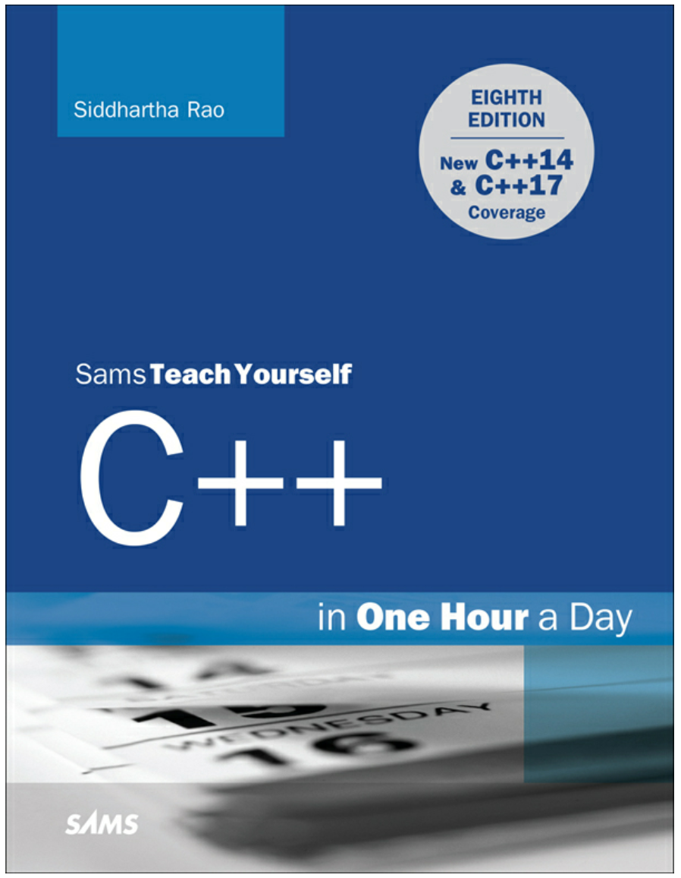
Introduction
Myths
C++ is hard to learn.
C++ is hard to read.
Useful to remember
Lines have to be ended with semicolons.
C++ is case sensitive.
Learn coding norms early and keep to them.
Descriptive naming.
Learn by doing and get a good book to reference. I like:
Rao, Siddhartha. C++ in One Hour a Day which is available on Kindle.

Slide 4
A basic C++ program
// An example program for the JEDI Academy
#include <iostream>
int main()
{
// Use iostream cout to write to screen
std::cout << Hello Dagobah << std::endl;
/* Another way to comment */
return 0;
}
Comments use either // or /* xxx */
Include the standard io stream and dependencies (provides cout)
“int main” means main is expected to return an integer. Often this is void if no return needed
std::cout use cout from the standard namespace
Return the required integer, 0 might represent a successful run.
Always remember to end lines with semicolon;

Slide 5
C++ Variables
KIND | VALUES
bool | true or false
char | 256 characters
short int | -32768 to 32767
long int (default) | -2147483648 to 2147483647
long long | -9223372036854775808 to 9223372036854775807
unsigned <int> | 0 to twice above upper limit
float | -1.2e-38 to 1.2e38
double | -2.2e-308 to 2.2e308
auto | C++11 compiler decides on best type
Variables do not necessarily have to be defined at the start of a code block.
std::cout << Hello Dagobah << std::endl;
bool amIAJediNow = false;

Slide 6
Variables
Typedef
In C++ you can set your own type definitions for convenience and can be helpful for avoiding bugs in complex codes.
typedef unsigned int usi;
usi myUnsignedInteger = 10;
Use of typedef is fairly extensive in JEDI and especially in the Fortran/C++ interfaces.
Const
const is used like parameter in Fortran. E.g.
const double avogadroNumber = 6.022140857e23;
const is also used like intent(in) for functions/subroutines.
constexpr can be used for functional constants e.g.
constexpr double getRDry() {return 8314.47 / 28.965 ;}

Slide 7
Arrays
An array in C++ is created as:
double myArray[3][3];
double myAarray[3][3] = {}; (Initialize to zero)
Indices start at 0 by default.
Row major, not column major so fastest to loop in opposite way from Fortran, e.g. go i, then j then k.
Particular entries can be accessed with e.g.
std::cout << "Element = "<< myArray[0][2] << std::endl;
Note that the following are equivalent:
double myArray[2][2] = {{1.0, 2.0},{3.0, 4.0}};
double myArray[2][2] = { 1.0, 2.0 , 3.0, 4.0 };

Slide 8
Dynamic Arrays
So far the arrays we’ve created are static. C++ offers the ability to use dynamic arrays through the standard library:
std::vector<double> dynArray(3);
dynArray.push_back(1.0);
std::cout << "Array[3] = " << dynArray[3] << std::endl;

Slide 9
Pointers
A pointer is declared using ‘*’. E.g.
double* pointsToDouble = NULL;
In C++ memory addresses are accessed with ‘&’ and this is how pointers are assigned.
double pi = 3.14159;
pointsToDouble = &pi;
Pointers can always be reassigned:
double twoPi = 6.28318;
pointsToDouble = &twoPi;
Access the value pointed to with *, example output
cout << "pointsToDouble = " << pointsToDouble << endl;
pointsToDouble = 0x7fff5b0839d0
cout << "pointsToDouble = " << *pointsToDouble << endl;
pointsToDouble = 3.14159

Slide 10
Operators
In addition to the usual +,-,/,*,% operators C++ supports shorthand that combine variables directly, e.g.:
int five = 5;
int one = 1;
int zero = 0;
int onePlusFive = 1;
int oneMinusFive = 1;
onePlusFive += five;
oneMinusFive -= five;
++five;
std::cout << "five + 1 = " << five << std::endl;
std::cout << "one + five = " << onePlusFive << std::endl;
> five + 1 = 6
> one + five = 6
> one - five = -4
Any operator can be overloaded so these are seen in JEDI for things like field + increment

Slide 11
C++ Maths
Math in C++ requires use of the header: #include <math.h>
Some of the capabilities from this library are listed here: http://www.cplusplus.com/reference/cmath/
Operation | C++
Square root | sqrt()
Raise to the power | pow(x,y)
Trig | cos(x), sin(x), tan(x)
arc trig | acos(x), asin(x), atan(x)
Hyperbolic trig | cosh(x), sinh(x), tanh(x)
exp, log | exp(x), log(x), log10(x)
Hypotenuse | z = hypot(x,y)

Slide 12
Loops in C++
FOR LOOP EXAMPLE
for (int indLoop = 0; indLoop < 10; ++indLoop) {
std::cout << "indLoop = " << indLoop << std::endl;
}
indLoop = 0
indLoop = 1
…
for(;;) {
std::cout << "Here for a VERY long time" << std::endl;
}
WHILE LOOPS EXAMPLE
int indWhile = 0;
while (indWhile < 10) {
std::cout << "indWhile = " << indWhile << std::endl;
++indWhile;
}

Slide 13
Logic in C++
IF Statement example
bool amIAJediNow = false;
bool attendedTheJediAcademy = true;
if (attendedTheJediAcademy == true)
amIAJediNow = true;
else
amIAJediNow = false;
And this is equivalent to:
int a = 2;
if (attendedTheJediAcademy == true) {
amIAJediNow = true;
}
else {
amIAJediNow = false;
}

Slide 14
Logic in C++
LOGIC | COMMAND
Equal to | ==
Not equal | !=
AND | &&
OR | ||

Slide 15
Calling subroutines/functions
double areaCircle (const double pi, double radius) {
return pi * radius * radius;
}
int main()
{
const double pi = 3.14159;
double radius;
double area;
radius = 4.0;
area = areaCircle(pi, radius);
std::cout << "Area = " << area << std::endl;
return 0;
}

Slide 16
Picking variables names
Always pick descriptive names for variables and functions. Avoid underscores for naming variables in C++, they have special meaning in OO programming. Instead stick to the following:
In JEDI lower “camelCase” is used for methods and variables e.g.:
int descriptiveVariable = 1;
For Functions we use all lower case, here you can use underscores, e.g.:
void schur_product_with(const IncrementFV3JEDI &);
“PascalCase” is used for classes and methods.
template<typename MODEL> class ControlVariable;

Slide 17
PART II: C++/Fortran interfacing

Slide 18
Introduction
Much of the work of JEDI is done by Fortran routines, which have knowledge of the model geometry and fields.
The OOPS layer controls the data assimilation process, e.g. the minimization but knows nothing about the model geometry or fields.
Generally the only information passed between the C++ and Fortran layers are the configurations (from json/yaml) and integers that perform bookkeeping.
The interfaces and structures of the Fortran layers mimic the C++ layers with bindings that instruct the compiler to interface between the two languages.

Slide 19
Model ‘Geometry’ class
namespace fv3jedi {
class GeometryFV3JEDI {
public:
explicit GeometryFV3JEDI(const eckit::Configuration &);
private:
F90geom keyGeom_;
}
namespace fv3jedi {
GeometryFV3JEDI::GeometryFV3JEDI(const eckit::Configuration & conf) {
const eckit::Configuration * configc = &conf;
fv3jedi_geo_setup_f90(keyGeom_, &configc);
}
}
Header interface to the Geometry constructor
.h
F90geom is just int.
keyGeom is some number associated to this geometry object.
.cc
C++ subroutine for Geometry constructor
_f90 denotes that this will interface to Fortran

Slide 20
Model Geometry Fortran
namespace fv3jedi {
typedef int F90geom;
extern "C" {
void fv3jedi_geo_setup_f90(F90geom &, const eckit::Configuration * const *);
}
}
subroutine c_fv3jedi_geo_setup(c_key_self, c_conf) bind(c,name='fv3jedi_geo_setup_f90’)
use iso_c_binding, only: c_int, c_ptr
integer(c_int), intent(inout) :: c_key_self
type(c_ptr), intent(in) :: c_conf
...
end subroutine c_fv3jedi_geo_setup
Header file for interfaces but now for Fortran. extern “c” tells compiler that we’re using mixed language.
.h
Still in C++ here.
This part’s Fortran. c_ to track that this is the C++ interface level
.F90
Receives c_int and c_ptr

Slide 21
Fortran.h
The header in the previous slide is Fortran.h
All the Fortran headers for the repository are typically stored in a single Fortran.h. Though there could be multiple, perhaps one for each class if desired.
extern "C" {
void fv3jedi_setup_f(const eckit::Configuration * const *);
void fv3jedi_finalize_f()
void fv3jedi_model_setup_f90(const eckit::Configuration * const *, const F90geom &, F90model &);
void fv3jedi_localization_mult_f90(const F90lclz &, const F90flds &);
} // extern "C"

Slide 22
The Key
The input is:
integer(c_int), intent(inout) :: c_key_self
And we need:
type(fv3jedi_geom), pointer :: self
JEDI uses linked lists to perform the bookkeeping and match keys to actual data.
Each module has e.g.
type(registry_t) :: fv3jedi_geom_registry
Which performs bookkeeping though: init, add, get, remove, finalize.
These subroutines are contained in linkedList_i.f and linkedList_c.f, which are generic and used by all Fortran modules within the repository and are included as follows:
#define LISTED_TYPE fv3jedi_geom
#include "linkedList_i.f"

Slide 23
linkedLists
type :: node_t
integer :: key
type(LISTED_TYPE) :: element
type(node_t), pointer :: next => NULL()
end type
type :: registry_t
logical :: l_init = .false.
integer :: count = 0
type(node_t), pointer :: head => NULL()
contains
procedure :: init => init_
procedure :: finalize => finalize_
procedure :: add => add_
procedure :: get => get_
procedure :: remove => remove_
end type
This is where the actual derived type data is in memory. Whenever working with Fortran subroutines we’re just pointing to this.

Slide 24
The Key and the linkedList
The Geometry constructor begins with:
call fv3jedi_geom_registry%init()
call fv3jedi_geom_registry%add(c_key_self)
call fv3jedi_geom_registry%get(c_key_self,self)
call fv3jedi_geom_registry%init()
This subroutine sets things up if first call. It sets the Key to zero and prepares the linked list.
call fv3jedi_geom_registry%add(c_key_self)
Adds 1 to the counter and sets key to current count. If first call to geom c_key is now 1.
Then allocates ‘next’ LISTED_TYPE, which is the next ‘node’ of the linked list. Move pointer along the list.
call fv3jedi_geom_registry%get(c_key_self,self)
Sweeps through the linked list to find matching key, sets pointer self to geom allocated in add.
For constructors Fortran generates the key, not C++.

Slide 25
The Key
Since self is a derived type you still have to allocate arrays, even though linkedList has allocated the type:
allocate ( self%grid_lon(self%bd%isd:self%bd%ied, self%bd%jsd:self%bd%jed) )
Geometry deallocation
call fv3jedi_geom_registry%get(c_key_self, self)
deallocate(self%grid_lon)
call fv3jedi_geom_registry%remove(c_key_self)
call fv3jedi_geom_registry%remove(c_key_self)
Sweeps linked list to find matching key. Deallocates the node associated with that key.

Slide 26
The Configuration
JEDI comes with support for reading the configuration json/yaml files within the Fortran subroutines.
use config_mod
if (config_element_exists(c_conf,"init_type")) then
init_type = config_get_string(c_conf,len(init_type),"init_type")
endif

Slide 27
Questions?

