Slide 1

Joint Effort for Data assimilation Integration
IODA subsystem
Joint Center for Satellite Data Assimilation (JCSDA)
JEDI Academy – 06 June2018

Slide 2
Requirements and Goals
From Yannick’s presentation:
Interface to isolate science code from data storage
Three levels:
Long term storage (historic database)
Files on disk (one DA cycle)
In memory handling of observations (hardware specific?)
Two environments:
Plotting, analyzing, verifying on workstation
DA and other HPC applications (MPI, threads, GPUs…)
Goal: one interface, possibly several implementations?

Slide 3
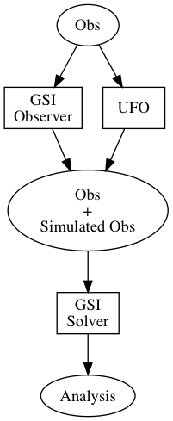
Observation Data Flow
The flow we are currently building places UFO in parallel with the GSI Observer.
  This is done so that UFO can be checked by running the same data through the GSI Observer
Observation operators in UFO (or the GSI Solver) create simulated observations from model fields.
The original observations plus the simulated observations are passed onto the GSI Solver to complete the generation of the analysis state.
Geovals
Geovals data are only used for testing UFO
  Removes need to run a model
Separate from the obs database

Slide 4
Handling Observation Data
Currently, we have a preliminary observation data store based on netcdf files
  Okay for a prototype system, not okay for a production system
  Enables us to have access to small amounts of observation data and therefore continue development of the other JEDI subsystems
We require a full-fledged database implementation which can handle large amounts of data and operate in an HPC environment (MPI)
After the academy we will start investigating implementation options for our Obs DataBase
  I will be visiting the UK Met Office in late June to look at using ECMWF’s ODB
  We will look at other formats as well

Slide 5
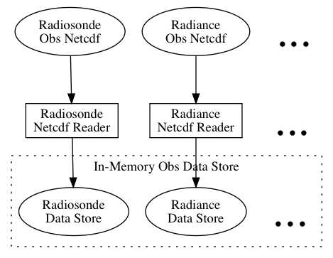
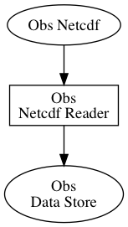
Path to an Observation DataBase
Obs DataBase
Month Ago
Today
(work in progress)
Future

Slide 6
Relationship to OOPS
IODA is the implementation of the following abstract interfaces in OOPS
ObsSpace
  Analogous to a mathematical space
ObsVector
  ObsVector represents the observation terms H(x) and y in the J(x) cost function
  ObsSpace is a set of ObsVectors
Locations
  Location information of observations which is used for horizontal interpolation of model fields
  Currently includes:
    Latitude
    Longitude
    Time

Slide 7
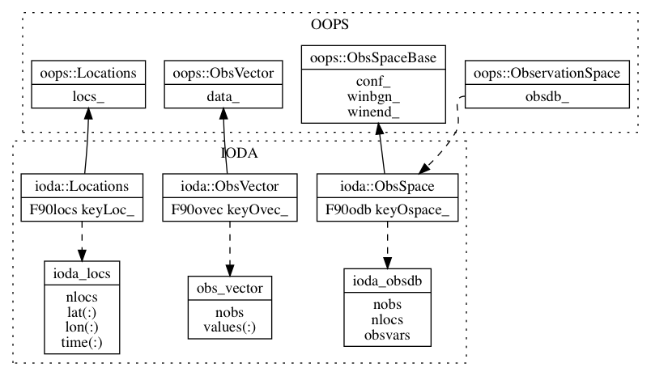
Class Structure
C++
Fortran
nobs = number of unique observations
nlocs = number of unique locations
C++ Objects use “pointers” to Fortran “objects”
  These are handled the same as the Geometry class example from yesterday

Slide 8
Observation Data Access
Access routines to observation data
C++ Level:
  ObsSpace::getdb(const std::string & col, int & keyData)
    Col is the variable name (as found in the netcdf file)
    keyData is an index that indicates an ObsVector of which to place the variable’s values
  ObsSpace::locations(const util::DateTime & t1, const util::DateTime & t2)
    t1 is time window beginning
    t2 is time window ending
Fortran level (ioda/src/ioda/ioda_obsdb_mod.F90):
  ioda_obsdb_var_to_ovec(self, ovec, vname)
    self is an ioda_obsdb type
    ovec is an ioda_obs_vector type
    vname is a string containing the variable name
  ioda_obsdb_getlocs(self, locs)
    self is an ioda_obsdb type
    locs is an ioda_locs type

Slide 9
Example Usage
At the Fortran level:
…
! The example assumes that there exists a type
! ioda_obsdb object called “obss”
! Declare an obs vector for holding the obs data
type(obs_vector) :: pressure
…
! Create the obs vector (constructor)
call ioda_obsvec_setup(pressure, obss%nobs)
! Transfer the obs data into the obs vector
call ioda_obsdb_var_to_ovec(obss, pressure, "Pressure")
…
! Use the obs vector data in your obs operator
do i = 1, hofx%nobs
p(i) = pressure%values(i)
...
enddo
…
! Destroy the obs vector (destructor)
call ioda_obsvec_delete(pressure)

