Slide 1
Putdb (netcdf format)
2. Test for putdb:
  -Run 3dvar,
  -Obs type: Radiosonde
  -2outer loops
  -10 inner iter
omb
Next step: MPI run
oma

Slide 2
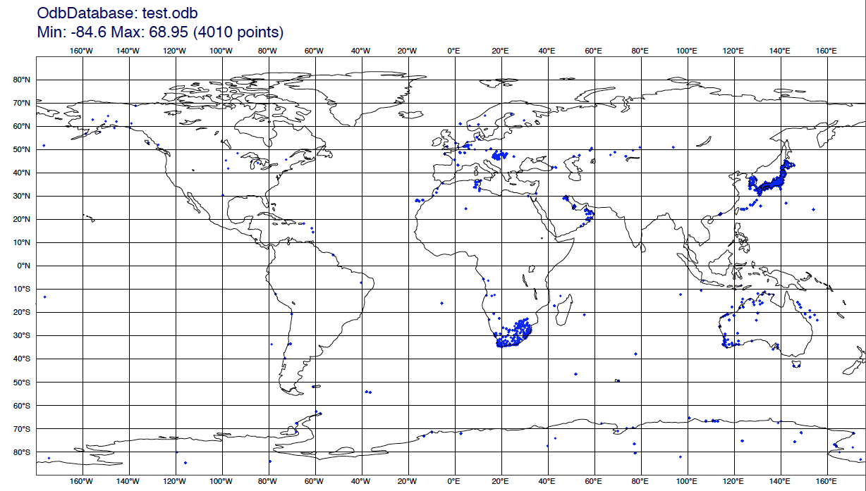
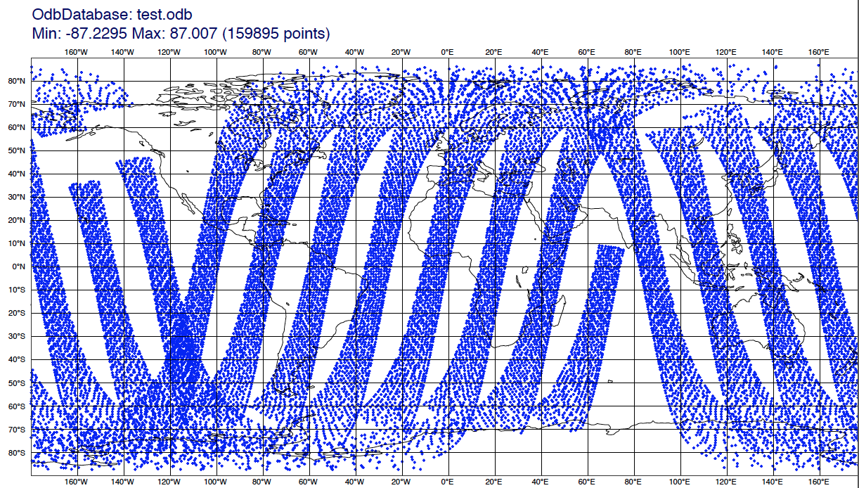
ODB Visualisation on cheyenne
installed Magics which offers a Python interface to plot ODB data
synop
amsua

