Slide 1
JEDI HofX test with 3DRTMA
JEDI HofX versus GSI observers

Slide 2
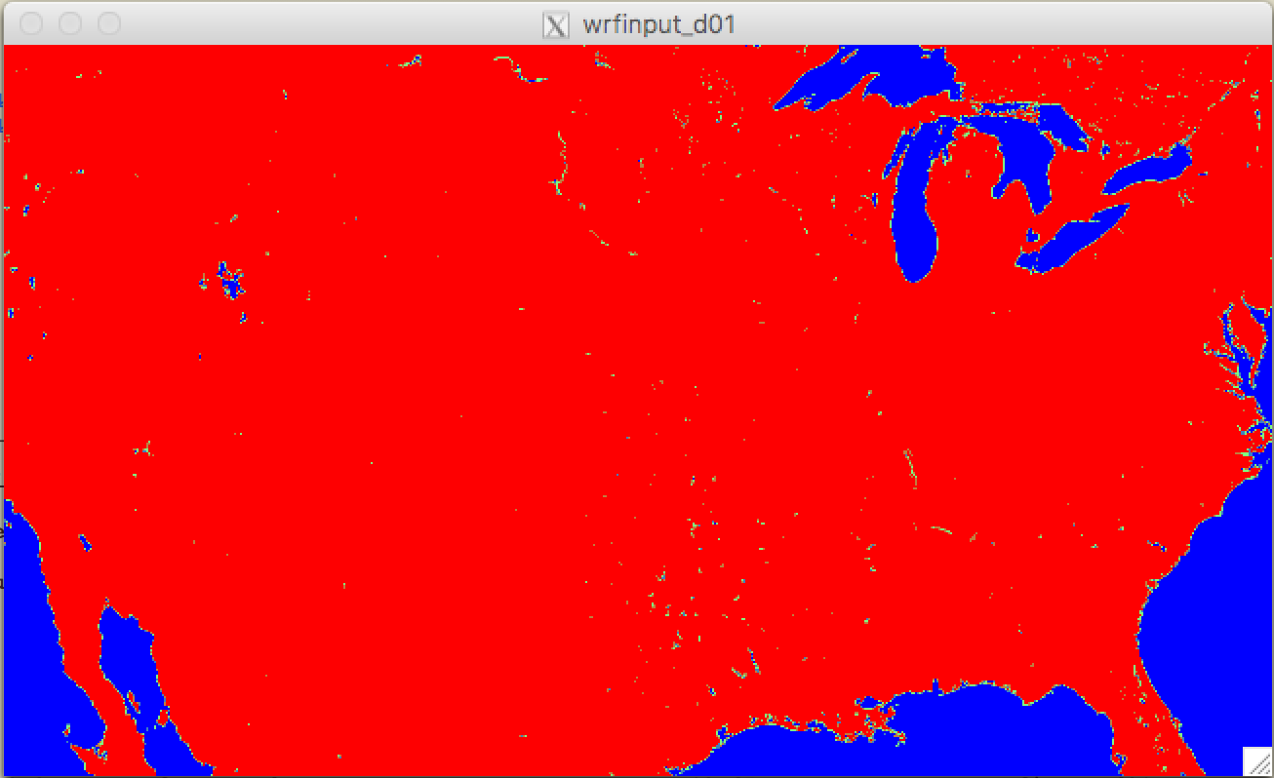
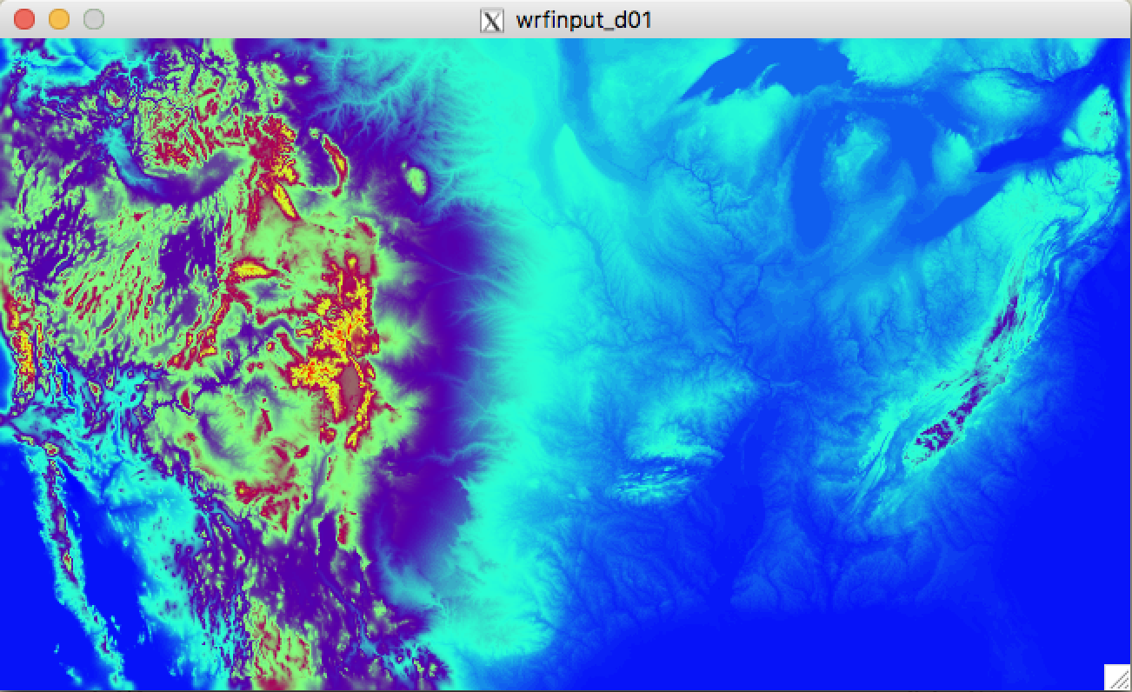
Test system
Landmask
Test case domain:
3km grid:
1300x750x50
Cover half of the HRRRx domain
Run twice per day at 00Z and 12Z on JET
Generate background for test
Run GSI generate Ncdiag files
Run ioda convertor to generate ioda files for GSI
Run WRF-JEDI hofx generate B for sounding observations
Compare O- B from HofX and O- B from GSI
Terrain

Slide 3
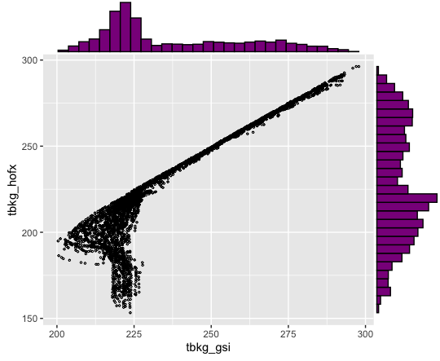
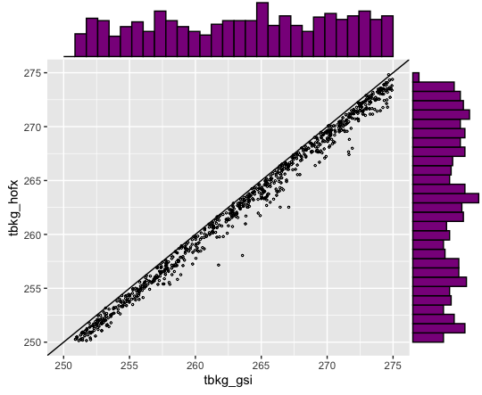
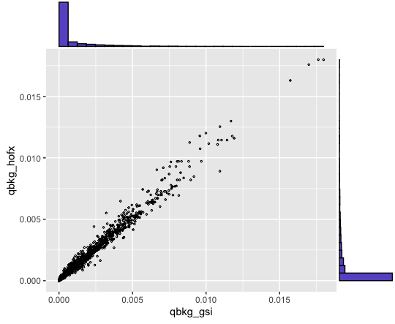
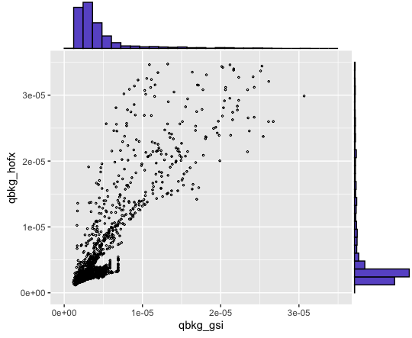
Compare B (background at observation location): first try with case 2020041412: sounding obs
Temperature
Temperature : zoom in high end
Scatter plots:
X = B from GSI observer
Y = B from HofX
Specific humidity
Specific humidity: zoom in low end

Slide 4
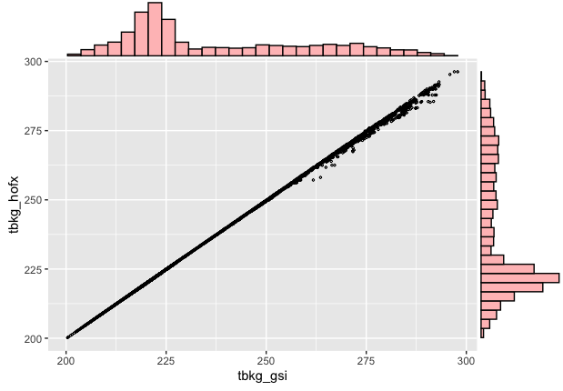
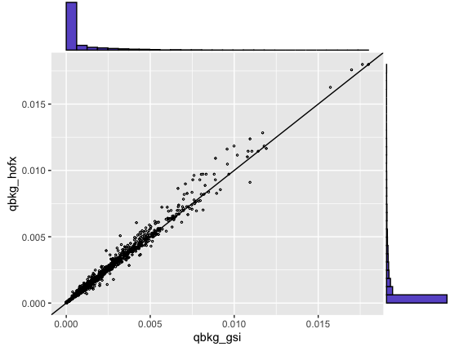
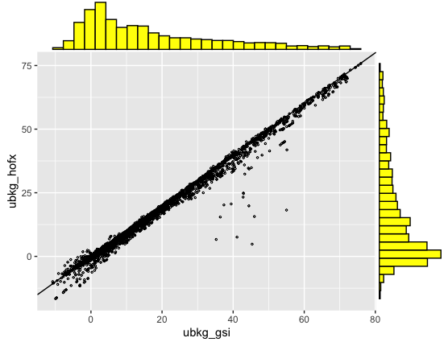
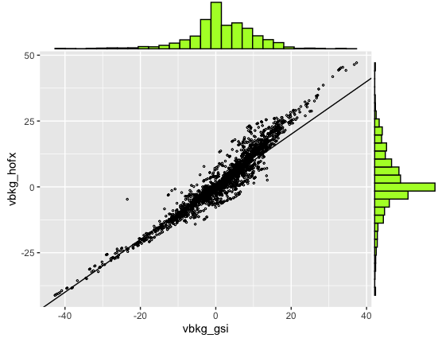
Compare B (background at observation location): after bug fix with case 2020041412: sounding obs
Temperature
Specific humidity
Scatter plots:
X = B from GSI observer
Y = B from HofX
U wind component
V wind component
BUG fixes;
Based on the first try, we found two bugs in 3D pressure calculation:
Need to calculate hybrid vertical coordinate
Model top value is missing

Slide 5
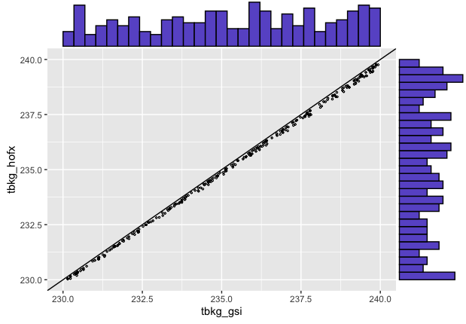
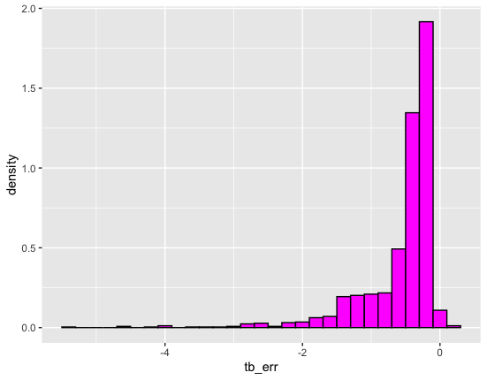
Compare B (background at observation location): after bug fix with case 2020041412: sounding obs
Temperature: zoom in 230K to 240 K range
Temperature
Temperature histogram: B Hofx – B GSI

Slide 6
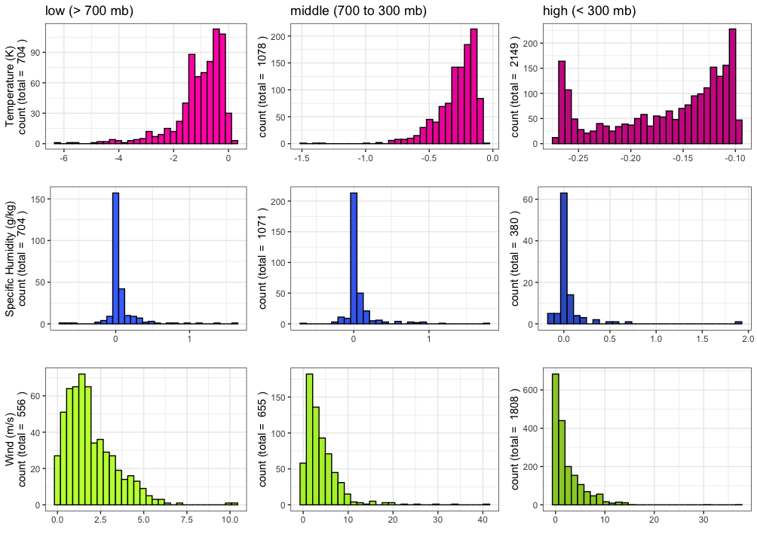

Slide 7
