Slide 1
Multivariate static covariance in MPAS-JEDI
BJ Jung ( on behalf of many )
at JEDI Discussing Meeting on June 4th 2020

Slide 2

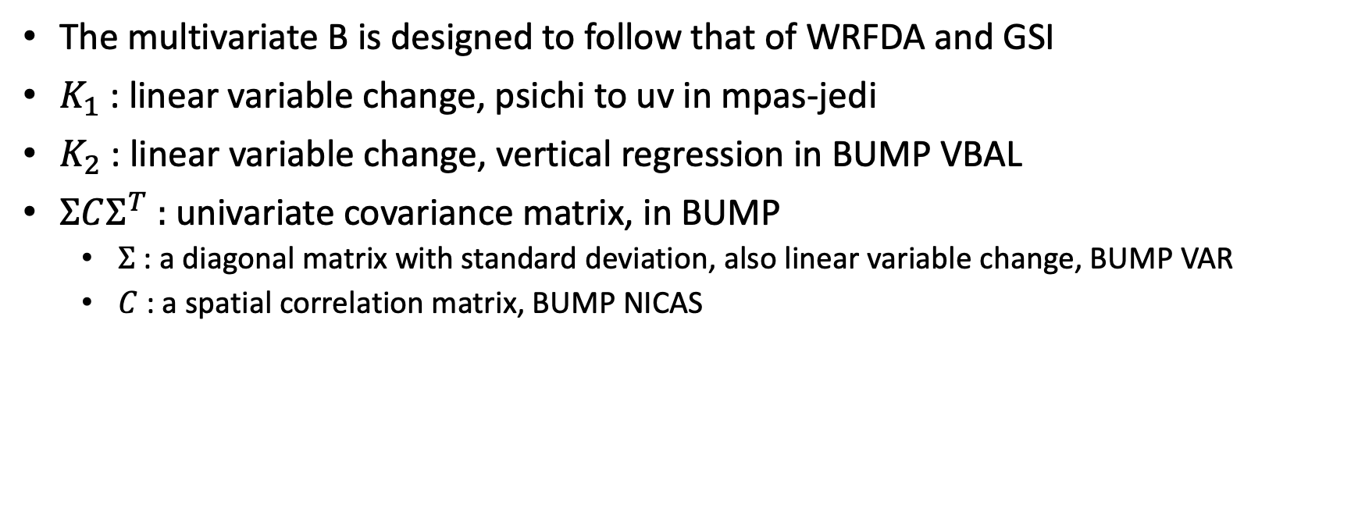
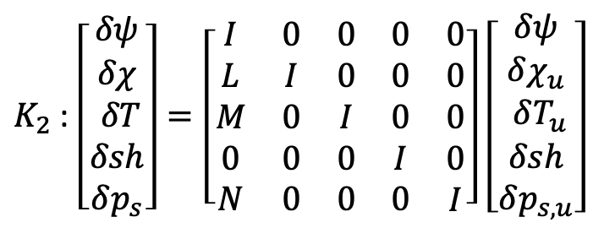

B design: overview
$$B=K_{1}K_{2}ΣCΣ^{T}K_{2}^{T}K_{1}^{T}$$
The multivariate B is designed to follow that of WRFDA and GSI
$K_{1}$ : linear variable change, psichi to uv in mpas-jedi
$K_{2}$ : linear variable change, vertical regression in BUMP VBAL
$ΣCΣ^{T}$ : univariate covariance matrix, in BUMP
  $Σ$ : a diagonal matrix with standard deviation, also linear variable change, BUMP VAR
  $C$ : a spatial correlation matrix, BUMP NICAS
$K_{1}$ : $\left[\begin{aligned}δu \\ δv \\ δT \\ δsh \\ δp_{s}\end{aligned}\right]=\left[\begin{matrix}\begin{aligned}−∂_{y} \\ ∂_{x} \\ 0 \\ 0 \\ 0\end{aligned} & \begin{aligned}−∂_{x} \\ −∂_{y} \\ 0 \\ 0 \\ 0\end{aligned} & \begin{matrix}\begin{aligned}0 \\ 0 \\ I \\ 0 \\ 0\end{aligned} & \begin{aligned}0 \\ 0 \\ 0 \\ I \\ 0\end{aligned} & \begin{aligned}0 \\ 0 \\ 0 \\ 0 \\ I\end{aligned}\end{matrix}\end{matrix}\right]$ $\left[\begin{aligned}δψ \\ δχ \\ δT \\ δsh \\ δp_{s}\end{aligned}\right]$
$K_{2}$ : $\left[\begin{aligned}δψ \\ δχ \\ δT \\ δsh \\ δp_{s}\end{aligned}\right]=\left[\begin{matrix}\begin{aligned}I \\ L \\ M \\ 0 \\ N\end{aligned} & \begin{aligned}0 \\ I \\ 0 \\ 0 \\ 0\end{aligned} & \begin{matrix}\begin{aligned}0 \\ 0 \\ I \\ 0 \\ 0\end{aligned} & \begin{aligned}0 \\ 0 \\ 0 \\ I \\ 0\end{aligned} & \begin{aligned}0 \\ 0 \\ 0 \\ 0 \\ I\end{aligned}\end{matrix}\end{matrix}\right]$ $\left[\begin{aligned}δψ \\ δχ_{u} \\ δT_{u} \\ δsh \\ δp_{s,u}\end{aligned}\right]$

Slide 3
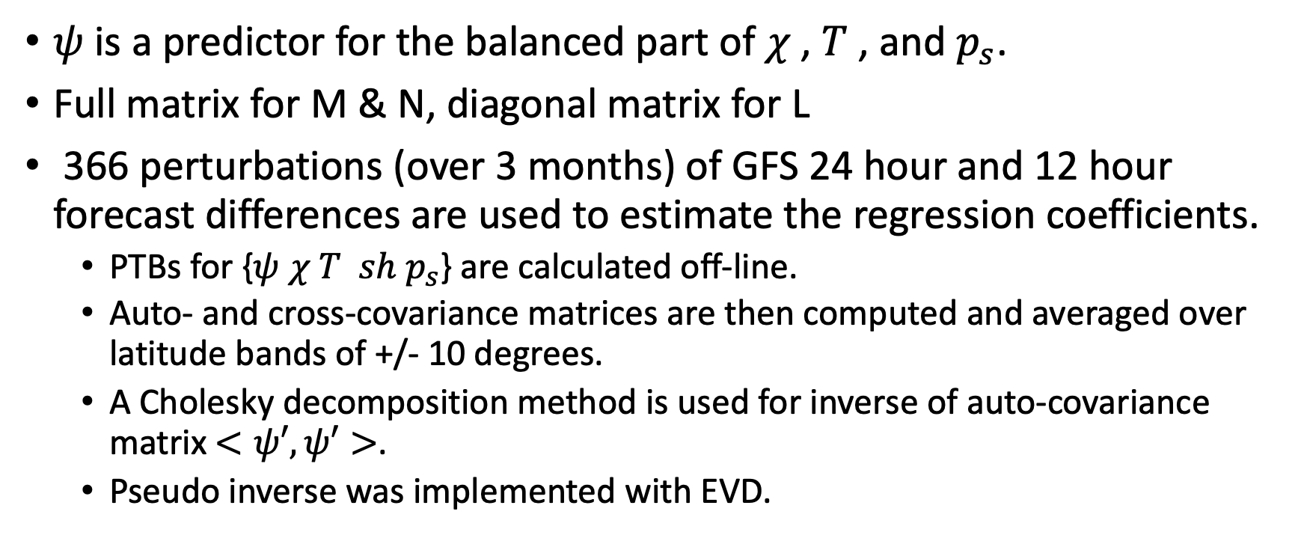
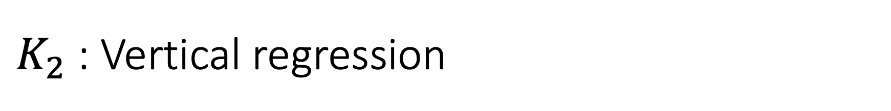

$K_{2}$ : Vertical regression
$K_{2}$ : $\left[\begin{aligned}δψ \\ δχ \\ δT \\ δsh \\ δp_{s}\end{aligned}\right]=\left[\begin{matrix}\begin{aligned}I \\ L \\ M \\ 0 \\ N\end{aligned} & \begin{aligned}0 \\ I \\ 0 \\ 0 \\ 0\end{aligned} & \begin{matrix}\begin{aligned}0 \\ 0 \\ I \\ 0 \\ 0\end{aligned} & \begin{aligned}0 \\ 0 \\ 0 \\ I \\ 0\end{aligned} & \begin{aligned}0 \\ 0 \\ 0 \\ 0 \\ I\end{aligned}\end{matrix}\end{matrix}\right]$ $\left[\begin{aligned}δψ \\ δχ_{u} \\ δT_{u} \\ δsh \\ δp_{s,u}\end{aligned}\right]$
$ψ$ is a predictor for the balanced part of $χ$ , $T$ , and $p_{s}$.
Full matrix for M & N, diagonal matrix for L
366 perturbations (over 3 months) of GFS 24 hour and 12 hour forecast differences are used to estimate the regression coefficients.
  PTBs for {$ψ$ $χ$ $T { sh p}_{s}$} are calculated off-line.
  Auto- and cross-covariance matrices are then computed and averaged over latitude bands of +/- 10 degrees.
  A Cholesky decomposition method is used for inverse of auto-covariance matrix $<ψ′,ψ′>$.
  Pseudo inverse was implemented with EVD.

Slide 4
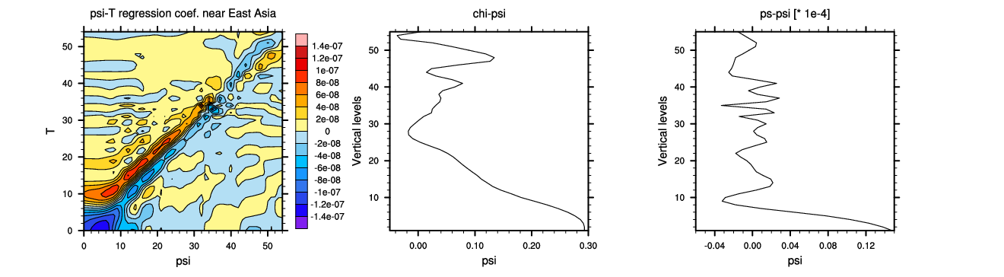
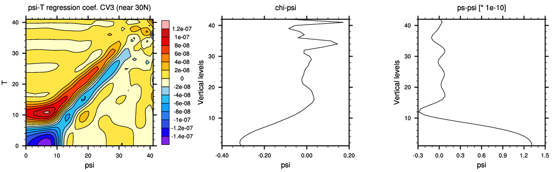
366 members, Pseudo inverse (20 modes)
cond(A) | 80 | 366
full | 1.59E+09 | 5.09E+07
20 | 8.15E+02 | 7.30E+02
CV3 (Global GSI) from WRFDA
Ln(ps) - psi

Slide 5
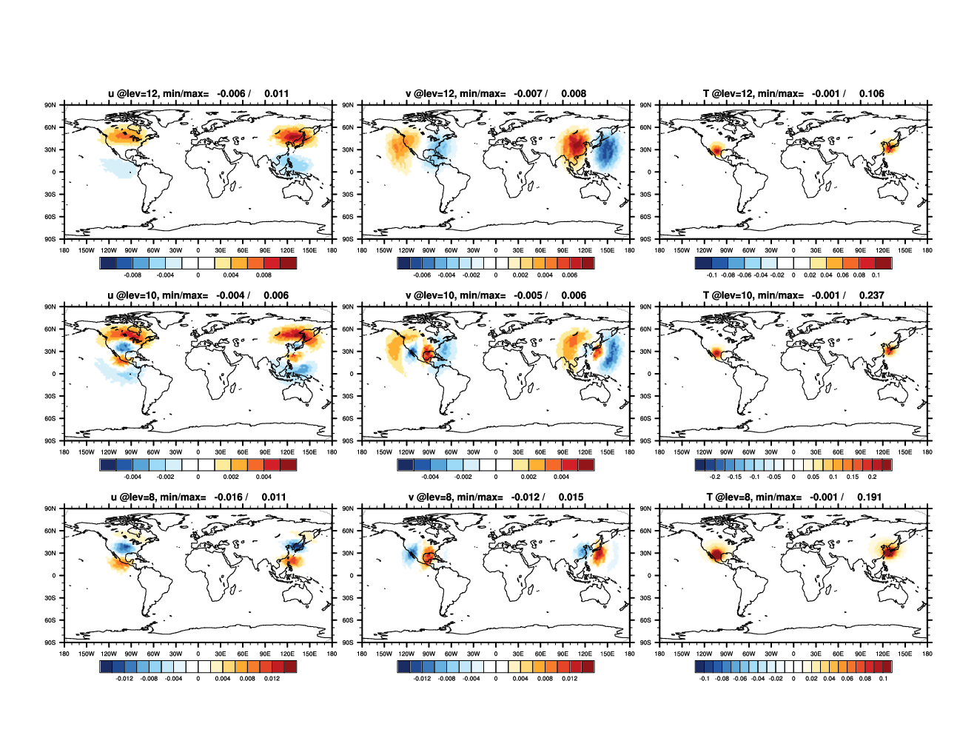
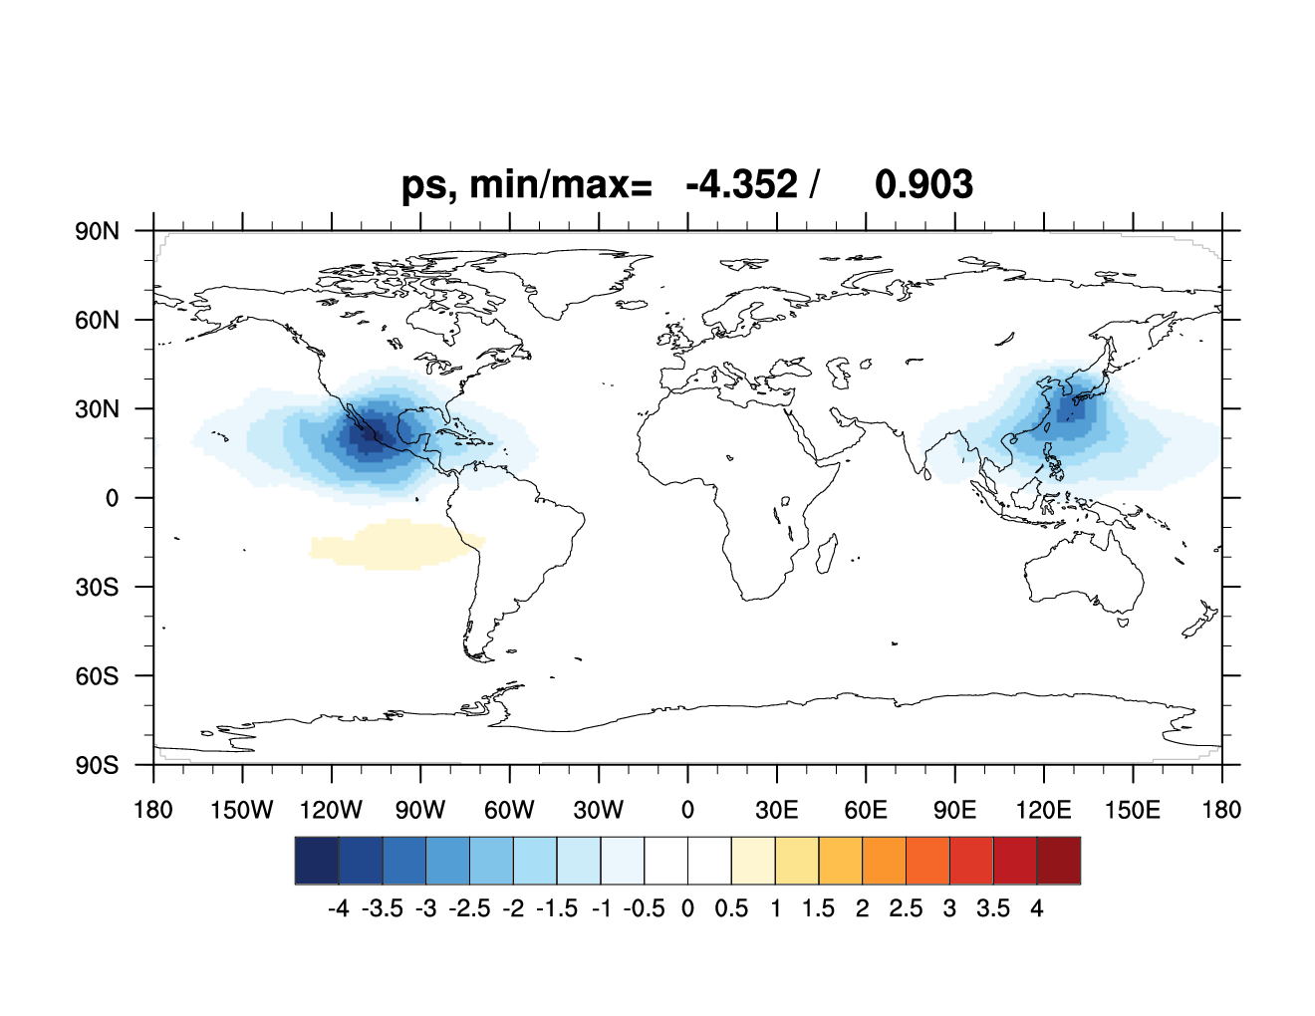
T obs : Both H&V length scales from HDIAG
1 K innov. @ lev=10

Slide 6
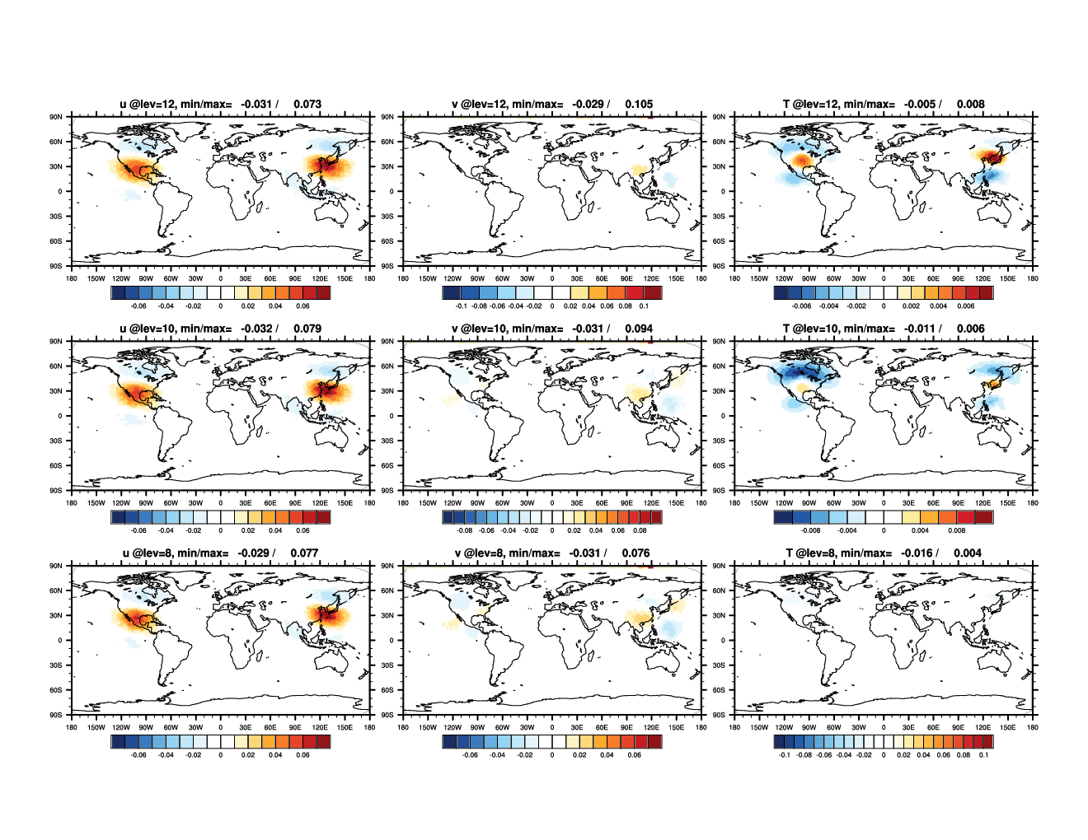
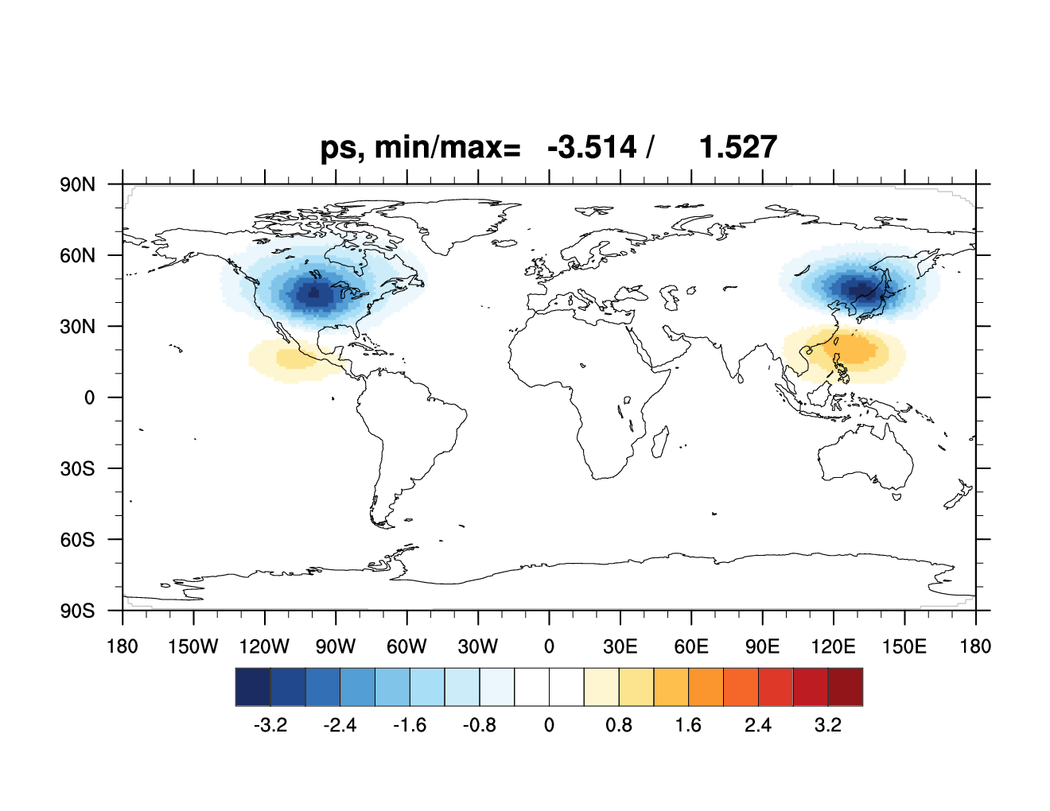
U obs : Both H&V length scales from HDIAG
1 m/s innov. @ lev=10

Slide 7
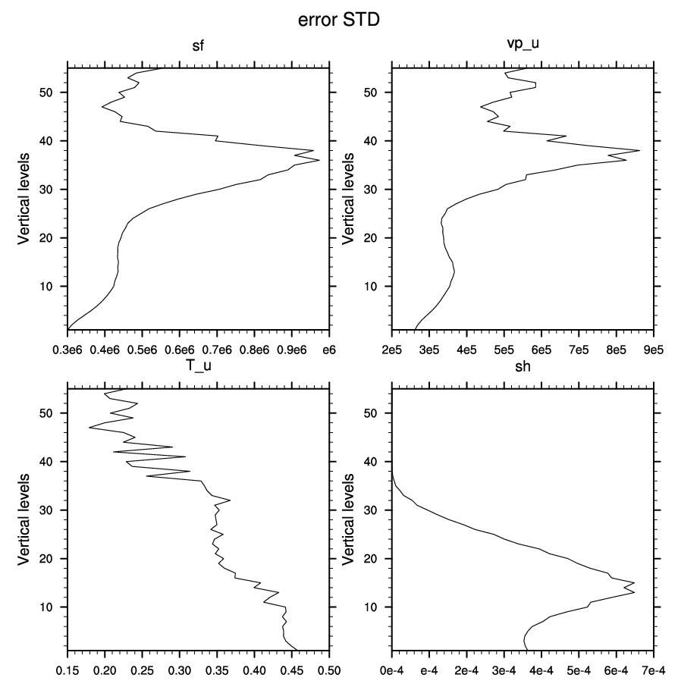
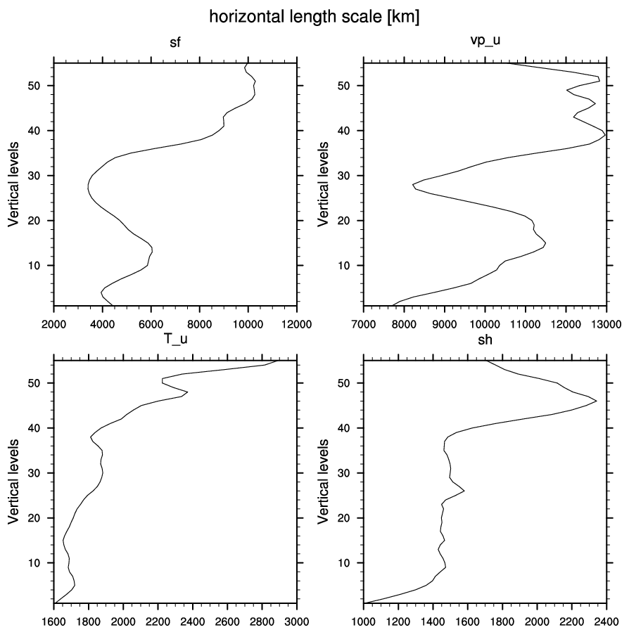
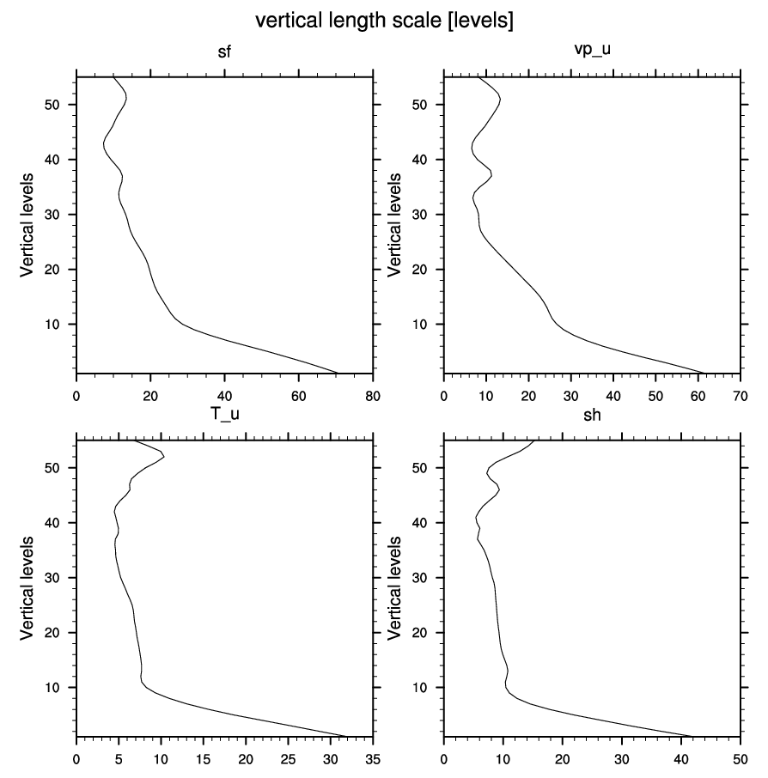
366 member, 20 modes
I feel this looks strange.
Especially, too large length scale at the lowest levels.
Ps_u : 38.35 Pa
Ps_u : 4453 km

