Slide 1

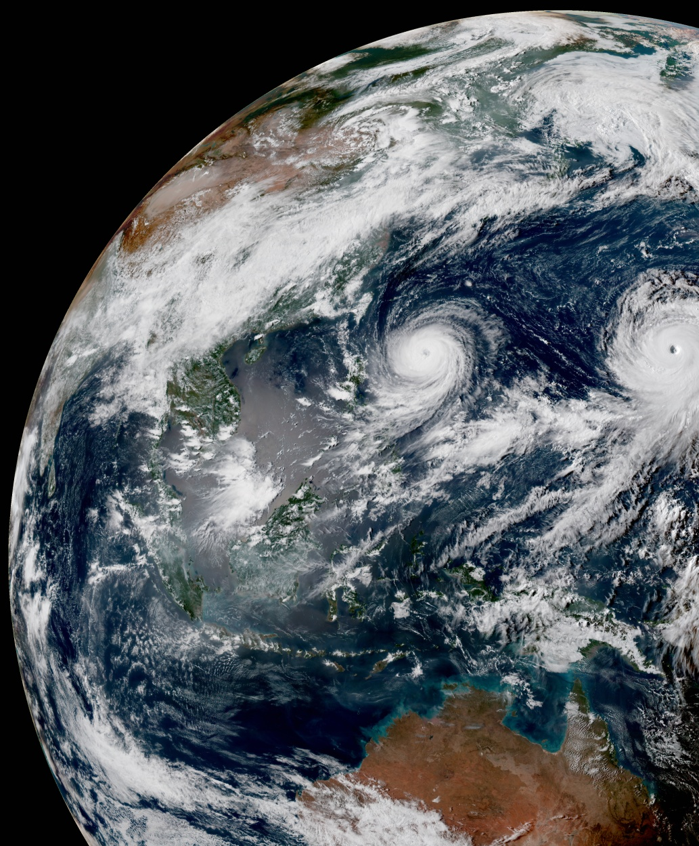
Ioda Engines: New interface and data model for observation data
Stephen Herbener
Ryan Honeyager
July 2, 2020

Slide 2
Motivation
Bring a consistent interface and data model to all the classes that work with observation data
Fix issues with current ObsSpace
  E.g., radiance data stored as a set of vectors instead of 2D data (locations x channels)
Eliminate duplicated code
  Similarities between ObsSpace, ObsVector, ObsDataVector, ObsDiagnostics and GeoVaLs

Slide 3
Ioda Engines: Data model
Group
Based on HDF5 data model
Analogous to a file system
  Groups (Directories)
  Variables (Files)
  Attributes can be attached to both Groups and Variables
Groups
Attributes
Variables
Attributes

Slide 4
Frontend and backend
The picture on previous slide shows the “frontend” of the interface
  The frontend is what the client uses to access the data store
  The frontend is intended to remain stable
The interface is structured so that multiple ”backends” can be attached
  The backend is the implementation of the data store
  Currently have the following backends:
    HDF5 (file, NetCDF is HDF5 underneath)
    ObsStore (in-memory)
It’s possible to add new backends (e.g., ODC)
The frontend (interface) is powered by the various backends, thus the name ioda-engines.

Slide 5
Variables and attributes
Both variables and attributes are dimensioned
  Support for n-dimensional shaped data
  Attribute dimensions are specified using a vector of sizes
  Variable dimensions are specified using ”dimension scales”
    A dimension scale is a separate variable that holds the coordinate values for the axis it represents
Both variables and attributes can be of the following data types
  Fundamental (int, float, char, etc.)
  String
It’s possible to add custom object types (e.g., DateTime)

Slide 6
Benefits
Common interface and data model for JEDI classes that work with observation data
Support for multi-dimensioned variables
  Brightness_temperature can be a single 2D (locations x channels) variable
  Can go to a higher rank than 2D
    E.g., marine wave spectra, 3D (locations x directions x frequencies)
No more character arrays for “vector of strings” variables
  Multi-dimensioned variables can contain varying length strings
Variables can retain attributes from IODA input to output
  E.g., units

Slide 7
Ioda Engines: Application interface
Separation of concerns
  Clients need access to observation data
  Clients don’t need to know how the permanent storage (file) is implemented
This frees up the implementation of the permanent storage to evolve over time, while keeping the frontend of the interface stable
  Direct access to AWS object storage
    HDF5 already has its own backend for this
  Network socket streams

Slide 8
Application interface structure
New class in ioda-engines called ObsGroup
  Derived from Group
  Access to observation data
  Encapsulates the file IO functionality
Idea is to create an ObsGroup instance and work with its functions to access observation data (avoiding direct interaction with file IO)
This part of the interface is under development
The remainder of the talk is given in the context of creating a IODA converter

Slide 9
ObsGroup notes
ObsGroup is a specialization of the generic Group class
  Holds dimension scale descriptions
  Provides helper functions for data access
  Encapsulates the Group/Variable structure in an ObsSpace
ObsGroup construction
  Generate an ObsGroup with the selected backend
  Set all dimension scales that will be used by the variables

Slide 10
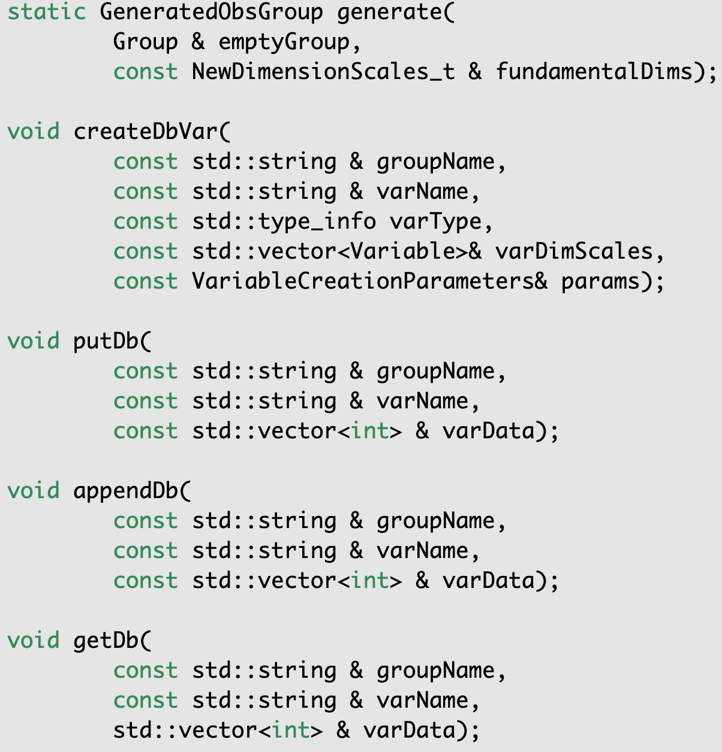
ObsGroup functions
generate()
  The backend selection returns an empty Group object which is used for the Group argument
  NewDimensionScales_t is a vector of dimension initializations
  See example
createDbVar()
  The params argument is a structure that holds initialization parameters for variable creation
  See example
These functions help maintain compatibility with the existing ObsSpace interface

Slide 11
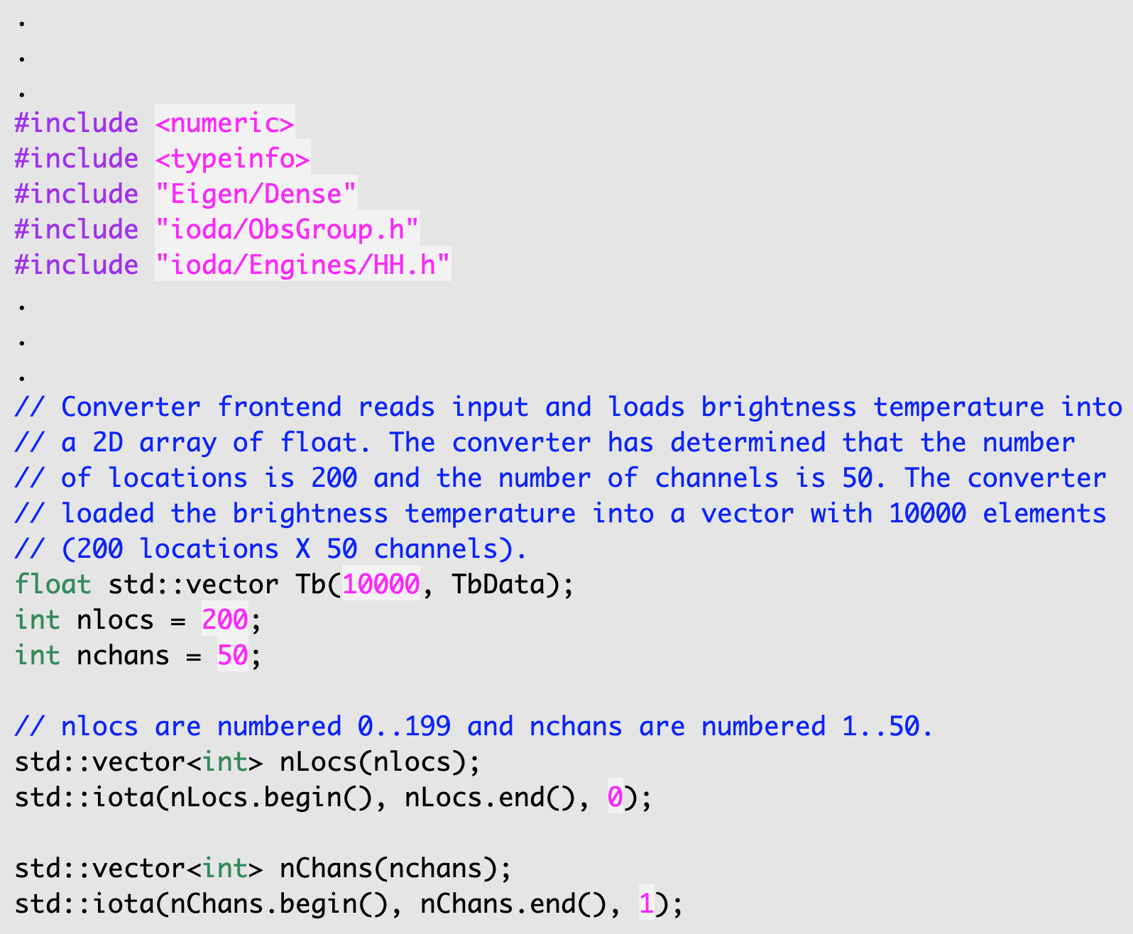
Example: Converter
Converter
Radiance obs type
Brightness Temperature, T_{b}
  200 locations
  50 channels
First dimension is locations
  Numbered 0 – 199
Second dimension is channels
  Numbered 1 - 50

Slide 12
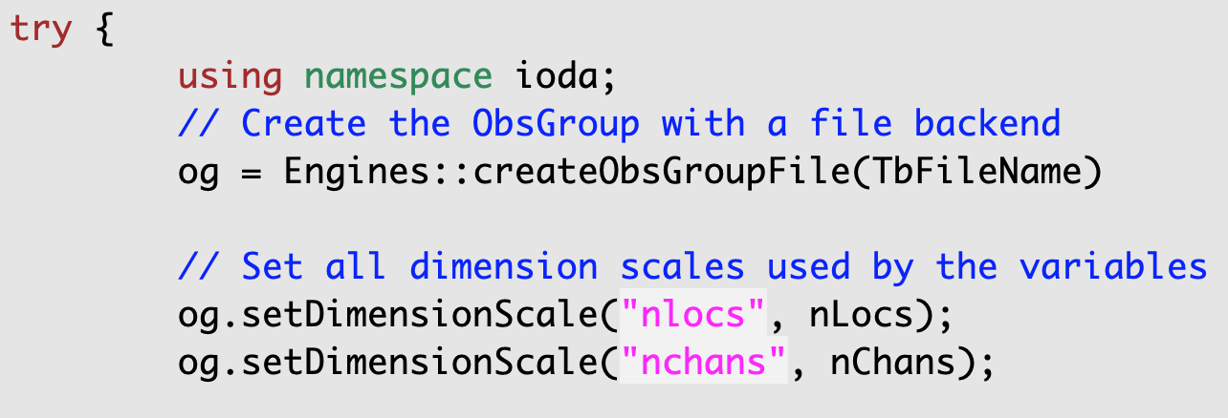
Create ObsGroup instance with dimensions
Construct the ObsGroup
Create Dimension Scales
  Coordinate values associated with nlocs and nchans

Slide 13
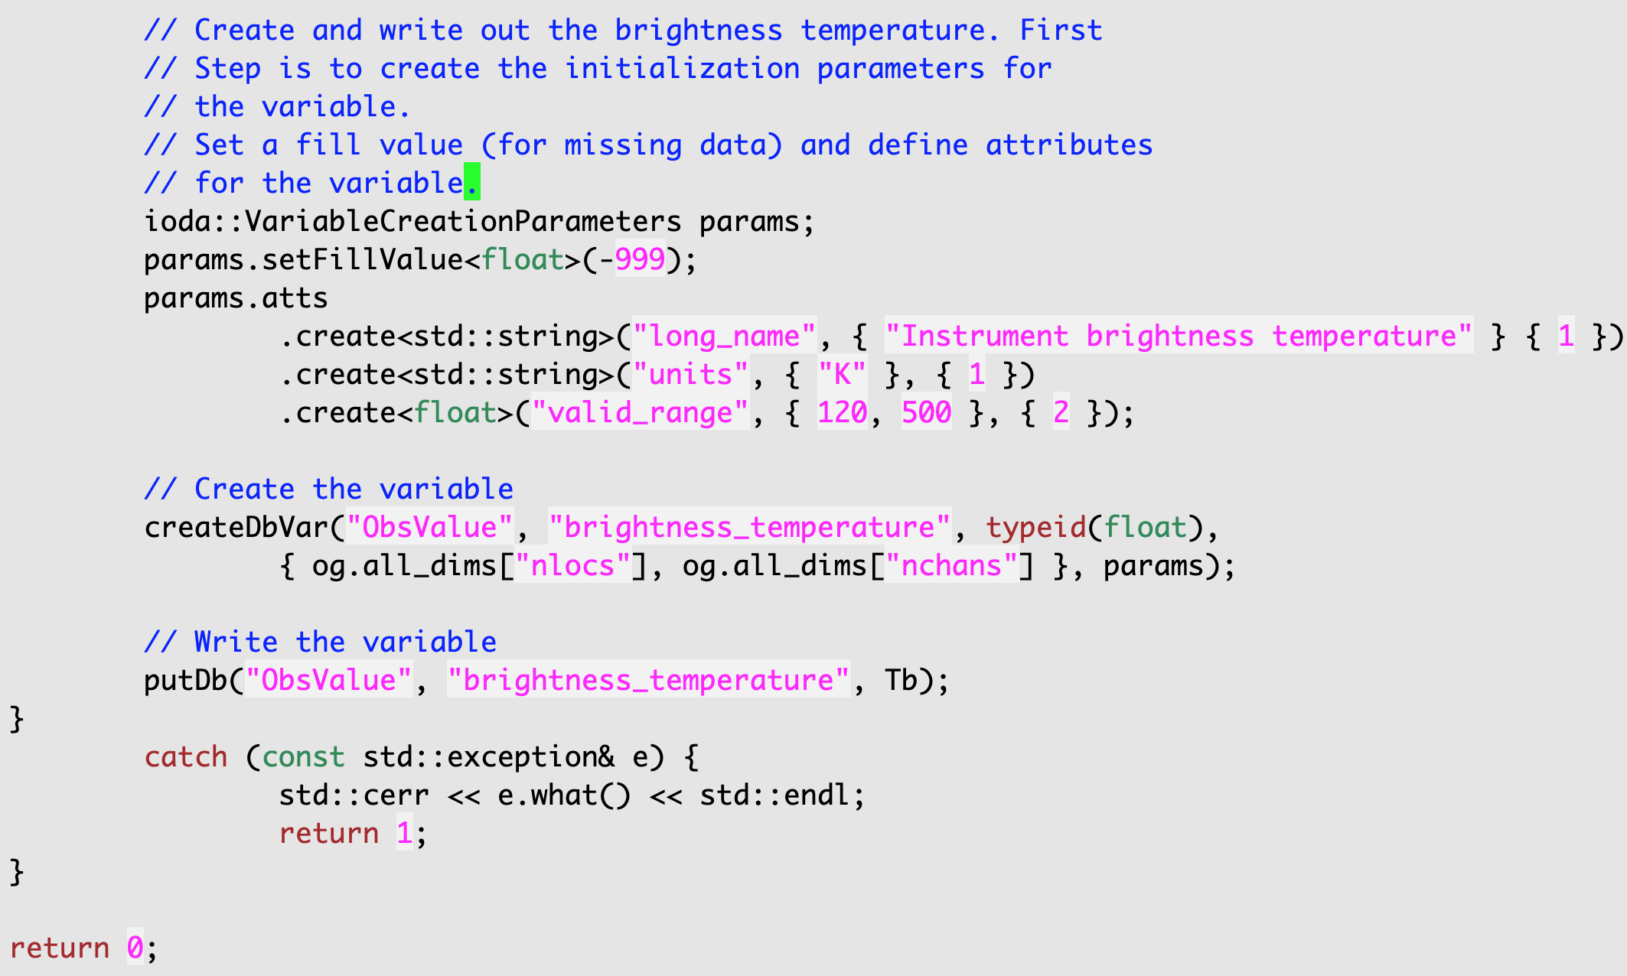
Create and write the variable
Create the variable initialization object
  VariableCreateParameters
Create the variable
  Assign two dimensions: nlocs and nchans
Write the variable

Slide 14
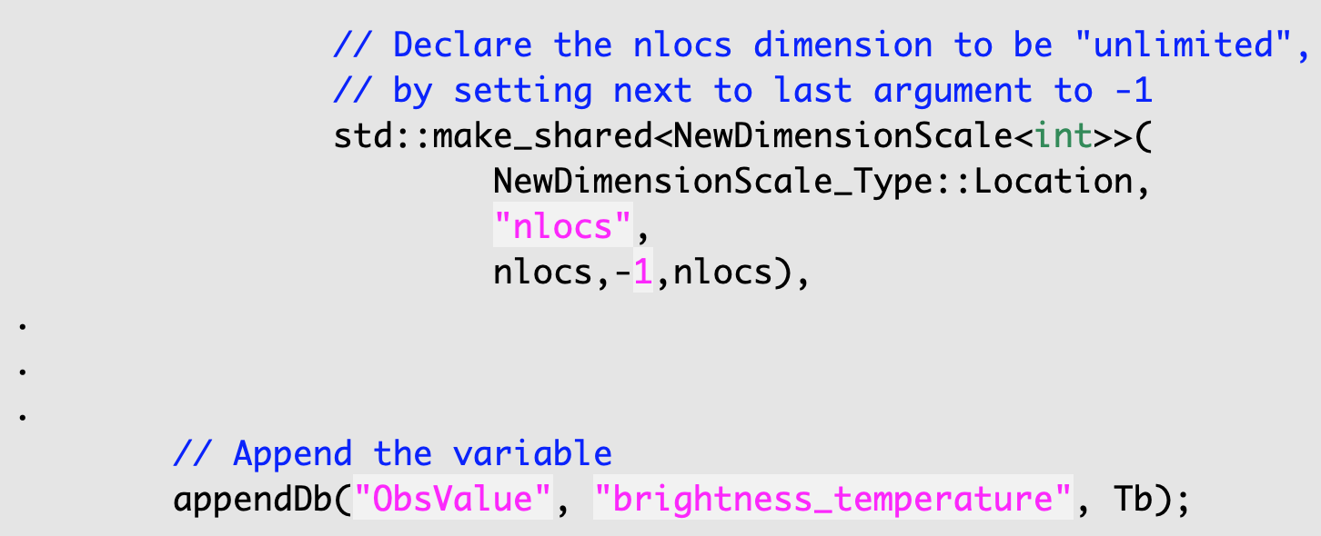
Append to the variable
Say you have a large input file and you don’t want to read the entire file into memory
You can divide the file up into sections, and transfer section by section into the output file
  Do a createDbVar(), putDb() for the first section
  Do an appendDb() for all subsequent sections
appendDb() will resize on the first dimension (nlocs), so you need to declare the nlocs dimension to be “unlimited”

