Slide 1
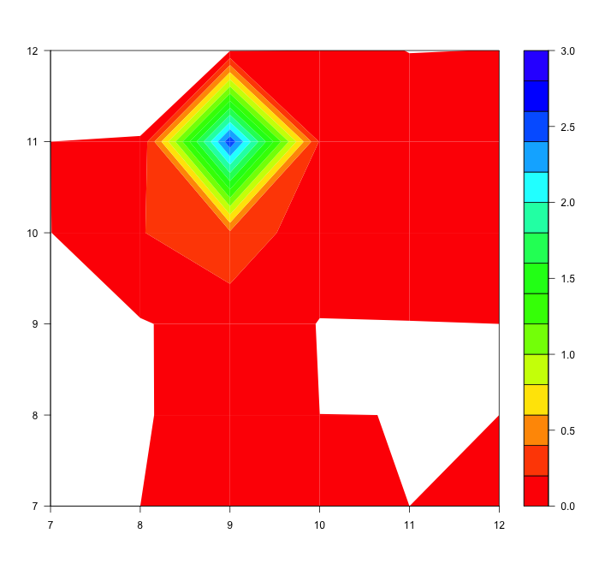
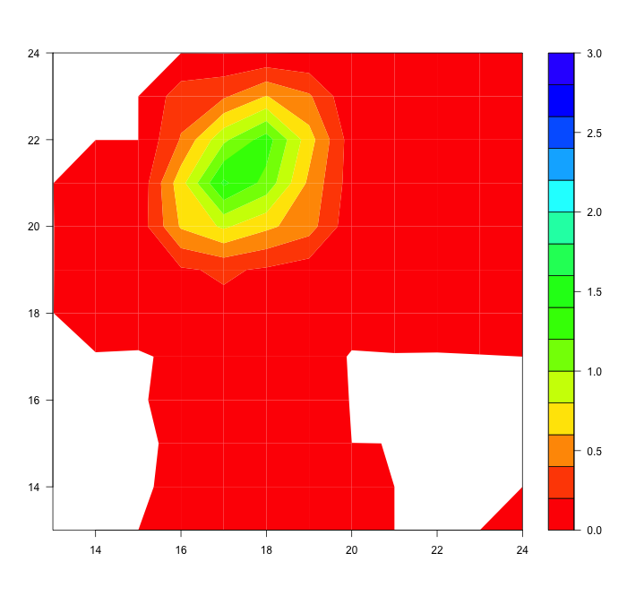
3DEnVar double-resolution problem
dust1 increment
cost_function:
Jb:
Background:
state:
- filetype: gfs
datapath: Data/inputs/gfs_aero_c24/
filename_core: 20180415.000000.fv_core.res.nc
filename_trcr: 20180415.000000.fv_tracer.res.nc
filename_cplr: 20180415.000000.coupler.res
variables: ["T","DELP","sphum",
"sulf","bc1","bc2","oc1","oc2",
"dust1","dust2","dust3","dust4","dust5",
"seas1","seas2","seas3","seas4"]
Covariance:
covariance: hybrid
static_weight: '0.01'
ensemble_weight: ‘1.0'
static:
date: '2018-04-15T00:00:00Z'
covariance: FV3JEDIstatic
ensemble:
date: '2018-04-15T00:00:00Z'
variables: ["sulf","bc1","bc2","oc1","oc2",
"dust1","dust2","dust3","dust4","dust5",
"seas1","seas2","seas3","seas4"]
members:
- filetype: gfs
datapath: Data/inputs/gfs_aero_c12/mem001/
filename_trcr: 20180415.000000.fv_tracer.res.nc
filename_cplr: 20180415.000000.coupler.res
- filetype: gfs
……
C12
C24

Slide 2
FGAT problem
cost_function:
Jb:
Background:
state:
- filetype: gfs
datapath_tile: Data/inputs/gfs_aero_c12/bkg/
filename_core: 20180414.210000.fv_core.res.nc
filename_trcr: 20180414.210000.fv_tracer.res.nc
filename_cplr: 20180414.210000.coupler.res
variables: ["T","DELP","sphum",
"sulf","bc1","bc2","oc1","oc2",
"dust1","dust2","dust3","dust4","dust5",
"seas1","seas2","seas3","seas4"]
Covariance:
covariance: hybrid
static_weight: '0.01'
ensemble_weight: '1.0'
static:
date: '2018-04-15T00:00:00Z'
covariance: FV3JEDIstatic
ensemble:
date: '2018-04-15T00:00:00Z'
variables: ["sulf","bc1","bc2","oc1","oc2",
"dust1","dust2","dust3","dust4","dust5",
"seas1","seas2","seas3","seas4"]
members:
- filetype: gfs
datapath_tile: Data/inputs/gfs_aero_c12/mem001/
filename_trcr: 20180414.210000.fv_tracer.res.nc
filename_cplr: 20180414.210000.coupler.res
- filetype: gfs
……
Does not care what time of ensemble covariance is
How to assimilate observations that occurred before the first forecast?
e.g. what if we wanted to center at
2018-04-15T00:00:00Z
and assimilate obs from
2018-04-14T21:00:00 Z to
2018-04-15T03:00:00Z

Slide 3
ObsBias issue
float aerosol_optical_depth_4@KnownObsBias(nlocs) ;
float aerosol_optical_depth_4@ObsBias(nlocs) ;
End Jo Observation Equivalent
Jo Departures:
Aod nobs= 6 Min=-2.48959, Max=-0.0976832, RMS=2.00232
End Jo Departures
Jo Bias Corrected Departures:
Aod nobs= 6 Min=-2.48959, Max=-0.0976832, RMS=2.00232
End Jo Bias Corrected Departures
ObsData::printJo not implemented
Test : CostJo : Nonlinear Jo(Aod) = 201.641, nobs = 6, Jo/n = 33.6068, err = 0.212603
Test : CostFunction: Nonlinear J = 201.641
CostJb: FG-BG
End Jo Observation Equivalent
Jo Departures:
Aod nobs= 6 Min=-2.48959, Max=-0.0976832, RMS=2.00232
End Jo Departures
Jo Bias Corrected Departures:
Aod nobs= 6 Min=-2.45459, Max=-0.0866832, RMS=1.97359
End Jo Bias Corrected Departures
ObsData::printJo not implemented
Test : CostJo : Nonlinear Jo(Aod) = 191.531, nobs = 6, Jo/n = 31.9219, err = 0.212603
Test : CostFunction: Nonlinear J = 191.531
CostJb: FG-BG

