Slide 1
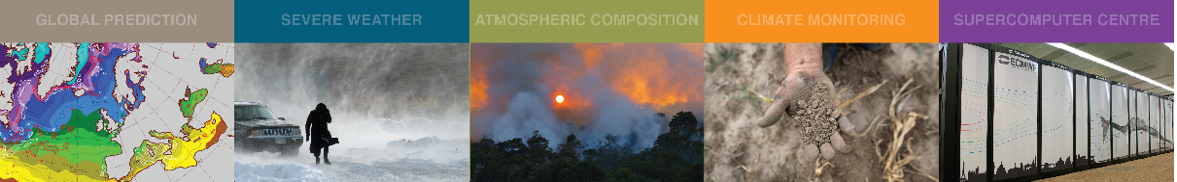
Atlas introduction
July 2020, JEDI discussion meeting
Willem Deconinck
willem.deconinck@ecmwf.int

Slide 2

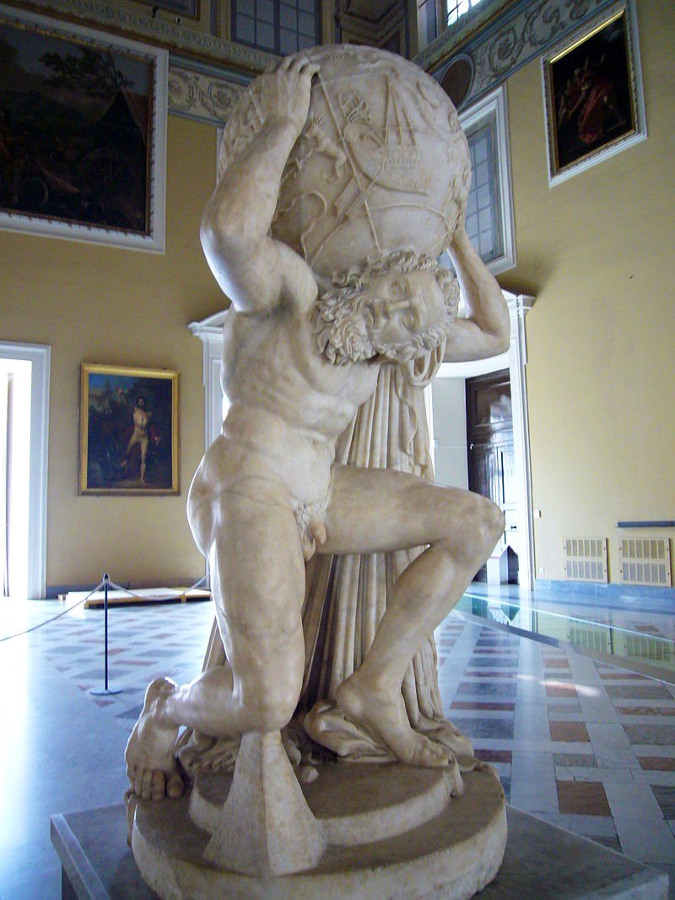
Atlas, a library for NWP and climate modelling – Deconinck et al. 2017, J-CPC
A new foundation built with future challenges for HPC in mind
Modern C++ library implementation with modern
Fortran 2008 (OOP) interfaces → integration in existing models
Data structures to enable new numerical algorithms,
e.g. based on unstructured meshes
Separation of concerns:
  Parallelisation
  Accelerator-awareness (GPU/CPU/…)
Readily available operators
  Remapping and interpolation
  Gradient, divergence, laplacian
  Spherical Harmonics transforms
Support structured and unstructured grids (global as well as regional)

Slide 3
Atlas, a library for NWP and climate modelling – Deconinck et al. 2017, J-CPC
Open-source (Apache 2.0), http://github.com/ecmwf/atlas
Continuous Integration:
  Travis [public] ( compilers: Clang, GNU, PGI ; platforms: Linux, OSX)
  Bamboo [in-house] ( compilers: Intel, Cray, GNU, PGI, Clang )
Documentation (Needs much more work),
https://sites.ecmwf.int/docs/atlas/

Slide 4
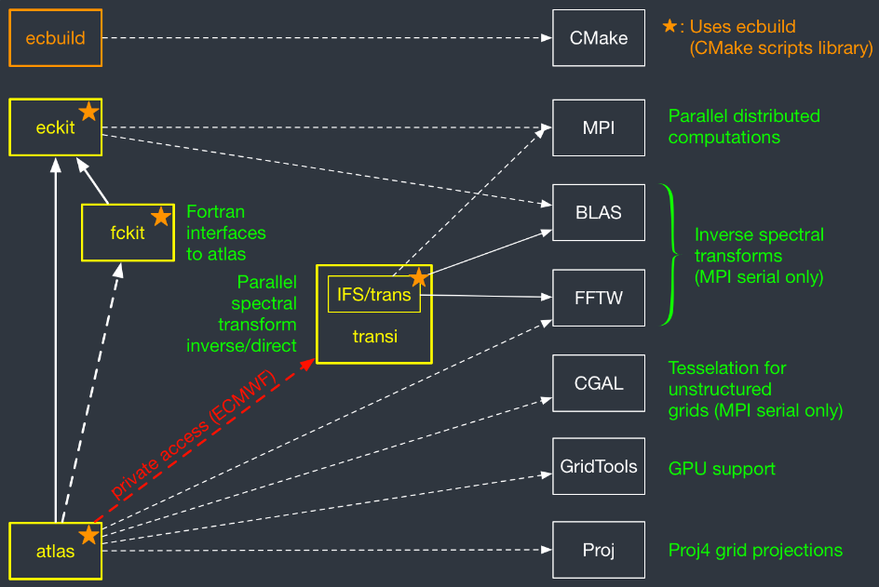
Atlas dependencies and requirements
Linux, OSX, …
→ POSIX
Compilers:
C++ 11
Fortran2008

Slide 5
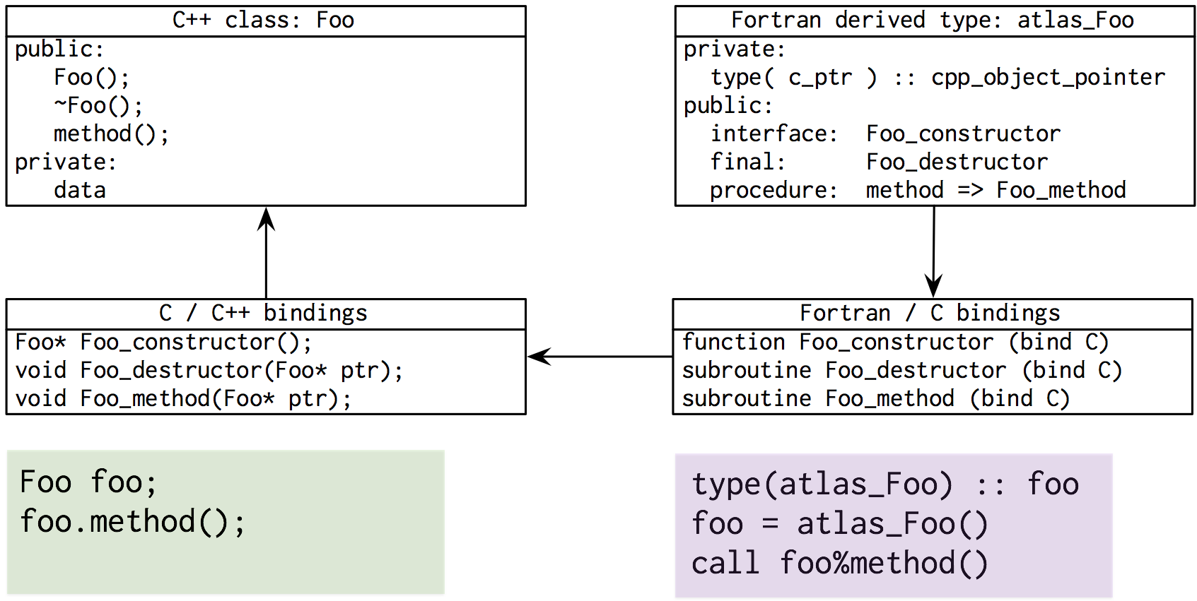
Object oriented design C++ / Modern Fortran

Slide 6
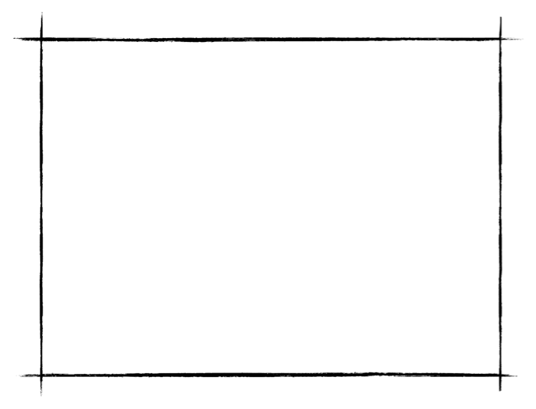
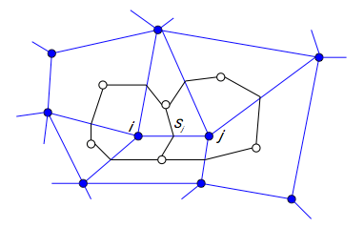
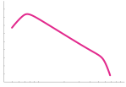
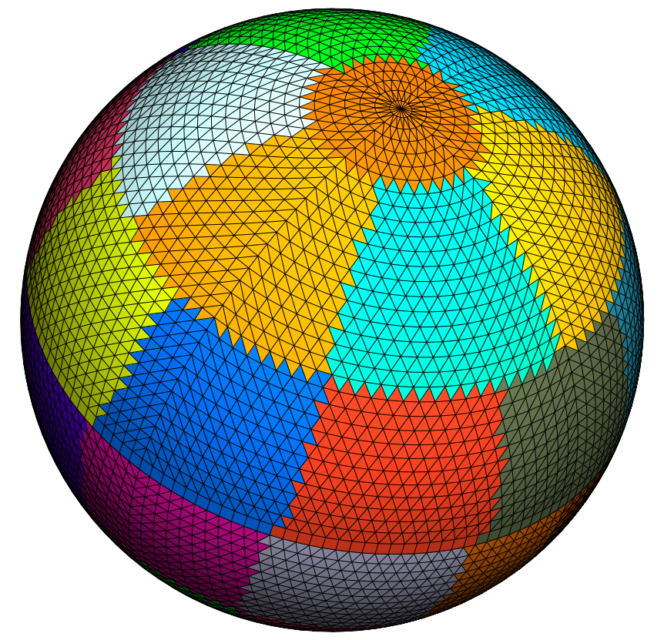


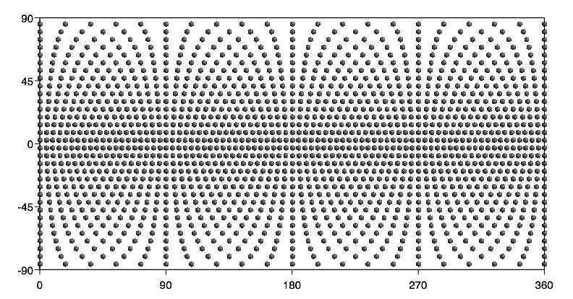

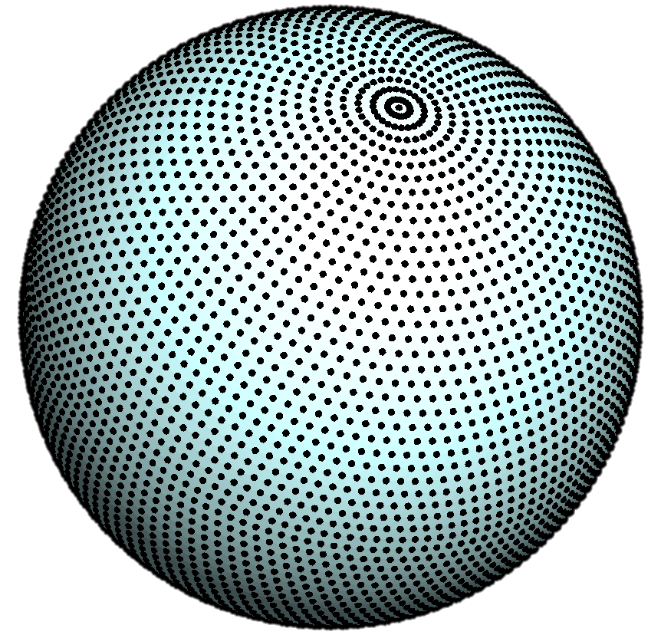

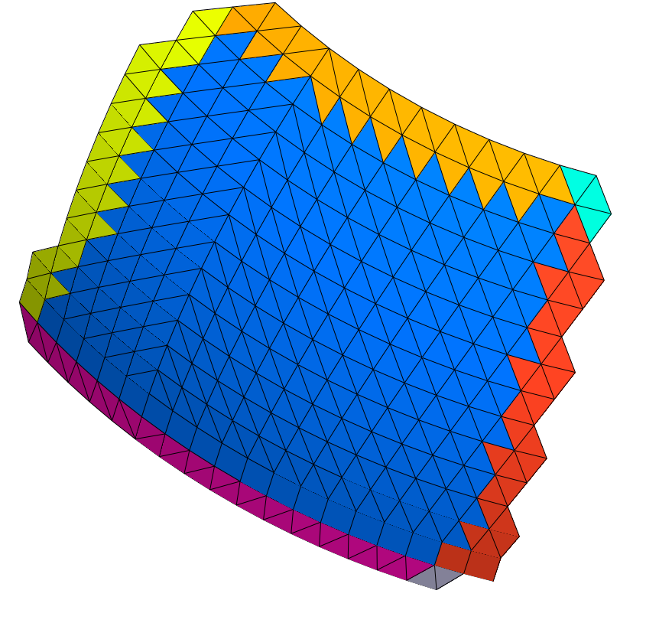
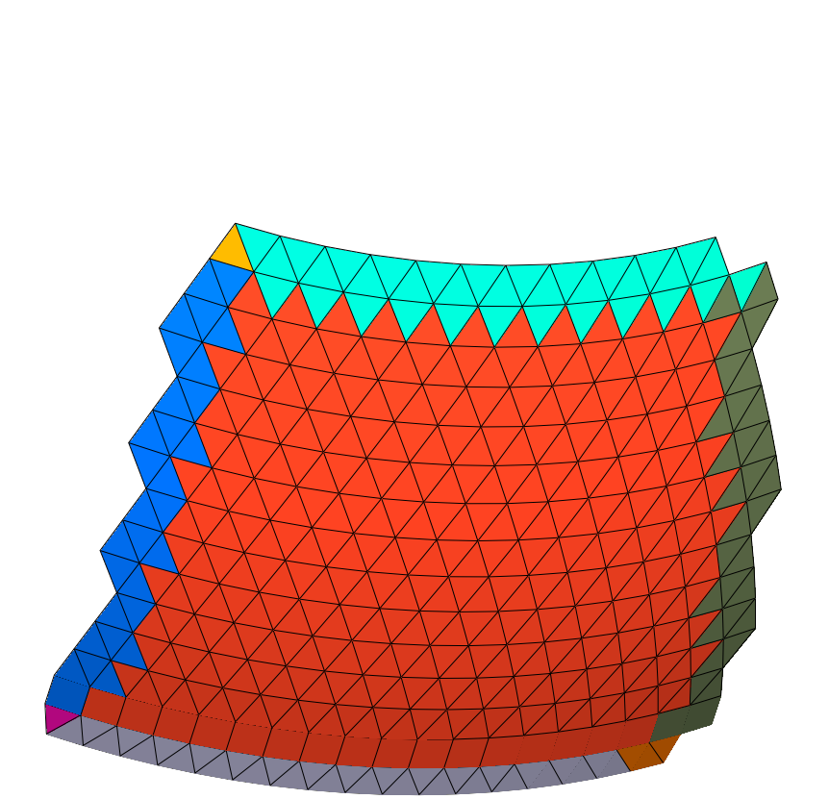
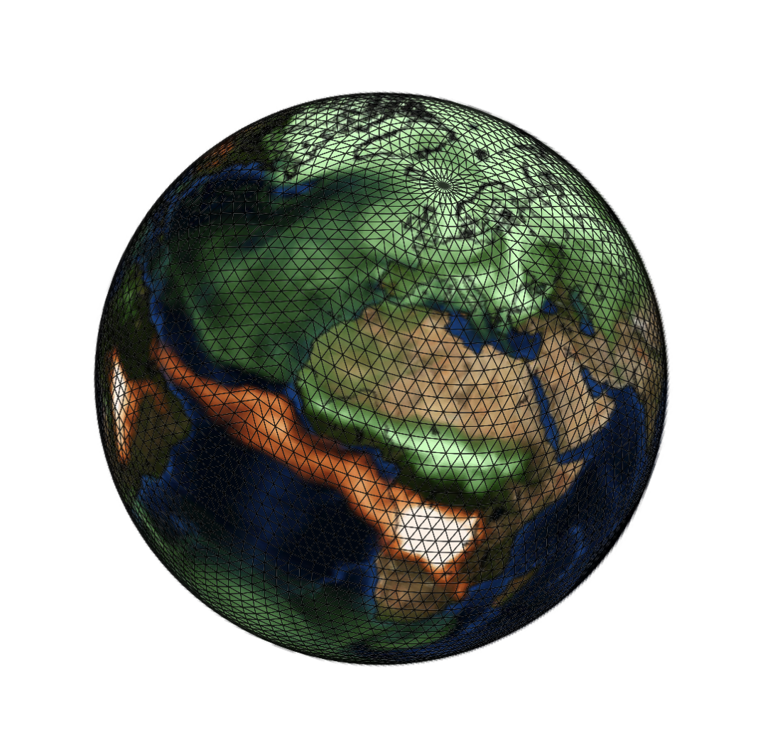

Atlas typical workflow
FunctionSpace
Mesh
Octahedral Gaussian grid (O32)
Finite Volume
Spectral
Transforms
The octahedral Gaussian grid is a “StructuredGrid"
Grid
Finite Element
Discontinuous
Spectral Element
Partitions
with halo’s
Field

Slide 7
A library of grid abstractions
y
x
y
y
x
x
Example creation of operational octahedral reduced Gaussian grid using unique identifier
C++
Fortran
atlas::Grid grid;
grid = atlas::Grid ( “O1280” )
type(atlas_Grid) :: grid
grid = atlas_Grid( “O1280” )

Slide 8
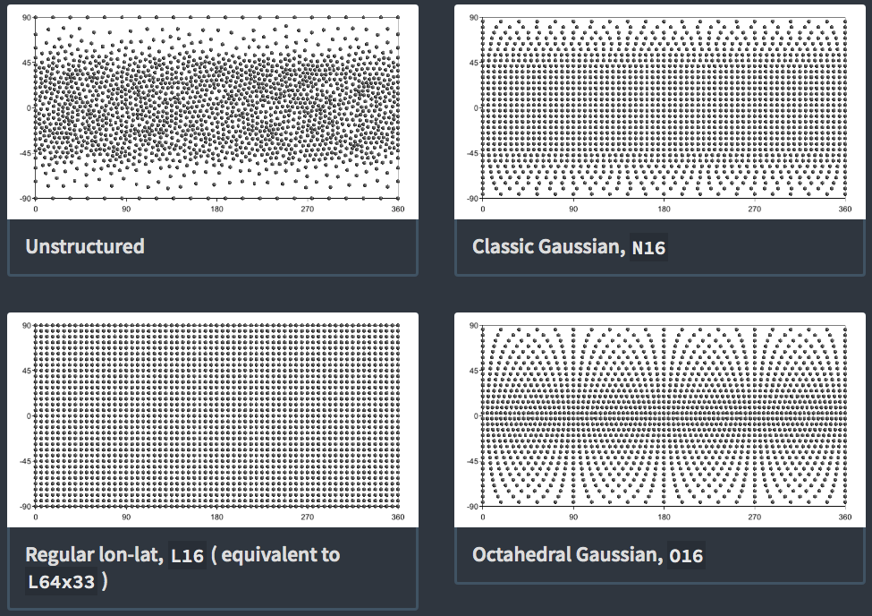

Slide 9
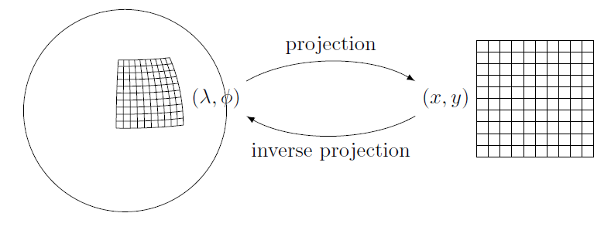
A library of grid abstractions
Iterating over all grid points, regardless of used projection, structure, domain
Grid coordinates (x,y)
Geographic coordinates (lon,lat)
for( PointXY p : grid.xy() ) {
double x = p.x();
double y = p.y();
}
for( PointLonLat p : grid.lonlat() ) {
double lon = p.lon();
double lat = p.lat();
}

Slide 10
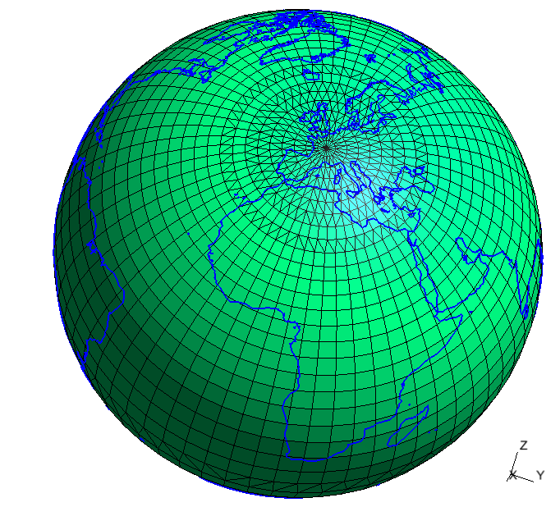
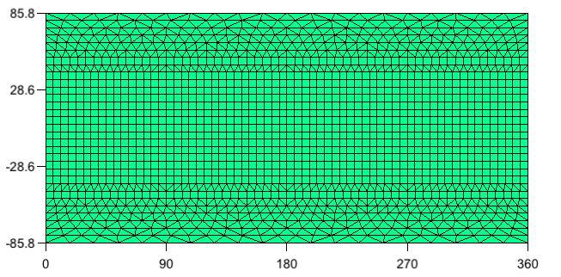
{
"type" : "classic_gaussian",
"N" : 16
"projection" : {
"type" : "rotated_schmidt",
"north_pole" : [3,47]
"stretching_factor" : 2
}
}
Stretching
ECEF (meters)
xy (degrees)

Slide 11
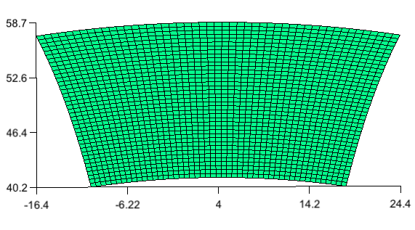
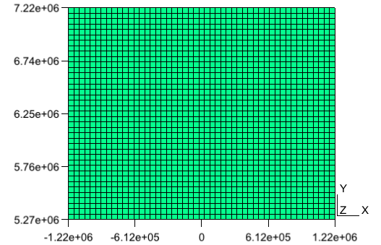
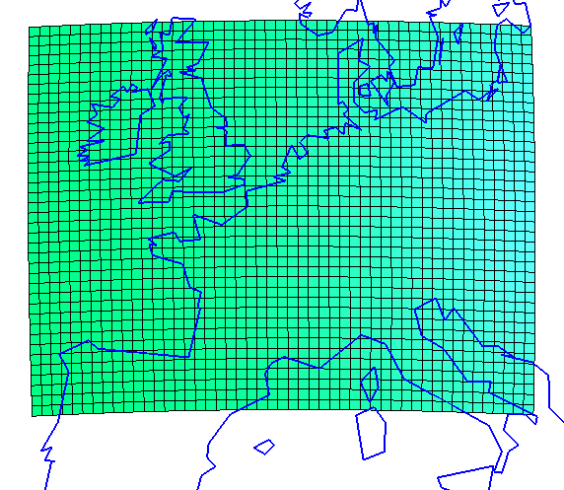
{
"type" : "regional",
"nx" : 50, "dx" : 50000,
"ny" : 40, "dy" : 50000,
"lonlat(centre)" : [4,50],
"projection" : {
"type" : "lambert_
conformal_conic",
"latitude1" : 50,
"longitude0" : 4
}
}
lonlat (degrees)
centre
xy (meters)
ECEF (meters)

Slide 12
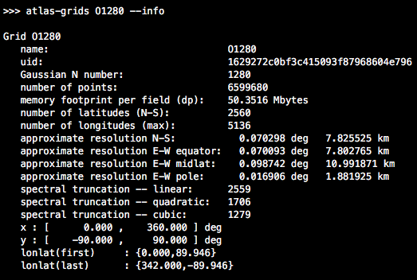
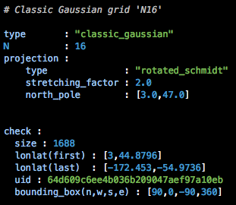
Grid information tool
Atlas contains a grid-information tool:
The <grid> argument can be a simple name, e.g. “O1280”
But it can also be a file-path containing a YAML or JSON grid specification.
Example:

Slide 13
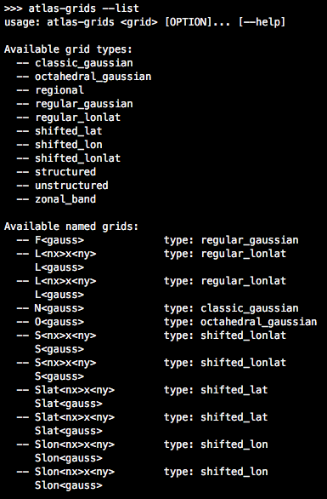
Grid information tool
To get a full list of supported grids:

Slide 14
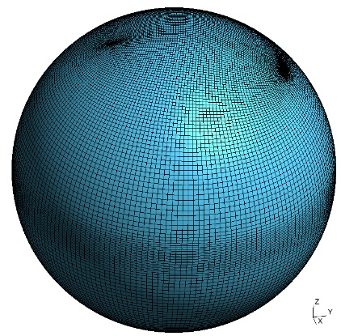
Extending Atlas with custom plugins
Example case: Ocean model NEMO has tripolar grids (ORCA),
very customized and to be read from file
(0.12 deg could be close to 500Mb)
Approaches:
Make Atlas aware of ORCA grids, and support natively, but optionally.
Data could be fetched before building.
Not ideal, code bloating in Atlas for very specific users
2) Plugin architecture: atlas-orca plugin library, dynamically loaded at
runtime. Self registration of ORCA grid at runtime
→ It will show up in tools that had no notion of ORCA,
like above-mentioned `atlas-grids` tool, or `atlas-meshgen`
Atlas source code was not touched. Personal control of your own plugin.
export ATLAS_PLUGINS=atlas-orca
export ATLAS_PLUGINS_SEARCH_PATHS=…
If atlas-orca is built within same ”bundle”, or installed in a
common install prefix with atlas, no search paths are required.
Points of extention: grids, mesh generators, partitioners, functionspaces

Slide 15
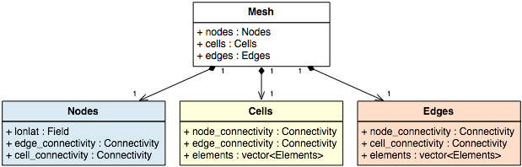

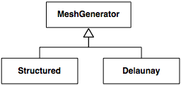

Atlas architecture
Mesh: connecting points (nodes) by edges and cells using connectivity tables
Support for multiple element types
Mesh generation
type(atlas_MeshGenerator) :: meshgen
type(atlas_Mesh) :: mesh
meshgen = atlas_MeshGenerator(“structured”)
mesh = meshgen%generate(grid)
MeshGenerator meshgen(“structured”);
Mesh mesh = meshgen.generate(grid);

Slide 16
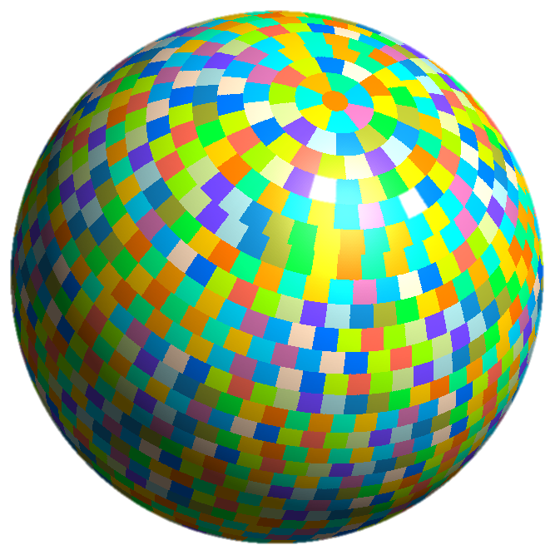
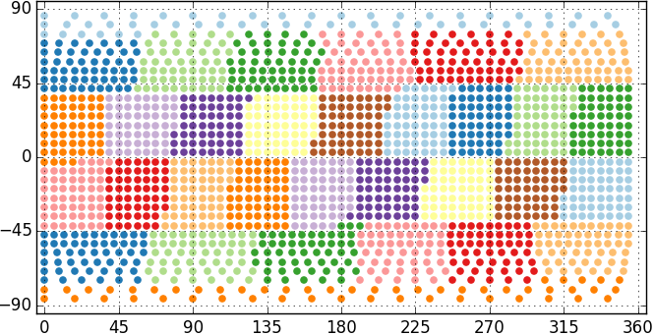
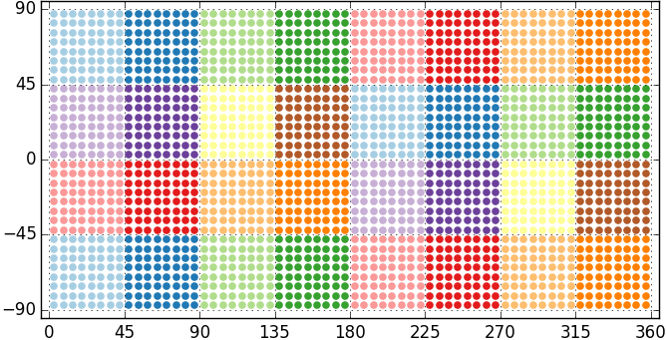
Multiple domain decomposition strategies
Equal Regions ( typical for IFS grids )
Checkerboard ( typical for regional grids )

Slide 17
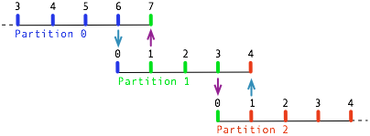
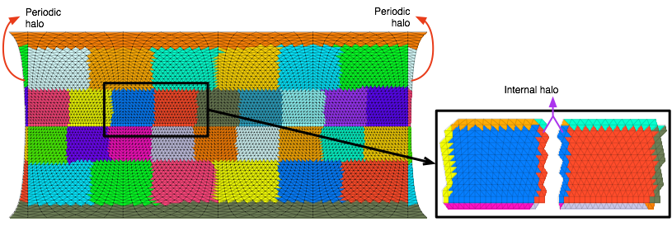
Halo exchanges
HaloExchange in
overlap regions

Slide 18
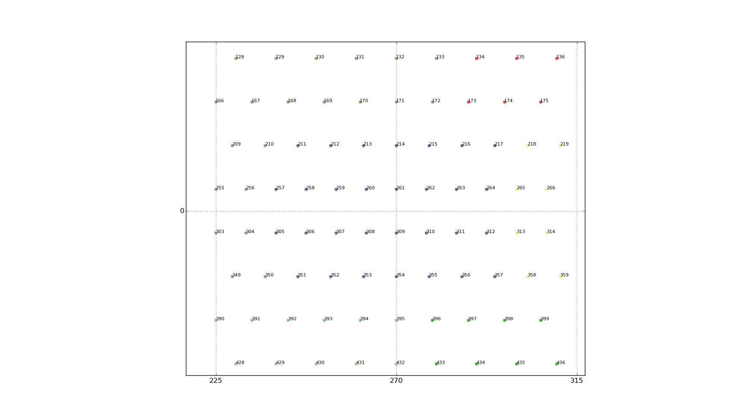
FunctionSpaces: Discretisation specific knowledge (arguably model specific)
FunctionSpace
functionspace::NodeColumns
functionspace::EdgeColumns
functionspace::StructuredColumns
Finite Difference method
Efficient semi-Lagrangian advection
Efficient spectral methods
Finite Volume
Finite Element
Discontinuous
Spectral Element

Slide 19




FunctionSpaces: Discretisation specific knowledge (arguably model specific)
FunctionSpace
FunctionSpace knows the grid or mesh
FunctionSpace knows about halos and its parallelisation
FunctionSpace knows the memory layout

Slide 20
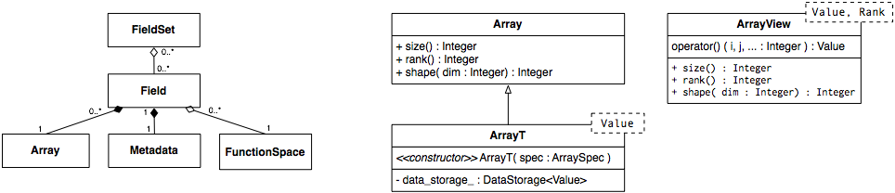
Atlas architecture
Field: container for data with metadata
Field field = Field(
/* name */ “P”,
/* kind */ make_datatype<double>(),
/* shape */ make_shape(npts,nlev) );
field.metadata().set(“units”,“hPa”)
field.metadata().set(“time”,450)
type(atlas_Field) :: field
type(atlas_Metadata) :: field_metadata
field = atlas_Field( &
name=“P”, &
kind=atlas_real(jprb), &
shape=[nlev,npts] )
field_metadata = field%metadata()
call field_metadata%set(“units”,“hPa”)
call field_metadata%set(“units”,450)

Slide 21
Acces to field data
auto field_data =
make_view<double,2>( field );
for( int jnode=0; jnode<npts; ++jnode ) {
for( int jlev=0; jlev<nlev; ++jlev ) {
field_data(jnode,jlev) = …
}
}
real(8), pointer :: field_data(:,:)
call make_view( field, field_data )
do jnode=1,npts
do jlev=1,nlev
field_data(jlev,jnode) = …
enddo
enddo

Slide 22
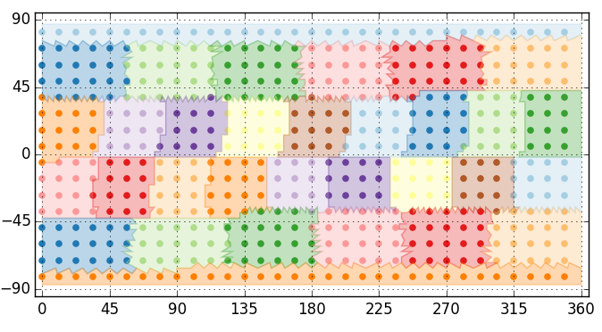
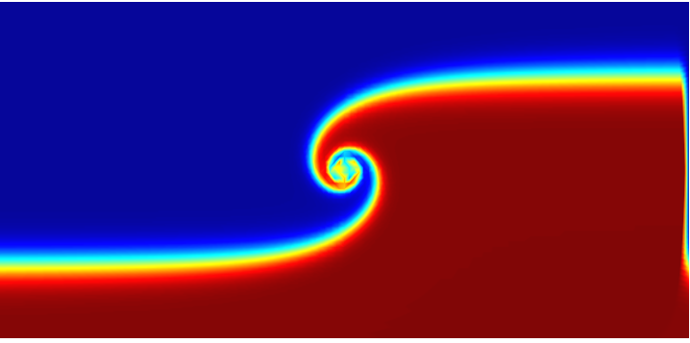
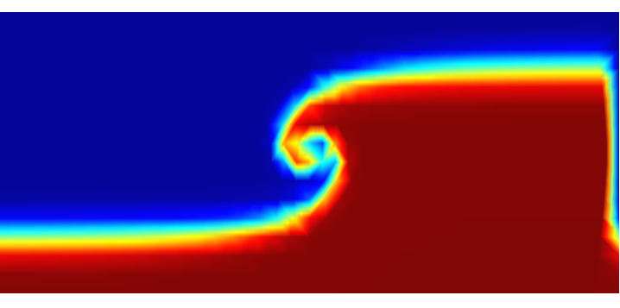
Remapping, using matching
domain decompositions
Thanks to Pedro Maciel (ECMWF)
Domain decompositions match
to avoid MPI communication
Parallel interpolation:
- nearest neighbour
- k-nearest neighbour
- linear element-based
- structured linear, cubic, quasicubic
Example interpolation: O32 to F8
22

Slide 23
Remapping using matching domain decompositions
Coupling
23
grid_A = atlas_Grid("O1280")
partitioner_A = atlas_EqualRegionsPartitioner()
mesh_A = meshgenerator % generate(grid_A, partitioner_A)
fs_A = atlas_functionspace_NodeColumns(mesh_A)
grid_B = atlas_Grid("O640")
partitioner_B = atlas_MatchingMeshPartitioner(mesh_A)
mesh_B = meshgenerator % generate(grid_B, partitioner_B)
fs_B = atlas_functionspace_NodeColumns(mesh_B)
interpolation_AB = atlas_Interpolation(type="finite-element",
source=fs_A, target=fs_B)
call interpolation_AB %
execute(field_A, field_B)

Slide 24
C++ example
Atlas on GPUs
// Create field (double precision, with 2 dimensions)
auto field = Field( datatype(“real64”), shape(Ni,Nj) );
// Create a host view to interpret as 2D Array of doubles
auto host_view = make_host_view<double,2>(field);
// Modify data on host
for ( int i=0; i<Ni; ++i ) {
for ( int j=0; j<Nj; ++j ) {
host_view(i,j) = ...
}}
// Synchronise memory-spaces
field.syncHostDevice();
// Create a device view to interpret as 2D Array of doubles
auto device_view = make_device_view<double,2>(field);
// Use e.g. CUDA to process the device view…
some_cuda_kernel<<<1,1>>>(device_view);
// ... or GridTools or Kokkos
Two linked memory spaces:
host (CPU) and device (GPU)
Built on GridTools storage layer
Thanks to Carlos Osuna (MeteoSwiss)

Slide 25
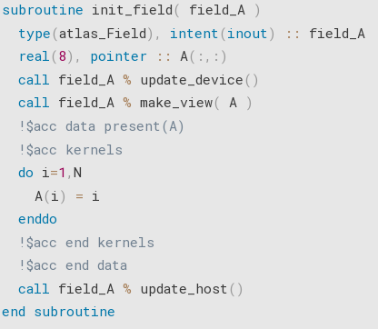
Atlas on GPUS with OpenACC for Fortran
Copy field_A from CPU to GPU
Create a view of field_A into array A,
and map it to OpenACC runtime
Tell OpenACC that array A is already on GPU
Computations on GPU
Copy field_A from GPU to CPU

Slide 26
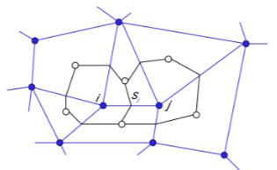

Mathematical operations
Example Fortran code to create and apply the Nabla operator to compute gradient and laplacian
method = atlas_fvm_Method( mesh, levels=137 )
nabla = atlas_Nabla( method )
call nabla%gradient ( scalarfield, gradfield )
call nabla%laplacian( scalarfield, laplfield )
FVM

Slide 27


Spectral Transforms in Atlas
C++ example
Grid grid(“O1280”);
StructuredColumns gp ( grid, levels(137) );
Spectral sp( 1279, levels(137) );
Field gpfield = gp.createField<double>();
Field spfield = sp.createField<double>();
Trans trans( gp, sp ); // TCo1279
trans.dirtrans( gpfield, spfield );
trans.invtrans( spfield, gpfield );
Grid (Octahedral Gaussian O1280)
FunctionSpaces gp and sp
Creation of fields
through FunctionSpace
Internally sets up IFS-trans
Transforms
MIR
Similar
in Fortran
FVM

