Slide 1
NCAR/MM (PANDA-C) Observation-space Diagnostics Tools

Slide 2
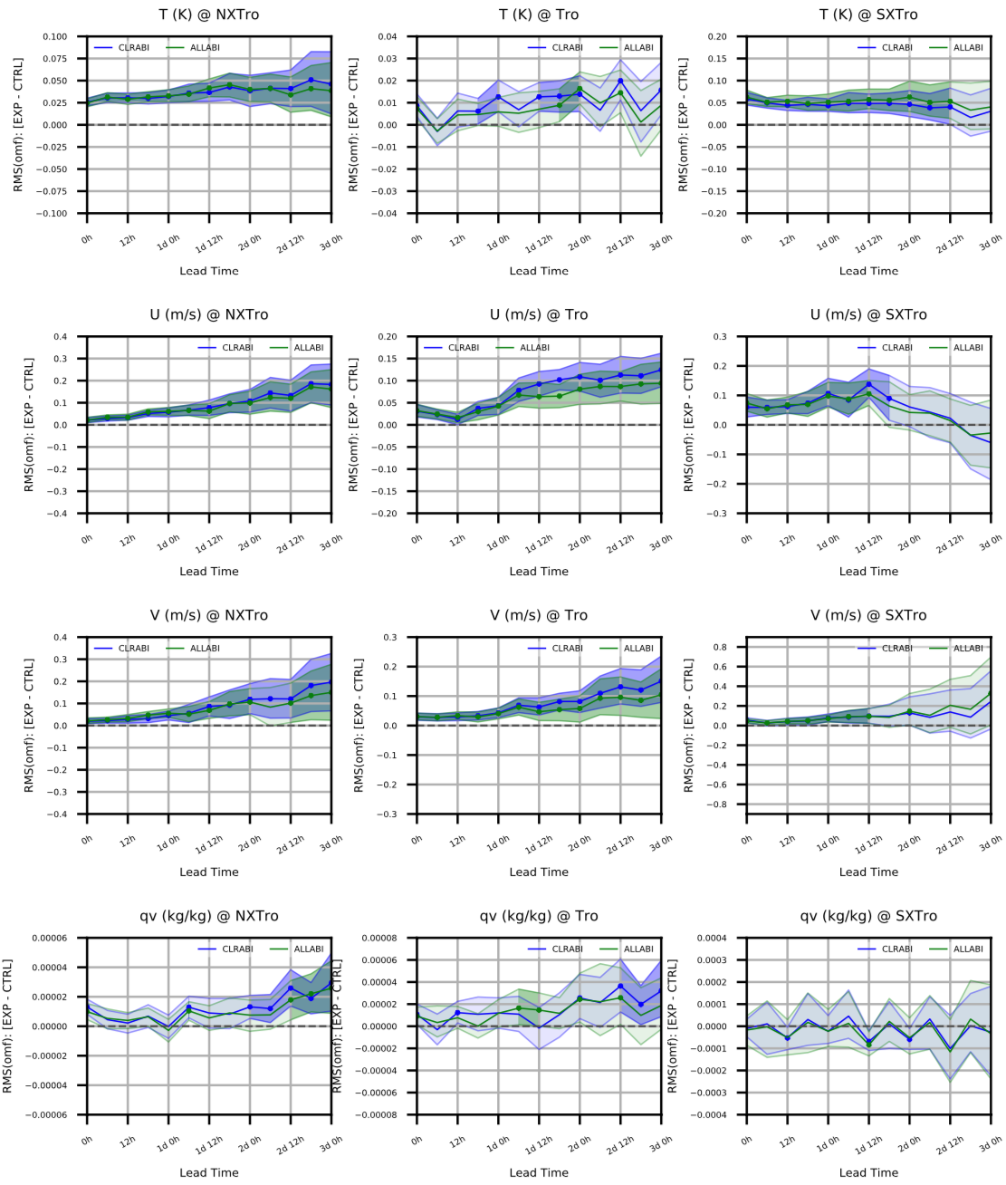
First, an example of the output:
Aircraft OMF (0-3day FC) Verification
y-axis: difference in RMSd between new experiment and prototype-III control experiment
x-axis: forecast lead-time
binVal: latitude band (category) + QC is good (category)
shaded: 95% confidence interval from aggregated bootstrap across 2 x 27 cycles

Slide 3
How does data feed into each plot point?
RMSd of OMF for CLRABI and CTRL experiments (EXP) at 2d18h forecast length (FC) from 00Z and 12Z cycles (CY) across 27 days
Reading entire or partial obs, geoval, diag database across many combinations of EXP/CY/FC is costly even for moderate location counts (nlocs), and need not be repeated every time figures are generated
Traditional statistical measures (Count, Mean, RMS, STD, MS, Min, Max) are easily aggregated across independent subpopulations
Thus RMSd of OMF can be calculated independently for each combination of EXP/CY/FC, then aggregated as needed

Slide 4
Two-part post-processing
For each observation type (aircraft, sondes, gnssro, amsua_n19, abi_g16, etc…)
For each EXP/CY/FC index: create statistics database file
  For each observed variable and each configured combination of binning functions and bounds
    Bin locations and calculate statistics (computational work)
  Write all statistics and metadata to individual database file (netcdf)
Generate “analyses” (figures, gross statistical information, etc...)
  Create “StatsDB” object (wrapper class for a pandas DataFrame object) that includes EXP/CY/FC indices specified in configuration
  Create “analyses” based on configuration and data available in StatsDB object
Binning function: similar to UFO ObsFunction class; custom-defined function of variables in ObsSpace, GeoVaLs, and ObsDiagnostics, including identity function

Slide 5
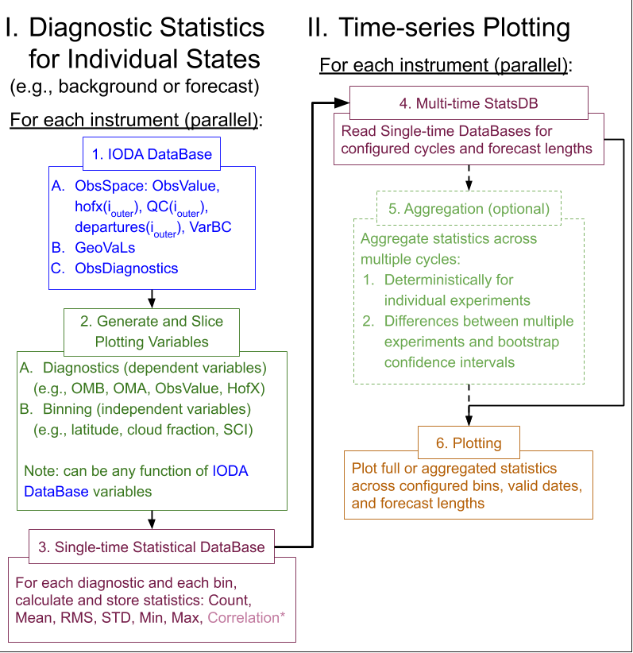
Two-part post-processing
BG
AN
BG
AN
BG
AN
BG
AN
FC₁
FC₂
FC_{n}

Slide 6
StatsDB class
Can be sliced across any of these pandas MultiIndex variables:
expName, fcTDelta, cyDTime, varName,
diagName, binVar, binVal, binMethod
Binning values (binVal) can be categorical (e.g., cloudy, clear, land, sea, latitude band, QC flag) or continuously varying (cloud fraction, latitude, zenith angle, glint angle)
The combination of binMethod, binVar, and binVal enables MANY unique binning strategies to be achieved, e.g., Northern Extratropics, good QC, and zenith angle between 0 and 10 degrees

Slide 7
Aircraft OMF (0-3day FC) Verification
y-axis: difference in RMSd between experiment and control
x-axis: forecast lead-time (FC) binVal: latitude band (category) + PreQC is good (category)
shaded: 95% confidence interval from aggregated bootstrap across all cycles
Northern
Extratropics
Tropics
Southern
Extratropics
lines: 2 experiments
ABI CLRSKY
ABI ALLSKY
T (K)
U (m/s)
V (m/s)
Qv (kg/kg)

Slide 8
AMSUA NOAA-19 for one month experiment
y-axis: RMS(OMF-6hr)
x-axis: cycle date (CY)
subplots: channels
binVal:
PreQC is GOOD (category)
lines: 3 experiments
CONTROL
ABI CLRSKY
ABI ALLSKY

Slide 9
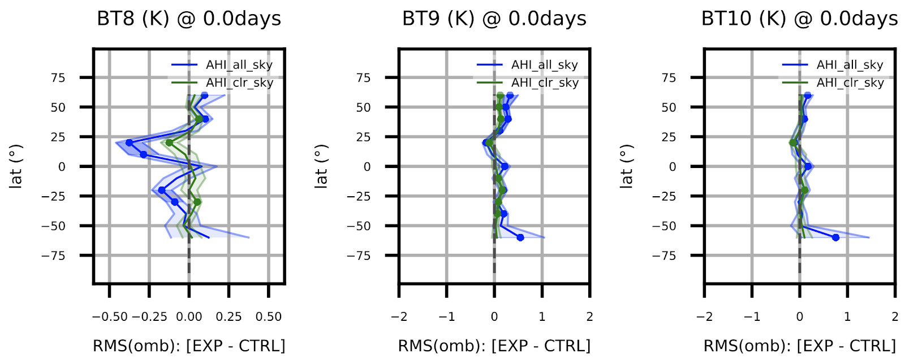
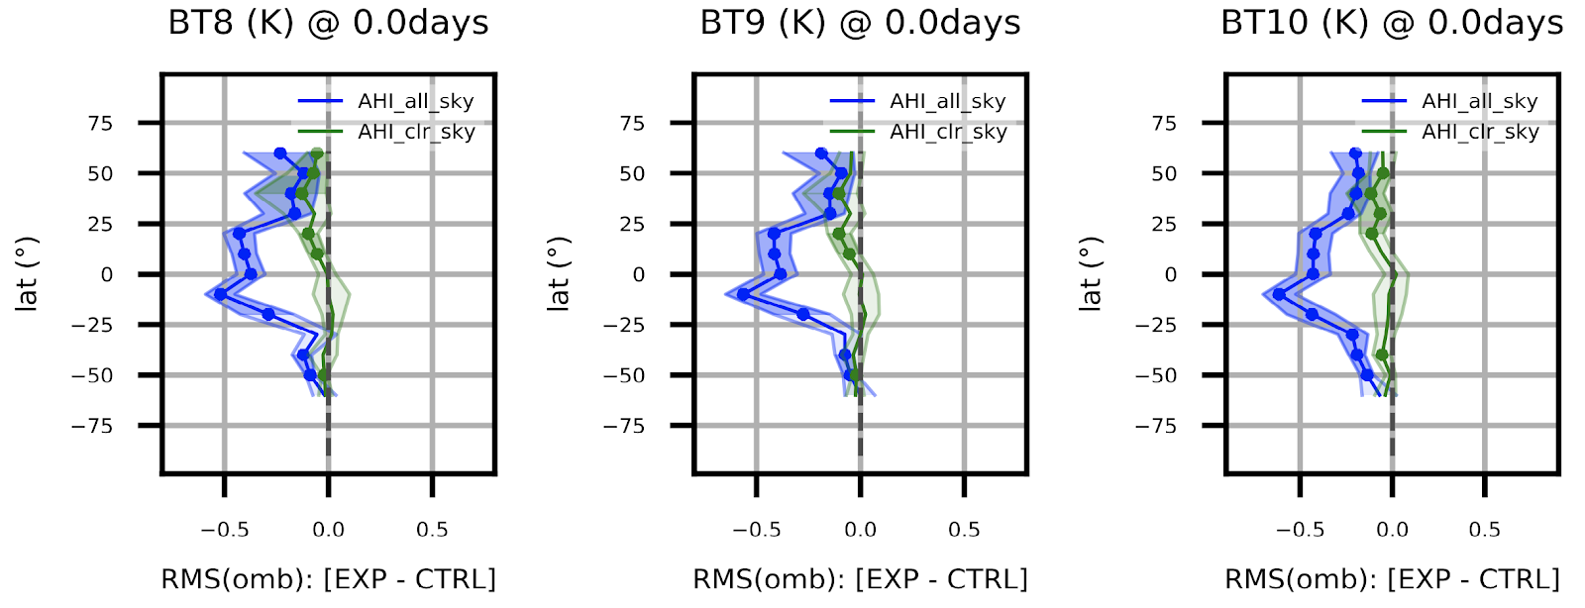
AHI WV channel OMB (6-hr FC) Verification
x-axis: difference in RMSd between experiment and control
y-axis: latitude binVals: cloudiness (category), latitude (1D), QC is GOOD (category)
shaded: 95% confidence interval from aggregated bootstrap across all cycles
lines: 2 experiments
CF ≡ Retrieved Cloud Fraction
AHI CLRSKY
AHI ALLSKY
Ch. 8 BT (K)
Ch. 9 BT (K)
CF < 0.05
(clear)
CF > 0.95
(cloudy)

Slide 10
Aircraft OMB (6-hr FC) Verification (2D)
x-axis: cycle date (CY)
y-axis: pressure
color: Mean OMB (bias)
columns: 3 experiments
rows: observed variables (T, U, V, qv)
binVals: pressure (1D)
PreQC is GOOD (category)
Notes:
Fixed pressure bins are selected; cells with no data show up as black
Any 1D variable can go on y-axis: pressure, height, latitude, local hour, etc…

Slide 11
More info
Additional product: calculate and print gross statistics for any binning strategy (e.g., all GOOD data)
Extensibility:
  We have all the data slicing needed to create obs-space score cards, with many options for contents
  Same two-part strategy will work for model-space diagnostics too! The plotting classes/functions from obs-space analyses are reusable due to the generic nature of the StatsDB MultiIndex
  New binVars and binMethods are added easily as python dictionary entries, but could be replaced with YAML
  Additional diagnostics are easily added (not just Obs-Model). E.g., ObsValue, HofX, ObsError, or any function of any IODA database variables
  May be able to add correlation as a statistic, but would require a bit of work

Slide 12
Thank you. Questions?

Slide 13
Extra

Slide 14
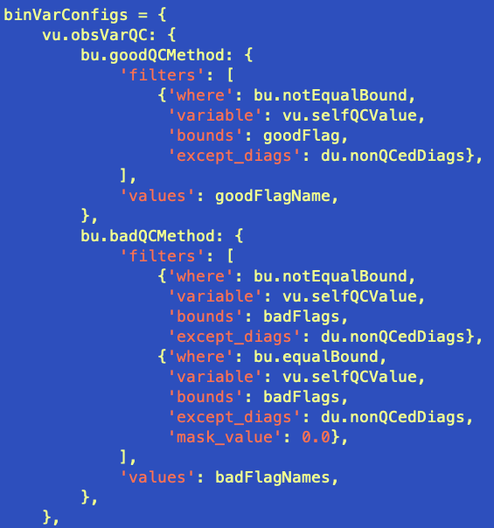
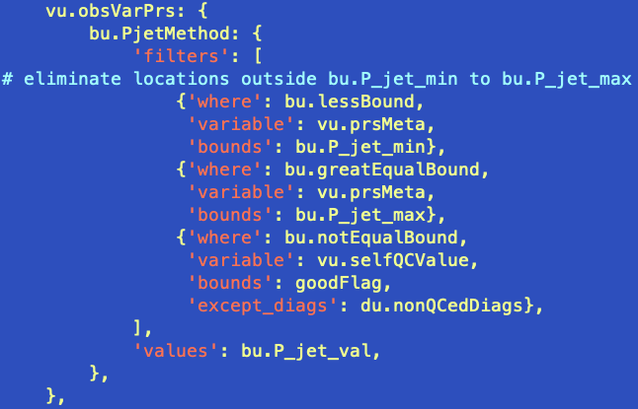
binning_configs excerpts
Jet stream pressure bounds (binVar = vu.obsVarPrs)
All good QC
binVar = vu.obsVarQC (iteration dependent)
All bad QC

Slide 15
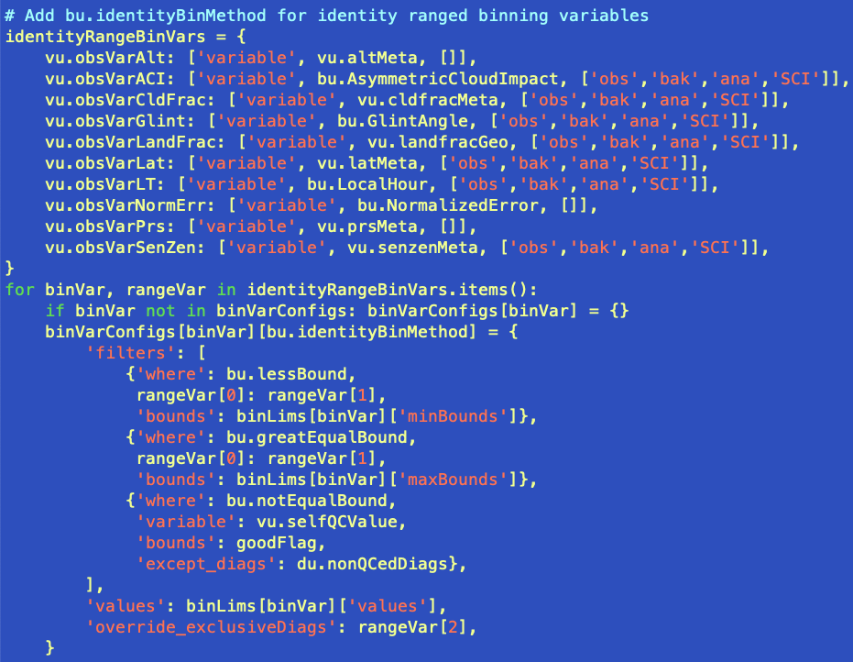
binning_configs excerpts
Multiple binVars
All 1D identity binMethods

Slide 16
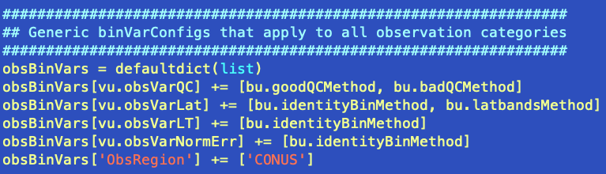
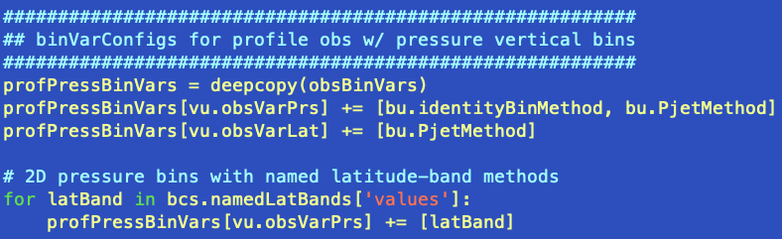
binMethod selection

