Slide 1
ioda-plots
spatial and temporal binning of obs space statistics
quickly generate a whole giant bucket load of plots, automatically, from any ioda formatted files, with little or no configuration required
Not always the prettiest plots, but highly automatic
Decrease amount of data needed to be saved for long experiments, and speed up plotting for real-time usage

Slide 2
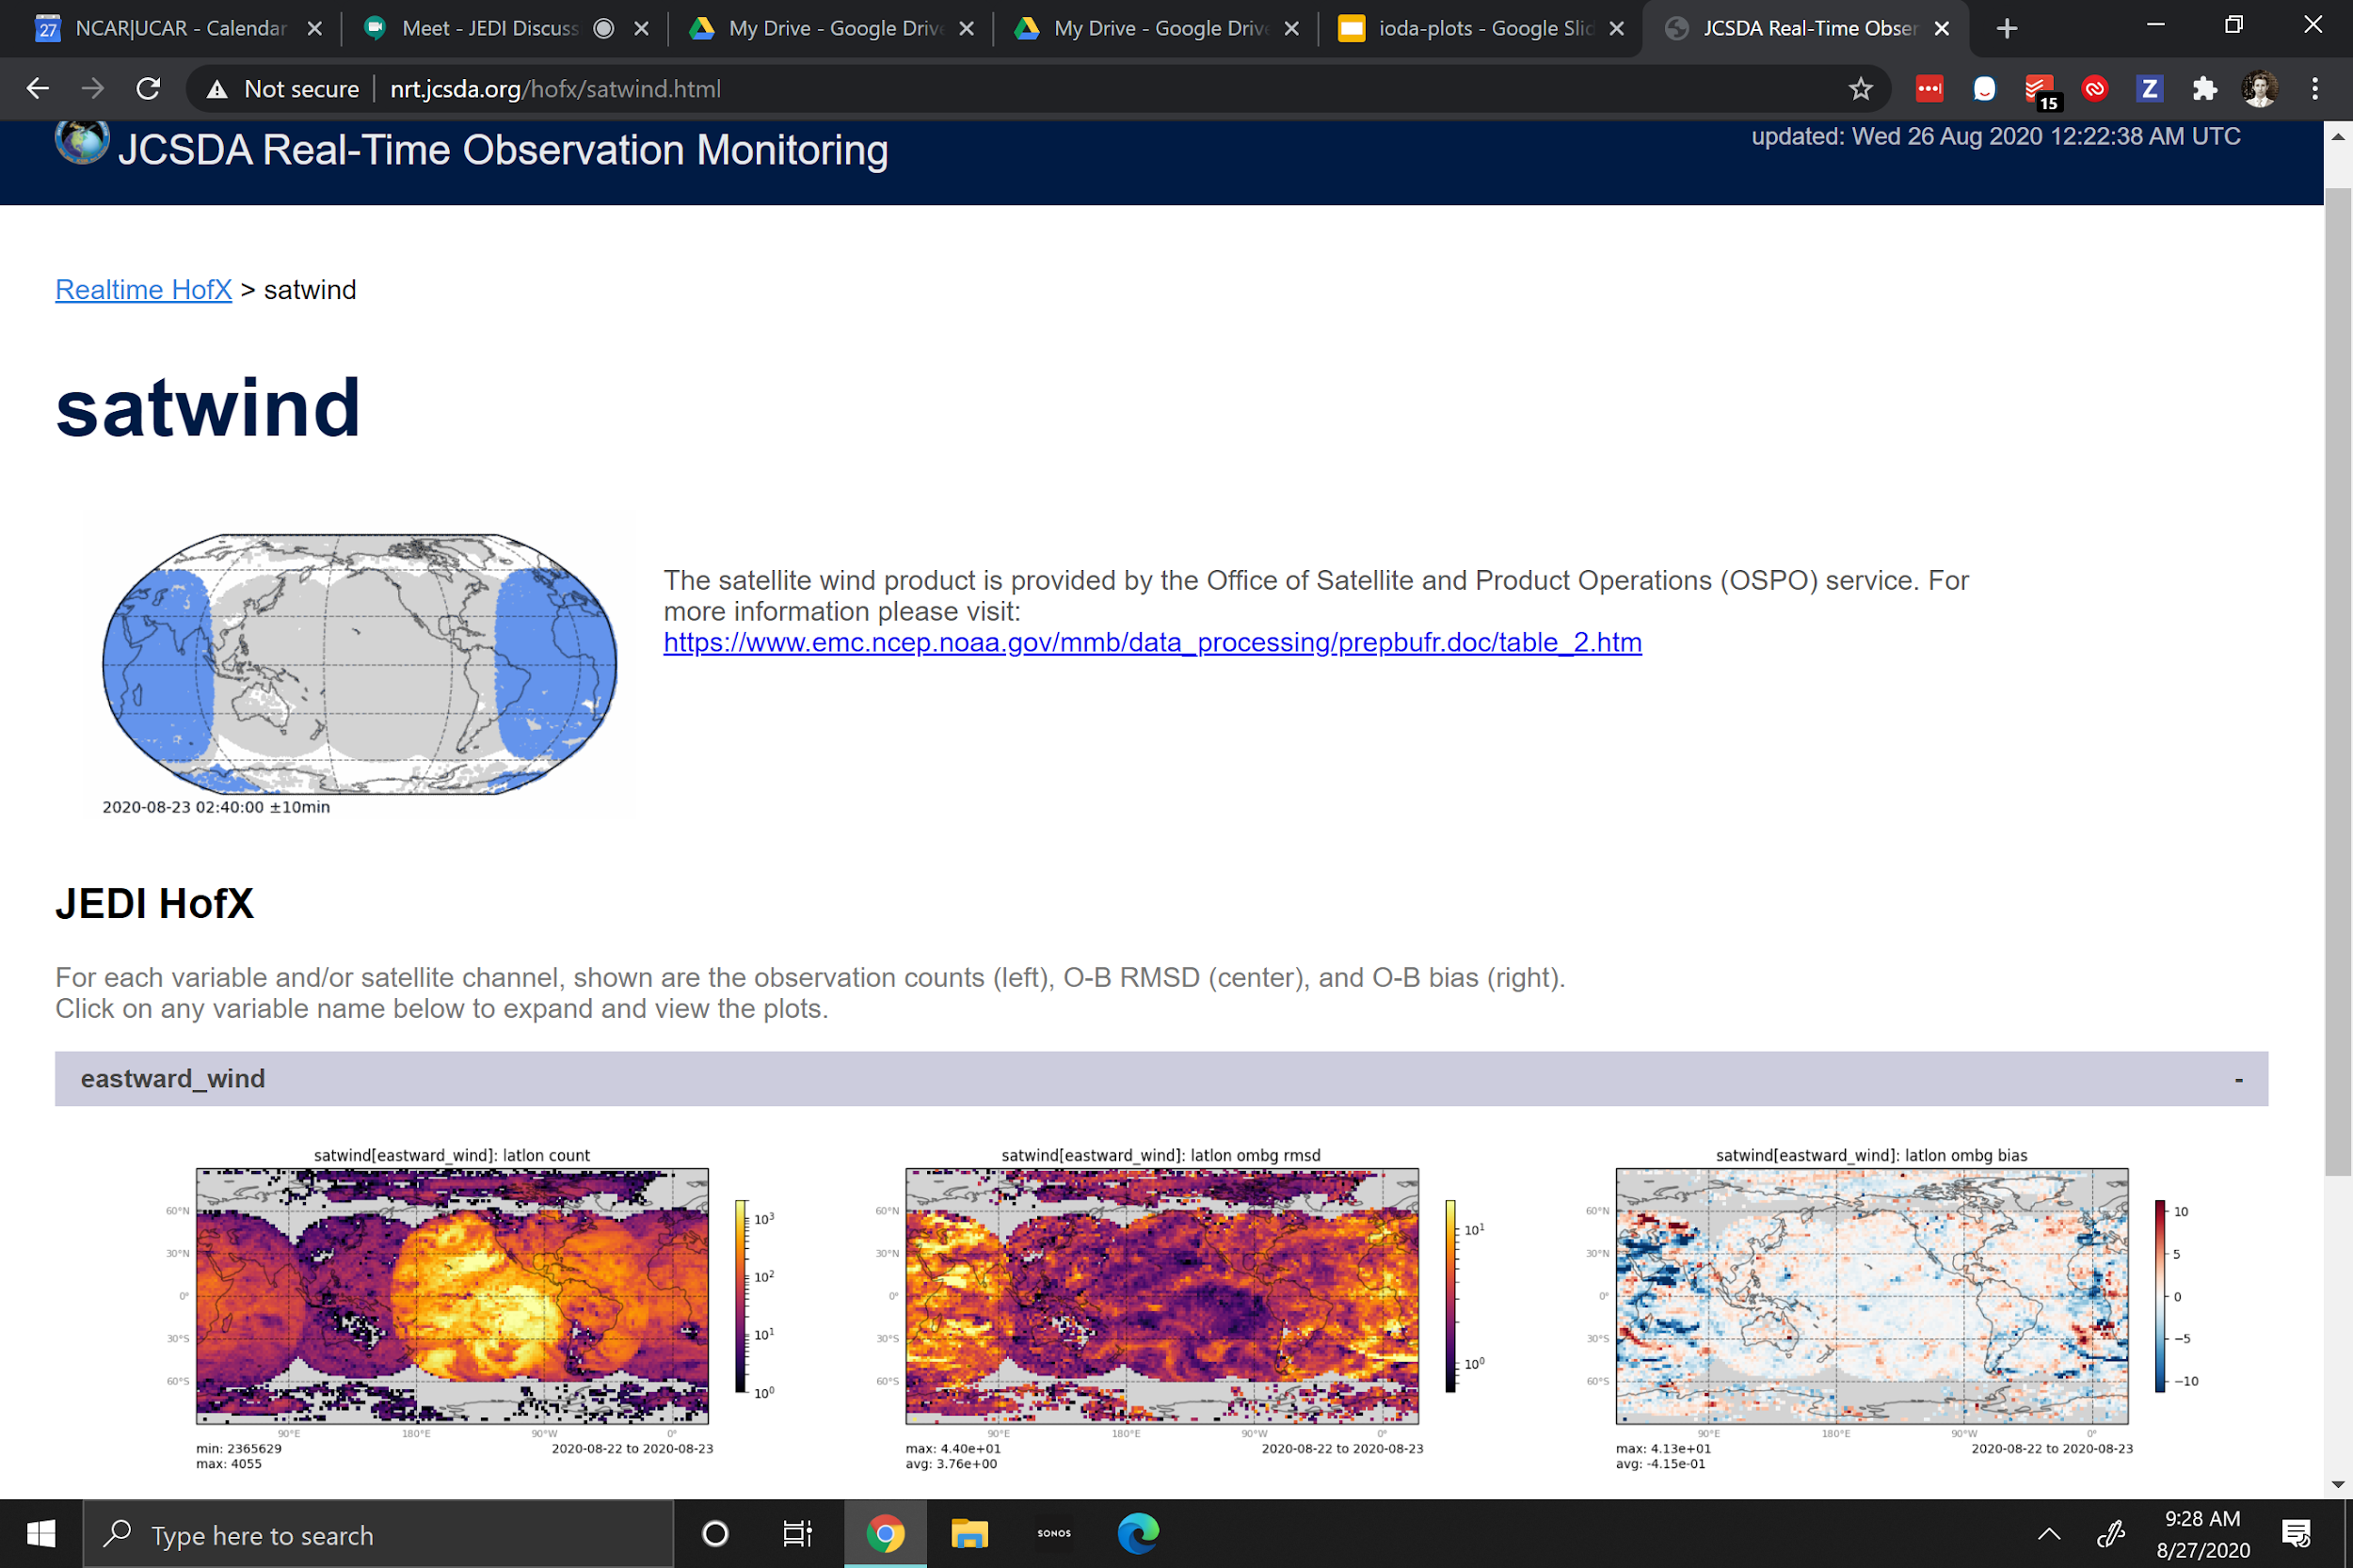

Slide 3
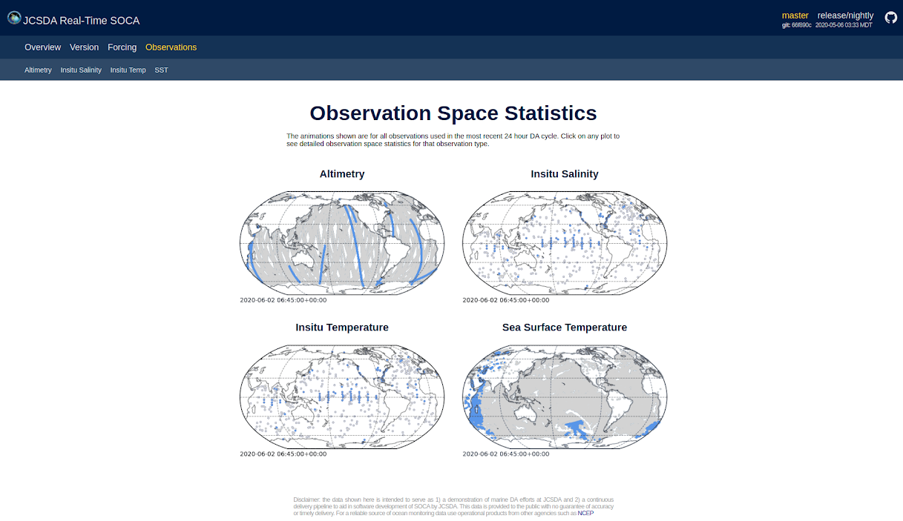
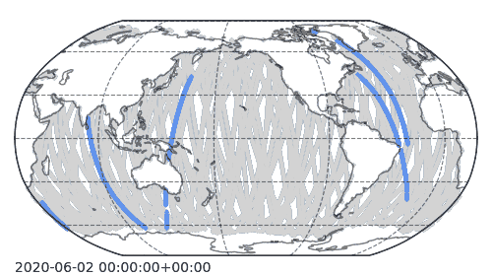
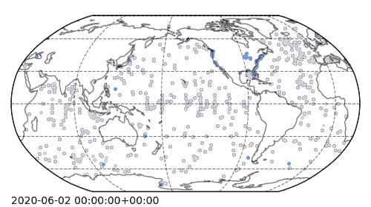
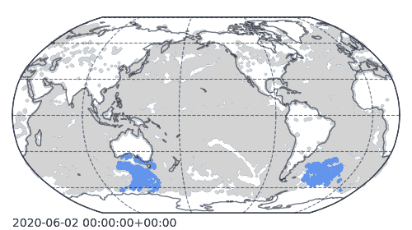
soca.jcsda.org

Slide 4
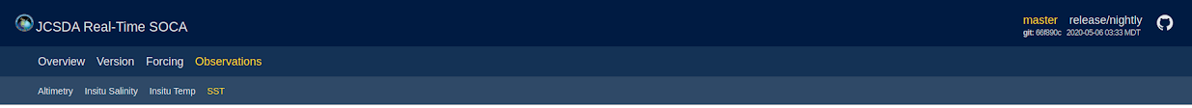
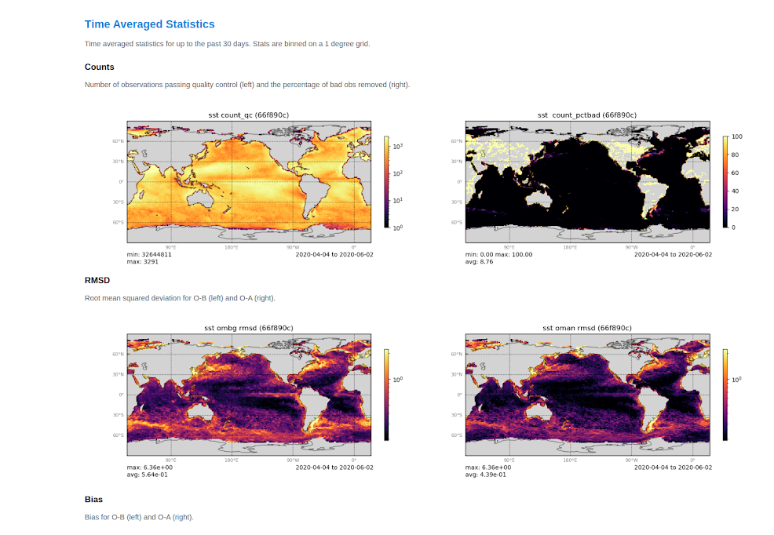

Slide 5
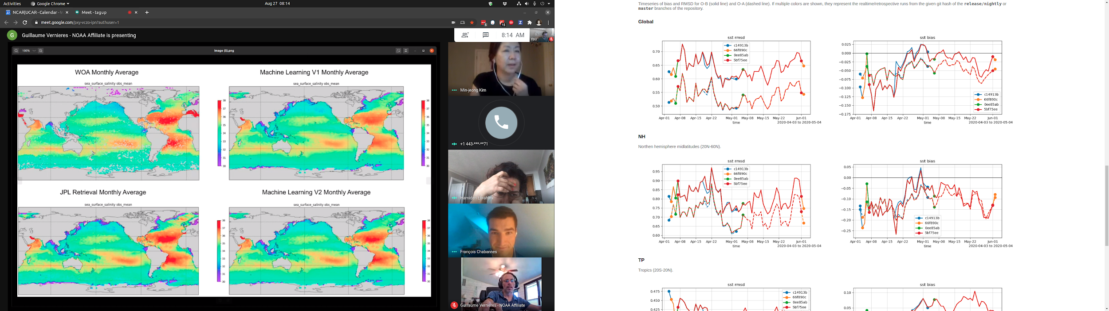

Slide 6
2018-03-01 hofx files
iodplots bin ...
2018-03-02 hofx files
iodplots bin ...
iodaplots merge/cat ...
2018-03-03 hofx files
iodplots bin ...
...
iodaplots plot

Slide 7
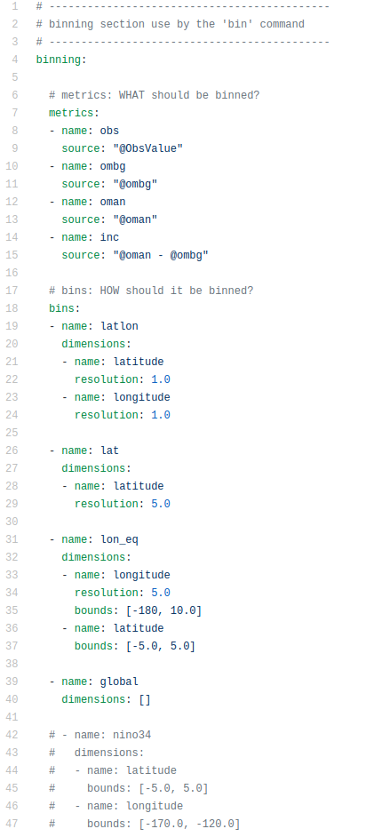
ioda plots can be run with no configuration and will try to guess what should be binned and plotted. Or, a custom yaml file can be given:
metrics: what should be binned.
by default O-B, O-A, obs value, and counts are calculated.
counts / mean / and sum-of-square-diff-from-mean are binned

Slide 8
bins: how the spatial binning is done
by default: latlon 1 degree, global, and vertical profile (if depth/height coordinate available)
any dimension name can be used, so long as it is in the ioda files
clipping to certain regions
(e.g. NH/SH/TP, or nino3.4)

Slide 9
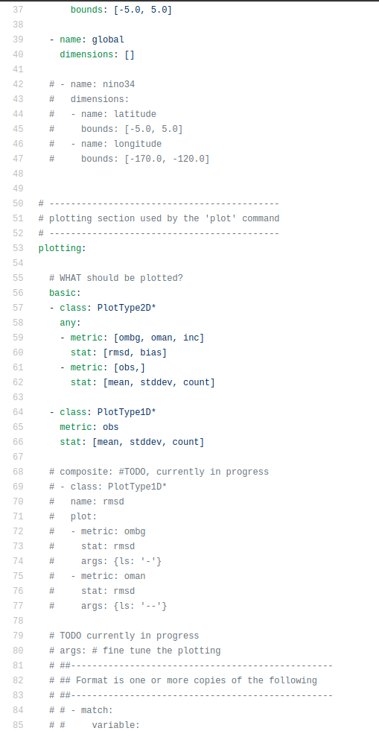
plots
by default: every variable / metric/ binning combination is given its own plot (for a LOT of plots)
only a subset of plots can be selected, and/or metrics combined into single plot
Types of plots automatically chosen based on what the binning dimension types are:
PlotType1D
  PlotType1DLat
  PlotType1DTimeseries
  PlotType1DProfile
PlotType2D
  PlotType2DHovmoller
  PlotType2DLatLon

Slide 10
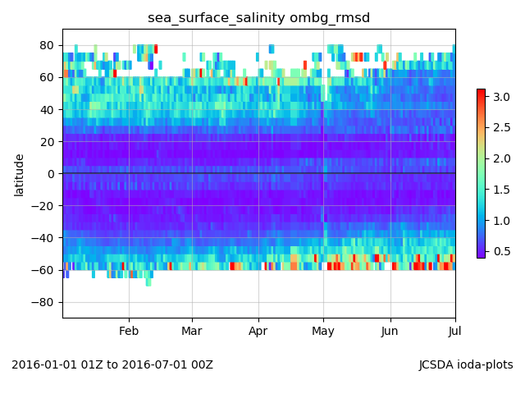
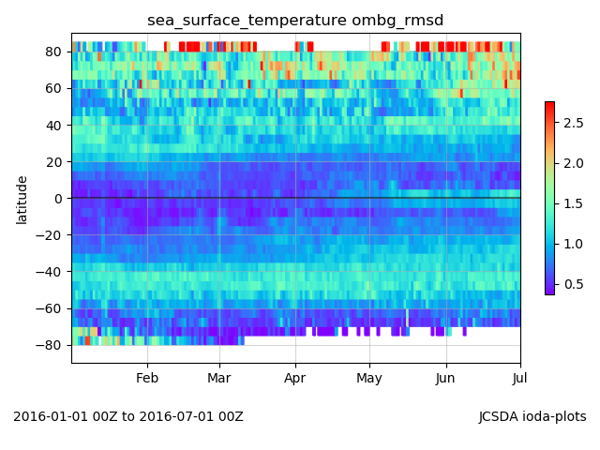
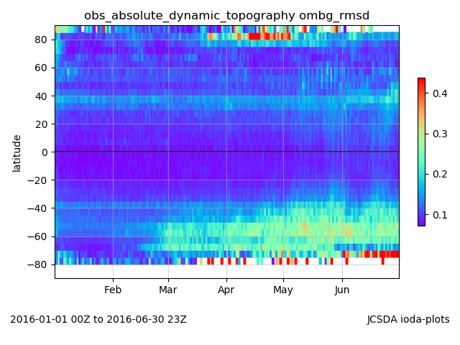
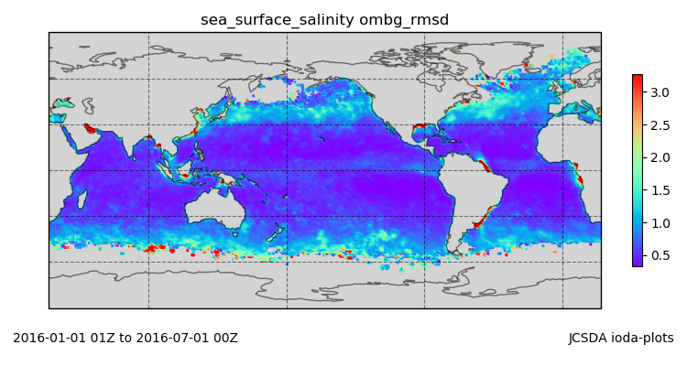
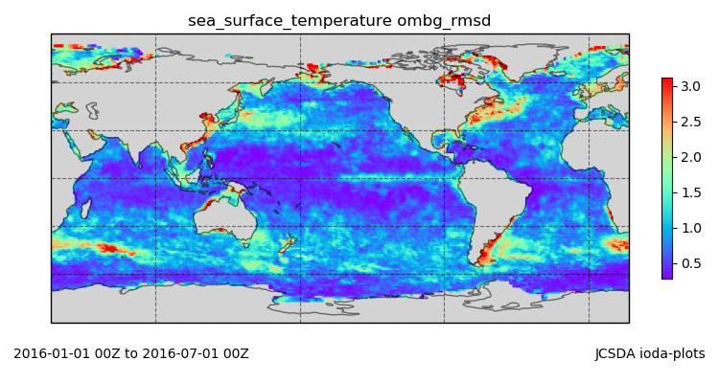
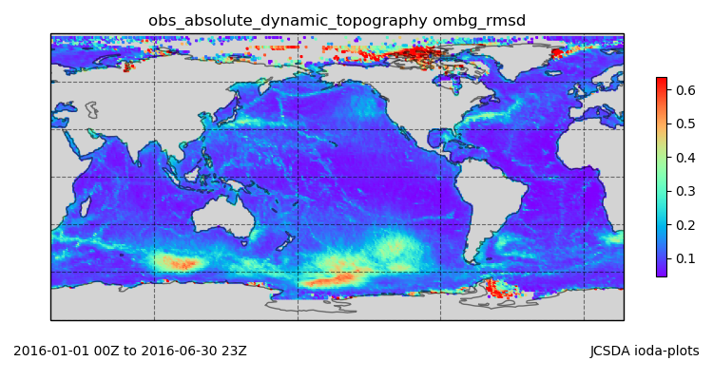
SOCA Static covarance model testing
SMAP | MW: GMI, AMSR2, WindSat IR: NOAA-19 | Jason-2, Cryosat-2, SARAL, Sentinel-3
‹#›

Slide 11
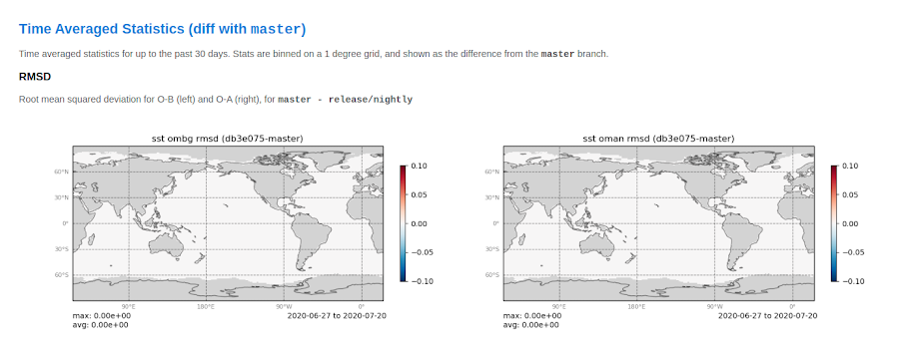
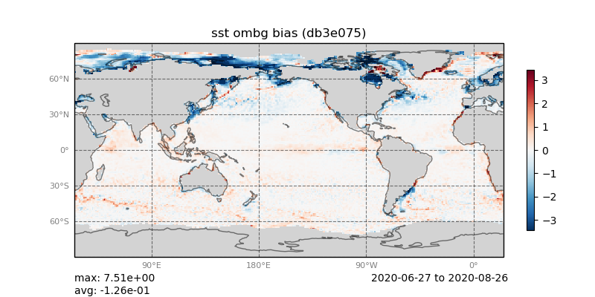
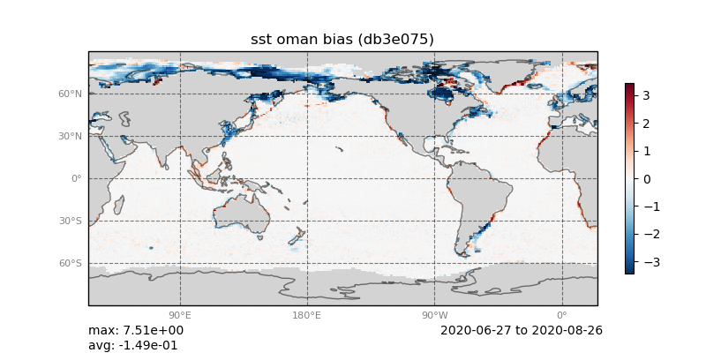
experiment comparisons
iodaplots plot --exp path_to_exp1 --exp path_to_exp2

Slide 12
experiment comparisons
iodaplots plot --exp path_to_exp1 --exp path_to_exp2

