Slide 1

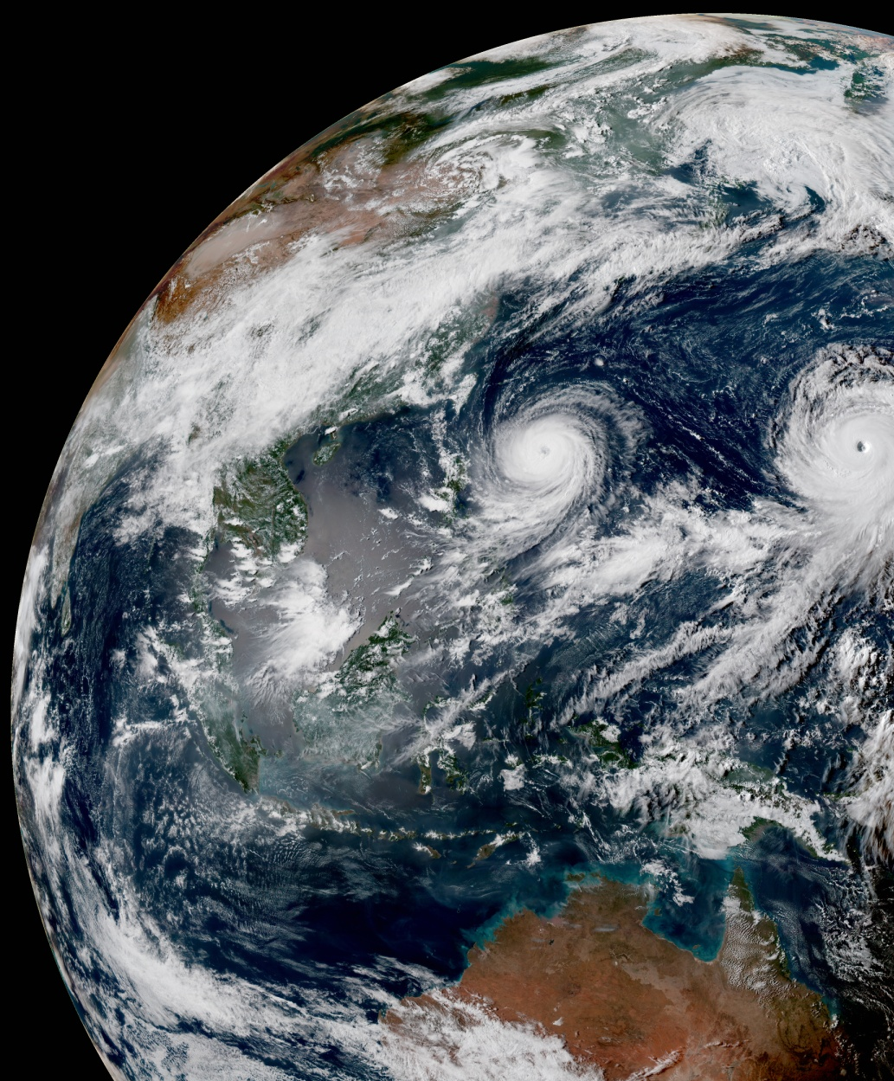
Ioda Engines: Writing a Converter
Stephen Herbener
Ryan Honeyager
September 10, 2020

Slide 2
Ioda-engines concepts
Groups
Attributes
Variables
  Dimension scales (coordinate values)
  Regular variables
Frontend
  How the data storage appears to the client
  The API aspect of ioda-engines
Backend
  How the data storage is implemented
    File, in-memory

Slide 3
New concerns
Groups
  Define a hierarchical structure
Dimension scales
  Variables holding coordinate values of axes in a coordinate system
Dimensionality of regular variables
  Retain “shape” of data: rank, sizes
Frontend/Backend
ObsGroup class introduced to help you manage these

Slide 4
Hierarchical structure (groups)
Data Layout Policy
  ObsGroup feature that helps you manage the hierarchical structure
The client (frontend) always sees the same hierarchical structure
  Group/Variable
Can use two syntaxes for variable names to specify hierarchical paths
  “Variable@Group” (current style)
  “Group/Variable” (new style)
/
ObsGroup
ObsValue
T
ObsValue/T
ObsError
T
ObsError/T

Slide 5
Dimension scales
Attach dimension scales to regular variables
ObsGroup function “generate”
  Attach a backend
  Specify all the dimension scales that will be attached to the variables
2D Field Variable
f1(x, y)
Dimension Scales
x(11)
-5
…
5
y(11)
-5
…
5

Slide 6
Variable dimensionality
Variables hold dimensionality information
  Rank, sizes , maximum allowed sizes (for resizing)
Variable function “createWithScales”
  Creates a new variable and attaches the specified dimension scale variables
ObsGroup function “resize”
  Resize takes in a dimension scale variable and a new size
  Resizes the dimension scale variable
  Walks through entire hierarchy and resizes every variable that uses the dimension scale variable
Variable function “getDimensions”
  Returns a struct with dimension information

Slide 7
Main steps for a converter
Assumes that you supply a reader for whatever file you are converting from
Steps
  Construct a backend (file or in-memory)
  Generate an ObsGroup object (generate function)
    Attach the backend
    Specify all dimensions that will be used by variables
  Create the output variables (createWithScales function)
  Transfer the variable data to the ObsGroup object (write function)

Slide 8
Variable creation
Variable parameters
  Chunking
    Hint to the file backend for optimizing storage space
  Compression
    Gzip and Szip supported for file backend
  Fill value
    Missing value mark
    IODA reader will query variable for its fill value and replace fill values with internal JEDI missing marks
VariableCreationParameters
  Struct to help specify variable parameters

Slide 9
Example: nlocs known before transferring data
Create an ObsGroup with a file backend containing:
  Dimension scales
    nlocs (number of locations)
    nchans (number of channels)
  Variables
    MetaData/latitude(nlocs)
    MetaData/longitude(nlocs)
    ObsValue/brightness_temperature(nlocs, nchans)
Code example
  ioda-engines repository
  develop branch
  Example/Basic/05-ObsGroup.cpp

Slide 10
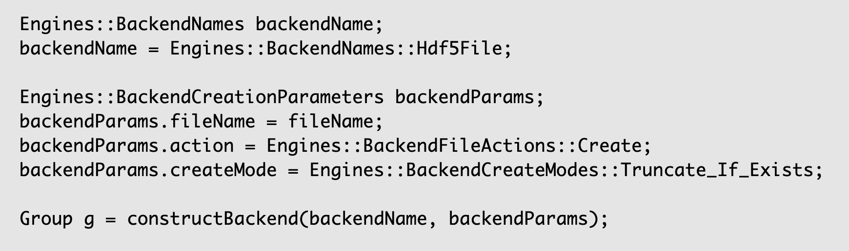
Step 1: construct a backend
Select the HDF5 file backend
Specify:
File name
Write (create)
Clobber existing file
Construct the backend

Slide 11
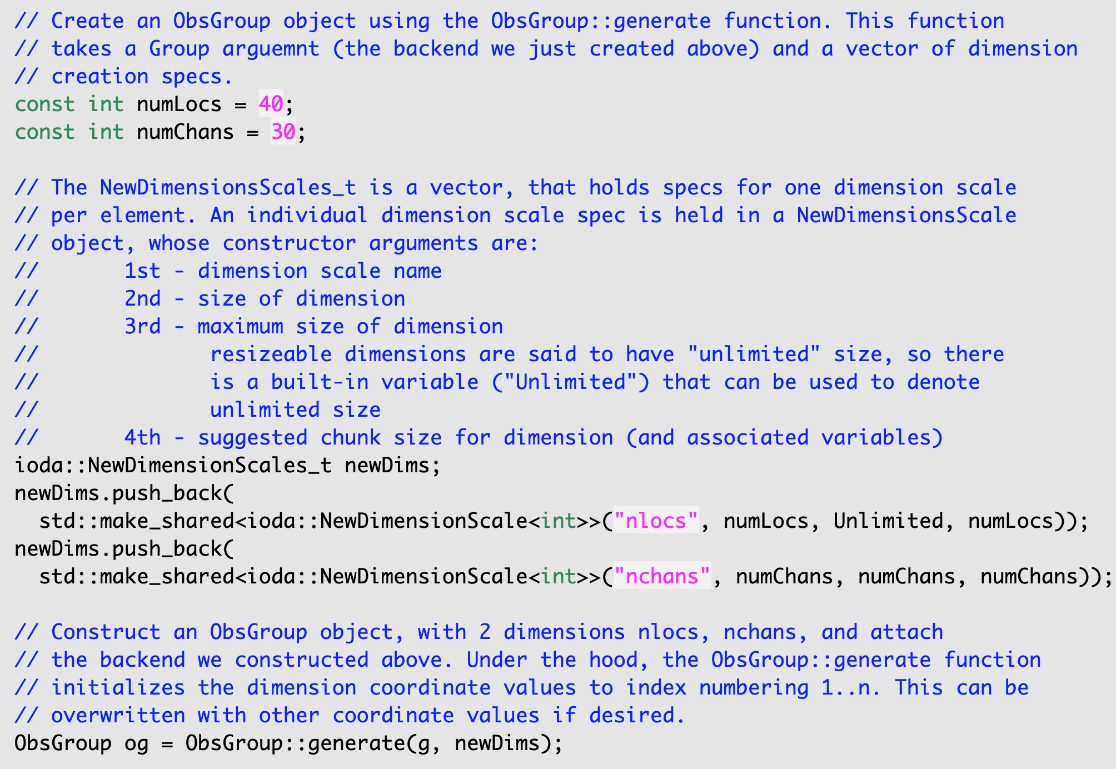
Step 2: generate an ObsGroup object
Specify dimension – nlocs and nchans
Maximum size of nlocs is Unlimited
If size is very large (e.g., 1,000,000), consider making the chunk size smaller (e.g., 1000).
Generate the ObsGroup object

Slide 12
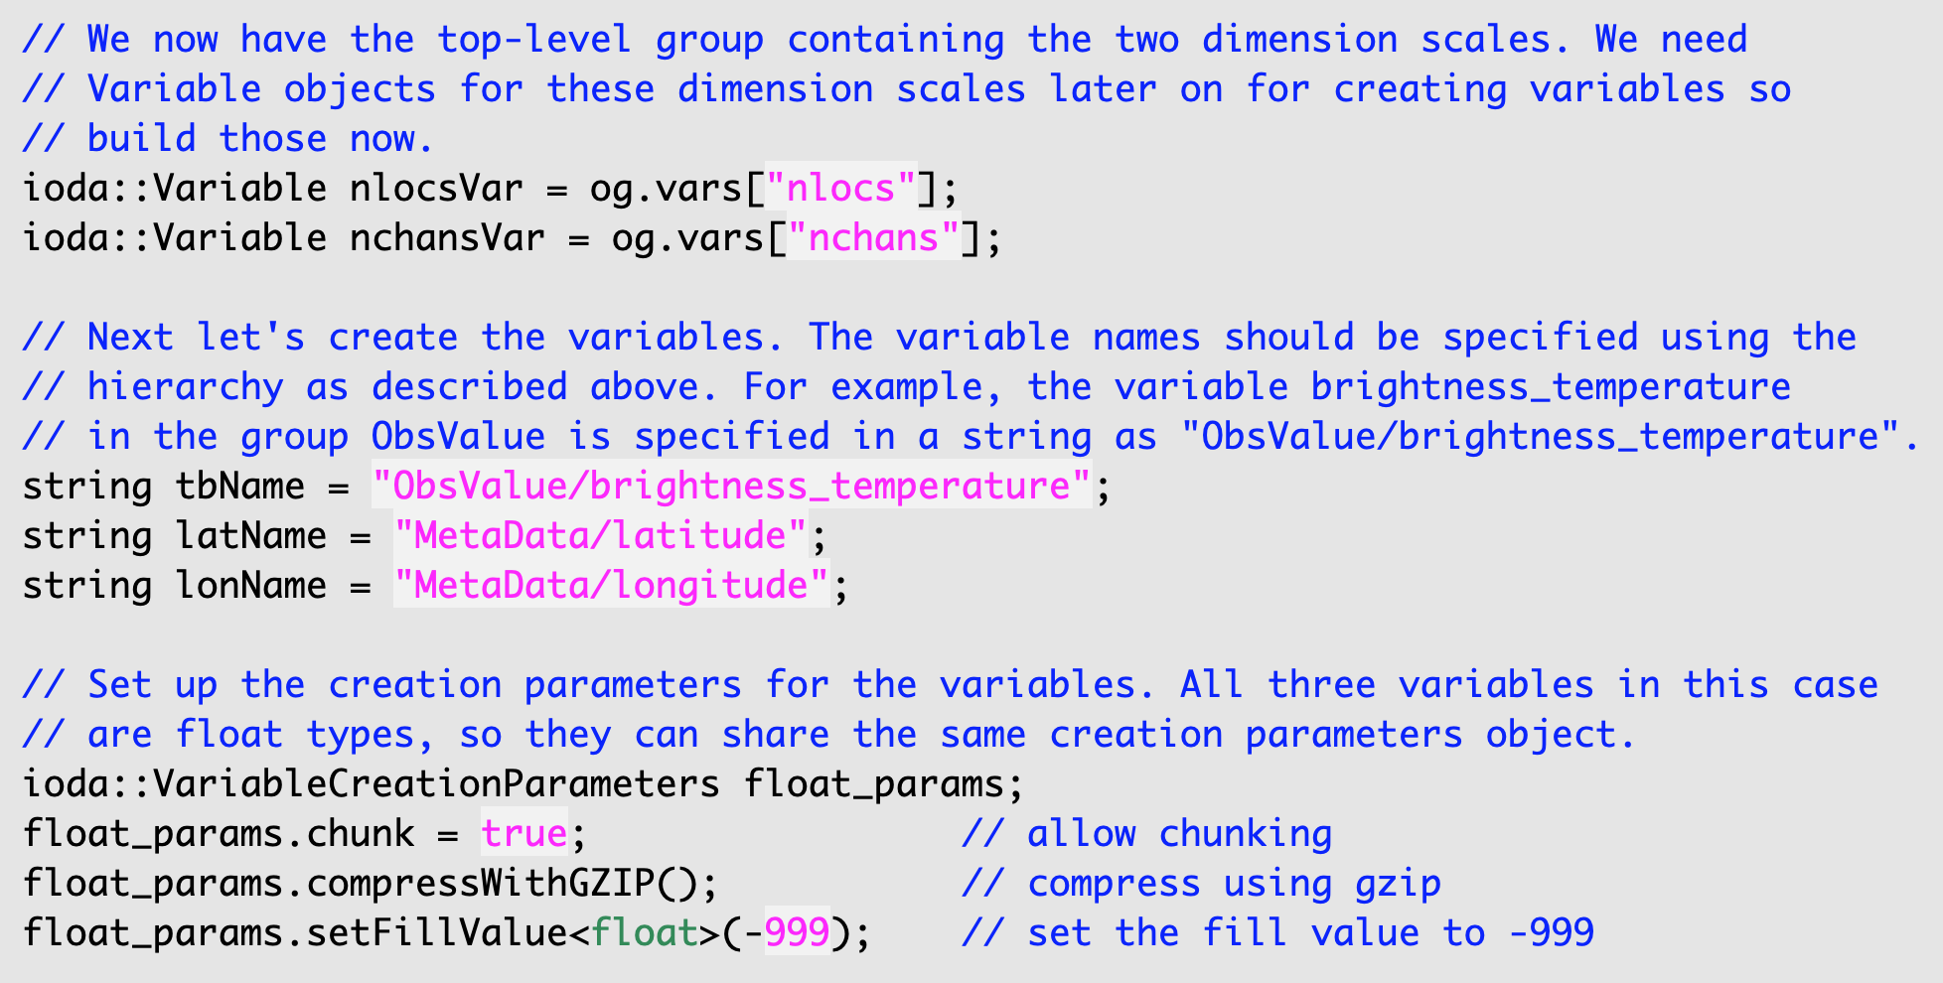
Step 3: Create the output variables
Useful items for the upcoming create commands
Helper struct for the upcoming create commands

Slide 13
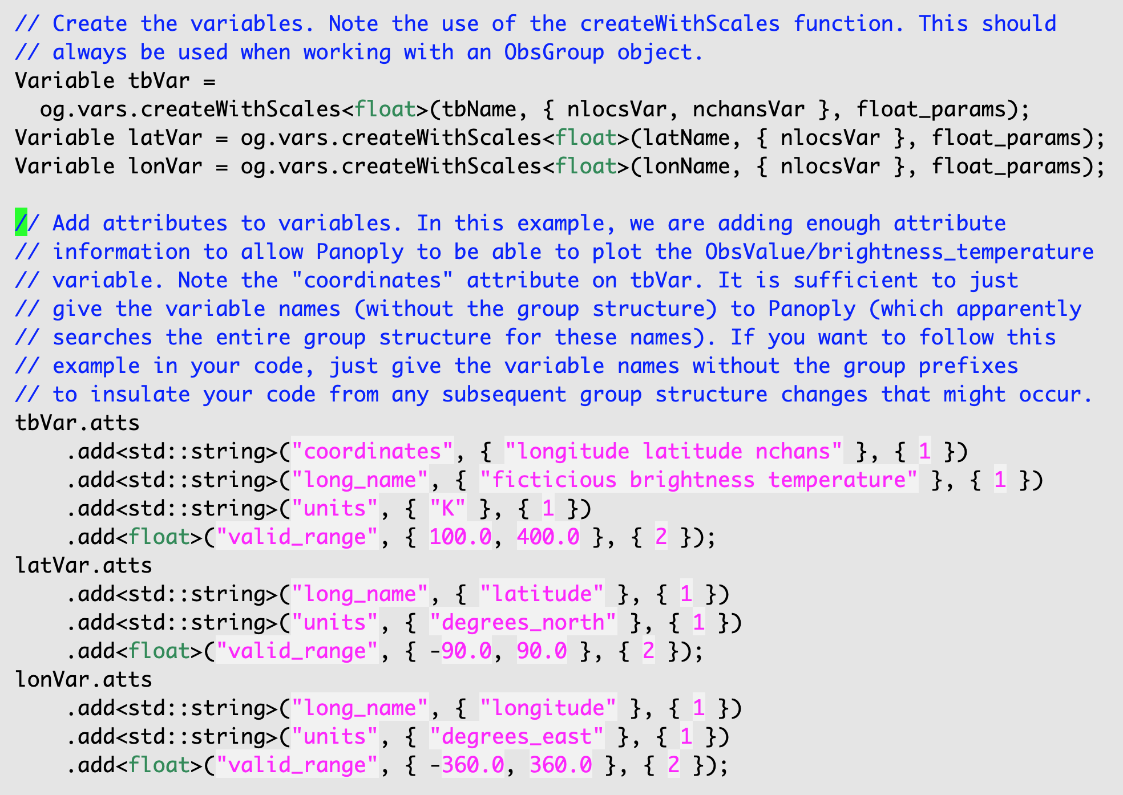
Step 3: Create the output variables (cont.)
Create the variables
Note template type is how variable type is specified
Note vectors of dimension scale variables for second argument
Attach attributes to variables.
This example shows attributes that Panoply uses to connect geo locations to the Tb data.

Slide 14
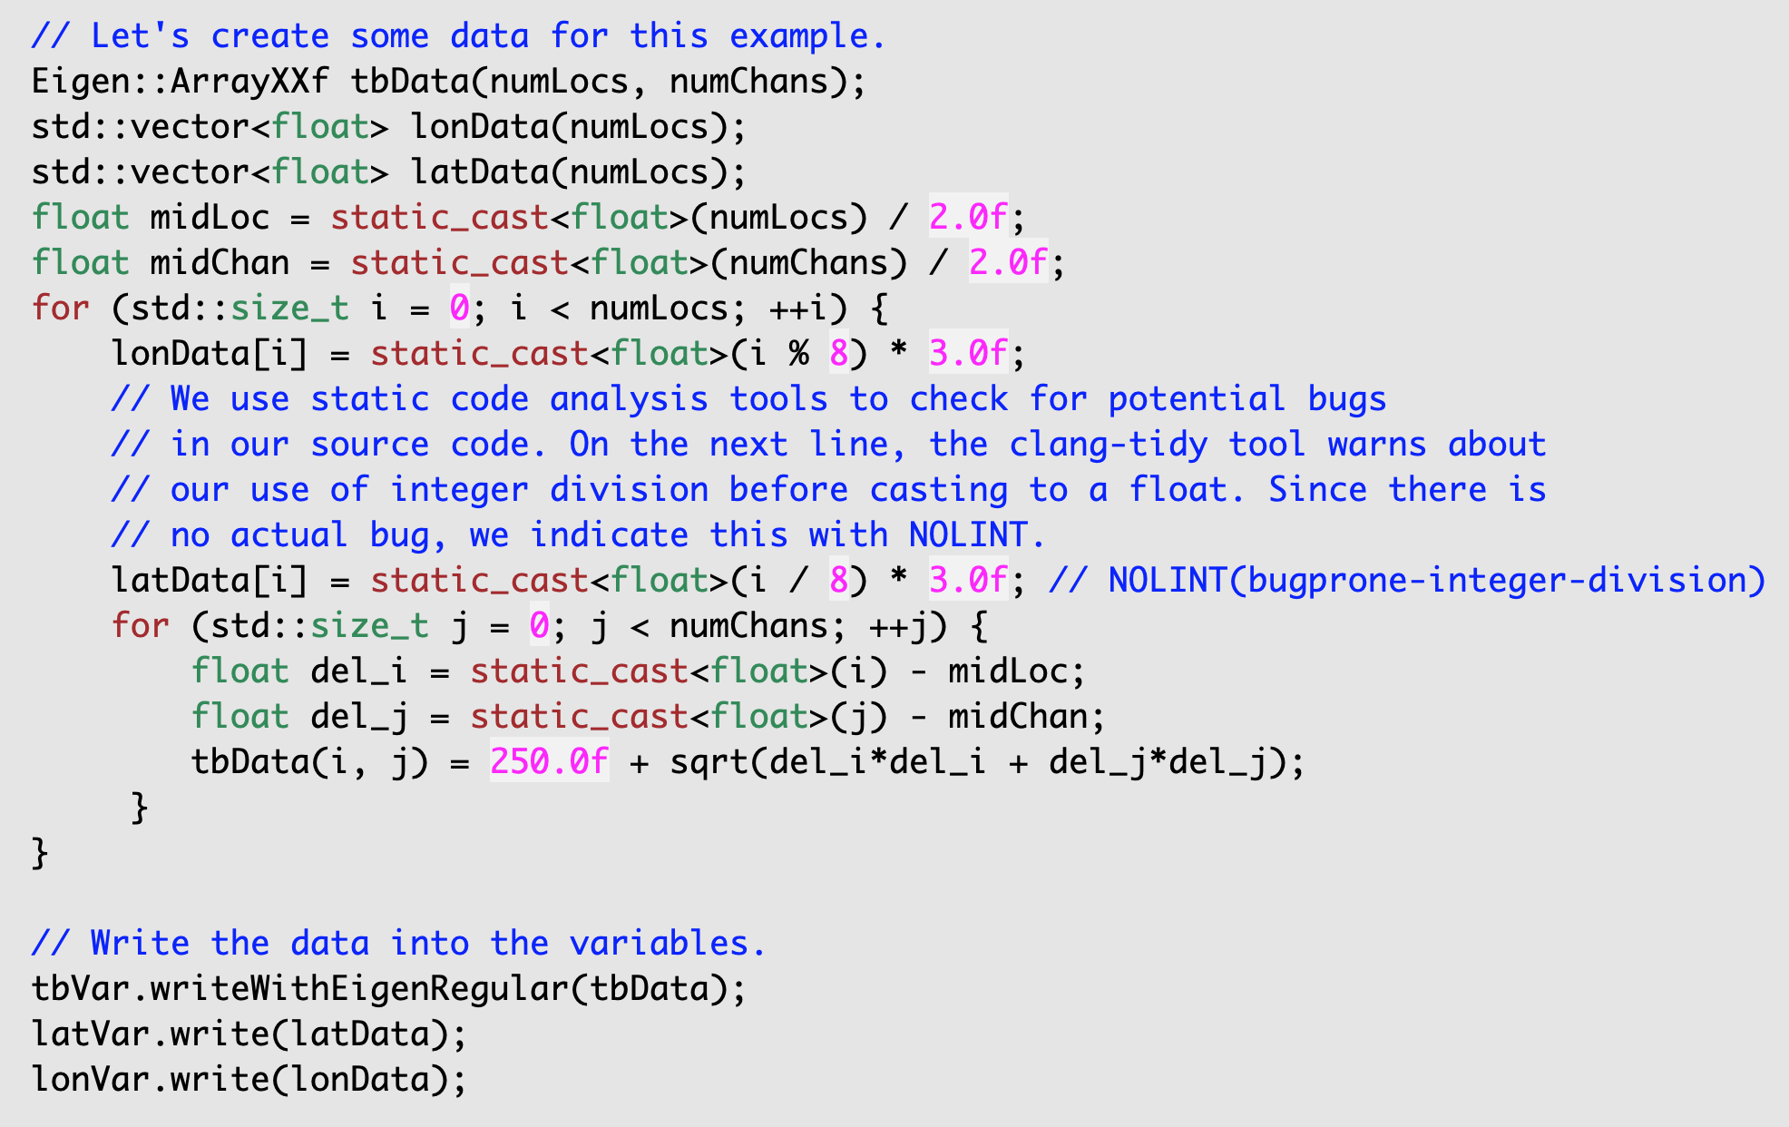
Step 4: Transfer the variable data to the ObsGroup object
Creation of contrived data for this example.
Data transfer

Slide 15
Example: nlocs not known before transferring data
Same task as prior example
Steps 1-3 are the same as before
Step 4 (transfer of data) is now done in sections
  Contiguous pieces transferred one at a time
  Pieces are split along the nlocs dimension
    First 10 locations, next 10 locations, next 10 location, etc.
  Will use the Variable Selection feature in ioda-engines to do this style of data transfer
Code example
  ioda-engines repository
  feature/obsgroup-append-example branch (PR under review)
  Example/Basic/05b-ObsGroupAppend.cpp

Slide 16
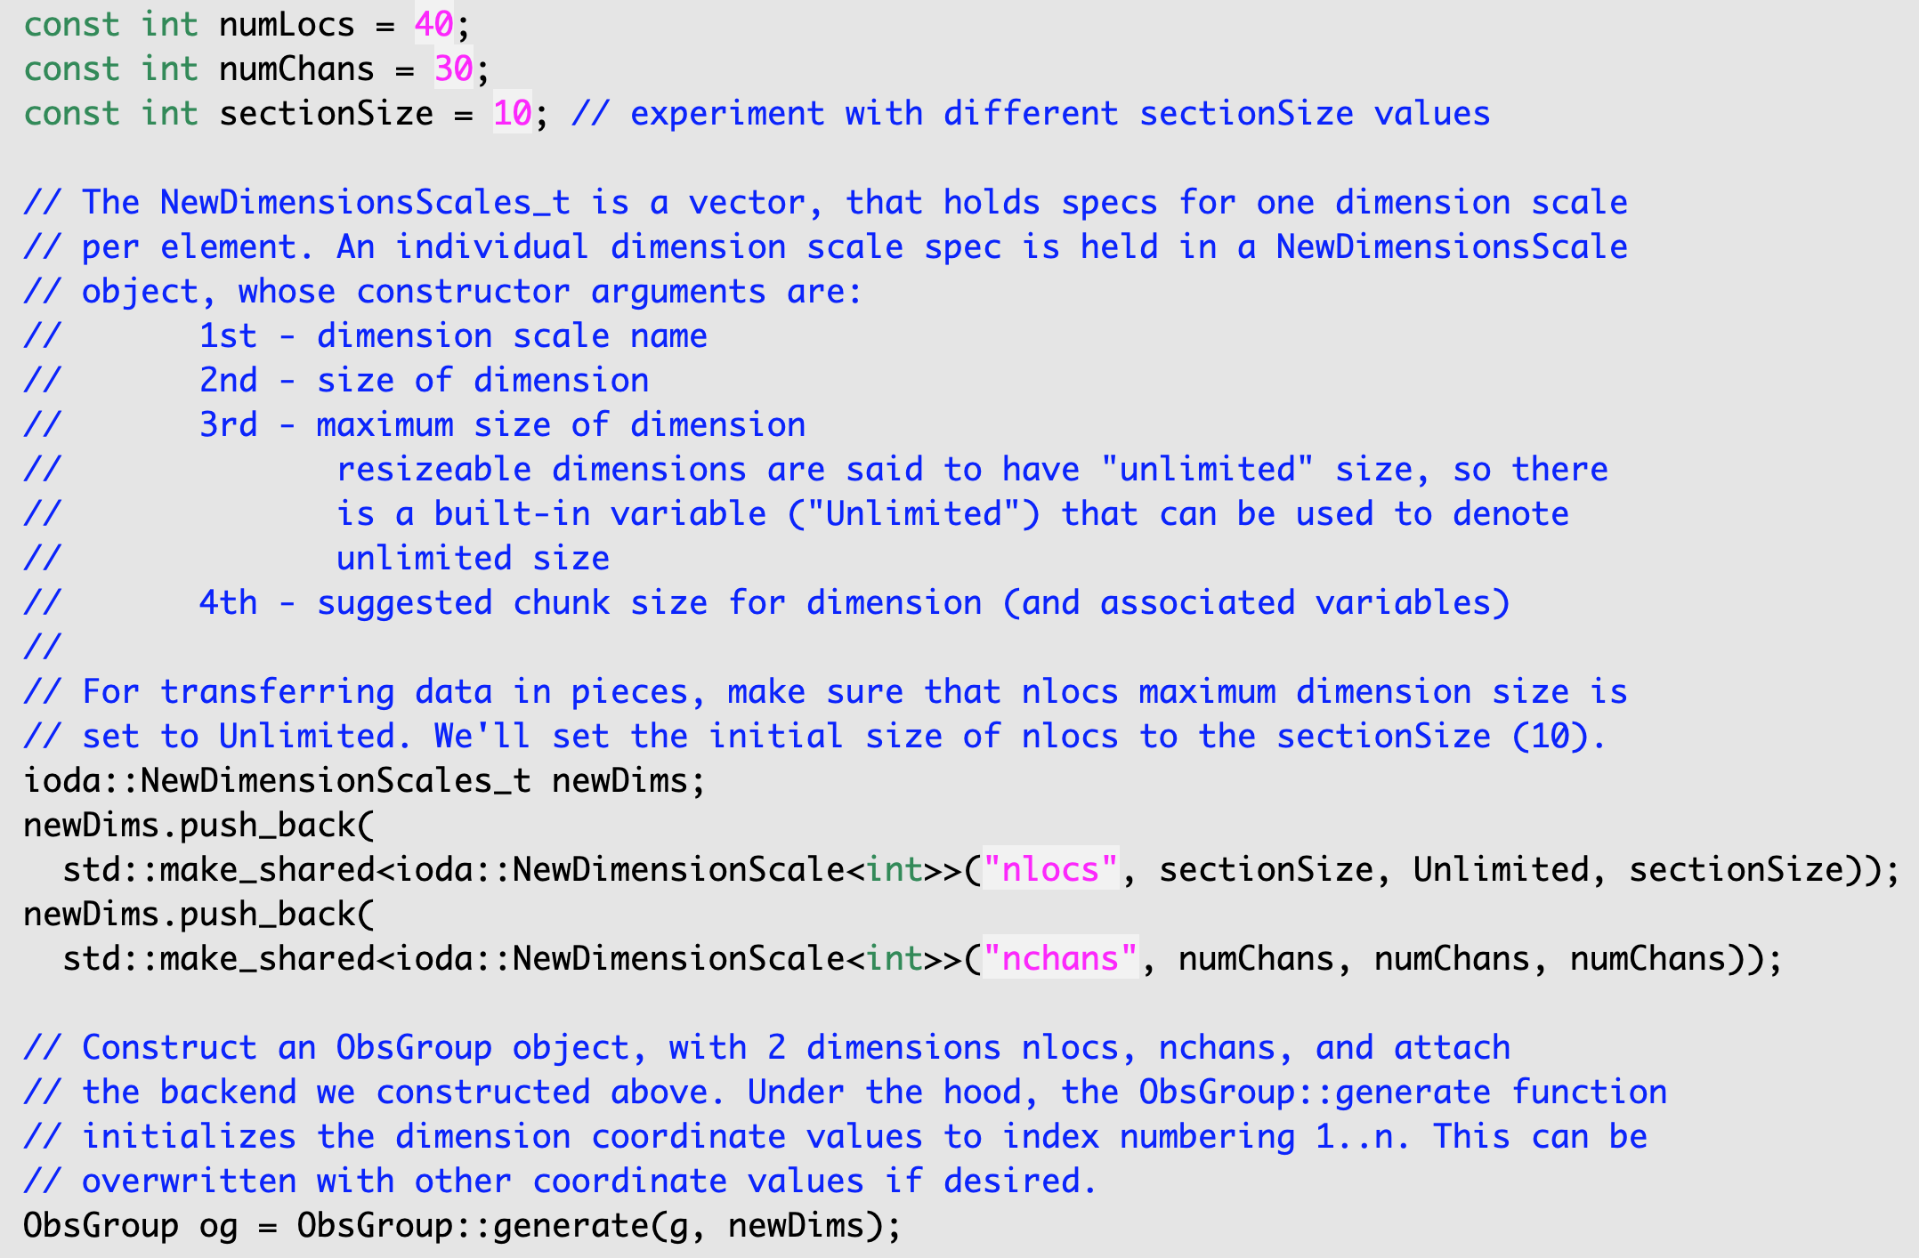
Step 2 – note about nlocs dimension
Added section size specification. With these specs, there will be 4 sections.
Using sectionSize instead of numLocs now (since we aren’t supposed to know the value of numLocs in this example).
The practice of setting the chunk size to the section size (increment you will grow along the nlocs dimension) is reasonable.

Slide 17
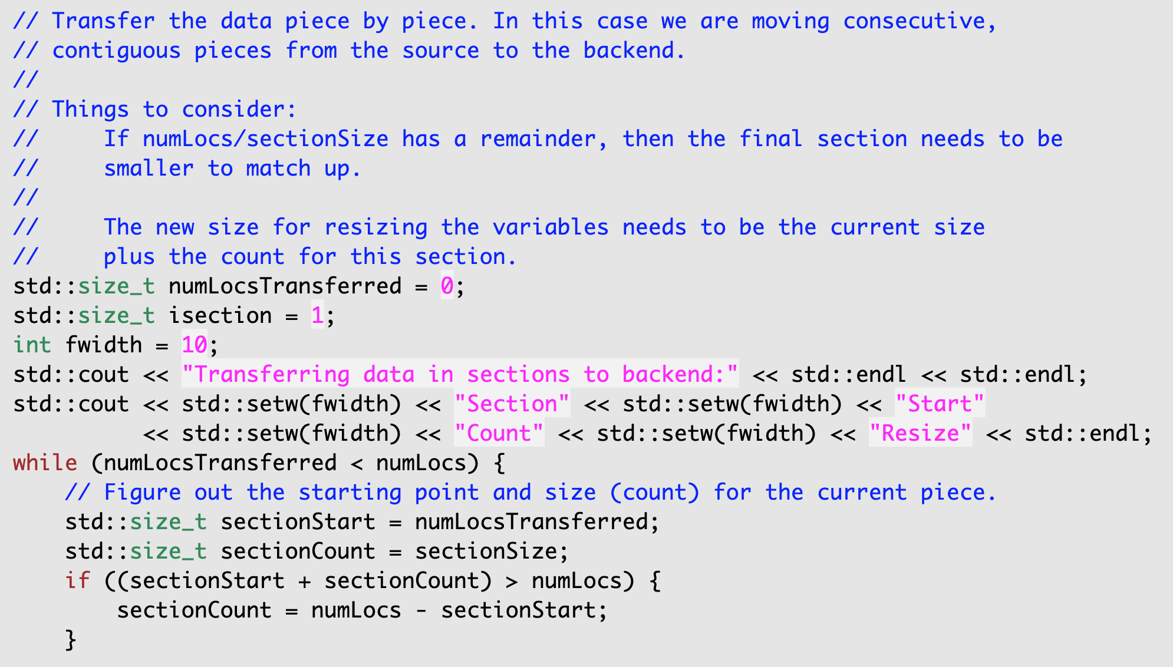
Step 4: data transfer – determine size of section
Note contrived case, in real situation there will be some other means of terminating the loop such as EOF of the input file.
The final section size might need to be smaller than sectionSize

Slide 18
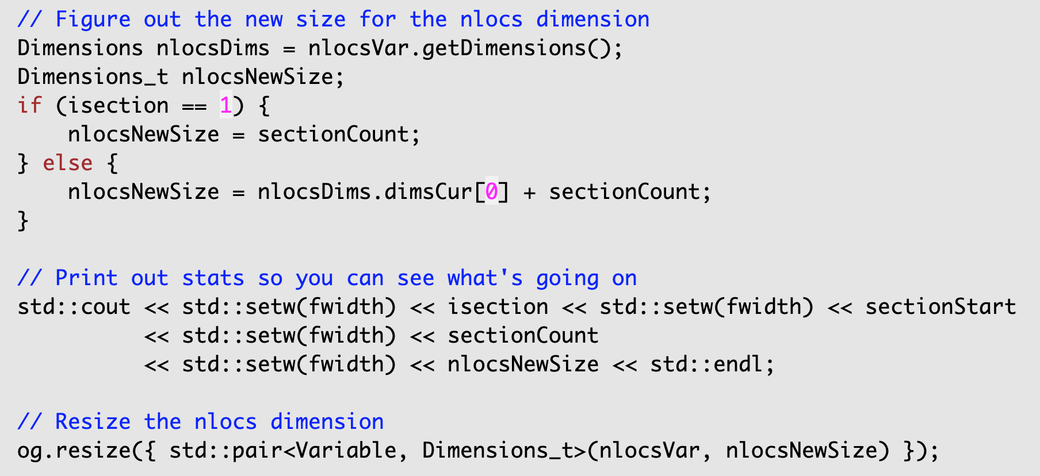
Step 4: data transfer – resize along nlocs dimension
Note still inside the while loop
If on the first section resize to the section size, otherwise increment the current size by sectionCount
ObsGroup::resize will resize nlocs, plus all variables dimensioned by nlocs.

Slide 19
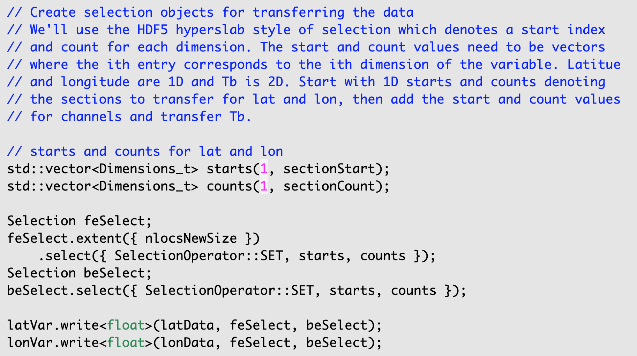
Step 4: data transfer – create Selection objects and transfer data for 1D variables
Note still inside the while loop
Note contrived case where we have the entire input variable in memory.
Typically, you would have only the current piece in memory and you would need to select the entire memory space. I.e.:
start = 0
count = sectionCount
Create Selection objects (1D)
Transfer data

Slide 20
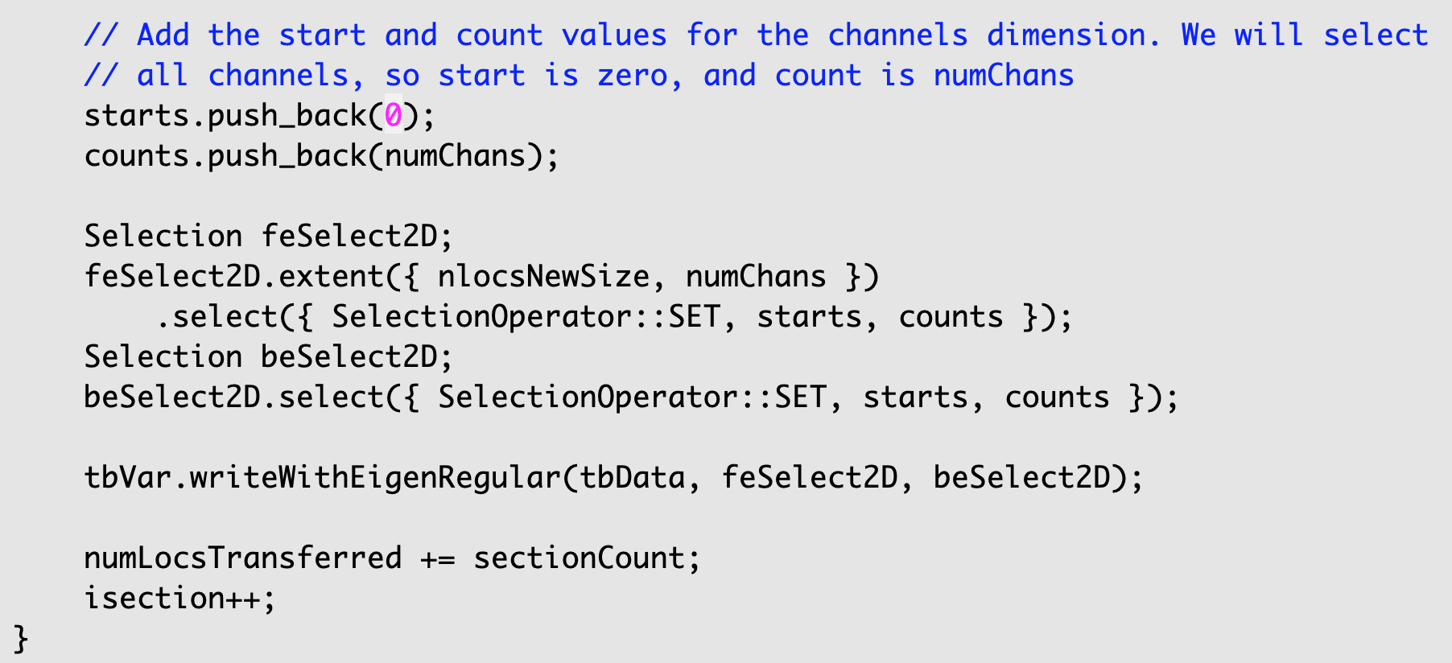
Step 4: transfer data – create Selection objects and transfer data for 2D variable
Note still inside the while loop
Create Selection objects (2D)
Transfer data
End of while loop

Slide 21
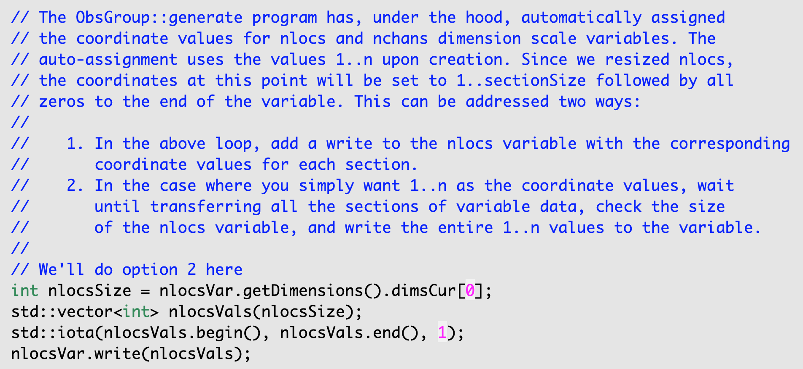
Note about nlocs dimension

