Slide 1
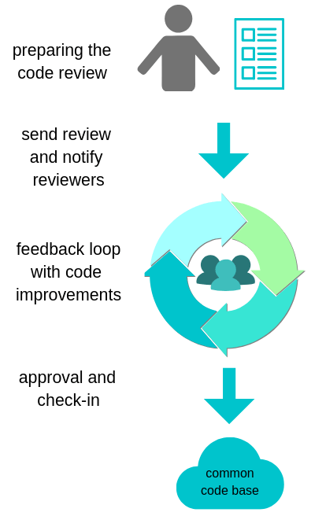
Lifecycle of Code Reviews
Notes:
Prepare
Github / Zenhub provides tools
Describe the purpose and motivation of changes (use a template)
Don’t select too many reviewers
Select relevant reviewers, but “share the load” – include appropriate stakeholders where appropriate
Pairwise programming – already reviewed
Simple change(s)? – one reviewer is probably sufficient
Provide / accept / incorporate feedback
Approval is more than clicking a radio button
Testing is critical – ideally they are run / pass prior to review submittal
Be thorough – as a reviewer, you become an owner of code

Slide 2
The Standard of Code Review
The primary purpose of code review is to make sure that the overall health of a code base is improving over time.
This requires trade-offs:
      Developers need to make progress; timely code reviews helps developers.
    Reviewers must make sure that PR are of such a quality that overall code base health increases; they
    must also own and be responsible for code being reviewed to ensure consistency and maintainability.
Code reviews are work – they’re time constrained, impact both developer and reviewers, and should
be valued and understood as an important part of team members’ work.
Expected standard: favor approval of a PR when it definitely improves overall code health, even if it’s not
perfect. There isn’t perfect code, just better code.
Other Benefits:
Sharing knowledge / increase knowledge transfer / build team awareness
Improve development process
Mentoring of all team members

Slide 3
What to Look for in a Code Review
Design
Functionality
Complexity
Testing
  Unit / integration / end-to-end tests, as appropriate
Comments
  Explain a why, not a what
Style and Consistency
Documentation
  If a PR changes behavior or instructions, accompanying documentation also changes
Every Line
Context
Notes:
Design:
Do code interactions make sense?
Does this belong in the code base, or in an ancillary library, or ?
Functionality:
Does the PR do what is intended?
Are changes good for both end-users and developers?
Complexity
Easily understood by the reader / reviewer?
Testing
Comments
Not the same as documentation of classes / modules / functions (express purpose, how to use, how it behaves, etc.)
Style and consistency
Style Guide always wins

Slide 4
Comments in a Code Review
Courtesy
Explain why – provide useful feedback
Guidance
Summary
  Be kind
  Explain your reasoning
  Balance directions with just pointing out issues (and let the developer decide)
  Encourage developers to simplify code, or add comments as appropriate
Notes:
Courtesy:
Be respectful, but also clear and helpful – comments are about code, period
Explain Why:
Provide explanation around the intent of a comment (how it improves code health, for example)
Guidance
Strike a balance between pointing out issues and direct instructions (it’s the developer’s job to fix a PR)
Point out the things done well, and why (not just the changes you may suggest)

Slide 5
Pushback in a Code Review
Who is right?
“Clean it up later”
Small PRs vs. large PRs
Conflicts
Reviewers should favor approving a PR where it improves overall code health of a system, even if it’s not perfect. There is no perfect code, just better code.
  Technical facts and data overrule opinions and preferences
  A Style Guide (if applicable) is absolute authority
  Software design aspects are not style issues or personal preference – they are underlying principles
Notes:
Who is right
Consider the comments and suggestions – do they make sense?
Provide a good explanation (both suggestion and replies)
Clean it up later
Don’t sacrifice code health and forget things for the sake of (individual and team) velocity
Small PRs vs Large PRs
Prefer small PRs; large PRs tend to be neglected or take significant time to complete, impacting other work
If necessary, and a large PR can’t be broken up into smaller pieces, set aside a day or two for review
Break up large PRs into incremental pieces so that changes follow a logical direction for change
Conflicts
When in doubt, see: Standard of a Code Review

Slide 6
Benefits and References
      Optimization of the development process
      Increase team development velocity
      Improve estimation and planning
Suggested References
    The Ultimate Code Review Blog Post Series
    Google’s Engineering Practices
    Atlassian: Why code reviews matter (and actually save time!)
Notes:
https://www.michaelagreiler.com/code-review-blog-post-series/
https://google.github.io/eng-practices/
https://www.atlassian.com/agile/software-development/code-reviews

