Slide 1


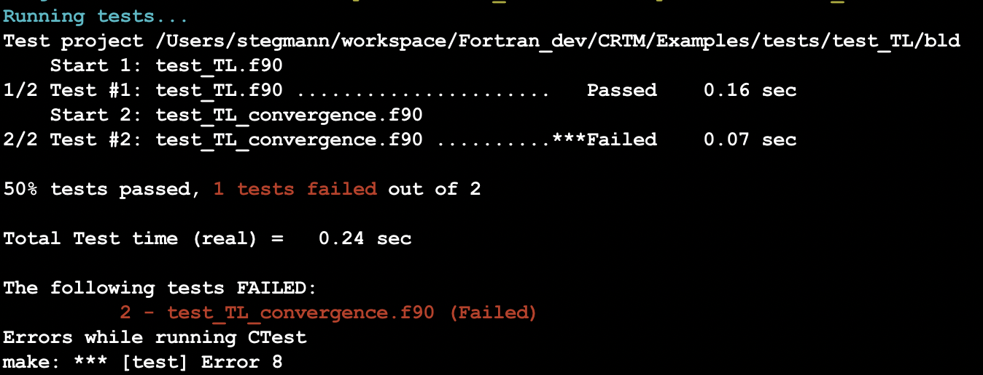
CRTM 2.4 Automated Build System and Testing: CRTM TL/AD CTESTS
Fig. 1: TL/AD Fortran ctest suite with TL convergence test failing on purpose.

Slide 2
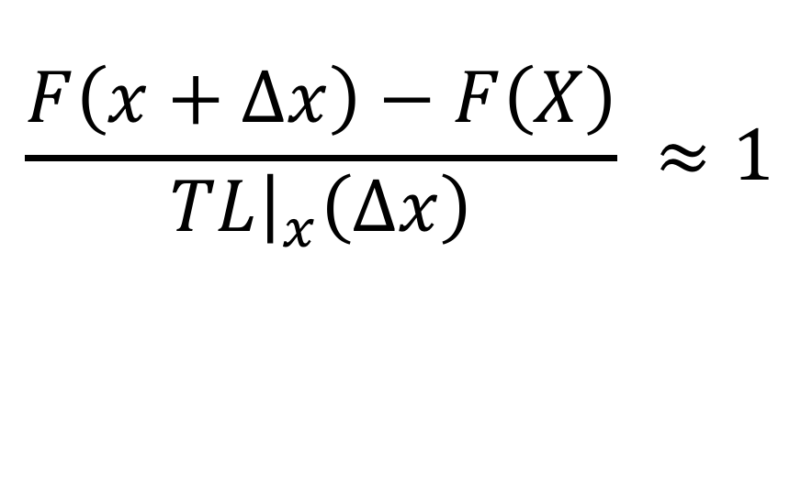
CRTM 2.4 Automated Build System and Testing: CRTM TL/AD CTESTS
Simple Finite Difference test of the Tangent-Linear case.
$$\frac{F\left(x+Δx\right)−F\left(X\right)}{TL{\left.​\right|}_{x}\left(Δx\right)} ≈1$$

Slide 3
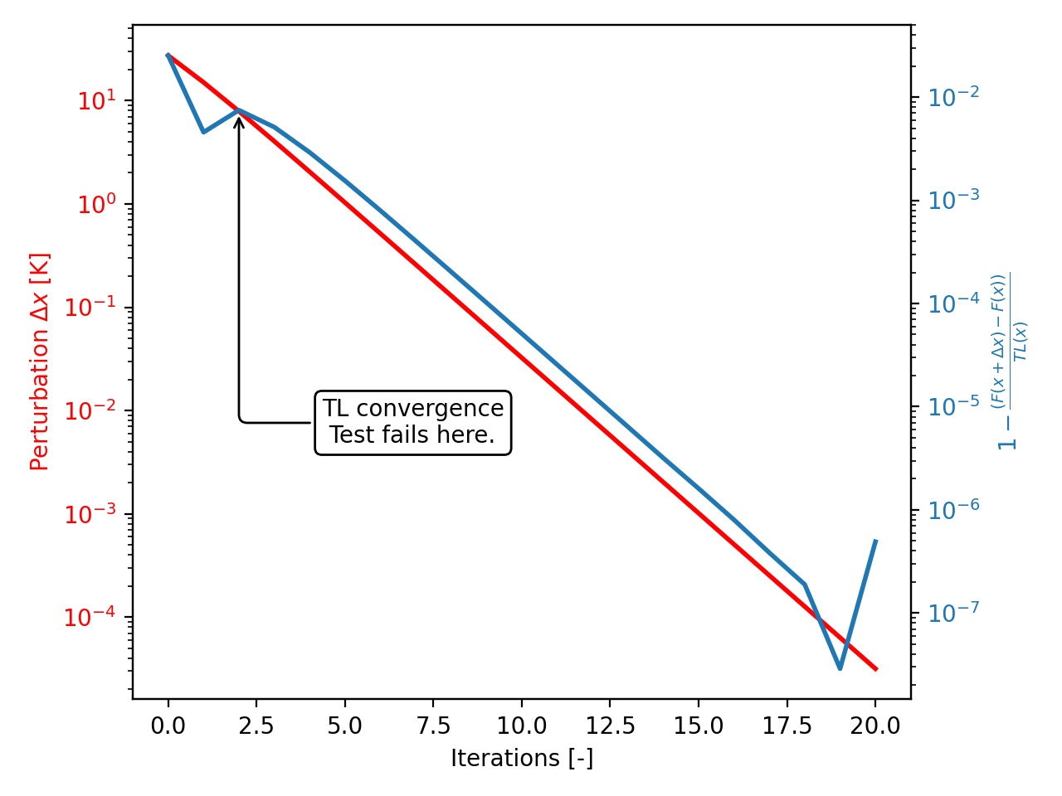
CRTM 2.4 Automated Build System and Testing: CRTM TL/AD CTESTS
Fig. 2: Failing TL convergence test in more detail.

Slide 4
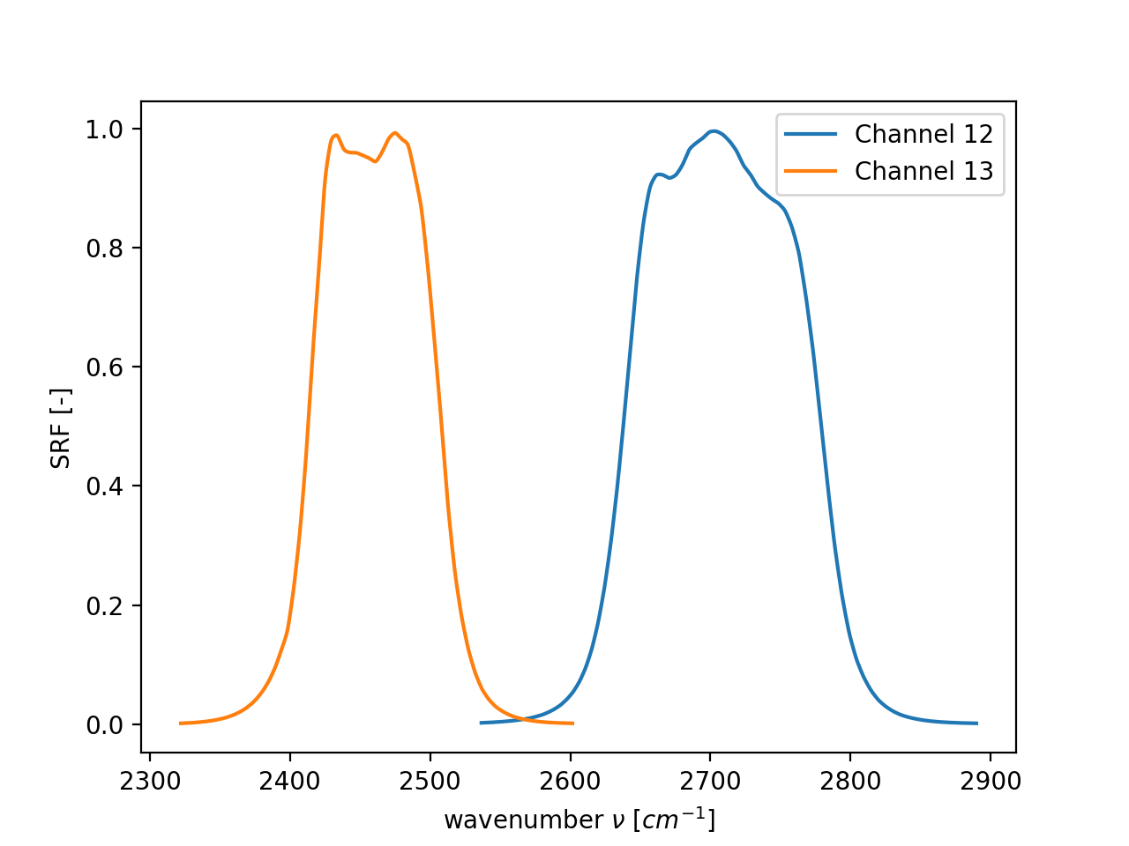
CRTM 1.2 Modernized Transmittance Coefficient Package: VIIRS Comparison
Fig. 3: VIIRS-M_NPP SRFs for Ch. 12 & 13.

Slide 5
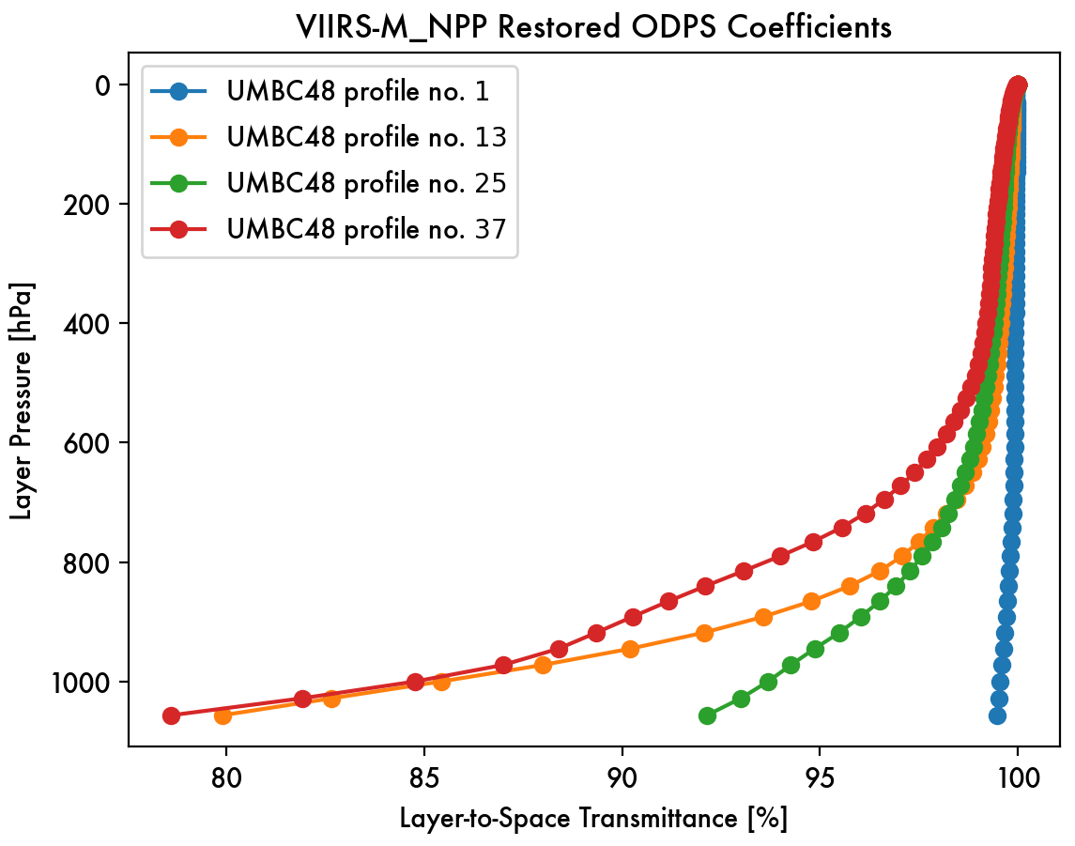
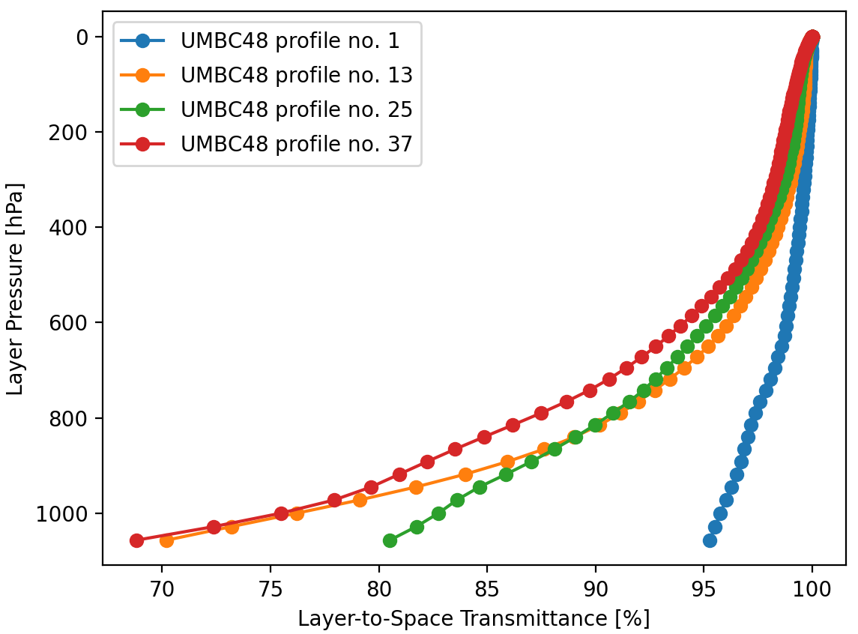
CRTM 1.2 Modernized Transmittance Coefficient Package: VIIRS Comparison
Comment: Qualitative agreement of the layer-to-space transmittance profiles, but significant differences across the board, especially for high pressure values. Absorption is too low.

Slide 6
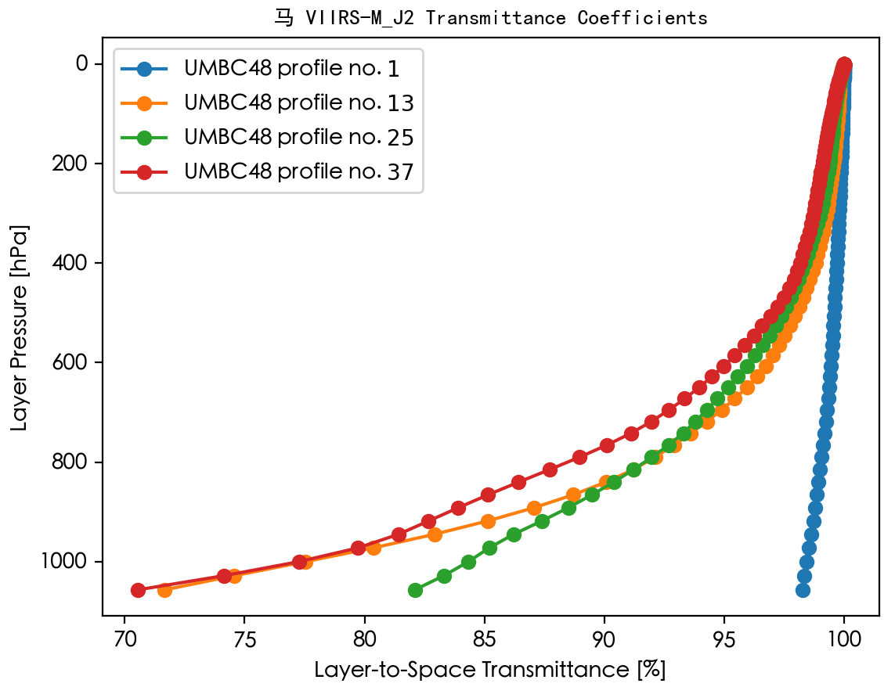
CRTM 1.2 Modernized Transmittance Coefficient Package: VIIRS Comparison
Comment: Improvement for UMBC48 profiles #13 to #37, but still significant differences, in particular for #1.

Slide 7
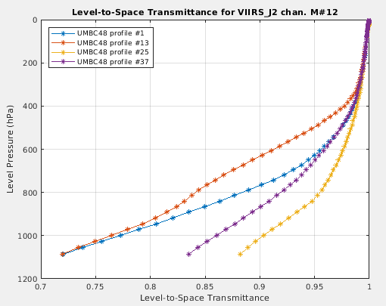
CRTM 1.2 Modernized Transmittance Coefficient Package: VIIRS Comparison
Fig.: VIIRS-M_J2 Level-to-Space Transmittance plot for Ch. 12 by Yingtao.

Slide 8
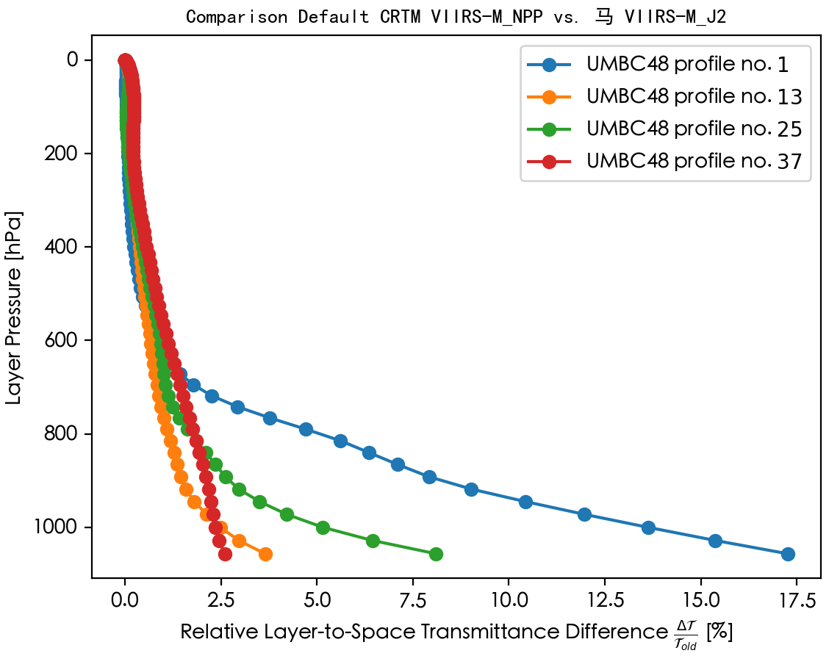
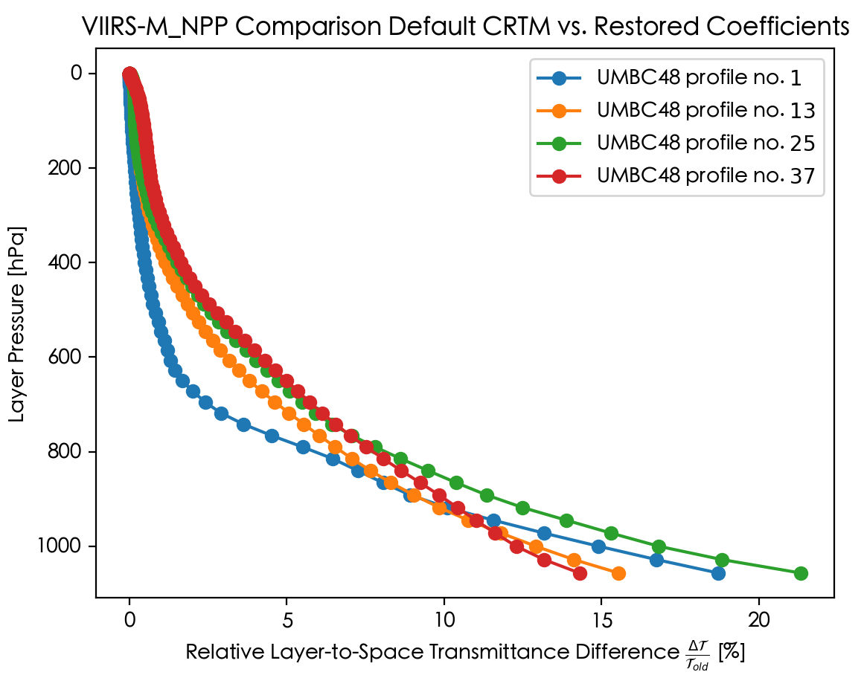
CRTM 1.2 Modernized Transmittance Coefficient Package: VIIRS Comparison
Comment: Overall high differences, consistent for UMBC48 profile #1.

Slide 9
CRTM 1.2 Modernized Transmittance Coefficient Package: VIIRS Comparison
Possible Explanations:
No ODAS Merge with ODPS for water line absorption.
SRF Influence?
Mismatching set of training absorbers:
(mol7 all wco molc2 molc3 molc4 molc5 molc6)
Mismatching training profile (ECMWF83 vs. UMBC48)?
„Unknown unknowns“ ?

