Slide 1

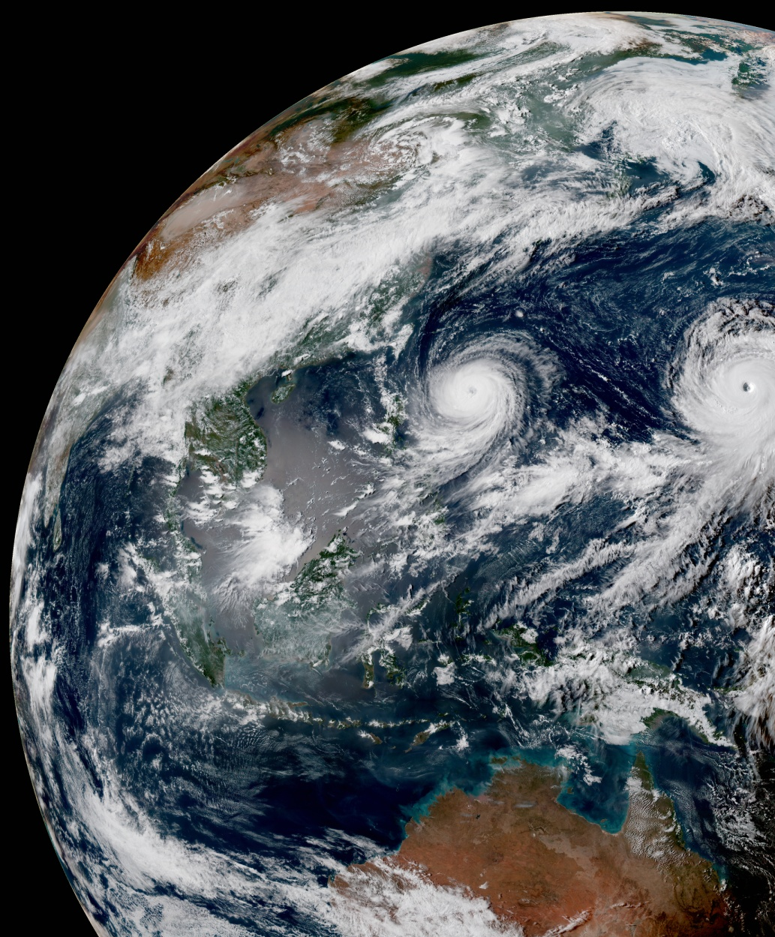
UFO Code Sprints
December 7-18, 2020 &
January 5-15, 2021
OBS Core Team + E. Liu, C. Martin & D. Merkova Z. Liu. C. Harlow, J. Jin
with support of the JEDI/CRTM Core Team

Slide 2
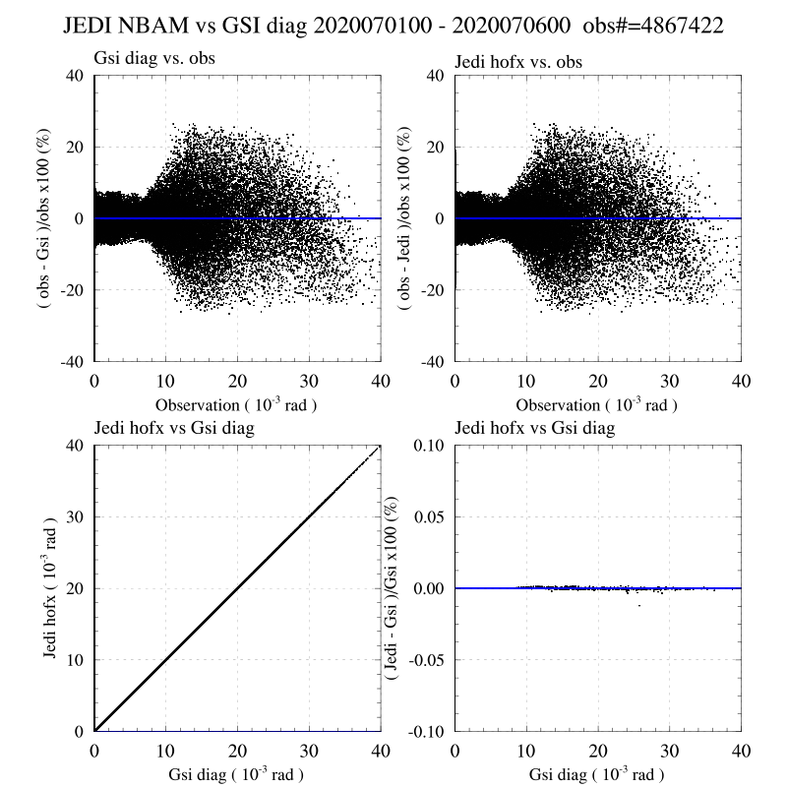
JEDI UFO Support for NOAA Operational Observations: GSI Observer
O vs (O-GSI)/O
O vs (O-JEDI)/O
GSI vs JEDI
GSI vs (JEDI-GSI)/GSI
NCEP Bending Angle Model (NBAM) GSI vs JEDI implementations

Slide 3
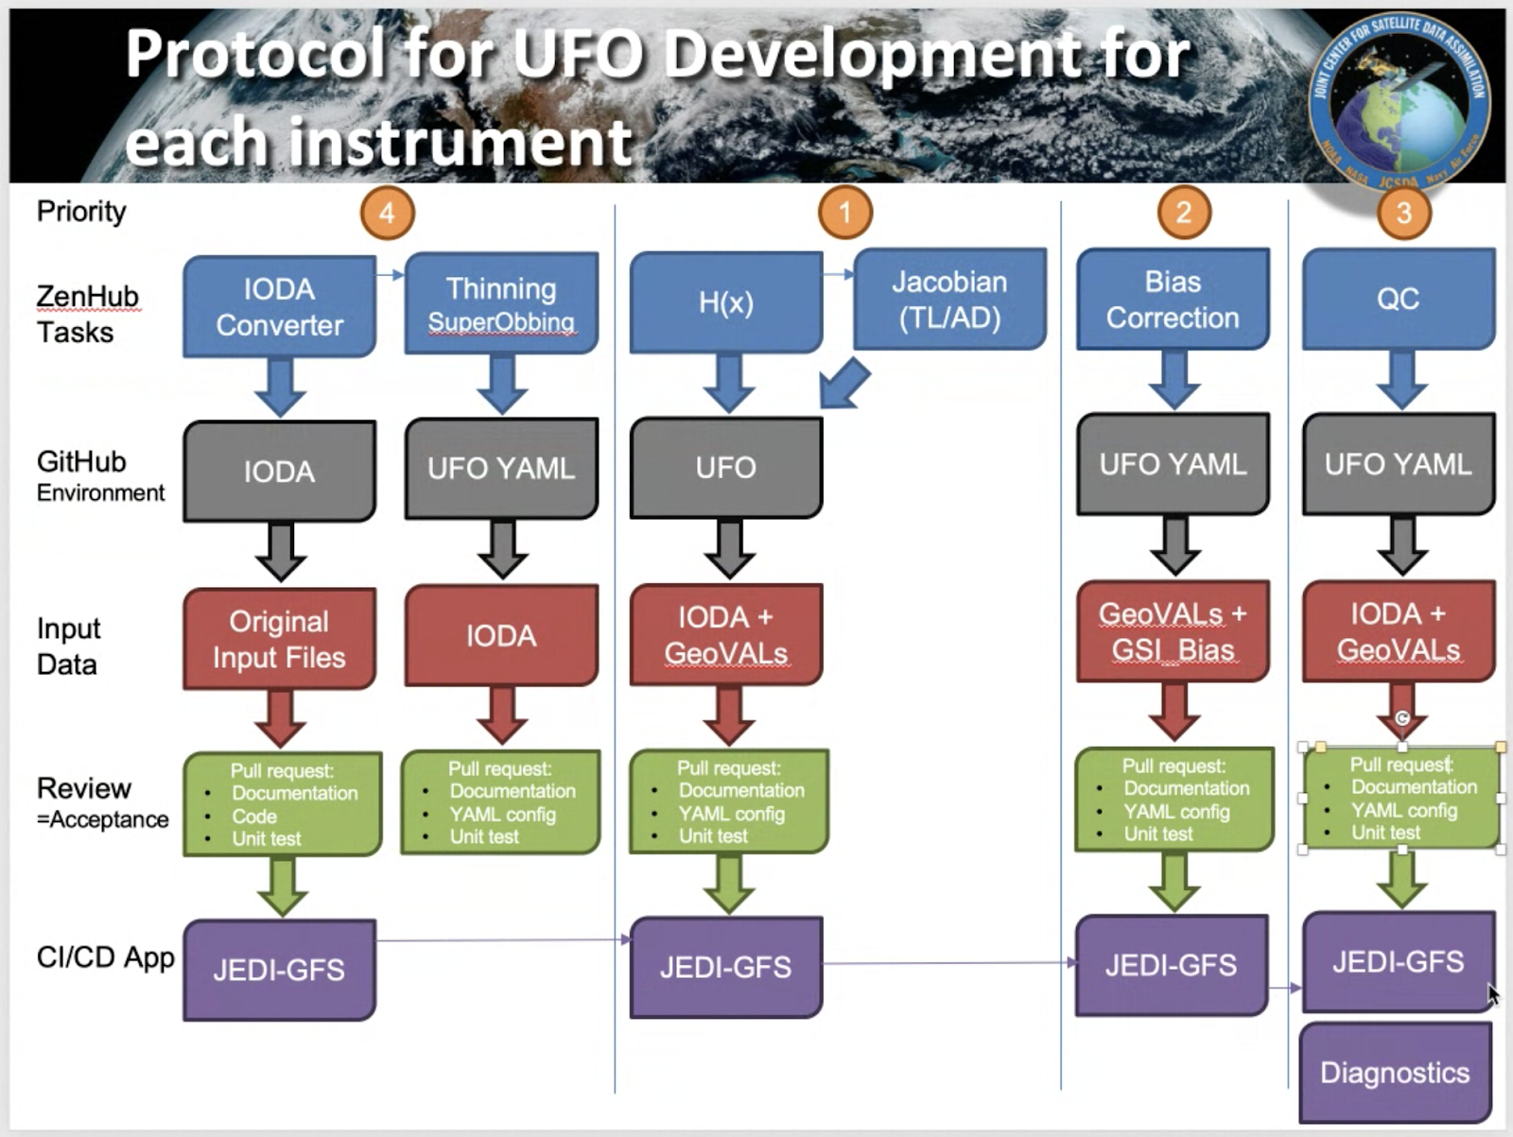
2019 IOS Tasks Overview

Slide 4
UFO Code Sprints
Goal:
Develop, test, accept, and deliver HofX, Bias Correction, and QC for all operational instruments at EMC
Outcomes:
PRs in UFO repository with YAML files for each validated UFO capability (Hofx, BC & QC) for each instrument
Document (in ZenHub) missing features to replicate GSI performances

Slide 5
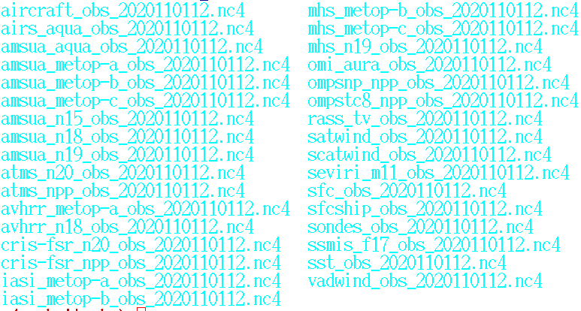
UFO Input Data Generation
geoval and obs files for 2020/11/01 12Z:
Generated with GSI and ioda-converters
33 full analysis size files from 610Kb to 345Mb
Subsampled Medium and Small size files

Slide 6
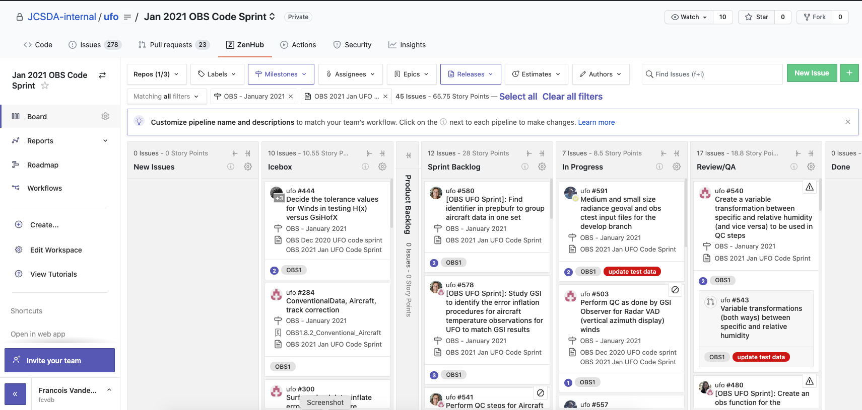
ZenHub Board
Milestone: OBS December 2020
OBS January 2021
Release: OBS Dec 2020 UFO Code sprint
OBS 2021 Jan UFO Code Sprint

