Slide 1

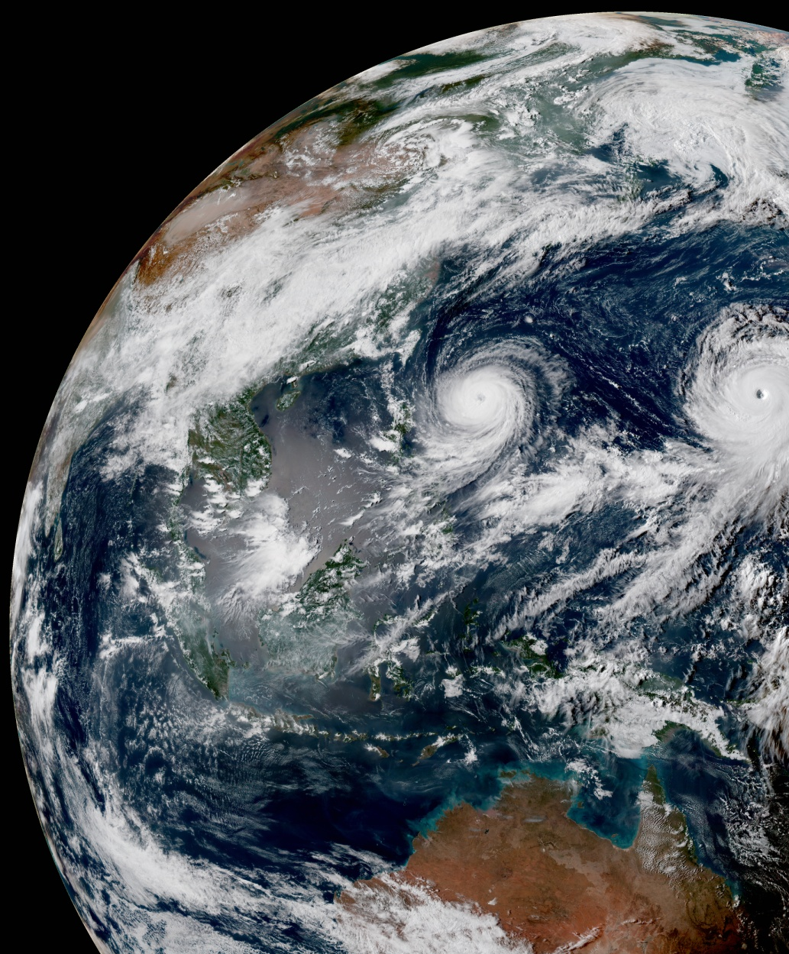
OBS1.7: Satellite Winds
OBS1.8: Conventional Data
Product Team:
G. Thompson
H. Shao, F. Vandenberg, H. Zhang, R. Honeyager
In-Kind Contributors:
I. Genkova
D. Merkova (NCEP-EMC),
P. Pauley (NRL),
L. Hawkness-Smith, C. Thomas, J. Cotton, W. Smigaj*, D. Simonin (UKMO)
M. Hu, G. Ge (NOAA-ESRL)
update: 2021Jan20 *special thanks to Wojciech

Slide 2


OBS1.7 & 1.8 – SatWinds & Conventional
Summary
High level current project status:
  On time! (code sprints Dec/Jan caught up)
Main achievements from reporting period
  SatWinds (AMV) and Scatterometer winds nearly complete
  Aircraft data: all except temp bias correction nearly complete
  Surface obs, land and ocean nearly complete
  VAD-Winds (radar-based) nearly complete
  Radiosondes/dropsondes: a few steps remain
  Each agency’s in-kinds are highly engaged and active

Slide 3
OBS1.7 & 1.8 – SatWinds & Conventional
Technical/Scientific Progress
GitHub: UFO closed Pull Requests, new ObsFunctions
#251: ObsErrorModelStepwiseLinear@ObsFunction
#620: StepwiseLinear with multiplier
#379: ObsErrorFactorSfcPressure@ObsFunction
#433: SfcPCorrected height/surface_altitude var name change
#645: GeoVaLs var names change option
#392: SatWindsLNVDCheck@ObsFunction
#457: SatWindsSPDBCheck@ObsFunction
#483: WindDirAngleDiff@ObsFunction
#491: TropopauseEstimate@ObsFunction
#661: ObsErrorFactorQuotient@ObsFunction
#480: ObsErrorFactorConventional (vertical distribution)
#648: Variable transforms: specific_humidity <-> relative_humidity
#460, 501, 538, 613: Misc.
GitHub: UFO closed Pull Requests, HofX testing
#421: Aircraft data
#422: SatWinds
#423: Scatterometer winds
#472: RASS temperature profiles
#519: Sonde data
#531: Surface (land & marine) data
#665: Merge all into develop branch
GitHub: UFO open Issue/PR, QC steps
#648: Surface data
#503: VAD-winds
#505: Final ObsError check
#650: Sonde data
#541: Aircraft data
GitHub: UFO closed Pull Requests, QC steps
#537: SatWinds & Scatterometer winds

Slide 4
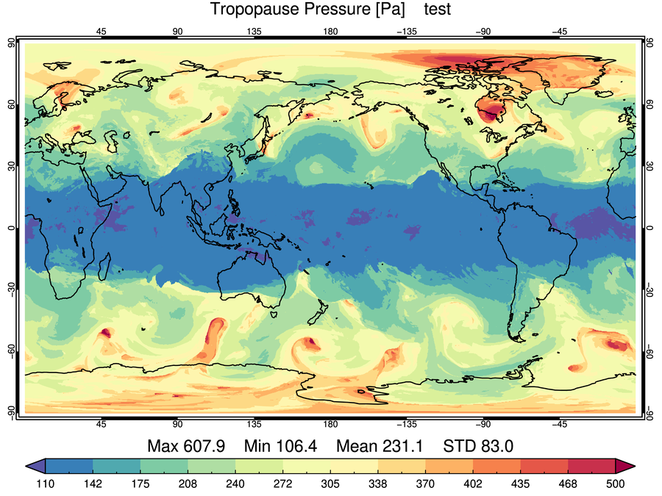
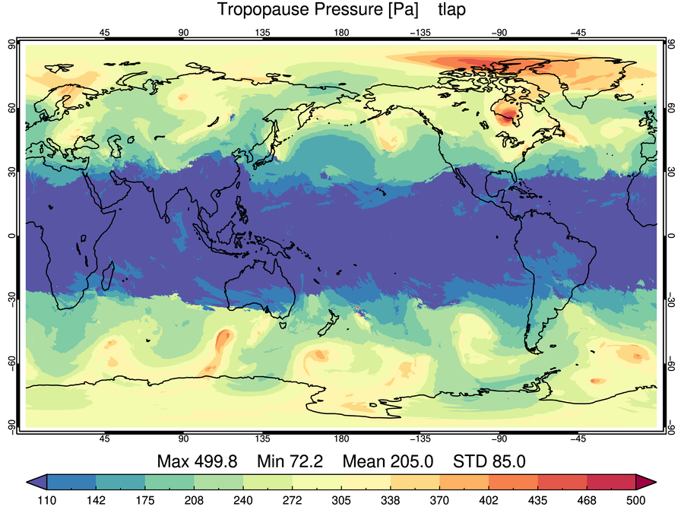
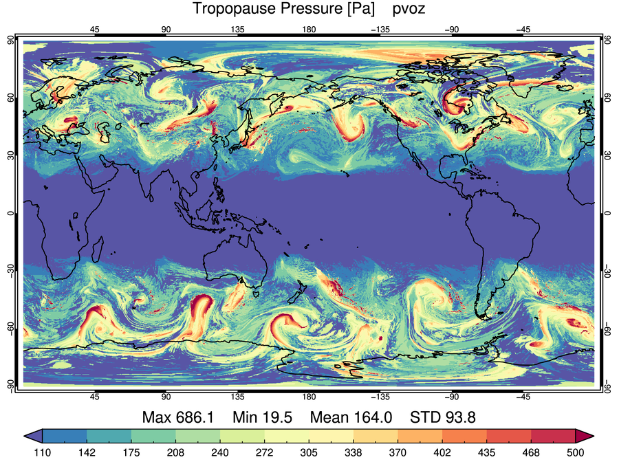
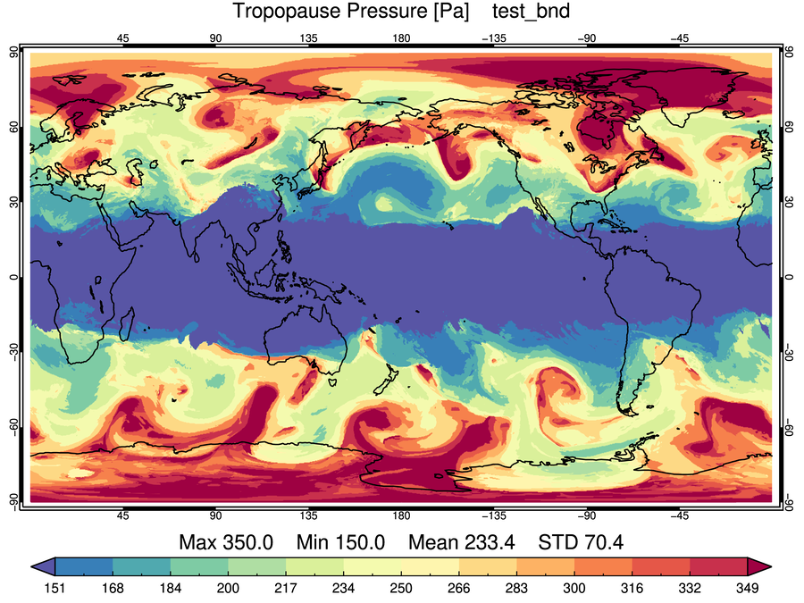
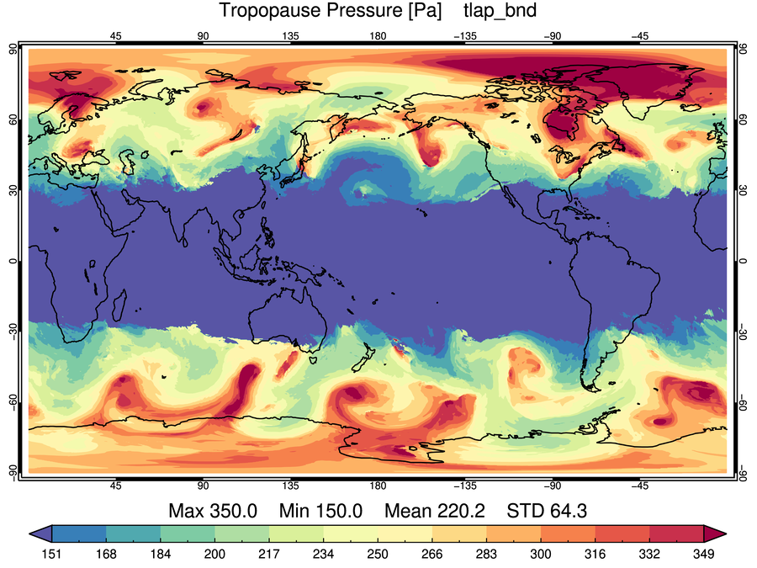
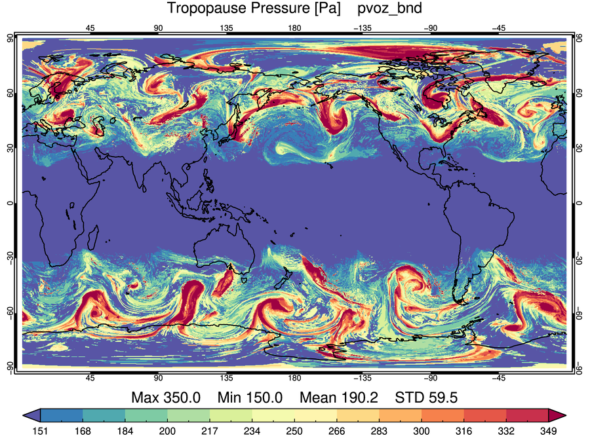
Detail: TropopauseEstimate@ObsFunction
UFO PR#491, issue#486 and #70, FV3-JEDI PR#68, issue#28
Without changing how GeoVaLs produces tropopause pressure, the ObsFunction gives an estimate based on day-of-year and decreases from tropics to poles similar to “Thompson” method shown here.
Potential Temperature (Thompson)
Temperature Lapse Rate (GSI Regional)
Potential Vorticity + Ozone (GSI Global)
MAX(150, MIN(350, tropprs))
MAX(150, MIN(350, tropprs))
Potential Temperature (Thompson)
Temperature Lapse Rate (GSI Regional)
Potential Vorticity + Ozone (GSI Global)

Slide 5
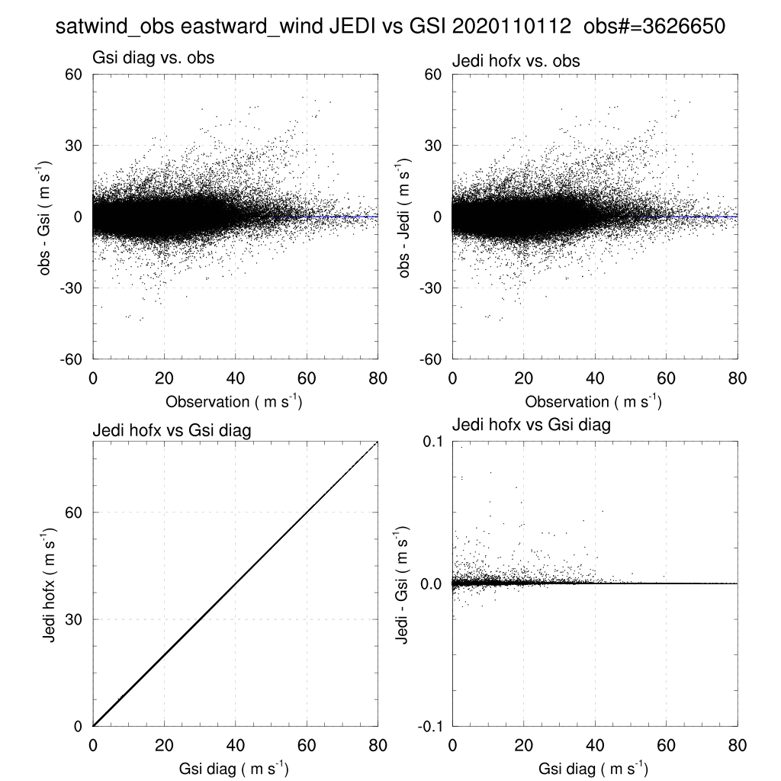
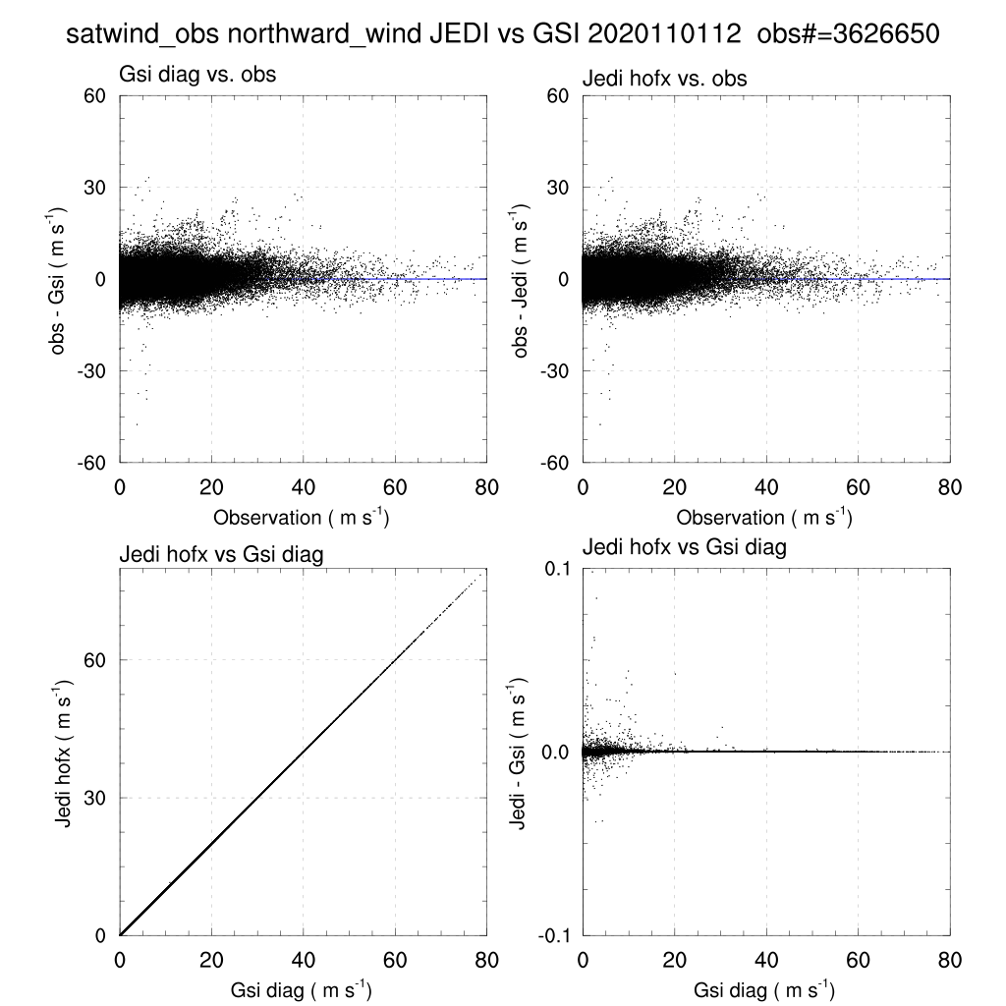
OBS1.7 & 1.8 – SatWinds & Conventional
Technical/Scientific Progress
Detail: SatWinds GsiHofX versus JEDI-HofX

Slide 6
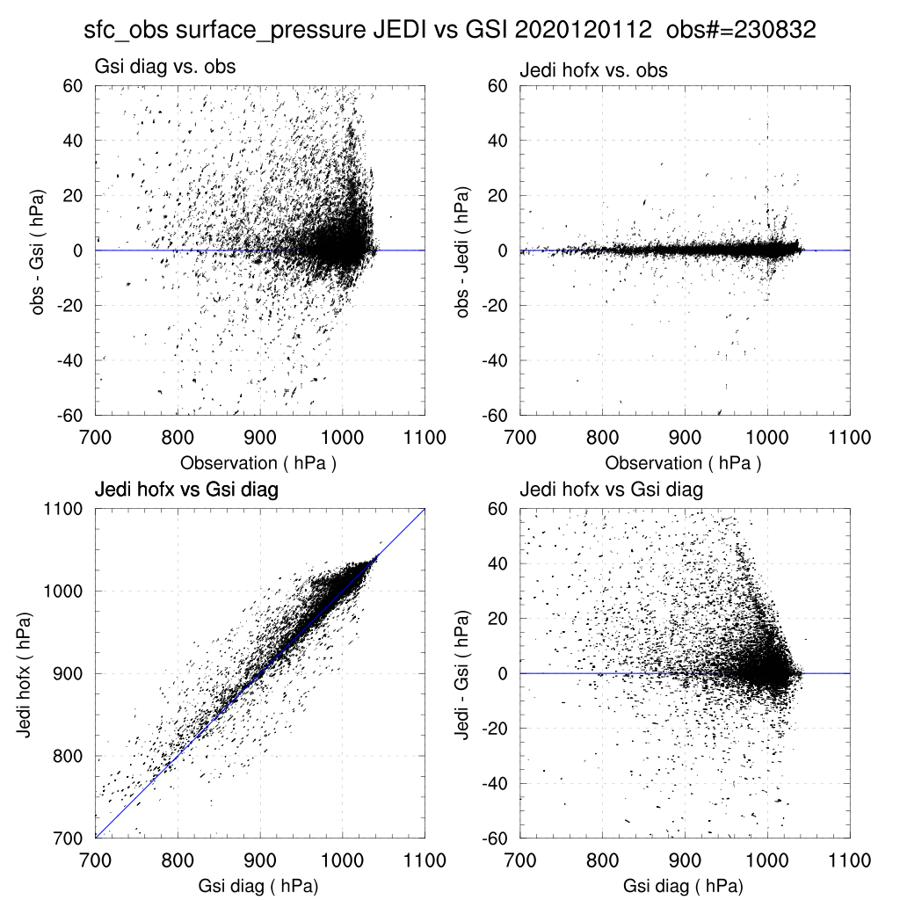
OBS1.7 & 1.8 – SatWinds & Conventional
Technical/Scientific Progress
Detail: Surface Data (surface pressure)
GSI surface pressure reduction method uses model lowest temperature level
JEDI surface pressure reduction using UK Met Office method uses 2-km AGL temperature (less influenced by diurnal cycle)

Slide 7
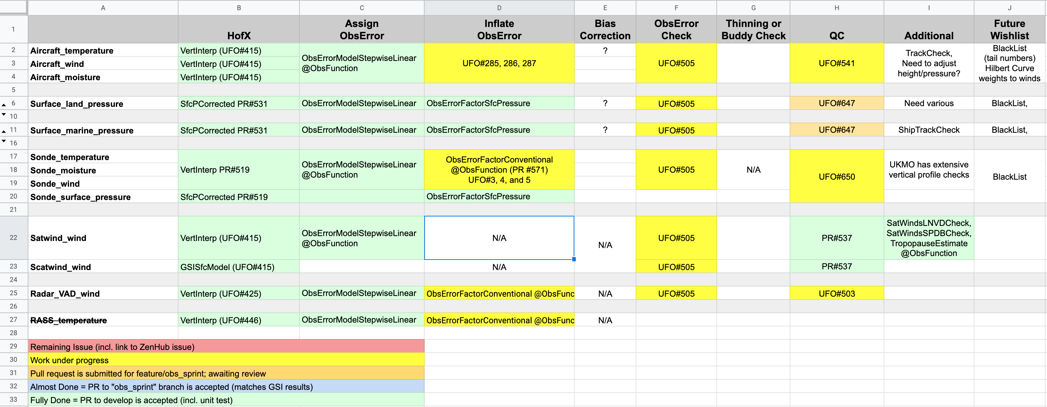
OBS1.7 & 1.8 – SatWinds & Conventional
Technical/Scientific Progress
Progress/Status check during code sprint

Slide 8
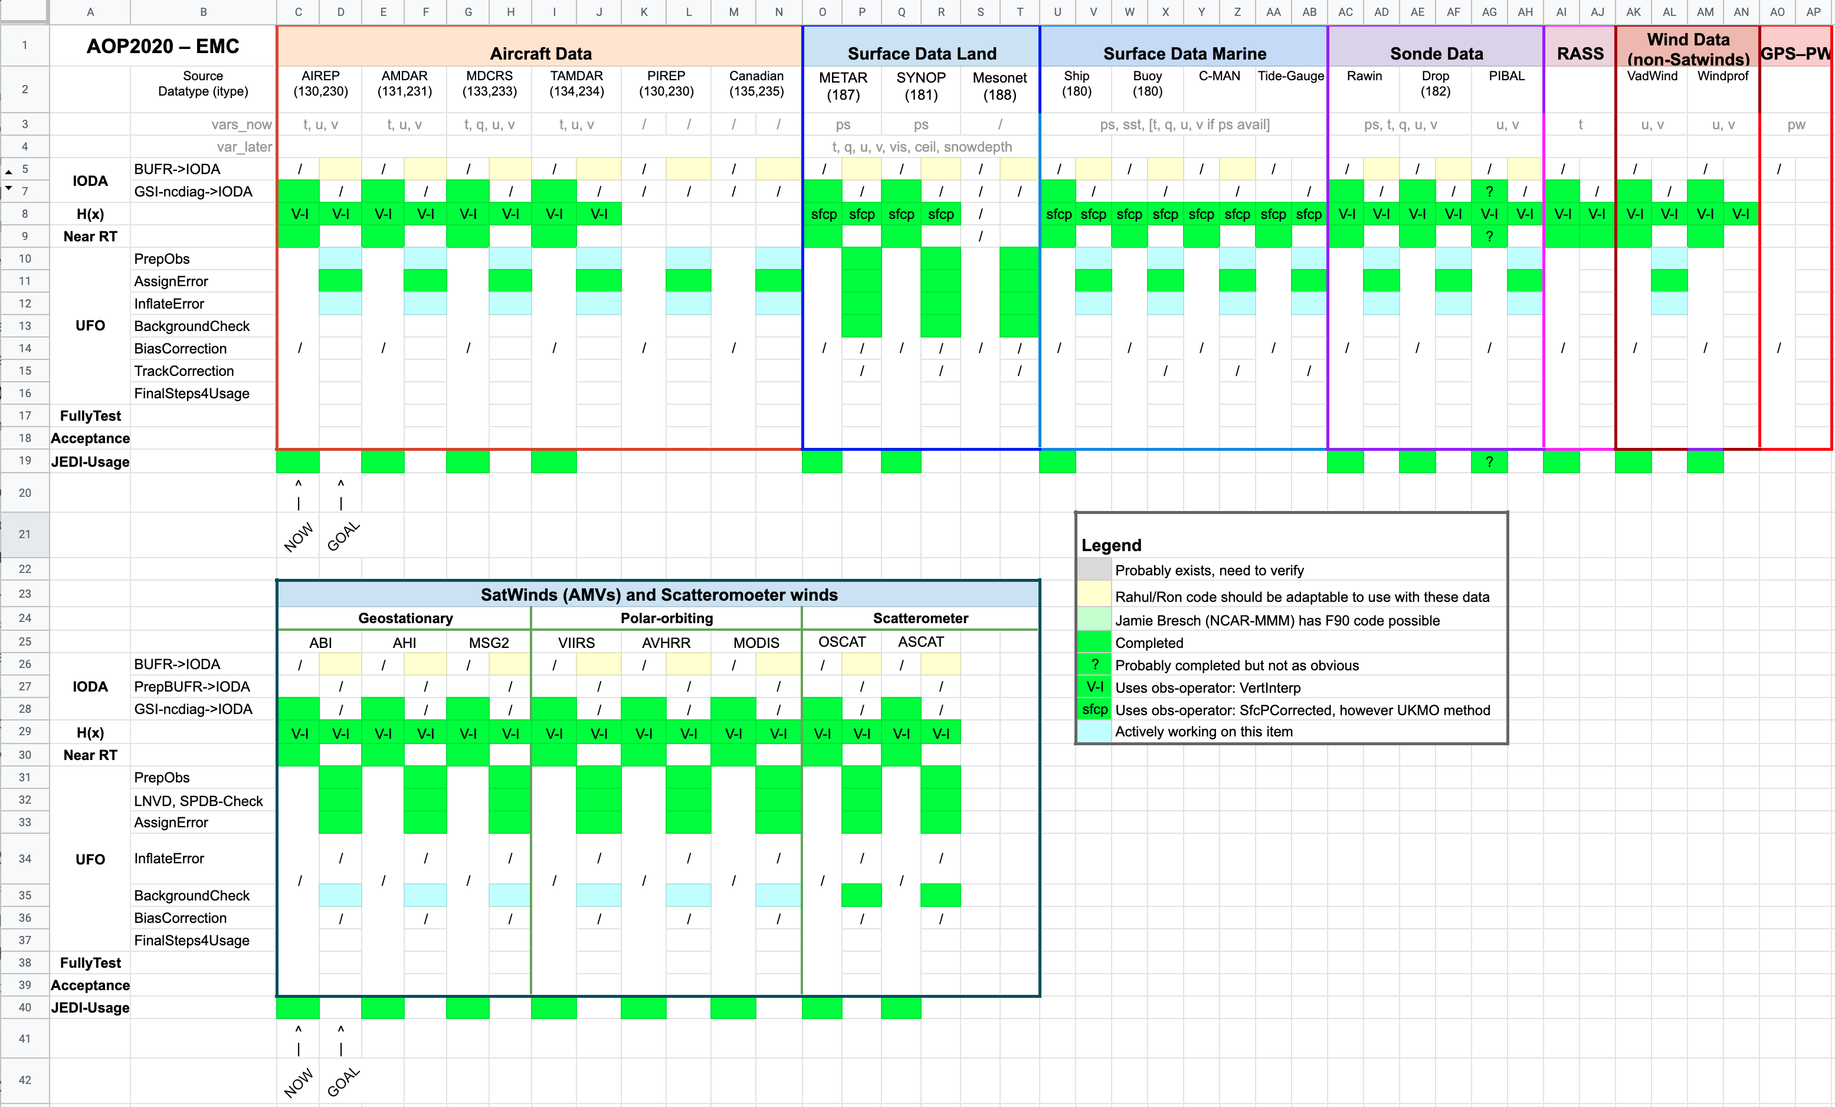
OBS1.7 & 1.8 – SatWinds & Conventional
Technical/Scientific Progress
Progress/Status check *beyond* code sprint

Slide 9
OBS1.7 & 1.8 – SatWinds & Conventional
Challenges
Additional mnemonics needed from BUFR to IODA (e.g., sonde launch time)
NC-diag files converted to IODA contain duplicates (e.g., VAD-wind profiles)
Wind data near surface not matching GSI as well as upper levels
Some, not all, parts of ObsProc in place (to eliminate NC-diag files)
BUFR-to-IODA direct conversions of incoming data required

Slide 10
OBS1.7 & 1.8 – Satwinds &Conventional
Plans
This month:
Complete radiosonde temp/moisture/winds UFO QC steps
Complete surface data UFO QC steps
Add aircraft data temp bias correction and “Hilbert curves” error inflation of winds
Create diagnostics
Next two months:
Complete aircraft data UFO QC steps
Begin migration of raw data processing BUFR->IODA
Need to begin using IODA variable naming conventions
Implement QC processing of raw data similar to ObsProc, removing dependence on NC-diag files of GSI

