Slide 1
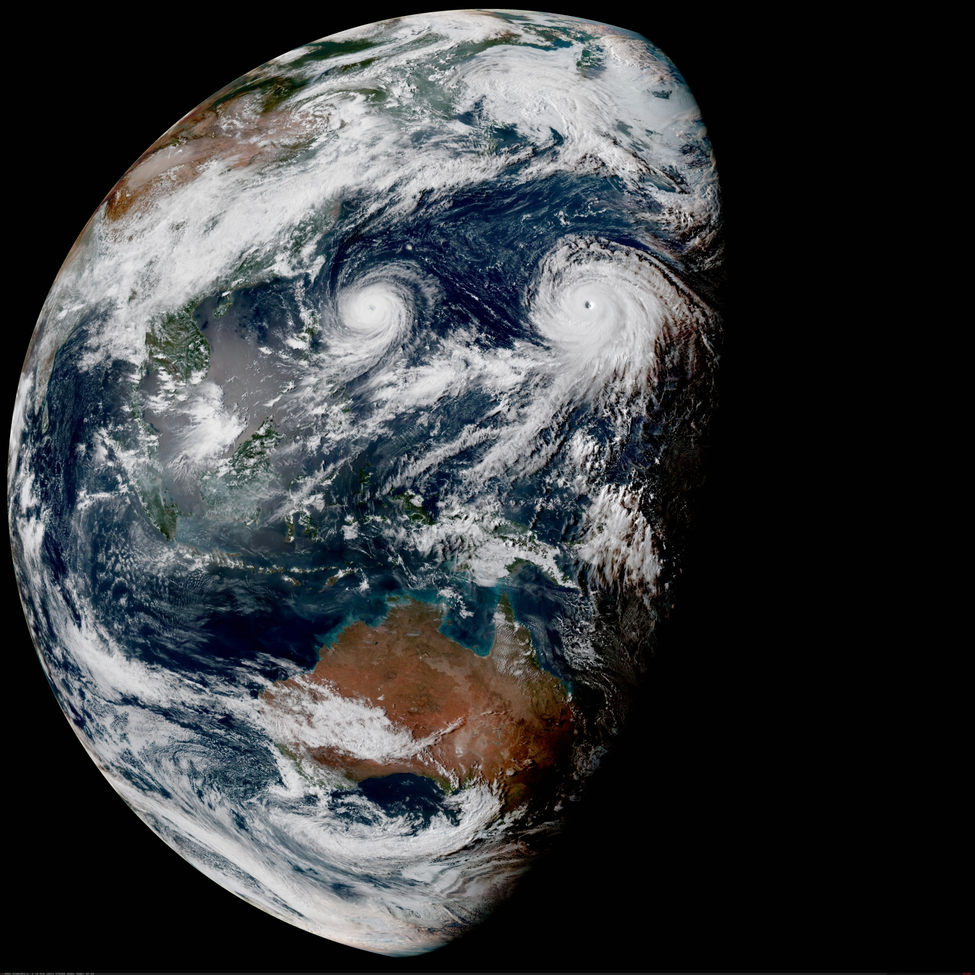

Development and validation of UFO radiance
OBS Team:
W. Han, F. Diniz, N. Chen
With support of the JEDI/CRTM Core Teams
In-Kind Contributors:
E. Liu (EMC)
Z. Liu (NCAR)
C. Harlow(UKMO)
J. Jin (GMAO)
January 21 2021
JEDI Weekly Meeting

Slide 2
Outline
UFO radiance status
  Replicating GSI v16 capability
  A simple case : SEVIRI QC
Lessons learned
  BC
  QC
  Use of data
  Variable names and types (obs and geoval)
Discussions of path forward

Slide 3
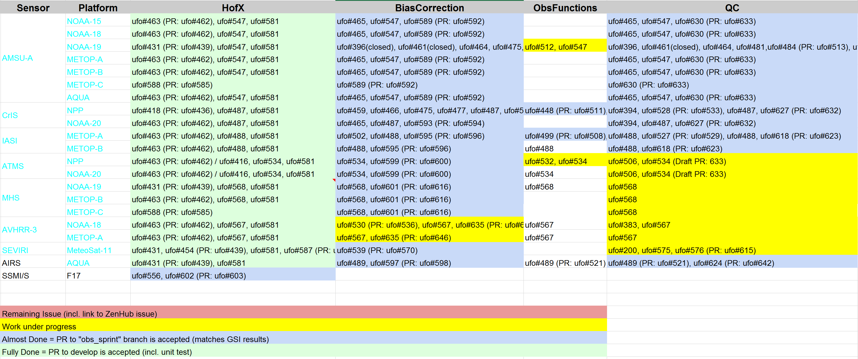
  UFO radiance: progress toward meeting EMC requirements for replicating GSI v16 capability using NC_DIAG(obs and geoval)
ATMS : QC for humidity sounding channels (small differences after QC, 5000(50) )
SEVIRI: QC (small differences after QC, 3800 (6) , https://github.com/JCSDA-internal/ufo/issues/576)
AVHRR: BC, QC
SSMIS : BC, QC
Todo list:

Slide 4
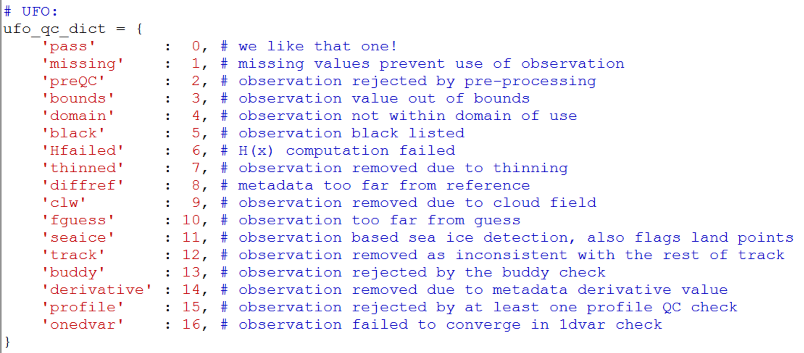
UFO QC flags

Slide 5
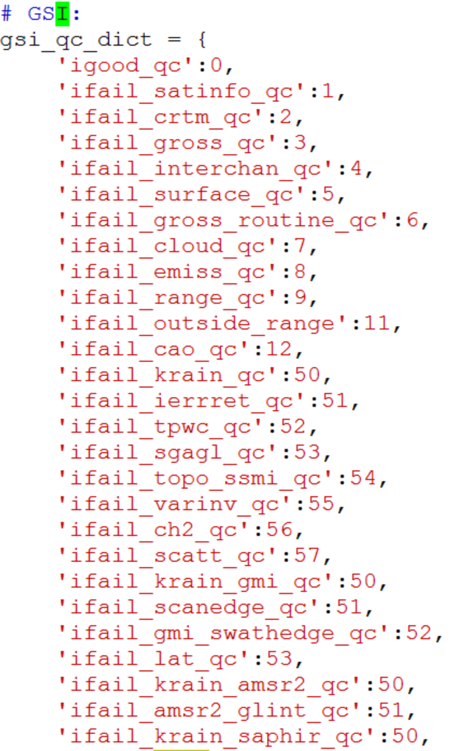
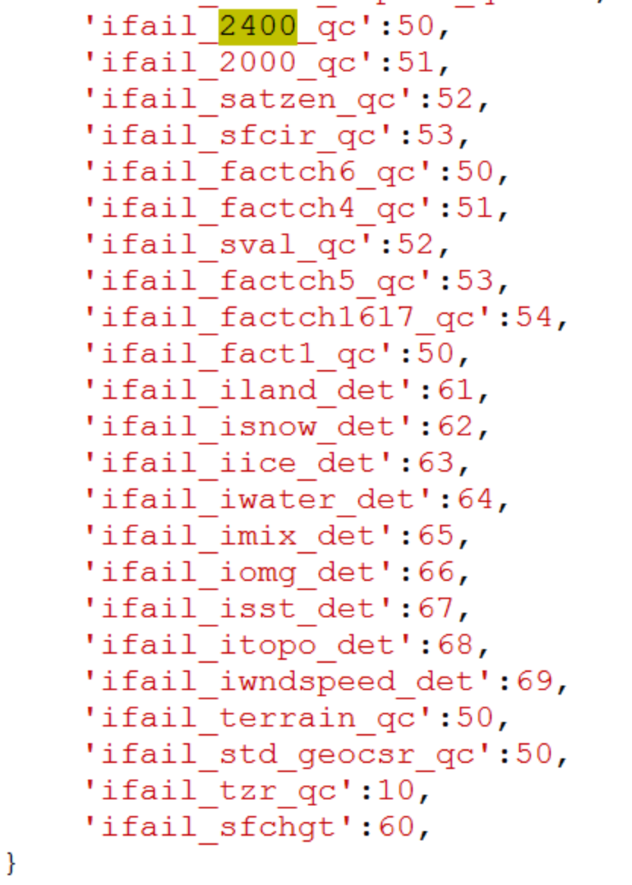
GSI QC flags

Slide 6
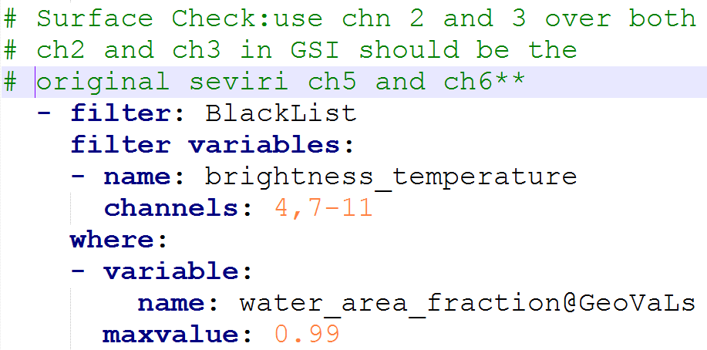
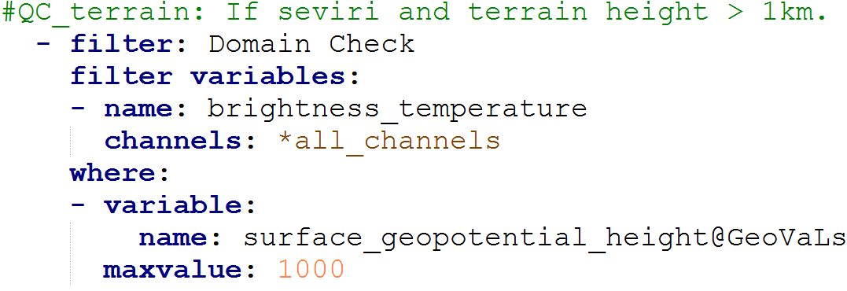
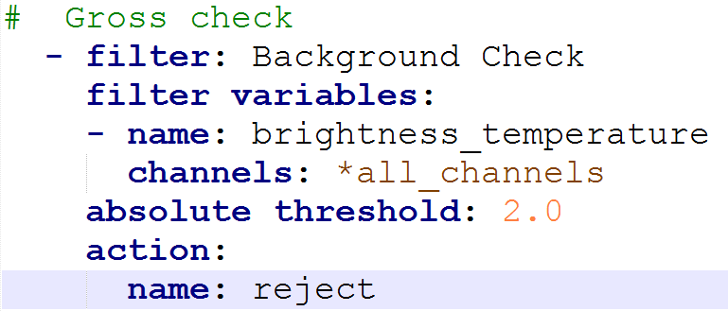
Development of UFO radiance HoFx, BC and QC for SEVIRI CSR: a simple case
GSI
step1: Surface check
step2: Terrain heigh check
step3: Background check
step4: Modify observation error
The QC for seviri is in src/qcmod.f90 :
subroutine qc_seviri(nchanl,is,ndat,nsig,ich,sea,land,ice,snow,luse, &
zsges,tzbgr,tbc,tnoise,temp,wmix,emissivity_k,ts, &
id_qc,aivals,errf,varinv)
https://github.com/JCSDA-internal/ufo/issues/576

Slide 7
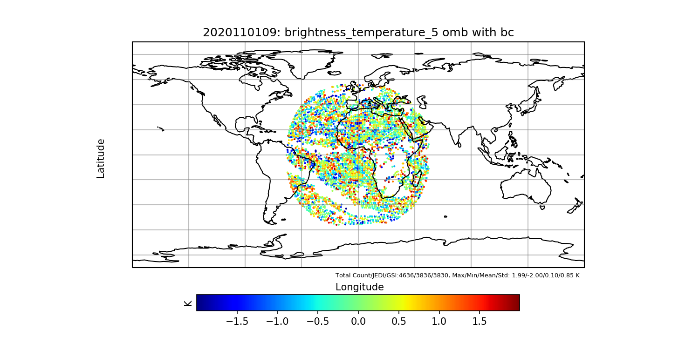
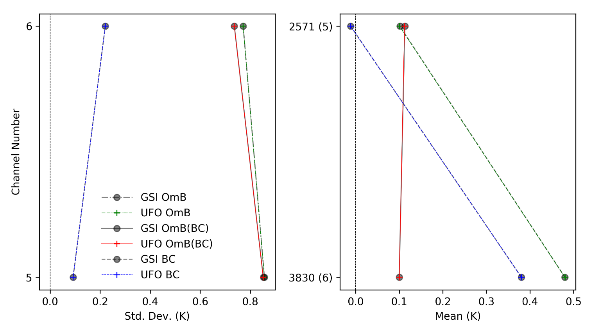
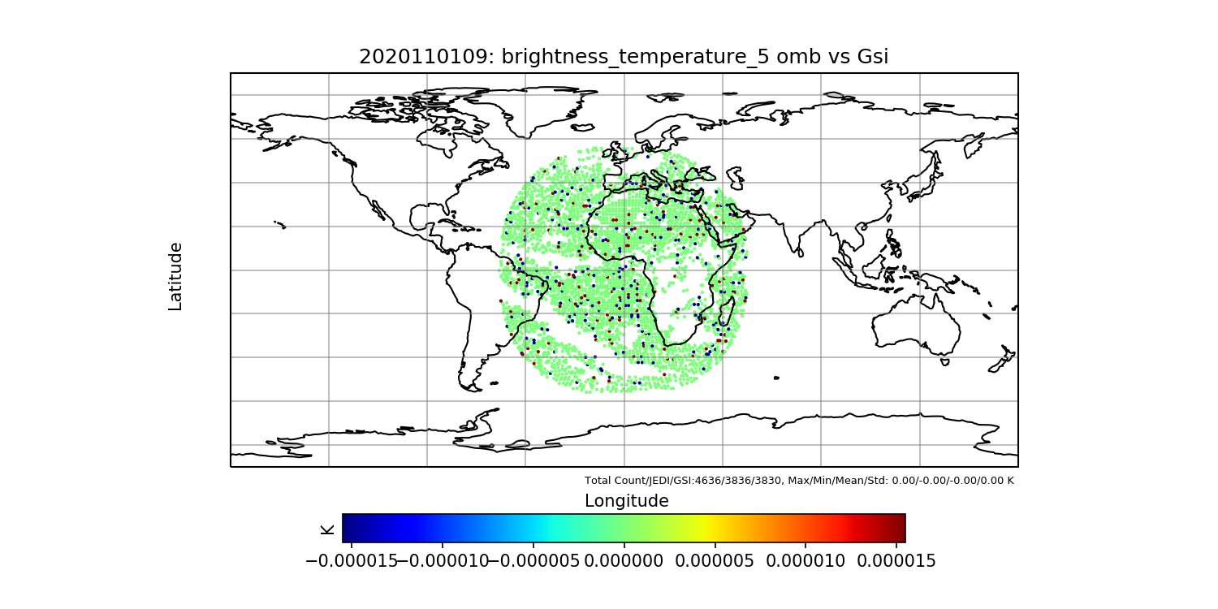
Replication of GSI radiance in UFO: SEVIRI/Meteosat-11
QC_GSI(QC_UFO-QC_GSI)
UFO
2020110112 (Time window: 09Z-15Z)
The surface check is using surface logical values in GSI:
The surface check is using float type variables in UFO:
land_area_fraction , water_area_fraction , surface_snow_area_fraction
and ice_area_fraction of geoval for surface check.
32 observations of severi ch5 (2020110112) are blacklisted in GSI ifail_surface_qc(5).
25 observations of severi ch5 (2020110112) are blacklisted in UFO.
UFO-GSI
https://github.com/JCSDA-internal/ufo/issues/576
Notes:
https://github.com/JCSDA-internal/ufo/issues/576

Slide 8
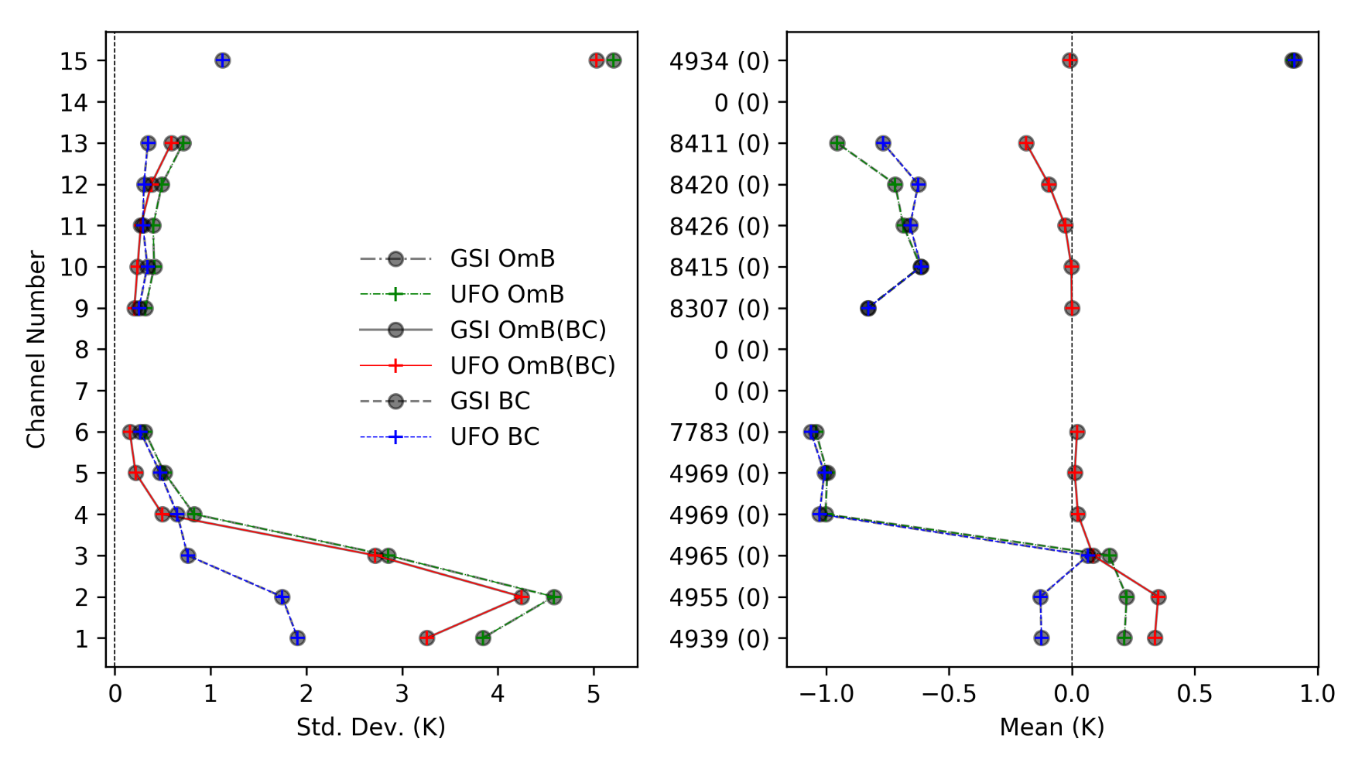
Replication of GSI radiance in UFO: AMSU-A/NOAA-19
QC_GSI(QC_GSI-QC_UFO)
2020110112 (Time window: 09Z-15Z)

Slide 9
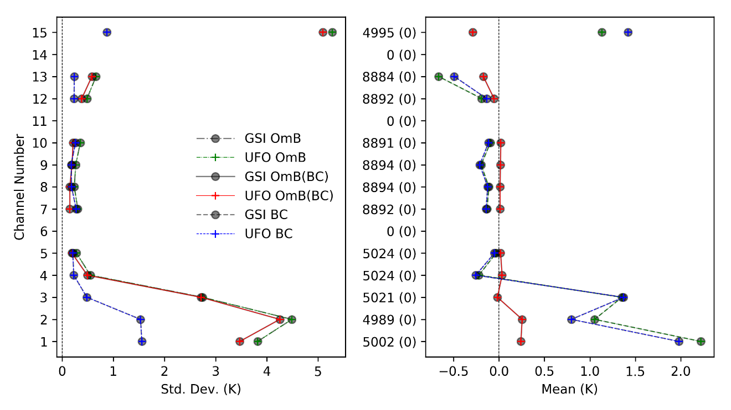
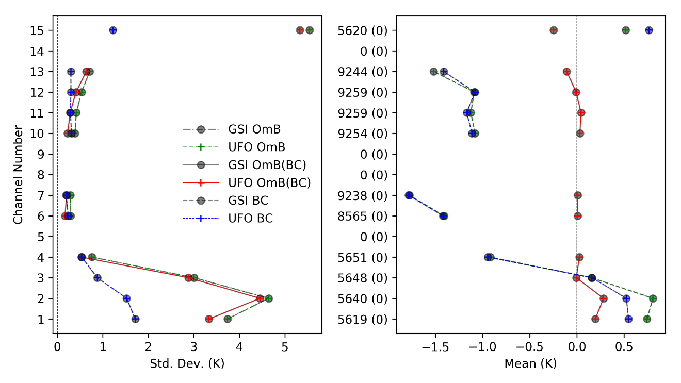
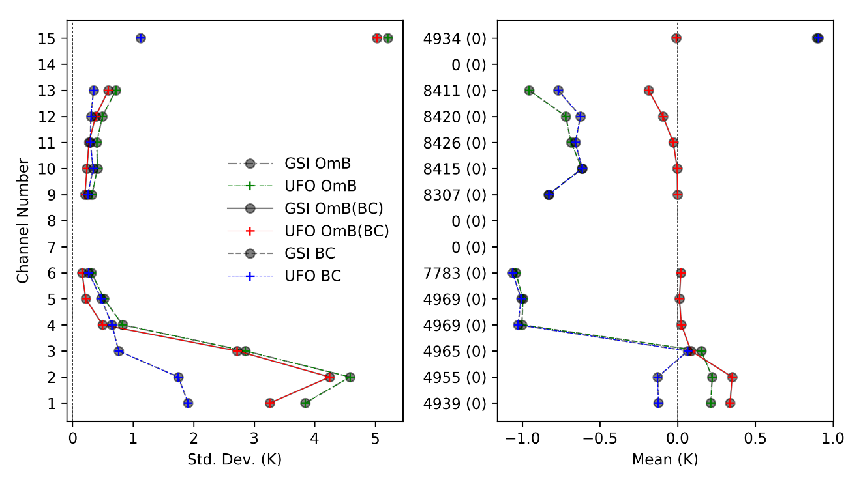
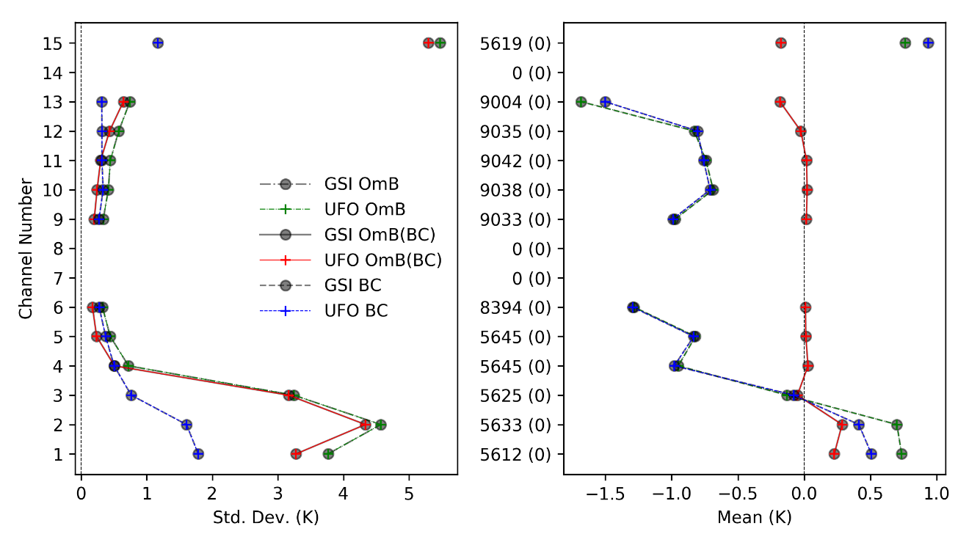
Replication of GSI radiance in UFO: AMSU-A
NOAA-15
NOAA-18
NOAA-19
METOP-A

Slide 10
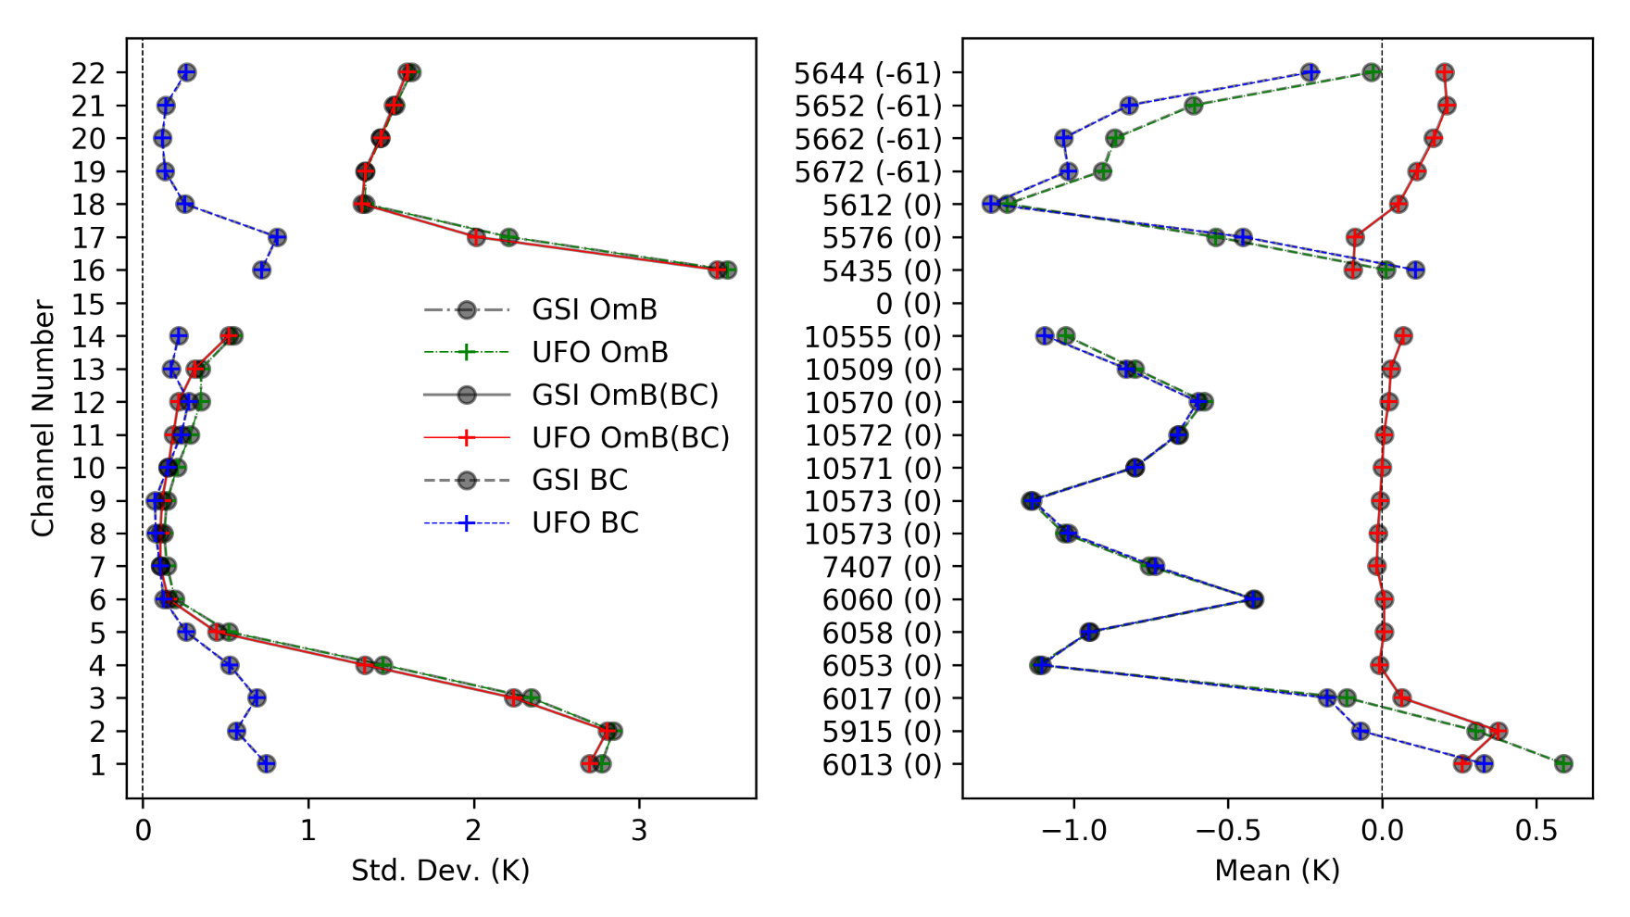
Replication of GSI radiance in UFO: ATMS/N20
QC_GSI(QC_UFO-QC_GSI)
2020110112 (Time window: 09Z-15Z)

Slide 11
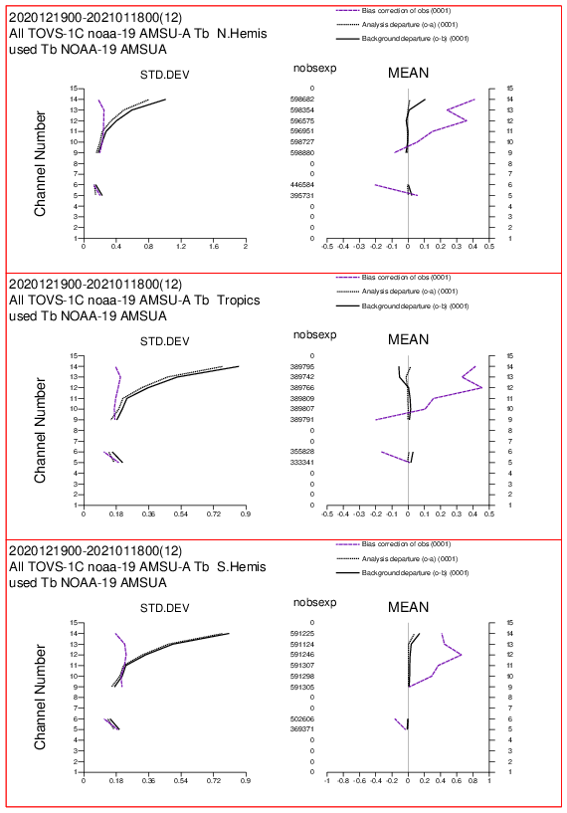
What do you find ?
O2R
R2O
HoFx, BC and QC
ObsNum_GSI(UFO-GSI)
ECMWF
amsua_n19
2020110112
AMSUA-NOAA19
Notes:
https://www.ecmwf.int/en/forecasts/charts/obstat/atovs_amsua__rmsplot_0001_plot_o_rmsplot_atovs_amsua?facets=Parameter,Radiances%3BData%20type,Microwave%20radiances&time=2021011800&Satellite=NOAA-19

Slide 12
Met Office progress towards ATMS Processing
Green elements are in hand.
Orange are being developed at the moment.
*ODB ingest in IODA is critical for Met Office processing
RTTOV interface
Yaml file
Online Bias Correction
Data feed in ODB*
UFO
QC’d Data to assimilation
Obs Filters/Functions used in QC
Bennartz Test
Transmittance Test
Cloud Cost Test
RTTOV 1DVar
Thinning routines
Notes:
Cloud Cost Test: calculate a 1D cost function in QC to find observations that are too far from the background. This is used in the QC of MHS channels and ATMS Ch. 18-22. Obs that have a value of this cost greater than some threshold are flagged.

Slide 13
Summary
UFO radiance status
  toward meeting EMC requirements for replicating GSI v16 capability
Lessons learned
  BC
  QC
  Use of data
  Variable names and types (obs and geoval)
Path forward
  Software (obs and filter functions)
  Science and algorithm (QC methods for different classes of sensors)
  Monitoring of the data and information in data assimilation systems

Slide 14
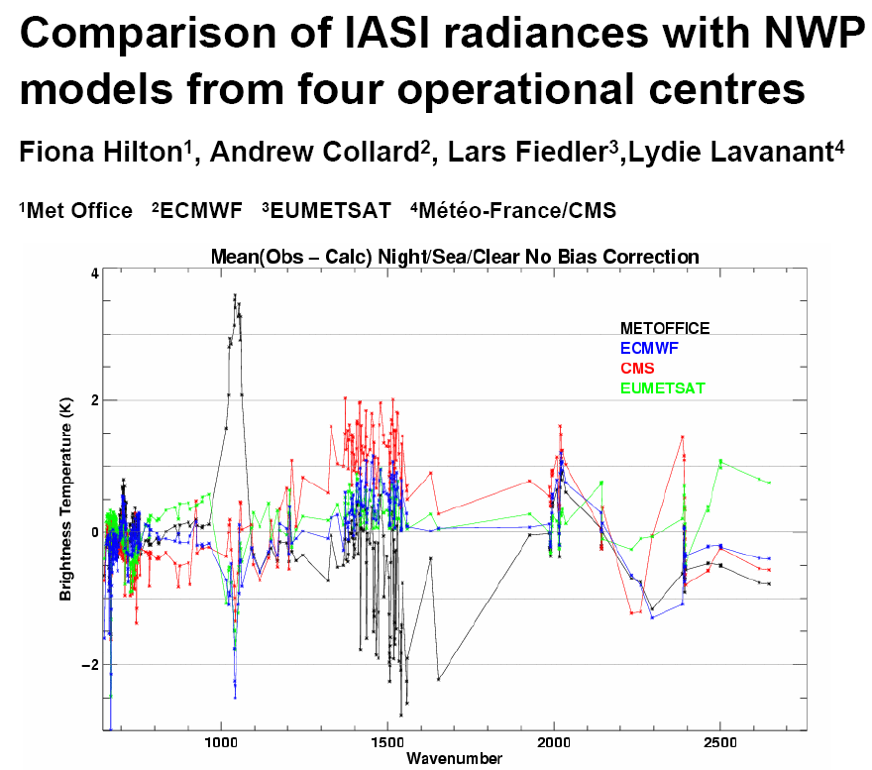
Monitoring
ONE Platform
ONE Global Observing System
Multiple NWP background
Mulitple Obs. Bias Correction
Multiple QC
ITSC16

