Slide 1
JCSDA Workflow Requirements
  Models
  FV3-GFS / FV3-GEOS
  MOM6 / SOCA
  UFS
  MPAS
  Neptune
  LFRic
  …
  Systems
  HPC (NOAA, NASA, Navy, USAF, NCAR, Met Office…)
  Cloud (AWS, …)
  Workstations, laptops (Linux, OSX)
  Workflow engines
  ecFlow
  Cylc
  Airflow?
In addition to all normal operational and research requirements

Slide 2
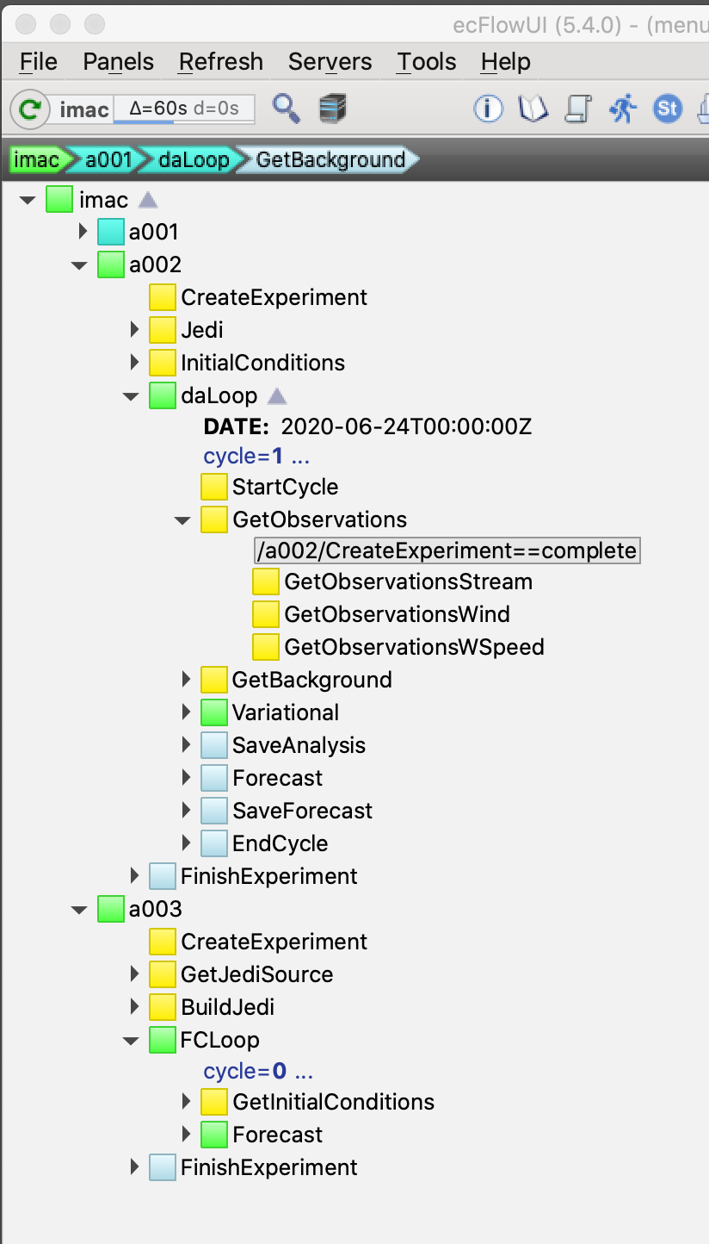
Experiments and Workflows Orchestration Kit
EWOK provides generic tools to describe suites = abstract algorithms (same concepts as OOPS/JEDI)
Tasks are generic as much as possible, delegating to model specific implementations when required (same concepts as OOPS/JEDI)
Given specific parameters (experiment configuration) a suite for a target model (UFS, MPAS, Lorenz…) and workflow engine (ecflow, cylc…) is generated

Slide 3
Research Repository for Data and Diagnostics
Access to data is a major obstacle to portability and genericity.
R2D2 abstracts storage from the workflow
Data is managed and accessed by key/values (not path or filename).
Easy access for experiments (HPC, cloud) and diagnostics (desktop, cloud).
It can store/fetch data in the cloud (S3) and locally, or a combination of both (local data store first, then remote).
As importantly for JCSDA, R2D2 will be used for comparing experiments between partners.
It opens the door to new collaboration possibilities yet to be explored, including potential for storing/exchanging observations for reanalyses.

