Slide 1
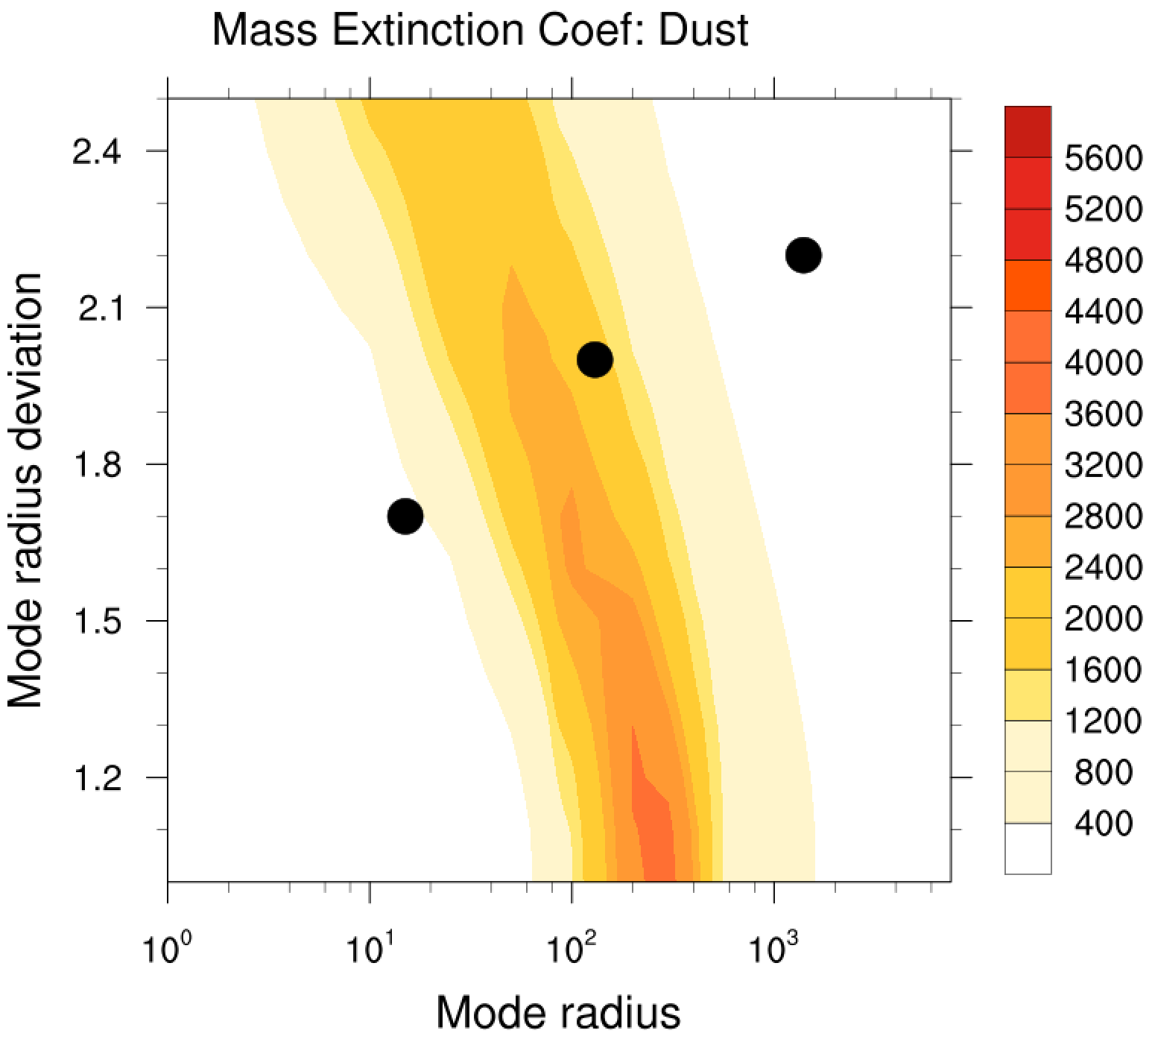
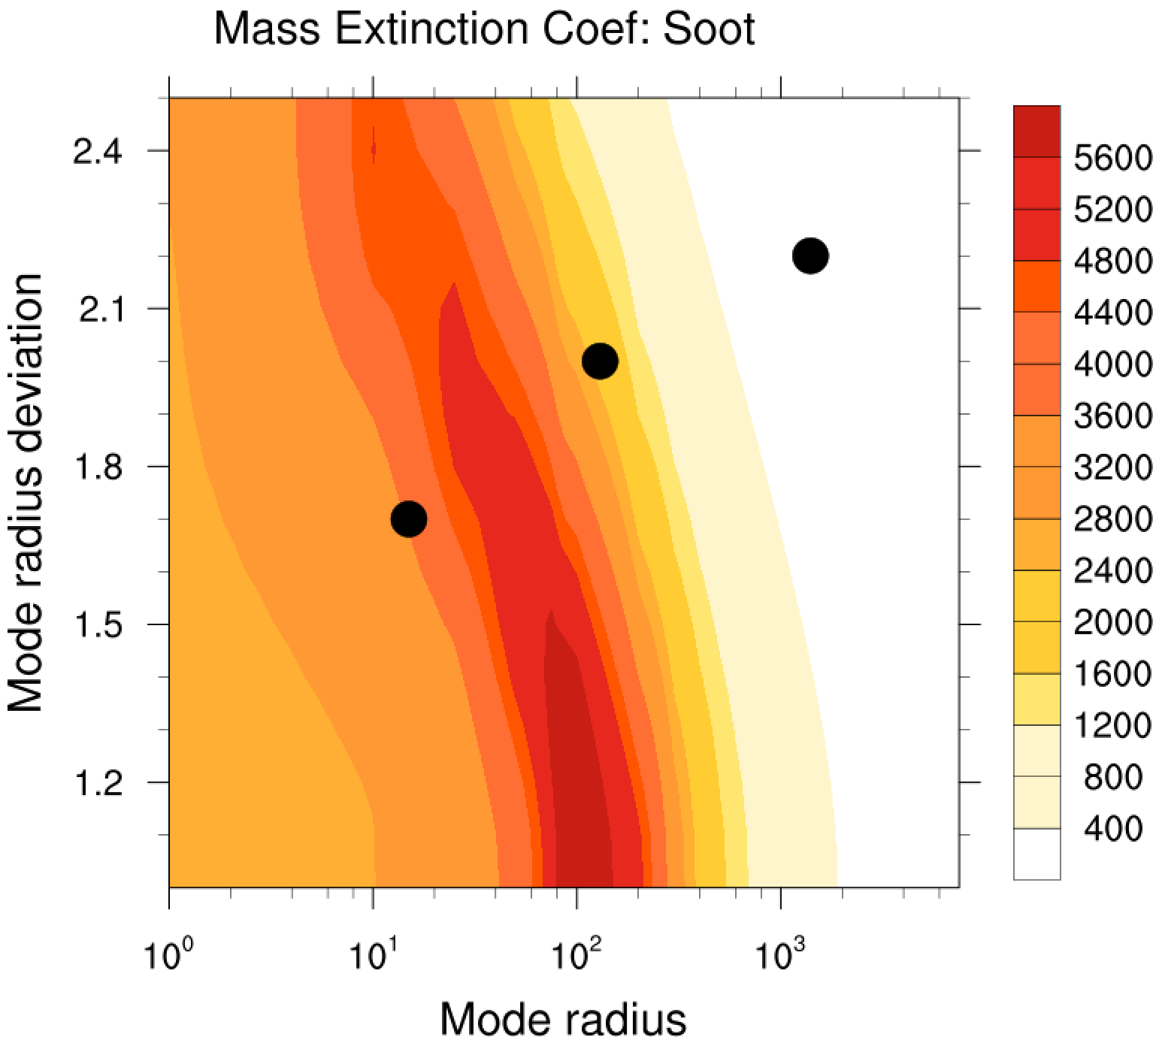
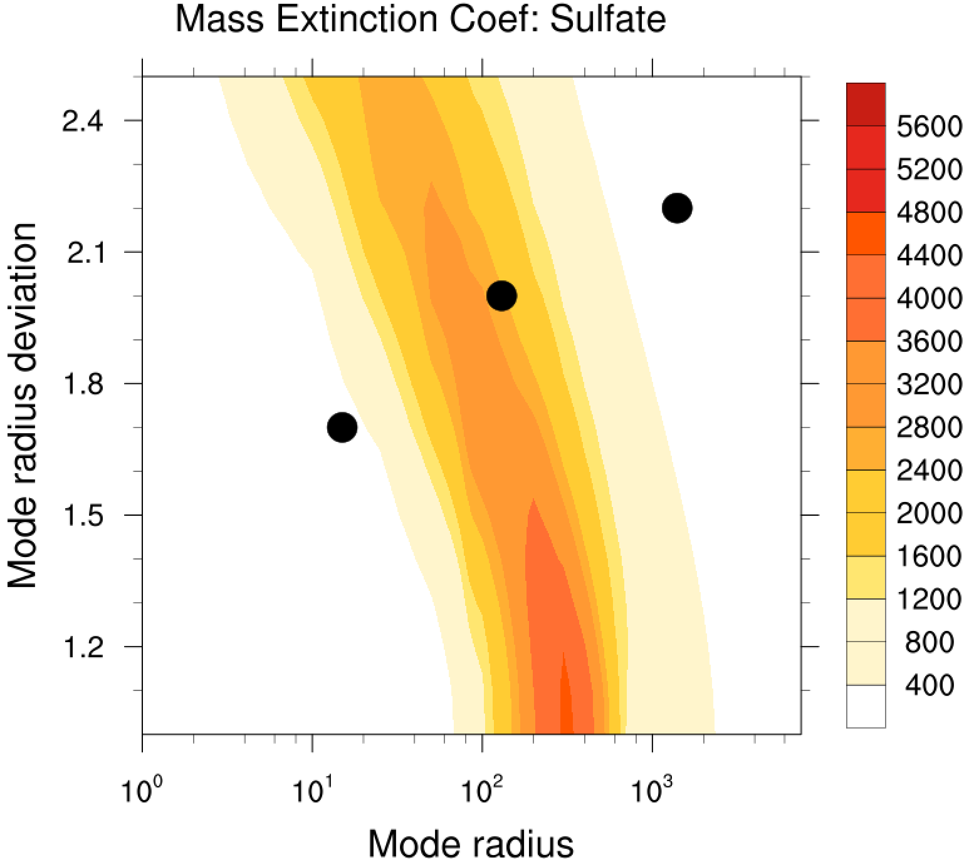
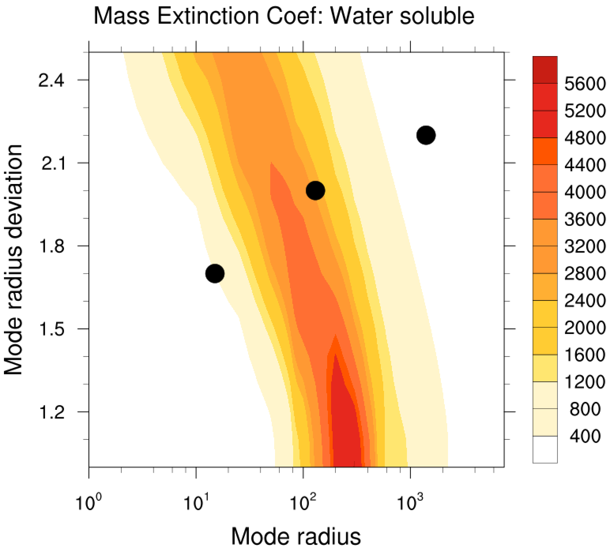
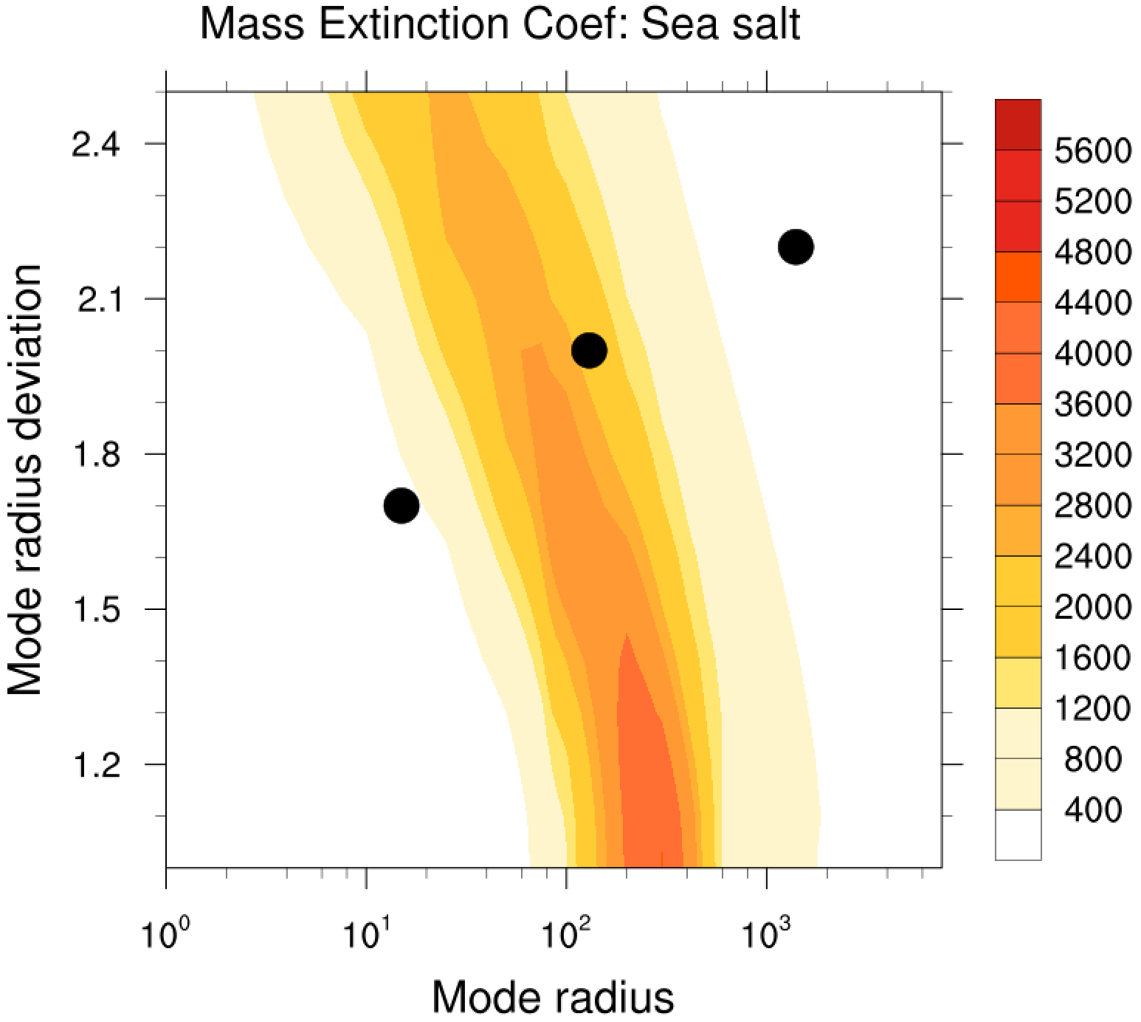
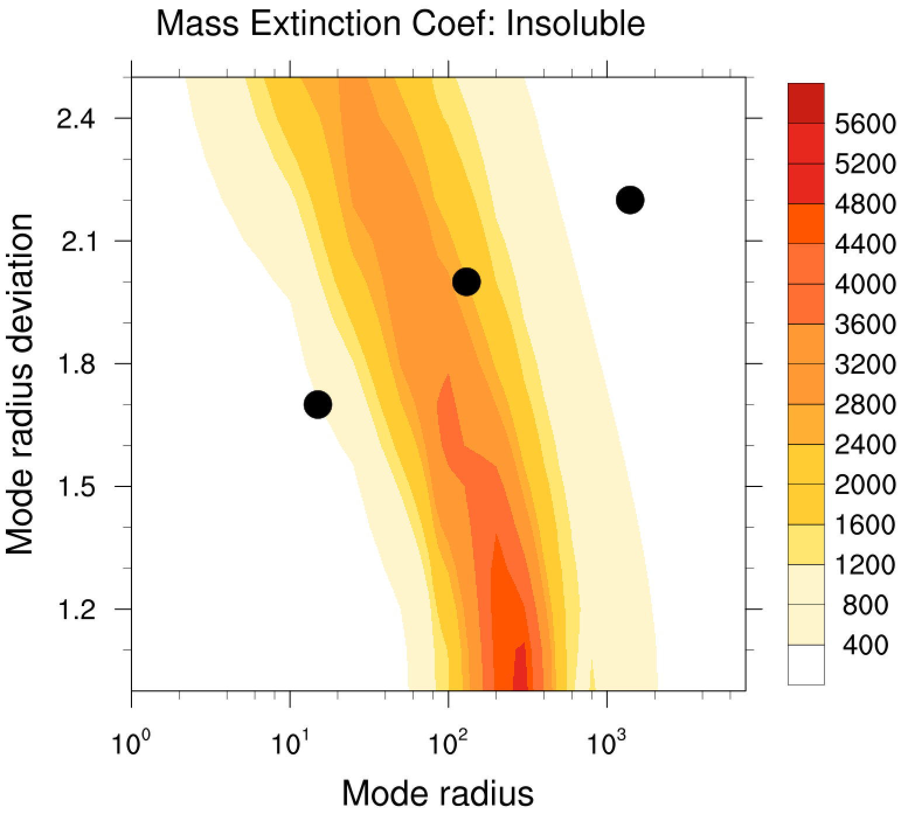
Mass Extinction Coefficients at Wavelength 550nm
CMAQ-LUT
K
J
I
Notes:
15, 130, 1400 nm
Std: 1.7, 2.0, 2.2

Slide 2
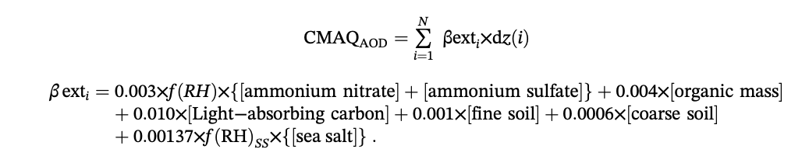
Mass Coefficient in Reconstruction Method
Kumar, R., Delle Monache, L., Bresch, J., Saide, P. E., Tang, Y., Liu, Z., … Djalalova, I. (2019). Toward improving short‐term predictions of fine particulate matter over the United States via assimilation of satellite aerosol optical depth retrievals. Journal Of Geophysical Research: Atmospheres, 124, 2753-2773. doi:10.1029/2018JD029009

Slide 3
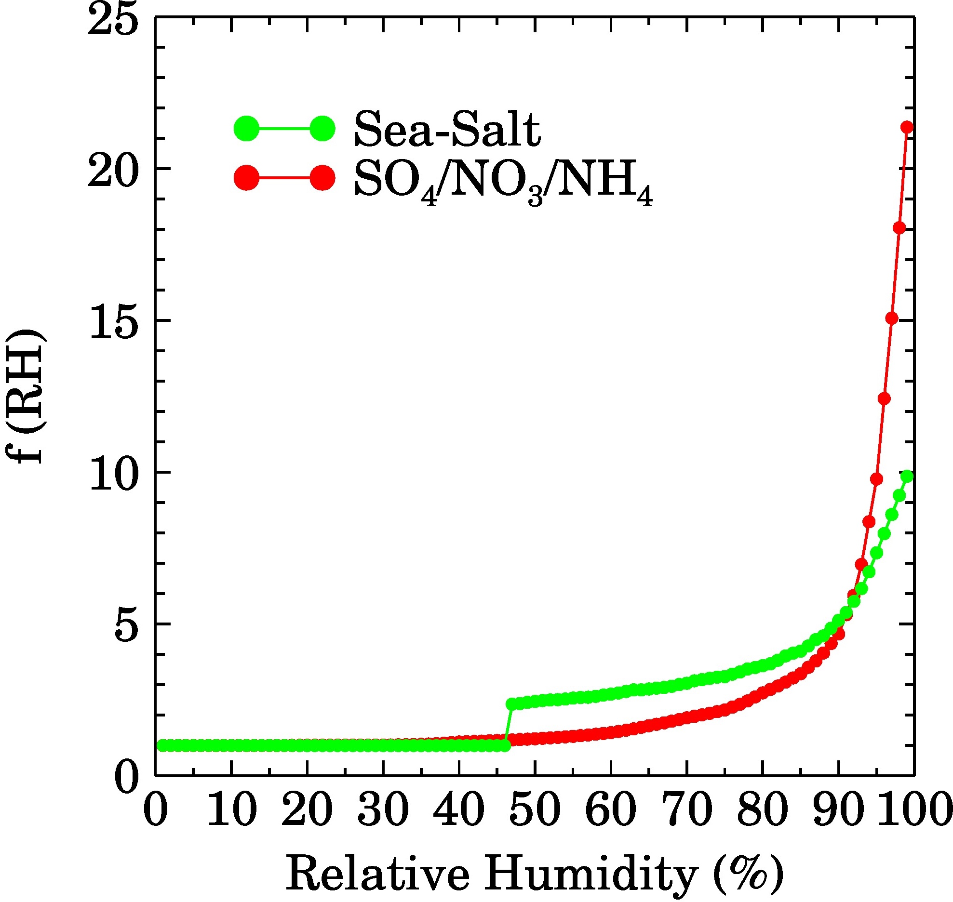
Mass Extinction Coefficients at Wavelength 550nm
CMAQ-LUT
Reconstruction
K
J
I
1000
Except 600 for asoil acor
10000
3000*frh
3000*frh
1370*frh_ss
4000
Notes:
About 15, 130, 1400 nm
Std: 1.7, 2.0, 2.2

Slide 4
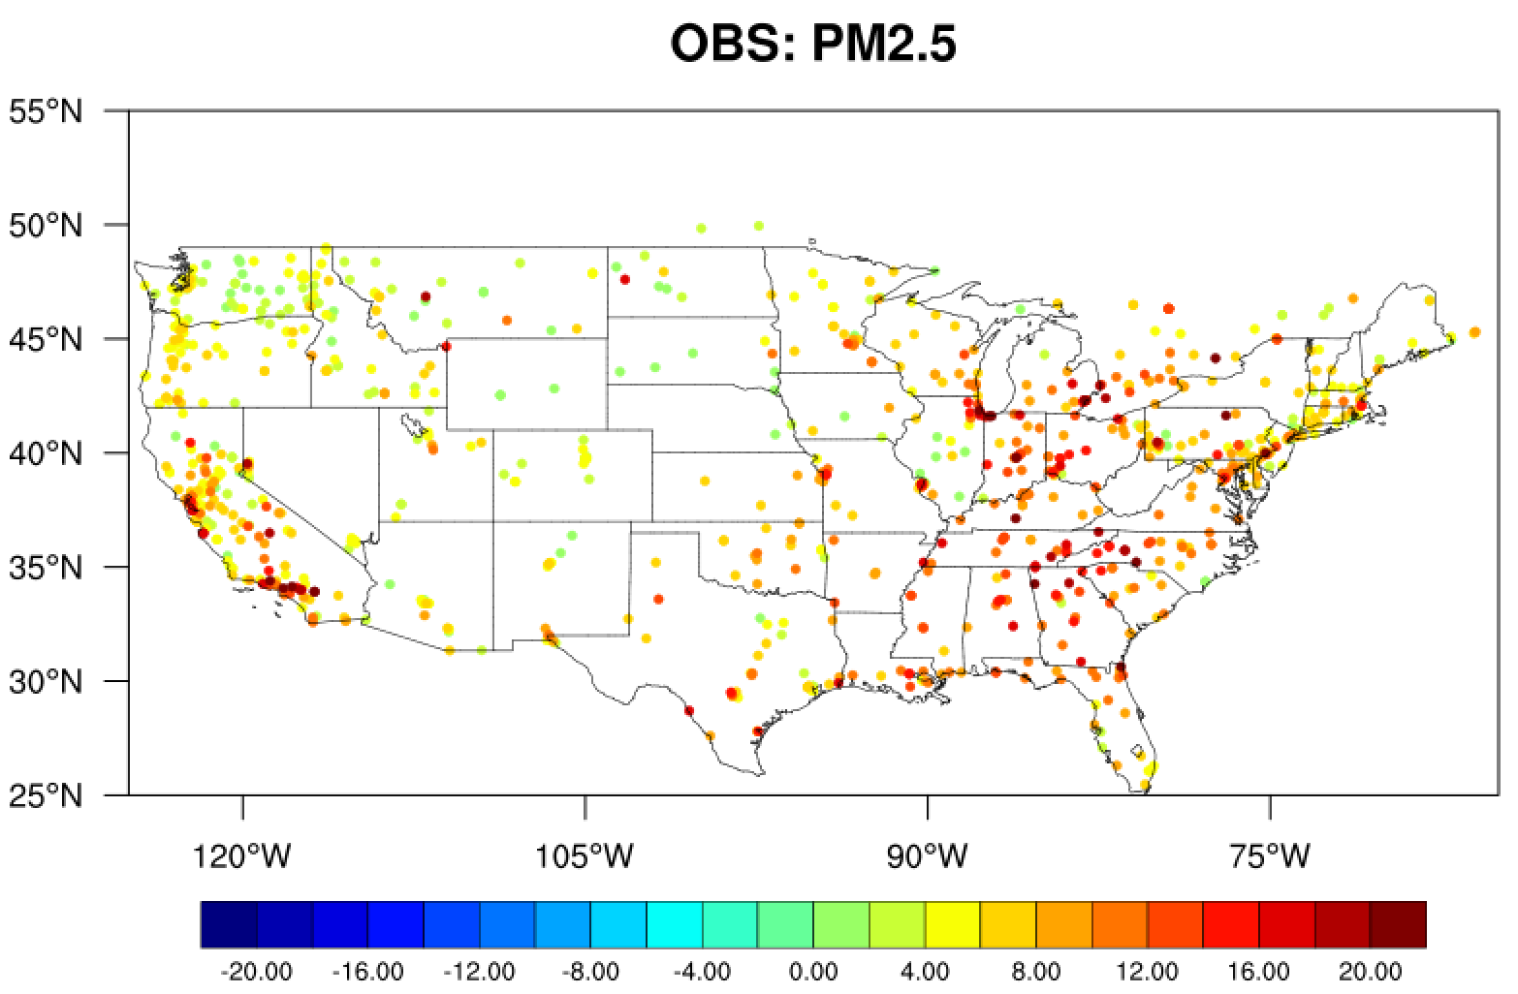
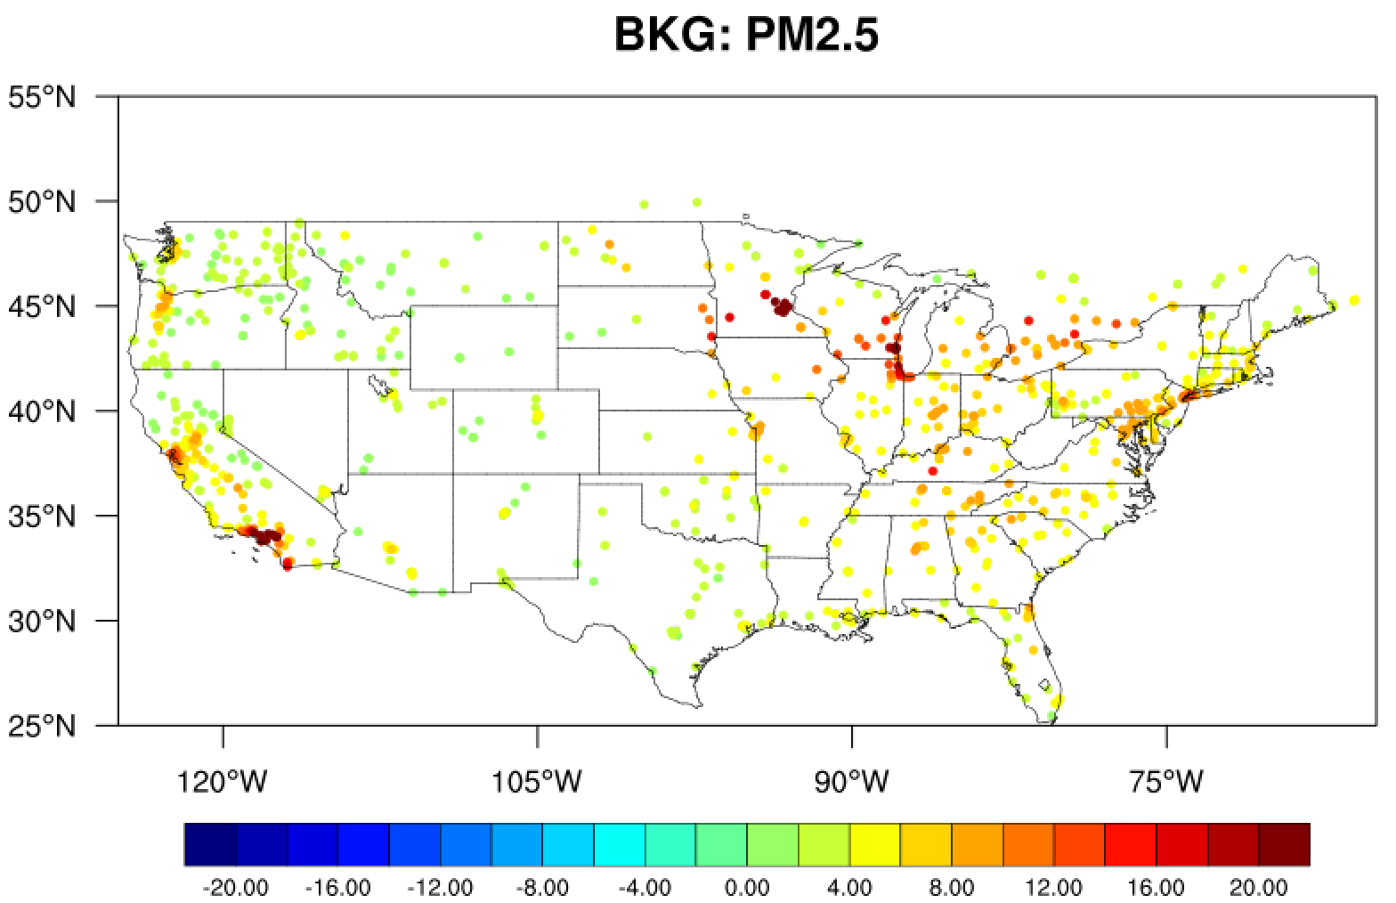
19UTC 12 Aug 2019
min=0 max=43.1
min=0.295 max=38.585

Slide 5
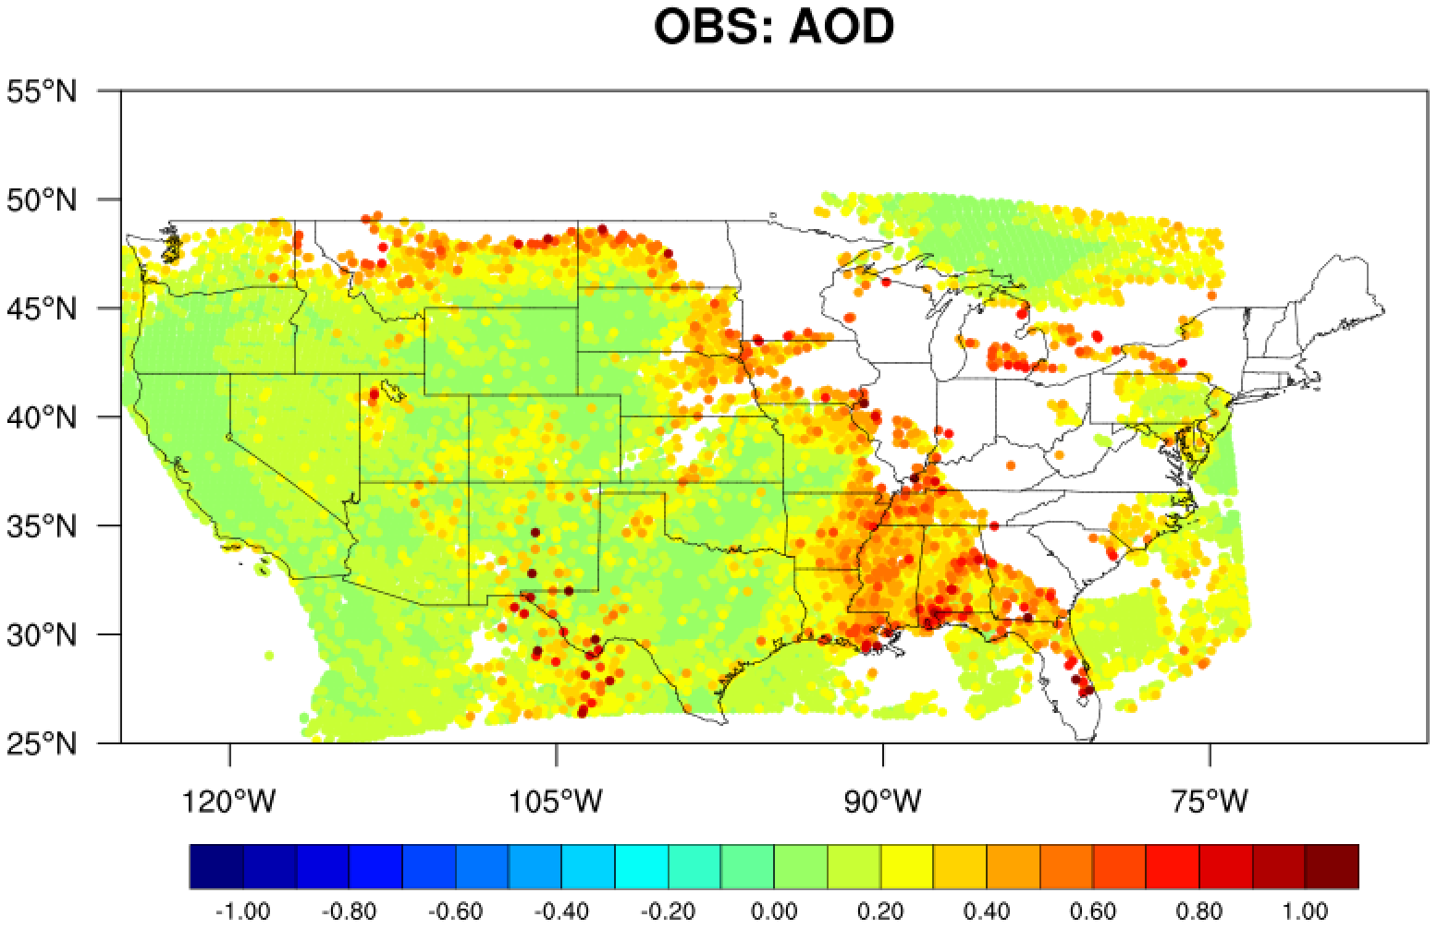
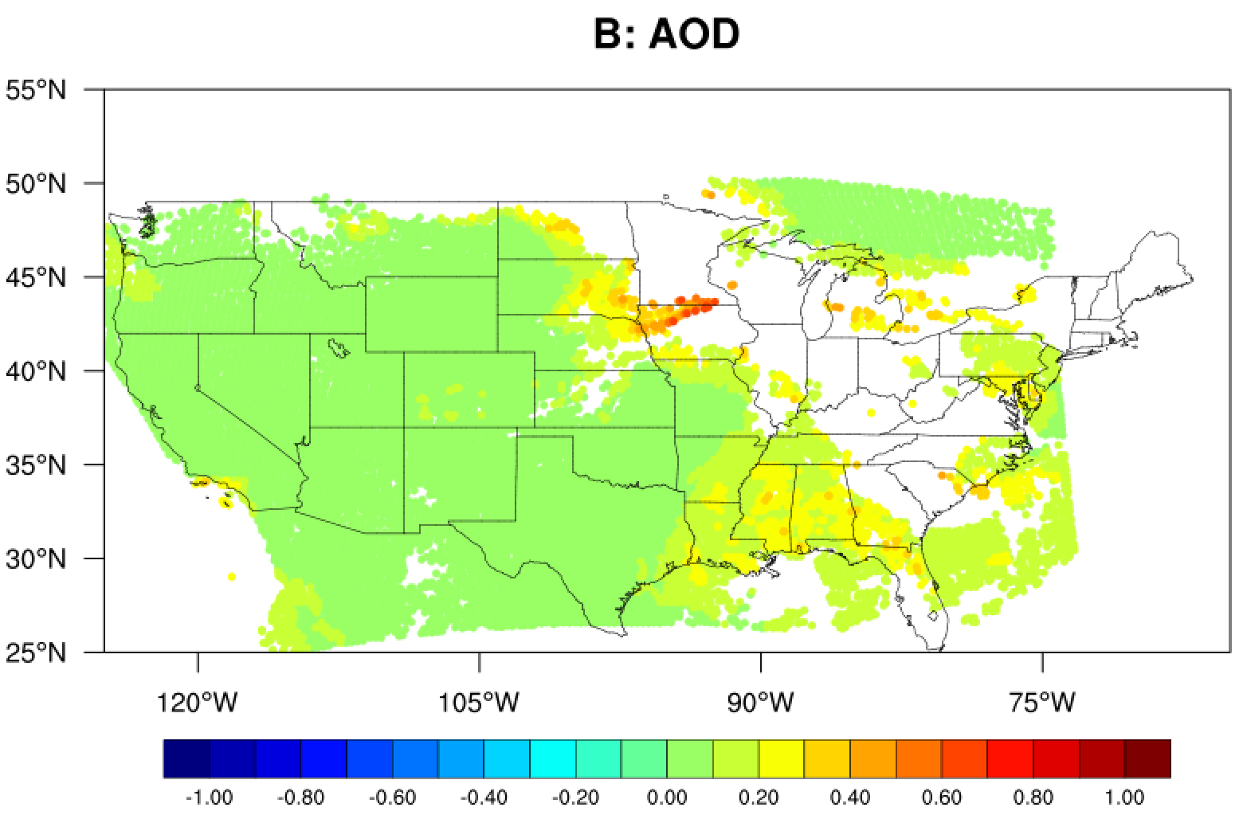
19UTC 12 Aug 2019
Reconstruction
min=0 max=1.747
min=0.0179 max=0.691

