Slide 1

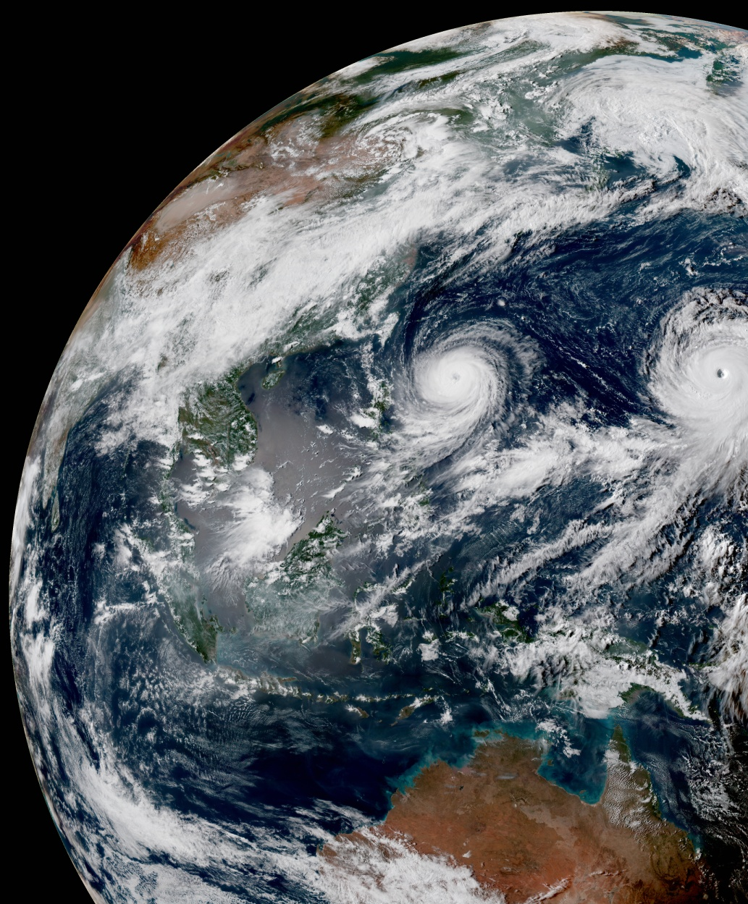
CRTM Monthly Meeting
March 2021
March 25, 2021
Virtual

Slide 2
AOP 2020
Summary of Achievements

Slide 3
New Aerosol Cloud Coefficients
CMAQ contributed by Yingtao Ma
GOCART GEOS-5 merged by Cheng
NAAPS data implemented by Cheng
New flexible aerosol interface

Slide 4
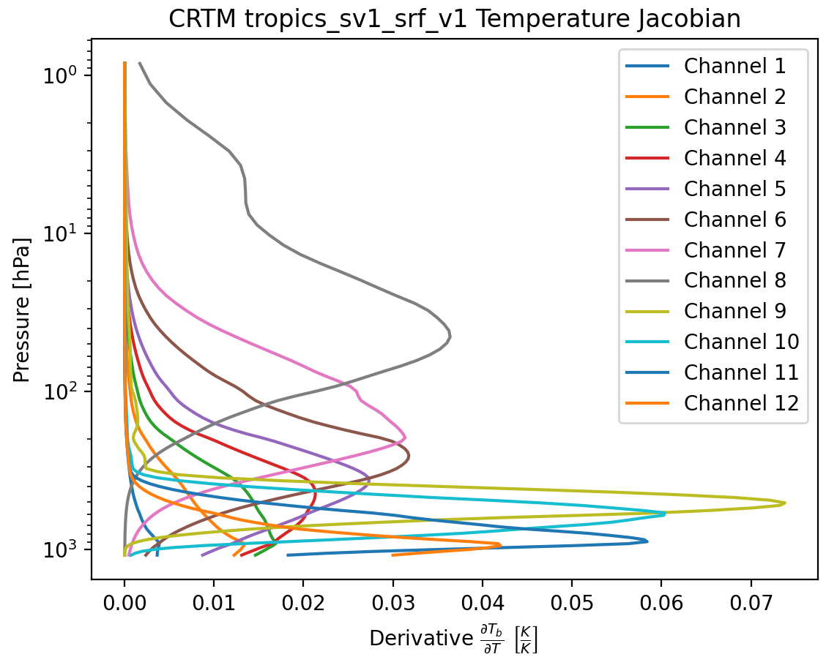
New Instrument Coefficients
ABI_G17, AMI_GK2, VIIRS-J2 contributed by Yingtao Ma
Pathfinder TROPICS (MW Sounder) with new polarization scheme
Preliminary coefficients for MetOp-SG IASI-NG (Spectrometer)

Slide 5
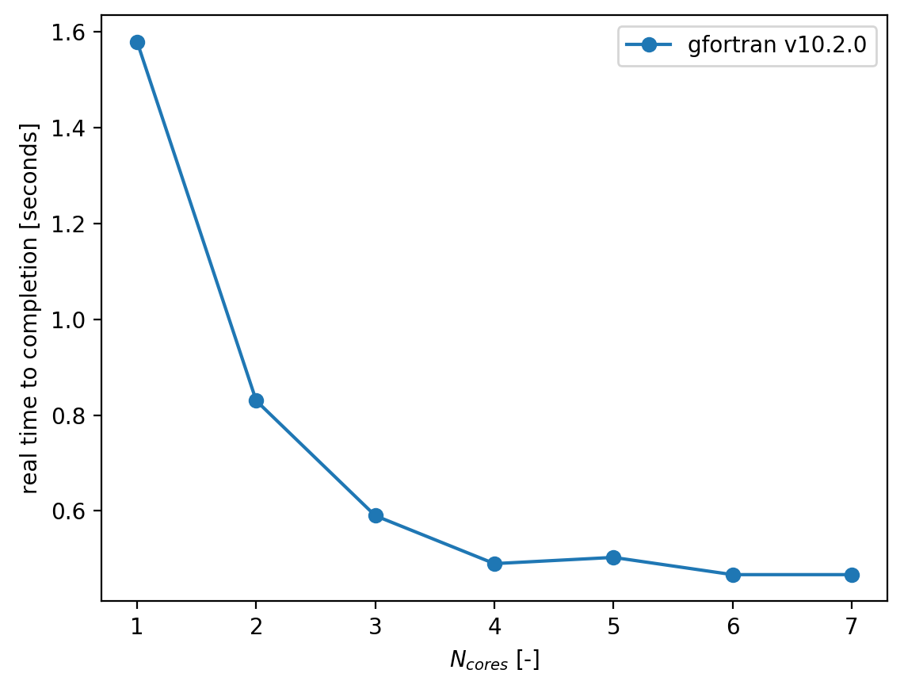
OpenMP Parallelization of the CRTM
OMP over profiles by Jim Rosinski
OMP over channels and vectorization over layers by Daniel Abdi
OMP for polarized solver in v3.0 by Liu Quanhua

Slide 6
CRTM v3.0 Development
Based on Dr. Liu‘s polarized ADA CRTM solver.
Fully polarized Forward operator with corresponding Tangent-Linear and Adjoint.
CSEM code available for review.

Slide 7
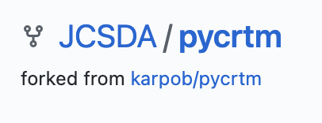
pyCRTM
Python interface for the CRTM
Developed by Brian Karpowicz
OMP-parallel
Works with Jupyter notebooks
First Release in October 2020

Slide 8
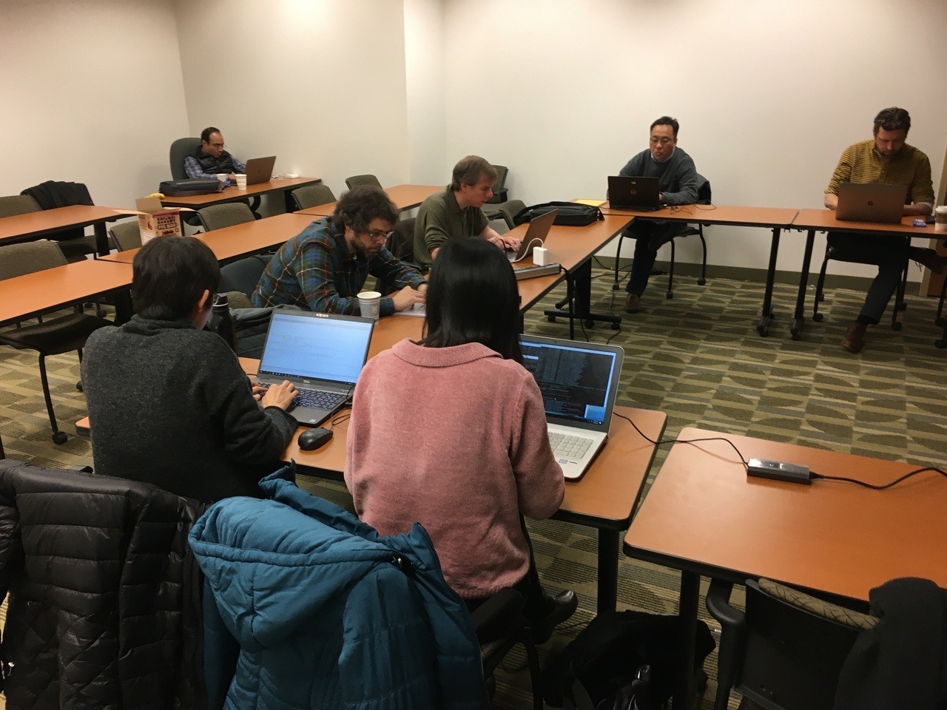
Transmittance Coefficient Generation
JCSDA transmittance coefficient generation capability restored.
Thanks to all participants of the January 2020 code sprint.
Supports MW, IR, and spectrometer instruments.

Slide 9
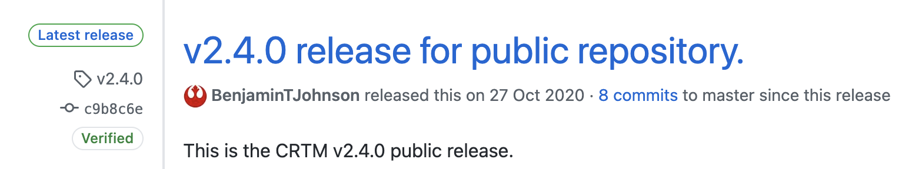
CRTM v2.4.0
Released in October 2020, together with fv3-jedi 1.0
OMP-parallel over atmospheric profiles (Jim Rosinski)
New, flexible netCDF I/O for aerosol and water cloud coefficients
New build system: ecbuild
Updated testing framework

Slide 10
CRTM v2.4.1
Recent Updates

Slide 11
CRTM v2.4.1 Updates
Minor bugfixes
Return to Git-LFS support of large coefficient files
Updated Release branch for EMC
Tarball for users without Git
Target release date for integration testing is mid-April

Slide 12
CRTM v3.0.0
Release Plans

Slide 13
CRTM v3.0 Release Plans
Limited beta-release expected towards the end of April.
Based on Dr. Liu‘s polarized solver.
Includes v2.4.1 bugfixes.
Primarily for testing and integration checks.
No adoption required yet.

