Slide 1

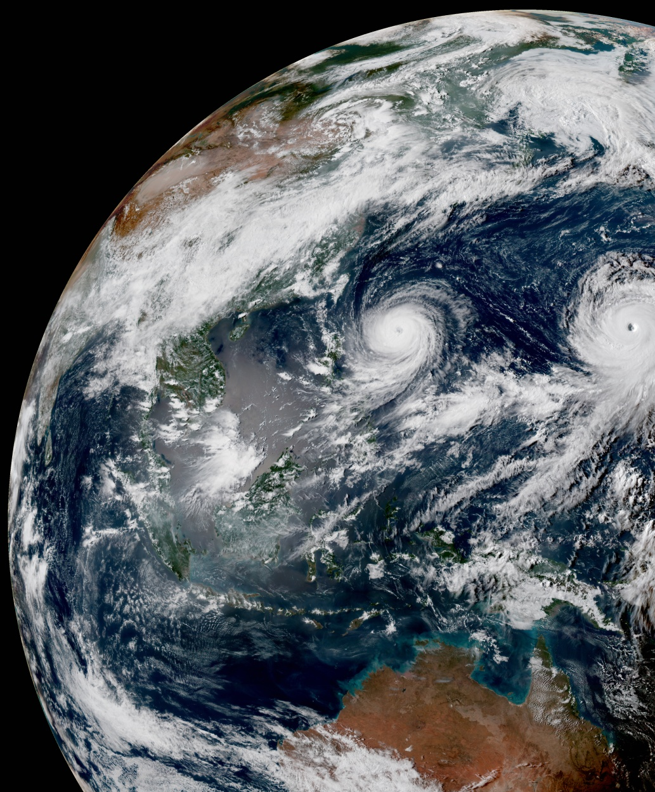
IODA v2
Stephen Herbener
Ryan Honeyager
May 6, 2021

Slide 2
The idea
IODA v2 Release (Q1)
After Release (Q2)
Planned / Potential
Build high performance data storage containers. Separate the client interface from the storage implementation details.
HDF5
ObsStore
BUFR
ODC
YAML
ATLAS
User-facing classes
IODA-Engines: Groups, Variables, Dimensions, Attributes, Type System
ObsSpace
Bias
Converters
Diagnostics
Other Containers
Consistent, well-documented data access
Less code duplication
Separation of data access / frame reads / MPI
Cross-language bindings (C++, C, Python, Fortran)
Multidimensional data
Rich type system (more integers and floats)

Slide 3
Release features
ObsSpace is migrated to ioda-engines.
Multidimensional variables are now supported.
  Radiances are stored in 2-D.
Changes are fully backwards compatible with UFO!
  get_db, put_db interface remains available for now.
  After release, we will migrate UFO to prefer the newer functions.
Standalone ioda-python interface.
  Converters and diagnostics can use ioda to read and write ioda data.

Slide 4
Breaking changes
New IODA file format.
  Observation files and bias correction files are upgraded to the new format.
  GeoVaLs test data are unchanged, pending code refactor to C++.
  Converters will switch to the new format after release.
  We provide a file upgrade program to convert to the new format.
  Further changes to the format are anticipated. Data conventions will be tackled by OBS. Variable names, units, dimensions, attributes, etc.
Converted test data are staged on GitHub using Git LFS.
  ufo-data and ioda-data repositories.
  IODA test files should be stored in ioda-data. UFO test files should be in ufo-data.

Slide 5
IODA layout and standards
/
IODA files are collections of variables organized into Groups to form a tree structure.
Variables are always placed into a group. ObsValue, ObsError, PreQC, …
Variable names, units, types, and dimensions should follow obs conventions.
Dimension scales (location, channel, etc.) should be placed at the root node of the tree. Each axis of every variable should be attached to a scale.
ObsGroup
ObsValue
Var1
ObsValue/Var1
ObsError
Var2
ObsError/Var2

Slide 6
IODA format changes
/
Expect full convention document in summer.
IODA-v2 release changes:
Variables are now grouped in a tree structure. Var@Group becomes Group/Var.
We now write strings as proper variable-length UTF-8 strings instead of multidimensional character arrays.
Radiance_ch1, Radiance_ch2, … Radiance_chN are gone. We add a channel dimension and write a multidimensional variable instead (Location x Channel).
ObsGroup
ObsValue
Var1
ObsValue/Var1
ObsError
Var2
ObsError/Var2

Slide 7
IODA file migration steps
New code is in feature/ioda-v2 branches of ioda and ufo. Will merge to develop soon.
New code includes a file upgrader that works in 99% of cases.
  ioda-upgrade.x [–n] old_file new_file
  -n: do not group similar variables into one 2D variable (needed for some files).
Steps
  Build your bundle using the feature/ioda-v2 branches for ufo and ioda.
    Need to include cmake updates for ufo-data and ioda-data inclusion
      Use feature/ioda-v2 branches in ioda-bundle and ufo-bundle as guide
  Run the upgrader on all of your ioda obs files (test and experiment areas)
  Run tests

Slide 8
Resources
Previous talks:
  Intro to IODA-engines (July 2, 2020)
  IODA interface demo (August 12, 2020)
  Converter tutorial (September 10, 2020)
  IODA file migration (April 1, 2021)
Documentation will mostly go live as the release approaches:
  Basic ioda-engines usage tutorials are available for C++, C, and Python.
  ReadTheDocs will feature updated IODA and UFO pages showing how to use the new ObsSpaces.
  Doxygen prototypes are on our S3 documentation bucket.
  The upcoming JEDI academy.

