Slide 1

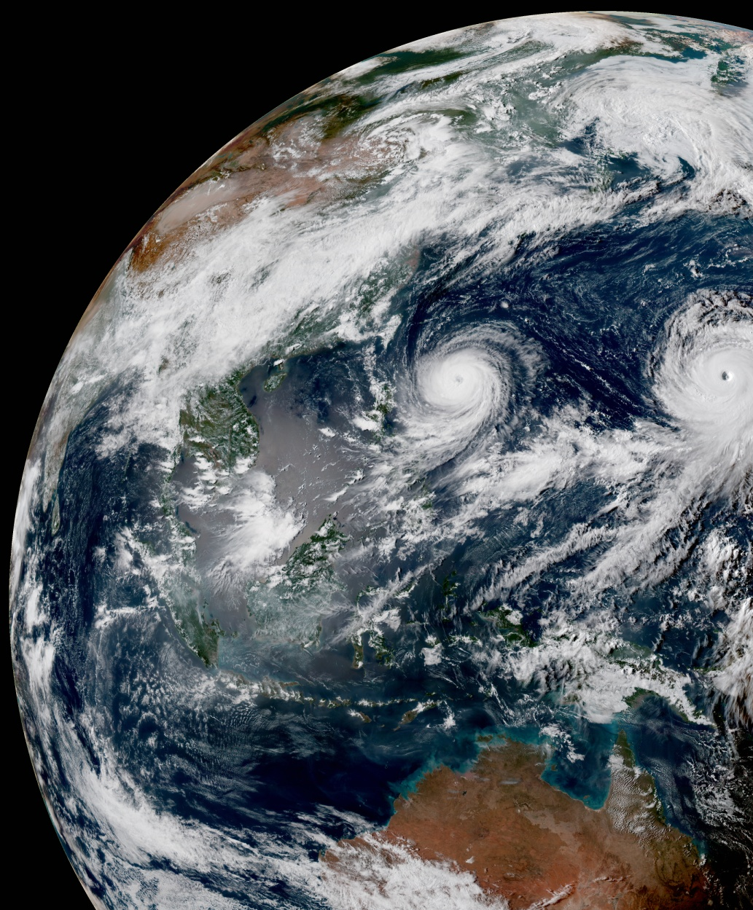
CRTM Monthly Meeting, July 2021
July 29, 2021

Slide 2
Updates on CRTM v2.4.1

Slide 3
Update Overview
New Coefficients
NetCDF4 I/O for TauCoeff & SpcCoeff files
New Aerosol Schemes

Slide 4
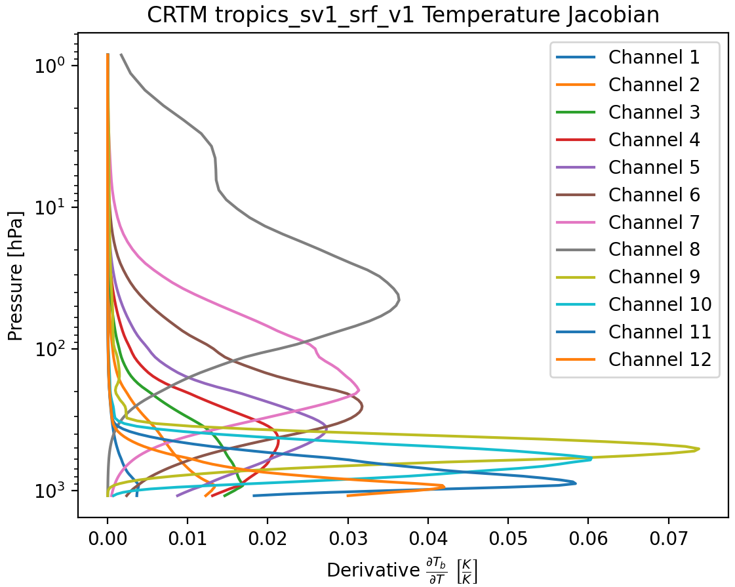
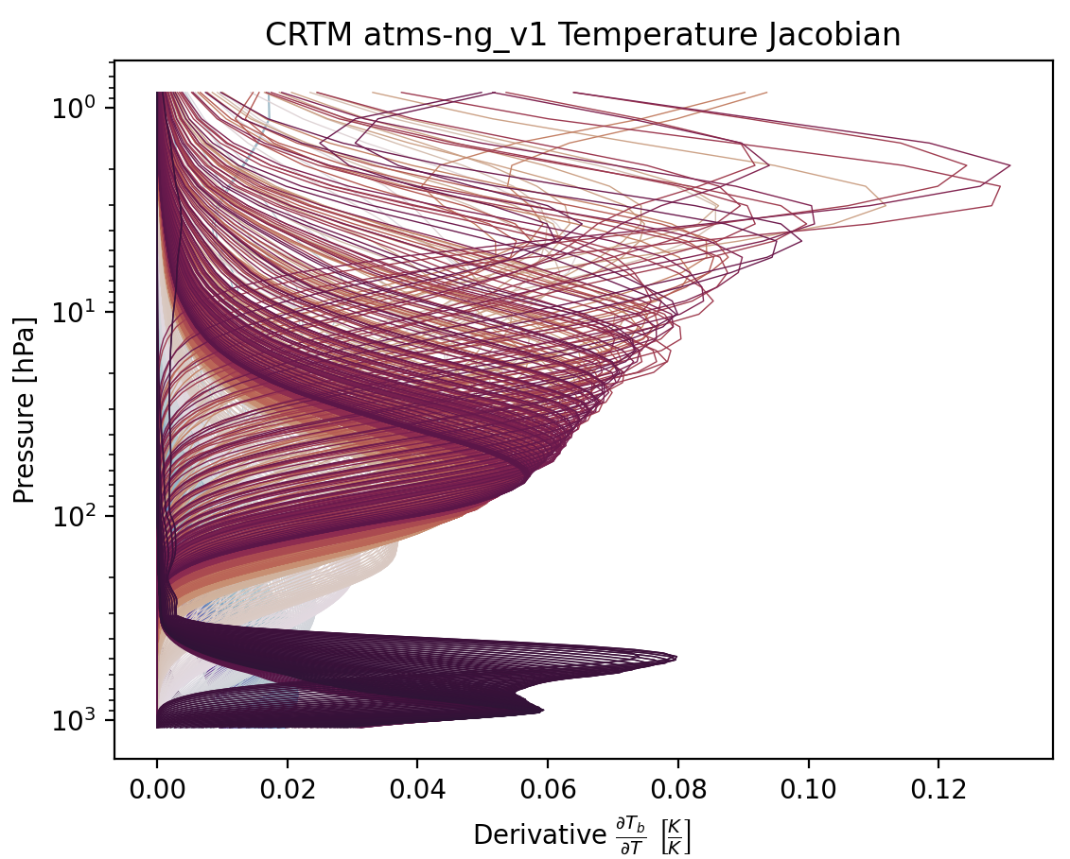
New Coefficients
TROPICS Pathfinder, with SRF (MW Sounder Cubesat)
ATMS-NG (Experimental, hyperspectral MW, ATMS-like)
GOES-18 ABI

Slide 5
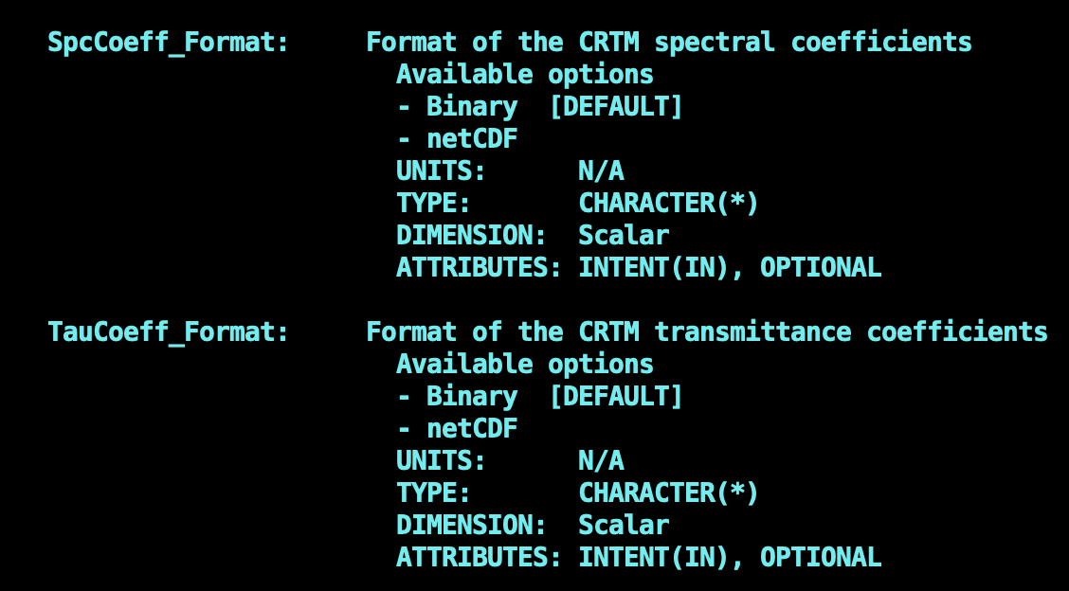
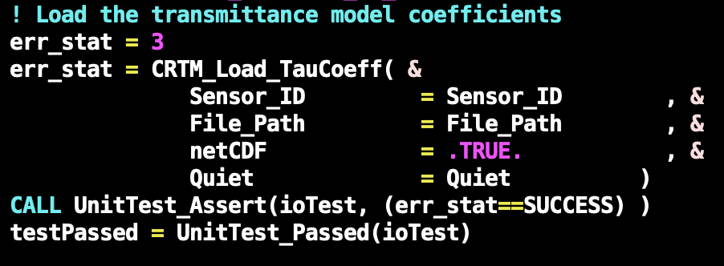
NetCDF I/O for TauCoeff & SpcCoeff Files
NetCDF format can be specified when calling CRTM_Init() or when loading coefficients separately.

Slide 6
Aerosol Updates

Slide 7
Upcoming Meetings

Slide 8
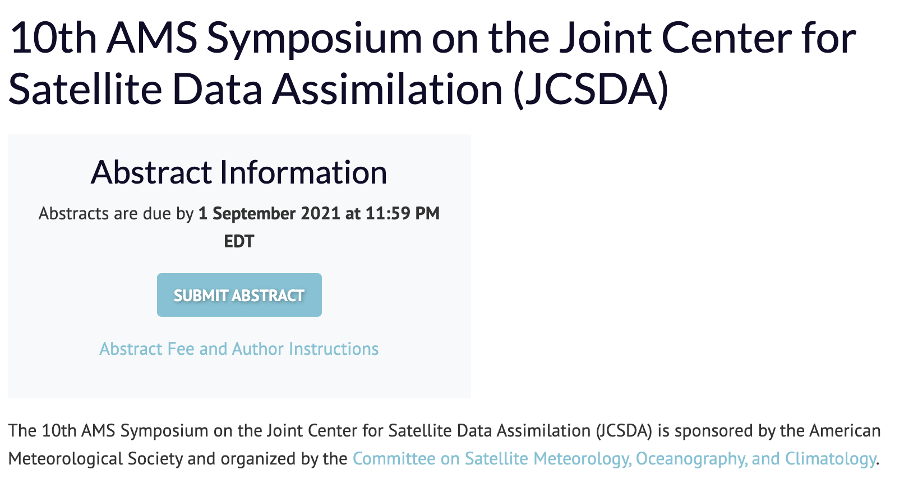
JCSDA Meetings
AMS-2022 JCSDA Symposium (Deadline: September)
CRTM User/Developer Workshop (virtual, October): Planing Phase.
Instrument Coefficient Generation Roundtable Meeting

Slide 9
Coefficient Generation Roundtable Meeting
For instrument scientists and algorithm developers.
Please participate in the Doodle Poll.
Provides Package Overview
Introduces Agile Open Source Development Policy and documentation requirements
Requires HPC access with slurm scheduler

Slide 10
Scattering Datastructure
Refactoring for v3.0+

Slide 11
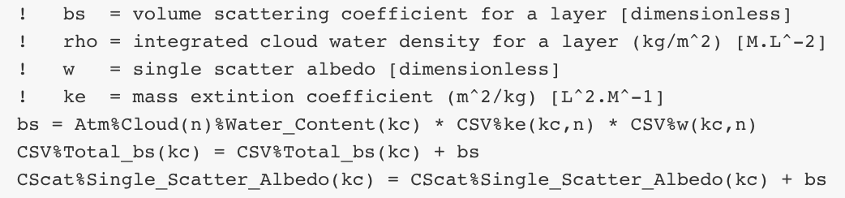
Scattering Datastructure Refactoring
Recurring issue; Original task comes from Paul van Delst
Identifying and Removing duplicates
Enforcing physical unit consistency
Improving code readability

