Slide 1
Analysis of CRTM and NASA LUTs aerosol hofx AOD differences
Andy Tangborn
In collaboration with Cory Martin, Mariusz Pagowski and Bo Huang
Cycling experiments without data assimilation.
Hofx computed for modis AOD observation locations for MODIS Terra.
June 1-22 2016.
Detailed analysis by surface type, AOD magnitude and aerosol species for June 1, 2016 06Z.

Slide 2
The comparisons between NASA LUTs and CRTM cannot (yet) identify which is more accurate.
This will require better knowledge of the accuracy of the individual aerosol species in the model, which can be obtained using in situ observations such as ATom.
The observation - forecast differences also will depend on the accuracy of the satellite retrievals (MODIS in this case), which also have significant biases and uncertainties.
The goal here is instead to understand the source of the differences between NASA LUTs and CRTM through the individual species and observation parameters.

Slide 3
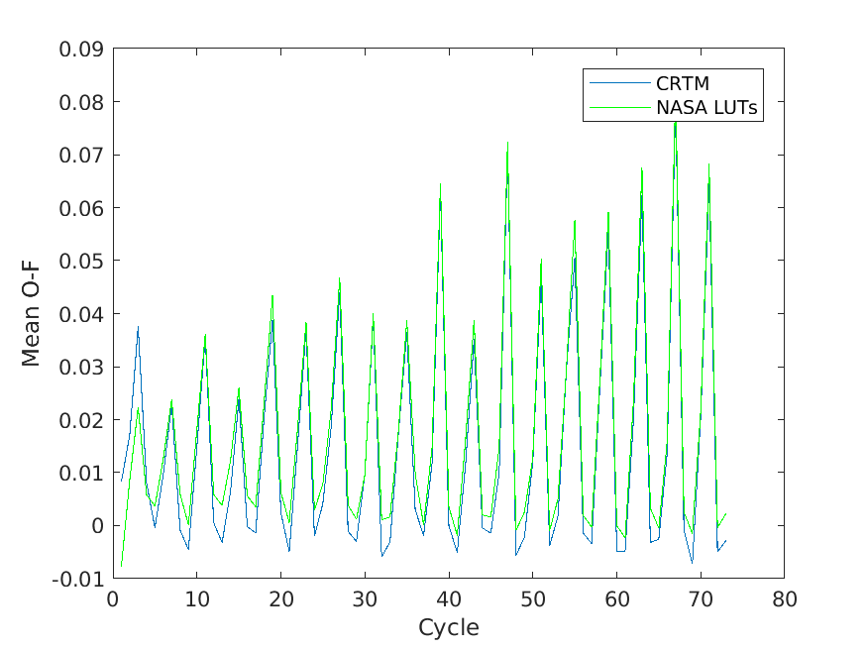
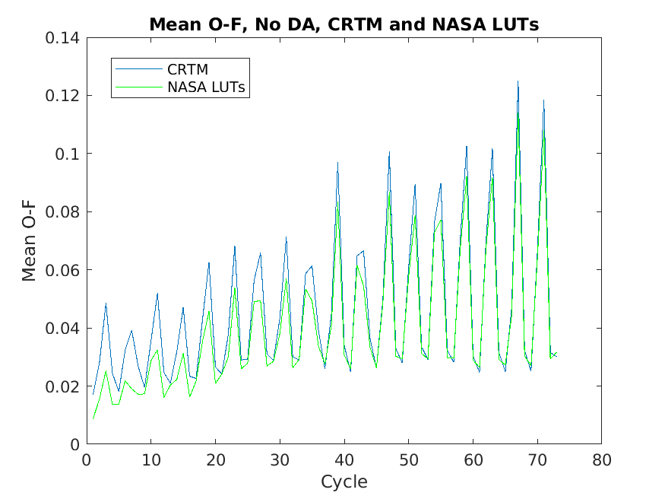
Mean Obs - Hofx (O-F), MODIS Observations, June 1-19, 2016
O-F is smaller for NASA LUTs without DA.
Forecast may include substantial bias
MODIS obs have bias as well
Mean O-F, No DA
Mean O-F, with DA

Slide 4
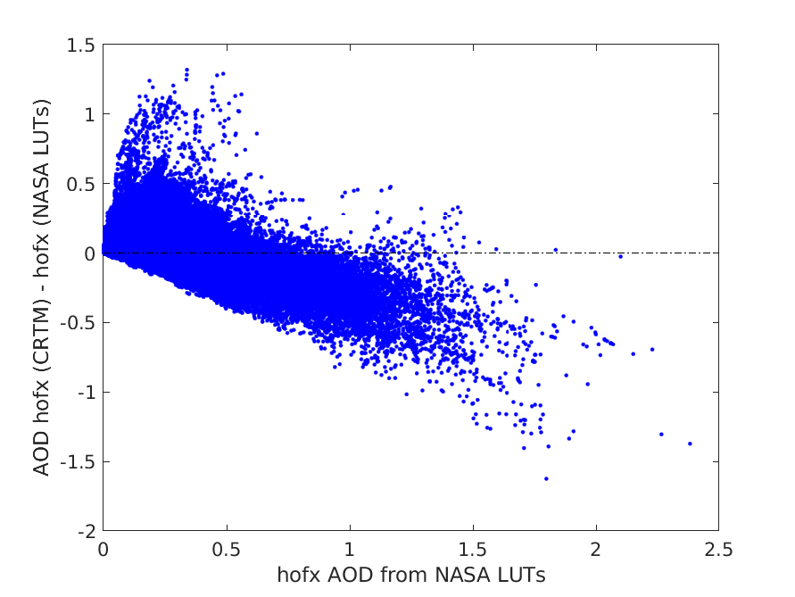
AOD CRTM - AOD LUTs vs. AOD LUTs
From three week no DA experiments
Each dot represents an hofx AOD simulated observation
CRTM - LUTs generally decreases with AOD magnitude.
Some large variability occurs at low AOD values. These may be due to variations in surface type or aerosol species.
This collection contains influences from the entire set of 16 species, including observations over both land and ocean.
This makes it difficult to analyze the nature of the differences between hofx from CRTM and NASA LUTs.
It’s helpful to separate the forward operator calculations to the species separately.

Slide 5
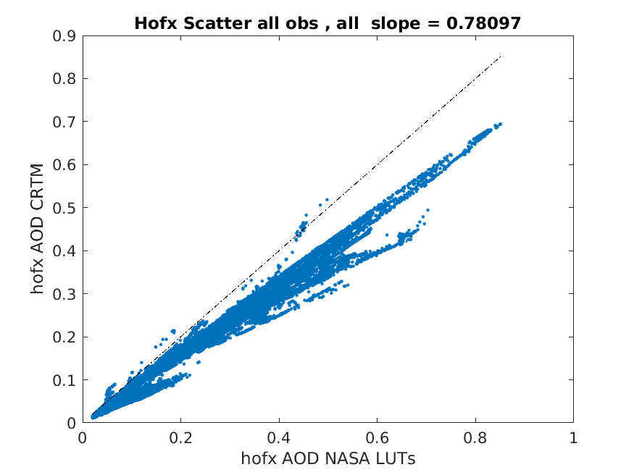
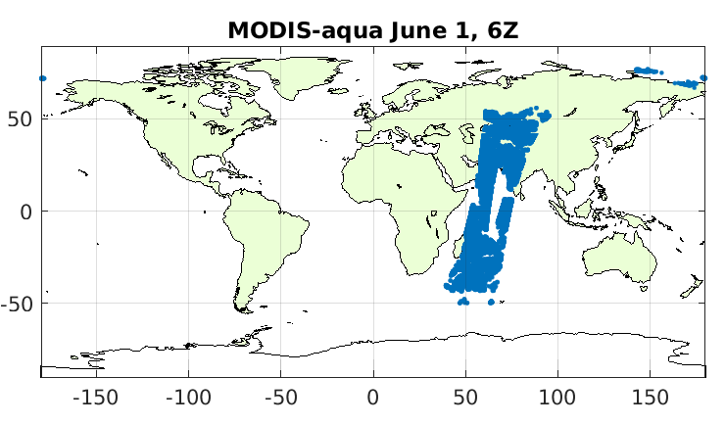
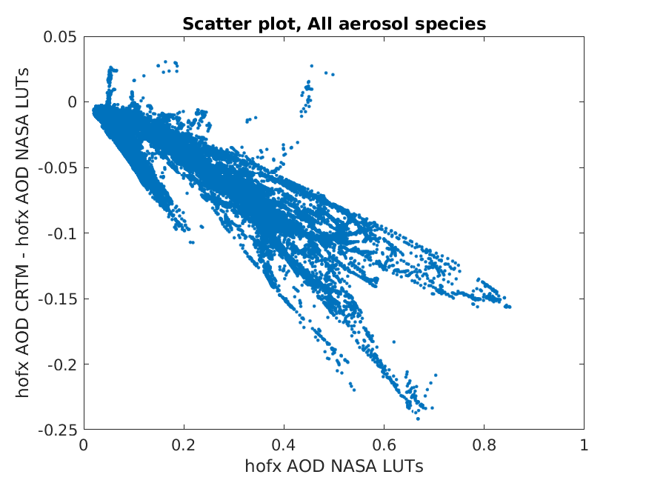
To simplify the comparisons, we consider a single 6 hour window centered on June 1, 2016, 06Z
Scatter plots of AOD CRTM - LUTs vs AOD LUTs show distinct lines with different slopes.
The various species show more clearly in this smaller set of Hofx values

Slide 6
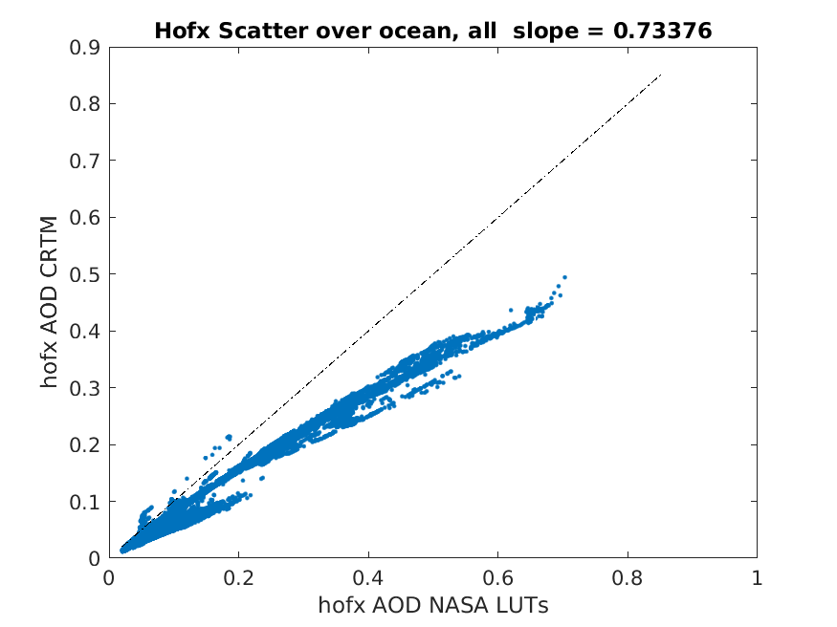
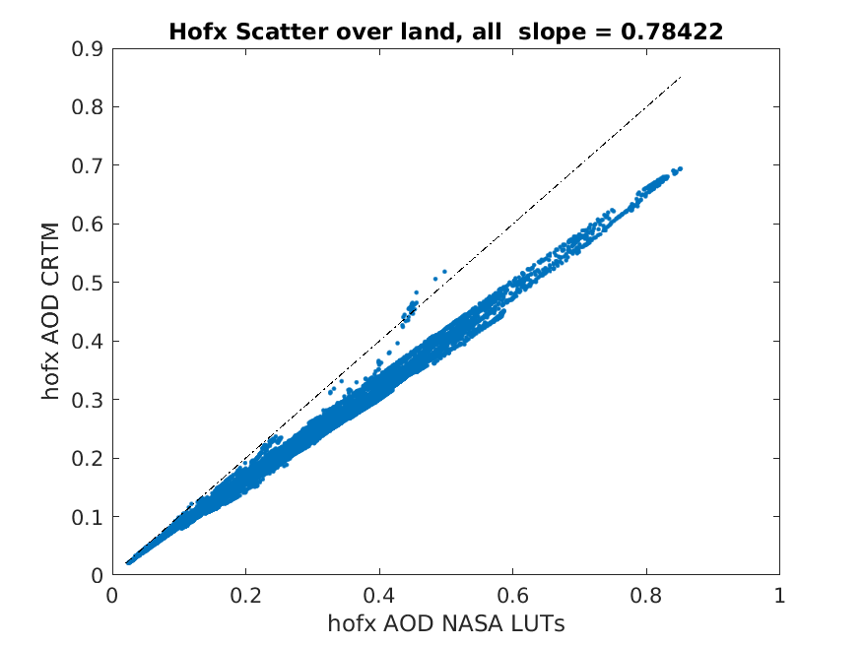
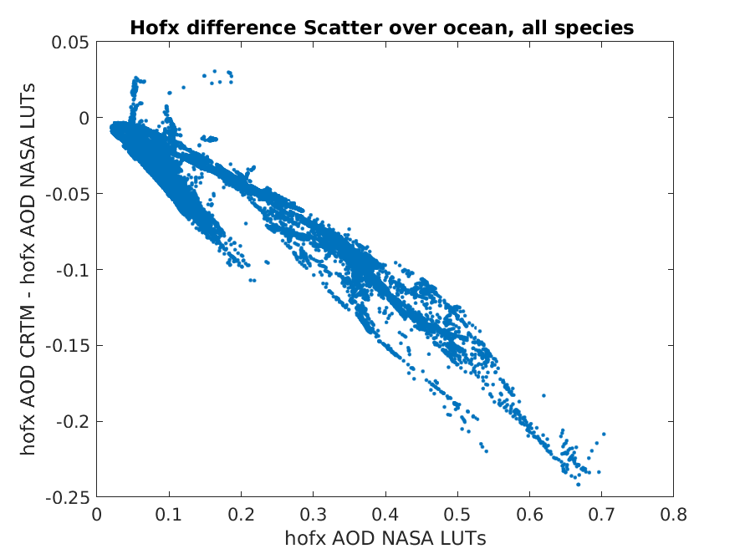
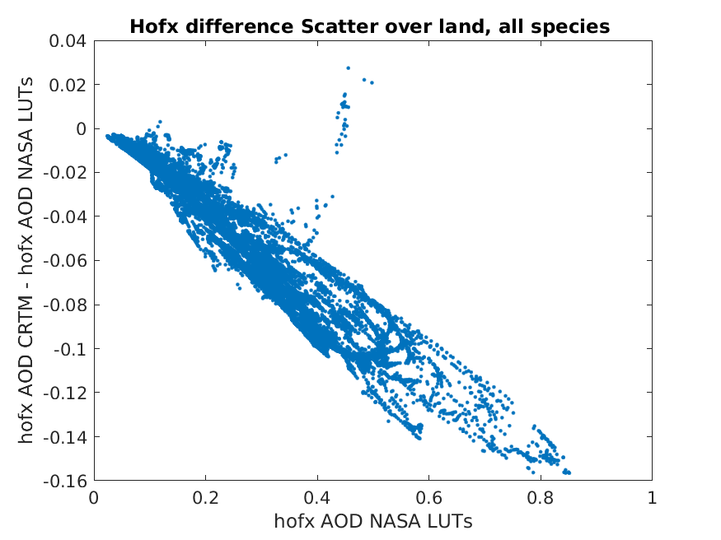
All species

Slide 7
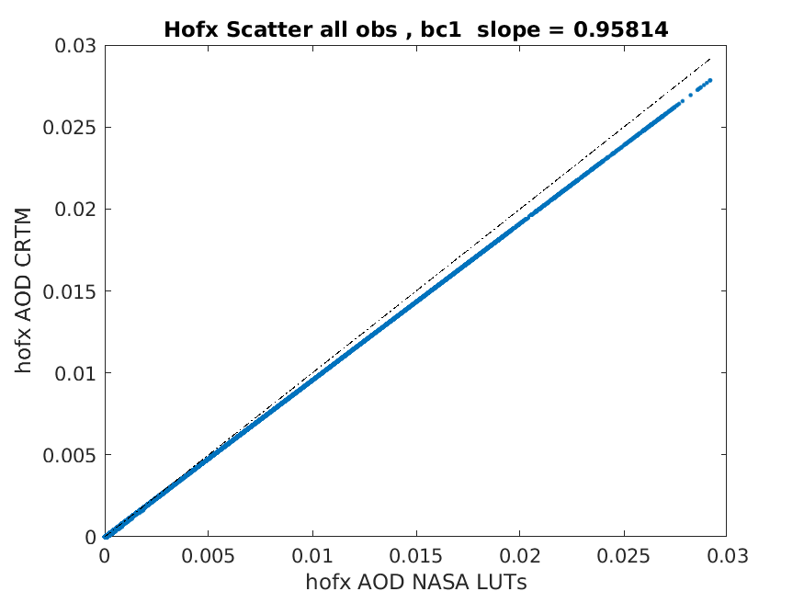
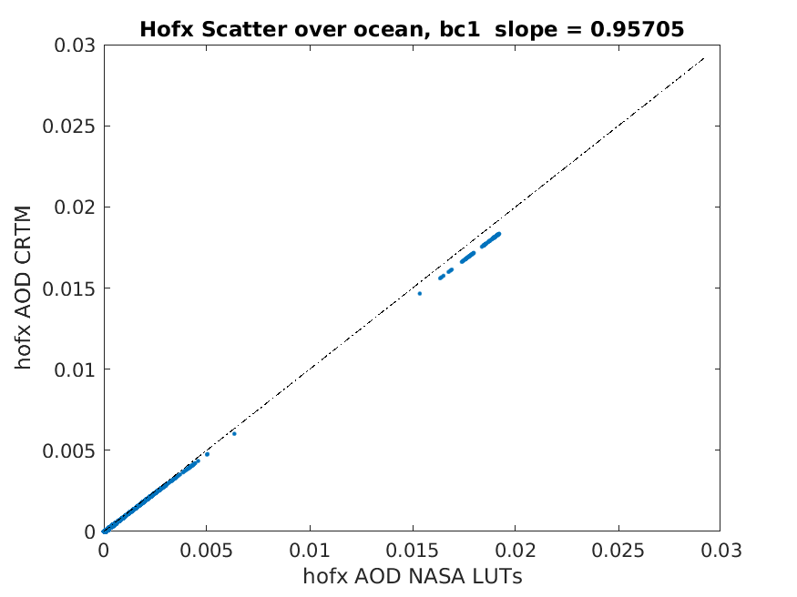

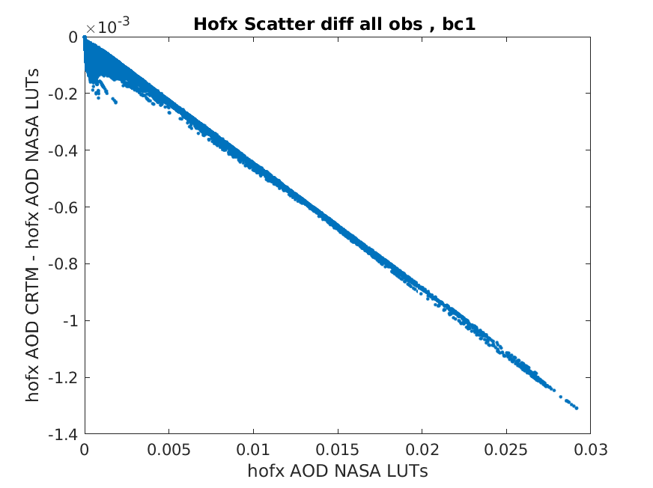
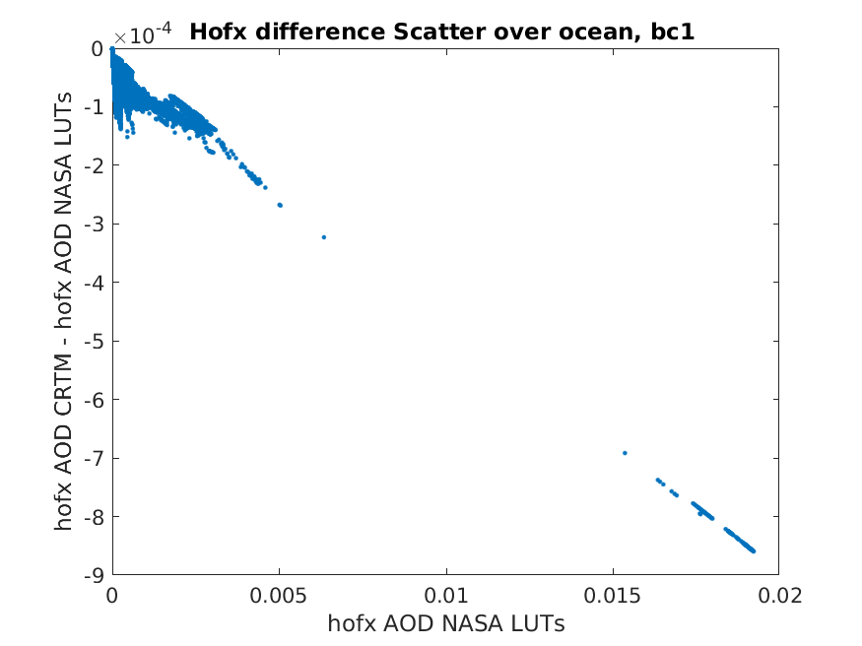
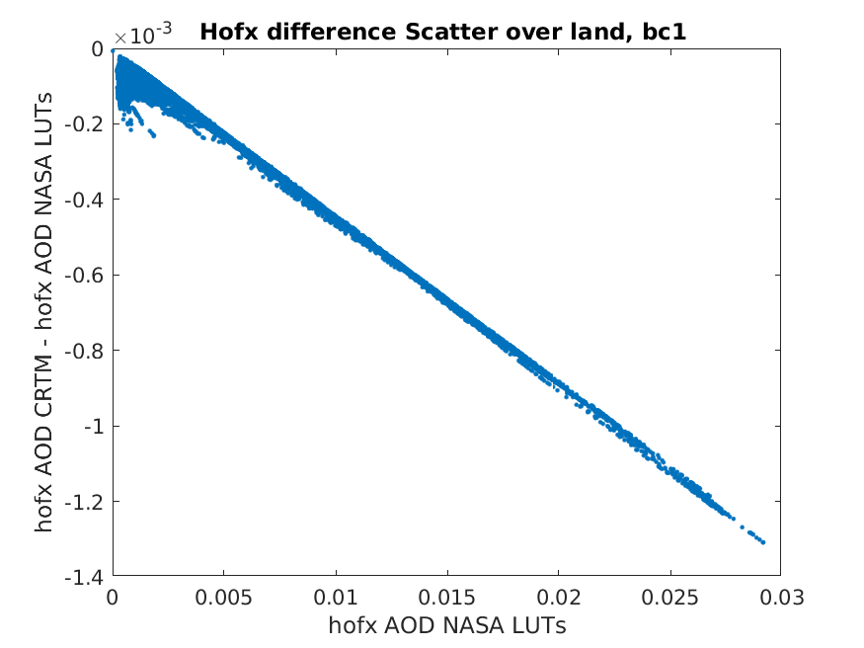
Hydrophobic black carbon (BC1)

Slide 8
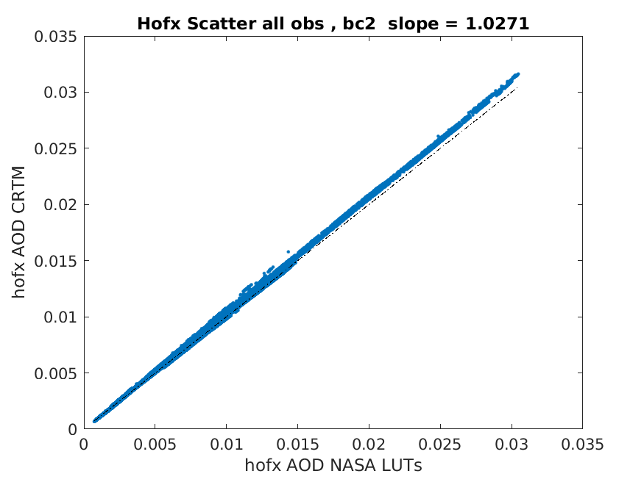
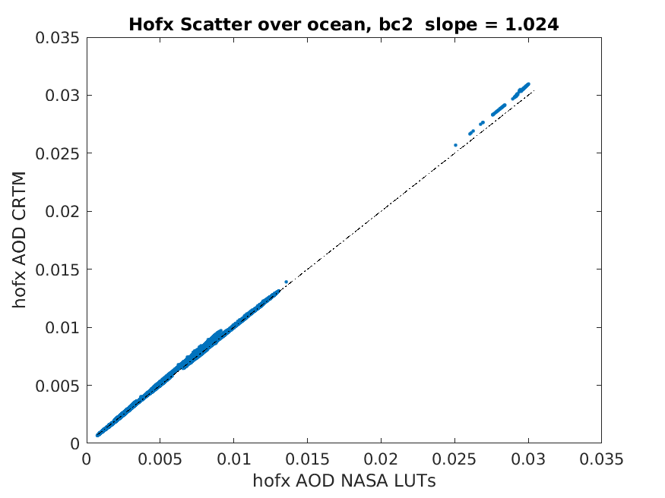
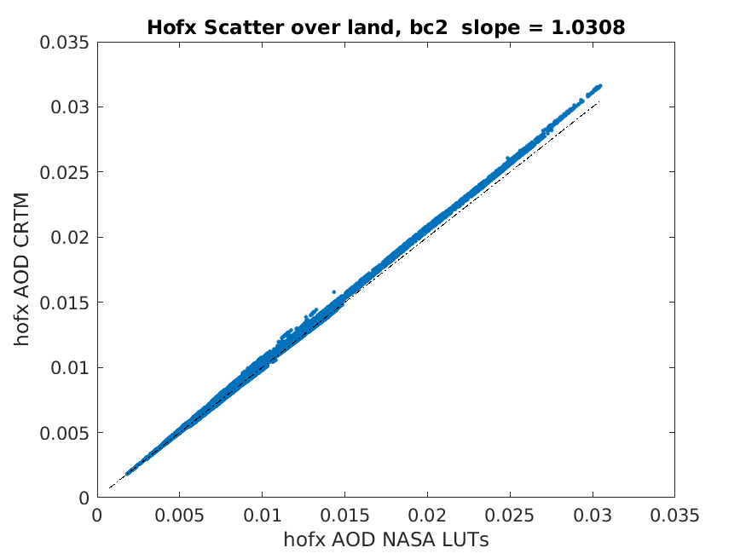
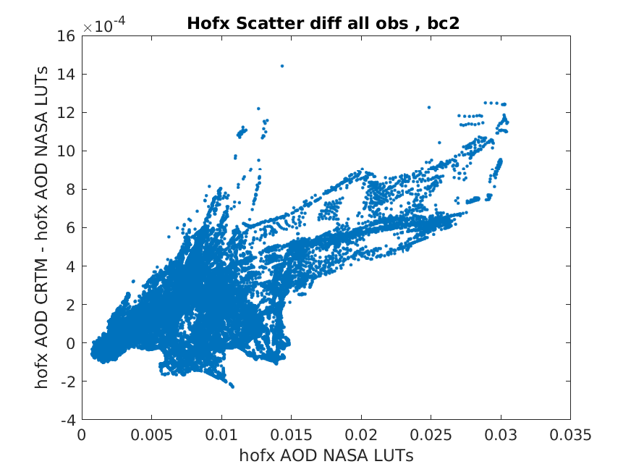
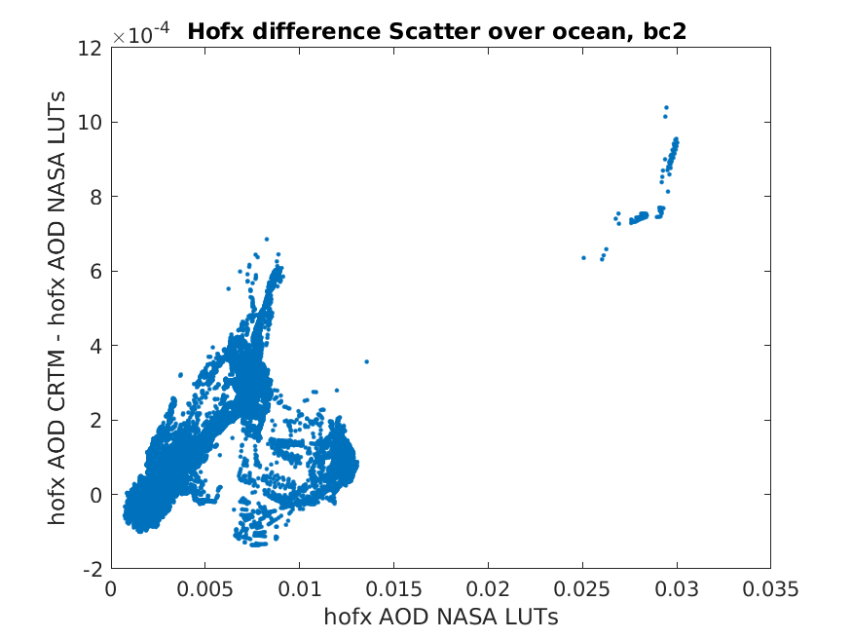
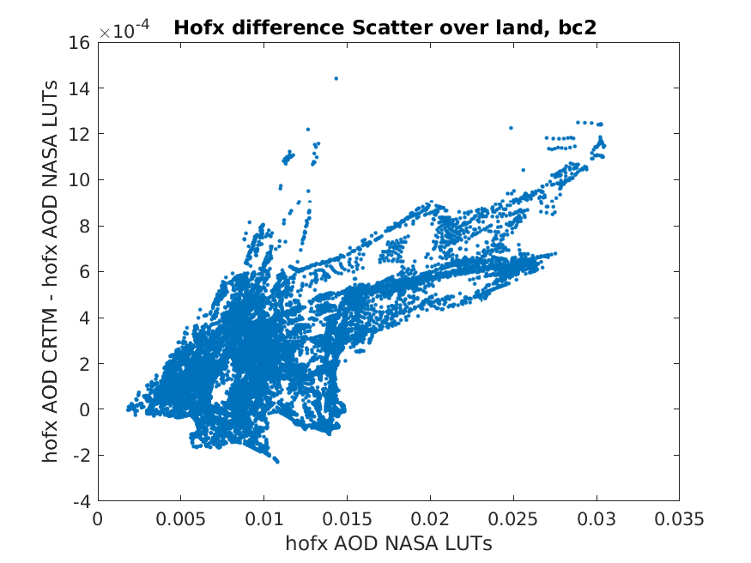
Hydrophilic Black Carbon (BC2)

Slide 9
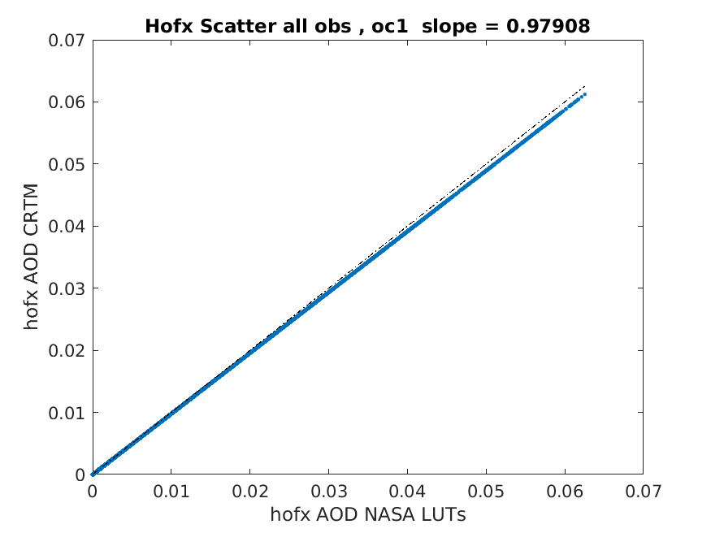
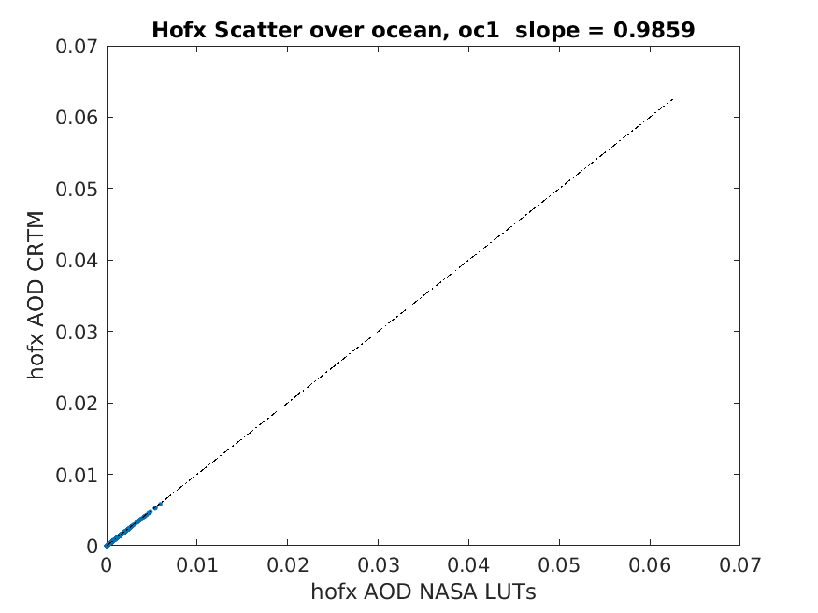
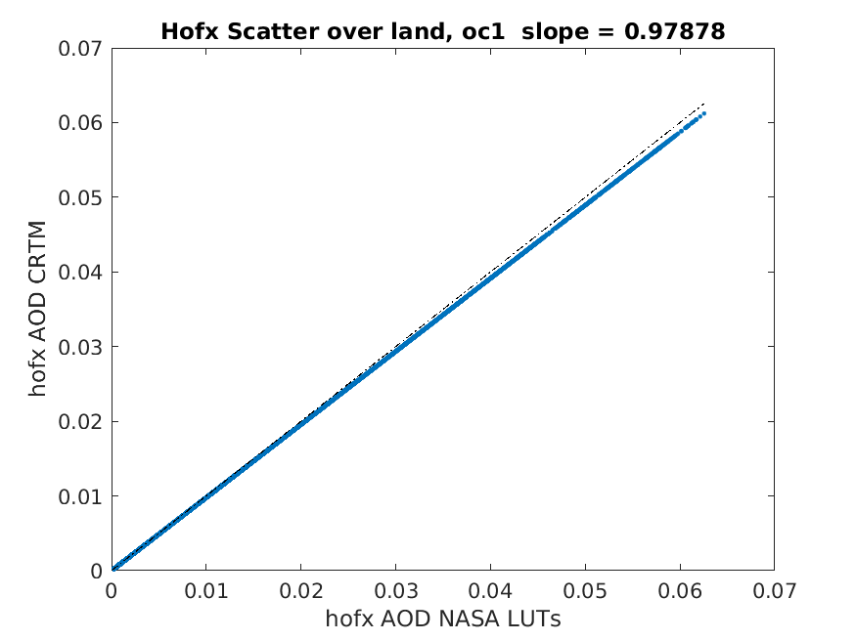
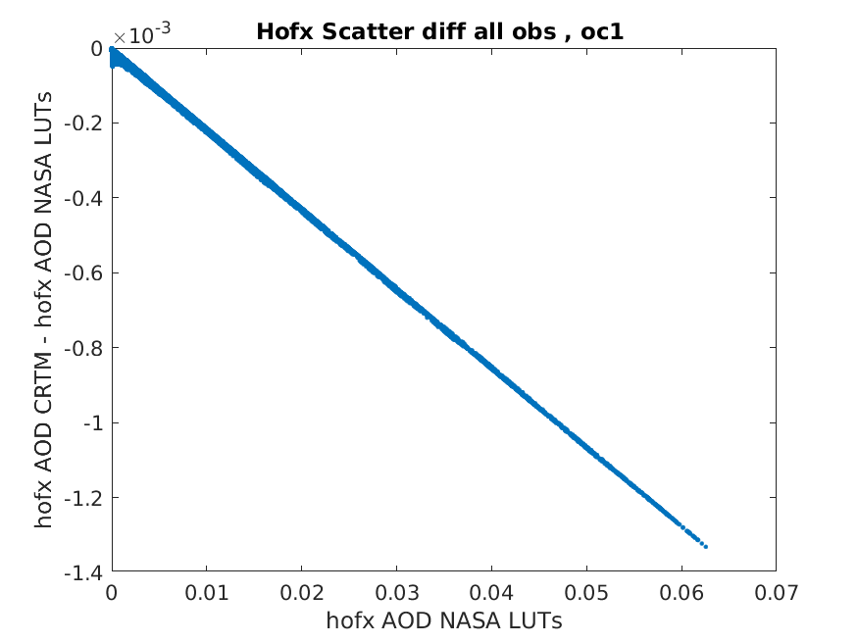
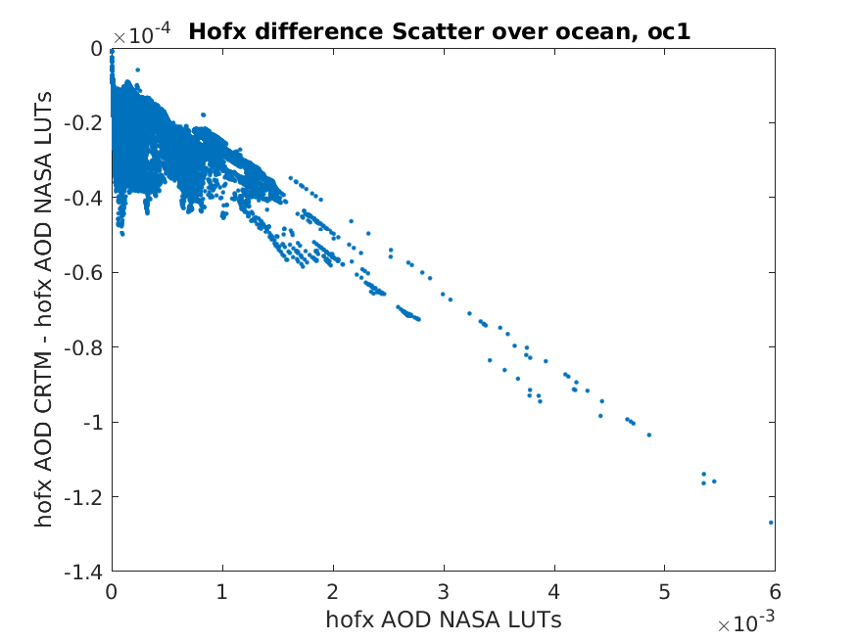
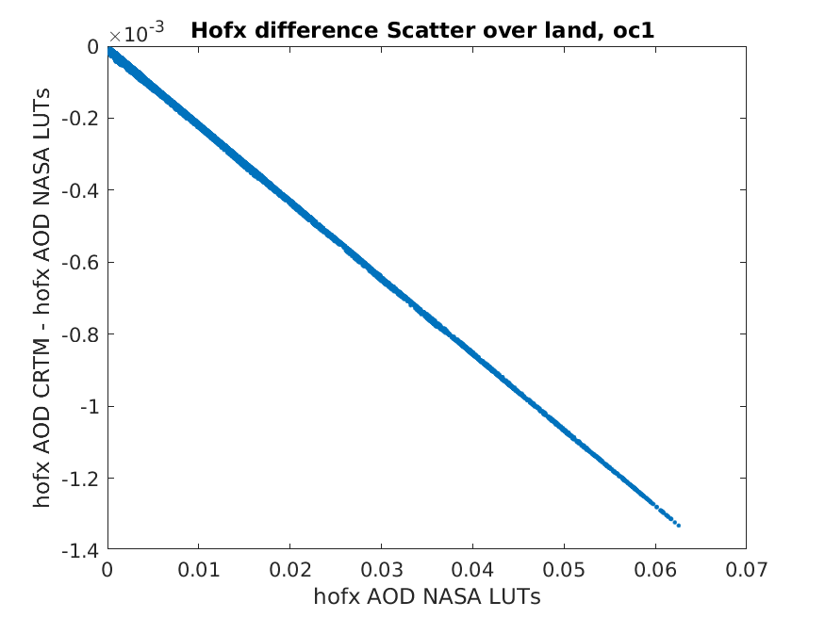
Hydrophobic organic carbon (OC1)

Slide 10
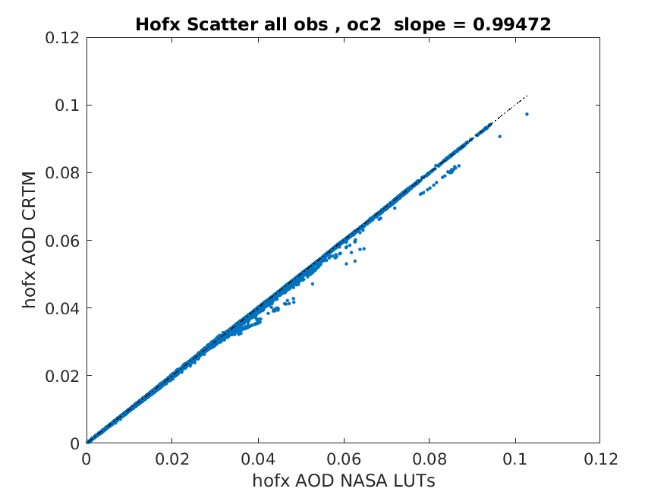
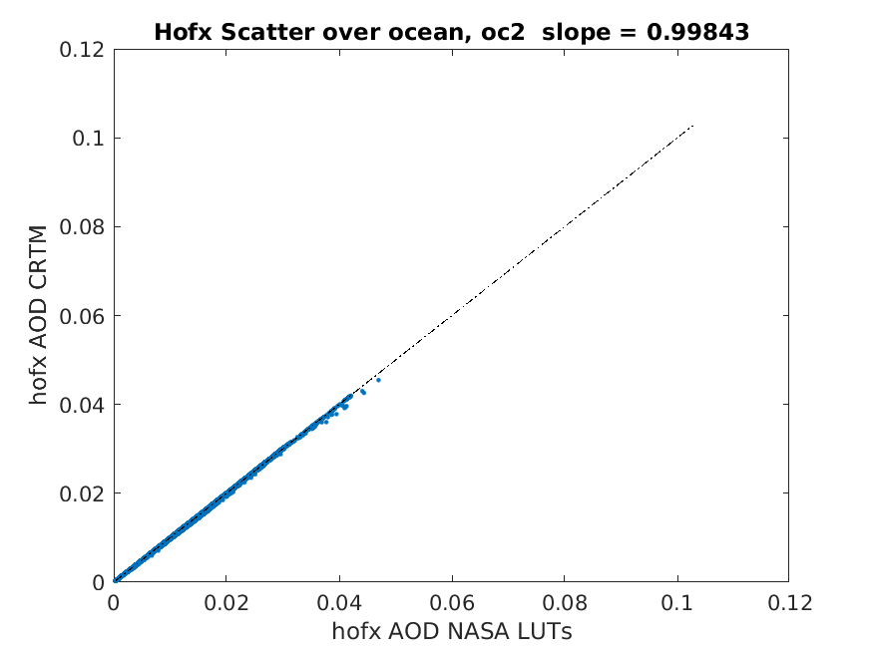
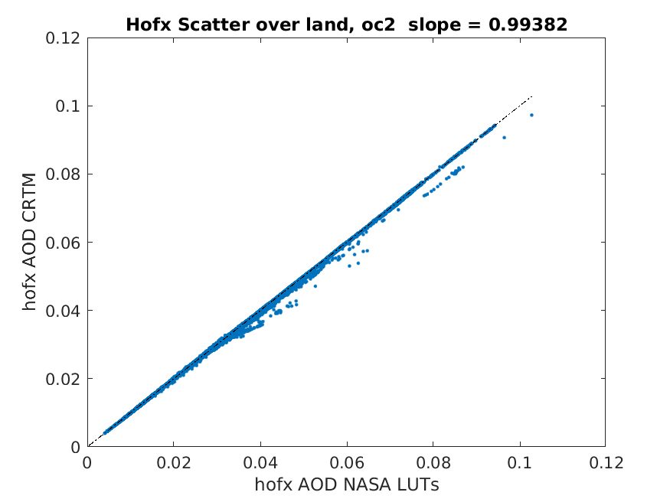
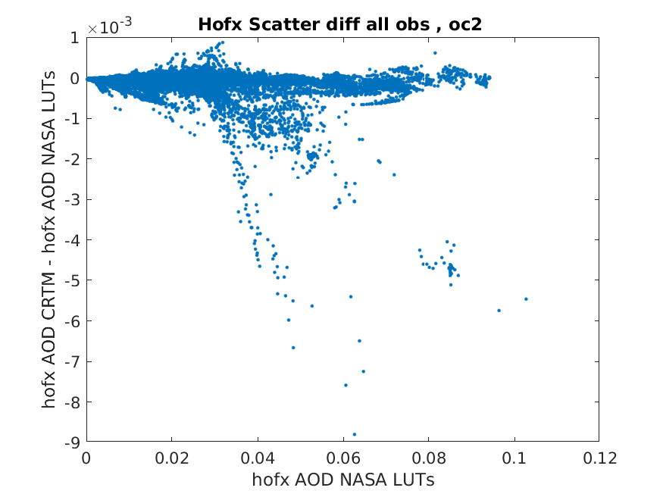
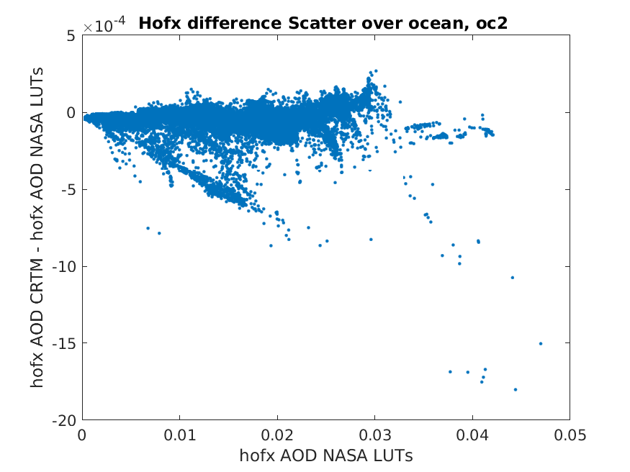
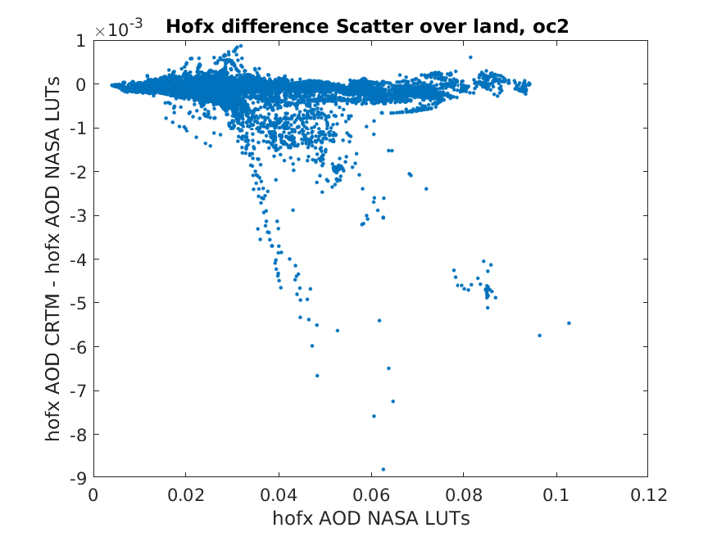
Hydrophilic organic carbon (OC2)

Slide 11
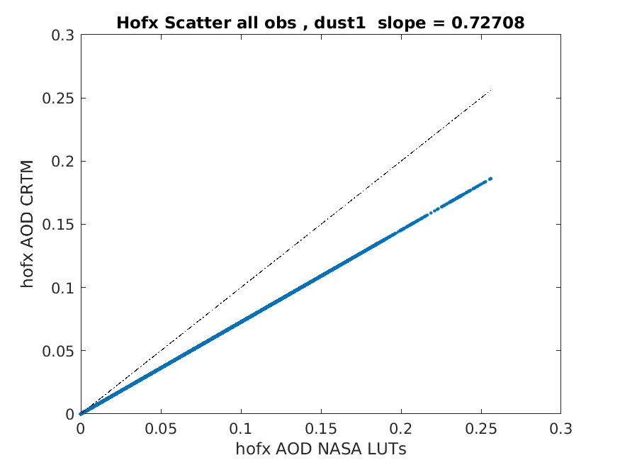
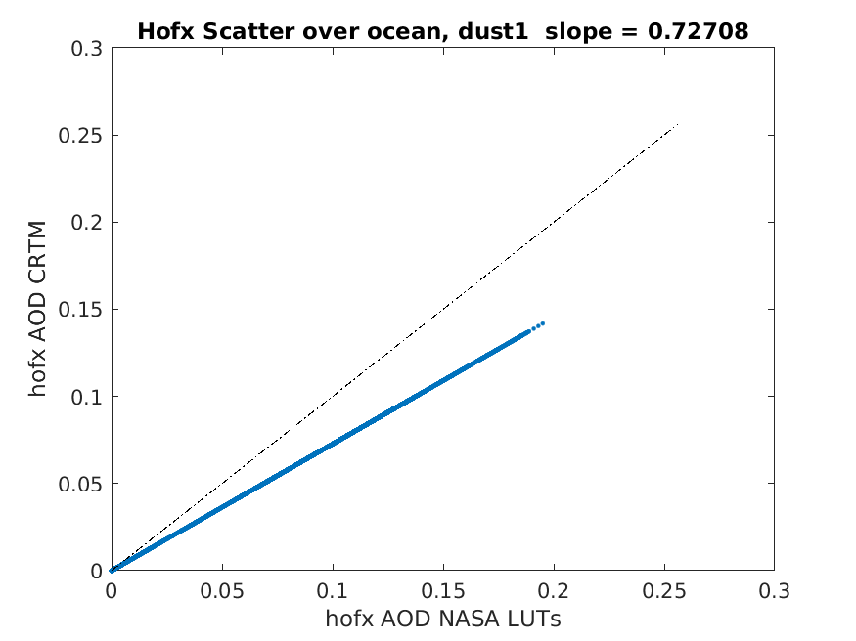
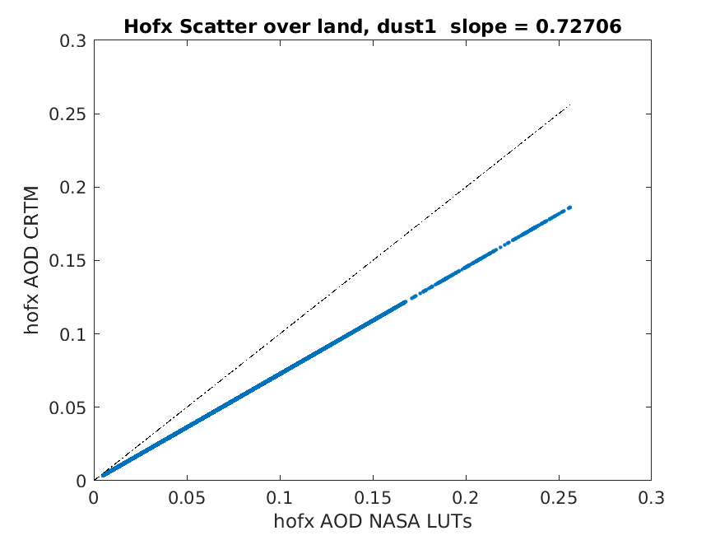
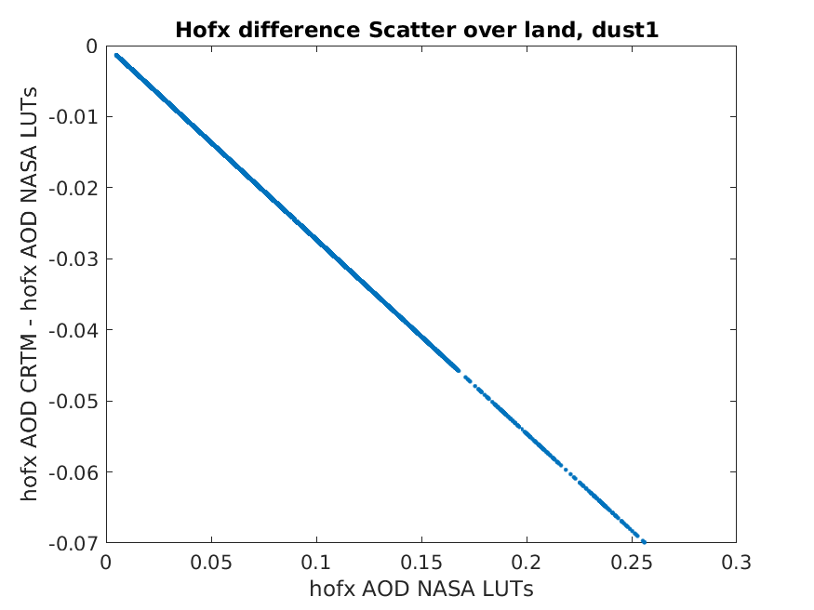
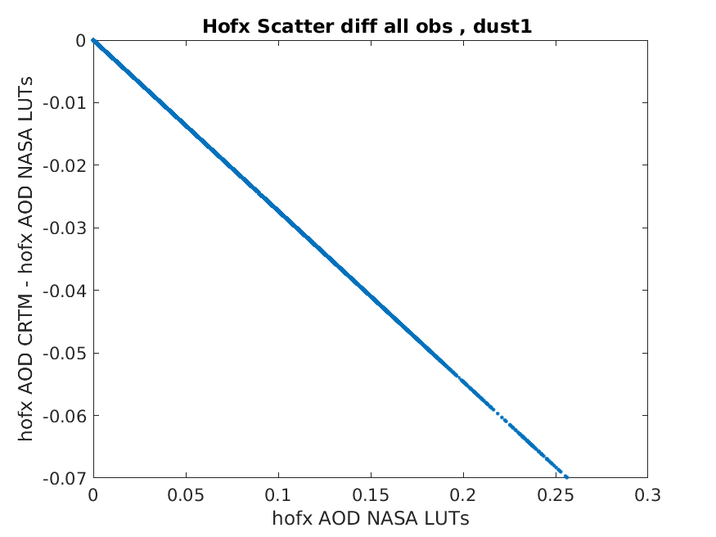
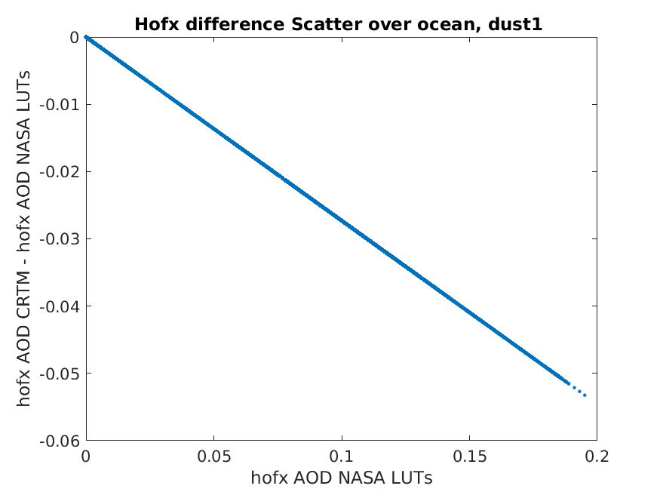

Slide 12
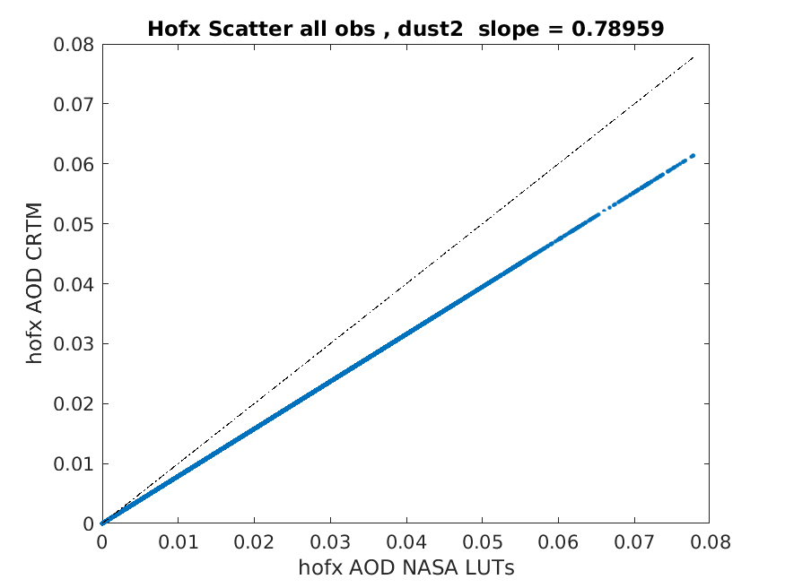
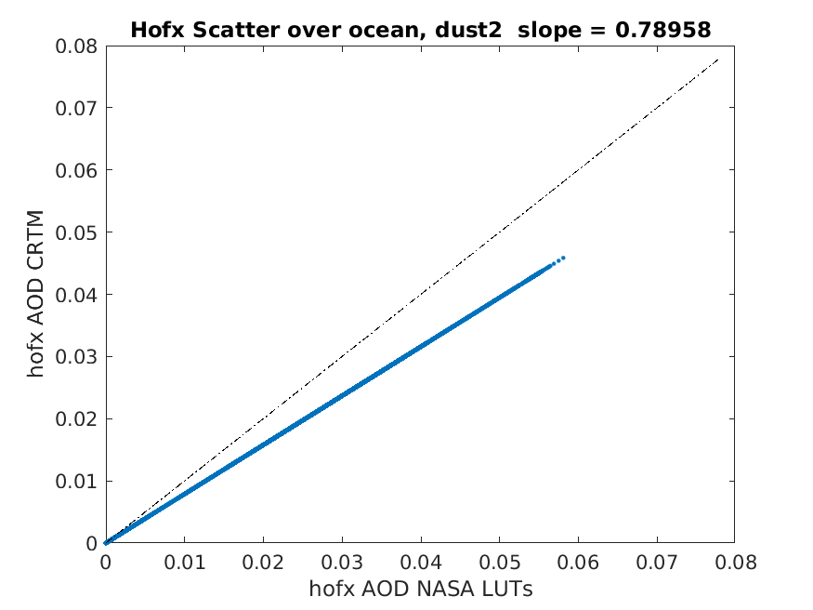
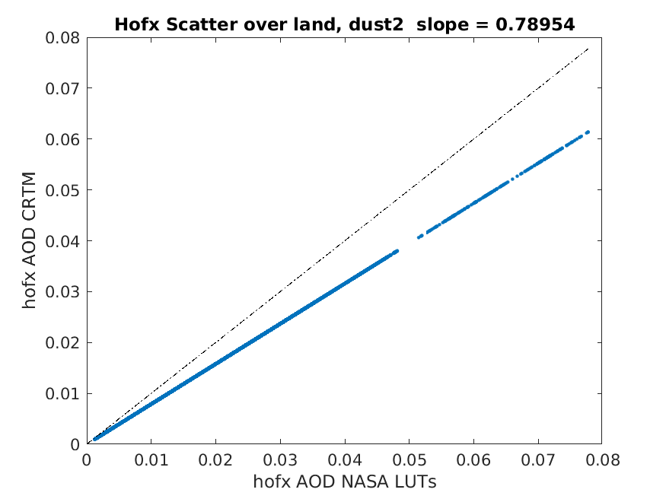
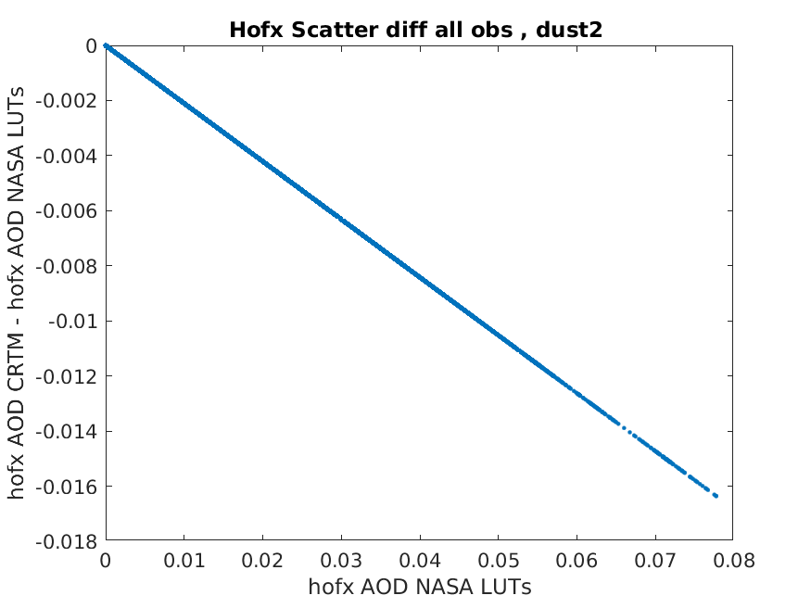
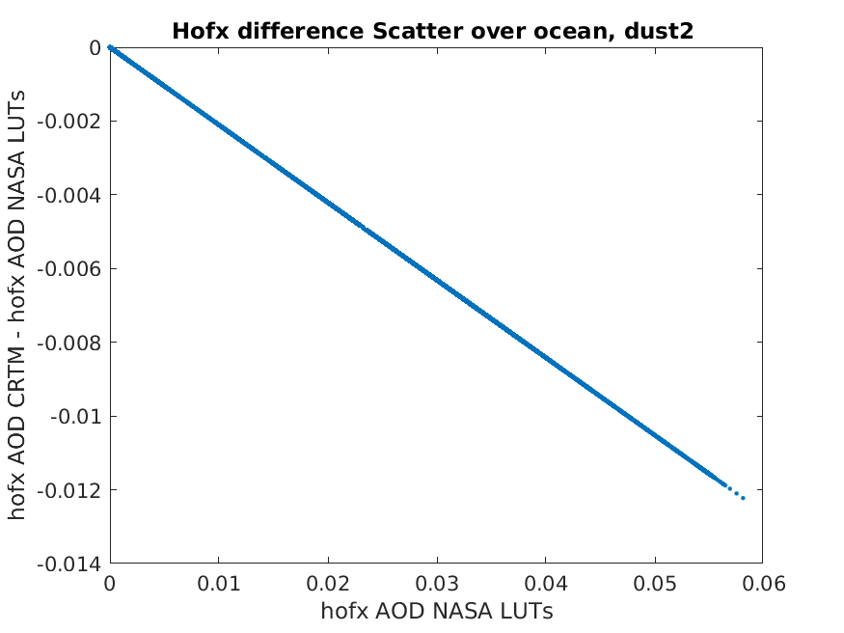
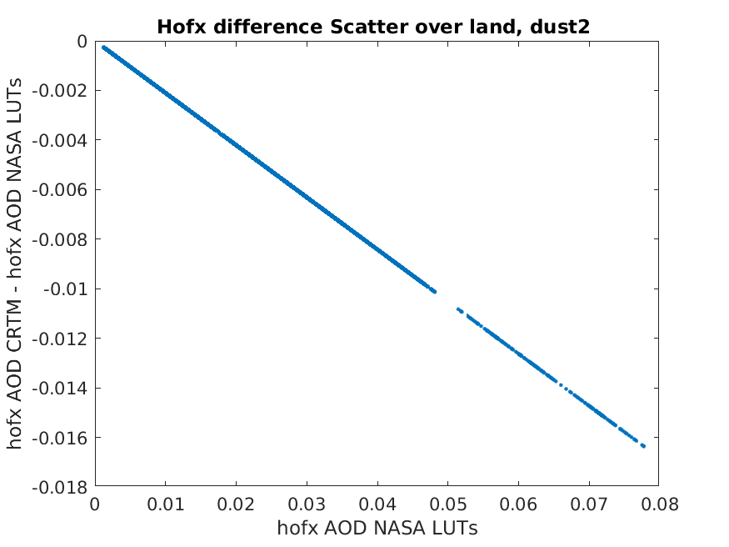
Dust 2

Slide 13
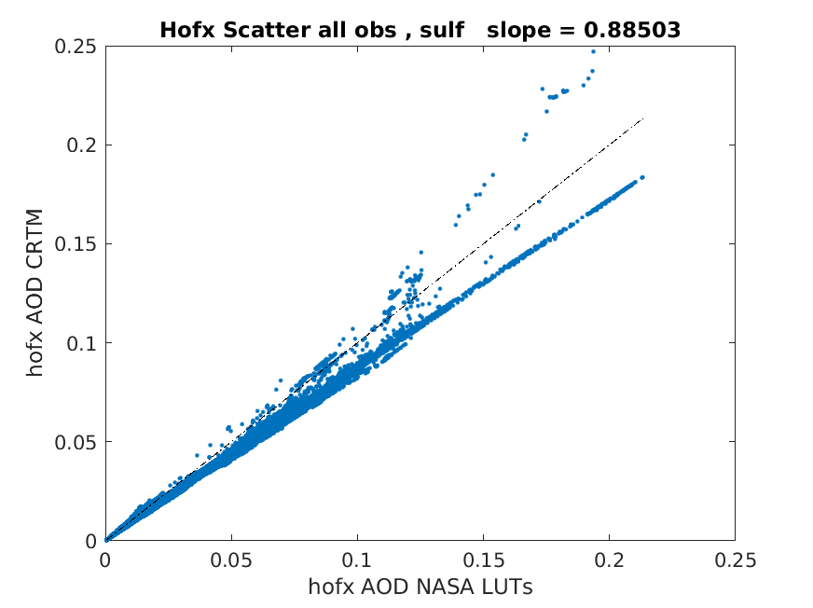
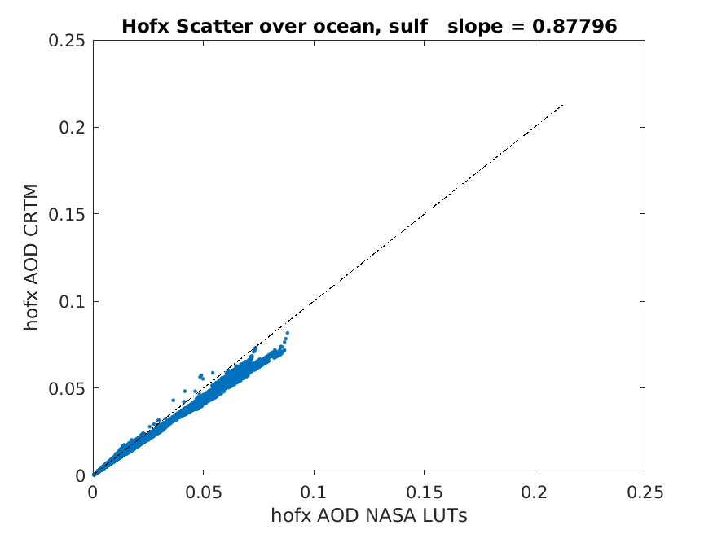
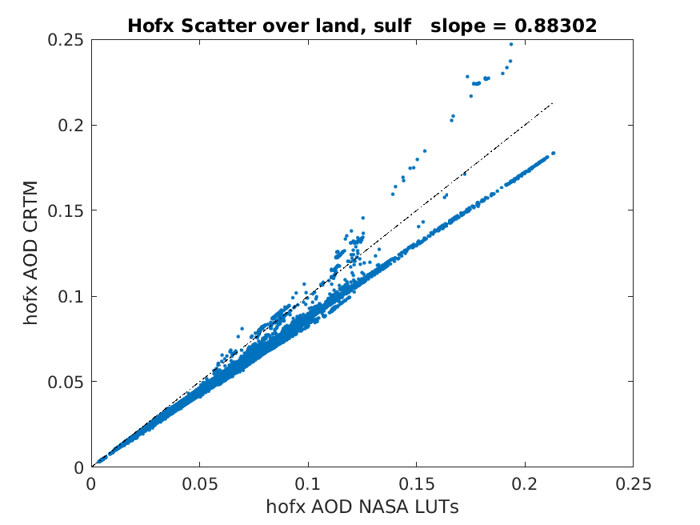
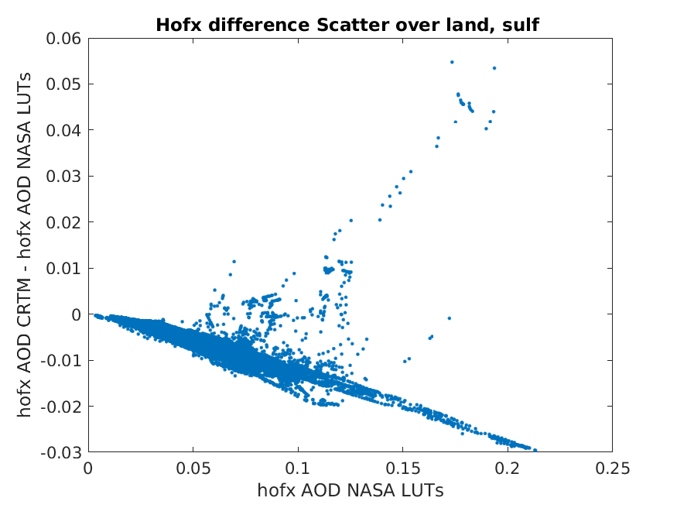
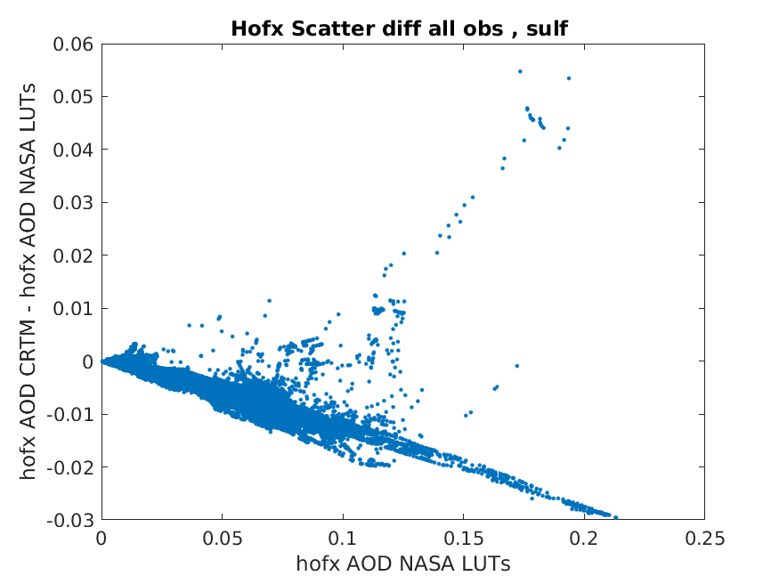

Sulfate

Slide 14
Some Initial Conclusions
We can identify aerosol species in which the AOD calculations in NASA LUTs and CRTM contain measurable bias: Dust species and Sulfate.
Others contain systematic differences that are small compared to random differences (hydrophilic black carbon and hydrophilic organic carbon)
Several have systematic differences that are only slightly larger than the random differences (hydrophobic black carbon and organic carbon).
We cannot make any statement as to which is more accurate until comparisons with in situ aerosol observations with AToms have been made. Recent implementation of AERONET into JEDI will help with this evaluation.
The differences between the operators do have implications for assimilation, since they affect the changes to the aerosol fields differently, and these difference are carried forward in time by the forecast model.

