Slide 1
Multi-tier testing in JEDI

Slide 2
What are the testing tiers we should define and what distinguishes one tier from another?
How often should each of the tests be run and on what platforms (cloud or HPC?)?
How should we manage test data for the different tiers?
How should performance monitoring be integrated into the multi-tier structure?
When tests are run for a given test tier n, should all lower-tier tests (n < 1) also be run?
What should be the criterion for when a test passes or not? For simple Tier-1 unit tests we often compare to a reference file with a given tolerance. But, regression tests at the application level can be more subtle.
How should the test tier be specified (e.g. through environment or CMake variables)?
Should centers be encouraged to run their own supplemental tests or should the procedure be standardized across all JCSDA Testbed applications?

Slide 3
Tier | Test time | Test data | Trigger | Machine | Comments
1 (unit test) | shortest | Git LFS (low res) Egress $ | Every PR commit | AWS CodeBuild | Fast unit tests using low res small test files Test outputs published to CDASH Computational performance
2 | short | Git LFS (same data as tier 1) Egress $ | Cron Job (daily?) | AWS CodeBuild & potentially CodePipeline | Unit tests that take longer than tier 1 and use the same test files as tier 1. Examples: saber testing w/multi-core. Valgrind tests Test outputs published to CDASH Computational performance
3 | Medium | AWS S3 No egress | Cron Job (weekly??) | AWS | Unit tests and regression tests that use higher-res test files/more obs compared to tier 1.
Comprehensive testing | Medium/long | Git LFS Egress $ | Manually with a commit msg and part of tier 2 | AWS CodePipeline | Same as tier 1 but test for downstream repos. For example test mpas-jedi (or any other model) from PRs in saber or oops
Testbed application | Longest | R2d2 No egress cost if data is available on HPC or S3 to EC2 | Cron job (weekly) | AWS (needs ewok in containers or AWS nodes?) HPC | Run testbed application with the latest code and publish the results on a dashboard. Can also track computational performance, scientific performance,...

Slide 4
How should the test tier be specified (e.g. through environment or CMake variables)?
Examples:
FV3-JEDI:
FV3JEDI_TEST_TIER
Env variable. Can be set to 1 or 2.
SKIP_LARGE_TESTS
CMAKE option, default is OFF. When ON: skip tests with more than 6 processors
SABER:
SABER_TEST_TIER
Env variable. Can be set to 1, 2, or 3

Slide 5
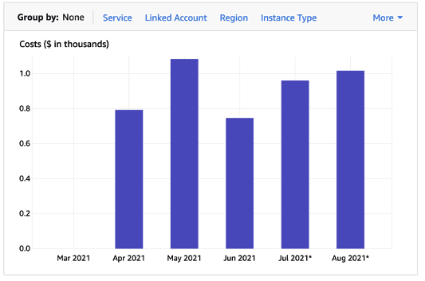
Cost
Estimated cost for tier 1 testing ~$1,000/mo
Estimated cost of running Comprehensive testing for every PRs (fv3, soca, and mpas bundles) ~$900/mo
Egress cost:
Storing test data on git-lfs and running tests on AWS or HPC
Storing test data on S3 running tests on HPC
Compute instance type | Memory | vCPU | Linux price per build minute
general1.small | 3 GB | 2 | $0.005
general1.medium | 7 GB | 4 | $0.01
general1.large | 15 GB | 8 | $0.02

Slide 6
What are the testing tiers we should define and what distinguishes one tier from another?
How often should each of the tests be run and on what platforms (cloud or HPC?)?
How should we manage test data for the different tiers?
How should performance monitoring be integrated into the multi-tier structure?
When tests are run for a given test tier n, should all lower-tier tests (n < 1) also be run?
What should be the criterion for when a test passes or not? For simple Tier-1 unit tests we often compare to a reference file with a given tolerance. But, regression tests at the application level can be more subtle.
How should the test tier be specified (e.g. through environment or CMake variables)?
Should centers be encouraged to run their own supplemental tests or should the procedure be standardized across all JCSDA Testbed applications?

