Slide 1
Adjoint-interpolation using Atlas
Marek Wlasak
2021-09-20

Slide 2
Motivation for adjoint interpolation
Initial issue here is that we want an atlas-derived background error covariance that can deal with both EndGame (staggered longitude-latitude grids) and LFRic (cubed-sphere grid).
In both systems we are using a ECMWF trans library to do the spectral covariances. This package requires data to be on a Gaussian latitude grid. So we need interpolation from gaussian grid to model grid (and adjoint).
(Spatial part of B matrix Interpolation Spectral B Adjoint of interpolation
not including variable = from Gaussian latitude on Gaussian from Gaussian latitude
changes) grid to model grid latitude grid grid to model grid.
We want spectral B to work for any global model grid

Slide 3
Motivation for adjoint interpolation (2)
Bigger issue:
Could interpolation schemes in Atlas be more widely used in JEDI?
Adjoint of interpolation schemes could help that happen.
Could code be leveraged to for efficient interpolation to observations?

Slide 4

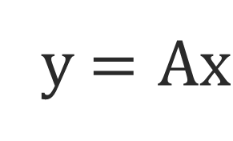
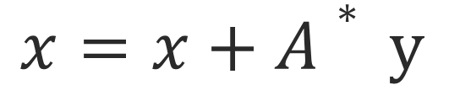
Basic procedure.
Forward | Adjoint
y $=Ax$
$x=x+A∗ y$
$$x=x$$
y = 0
When A is linear operator it can be represented as a matrix.
When x and y are real the adjoint operator A* can be represented as a transpose of matrix A ie A^{T}.

Slide 5
Atlas interpolation
Many of Atlas’s interpolation schemes store
interpolation weights in eckit sparse_matrix container. (Olly noticed this!)
eckit sparse_matrix has a transpose method for constructing a transpose matrix. So we have all that we need. ☺ (I added the adjoint of the halo-exchange previously).

Slide 6
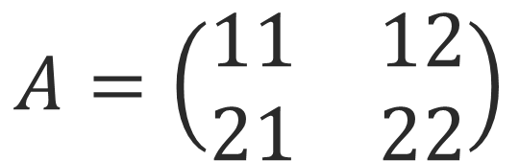
Sparse Matrix Formulation
Row major format.
outer_ = start of rows
inner_ = column indices
data_ = matrix entries
$$A=\left(\begin{matrix}11 & 12 \\ 21 & 22\end{matrix}\right)$$
outer_= [0, 2, 4]
inner_= [0,1,0,1]
data_= [11,12, 21, 22]
Note that:
Atlas’s backend to this can use OpenMP
Calculating on the fly the transpose matrix in this format can lead to race-conditions when using OpenMP.
That is why we store the transpose matrix in the constructor and treat it as a “new” matrix.

Slide 7
A question of interfaces
Originally implemented as on slide 4. It is in ecmwf atlas develop branch. However …
In oops we tend to not zero y in adjoint code … instead we set it as constant (in C++ sense) to avoid unnecessary calculations. This is only a problem if that adjoint variable is reused.
There is a quick PR (in review) to ecmwf atlas develop to be more consistent with how we do things in oops.
Testing:
Adjoint interpolation test are done for interpolation from octahedral grid O32 to octahedral grid O64 for double and floating precision for linear schemes that use linear and cubic basis functions.
Adjoint tests pass <AA^{T}x, x> = <Ax, Ax> with relative tolerance
(for floating numbers 4e-6 ) and
(for double precision 2e-14).

Slide 8
Summary and Additional work
We have an implemented the capability for adjoint interpolation in atlas for any atlas interpolation scheme that is represented by a sparse matrix.
Additional work (taster of other work done by me and Olly)
Olly has implemented a cubed-sphere mesh generator in atlas.
Marek has done single PE interpolation on a cubed-sphere to arbitrary set of points taking advantage of cubed-sphere structures. (not in atlas develop and further work needed on edges of the cubed-sphere and using the cubed-sphere mesh generator.)
Spectral part of um-jedi B broadly compares with operational B at N320 resolution.

