Slide 1
GPU use in VAST
(current and future)
John Clyne

Slide 2
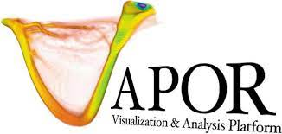
VAPOR Project
What: VAPOR visualization application for geoscience data
Platform portable (Mac OSX, Linux, Windows), runs on desktop/laptop
3D graphics rendering performed via OpenGL API (port Vulkan in future?)
Computationally-intensive, non-rendering algorithms implemented on CPU
  E.g. Trajectory integration, decompression, etc.
Language: C++
Status: Just thinking about possibilities (wrt GPU ports of non-rendering code)
Where we could use help?
Guidance on porting computationally-intensive vis. Algorithms to GPUs
  OpenACC vs CUDA vs OpenMP vs Other?

Slide 3

GeoCAT Project
What: A growing collection of geoscience analysis functions with Python language bindings
The NCL pivot to Python
Currently using Dask for threaded parallelization
Runs on MacOSX/Linux currently, possibly adding Windows in the future
Language: Fortran, Python, and some C
Status: just thinking about possibilities
Where we could use help?
Guidance on porting
  OpenACC vs CUDA vs OpenMP for compiled language implementations
  CuPy vs Dask-GPU for pure-Python code?

