Slide 1
Implementing the Cubed Sphere Mesh in Atlas
Oliver Lomax
Marek Wlasak, Steve Vahl, Willem Deconinck and Dan Holdaway
JEDI Weekly Meeting – 09/12/2021

Slide 2
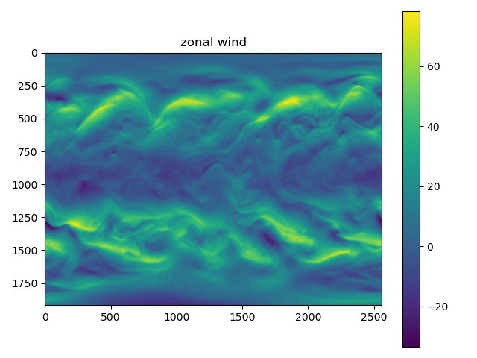
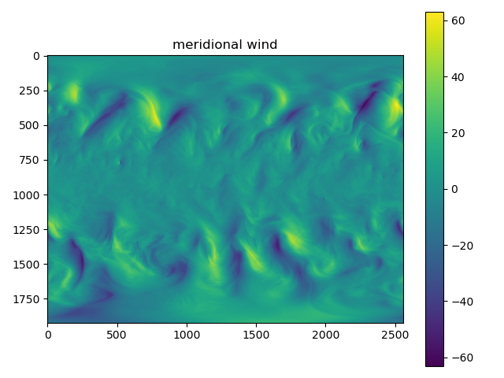
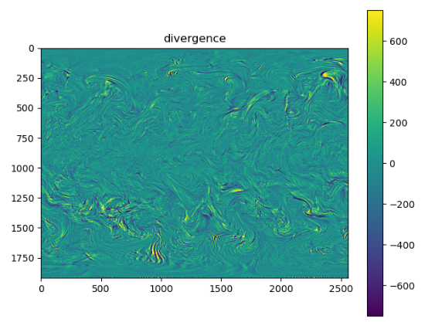
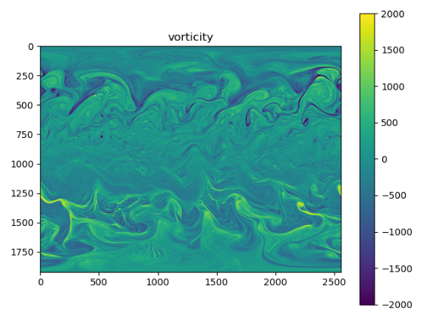
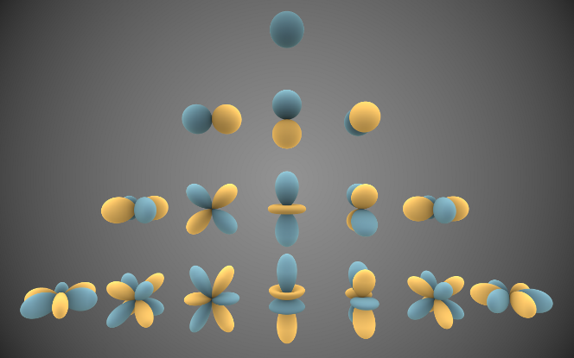
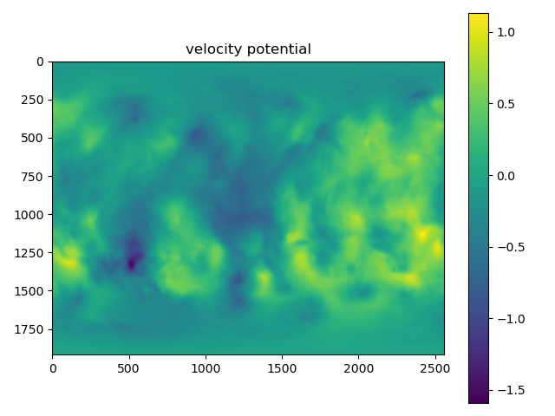
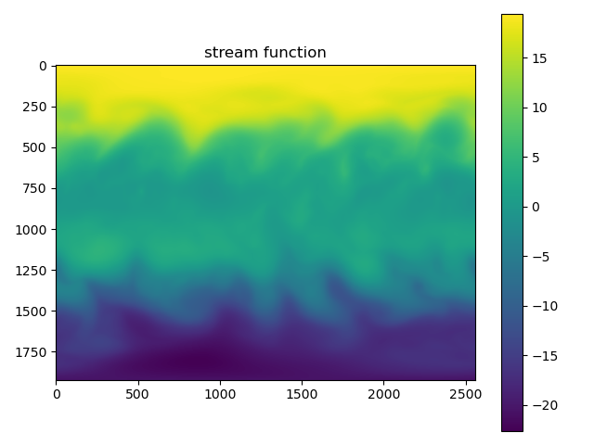
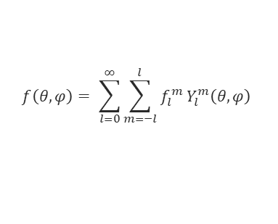

Motivation: Static B
Hardwired to UM
$$f\left(θ,φ\right)= \sum_{l=0}^{∞}{\sum_{m=−l}^{l}{f_{l}^{m} Y_{l}^{m}\left(θ,φ\right)}}$$
$$f_{l}^{m} =\int_{Ω}{f\left(θ,φ\right)}{Y_{l}^{m}}^{∗}\left(θ,φ\right) dΩ$$
l
m
https://commons.wikimedia.org/wiki/File:Spherical_Harmonics.png

Slide 3
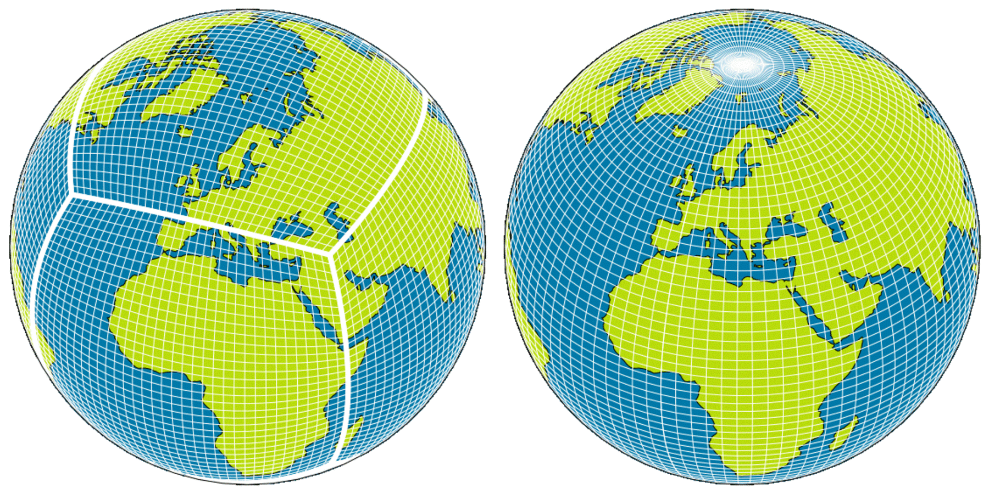
Why Atlas?
LFRic
UM
Quoting Atlas GitHub page:
  “Atlas is a ECMWF library for parallel data-structures supporting unstructured grids and function spaces, with the aim to investigate alternative more scalable dynamical core options for Earth System models, and to support modern interpolation and product generation software”.
Interface with Trans.
Turns a B problem into an interpolation problem.
https://www.metoffice.gov.uk/research/news/2019/gungho-and-lfric

Slide 4
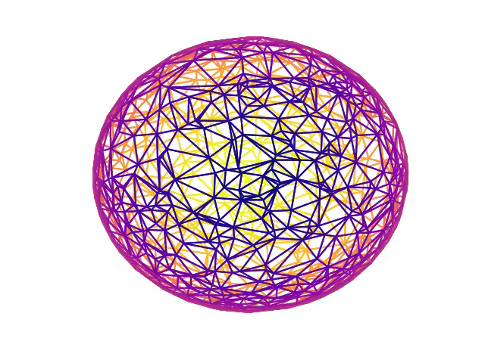
Ingredients of interpolation
Unstructured
  General. Performance considerations.
Structured
  Needs implementation of Atlas data structures:
    Grid (+projection)
    Mesh (+partitioner)
    Functionspace
  Generic interpolation methods work (Plan B).
  Can implement more efficient/accurate methods (Plan A).

Slide 5
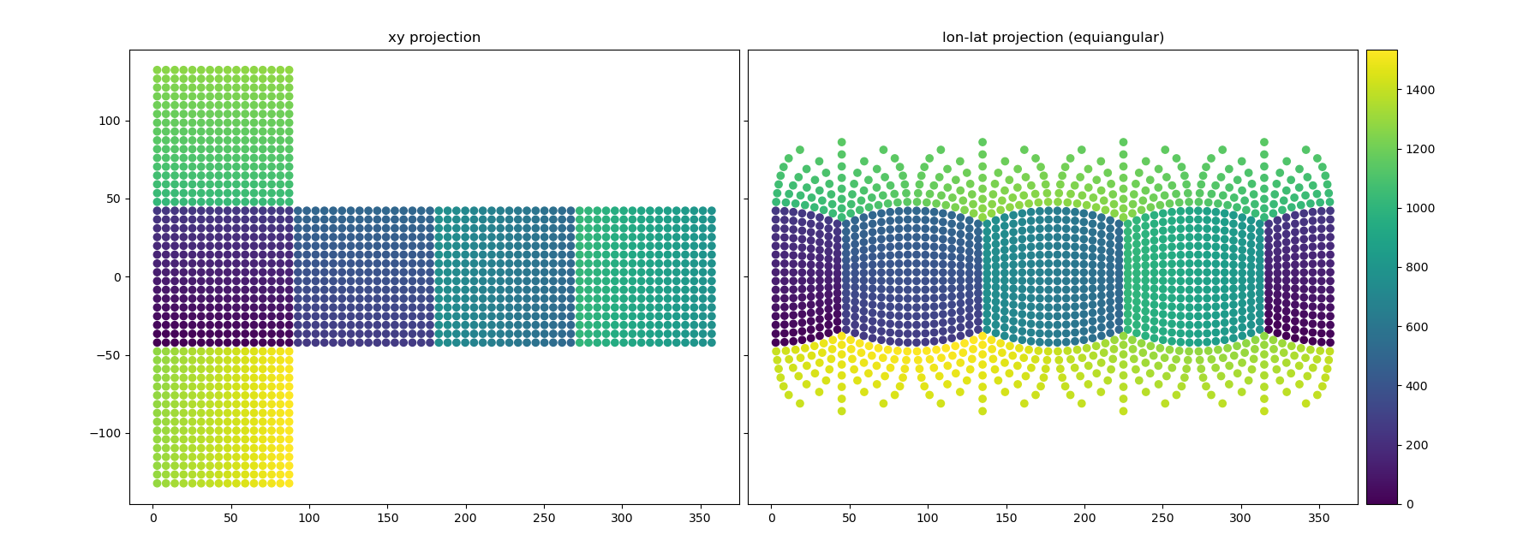
Cubed sphere grid.
y
lat [°]
x
lon [°]

Slide 6
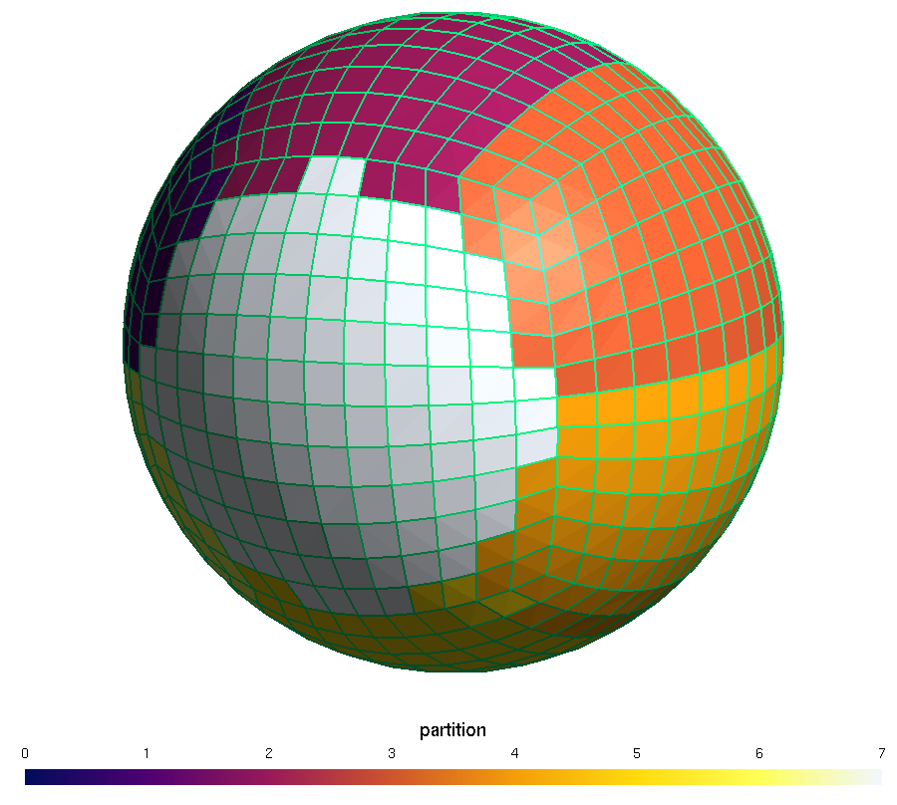
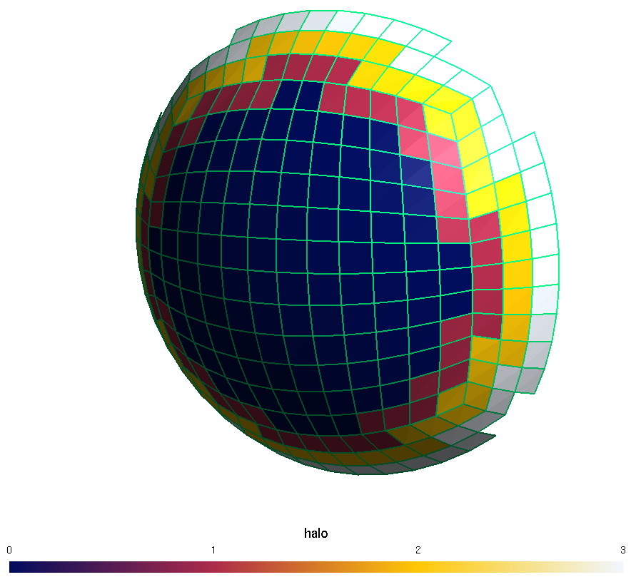
Cubed sphere mesh

Slide 7
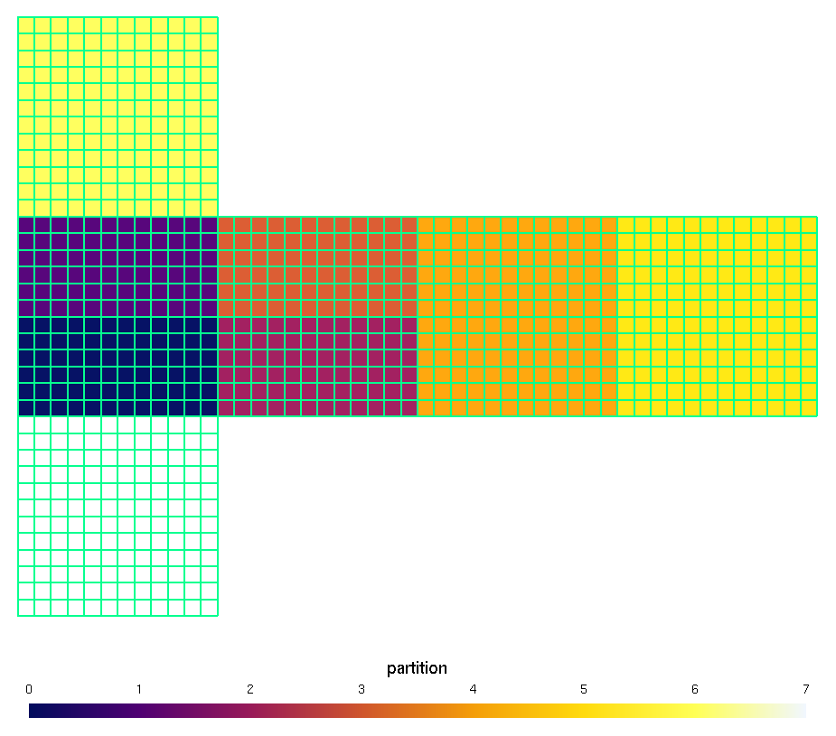
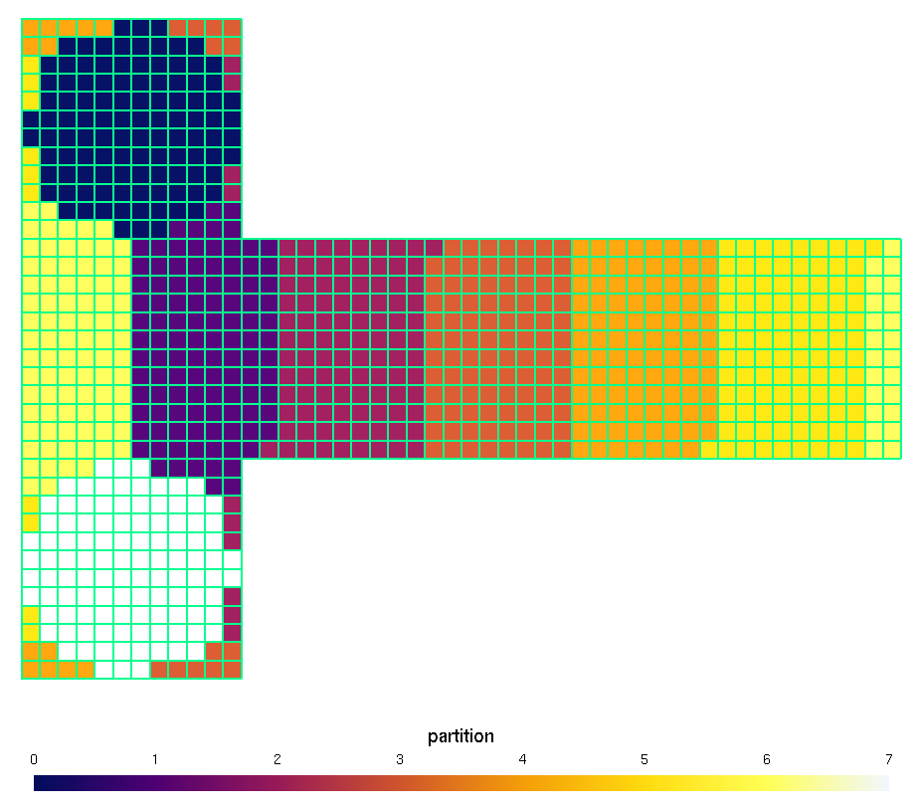
Cubed sphere mesh

Slide 8
Functionspace
t = 0
t = 1
j
k
Mesh
i
CubedSphere
Columns FunctionSpace
index(t, i, j)
parallel_for(f(idx, t, i, j, k))
Field
array_view(idx, k)

Slide 9
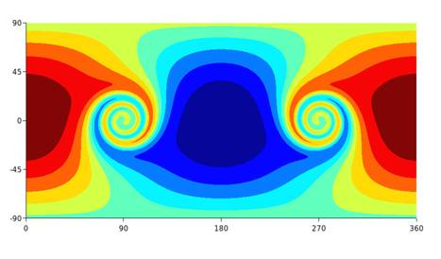
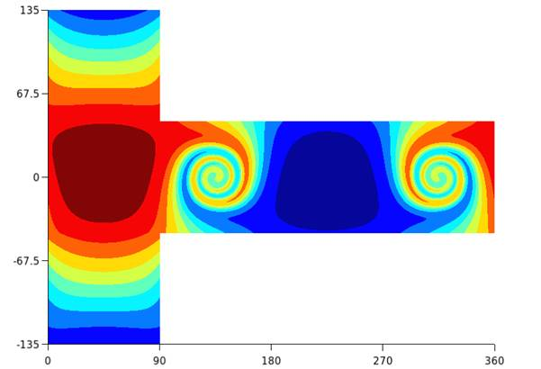
Interpolation
Gaussian grid
CS grid
CS mesh
Cubed Sphere
CS functionspace
+ fields
Other functionspace
+ fields
interpolation
Willem Deconinck, personal communication.

Slide 10
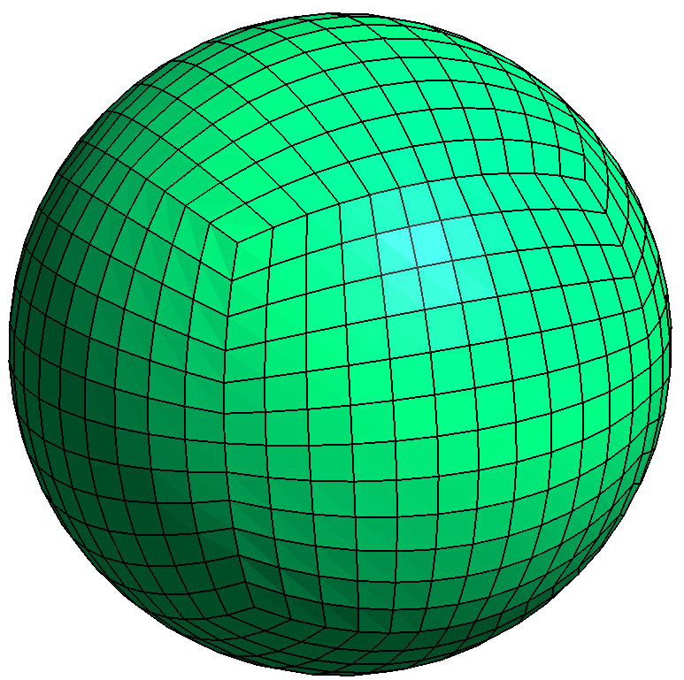
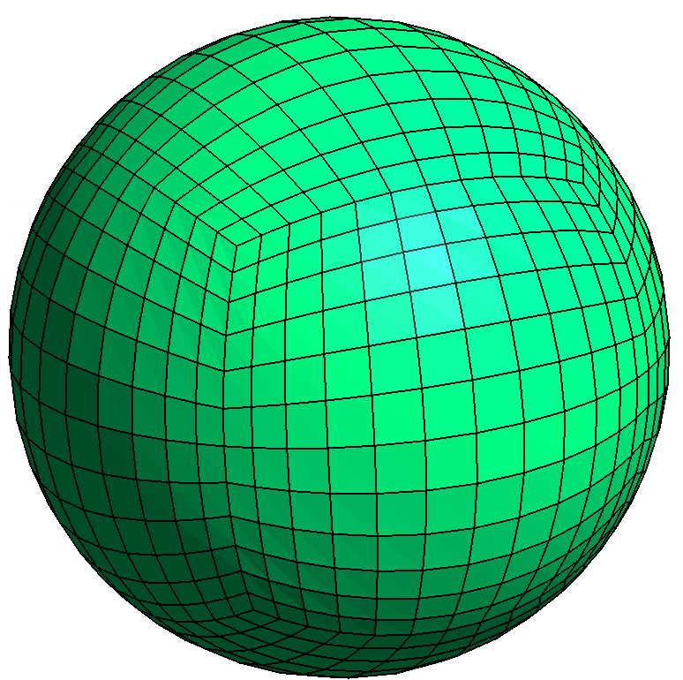
Customisation: projection
Equiangular
Equidistant

Slide 11
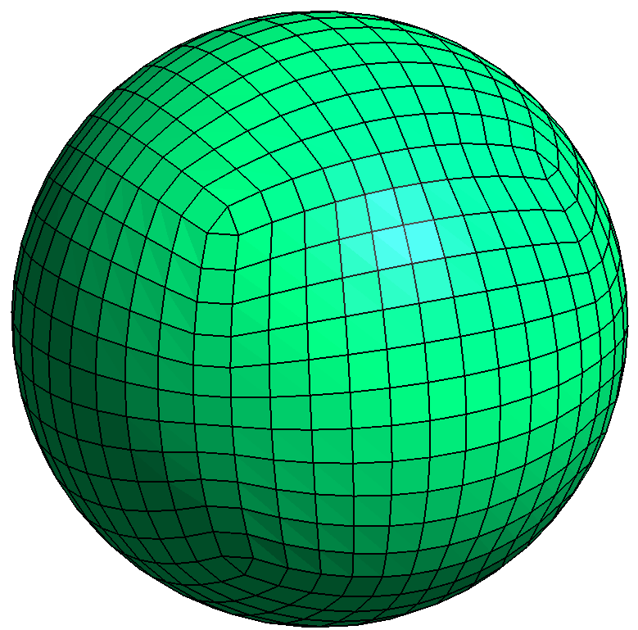

Customisation: dual mesh
Equiangular
Equidistant

Slide 12
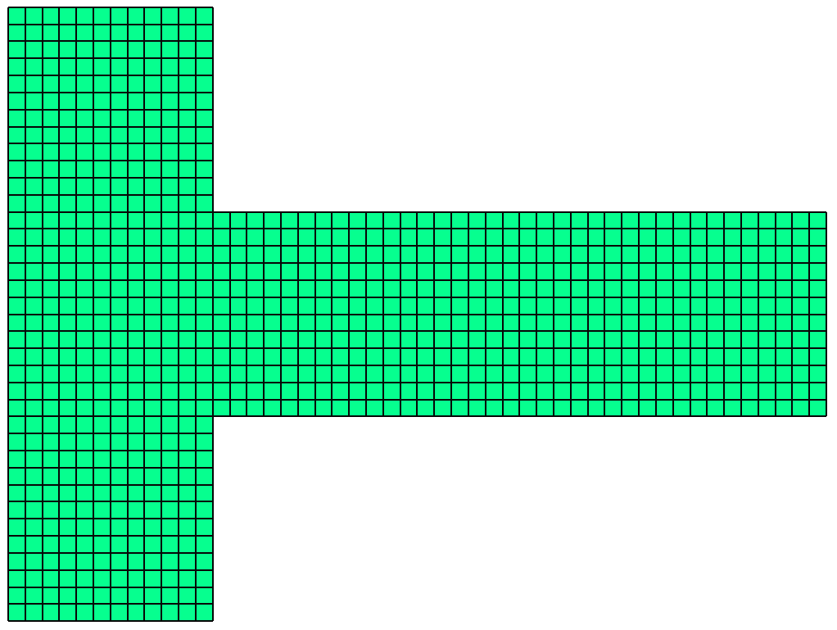
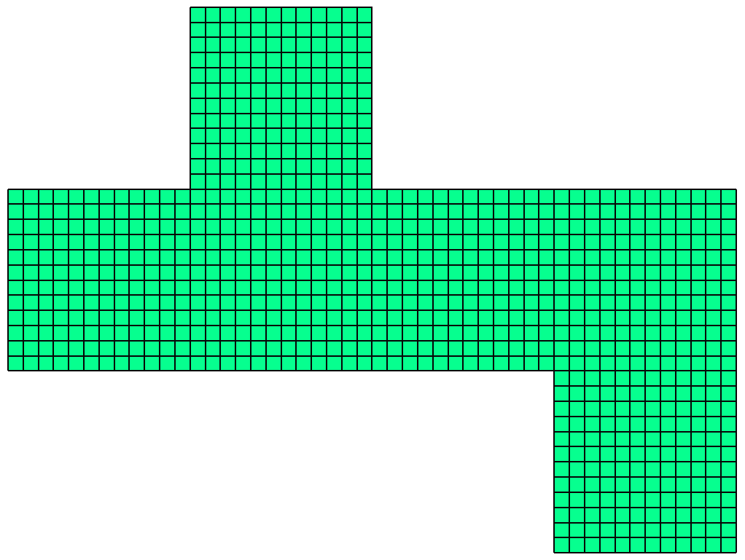
Customisation: tiles
LFRic
FV3
(partially implemented)

Slide 13
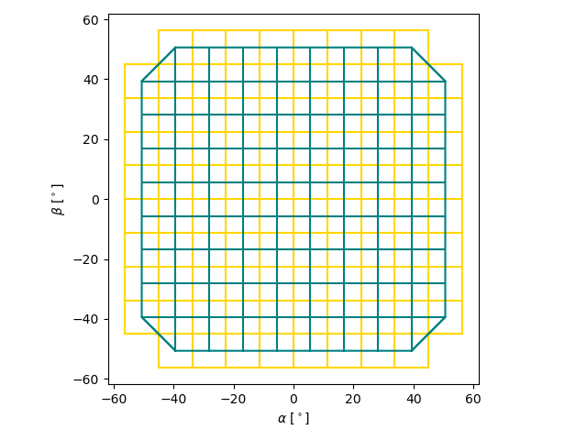
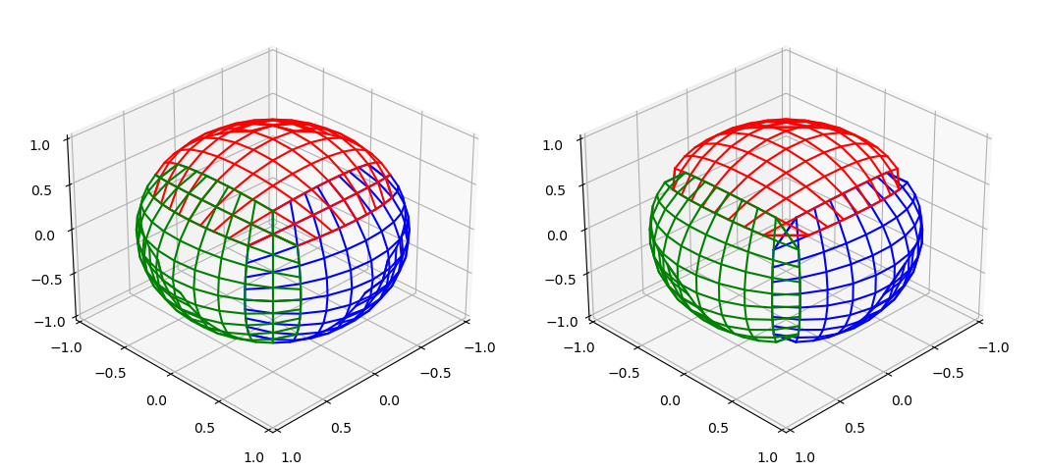
Current work: Interpolation.
Primal mesh
Dual mesh
Primal mesh
Dual mesh

Slide 14
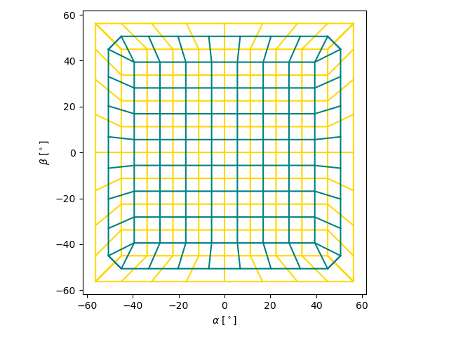
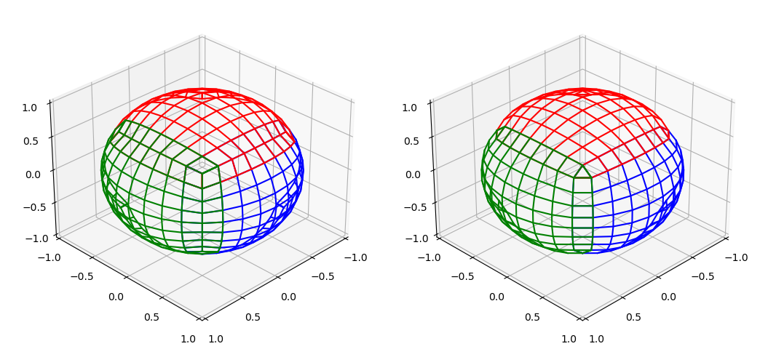
Current work: Interpolation.
Primal mesh
Dual mesh
Primal mesh
Dual mesh

Slide 15
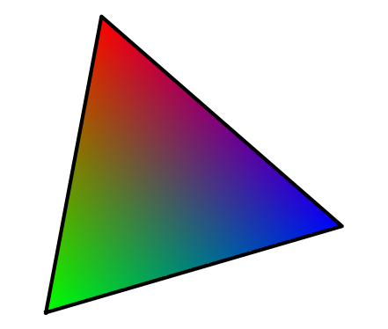
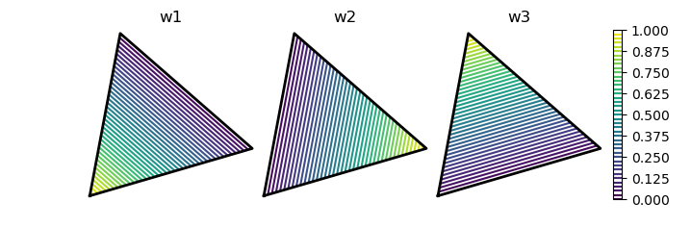
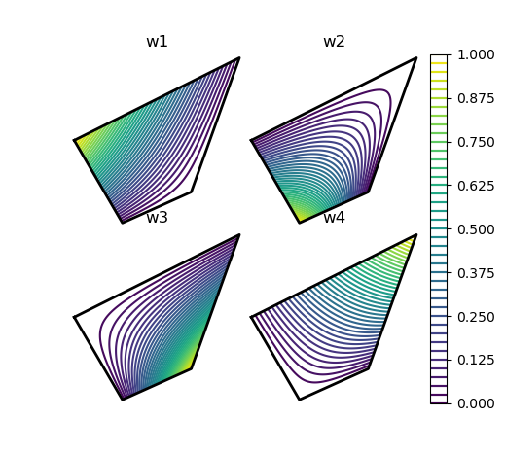
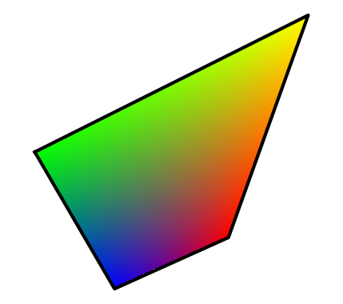
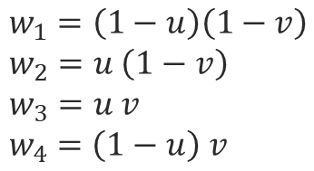

Current work: Interpolation.
3
$$w_{1}+w_{2}+w_{3}=1$$
2
4
1
$$w_{1}=\left(1−u\right)\left(1−v\right) \\ w_{2}=u \left(1−v\right) \\ w_{3}=u v \\ w_{4}=\left(1−u\right) v$$
1
3
2

Slide 16
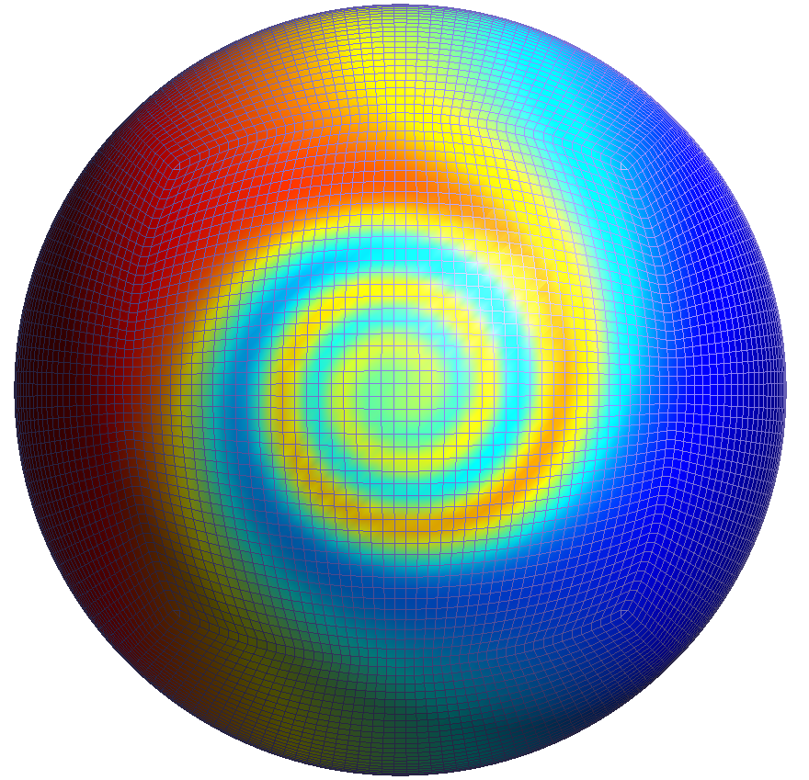
Summary/Further work
Atlas implementation of cubed sphere.
  LFRic implementation with FV3 hooks.
  Atlas interp. methods to CS exist.
  Atlas interp. method from CS scoped.
FV3 Capability.
  Projection.
  Tiles.
  Partitioner (optional).
  Missed anything?
General questions.
  Interest?
  Collocated winds?

