Slide 1
NEPTUNE DA – Top Three Obstacles
We (JEDI-based DA developers) are a very small group. It is hard to simultaneously
  Develop a new data assimilation system based on new (different) software
  Integrate with a new forecast model that is also changing
  Keep up with JEDI which is also changing
JEDI is new software for us – so it is a learning curve for new developers. It will be an even bigger learner curve for OPS.
Our timeline (deadlines) are fixed, so we have to find ways to compromise
  Pre-processed obs
  3DVar vs Hybrid 4DVar
  Re-use Navy Global (NAVGEM) code and diagnostics
  Find equivalent of our “assimilate” files. Temporal variations in obs stream.

Slide 2
An Update on the Navy’s JEDI-enabled NEPTUNE Data Assimilation System
Co-authors: Nancy L. Baker¹, Sarah A. King¹, Elizabeth A. Satterfield¹, Ben C. Ruston², Liang Xu¹, Alex Reinecke¹, James Doyle¹, Justin S. Tsu¹, John Michalakes³, Boon Chua⁴, Ed Zaron⁴
¹U.S. Naval Research Laboratory, Monterey, CA
²JCSDA, Boulder, CO
³UCAR, Boulder, CO
⁴SAIC
Sponsors: Office of Naval Research, NRL
Special Acknowledgements to JCSDA & JEDI Community
NEPTUNE: Navy Environmental Prediction sysTem Utilizing a Nonhydrostatic Engine
10th Symposium on the JCSDA
AMS 2022: January 23 –27, 2021 Virtual
Notes:
This talk will focus on Navy’s focus on develop DA for next gen model Navy Unified model - NEPTUNE - using JEDI
Last slide – acknowledgements

Slide 3
NEPTUNE Data Assimilation Enabled by JEDI
Joint Effort for Data assimilation Infrastructure
NEPTUNE is the Navy’s next-generation unified modeling and DA system
  Applications – global, limited area, coupled, ESPC, ensembles, TC, …
  Many DA components are provided through JCSDA & JEDI
  Initial target for the global model application is 3DVar—eventual target is hybrid 4DVar
  Leveraging community based tools (JCSDA, JEDI, METplus)
NEPTUNE Model
  Three-dimensional spectral element model on a cubed sphere representation
  Fully compressible, deep atmosphere, non-hydrostatic equation set
  Designed to be highly scalable to meet future exascale computational challenges
  NEPTUNE utilizes the common community physic package (CCPP) and the NOAH LSM
  See AMS WAF/NWP: Presentations by Alex Reinecke and Jim Doyle
An Ambitious Timeline …
  Target: Global Atmospheric Prediction System ~ 8 km/100 levels with JEDI-enabled 3DVar
  Code “soft freeze” end of September 2022. Code “hard freeze” for transition testing by the end of March 2023. Code delivery by the end of September 2023
  We have ongoing requirements for development and support of current NWP systems

Slide 4
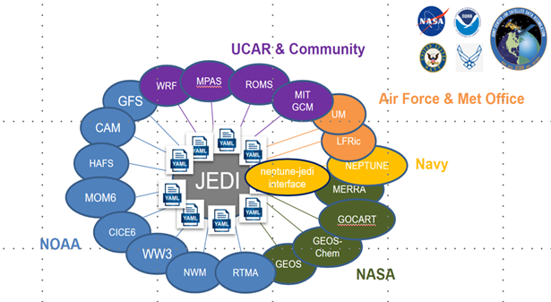
JCSDA Partnership
The need for community partnership for DA grew out of rapidly evolving observing system capabilities and earth system science
NRL is partnering with the JCSDA and the Joint Effort for Data assimilation Integration (JEDI) project to develop, improve, and maintain the common infrastructure required for DA.
We are responsible for the development of the Navy-specific components
JEDI represents a paradigm shift for Navy DA research, development.
One system with multiple configurations for Earth system DA. Share as much as possible without imposing a single approach.
Notes:
Our partnership with JCSDA dates back to 2002
The JEDI effort has enhanced this partnership
The JCSDA JEDI effort evolved from community needs -- as the global observing system and the numerical models continue to evolve and include more components of the earth system, the underlying DA needs to become more complex.

Slide 5
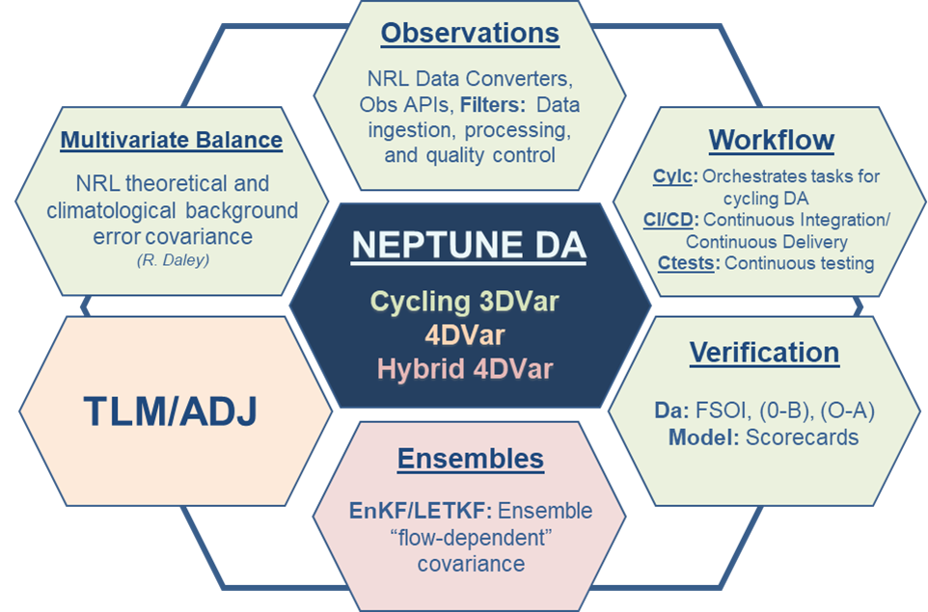
Approach for JEDI-enabled NEPTUNE DA
Compressed timeline → we are adapting Navy NWP components for NEPTUNE where feasible
Observations: Adapt global NWP obs stream
Multivariate static B: adapted NRL static background error covariance
NEPTUNE DA: JEDI 3DVar initially → 4DVar & Hybrid 4DVar
Cylc is used for the cycling DA infrastructure
Diagnostics: Based on NAVGEM and METplus
Forecast verification and scorecards: in progress – mostly python based.
Objective: Develop a flexible and modular system for future NEPTUNE applications – coupled, ensembles, limited area, high altitude…
Notes:
The NEPTUNE model verification will be provided through the NRL-developed Automated Diagnostics System (ADS) Python 3 enabled software originally developed for NAVGEM. This software packing includes scorecard plotting for RMSE and anomaly correlation scores, with additional statistic generated through community developed MET.

Slide 6
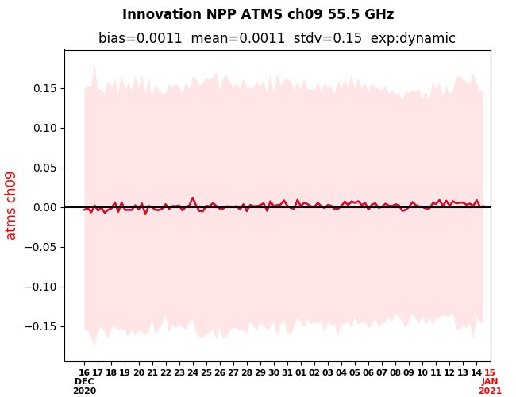
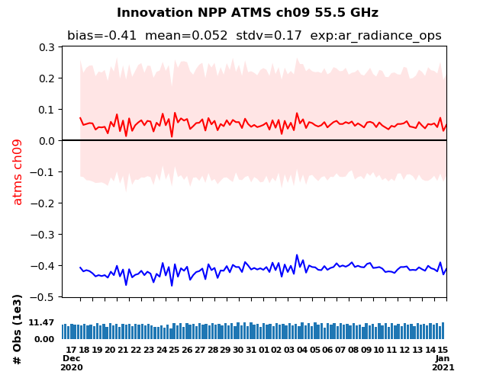
Observations and Diagnostics
Build a flexible observation API to provide system portability (COAMPS®, NAVGEM, NEPTUNE, Navy ESPC)
  Observation decoding, QC, thinning/super obs, etc.
  Approach: For now, use observations that have been successfully assimilated by NAVGEM. Use NAVGEM bias-corrected radiances as the observed value.
Adapt NAVGEM diagnostics for NEPTUNE
  Consistent graphics facilitate comparisons between NAVGEM and NEPTUNE
  Integrated python-based diagnostic tools
  https://www.nrlmry.navy.mil/metoc/ar_monitor/
Utilize NEPTUNE Post Processor (NPP)
  Python-based NPP is used to visualize DA increments, analyses and background fields
Comparable innovation statistics
NEPTUNE
NAVGEM
Notes:
For NEPTUNE DA, a new flexible model agnostic observation API is being built to link the NAVGEM-based observation decoding, ingest, QC to JEDI. Additional NEPTUNE specific QC and filters are then configured with JEDI yamlfiles.

Slide 7
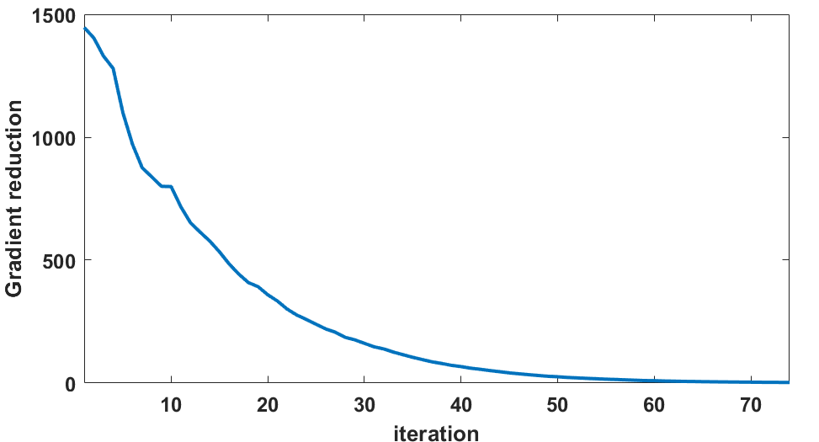
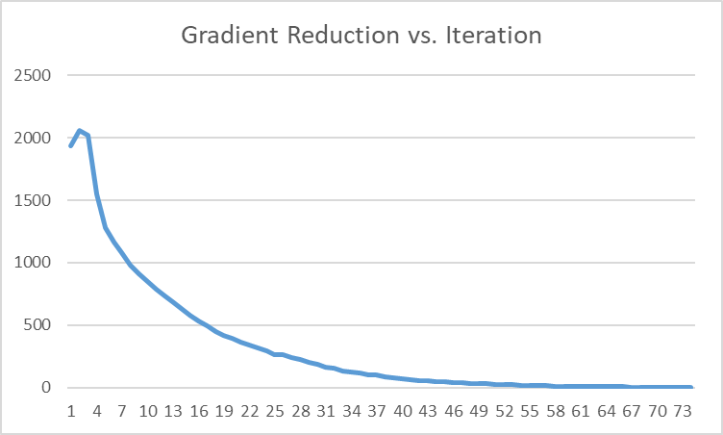
JEDI-enabled NEPTUNE 3DVar – Current Status
Solver
  3DVar (non-FGAT) Derber-Rosati Inexact Preconditioned Conjugate Gradient (DRIPCG)
  Convergence criteria 10⁻³; converges in 75-80 iterations
Status
  We have completed multiple 1-3 month cycling 3DVar data assimilation runs with NEPTUNE
  ~ 1.2M obs assimilated per real-time 6-hr update cycle
  Errors (bias and RMS) are somewhat larger than NAVGEM, as expected for a new forecast model
  DA quality is sufficient to identify/confirm forecast model biases (i.e. to tune physics)
  Initial NAVGEM-based diagnostics integrated with cylc suite (raobs and “radgrams”)

Slide 8
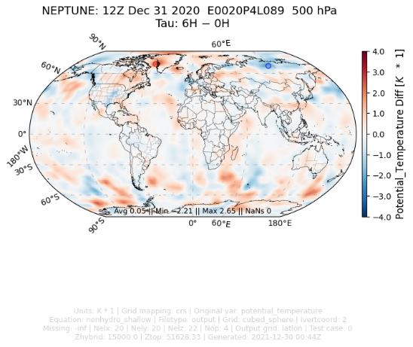
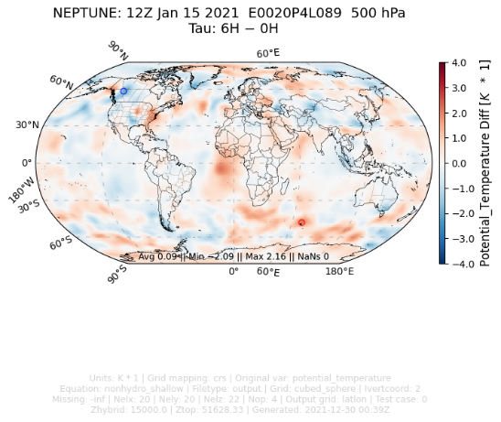
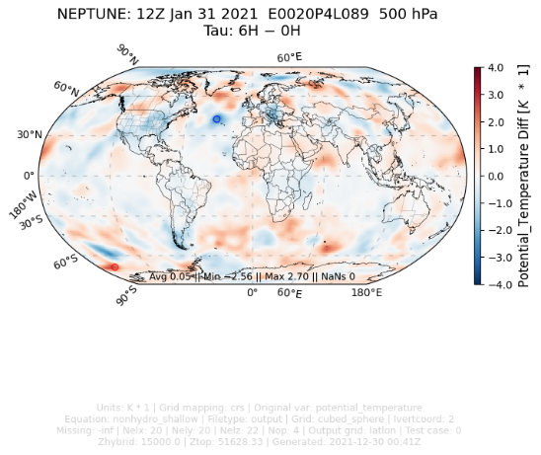
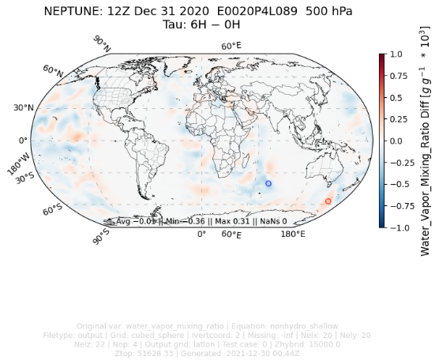
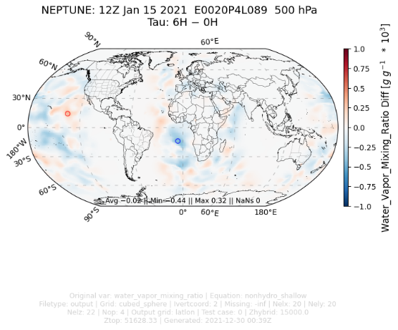
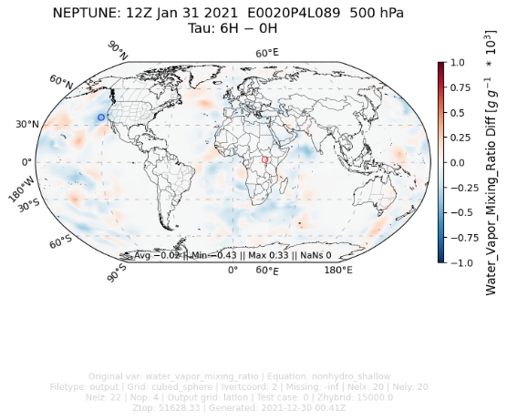
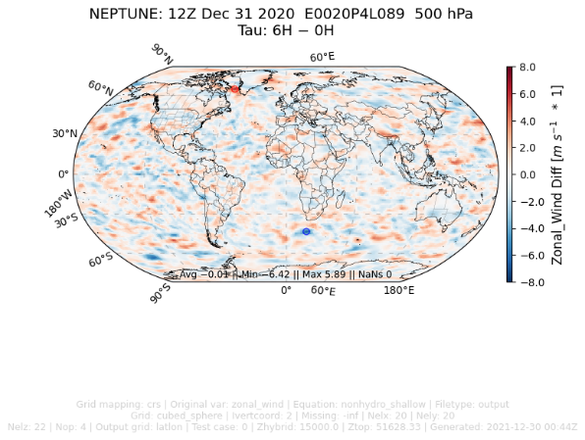
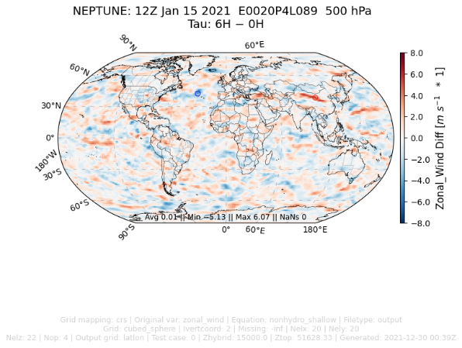
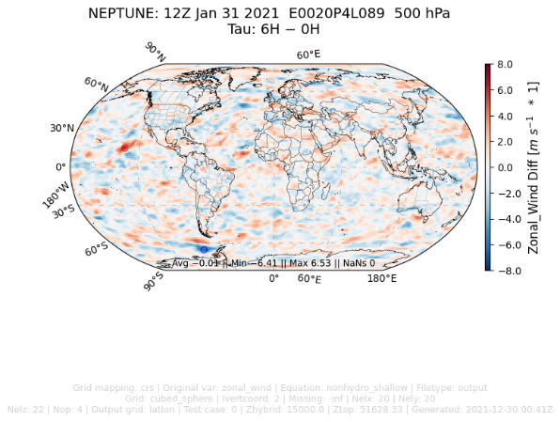
NEPTUNE DA Cycling DA - Current Status
Completed a 3-month cycling DA test
AMSU-A (metop-a, noaa19)
  Assimilate 9-11
  Inflate error (monitor) 4-6,12
ATMS (npp, noaa20)
  Assimilate 8-11, 20-22
  Inflate error (monitor) 4-7, 18-19
Radiosondes (mandatory & significant levels)
  Assimilate T, u, v
  Monitor q (inflate q error)
  Monitor all obs above 10 hPa
Aircraft
  Assimilate u, v only
Satellite AMV (winds; u, v)
  Geostationary (primary agencies)
  Geostationary (CIMMS)
  Polar AMVs
Increments 15 days apart (Dec 31@12UTC; Jan 15@12UTC; 31Jan@12UTC)
Potential temperature:
Mixing ratio:
Zonal wind:
Analysis increments are stable and comparable to NAVDAS-AR

Slide 9
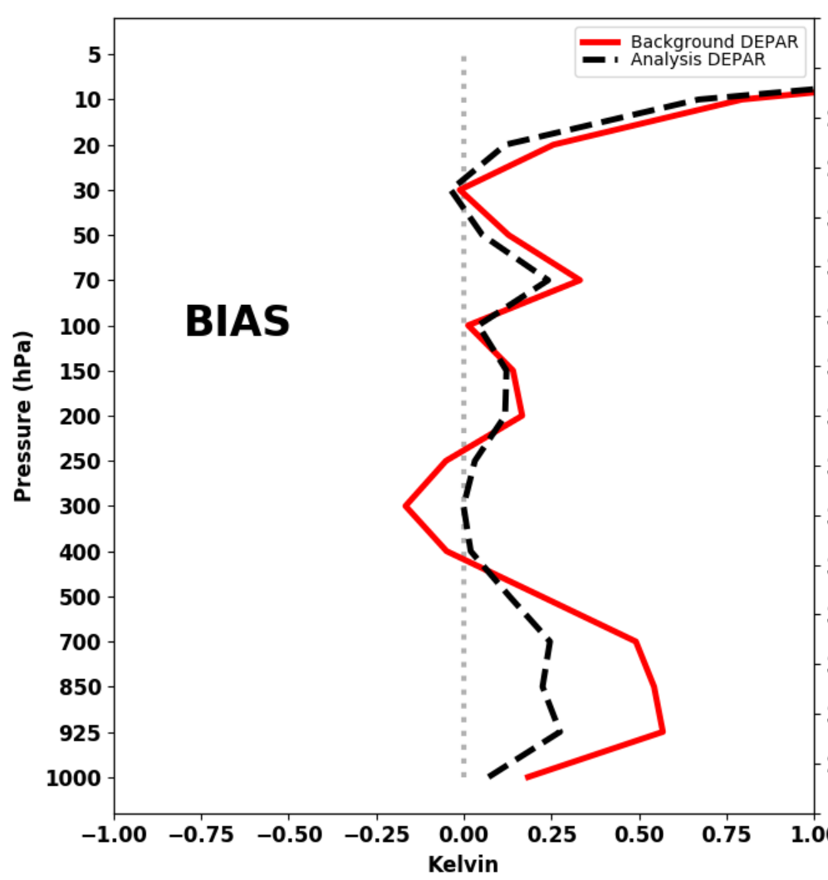
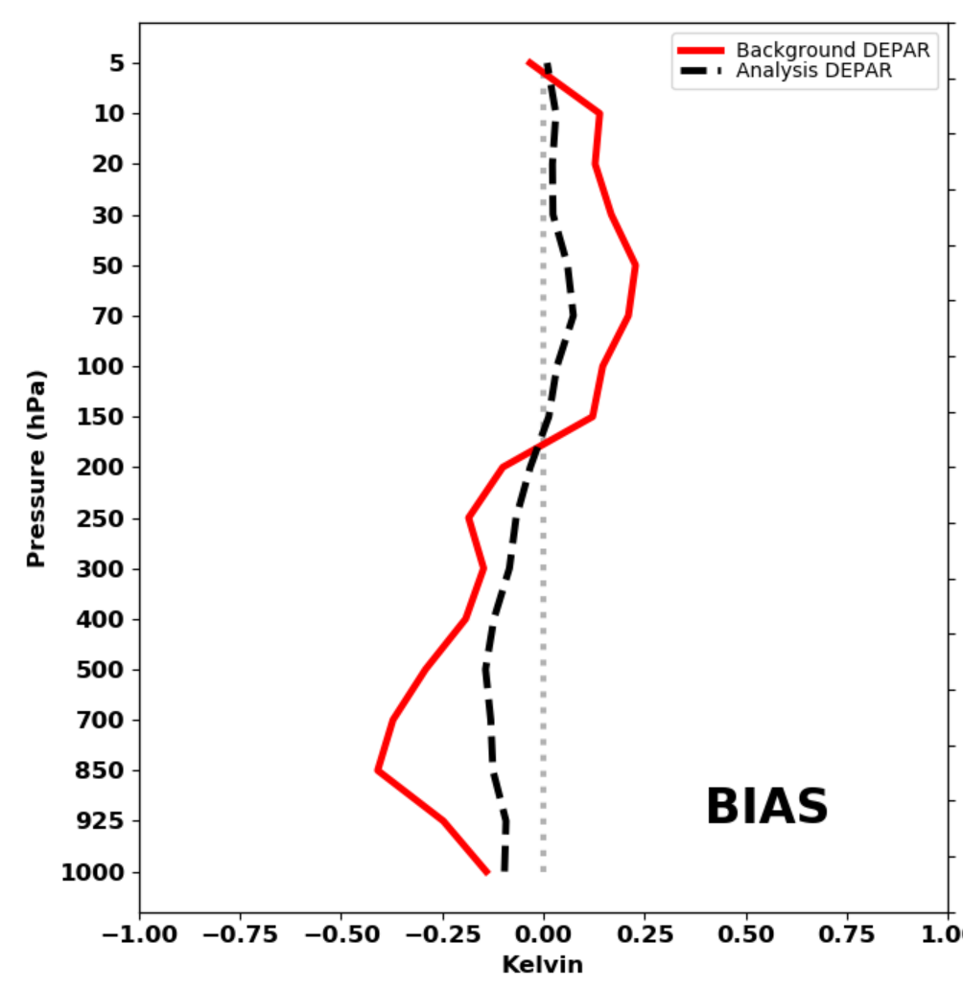
NEPTUNE DA – Radiosonde verification
(O-B; O-A)
NEPTUNE: 30 day average radiosonde global temperature bias (ending on 2021011512)
NAVGEM: 30 day average radiosonde global temperature bias (ending on 2021011512)
Sponge layer: we currently do not assimilate raobs above 10hPa (this will be extended in next model version)
Cold bias in NEPTUNE lower troposphere that is physics related.
---- Observation minus forecast
---- Observation minus analysis
Radiosonde bias and standard deviation are comparable in magnitude to NAVGEM/NAVDAS-AR

Slide 10
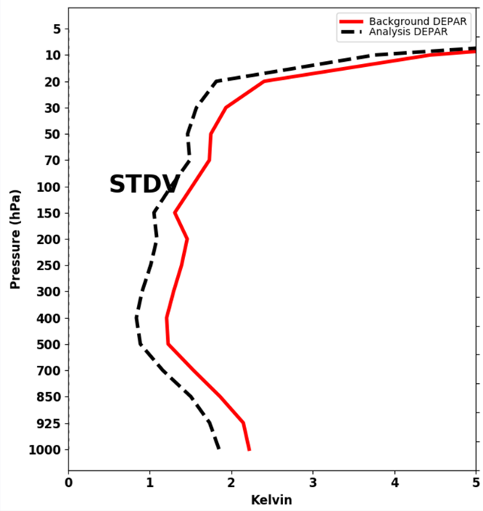
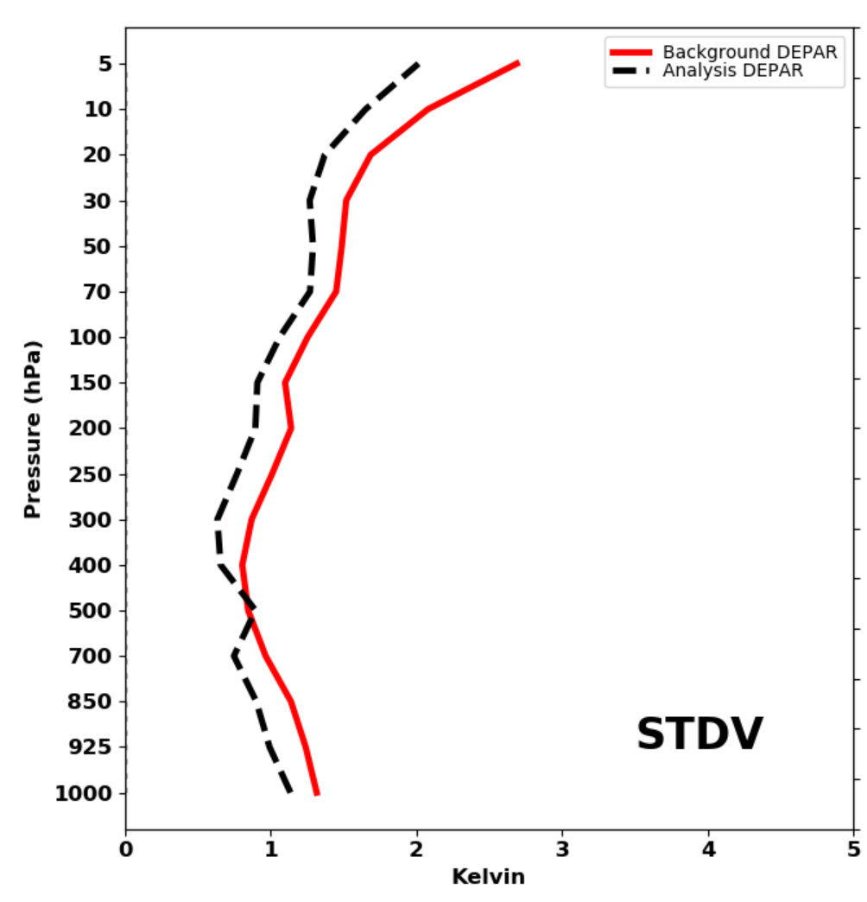
NEPTUNE DA – Radiosonde verification
(O-B; O-A)
NEPTUNE: 30 day average raob global temperature StDev (ending on 2021011512)
NAVGEM: 30 day average raob global temperature StDev (ending on 2021011512)
---- Observation minus forecast
-----Observation minus analysis
Radiosonde bias and standard deviation are comparable in magnitude to NAVGEM/NAVDAS-AR

Slide 11
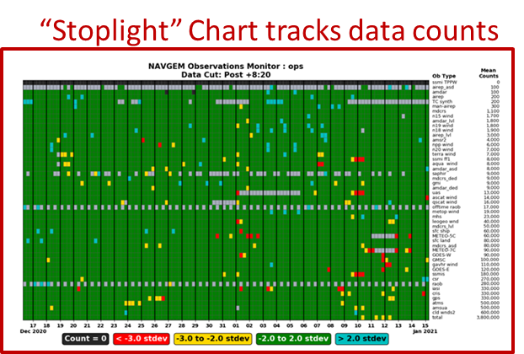
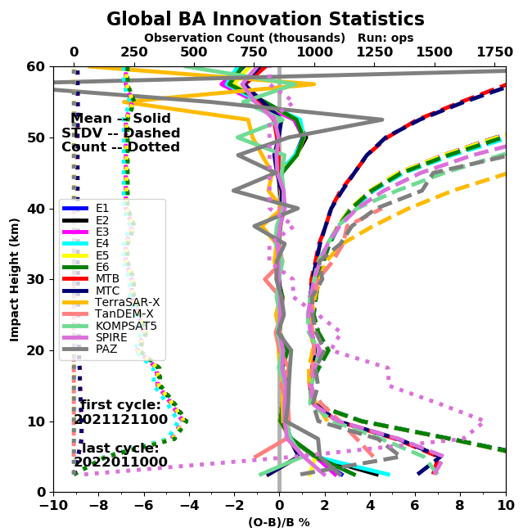
NEPTUNE DA – Next Steps
Observations - move to a less-processed data stream
  Surface observations, including ocean surface winds
  Hyperspectral IR radiances
  GNSS-RO and GNSS-GB
  Variational satellite radiance bias correction
NEPTUNE-JEDI 3DVar
  Column pressure update/increment
  Increase horizontal resolution to 36 km and number of vertical levels to 100
  Refine and tune NRL multivariate static B
Diagnostics: Based on NAVGEM and METplus
  Data count summaries, including QC flag summaries
  Cost function minimization plots
  Integrate with METplus diagnostics
Forecast verification and scorecards
Extensive multi-month cycling experiments

Slide 12
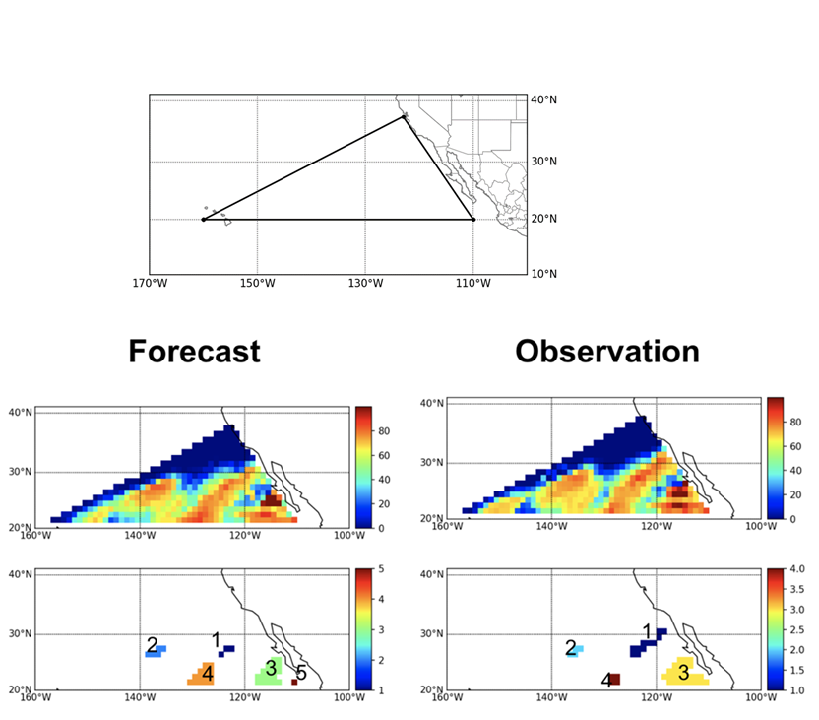
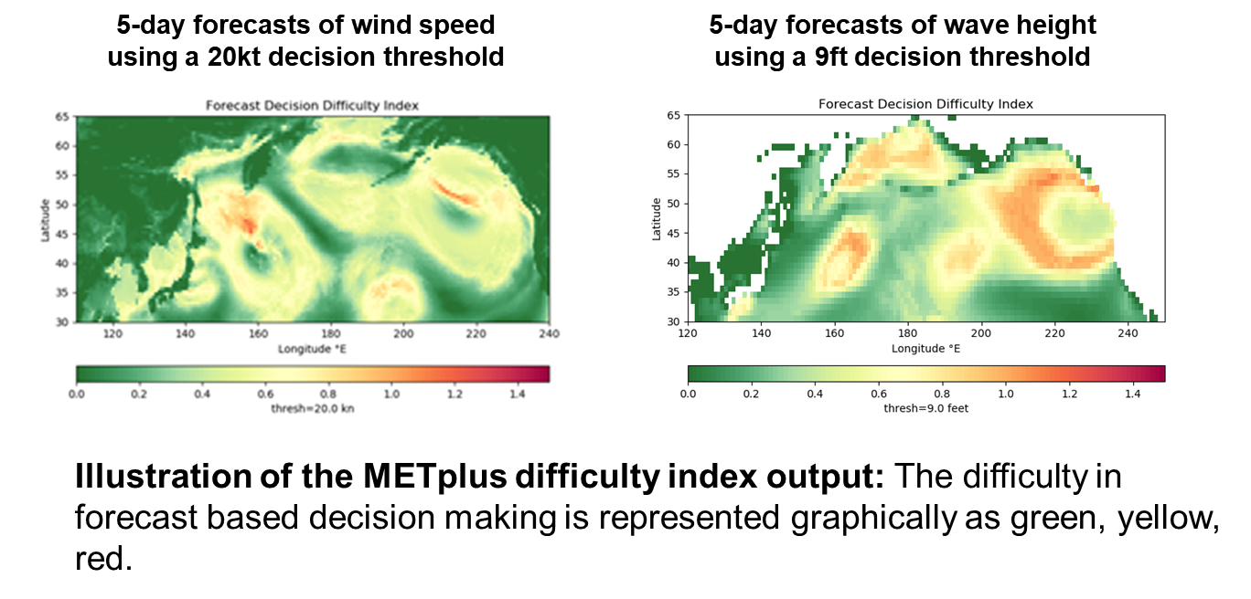
Verification using MET/METplus
Object-based verification
Transition to MET
Forecast Difficulty Index
Example using MODE to compare “regions of interest” between a forecast and observation
Compare object attributes such as size, axis angle, complexity, intensity, curvature
We have tested parameters to optimize identification of cloudy and clear states on global and regional domains
Distribution Statement A. Approved for public release, distribution is unlimited.

Slide 13
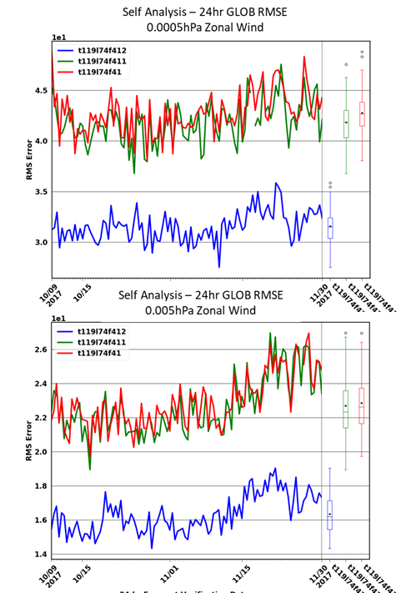
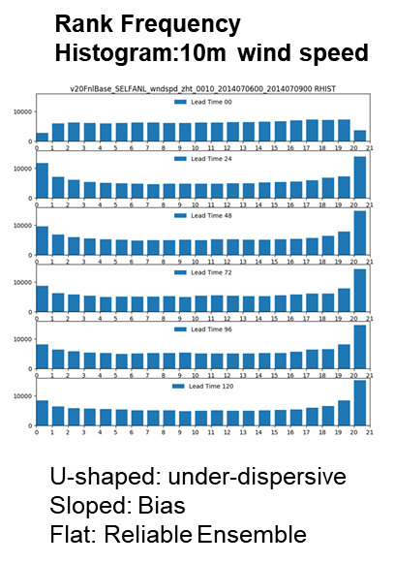
Verification using NRL Automated Diagnostics System
NRL Automated Diagnostics System (ADS)
ADS upgraded to Python 3 and integrated with MET (Singularity build)
Left: ADS software includes scorecard plotting for RMSE and anomaly correlation scores (example is for very high altitude winds). Statistics are generated through MET.
Right: Observation space diagnostics for ensemble evaluation
NRL ensemble evaluation package has been extended to include threshold and probabilistic based metrics
Calculation of receiver operating characteristic (ROC), ignorance score, Brier score, and rank histograms delivery to FNMOC 4QFY21
Distribution Statement A. Approved for public release, distribution is unlimited.

Slide 14

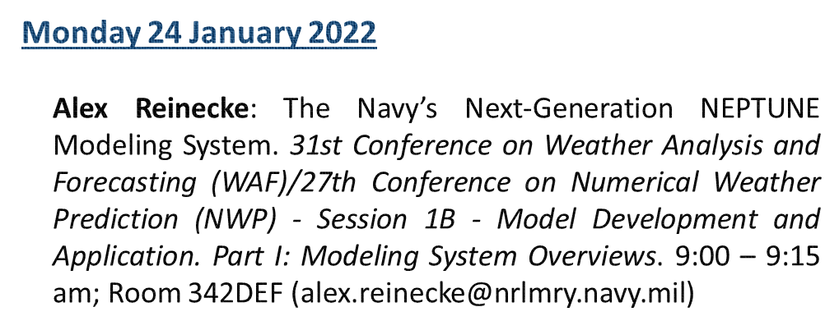
Acknowledgements
Data Assimilation and Infrastructure
Nancy Baker¹
Sarah King¹
Liz Satterfield¹
Justin Tsu¹
Ben Ruston^{1,2}
Bill Campbell¹
Pedro Tsai⁴
Bailey Stevens^{1,4}
Liang Xu¹
JCSDA Core Team
Thomas Auligne
Yannick Trémolet
Ben Johnson
Anna Shlyaeva
Steve Herbener
Fabio Diniz
Francois Vandenberge
And many more …
Modeling and Infrastructure
Alex Reinecke¹
Jim Doyle¹
John Michalakes²
Kevin Viner¹
Matus Martini³
Dave Flagg¹
Sasa Gabersek¹
Boon Chua⁴
Ed Zaron⁴
Phillip Gibbs
Dom Heinsell
Ryan Honeyager
Ben Ruston
Hui Shao
Greg Thompson
Mark Miesch
Dan Holdaway
¹ NRL, Monterey, CA, ²JCSDA, Boulder, CO, ³UCAR, Boulder, CO, ⁴SAIC, Monterey, CA
Notes:
Monday – 4-4:15 pm CST.
4.2 - Implementation and Testing of Physics in the NEPTUNE Modeling System
31st Conference on Weather Analysis and Forecasting (WAF)/27th Conference on Numerical Weather Prediction (NWP)
James D. Doyle (Presenter), Alex A. Reinecke, Michael Diaz (SAIC), Matus Martini (Devine)

Slide 15
Opportunities
  Interested in working for NRL?
    Email: elizabeth.satterfield@nrlmry.navy.mil
    Naval Research Laboratory: https://www.nrl.navy.mil/
    Marine Meteorology Division: https://www.nrlmry.navy.mil/
    Satellite Data Assimilation Specialist & Microwave Remote Sensing and Sensor Calibration/Validation Specialist
Interested in a post-doc at NRL?
    NRC: http://sites.nationalacademies.org/PGA/RAP/index.htm
    ASEE: https://nrl.asee.org/
Interested in a summer internships & work at NRL?
    NREIP: https://nreip.asee.org/
    SSEP: https://www.nrl.navy.mil/careers/students/ssep/

