Slide 1


UFS R2O
Sergey Frolov
On behalf of the UFS R2O DA/R&R team
Presented at: JCSDA special topic meeting on cycling DA
Jan 31, 2022

Slide 2
Disclaimer
I will share experience of our team:
  successes and challenges.
This is not a criticism:
  Instead: looking for a better way to work together.

Slide 3
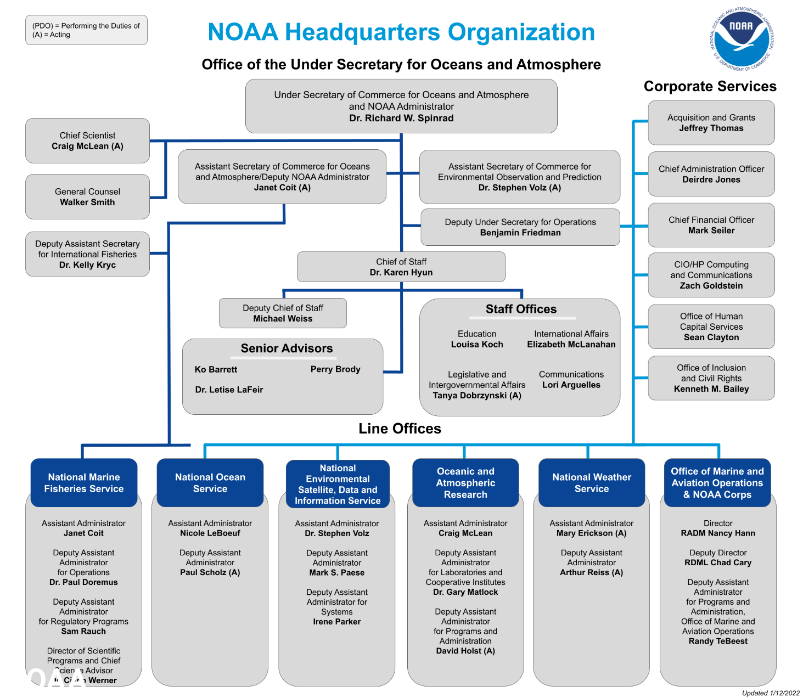
Research to operations in NOAA
Contributions from external collaborations
UFS R2O

Slide 4
UFS R2O project
Project leads
Whitaker, Tallapragada, and Kinter
NWS/OSTI OAR/WPO
Sims, Huang, and Kondragunta
Project Engineers
Adimi and Kumar
MRW/S2S Integrated Application Team (including T&E)
Mehra/Stan
SRW/CAM Integrated Application Team (including T&E)
Alexander/Carley
Hurricane Integrated Application Team (including T&E)
Z. Zhang/X. Zhang
Data Assimilation, Reanalysis & Reforecast
Kleist/Frolov
Application Support
Wolff/ Bernardet
Modeling Infrastructure
Dunlap/ Chawla
Verification & Post-Processing Infrastructure
Levit/Jensen
Atmospheric Composition
Stajner/Frost
Marine Components
Meixner/ Hallberg
Atmospheric Physics and Dynamics, (including stochastic physics & land)
Yang/ Bengtsson
Focus of this team is on global systems
(cycling prototypes for GFSv17, GEFSv13) and
enabling JEDI transition across applications (global and regional).

Slide 5
Integration challenge
Series of cycling prototypes
(currently at 1° weakly coupled UFS/3DVAR)
GSI
FV3-JEDI
SOCA
UFS prototypes
JCSDA-obs
EMC infrustr.
Land init.
EMC obs.
UFO transition
…
Can use more coherence
(needs a team to develop
a series of prototypes)
Haven't started integrating some of siloed work yet

Slide 6
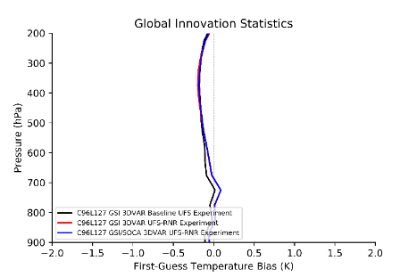
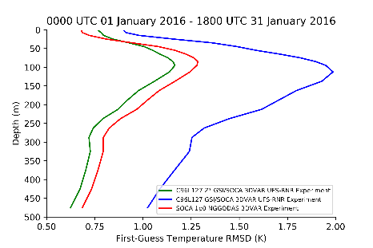
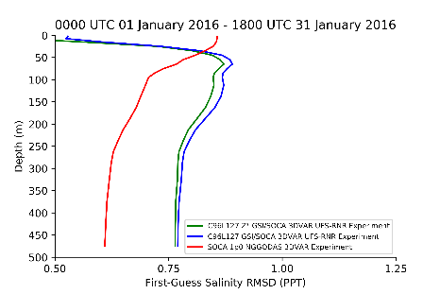
Integration challenge
Discrepancy between UFS config used by SOCA team and UFS team
GSI
SOCA (T)
NG-GODAS, UFS RnR
SOCA (S)
NG-GODAS, UFS RnR
Series of cycling prototypes
(currently at 1° weakly coupled UFS/3DVAR)
GSI
FV3-JEDI
SOCA
UFS prototypes
JCSDA-obs
EMC infrustr.
Land init.
EMC obs.
UFO transition
…
Can use more coherence
Haven't started integrating some of siloed work yet

Slide 7
Integration challenge
Discrepancy between UFS config used by SOCA team and UFS team
GSI
SOCA (T)
NG-GODAS, UFS RnR
SOCA (S)
NG-GODAS, UFS RnR
Current status of coupled cycling:
Runs with the latest stable UFS (B7c)
GSI: replicates uncoupled run
SOCA temperature: ok
SOCA salinity: needs work
SOCA ice: ok
UFS land: needs work (fractional grids, NOAH-MP)
Next steps:
Cycling fv3-jedi GETKF with radiosondes.
Longer runs with higher resolution (using GSI/SOCA).
Shorter runs in full hybrid configuration (using GSI/SOCA).
Series of cycling prototypes
(currently at 1° weakly coupled UFS/3DVAR)
GSI
FV3-JEDI
SOCA
UFS prototypes
JCSDA-obs
EMC infrustr.
Land init.
EMC obs.
UFO transition
…
Can use more coherence
Haven't started integrating some of siloed work yet

Slide 8
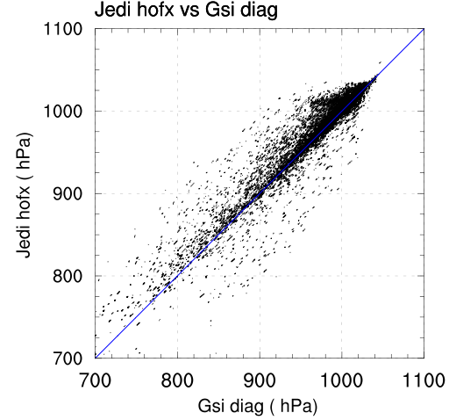
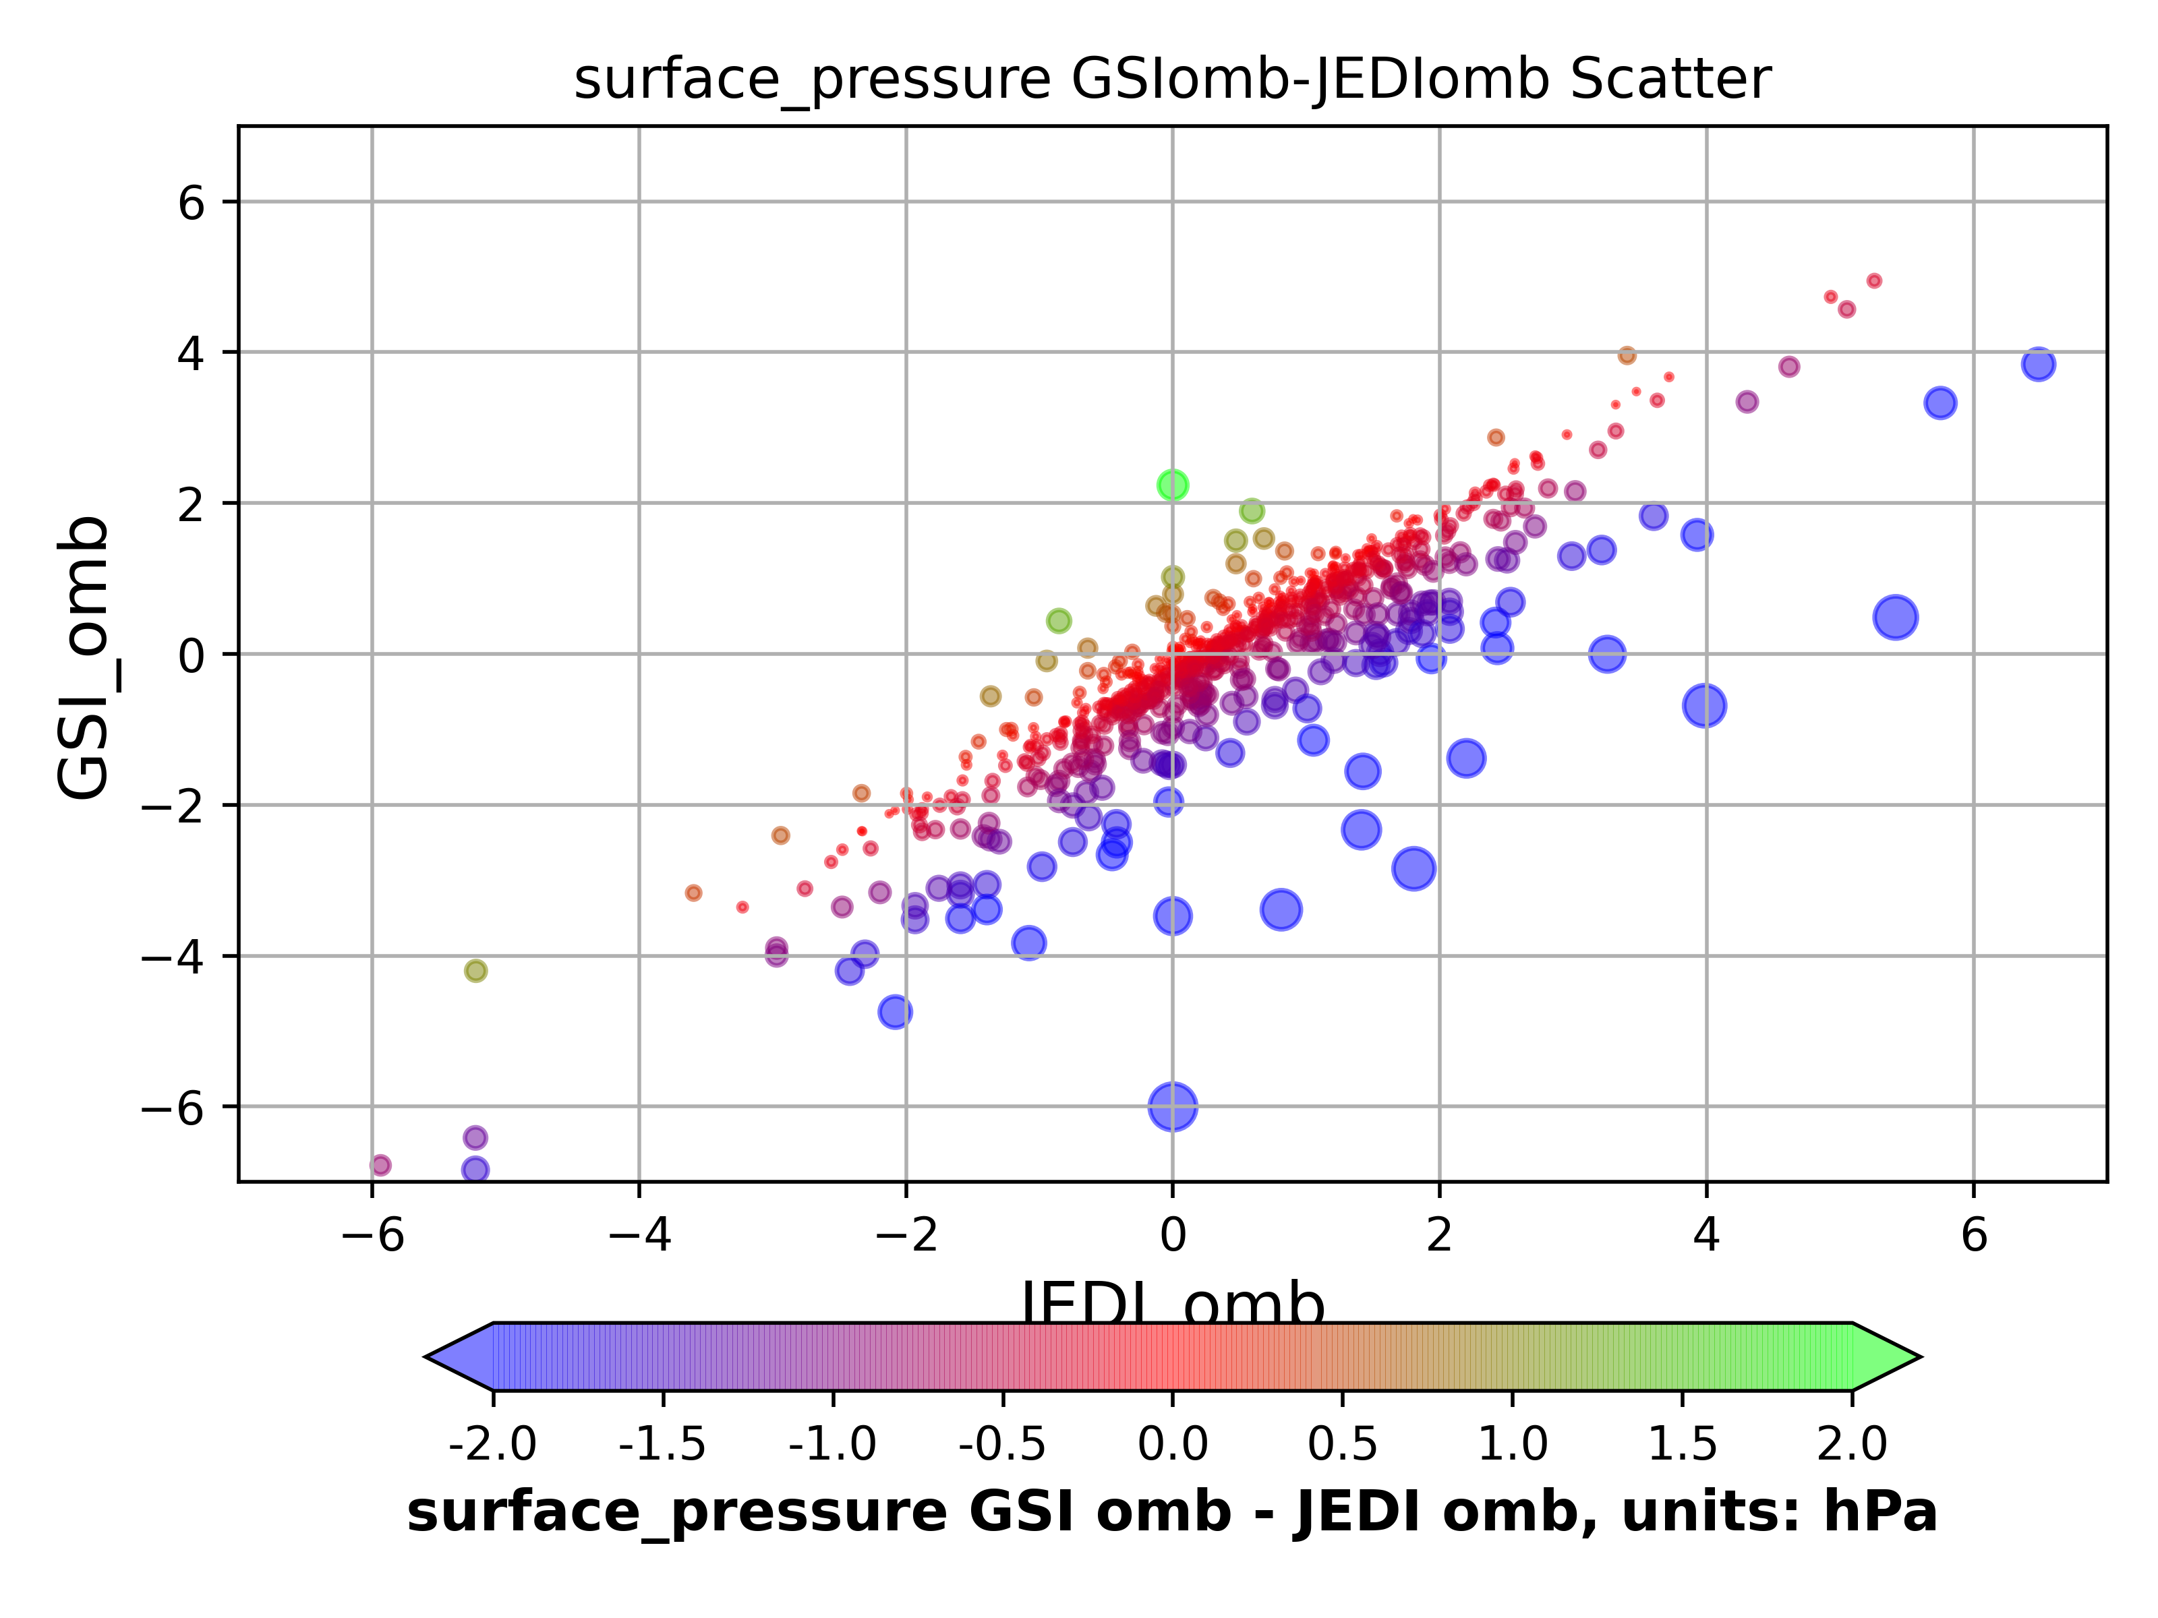
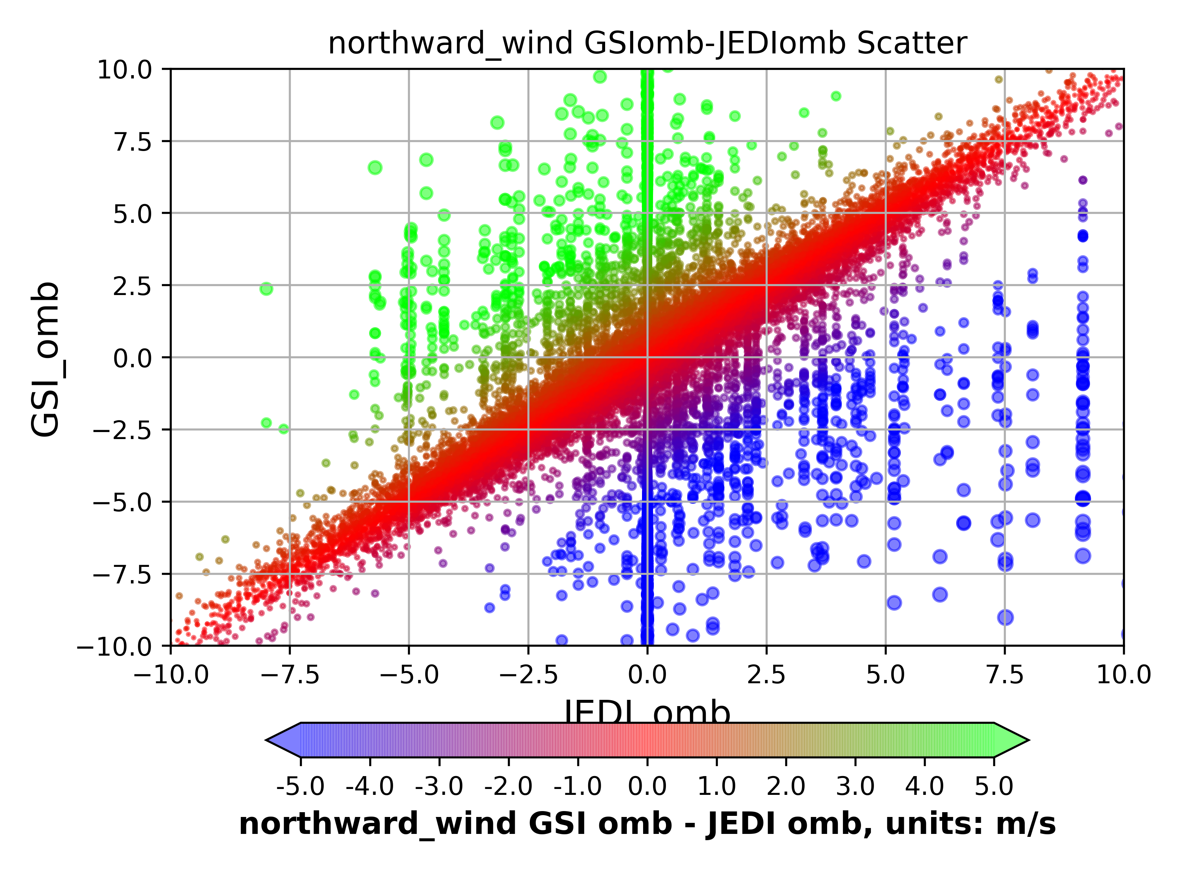
Status of fv3-jedi getkf testing
Plot made by UFO transition team
Plot made by GETKF testing team
Instruction:
  Use yaml files from ufo/ewok in your experiment.
Reality:
  UFO yaml were not tested extensively for radiosondes.
  UFO yamls miss half of raob T from NCEP files.
  UFO testing is relaying heavily on geovals from GSI.
Next steps:
  Working with Cory to develop better yamls and diagnose source of large discrepancies in UFO ombs.
Overall, GETKF testing is a success:
  Caught several “bugs” specific to GETKF: (obs distribution, QC, surface pressure localization).
  Identified discrepancies between GSI and UFO ombs that need addressing.

Slide 9
Obstacles for existing experimentation
No efficient forum to talk across development teams:
  Will be great to be aware of successes/challenges/best practices at other centers.
  Communicate/negotiate priorities to team leaders.
  Ideally a small forum (maybe no more than 10 invites?)
Unified plotting/diagnostic libraries will be very helpful:
  Shared tools/best practices for UFO and solver testing across centers.

