Slide 1

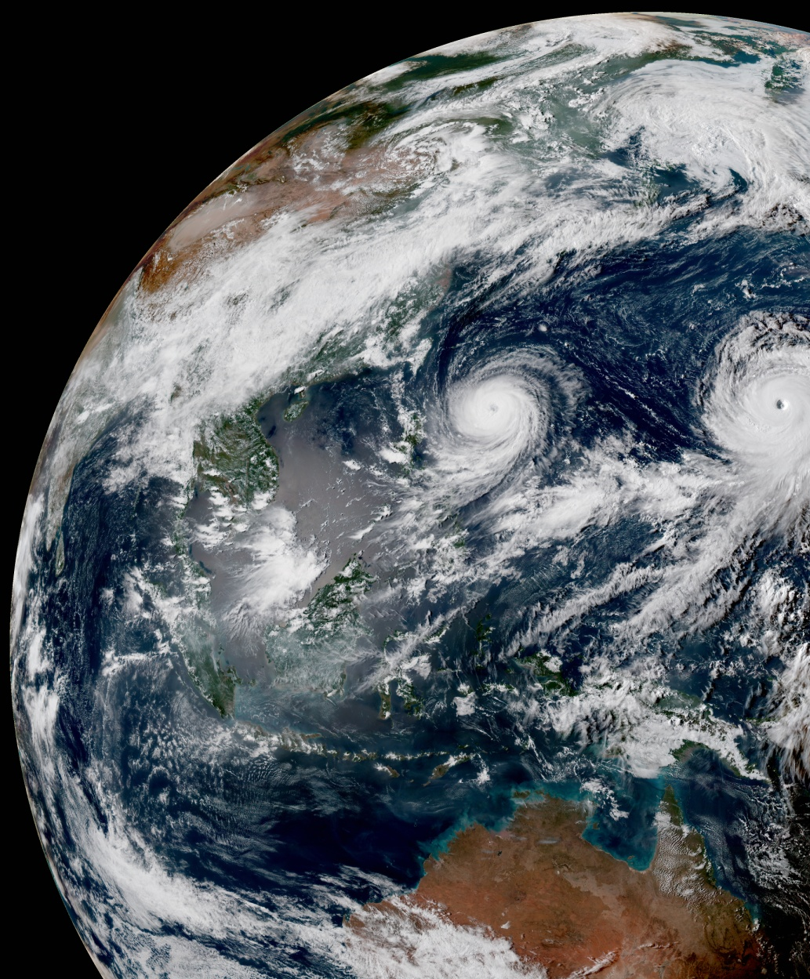
Introduction to VADER
Steve Vahl, JCSDA

Slide 2

Overview
What is VADER?
  Purpose
  Components
How does someone use VADER?
How does VADER work?
How does someone contribute to VADER?
Current and Future capabilities

Slide 3

Meet VADER
What is VADER?
  VAriable DErivation Repository
  VADER is a new repository that will implement variable changes in a model-agnostic way, so that all models can use them.

Slide 4
Why VADER?
Currently, there is duplication of common variable change code in different models.
A variable change implemented in VADER can be used by any model.
For new models there is less code to implement.
All the models and core team can share the tasks of troubleshooting, maintaining, and optimizing this common code.

Slide 5
Cut to the chase
So how would a model use VADER?
Because VADER is model-agnostic, the model must communicate using a generic language.
In JEDI, that usually means ATLAS. (Fields and FieldSets).
So your model must implement <set/to/fromAtlas> for the State class.*
*OOPS interface still being designed.

Slide 6
Code for calling VADER
The changeVar method in vader does the work.
The VariableChange class is still needed in the model. It is this class which instantiates VADER and makes the call to changeVar.
After the call to changeVar, the model class variable change code can continue, almost unaltered, to perform the variable changes that VADER didn’t do.
Note: The FieldSet passed to VADER must contain allocated Fields for both the variables currently in the State, and also those that are desired from VADER.

Slide 7

VADER Preview
Workflow for calling VADER:
Model Variable Change
(VariableChange.cc)
VADER
Model Variable Change calls State/Increment “toAtlas” method
Passes Atlas FieldSet and Variable list to VADER
VADER creates as many variables in the list as it can
Model Variable Change calls “fromAtlas” method
VADER passes FieldSet and list of remaining variables back
Converts remaining variables

Slide 8
Example from FV3
// Call Vader to perform first set of variable transforms
// ------------------------------------------------------
// Make sure state contains fields for all the variables (input and output)
x.updateFields(allVars);
// Create fieldset to pass to vader
std::unique_ptr<atlas::FieldSet> xfs(new atlas::FieldSet());
x.setAtlas(xfs.get());
x.toAtlas(xfs.get());
// Call vader
oops::Variables neededVarsLongVader = neededVarsLong;
vader_.changeVar(xfs.get(), neededVarsLongVader);
// Back from Atlas
x.fromAtlas(xfs.get());
Thanks to Dan Holdaway. Snippet from VariableChange::changeVar in fv3jedi/VariableChange/VariableChange.cc in feature/vader branch.

Slide 9
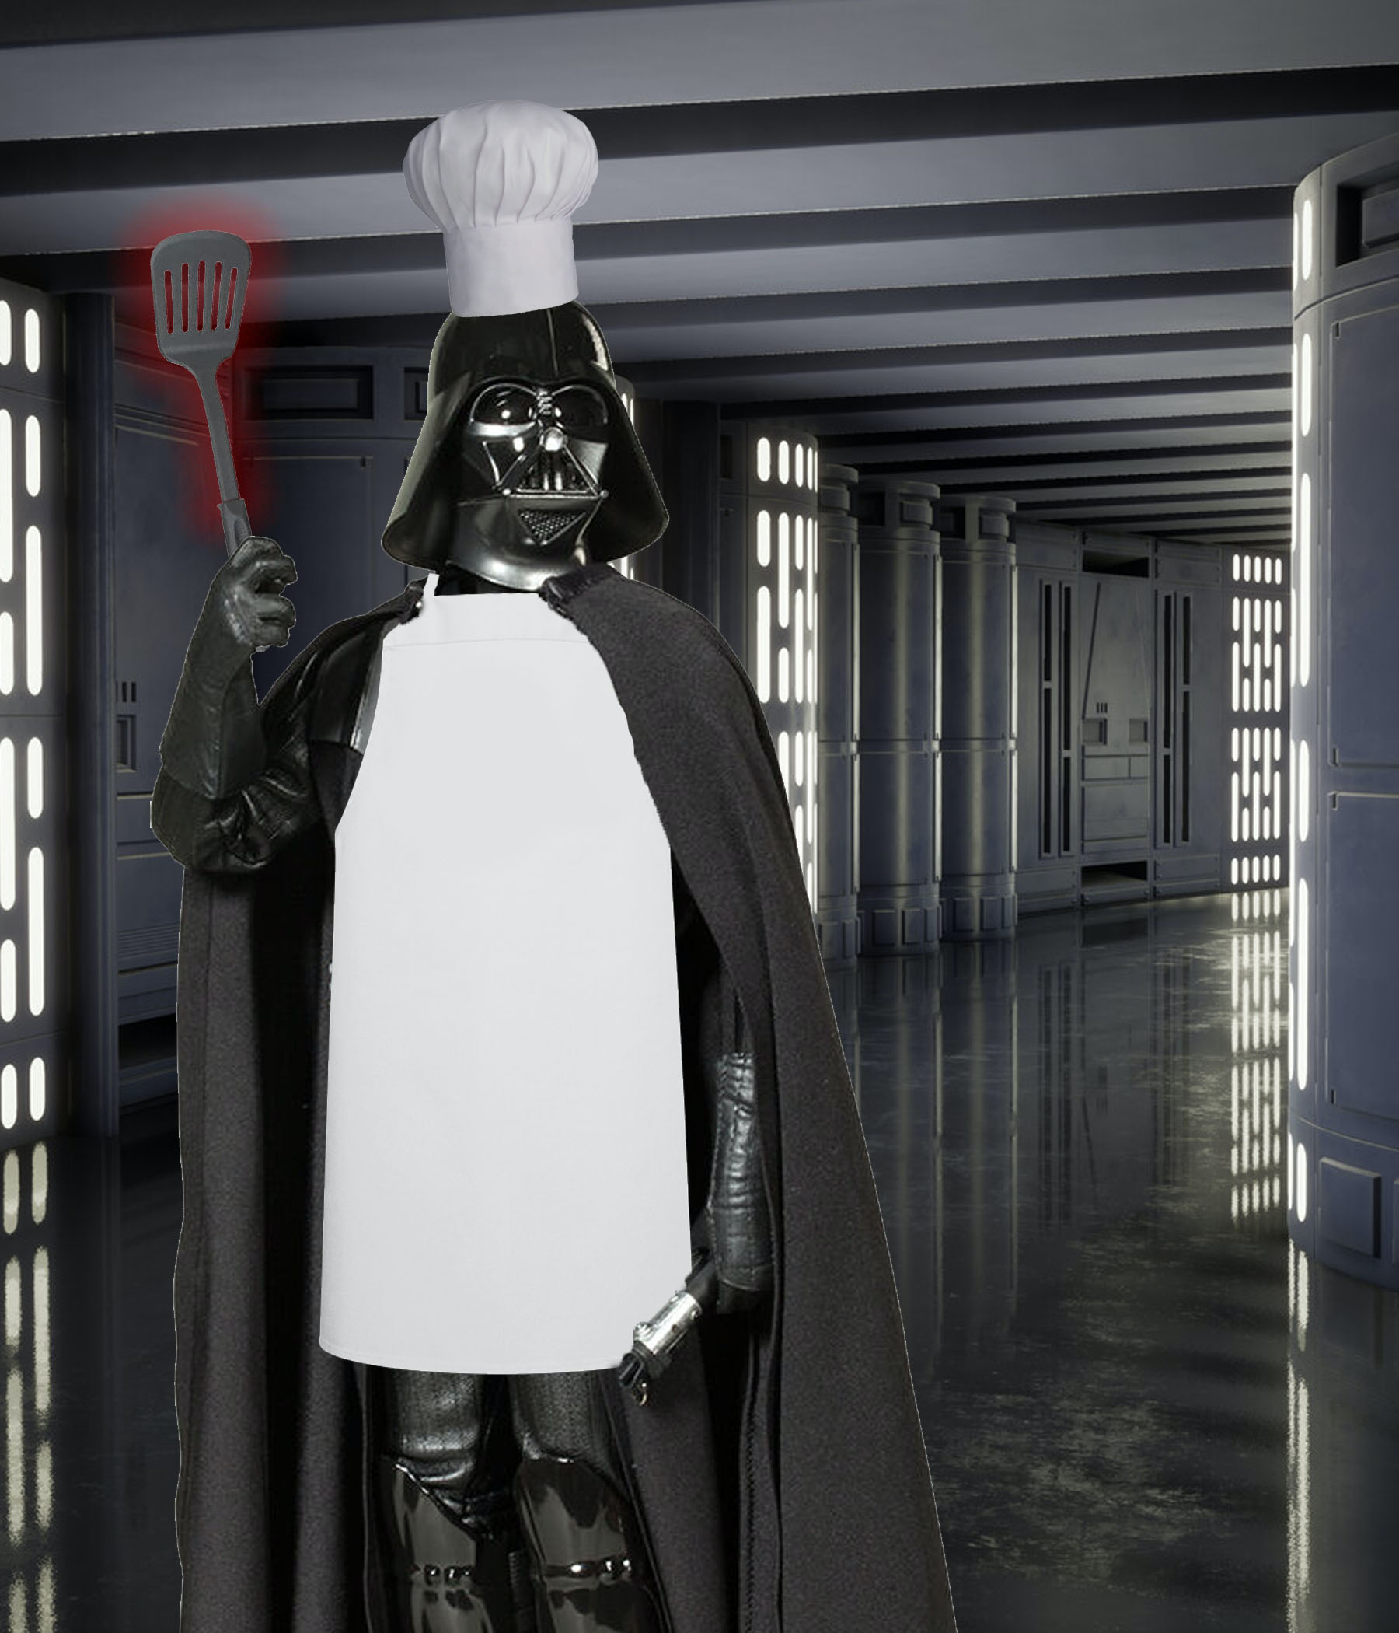
Vader design metaphor
How does VADER work?
Peeking into the kitchen…

Slide 10
VADER design metaphor
VADER code uses a recipe/cookbook metaphor.
Has “Recipes” to produce individual variables. (Vader supports having multiple recipes that produce the same variable.)
Recipes provide a list of their required “ingredients” (input variables).
Recipes are put in a “cookbook” that defines which recipes are attempted and in what order.
VADER has a default cookbook, but (in coming functionality) it can be configured by the caller.

Slide 11
Current Vader Algorithm
Loop through list of all caller-requested variables
Target Variable
(trying to make)
Untried Recipe for variable in cookbook?
Target Recipe
(trying to execute)
Yes
No
Vader can’t make variable or ingredient.
Variables not produced are kept in the list returned to caller
No
Have all ingredients for recipe?
Yes
No
Call algorithm recursively to attempt to create missing ingredient.
Execute Recipe. Variable is calculated and populated in FieldSet.
Variables produced are removed from the list returned to caller

Slide 12
Contributing to Vader
Create a recipe:
  Similar factory architecture used as for ObsOperators in UFO.
  All Recipe classes inherit from RecipeBase
  A couple of examples in: src/vader/recipes
Add Recipe to Cookbook:
  src/vader/cookbook.h
More detail provided in this document

Slide 13
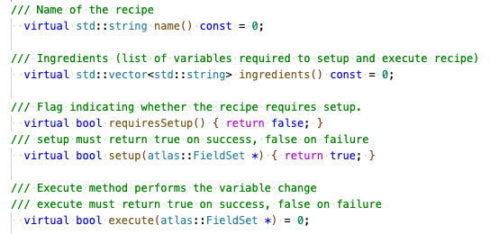
A look at RecipeBase

Slide 14
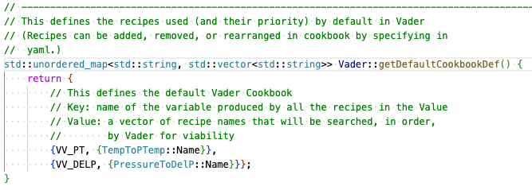
A look at the cookbook
(For now, variable string names are defined in src/vader/vadervariables.h)

Slide 15
VADER design principle
Can be “plugged in” without configuration or knowledge of recipes or cookbook.
At worst, it simply doesn’t execute the Recipe, and variable stays in the list.
No RequiredParameters for Recipes
  Provide a default configuration, or do nothing if this is impossible
Default cookbook

Slide 16

Capabilities
Vader is still young and training…

Slide 17
Design aspects still in progress
Variable names – standards discussions in progress
Recipe names
State and Increment interface for to/fromAtlas

Slide 18
Capabilities
Currently has:
  Functionality to support non-linear variable changes that do not require Geometry information.
Does not have:
  Linear variable changes
  In-repository ctest harness for Recipes
  Recipe library
  Ability to custom configure the cookbook
  A lot of real-world testing yet

Slide 19
Timeline for Coming attractions
When will <missing functionality> be ready?
Still determining staffing resources for more core VADER functionality development.
Recipes supported by current functionality can be submitted as PR’s now.

Slide 20
Questions

