Slide 1

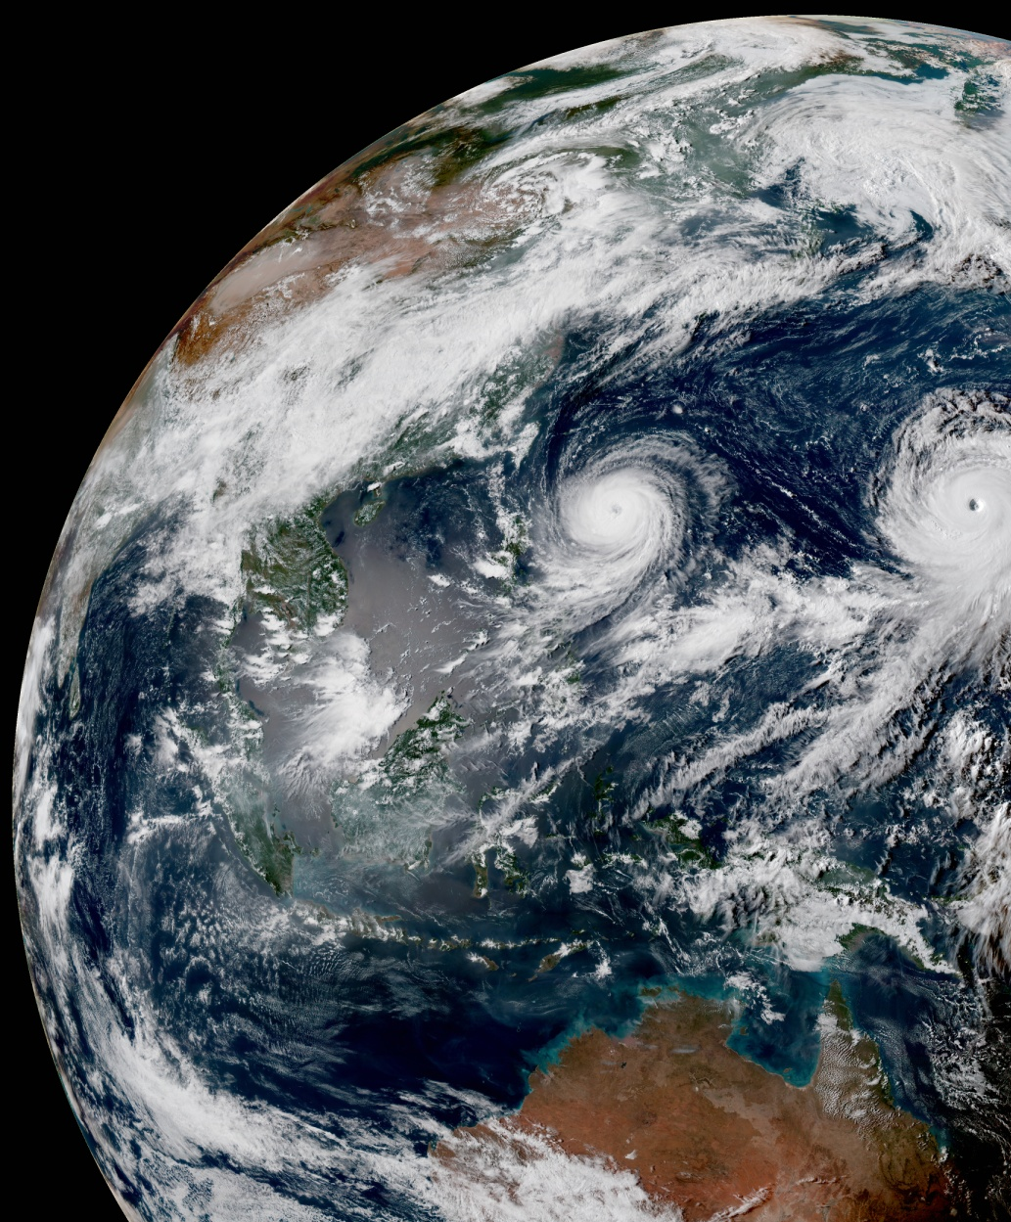
Model Variable Naming Standard
Steve Vahl, JCSDA
8 Sept 2022

Slide 2
Why now?
JEDI components are being created/enhanced that manipulate model variables in model-agnostic code, creating the need for model-agnostic model variable names.
VADER
SABER

Slide 3
What are the choices
As I looked into possible existing standards, I only found two name-standard possibilities:
  CCPP Naming Standard
  JEDI Observation Variable Naming Standard

Slide 4
CCPP
Names developed for use with Common Community Physics Package
CF Naming-compatible
Designed for use with physics packages
Example name: air_potential_temperature
Also has documented guidelines for the creation of new names, which are approved via PR to the CCPP repository.
See Github: ESCOMP/CCPPStandardNames

Slide 5
JEDI Obs Variable Naming
JEDI Obs Team has developed a naming standard being used with IODA and UFO variables.
Example name: potentialTemperature
Names were developed through meetings.
See the JCSDA JEDI ReadTheDocs. Search for “Convention Tables”

Slide 6
Considerations
Some people seem to not care much about the names. ”It’s just a string”.
Some people do:
  Name length vs. clarity
  Consistency across JEDI
  Since neither standard has all the names we’ll need, what is the process for adding new names? How many meetings and person-hours are required?

Slide 7
Today’s Proposal
Proceed with the CCPP Naming Standard
  Long names
  In some cases won’t be consistent with Obs name for the same thing
  Clearly defined rules for adding new names
  Also a defined process for both new name approval, and also new rules approval
  Only metadata is the Units

Slide 8
Conclusion
Questions? (Please remember to use “Raise Hand” feature.)
Debate?
Unanimous approval?

