Slide 1
Using Postgres/PostGIS for WFSRI
Kajal Claypool, Oliver Newell
19 Nov 2009
Notes:
1
1

Slide 2
WFS Specification at a Glance
Basic WFS:
  “Read-only”
  Disseminates geographic features and associated attributes for analysis and display
  Supported Operations:
    getCapabilities – retrieves a listing of services offered by a given server
    describeFeatureType – retrieves a description of the available feature types
    getFeature – retrieve a collection of features from a given feature type (Filtered or not)
    ** Supports OGC Filter Specification
Transactional WFS (WFS-T)
  Supports Basic WFS + CRUD operations on geographic feature instances
    Insert
    Update
    Delete

Slide 3
NNEW – WFS Extension
Subscription WFS
  Supports Transactional WFS + subscription capabilities
  Operations supported
    subscribe – sets up a subscription to receive a collection of features from a given feature type (Filtered or not)
    ** Supports OGC Filter Specification
    subscribeResponse – pushes filtered features from a given feature type to the subscriber
    ** cannot be invoked by the user.

Slide 4
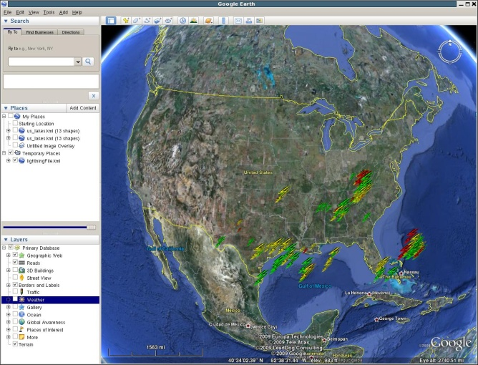
NNEW WFSRI Architecture
WFS Client
Real Time
Client
Data
Publisher
<wfs:featureCollection>
<nawx:LightningFlash gml:id="id5" >
<wx:observationTime>
<gml:TimeInstant gml:id="id6">
<gml:timePosition>2008-07-09T03:54:25Z</gml:timePosition>
</gml:TimeInstant>
</wx:observationTime>
<nawx:strength uom="kA">-30.0</nawx:strength>
<nawx:numStrokes>3</nawx:numStrokes>
<nawx:geometry>
<gml:Point gml:id="id7" srsName="urn:ogc:def:crs:EPSG::4326" srsDimension="2">
<gml:pos>38.611629486083984 -81.6015625</gml:pos>
</gml:Point>
</nawx:geometry>
</nawx:LightningFlash>
WFS – Real Time Access
<wfs:featureCollection>
<nawx:LightningFlash gml:id="id5" >
<wx:observationTime>
<gml:TimeInstant gml:id="id6">
<gml:timePosition>2008-07-09T03:54:25Z</gml:timePosition>
</gml:TimeInstant>
</wx:observationTime>
<nawx:strength uom="kA">-30.0</nawx:strength>
<nawx:numStrokes>3</nawx:numStrokes>
<nawx:geometry>
<gml:Point gml:id="id7" srsName="urn:ogc:def:crs:EPSG::4326" srsDimension="2">
<gml:pos>38.611629486083984 -81.6015625</gml:pos>
</gml:Point>
</nawx:geometry>
</nawx:LightningFlash>
XML Over HTTP
WFS-Archiving
Web Feature Service
Data Store
Partitioned
For Optimal
Performance
Jan
Feb
OGC Filter
Mar
Asynchronous Access
Oct
Dec

Slide 5

NNEW WFS RI Capabilities
Capability | WFS 1.1 | NNEW WFSRI 1.0 | Comments
getFeature |  |  | Supports: Temporal subsetting Geographic subsetting Property –value filtering Does not support projections Does not support all NNEW WFSRI filtering requirements
getCapabilities
describeFeatureType
WFS-T |  |  | Insert only. There are no plans to support update/deletes in the NNEW WFSRI
subscribe |  |  | Supports all filtering capabilities of the getFeature
subscribeResponse |  |  | Supports transport of filtered data to JMS queue
Data storage support |  |  | Supports fast performance partitioning WFSRI 1.1 supports flexible creation of feature tables based on either a mapping file or an annotated schema.
FeatureType Admin |  |  | Allows creation of feature types Secure “write” for feature producer
BASIC
Txn
Sub

Slide 6
Oracle Technologies Used
Oracle Technology | WFSRI Feature | Description
Oracle Advanced Queues (crucial for WFS Subscription) | Supports WFSRI Architecture: subscribe, subscribeResponse, getFeature | This feature is key for supporting equivalent spatial and temporal subsetting capabilities for request/response and subscriptions.
Oracle Spatial | Spatial support and filtering | Provides the core capabilities for meeting NNEW WFSRI spatial subsetting requirements
Oracle XML | XML Storage and Xpath filtering | Supports flexible storage of feature instances, allowing extraction of elements for fast query access. Access to everything in the XML message is granted through Xpath queries
Oracle Timestamp | Temporal subsetting | Key for supporting NNEW WFSRI temporal subsetting requirements

Slide 7
Oracle Technologies Used
Oracle Technology | WFSRI Feature | Description
XML Indexing | Performance | Provides fast access for Xpath/Xquery queries
Spatial Indexing | Performance | Provides fast access for spatial queries (within, BBOX, overlap)
Oracle Partitioning | Performance/Archiving
Oracle Security | Haven’t really explored this beyond basic role based authorization and a “sandbox” environment for developers | Could be leveraged heavily depending on the WFSRI security requirements.

Slide 8
Comparison with Postgres/PostGIS
Feature | Oracle | Postgres/PostGIS | Impact
Queues/Subscription Support | Oracle Advanced Queues (crucial for WFS Subscription) | No equivalent support | WFS Subscription can not be supported using the current RI architecture. Significant implementation effort would be required to support this using just JMS.
Spatial Support | Support Supports 2D and 3D geometries. Supports geodetic data | Supports 2D geometries and some 3D geometries. PostGIS 1.5 is likely to have more spatial support.

Slide 9
Comparison with Postgres/PostGIS
Feature | Oracle | Postgres/PostGIS | Impact
Spatial Filtering | Supports ~400 functions. Geodetic support | ~300 functions | Equivalent support between Oracle and PostGis for 2D
XML Storage | Native storage Binary XML (post-process, optimized format) Data validation | Native XML type as of Postgres 8.3 and 8.4 No validation support | No real impact. Data validation is big difference, but WFSRI is not currently using Oracle validation due to issues with GML 3.2
XML Querying | Supports Xpath and Xquery as well as SQL and embedded Xpath/Xquery | Supports Xpath. No Xquery support. Suggest using text based searching which is inefficient! | Performance for Xpath queries could be an issue
Spatial Indexing | Yes | Yes
XML Indexing | Yes | No | Performance

Slide 10
Oracle vs Postgres/PostGIS
Feature | Oracle | Postgres/PostGIS | Impact
Partitioning | Yes together with partitioned indexes for better performance | Base support -- implemented using tables. Unclear whether this would really perform well. | Required for performance and archiving. Could be implemented with Postgres Partitioning. Performance impact unclear.
Security | extensive security features, from basic authentication and LDAP integration to Virtual Private Databases. Extensive auditing capabilities | Basic authentication and some LDAP integration | We are not currently using many of the Oracle security features other than basic authentication and authorization. This will likely expand in Version 2 and it is unclear how Postgres will match up with that.

Slide 11
Summary/Options
Using Postgres/PostGIS to support WFS-Subscription conformance is not feasible (would require many man-hours of work)
Options:
Redo the WFSRI architecture to have layered functionality
    WFSRI-Basic: Supports Read only access. Can be cross DBMS vendor
    WFSRI-Transaction: Supports WFSRI-Basic + Txn Insert. Can be cross DBMS vendor
    WFSRI-Subscription: Supports subscription capability in addition to WFSRI-T. Oracle implementation only!
    WFSRI-Hybrid: Supports WFS-T and JMS based subscription layer with no spatial and temporal subsetting for subscriptions.

Slide 12
Options
Use GeoServer or Deegree open source WFS implementations for WFS-T and use JMS for subscriptions. WFSRI-hybrid constraints apply.
    Performance and other issues do exist for the open source implementation
Use Oracle Express – Oracle’s free version
  Does not support Oracle Spatial but has a free version “Oracle Locator”
  Functionality equivalent to PostGIS
  Supports Advanced queues ➔ can support WFSRI-Subscription but with 2D geometries only. Volumetric analysis will likely not be supported.
  Partitioning will not be supported
  Security is scaled down

Slide 13
References
http://www.bostongis.com/PrinterFriendly.aspx?content_name=sqlserver2008_postgis_mysql_compare
http://www.postgresql.org/
http://wiki.postgresql.org/wiki/Main_Page
http://postgis.refractions.net/
http://wiki.postgresql.org/wiki/Performance_Optimization
http://www.postgresonline.com/periodical.php?i_id=17
  There is an accompanying video that also does a comparison between Oracle Spatial and PostGIS (http://blip.tv/file/2795843/)
  Interesting take: not one or the other but maybe both!

