Slide 1
WFS 2.0
Kajal Claypool, Oliver Newell
19 Nov 2009
Notes:
1
1

Slide 2
WFS 2.0 Highlights (ISO Draft)
Better developed than current WFS 1.1 specification
Improved exception handling specification
Improved conformance classes and test suites for the conformance classes
Much more advanced filtering support
  (Spatial and temporal joins, stored queries)
Supports GML 3.2

Slide 3
WFS 2.0 Specification at a Glance
Defines 11 operations
  GetCapabilities
  DescribeFeatureType
  GetPropertyValue**
  GetFeature
  GetFeatureWithLock*
  LockFeature*
  Transaction
  CreateStoredQuery**
  DropStoredQuery**
  ListStoredQueries**
  DescribeStoredQueries**

Slide 4
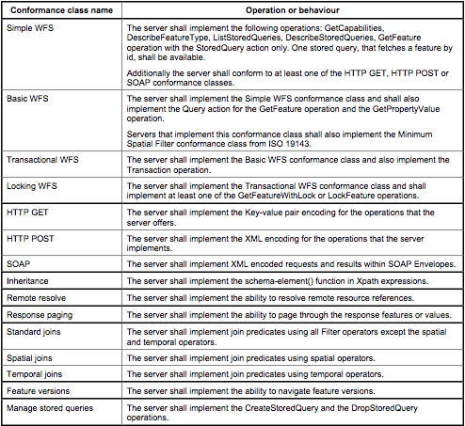
Conformance Classes

Slide 5
Moving to WFS 2.0
Positives:
  Can participate in OWS-7
  Provides a “spec” form for satisfying WFSRI requirements such as “aggregation”
  Move to GML 3.2
Negatives:
  More work ☹
  Still a draft – we think it is stable but there is potential for change
  Move to GML 3.2 – impact on service adaptor work
Move to WFS 2.0 without taking on additional functionality (beyond what is in WFSRI requirements) may be a good, yet manageable option.

