Slide 1

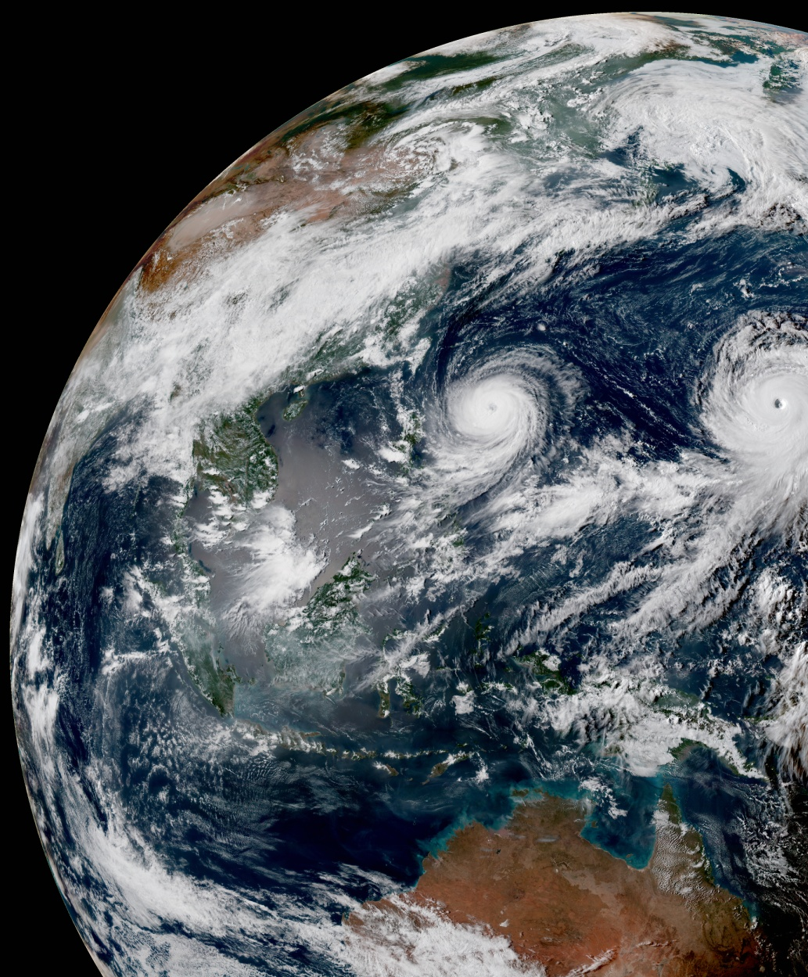
VADER Code Sprint Report
November 7-11 2022
Steve Vahl, JCSDA

Slide 2
Participants
Full time
  Anna Shlyaeva
  Steve Vahl
  Dan Holdaway (NASA)
  Marek Wlasak (MO)
  Stefano Migliorini (MO)
  Yonggang Yu (NCAR)
  Sarah King (NRL)
Part time
  Yannick Tremolet
  Francois Hebert
  Greg Thompson

Slide 3

Recall VADER
What is VADER?
  VAriable DErivation Repository
  VADER is a new repository that implements variable changes in a model-agnostic way, so that all models can use them.
Notes:
VADER is the new UFO

Slide 4
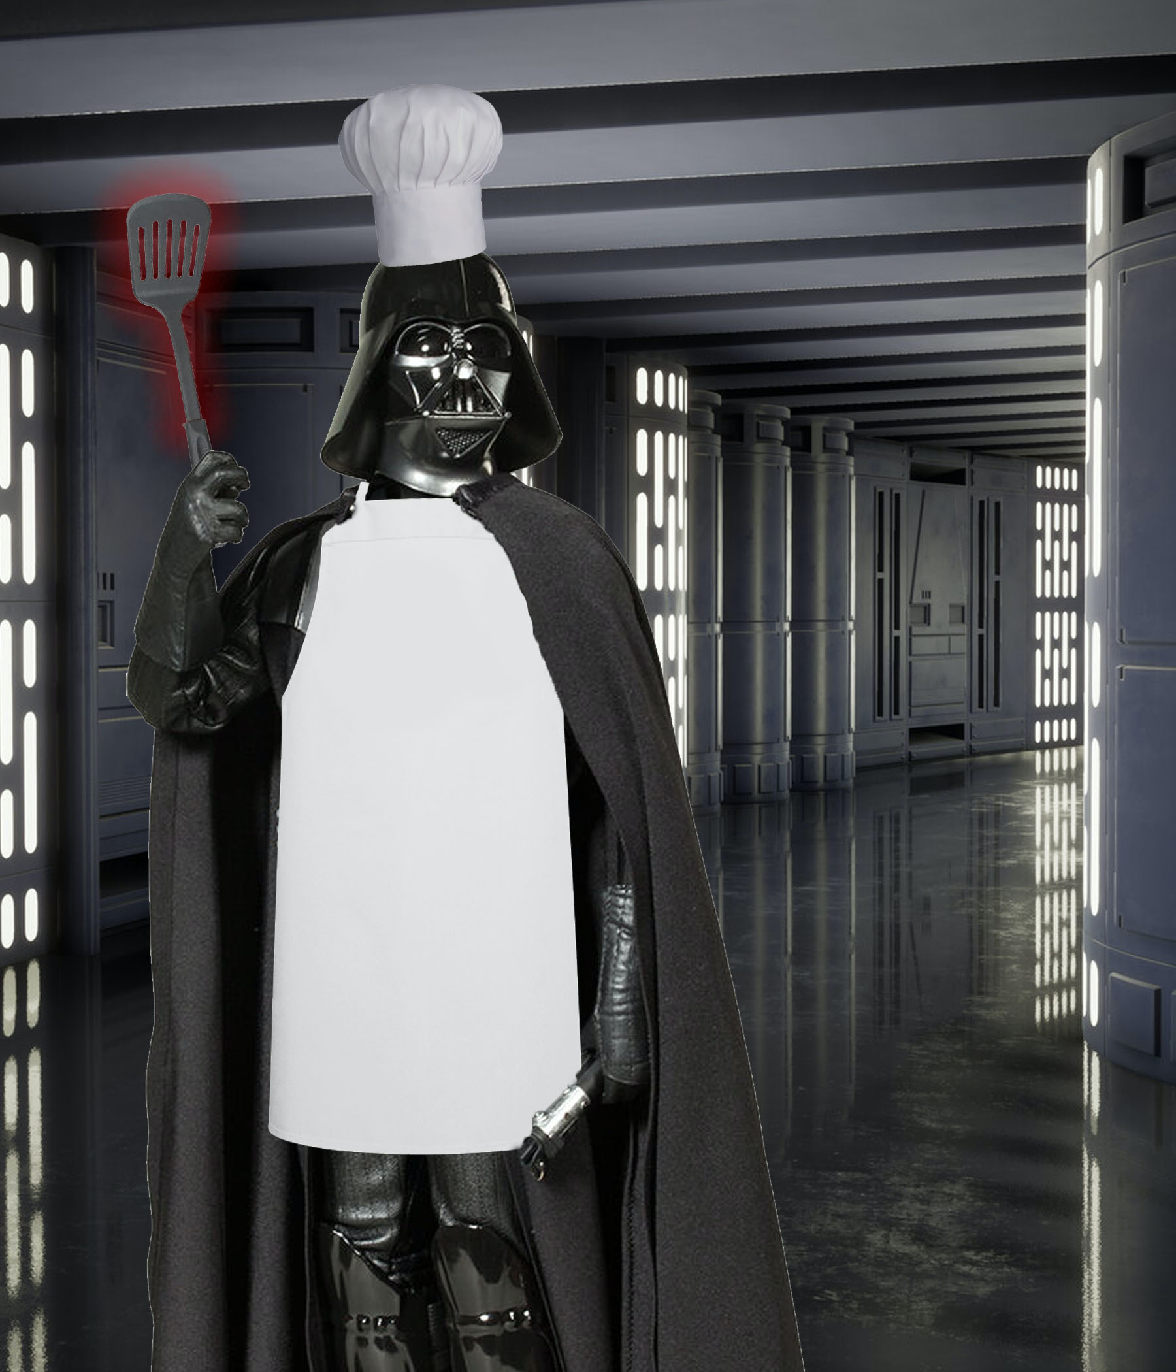
Vader design metaphor
How does VADER work?
Peeking into the kitchen…

Slide 5
VADER design metaphor
VADER code uses a recipe/cookbook metaphor.
Has “Recipes” to produce individual variables.
Recipes provide a list of their required “ingredients” (input variables).
Recipes are put in a “cookbook” that defines which recipes are attempted and in what order.
VADER has a default cookbook, but (in coming functionality) it can be configured by the caller.

Slide 6


Goal for the sprint
Our (metaphorical) goal for the Sprint…take VADER from childhood to adolescence.

Slide 7
Starting point
At the beginning of the sprint:
  Calls to VADER only implemented in FV3-JEDI
  Only two fully implemented Recipes
  These Recipes were the simplest I could find

Slide 8
Sprint (Actual) Goals
Implement VADER calls into more model interfaces (MPAS and NEPTUNE)
Implement many more Recipes
Implement a VADER SABER block
Implement at least one Recipe shared between models

Slide 9
Sprint Accomplishments
Implemented many Recipes:
  Dan implemented Recipes for all the pressure variable changes in FV3. Once fully into VADER, an entire Fortran module of these changes can be deleted from FV3-JEDI.
  Marek and Stefano created Recipes for LFRic Lite.

Slide 10
Sprint Accomplishments
Anna created the VADER Saber Block
Also developed new ways to test VADER code
Developed a naming standard for Recipes
Progress on the VADER implementation in MPAS and NEPTUNE.

Slide 11
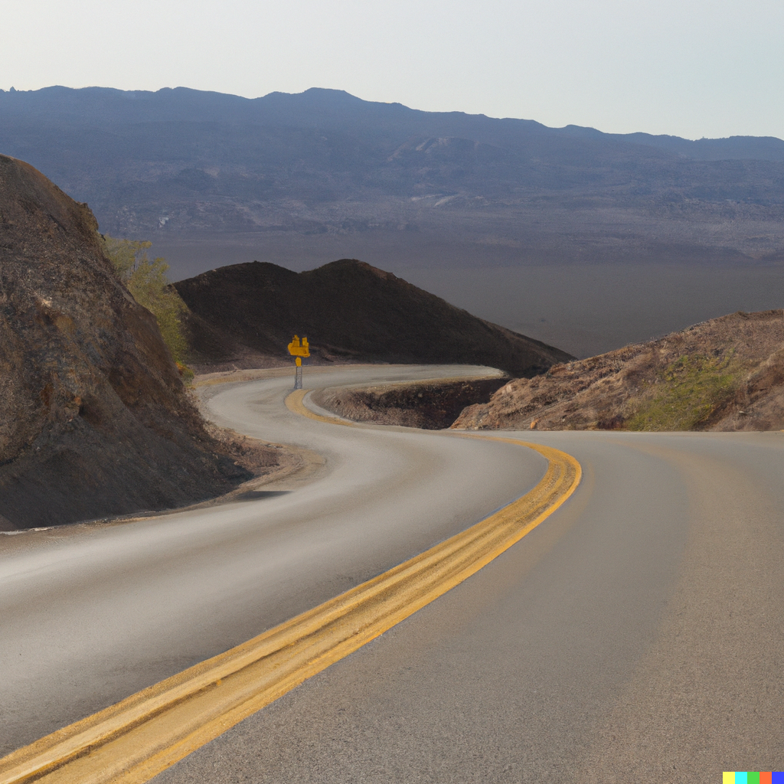
Summary
Code sprints are a journey…

Slide 12
Sprint (Soft) Accomplishments
In a focused group, we identified and discussed important issues for “real world” use of VADER.
  More complex Recipes
  Multiple models
This would have been much more difficult outside of a sprint environment.
More work to do, but now the path is clearer.

Slide 13
Questions

