Slide 1


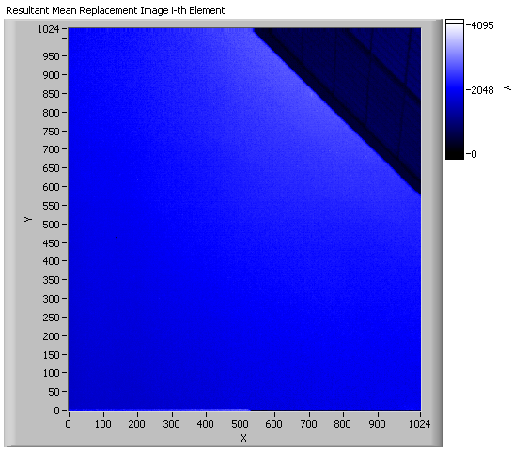
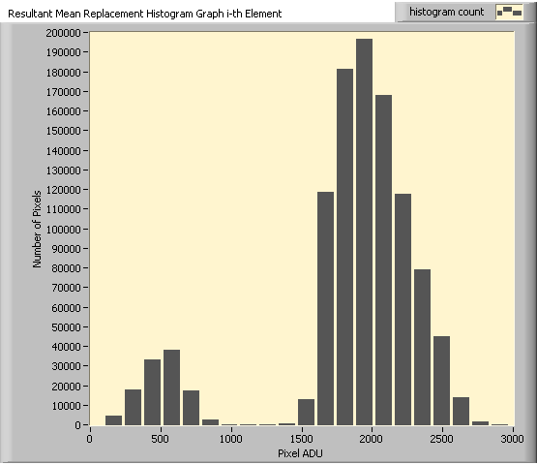
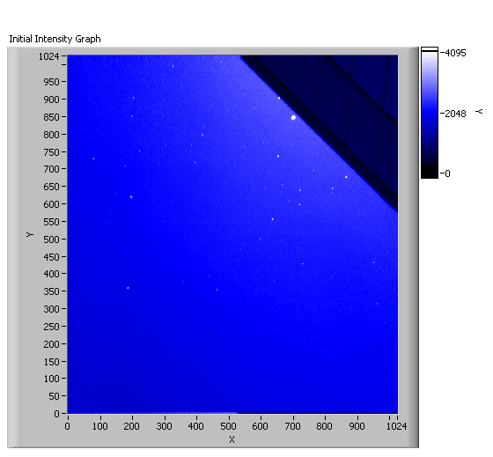
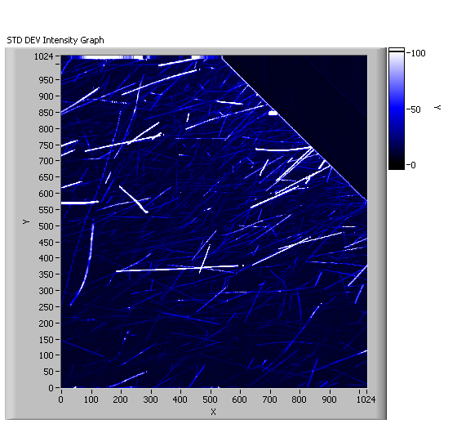
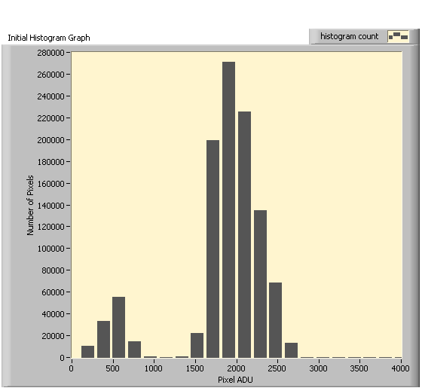
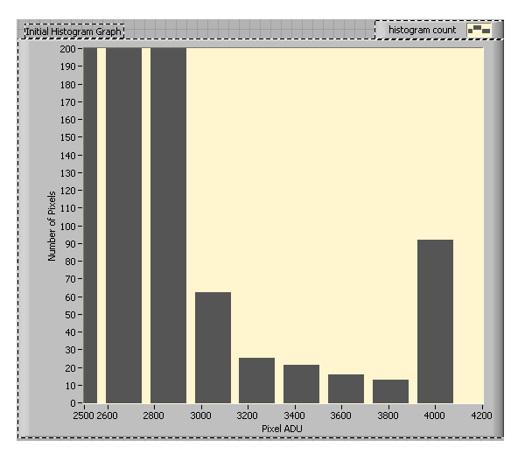
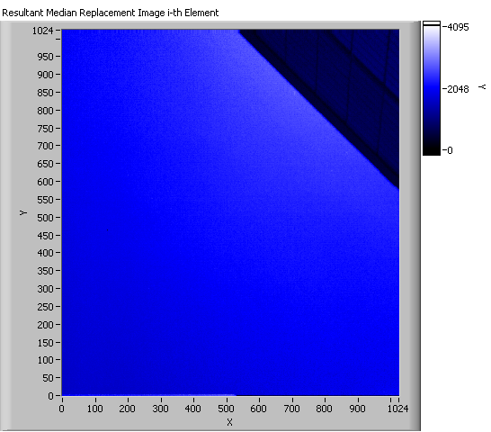
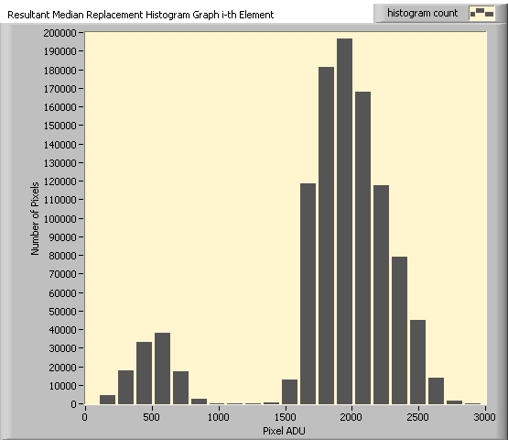
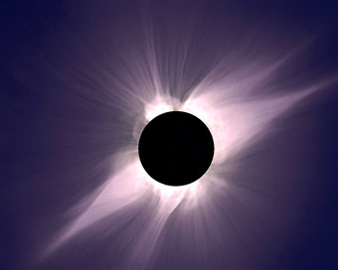
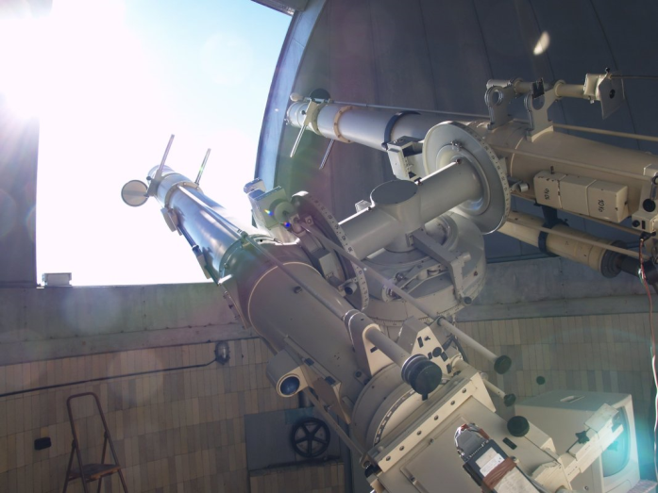
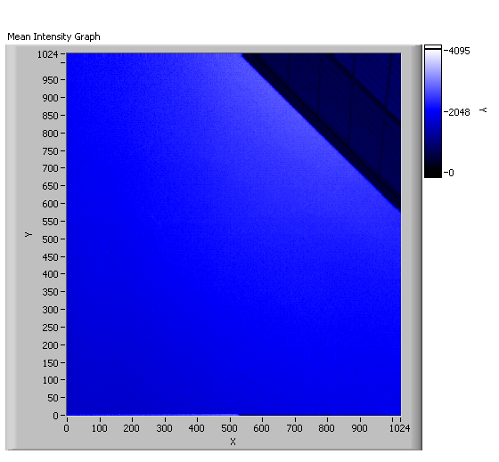





Image Processing Algorithms to Remove Aerosols from Solar Coronal Images
Curtis L. Walker (1,2), Scott Sewell (3), Steve Tomczyk (3)
1: Significant Opportunities in Atmospheric Research and Science, University Corporation for Atmospheric Research,
2: State University of New York College at Oneonta, 3: High Altitude Observatory, National Center for Atmospheric Research
Contact: Curtis Walker, walkcl50@suny.oneonta.edu
Abstract
Time Series Acquisition
Results
Coronal mass ejections, which are explosions of solar material and energy into space, pose a potential threat to satellite and electrical grid infrastructures, yet little is known about the solar corona. Various questions exist, relating to the origins of these mass ejections as well as the mechanisms involved in coronal heating. The corona and coronal mass ejections are measured by satellite and ground-based coronagraphs, instruments that produce a false eclipse of the Sun in order to separate the extremely faint coronal signature from the bright solar disk. Earth’s atmosphere and the presence of aerosols limit the usefulness of images obtained from ground-based coronagraphs compared to satellite observations.
We have developed image processing algorithms to remove aerosols from a new high-speed detector in real time. Two images were first generated from a time series of images containing real aerosols; a mean and a median image. Then a thresholding algorithm was applied to all of the images within the time series. If the pixel values exceeded the mean and/or median image value, they were replaced with the value in that mean or median image. Both techniques were successful in removing aerosols from imagery. Due to signal-to-noise advantages gained by utilizing the mean image instead of the median image, the mean is the preferred method. Processing ~1 second of imagery (150 frames per second) required ~180 seconds on a dual-core 2.33 GHz CPU. Further optimization will promote real-time aerosol removal in solar observation.
SUN
Mean Time Series Algorithm
This algorithm utilized the mean image and analyzed our complete time series on an image-by-image basis comparing an individual image to this mean image. If a pixel was greater than two standard deviations above the mean value, it was replaced with the pixel element from the mean image.
Aerosols
To create algorithms that would remove aerosols, a time series of images containing aerosols was obtained. A time series of 120 images was obtained in Boulder, CO on June 16, 2010 at 150 frames per second. This was accomplished by pointing the camera towards the sky, with the Sun obscured just behind the edge of a building like an occulting disk, and capturing the signal of aerosols illuminated by the Sun. This data set was analyzed visually and quantitatively prior to algorithm development.
Building Edge
Lens pointed towards sky using the building edge to obstruct sun (similar to occulting disk), but allow enough sunlight to illuminate aerosols.
Photon Focus CMOS Camera
Table for computer and camera mount
Fig. 3: This diagram shows the necessary setup to acquire the data set. The lines represent the camera’s field of view incorporating the aerosols and the building’s edge, but just missing the bright disk of the Sun.
Fig. 10: Mean Time Series Algorithm. Aerosols were not present.
Fig. 11: No signal above 3000 ADU corresponds to aerosol removal.
Median Time Series Algorithm
Background
Image Processing & Analysis
This algorithm utilized the median image and analyzed our complete time series on an image-by-image basis comparing an individual image to this median image. If a pixel was greater than two standard deviations above the median value, it was replaced with the pixel element from the median image.
Here are some general facts about the Sun’s corona:
Corona is Sun’s “Atmosphere”
~10⁶ K plasma
Origin of the Solar Wind (constant energy radiation)
Coronal Mass Ejections (CMEs) disrupt satellite and electrical grid infrastructures, pose health risk to astronauts
Corona seen naturally during total solar eclipse
Coronagraphs: instruments that produce a false solar eclipse via an occulting disk (satellite and ground-based)
Characteristics of Aerosol Distribution Time Series in Boulder, CO on June 16, 2010
Fig. 4: Single frame shows aerosols as white dots. The primary aerosol distribution was cottonwood pollen. The diagonal structure was the building’s edge, our occulting disk.
Fig. 5: Aerosol trajectories over approx. 1 sec. This image was obtained by taking the standard deviation of all 120 images in the time series.
Fig. 6: Image histogram shows pixel brightness values measured in Analog-to-Digital Units (ADU). Peak at 500 ADU is due to building, peak at 2000 ADU is due to blue sky.
Fig. 7: Spike at 4000 ADU is due to aerosol contamination; aerosols appear as white, or saturated, pixels.
Fig. 12: Median Time Series Algorithm. Aerosols were not present.
Fig. 13: No signal above 3000 ADU corresponds to aerosol removal.
Fig. 1: Total solar eclipse, July 11, 1991, observed at Hawaii.
Photo Credit: S. Koutcmy, IAP-CNRS (France)
Fig.2: Zeiss Coronagraph at Lomnicky Peak Observatory in Slovakia
Photo Credit: Steve Tomczyk
Development of Time Series Algorithms to Remove Aerosols: Mean & Median Images
Conclusions & Future Work
The algorithms removed aerosols from the time series efficiently; however, future evaluation will determine subtle deviations between the mean and median methods. In addition, future work hopes to optimize these algorithms for real-time performance (1 sec. of data takes 1 sec. to process). This objective was not successful during this evaluation (1 sec. of data took 180 sec.); although, the evolution of high-performance computers with adequate memory capabilities may provide a solution.
Methods
Calculate a mean and median image from the time series on a pixel-by-pixel basis. Each pixel is evaluated 120 times and a mean/median brightness value was calculated. The calculated mean/median brightness values were converted into an image.
Analyze each pixel in the time series to determine if its brightness value exceeded two standard deviations above the mean brightness value. Each pixel was evaluated 120 times to account for aerosol motion over the time series.
If no, leave pixel alone.
If yes, replace that pixel with the same pixel element from mean/median image. Pixel replacement scheme using the mean/median image and a threshold of two standard deviations above the mean (2-sigma).
Acknowledgments
This work was performed under the auspices of the Significant Opportunities in Atmospheric Research and Science Program. SOARS is managed by the University Corporation for Atmospheric Research and is funded by the National Science Foundation, the National Oceanic and Atmospheric Administration, the Cooperative Institute for Research in Environmental Science, and by the Center for Multiscale Modeling of Atmospheric Processes. In addition, I would like to thank my mentors Scott Sewell, Amy Stevermer, Lance Jones, and Theresa Aguilar for their support.
Fig. 8: Mean Image
Fig. 9: Median Image

