Slide 1


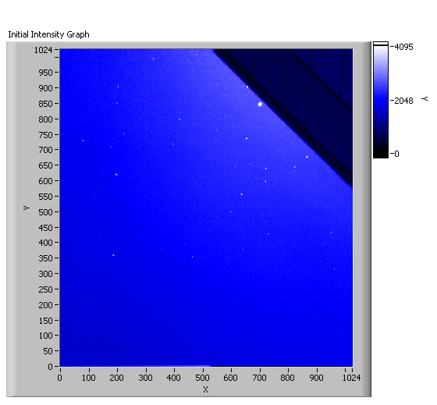
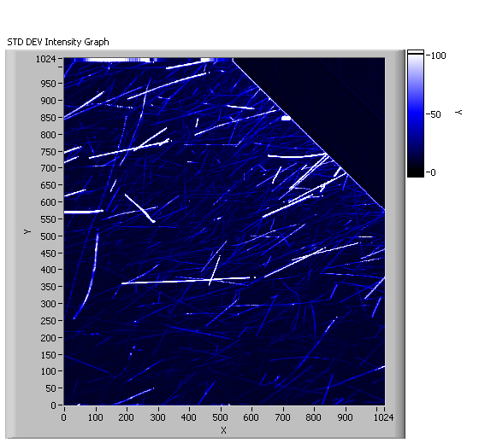
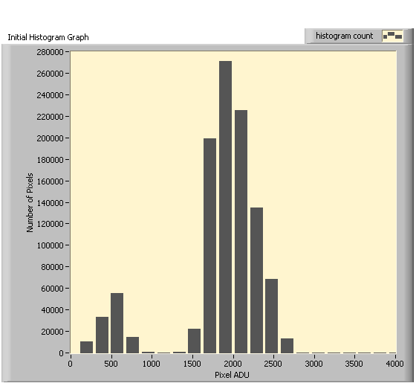
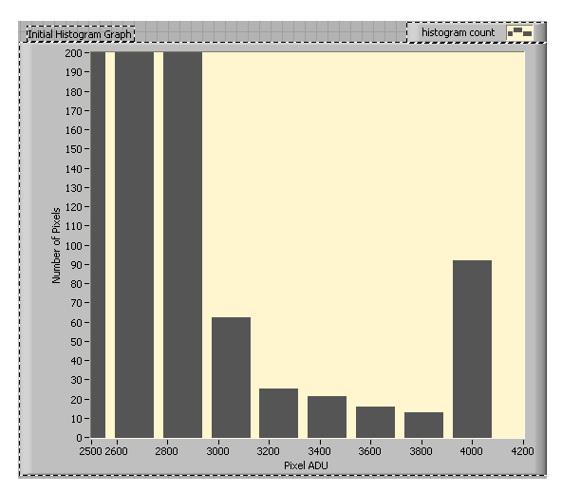
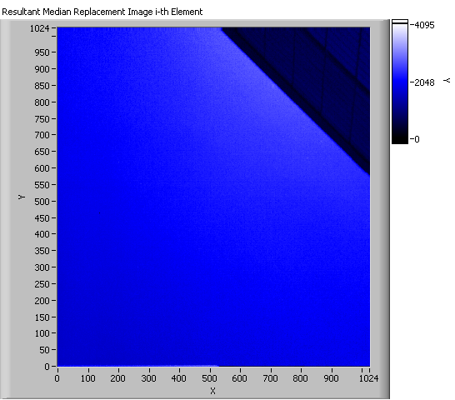
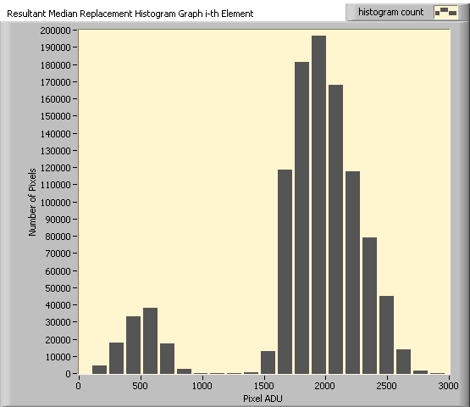
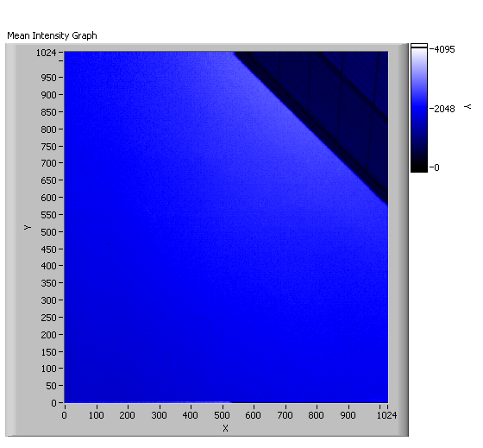

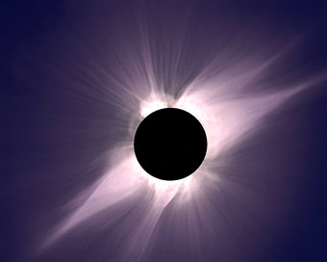
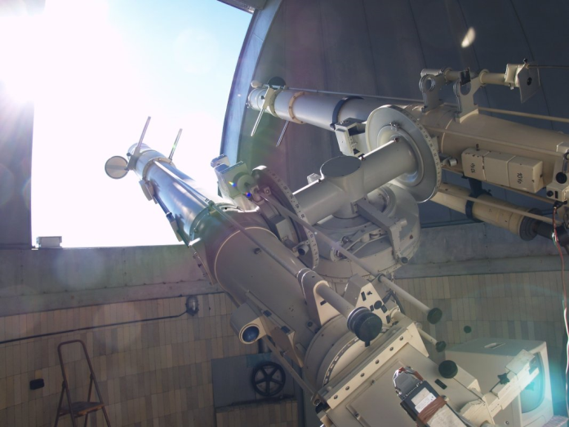
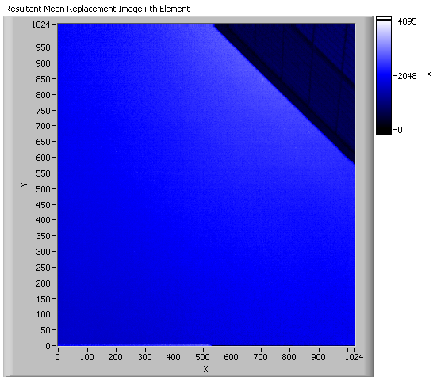
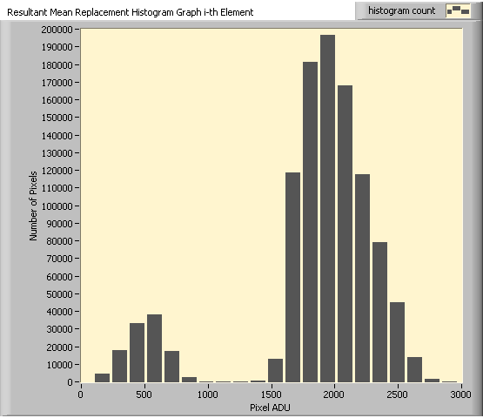
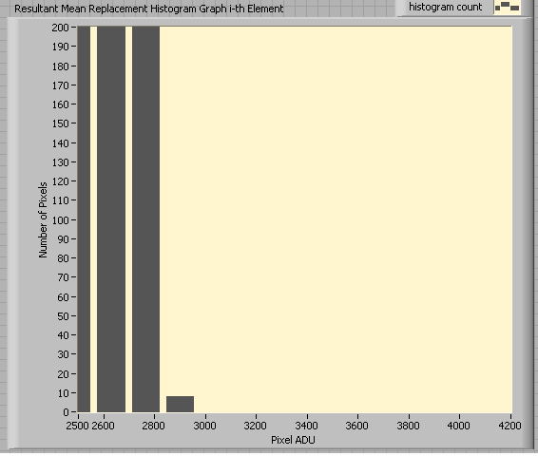
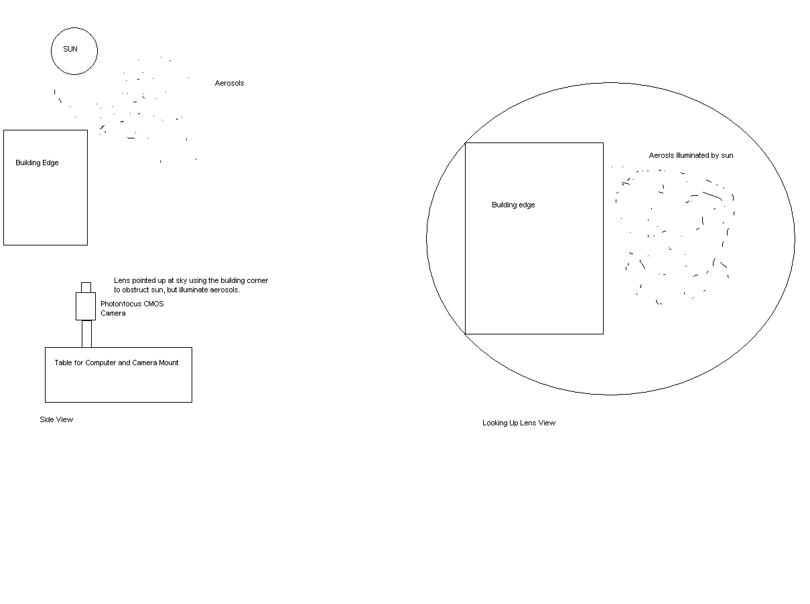


Image Processing Algorithms to Remove Aerosols from Solar Coronal Images
Curtis L. Walker, State University of New York College at Oneonta, Oneonta, NY, 13820
Significant Opportunities in Atmospheric Research and Science, UCAR, Boulder, CO, 80305
Scott Sewell, High Altitude Observatory, National Center for Atmospheric Research, Boulder, CO, 80301
Steve Tomczyk, High Altitude Observatory, National Center for Atmospheric Research, Boulder, CO, 80301
Abstract
Aerosol Distribution in Boulder, CO on June 16, 2010
Median Time Series Algorithm
Coronal mass ejections, which are explosions of solar material and energy into space, pose a potential threat to satellite and electrical grid infrastructures, yet little is known about the solar corona. Various questions exist, relating to the origins of these mass ejections as well as the mechanisms involved in coronal heating. The corona and coronal mass ejections are measured by satellite and ground-based coronagraphs, instruments that produce a false eclipse of the Sun in order to separate the extremely faint coronal signature from the bright solar disk. Earth’s atmosphere and the presence of aerosols limit the usefulness of images obtained from ground-based coronagraphs compared to satellite observations. We have developed image processing algorithms to remove aerosols from a new high-speed detector in real-time. Two images were first generated from a time series of images containing real aerosols; a mean and a median image. Then a thresholding algorithm was applied to all of the images within the time series. If the pixel values exceeded the mean and/or median image value, they were replaced with the value in that mean or median image. Both techniques were successful in removing aerosols from imagery. Due to signal-to-noise advantages gained by utilizing the mean image instead of the median image, the mean is the preferred method. Processing ~1 second of imagery (150 frames per second) required ~180 seconds on a dual-core 2.33 GHz CPU. Further optimization will promote real-time aerosol removal in solar observation.
This algorithm utilized the median image and analyzed our complete time series on an image-by-image basis comparing an individual image to this mean image. If a pixel was greater than two standard deviations above the mean value, it was replaced with the pixel element from the median image.
Single frame shows aerosols as white dots. The primary aerosol constituent this day was cottonwood pollen.
Aerosol trajectories over a time series of approximately 1 second.
Image histogram shows pixel brightness values measure in Analog-to-Digital Units (ADU).
Histogram spike at 4000 ADU due to aerosol contamination of image.
Development of Time Series Based Algorithms to Remove Aerosols
From the data set, a mean and median image were calculated on a pixel-by-pixel basis. Each pixel element was evaluated 120 times and a mean/median value was calculated. All of these values were then recreated into a unique image that would serve as the basis for pixel replacement.
Image result from Median Time Series Algorithm. Aerosols were not present.
Image histogram shows similar structure to initial histogram.
Background
Corona is Sun’s “Atmosphere”
~10⁶ K plasma
Origin of the Solar Wind (constant energy radiation)
Coronal Mass Ejections (CMEs) can disrupt our satellite and electrical grid infrastructures
Corona can only be seen naturally during total solar eclipse
Coronagraphs are instruments that produce a false solar eclipse via an occulting disk, and come in satellite and ground-based varieties
Conclusions & Future Work
Mean Image
Median Image
The algorithms removed aerosols from the time series efficiently
Future evaluation will determine subtle deviations between the mean and median methods
Future work hopes to optimize these algorithms for real time performance (One second of data take one second to process).
Mean Time Series Algorithm
Total solar eclipse, July 11, 1991, observed at Hawaii.
Photo Credit: S. Koutcmy, IAP-CNRS (France)
This algorithm utilized the mean image and analyzed our complete time series on an image-by-image basis comparing an individual image to this mean image. If a pixel was greater than two standard deviations above the mean value, it was replaced with the pixel element from the mean image.
Zeiss Coronagraph at Lomnicky Peak Observatory in Slovakia
Photo Credit: Steve Tomczyk
Data Acquisition
To create algorithms that would remove aerosols, a time series of images containing aerosols was obtained. A time series of 120 images was obtained in Boulder, CO on June 16, 2010 at 150 frames per second. This was accomplished by pointing the camera towards the Sun, obscured behind the edge of a building like an occulting disk, and capturing the signal of aerosols illuminated by the Sun. This data set was analyzed prior to algorithm development.
Acknowledgments
This work was performed under the auspices of the Significant Opportunities in Atmospheric Research and Science Program. SOARS is managed by the University Corporation for Atmospheric Research and is funded by the National Science Foundation, the National Oceanic and Atmospheric Administration, the Cooperative Institute for Research in Environmental Science, and by the Center for Multiscale Modeling of Atmospheric Processes.
Image result from Mean Time Series Algorithm. Aerosols were not present.
Image histogram shows similar structure to initial histogram.
Adjusted image histogram shows no signal at 4000 ADU.
This diagram shows the necessary setup.

